Slide 1
Technical Board Meeting, 29/6/2016

Slide 2
CRP design finalization, extensive presentation (last one on May 11th)
Updates on Field Cage and cathode design

Slide 3
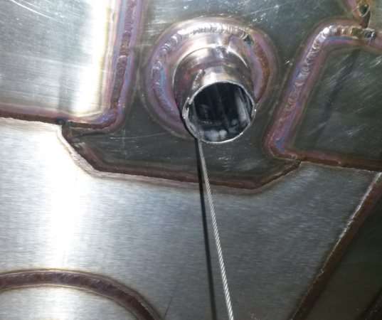
Suspension FT penetrations:
Some problems of non verticality of SFT pipes seen on 3x1x1
Mitigation strategy implemented by Marzio: bring the SFT pipes diameter from 40 mm to 60 mm (60 mm is the max compatible with the roof structure and pattern of corrugation, as found out after detailed discussions with GTT)
Cathode activities involvement of Princeton:
Meeting this Monday with K. McDonald. Princeton interested in Procurement, QA, machining of ITO coated PMMA plates for the cathode and in setting up a large size TPB evaporation system for plates of 1x1 m2. Detailed proposal to be formulated by August 10th.
Limits the adjustment possibility of the SFT on the horizontal plane important for CRPs alignment in 6x6x6
Difficult to predict the non verticality effects on 6x6x6 also by taking into account the cryostat roof bending during LAr filling

