Slide 1

The temperature of a single chaotic eigenstate
F. M. Izrailev
Instituto de Física, BUAP, Puebla, México
Michigan State University, USA
In collaboration with:
F. Borgonovi and F. Mattiotti (Brescia, Italy)

Slide 2
The Fermi-Pasta-Ulam (FPU) model
F.E.Fermi, J.Pasta and S.Ulam, “Studies of the Nonlinear
Problems, I. Los Alamos Report LA-1940 (1955).
Special Issue: CHAOS 15 (2005).
model:
model:
G.P.Berman and F.M.I., CHAOS, 15 (2005) 015104

Slide 3
Linear mode representation
model:
model:
Expectation of FPU: Equipartition of energy between linear modes due to a nonlinear interaction, for large

Slide 4
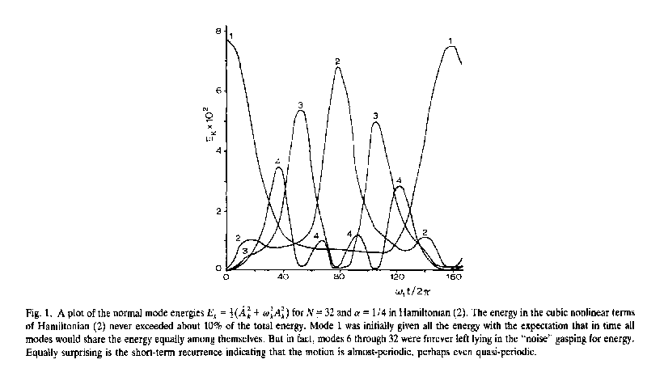
Numerical result of FPU
Quasi-periodic oscillations of the energy in each mode
Synergetic approach – numerical experiments – S.Ulam
!!
S.M.Ulam, “A Collection of Mathematical Problems” 1960.

Slide 5
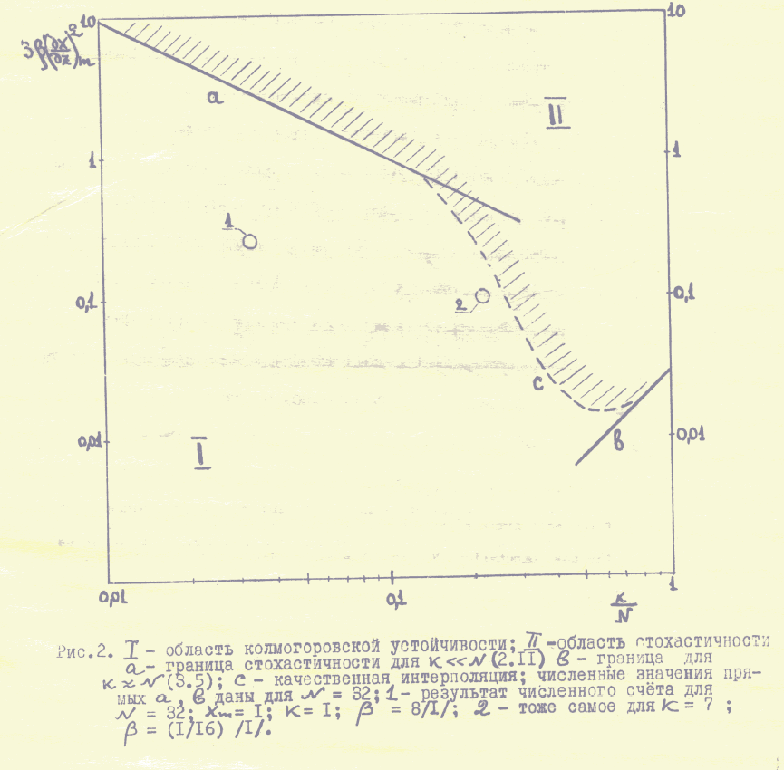
Border of chaos
Analytical result:
for the border of chaos
F.M.Izrailev, B.V.Chirikov
Report INP (1965);
Dokl. Akad.Nauk SSSR , 166 (1966) 57 .
Numerical confirmation: F.M.Izrailev, A.I.Khisamutdinov, B.V.Chirikov, Report 252 INP, 1968 (LA-4440-TR, Los Alamos, 1970)

Slide 6
“Quantum chaos” in deterministic systems
S.W. McDonald and A.N. Kaufman, “Spectrum and Eigenfunctions for a Hamiltonian with Stochastic Trajectories”, Phys. Rev. Lett. 42 (1979) 1189.
G.Casati, I.Guarneri, F.Valz-Gris, “On the connection between quantization of nonintegrable systems and statistical theory of spectra”, Lett. Nuovo Cimento 28 (1980) 279.
M.V. Berry, “Quantizing a Classically Ergodic System: Sinai’s Billiard and the KKR Method”, Annals of Physics, 131 (1981) 163.
O.Bohigas, M.-J.Giannoni, C.Schmit, “Characterization of Quantum Chaotic Spectra and Universality of Level Fluctuation Laws”, Phys. Rev. Lett. 52 (1984) 1.

Slide 7
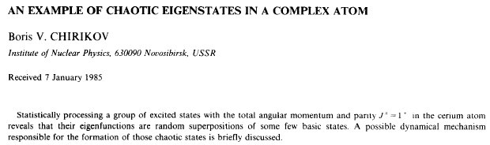
Chaotic eigenstates
M.Shapiro and G.Goelman, “Onset of Chaos in an Isolated Energy Eigenstate“, Phys. Rev. Lett. 53 (1984) 1714.
R.V.Jensen and R.Shankar, Phys. Rev. Lett. 54 (1985) 1879.

Slide 8

Chaotic eigenstates as the condition
for thermalization
L.D.Landau and E.M.Lifshitz:
Statistical Physics, Vol.5 (Pergamon, Oxford, 1969)
J.M.Deutsch, “Quantum statistical mechanics in a closed system, Phys. Rev. A 43 (1991) 2046.
M.Srednicki, “Chaos and quantum thermalization”, Phys. Rev. E 50 (1994) 888.

Slide 9
Chaos and thermalization in nuclei and atoms
M.Horoi, V.Zelevinsky, B.A.Brown, Phys. Rev. Lett. 74 (1995) 5194; V.Zelevinsky, M.Horoi, B.A.Brown, Phys. Lett. B 350 (1995) 141; V.Zelevinsky, B.A.Brown, M.Horoi, N.Frazier, Phys. Rep. 276 (1996) 85.
V.V.Flambaum, A.A.Gribakina, G.F.Gribakin, M.G.Kozlov, “Structure of compound states in the chaotic spectrum of the Ce atom: Localization properties, matrix elements, and enhancement of weak perturbations, Phys. Rev. A 50 (1994) 267.
in particular, the reduced density matrix operator was analyzed numerically for individual eigenstates, and compared with analytical average over number of chaotic states

Slide 10
Chaotic dynamics of systems of interacting particles
  - “non-perturbed” part (describes the non-interacting particles/quasi-particles)
interaction between particles, or, with an
external field
Many-body chaos – how to characterize?

Slide 11
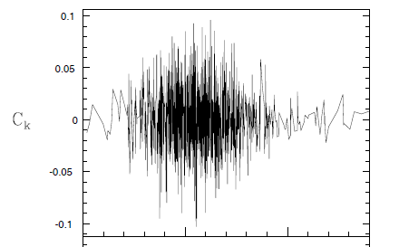
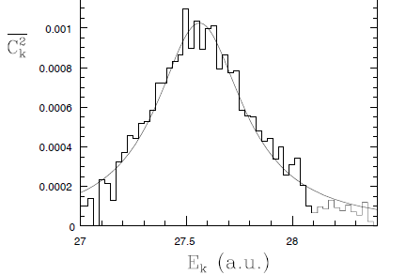
Chaotic eigenstates in a gold atom
G.F.Gribakin, A.A.Gribakina, V.V.Flambaum, arXiv:physics/9811010; Aust. J. Phys. 52 (1999) 443.
(problem of electron recombination )

Slide 12
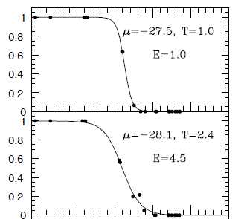
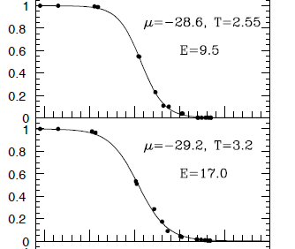

Thermalization in an isolated gold atom
G.F.Gribakin, A.A.Gribakina, V.V.Flambaum, arXiv:physics/9811010; Aust. J. Phys. 52 (1999) 443.

Slide 13
Two-Body Interaction Model
single-particle states
two-body matrix elements (random or dynamical)
number of single-particle states
number of particles (“quaisi-particles”)
energy of single-particle states
is considered in the many-particle basis of
determines the basis in which the dynamics occurs

Slide 14
V.V.Flambaum and F.M.I., “Statistical theory of finite Fermi systems based on the structure of chaotic eigenstates”, Phys. Rev. E 56 (1997) 5144; V.V.Flambaum, F.M.I., G.Casati, Phys. Rev. E 54 (1996) 2136.
- density of all many-body states
- density of many-body states directly connected by the two-body interaction
Onset of chaos:

Slide 15
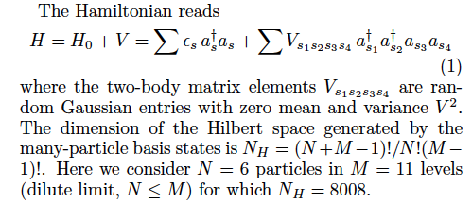

Slide 16
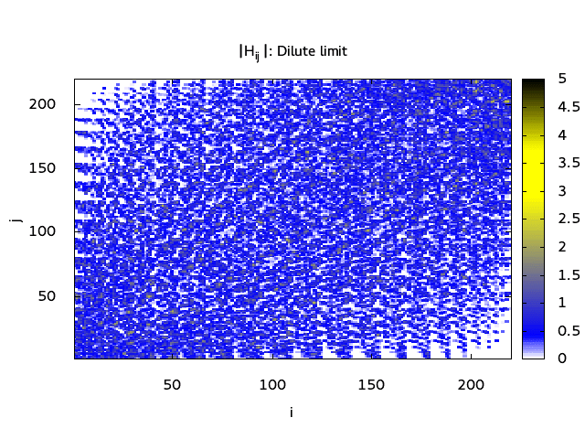

Slide 17
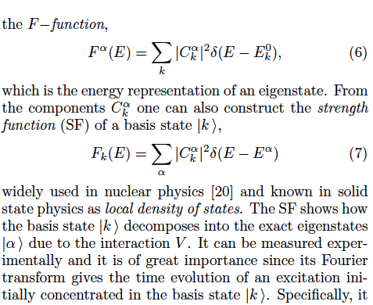

Slide 18
Strength function: from Breit-Wigner to Gauss
BW is characterized by half-width:
Gauss is characterized by its variance:
Transition to chaos occurs when
!!

Slide 19
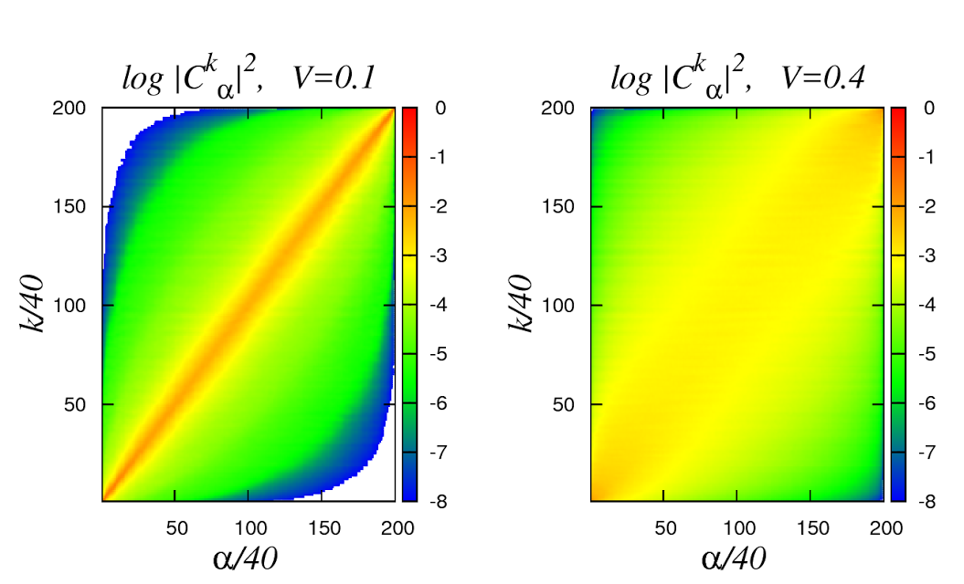

Slide 20
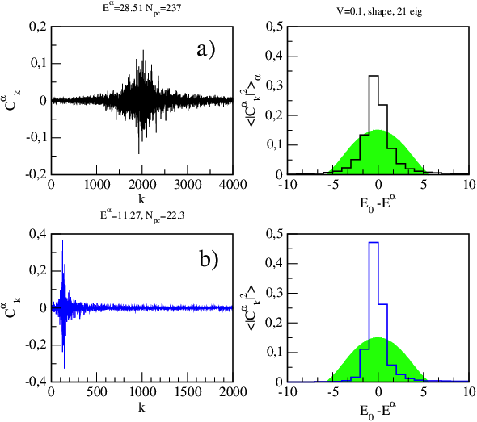

Slide 21
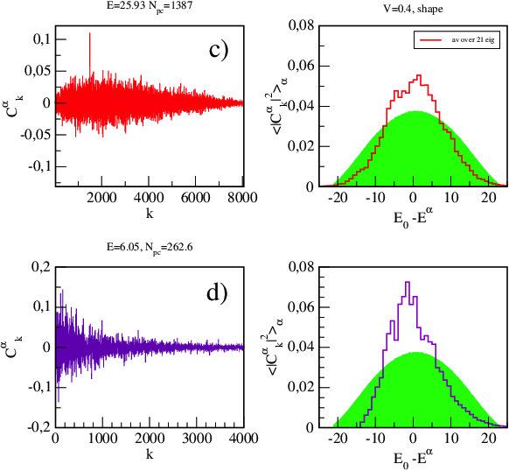

Slide 22
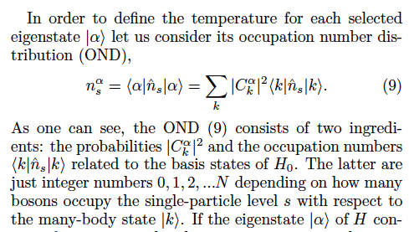

Slide 23
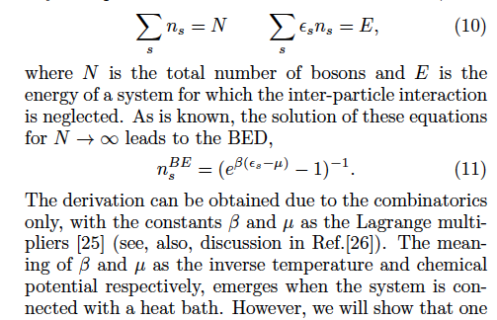

Slide 24
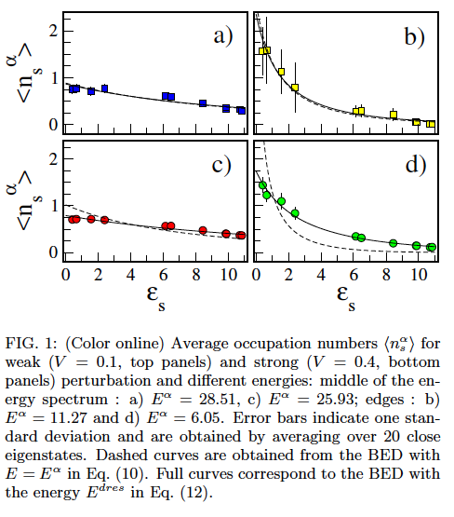

Slide 25
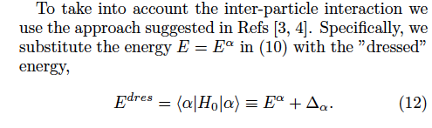



Slide 26
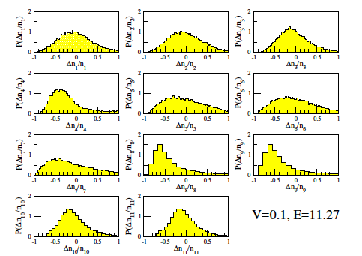

Slide 27
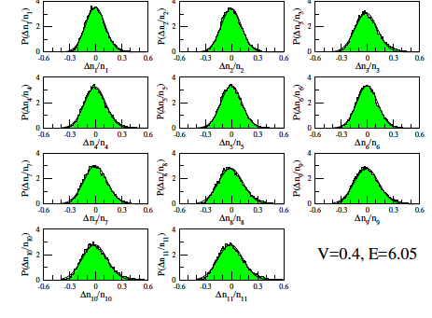

Slide 28

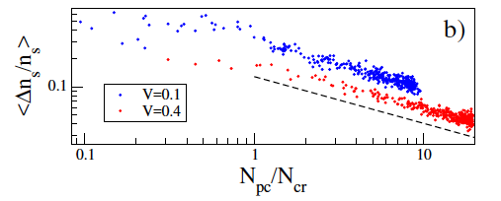

Slide 29
Thank you for your attention!

Slide 30
Transition to “chaos”: chaotic eigenstates

Slide 31
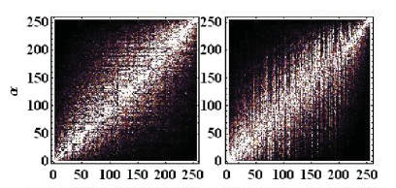
Structure of eigenfunctions
model 1
model 2

Slide 32
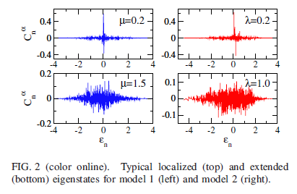
Emergence of chaotic states
- basis of
- basis of

Slide 33
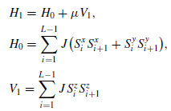

Chaos and relaxation dynamics in 1/2-spin models
model 1
integrable
model 2
non-integrable
- for transition from Poisson to Wigner-Dyson
L.F.Santos, F.Borgonovi, F.M.I., Phys. Rev. Lett. 108 (2012) 094102; Phys. Rev. E 85 (2012) 036209.

Slide 34
Chaos in integrable systems
B.V.Chirikov, “Transient Chaos in Quantum and Classical Mechanics”, Foundation of Physics, Vol.16, No.1 (1986).
Abstract: “Bogolubov’s classical example of statistical relaxation in a many-dimensional linear oscillator is discussed. The relation of the discovered relaxation mechanism to quantum dynamics as well as to some new problems in classical mechanics is considered.”
N.N.Bogoliubov, “On Some Statistical Methods in Mathematical Physics”, Academy of Sciences USSR Publishers, Kiev, 1945, p.115 (Russian); in: “Selected Papers” (Naukova Dumka, Kiev, 1970, Vol.2, p.77 (Russian).

Slide 35
Foundation of statistical mechanics
Two mechanisms of a statistical behavior (relaxation to a steady state distribution) in classical mechanics:
Thermodynamical limit ;
Exponential instability plus boundary in phase space ( ) – “dynamical (deterministic) chaos”
What is common for both mechanisms? – Infinite number of statistically independent frequencies in
the time evolution of observables.
in quantum mechanics – only second mechanism
B.V.Chirikov, “Linear and nonlinear dynamical chaos”,
Open. Sys. & Informaion Dyn. 4 (1997) 241-280 .

Slide 36
Quantum chaos:
Deterministic quantum systems with strong chaos in the classical limit
Classical chaos
Wave chaos
Properties:
(a) spectrum
(b) eigenstates
(c) dynamics
Deterministic quantum systems without classical limit
Disordered quantum systems
Santa Barbara, August 20, 2012

Slide 37
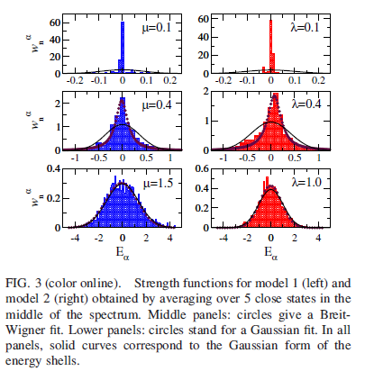
Strength functions (LDOS)

Slide 38
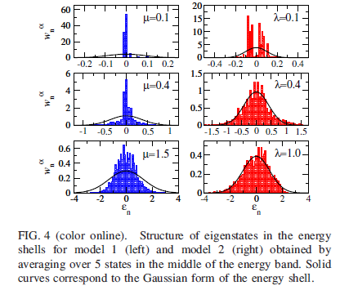
Delocalization in energy shell

Slide 39
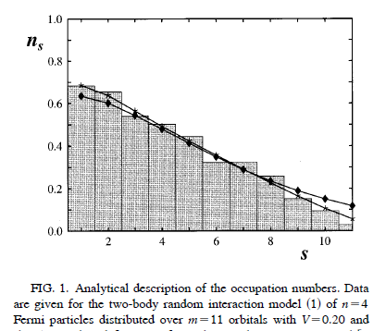

Fermi-Dirac distribution
Circles: analytical description versus numerical data,
Diamonds: Fermi-Dirac with thermodynamical temperature

