Slide 1
Cryogenics and Plan for Instrumentation
Alan A. Hahn
FNAL

Slide 2
Outline
Intro to PC4
Cryo Schedule/Timeline
Filling
Running
Emptying
Cryo Instrumentation
Purity Monitors
“Precision” Temperature Measurement
Gas Analyzers
“Standard” Cryo Devices

Slide 3
35-ton Prototype and LAPD Located in PC4, former Fixed Target Proton Beamline
35-ton Cryostat uses
the LAPD Filters
Gas Analyzers
Instrumentation
LAr can be shifted back & forth between LAPD & 35-ton
However there is a “tax”
~10% from LAPD->35 Ton
~30% from 35T -> LAPD
Function of pump head of two cryostats

Slide 4
35T Phase 2 Actual Timeline
76 days
Want to minimize the time between installation of apparatus and HV Commissioning

Slide 5
35T Cryo Timeline
35T Phase 2
From Detector Installation Finish to Running– 76 days
“Running” = start of HV Commissioning
At least one reason is that LAPD Commissioning started after the the Detector Installation and not before.
This time want LAPD filled and ready at time of Apparatus installation
Want Gas operation permit of 35 Ton (for purging and recirculation also on hand at/near time of installation.

Slide 6
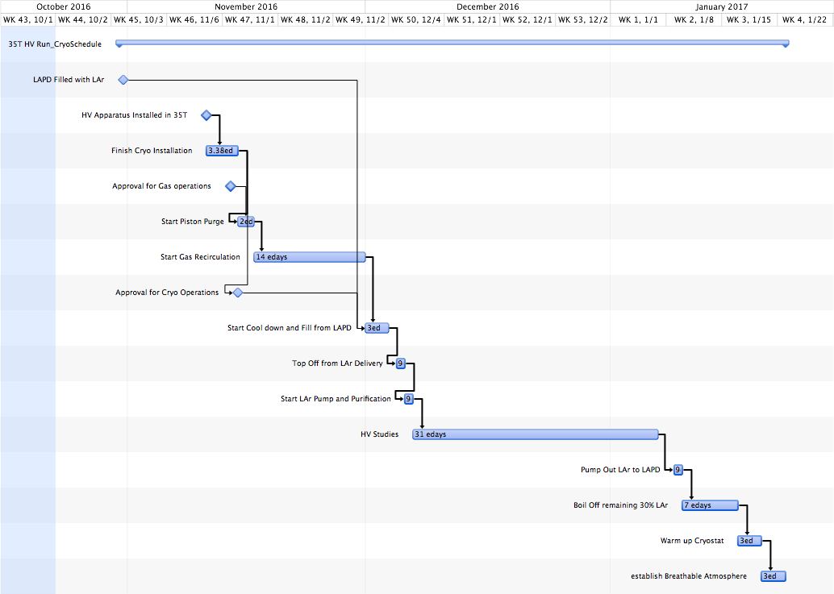
Stage 1 Cryo Run Timeline

Slide 7
Length of HV Run Period
Assume HV Commissioning starts as soon as Cryostat is filled (100%) and pump is recirculating LAr to filters.
It takes ~2 weeks to get to a e⁻ lifetime of ~2-3 ms.
See next slide.
Assume one week at Design Field & 2-3 ms e⁻ lifetime (impurities ~100 ppt) demonstrates “Holding” HV.
Adding extra week (or so) for contingency or higher HV fields gives ~1 month.
Length of Stage 1 run is limited by desire to get Stage 2 run finished in a “timely” manner

Slide 8
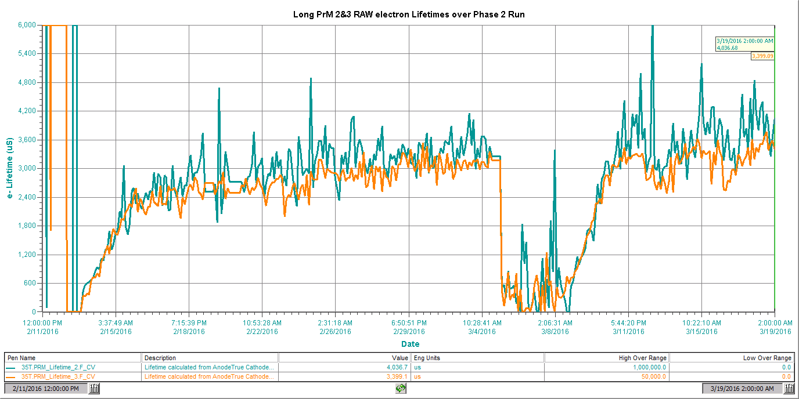
e⁻ Lifetime over Phase 2 Run
PrM2 & 3, both long PrMs at midway heights in Cryostat.
3 ms lifetime
Pump Restart
Sitewide Power Outage
~ 3 days
~ 2 weeks
Tubing Break
Pump Start
LN₂ Cooling Loss

Slide 9
35T Emptying Timeline
Reduction in time due to
No need to vaporize LAr as in last run– pump directly to LAPD
Plan to add electric heaters (6 kW) to boil off remaining LAr
~2-3x faster than bubbling N₂ as done before
Combine warmup (after LAr gone) with dry air purge
Need Cryo temps in 200 K range first.
Last Run

Slide 10
Cryo Instrumentation

Slide 11
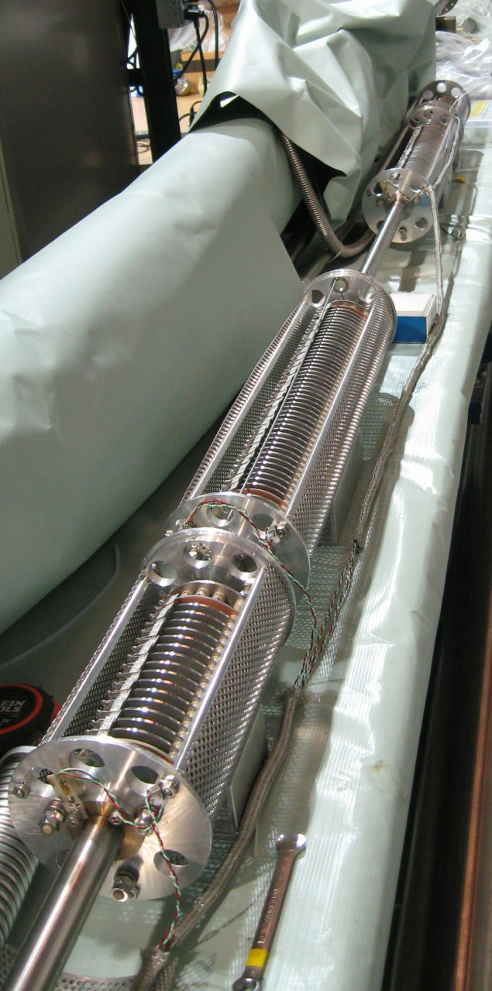
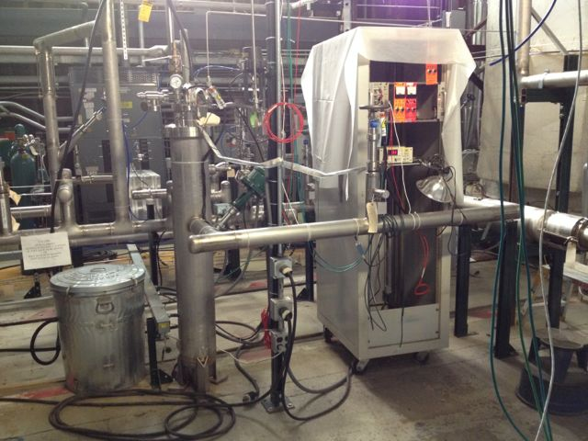
Purity Monitors
Cryostat: String of 4 PrMs, Short-Long—Long-Short
Inline –1 Long PrM mounted after filters
Always measures extremely Pure LAr
Flow back to 35 T
Flow from filters
RTDs
Inline PrM
PrM 2
PrM 1
PrM 4
PrM 3
E.Voiron Drawing

Slide 12
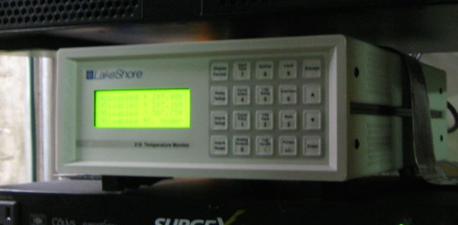
Precision Temperature Measurement
RTD Readout—Lakeshore 218
Have achieved ~ 2 mK rms resolution (statistical) on 35T Phase 2 RTD readout.
These are the RTDs shown in previous slide.

Slide 13
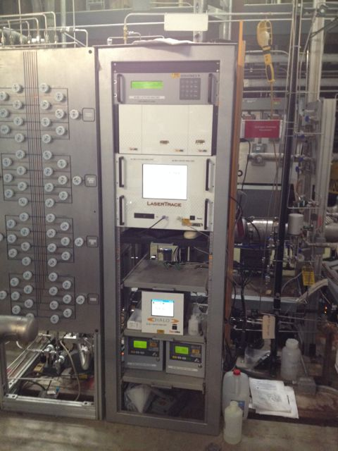
Gas Analyzers
Can “sniff” liquid or gas regions of cryostat
O₂, N₂, H₂O units, with sensitivities from % to sub-ppb levels
Useful for both debugging during initial phase of gas purging and during the run to help identify contamination

Slide 14
More Cryo Instrumentation
RTDs, Pressure Transducers, LAr Level Indicators…
Monitored and archived by the Cryo Controls System

Slide 15
Cryo Motivation for this Run (not directly related to HV)
35T Phase 2 (and perhaps Phase 1) showed that the Purity in Cryostat was vertically stratified.
Higher Purity at bottom of Cryostat.
See slides 12 and 17
Erik Voiron’s Computational Fluid Dynamics calculations can reproduce this if the filtered highly pure LAr that is returned to the Cryostat is slightly cooler than the bulk LAr.
See Erik’s DuneDocDB1156 for more info
Seems to be backed up by the PrM mounted RTDs (slide 12)
This pure LAr is being introduced at bottom of Cryostat and tends to stay there since it is cooler
The pump intake is also at the bottom.
We are filtering the LAr that is already pretty pure.
We plan to alter the return pipe to be near the surface layer of the Cryostat
See if this avoids the previous stratification by better mixing the return LAr into the bulk LAr.
Plan to place a “Precision” RTD near the return to sample the temperature.
As a side, with better mixing we might improve the overall purity of LAr.

Slide 16
Xtra slides

Slide 17
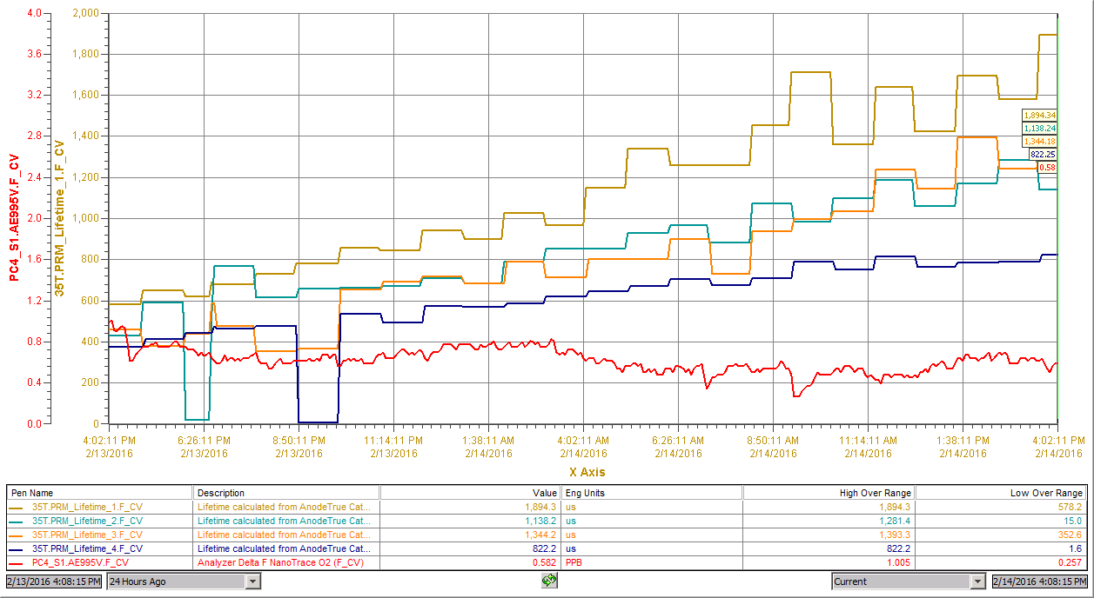
Immediately Notice Purity Stratification after pump start and purification
PrM 1 (near Cryostat bottom)
PrM 4 (near surface)
O2 Gas Analyzer, ~(~80 cm from bottom)

Slide 18
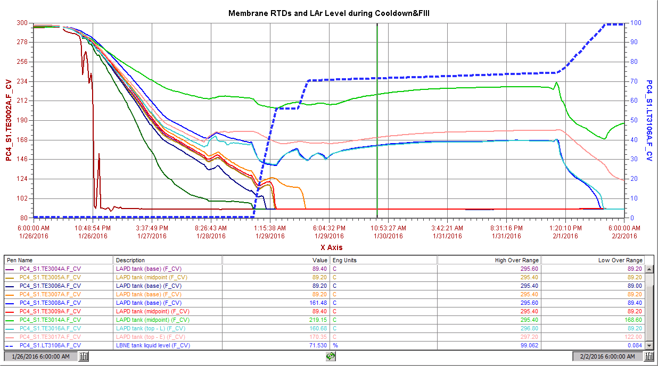
Phase 2: 35T Cooldown and Filling
~60 hrs
Membrane
Temperature
sensors
~16hrs
LAr Xfer
from LAPD
Top-Off from TRAILER
GAr xfer from LAPD (over weekend) ~1.5 tons
Cooldown rate
Mfg Specs <~ 10K/hr
LAPD Pump trip

Slide 19
LAr Shuffle LAPD->35T
35 T ~70% Filled by LAPD Pump Out
~8% left in LAPD

