Slide 1
Proton Improvement Plan
Bob Zwaska
All-Experimenters Meeting
July 18, 2016

Slide 2
PIP – Approaching Five Years
Started officially Oct. 1, 2011
Upgrade Linac & Booster for NOvA, BNB, & Muon experiments
More than double flux, rep rate, run for the long-term
Much has been achieved
Booster pulsed @ 15 Hz – 20 refurbished cavities
Beam on at 15 Hz – supported 700 kW operations
Operated at limit of shielding assessment
Several major tasks to complete:
Linac Modulators
Linac Laser Notcher
Booster RF Stations 21 &22
New Cavities
Beam physics, instrumentation, collimation

Slide 3
Proton Improvement Plan Goals and Scope (Established in 2011)
Increase the beam repetition rate from the present ~7.5 Hz to 15 Hz
Need at least 9 Hz for NOvA 12-batch slip-stacking
Requires RF cavities refurbishment, RF Systems
Eliminate major reliability vulnerabilities and maintain reliability at present levels (>85%) at the full repetition rate
Eliminate major obsolescence issues
Increase the proton source throughput, with a goal of reaching >2E17 protons/hour
Presently operating up to 1.8E17 protons/hour
Ensure a useful operating life of the proton source through at least 2025 (now extended to 2030 to accommodate PIP-II schedule)

Slide 4
Proton Improvement Plan Bill Pellico Bob Zwaska, Deputy Kenneth Domann, Project Controls Valeri Lebedev, Senior Physicist
Booster Keith Gollwitzer
200 MHz RF Power System Fernanda G. Garcia
High-Level RF Fernanda G. Garcia
Linac Modulator Matt Gardner
7835 Procurement Fernanda G. Garcia
Instrumentation Craig Drennan
Utilities
Matthew Gardner
Power Distribution Ryan Crawford
RF John Reid
Anode Supply Ryan Crawford
Bias Supply Pat Sheahan
New Tuners Matt Slabaugh
Replacement Cavities
Tom Kroc
Cavity 1013 Matt Slabaugh John Reid
Accelerator Physics Bob Zwaska
Booster Collimation Valeri Kapin
Radiation Shielding Keith Gollwitzer
Alignment & Aperture Kiyomi Seiya
Booster Notcher Salah Chaurize
Low-Conductivity Water System David Hixson
Power Distribution Ryan Crawford
Vacuum System Dave Augustine
Solid State Upgrade John Reid
Power Amplifier Steve Kotz
Driver Module Tom Kubicki
Cavity Test Stand Pat Sheahan
Linac Notch Creation Dave Johnson
Simulations & Studies Valery Kapin
Accelerator Physics Valeri Lebedev
Vacuum System Dave Augustine
Modulator Rene Padilla
Installation Rene Padilla Steve Kotz
Instrumentation Craig Drennan
Dampers Nathan Eddy
Utilities Todd Sullivan
Booster Cogging Kiyomi Seiya
Beam Position Monitors Nathan Eddy
Simulation & Studies Bob Zwaska
Linac Fernanda G. Garcia
Cavity & Tuner Refurb. Matt Slabaugh
RFQ Injector C. Y. Tan
Beam Position Monitors Nathan Eddy
Low-Cond. Water System Matt Gardner
Perpendicular Cavity CY Tan
Cavities 21&22 Matt Slabaugh Stations 21&22 Tom Kubicki
PIP has 34 Subprojects
24 are completed and closed
Where PIP effort has been since last AEM
Linac Modulator
Laser Notcher
Cavities 21 & 22
Stations 21 & 22
Perpendicular (2nd harmonic) Cavity
Beam Physics
Booster Collimators
Completed

Slide 5
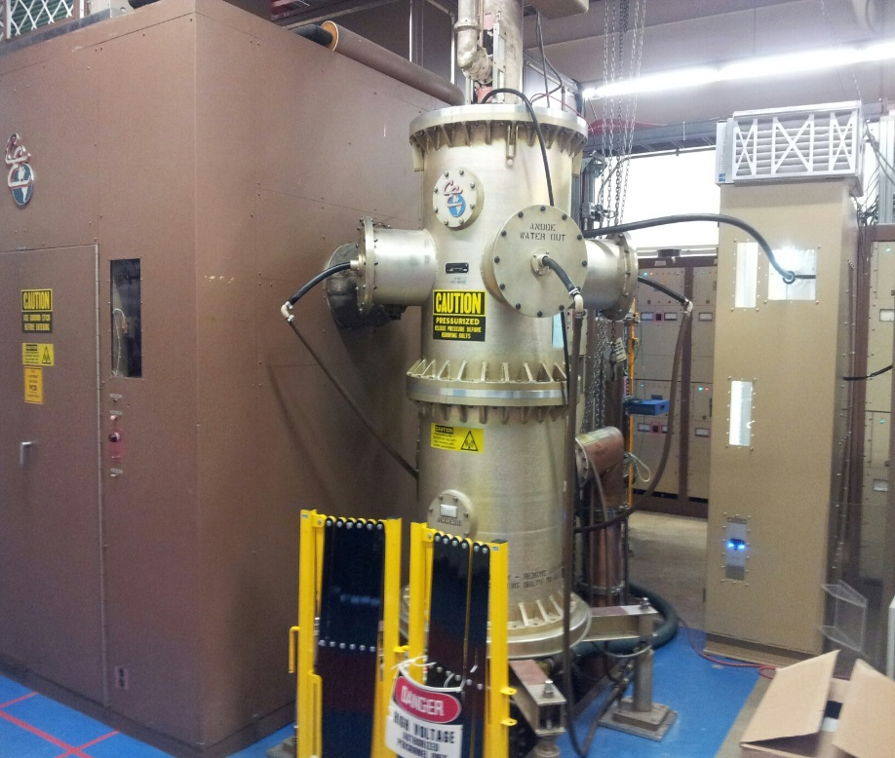
PIP - Linac 200 MHz RF Power System – Marx Modulators
35 kV Marx Modulator Upgrade
28-cell unit in operations - LRF1
Several months of stable operation
54-cell design for other stations
Prototype nearly complete
Will install on LRF5 this shutdown
Potential driver of shutdown schedule
Preparing to build 4 more modulators
Major procurements have begun
Install over next two shutdowns
Plan completion in 2018
Old
New

Slide 6
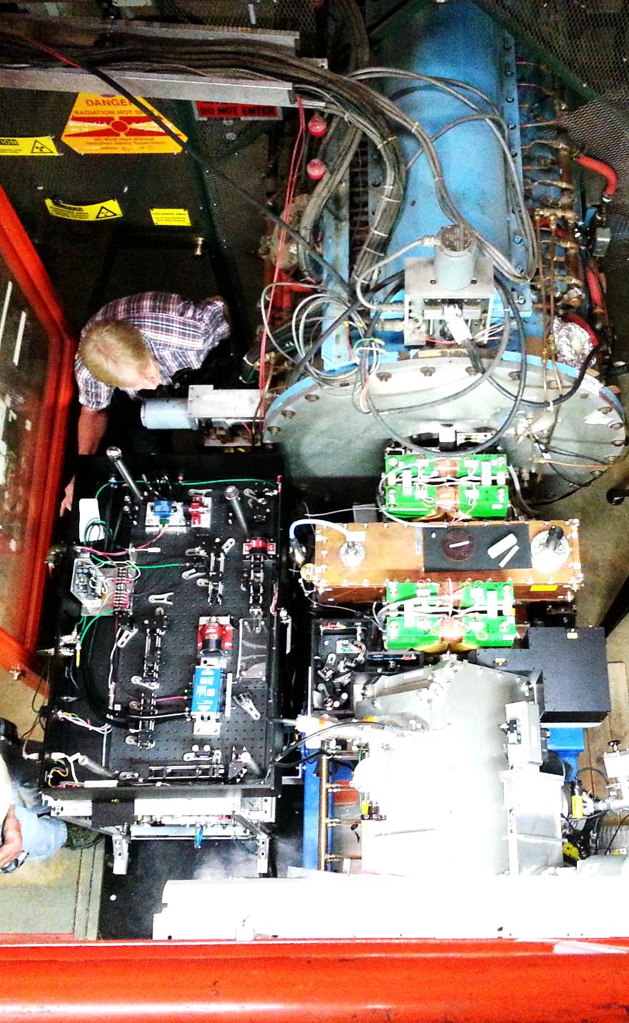
PIP - Linac Laser Notcher (loss at 750 keV, instead of 400 MeV)
Laser notch system
Complete system assembled and tested in lab at 15 Hz
Issues with stability under control, for the moment
Full system installed into Linac
Alignment nearly complete, timing in progress
Possible notching tomorrow!

Slide 7
PIP-Booster RF Stations 21 & 22
Restoring two previous Booster cavities and establishing two new RF Stations
Gain further 10% in accelerating voltage and overhead
Cavity 21 is complete awaiting test
Cavity 22 awaiting breakdown
New stations being built in Booster Gallery
New room for power supplies, amplifiers, controls, etc.
New runs of striplines to tune cavities
New slots in Booster available
Schedule: cavity 21 will be ready to go in this shutdown, cavity 22 later this year, Stations will be populated this fall; operation as cavities go in using spare power supplies

Slide 8
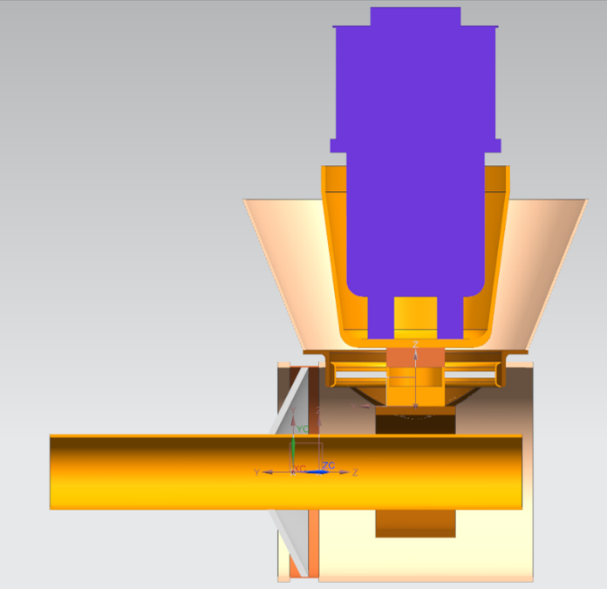
New RF Cavities
Half the length
of standard RF
cavity – yet with
more gap voltage
Harmonic Cavity
Perpendicular biasing
Improve injection capture & transition
R&D underway
Tests of tube amplifiers at 76 & 106 MHz
Tests of solid-state drivers
Tests of bonding for garnet pieces
Work on final design
Large solenoid & PS to bias the garnets
Thermal design is critical to making a reliable design
Replacement Cavities
Long term operations
Avoid known weak points of existing cavities
Higher current operations
Compatible with PIP-II+ requirements

Slide 9
Summary
PIP has made Booster ready for 15 Hz beam
Further improvements are for reliability/modernization and loss reduction
Major Replacement of Linac Modulators underway
Linac Laser Notcher is nearing operational tests
Additional Booster cavities to be implemented
2 additional stations for additional RF voltage & reliability
Harmonic Cavity
Replacement Cavities

