Slide 1
The H2 VLE Beam
Status report
N.Charitonidis and Y.Karyotakis (*)
July 20th 2016
(*) taking over the initial work from Ilias Efthymiopoulos

Slide 3
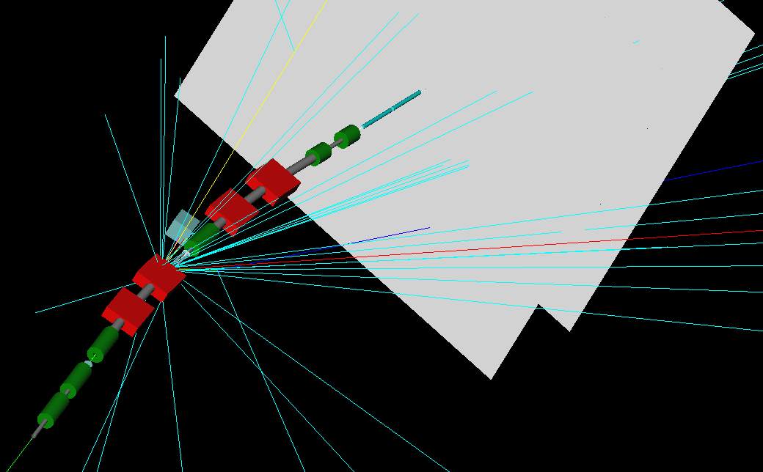
Simulation studies
GEANT4 based package (G4BeamLine)
  Full simulation of H2 beam line transport + sec. target + VLE extension
  All material included until the cryo membrane
  We request a particle to cross all our detectors
  Target W for 0.4 to 2. GeV/c and Cu for p > 2 GeV/c
We generate 6M events per energy

Slide 4
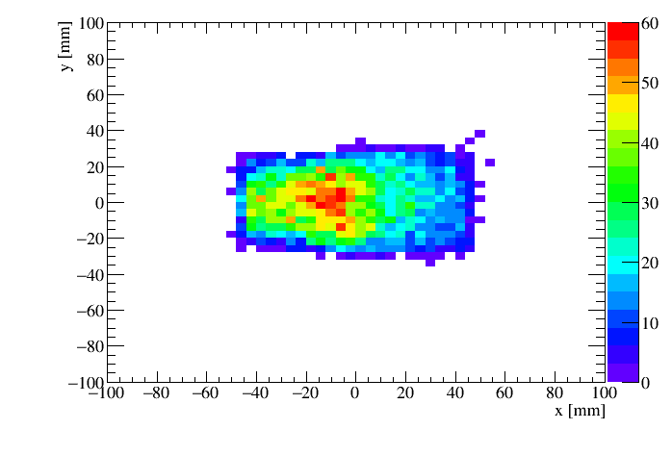
Beam profile @ center of DP

Slide 5
Beam Composition
+80GeVc -> +xxGeV/c

Slide 6
Data Taking time

Slide 7
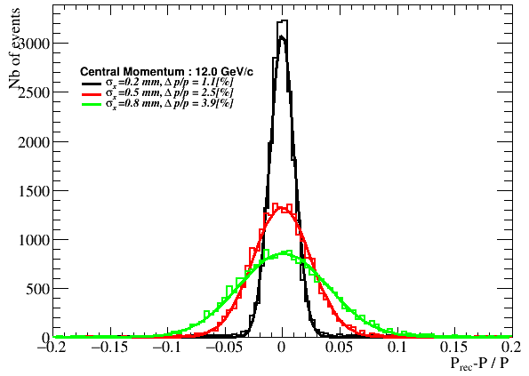
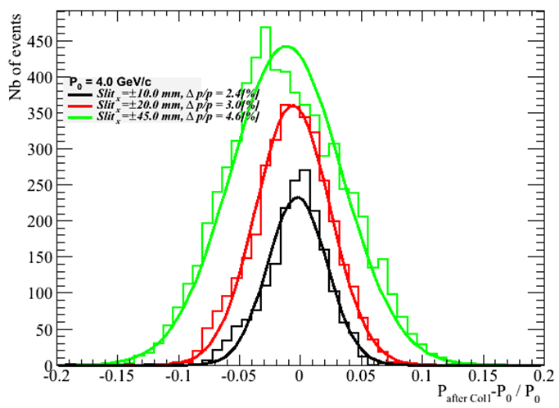
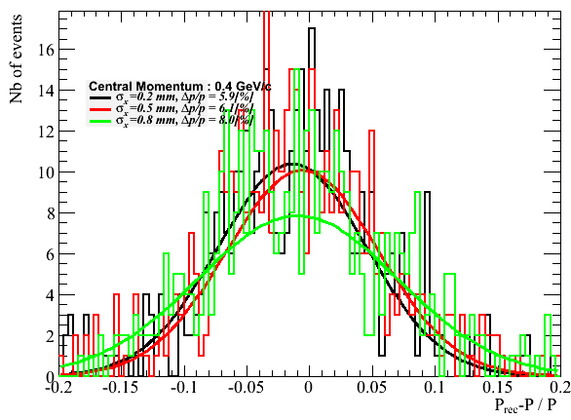
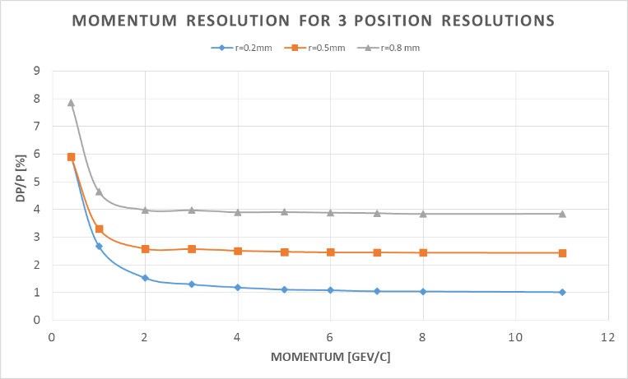
Momentum measurement
No material
Closing the collimator
All material included

Slide 8
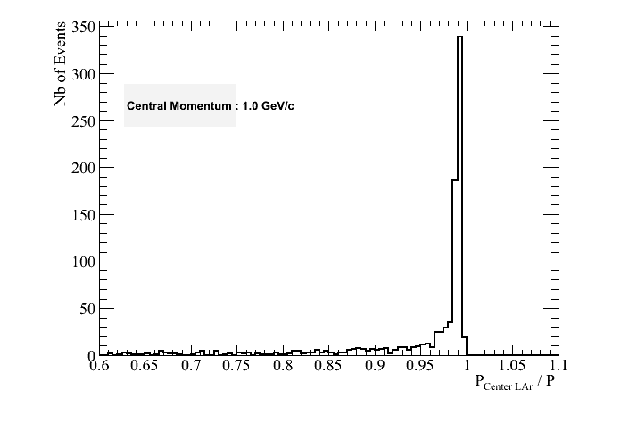
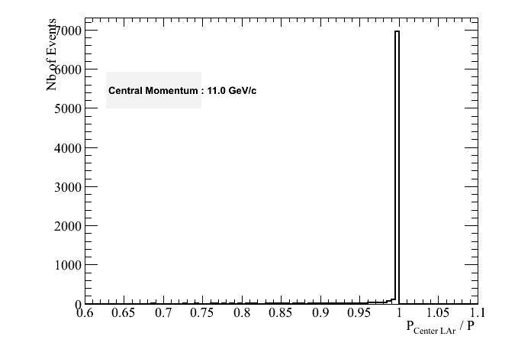
Material downstream the spectro

Slide 9
Material

Slide 10
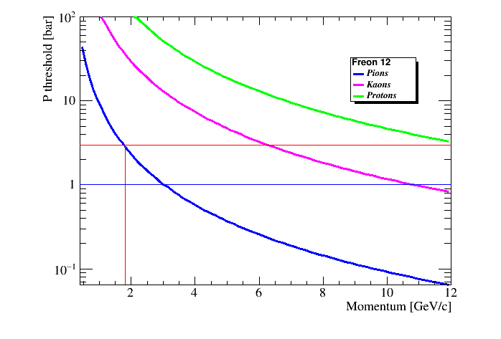
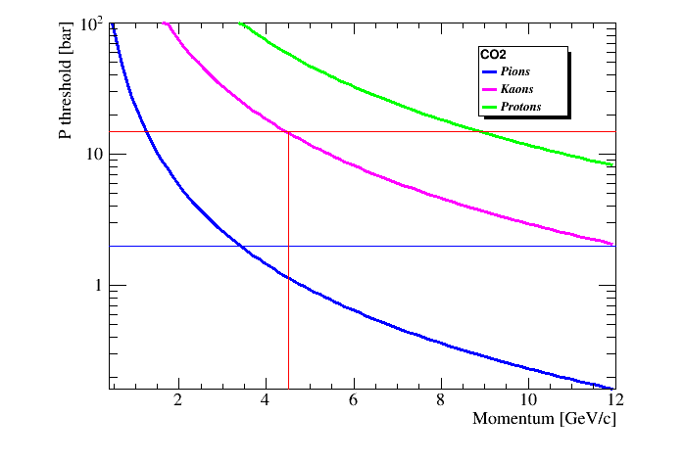
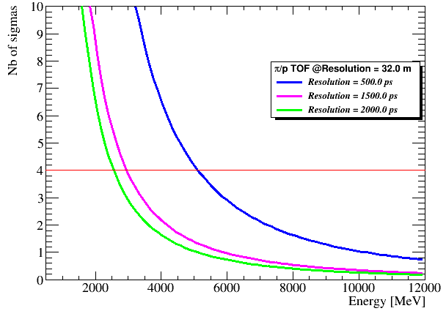
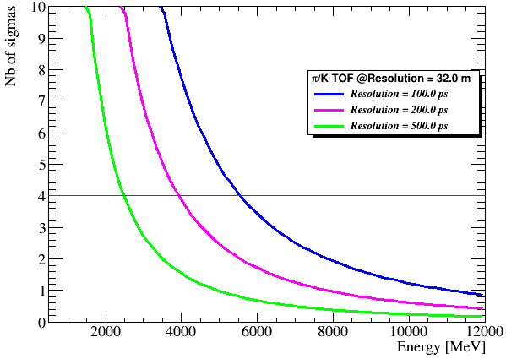
PID

Slide 11
For 3.0 to 4.5 GeV/c
  Beam ++ : We identify pions and (K⁺[0.64% - 1.46%]+p[7.6%]), therefore we call them all p contaminated by K⁺ [8%-16%]
  Beam +- : We identify pions and (anti-p[0.3%-0.65%]+K⁻[0.36%-0.65%]) Under investigation

Slide 12
Beam Detectors
Trigger
  3 scintillator tiles 10x10 cm2, S1,2,3
Tracking devices
  4 fiber layers ( 3 in vacuum and the 4th in front of LAr entrance) BPROF1,2,3,4
    1mm diameter one layer per coordinate, ~92% acceptance
Cherenkovs
  Two, 2m long threshold Cherenkovs
TOF
  Two layers of fibers, distant of 32m
  All detectors in vacuum, but BPROF4, and S3.

Slide 13
Summary
Extensive simulations finished for H2, data available on eos
  Physics list study
  Target optimization
  Background (muons)
  Momentum measurement
Material budget optimization
Detailed technical note to be submitted 1st of august 2016
Lunch detector production by September
  Build 1/10th of TOF and test it on SPS this autumn

