Slide 1
protoDUNE-SP Photon Detector System
Leon Mualem
Caltech
August 2, 2016
Photon Detector Review
University of Chicago

Slide 2
protoDUNE-SP
Photon Detector System
protoDUNE-SP
protoDUNE-SP Photon Detector System
protoDUNE-SP Photon Detector Goals
Photon Detector System Requirements
Risk
Lessons Learned
Schedule
Conclusions

Slide 3
protoDUNE-SP
Membrane Cryostat, approximately cube with 10m sides
Approximately 6m cube TPC inside

Slide 4
protoDUNE-SP TPC
The TPC consists of 6 anode plane assemblies with integrated photon detectors, 3 cathode plane assemblies
It is roughly 6m tall, 7m deep, and 7.2m wide

Slide 5
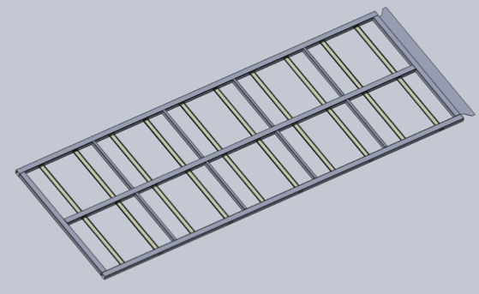
Photon Detector System
10 bars/paddles in each APA
  2 types, plus 2 R&D paddles
  Radiator/WLS Bar (IU)
  Dip-coated bars (MIT and FNAL)
  Arapuca Arrays (UNICAMP)
Array of 12 SiPMs per paddle
  CSU, NIU, Caltech
6 APAs
  60 paddles
  720 SiPMs
Bias and digitization provided by SiPM Signal Processor (SSP) (ANL)
240 readout channels
External Calibration Flasher with emitters on Cathode Plane (ANL)
MANY MANY more details in next 11 talks
10 PDs per APA Frame
PD area 2094mm X 84mm (each)
APA Frame area (Outside) 6060mm X 2300mm
PD Coverage fraction: ~12.6%

Slide 6
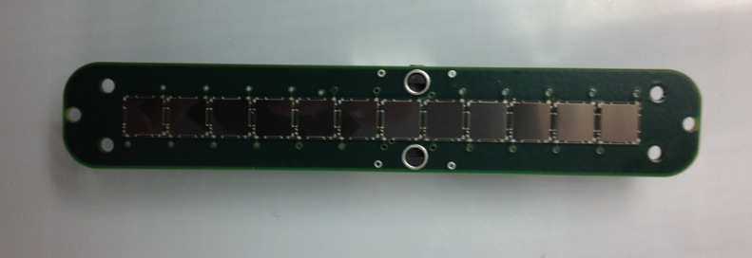
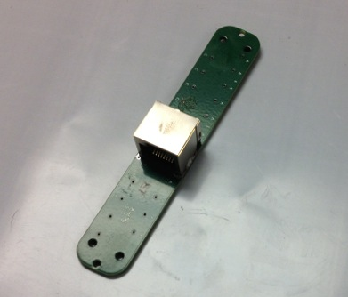
SiPM Mount PCB
12 SiPMs, 0.2mm separation
SMT RJ-45 connector

Slide 7
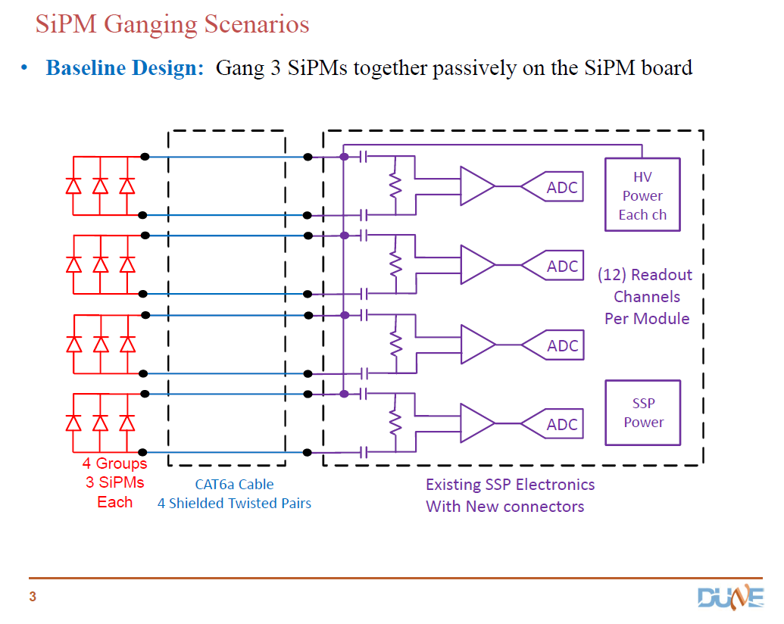
Baseline SiPM Readout Design
Use adaptation of Argonne National Lab SSP design used at test locations and 35T
Compatible and tested with DAQ already
Tested with 3 passively ganged SiPMs and proposed readout cables
See Gary Drake Talk for design, specs and pictures

Slide 8
protoDUNE-SP
Photon Detector
Demonstrate Light Detection Capability
  Determine Detection Sensitivity
  Measure Background Rates
Measure detector response to known particles for a reasonable number of production modules
Confirm modeling and simulations
Demonstrate interfaces have been addressed
  Mechanical interfaces
    Photon Detector System –Anode Plane Assembly
    Calibration system to – Cathode Plane
    Cryostat feedthroughs
  Electrical interfaces
    Grounding and shielding
    Power Distribution
  DAQ interfaces
    Readout
    Triggering
    Data rates
    Timing
Goals

Slide 9
protoDUNE-SP
Photon Detector
DUNE Requirements
Requirements for DUNE Science:
  Proton Decay
  Atmospheric Neutrino
  Supernova Neutrino
Resulting Photon Detector Requirements
  Parameter 0.1pe/MeV (at cathode plane)
  1 microsecond for position resolution
Future Photon Detector Requirements
  Committee to address possible updates to science and resulting PD requirements
  protoDUNE measurements will inform possibility of extending the science and detector requirements
Requirements

Slide 10
Global Objectives
ID | Object Heading | Object Text | Rationale | Parent | Verification method
Glo-obj-4 | Proton Decay | A search for proton decay in the far detector, yielding a significant improvement in current limits on the partial lifetime of the proton (τ/BR) in one or more important candidate decay modes, e.g. p→K⁺ν or p→e⁺π⁰ | As an additional note: measurements in the near detector with a neutrino beam could serve to understand backgrounds to the proton decay search. |  | data analysis
Glo-obj-5 | Neutrino Flux from a Core Collapse Supernova | Detection and measurement of the neutrino flux from a core collapse supernova within our galaxy, should one occur during the lifetime of DUNE |  |  | data analysis
Glo-obj-6 | Ancillary Science Program
Glo-obj-8 | Neutrino Oscillation Using Atmospheric Neutrinos | Measurements of neutrino oscillation phenomena using atmospheric neutrinos |  |  | data analysis
Glo-obj-13 | Additional Scientific Objectives
Glo-obj-14 | Diffuse Supernova Neutrino Flux | Detection and measurement of the diffuse supernova neutrino flux |  |  | data analysis
Global objectives from requirements document dune-doc-112 define the high level measurements and drive Global science requirements

Slide 11
Global Science Requirements
ID | Type | Object Heading | Object Text | Rationale | Parent
Glo-Sci-44 | heading | LBNF/DUNE Components
Glo-Sci-8 | requirement | Charged current interactions on Ar40 due to supernova burst. | Far detector shall be capable of collecting low energy (<100 MeV) charged current electron neutrino interactions on Ar40 nucleus that arrive in a short period of time (<100 sec) . The final state electron shall be detected and its energy measured. | Most of the events from a supernova neutrino burst are expected to be neutrino absorption on Ar40 producing electrons in the range of 5 to 100 MeV and arrive in less than one minute timeframe. In such events an electron and a K40 nucleus is in the final state. The total event count from a galactic supernova (10 kpc) is expected to be approximately 3,000 events for 40 kt of LAr. | Glo-obj-5
Glo-Sci-9 | requirement | Far Detector Availability | Far detector shall have high uptime with little event by event dead time to allow the capture of low probability astrophysical events that could occur at any time with no external trigger. (>90%) | Supernova events are expected to occur a few times per century within the Milky Way galaxy. For any 10 year period the probability of a supernova could be 20 to 30%. Capturing such an event at the same time as many of the other detectors around the Earth is very important. | Glo-obj-5
Glo-Sci-27 | requirement | Proton Decay sensitivity | The far-detector fiducial size multiplied by the duration of operation [expressed in kiloton-years] and the rejection of background events shall be sufficient to yield a scientifically competitive result on proton decay. | The result on the kaon-neutrino channel needs to be competitive to running experiments such as Super Kamiokande. | Glo-obj-4
Glo-Sci-33 | requirement | Timely trigger regarding Astrophysical Events | The DUNE detector systems shall be configured to provide information to other observatories on possible astrophysical events (such as a galactic supernova) in a short enough time to allow global coordination. | To obtain maximum scientific value out of a singular astronomical event, it is very important to inform all other observatories (including optical ones) immediately, so that they can begin observation of the evolution of the event. | Glo-obj-5
Glo-Sci-34 | requirement | Time Accuracy | Individual event times shall be measured with sufficient time accuracy to allow correlation of event times between detectors that are geographically separated. | This requirement will allow time correlations of events between various detectors across the world. This could include correlation between the DUNE near and far detectors. | Glo-obj-5
Global science requirements follow from global objectives, and result in performance requirements for the detectors
A few examples shown, many more in dune-doc-112

Slide 12
Far Detector Requirements
LArFD-L2-se-25 | heading | Photon Detection | This is the high level for PD |  |  | Parent
LArFD-L2-se-26 | design choice | Detect Scintillation light | A photon detector shall be implemented and integrated into the TPC modular design to detect the time and intensity of scintillation light from ionizing radiation in the active portion of the liquid argon detector. | It is important to integrate the photon detector into the current TPC design. This implies that the design must allow the TPC to function without interference, and the TPC must allow the scintillation light to reach the PD without being obscured. |  | larfd-l2-se-82
 |  |  |  |  |  | larfd-l2-se-83
LArFD-L2-se-27 | design choice | Photon Detector using light guides | The photon detector shall consist of light guides suitably coated and doped to shift liquid argon scintillation photons of 128 nm and transport them into solid state detectors mounted on the light guides | Defines the geometry. |  | larfd-l2-se-96
LArFD-L2-se-28 | requirement | Photon sytem performance I | The photon system shall detect sufficient light from events depositing visible energy >200 MeV to efficiently measure the time and total intensity. | This is the region for nucleon decay, atmospheric neutrinos. The time measurement is needed for vertex determination as specified in the parent. We require that this efficiency be high since this is high priority physics. | If proton decay vertex in the fiducial cannot be determined well , then the sensitivity will be affected by backgrounds from cosmic ray muons. | larfd-l2-se-82
LArFD-L2-se-29 | requirement | Photon System perfromance II | The photon system shall detect sufficient light from events depositing visible energy <200 MeV to provide a time measurement. The efficiency of this meansurement shall be adequate for supernova burst events. | This points back to low energy measurement of vertex for supernova burst events. Since the trigger is based on burst, the background is expected to be small, and so the main rationale behind this measurment is to improve the energy resolution. | Efficiency could vary significantly from visible energy of 5 MeV to 100 MeV. | larfd-l2-se-83
LArFD-L2-se-30 | requirement | photon system materials | The PD system shall use only materials compatible with high purity liquid argon and minimal natural radioactivity. |  |  | larfd-l2-se-7
 |  |  |  |  |  | glo-sci-8
LArFD-L2-se-31 | requirement | Photon system readout electronics | The photon system readout electronics shall record waveforms continuously with sufficient precision and range to achieve the key physics parameters | The resolution and dynamic range needs to be adjusted so that a few photo-electron signal can be detected with low noise. The dynamic range needs to be sufficiently high to measure light from a muon traversing a TPC module. | The current design readout will output time and pulse height continuously. Need to be able to synchonize with the TPC. | glo-sci-8
Requirements flow down from global objectives to global science requirements and finally to lower level performance requirements

Slide 13
Far Detector Requirements
LArFD-L2-se-81 | heading | Time measurements
LArFD-L2-se-82 | requirement | Event timing for high energy events | Event time shall be measured with high efficiency to allow the measurement of the drift coordinate with sufficient precision for events with visible energy above 200 MeV. | Time is needed for Proton decay and atmospheric neutrino event fiducialization and energy resolution. The minimum visible energy for a P to K+ neutrino decay is ~200 MeV including fermi motion effects. sufficient safety margin in terms of threshold needs to be discussed. | These are requirements for the photon detector | glo-sci-27
LArFD-L2-se-24 | requirement | Timing Accuracy, beam events | The detector shall measure the absolute time of occurrence of events with accuracy sufficient to correlate with beam spill for beamline events | the simulation of cosmic ray backgrounds indicate that timing of cosmic ray events with respect to beam spill is critical for background suppression. |  | glo-sci-20
LArFD-L2-se-83 | requirement | Event timing for low energy events. | Event time for events with visible energy <200 MeV shall be measured with high efficiency and sufficient precision to correct for drift time and improve energy resolution. | The drfit time correction for supernova induced electron tracks is expected to improve the energy resolution from ~20% to <10%. This is only one contribution to the supernova energy resolution. The resolution contribution due to other sources such as the nuclear states and deexcitation gammas must be understood. | These are requirements for the photon detector | glo-sci-8
LArFD-L2-se-84 | requirement | Absolute event timing | Absolute event time shall be measured with sufficient accuracy to allow global analysis of supernova neutrino wave front. | Needed for SN global inter-experiment absolute time measurement. Since the wavefront should take ~30 ms to cross the planet, an accuracy of <2 ms should be sufficient. | These are requirements for the photon detector | glo-sci-34
Requirements flow down from global objectives to global science requirements and finally to lower level performance requirements

Slide 14
Far Detector Parameter
Item | Value | Unit | Comment | Associated requirement
Physics Measurments
Minimum Goal Proton Decay to K+ and neutrino | >10^34 | years | Set limit at 90% | glo-obj-4 | These are requirements for the photon detector | glo-sci-27
Goal for Proton decay to K+ and neutrino | >3 10^35 | years | set limit with the full scope detector and livetime of 10 yrs | glo-obj-4 |  | glo-sci-20
Mass hierarchy resolution with Atmospheric neutrinos | > 3 | sigma | using independent techniques from beam neutrinos | glo-obj-8 | These are requirements for the photon detector | glo-sci-8
Detection of supernova | >1000 | events/10 sec burst | Yield from galactic event will depend on distance, energy threshold, detector size. | glo-obj-5 | These are requirements for the photon detector | glo-sci-34
Photon yield minimum | 0.1 | PE/MeV |  | Larfd-L2-se-28 => Ability to trigger @ 88 % eff. at 200 MeV visible energy
Photon time resolution | 1 | Micro-sec |  | larfd-L2-se-28=> larfd-L2-se-82 => Proton decay larfd-L2-se-29=> larfd-L2-se-83 => SN resolu
Performance requirements finally give the detector parameters at the lowest level that fulfill the requirements of the higher level objectives all the way back to the global objectives. These are also found in dune-doc-112

Slide 15
Project Risks
Schedule Risk – protoDUNE-SP schedule end date is driven by Long Shutdown at CERN
Mitigation: Advance purchases – light guide bars and acrylic base
Risk FD-073 Photon light yield too low
  Far detector Risk, mitigate by showing sufficient light yield in the prototype – protoDUNE-SP, mitigate by enhancement to light collection efficiency, double-ended readout, mirroring bars, increasing light yield, cathode plane radiator, xenon doping, more detectors
Risk FD-089 Photon detector SiPMs are not qualified for cryogenic use
  Far detector Risk, mitigate by testing – see talk, mitigate by allowing flexibility of design to swap photon detector, not only one to make 6mm SiPM, mitigate by making a large prototype detector – protoDUNE-SP
Risk FD-098 ProtoDUNE-SP Degraded Photon Detectors
  Prototype detector risk, mitigate by handling controls – shielded lighting during construction and installation specified already, protect during shipping and handling
Risk FD-117 ProtoDUNE-SP Photon Detector monitoring software is unavailable for commissioning
  Mitigate by being prepared, learning from lessons-learned from 35T detector, utilize software developed there, much longer assembly period for this prototype detector to enable testing and commissioning.

Slide 16
Lessons Learned
Pre-learned
  Don’t freeze technology before needed
    Install photon detectors after APA has been wound to maximize flexibility
Operating conditions (gain and threshold) were not defined for PD modules
  Perform and record (electronically) QA test data for use at detector
  All components will have ID for setting operating parameters
Software not available
  Define tests ahead of time
  3 months of integration testing before install in cryostat – longer than entire 35T run
Data Rates too high
  Utilize coincidence triggering and digest data (vs. waveform) for self-triggering
DUNE-DOC-913

Slide 17
ES&H Awareness
Indiana University
(WLS bar testing/Plate production)
  Procedures and processes reviewed by ES&H personnel to determine requirements for new lab space
Fermilab (Dip-coated production)
  Setting up new lab space and procedures and getting personnel assigned requires Technical Scope of Work (TSW) where all these requirements are defined and reviewed to assure procedures, facilities and personnel meet needs
CSU
  Reviewed by University and Fermilab when setting up Cryogenic Detector Test Facility at CSU
NIU
  Reviewed by University in the course of setting up for cryogenic testing of SiPMs and cables
Caltech
  Space and procedures were reviewed by department safety officer, and university undergrad safety office. Trained by university personnel on hazards of liquid nitrogen use.
Production sites have been internally (local university or national lab) and externally (Fermilab) reviewed for procedures and setup

Slide 18
Schedule
Key Dates
First Detector Modules to CSU
  May 2017
First tested SiPM modules to CSU
  March 2017
First Modules to CERN
  May 2017
Last Modules to CSU
  July 2017
Last Modules to CERN
  Oct 2017
Cryostat TCO Closed
  Feb 2018
Commissioning at CERN
  May 2018
End of Beam Operations
  November 2018
Integrated resources loaded schedule has been produced
Monthly Status reports on each task
Key links to other protoDUNE-SP subproject activities are included
Milestones updated and tracked

Slide 19
Schedule
Integrated resources loaded schedule has been produced
Monthly Status reports on each task
Key links to other protoDUNE-SP subproject activities are included
Milestones updated and tracked

Slide 20
Schedule II
Integrated resources loaded schedule has been produced
Monthly Status reports on each task
Key links to other protoDUNE-SP subproject activities are included
Milestones updated and tracked

Slide 21
Schedule III
Integrated resources loaded schedule has been produced
Monthly Status reports on each task
Key links to other protoDUNE-SP subproject activities are included
Milestones updated and tracked

Slide 22
Conclusions
Photon Detector System has been designed to meet the requirements of DUNE
protoDUNE-SP will give allow evaluation of the performance relative to the requirements
An integrated resource loaded schedule has been completed that meets the timeline of protoDUNE
The design builds on the lessons learned in 35T and other prototypes
Schedule and technical risks have been addressed for protoDUNE, and protoDUNE is a risk mitigation strategy for DUNE
The following talks will take you through the details of the protoDUNE Photon Detector System (PDS) design

Slide 23
Charge Matrix
Charge Item | Charge Question | Mualem | Himmel | Whittington | Mufson | Toups | Segreto | Zutshi | Mufson(2) | Warner | Warner(2) | Drake | Djurcic | Buchanan
1 | Does the Photon Detector System design enable validation and refinement of the DUNE photon detector requirements? | X | X | X |  |  | X
2 | Are Photon Detector System risks captured and is there a plan for managing and mitigating these risks? | X |  |  | X | X | X |  | X |  |  | X
3 | Does the design lead to a reasonable production schedule, including QA, transport, installation and commissioning? | X |  |  | X | X | X | X |  | X | X | X | X
4 | Does the documentation of the Photon Detector System technical design provide sufficiently comprehensive analysis and justification for the Photon Detector System design adopted? | X | X | X | X | X | X | X | X | X | X | X | X | X
5 | Is the Photon Detector system scope well defined and complete? Are all Photon Detector System interfaces to other detector components: APA, cryostat and DAQ systems documented, clearly identified and complete? Do the electronics feedthrough port and TPC integrated 3D models adequately represent the mechanical, electrical and electronic interfaces to the Photon Detector System? Is the cabling, power and calibration well defined and understood? Is the grounding and shielding understood and adequate? | X |  |  |  |  |  | X |  | X | X | X | X
6 | Are the Photon Detector System 3D model(s), top level assembly drawings, detail/part drawings and material and process specifications sufficiently complete to demonstrate that the design can be constructed and installed? |  |  |  | X | X | X | X |  | X | X
7 | Are operation conditions listed, understood and comprehensive? Is there an adequate calibration plan? | X |  |  |  |  |  | X |  | X | X | X | X
8 | Are the Photon Detector System engineering analyses sufficiently comprehensive for safe handling, installation and operation at the CERN Neutrino Platform? Is the installation plan sufficiently well developed? Is the design for installation tooling adequate for installing the photon system? |  |  |  |  |  |  |  |  |  | X
9 | Have applicable lessons-learned from previous LArTPC devices been documented and implemented into the QA plan? Are the Photon Detector System quality control test plans and inspection regimes sufficiently comprehensive to assure efficient commissioning and adequate operational performance of the NP04 experiment? | X |  |  |  |  |  |  |  |  |  |  |  | X

