Slide 1
protoDUNE-SP Photon Detector System
Leon Mualem
Caltech
August 2, 2016
Photon Detector Review
University of Chicago

Slide 2
protoDUNE-SP
Photon Detector System
protoDUNE-SP
protoDUNE-SP Photon Detector System
protoDUNE-SP Photon Detector Goals
Photon Detector System Requirements
Scope
Lessons Learned
Risk
Schedule

Slide 3
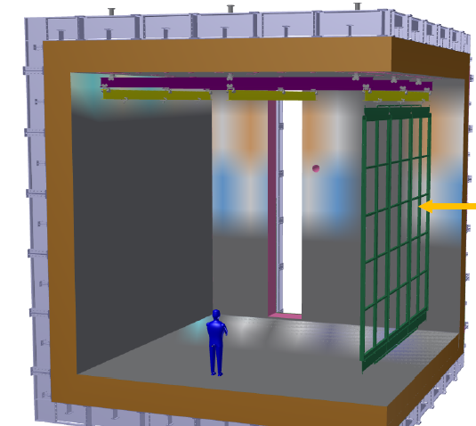
protoDUNE-SP
Describe protoDUNE
Get Picture of Full protoDUNE

Slide 4
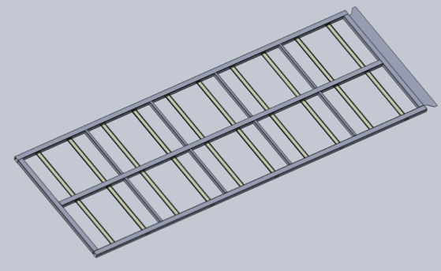
Photon Detector System
10 PDs per APA Frame
PD area 2094mm X 84mm (each)
APA Frame area (Outside) 6060mm X 2300mm
PD Coverage fraction: ~12.6%
10 bars/paddles in each APA
  2 types, plus 2 R&D paddles
Array of 12 SiPM photodetectors/paddle
6 APAs
  60 paddles
  720 SiPMs
Bias and digitization provided by SiPM Signal Processor (SSP)
240 readout channels
External Calibration Flasher with emitters on Cathode Plane
MANY MANY more details in next 11 talks

Slide 5
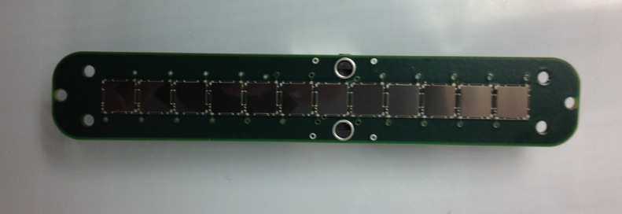
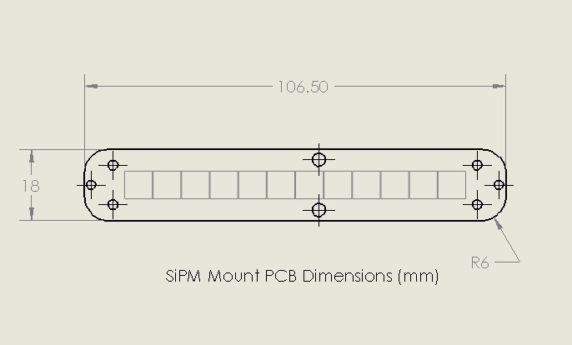
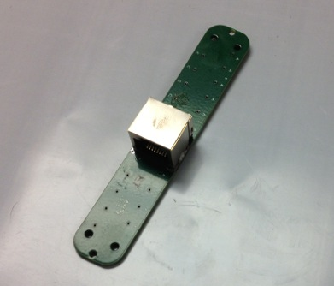
SiPM Mount PCB
12 SiPMs, 0.2mm separation
SMT RJ-45 connector
STEAL MORE RECENT PIC FROM DAVE

Slide 6
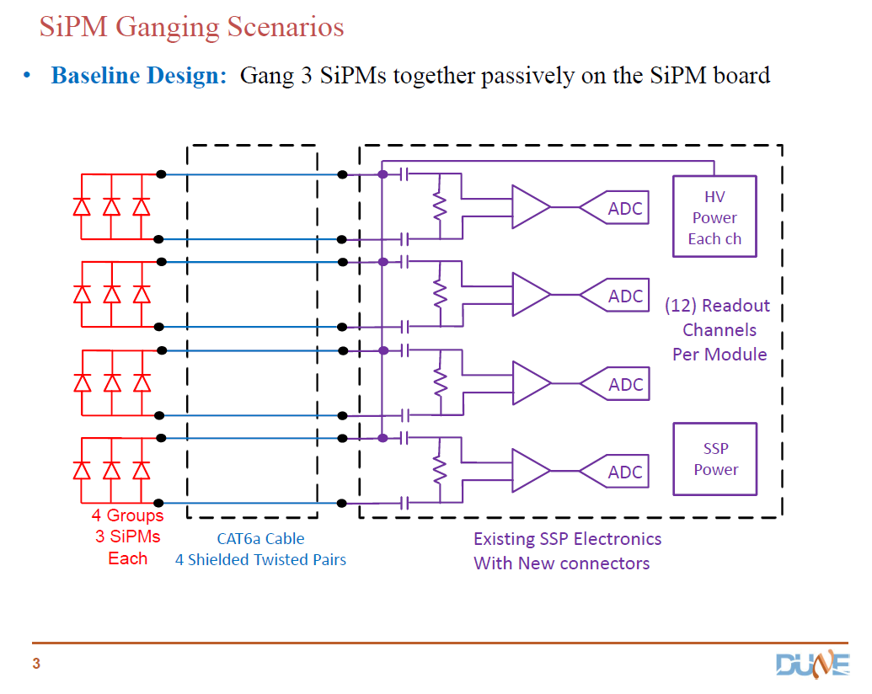
Baseline SiPM Readout Design
Use adaptation of SSP design used at test locations and 35T
Compatible and tested with DAQ already
Tested with 3 passively ganged SiPMs and proposed readout cables
See Gary Drake Talk for design, specs and pictures

Slide 7
protoDUNE-SP
Photon Detector
Demonstrate Light Detection Capability
  Determine Detection Sensitivity
  Measure Background Rates
Measure detector response to known particles for a reasonable number of production modules
Confirm modeling and simulations
Demonstrate interfaces have been addressed
  Mechanical interfaces
    Photon Detector System –Anode Plane Assembly
    Calibration system to – Cathode Plane
    Cryostat feedthroughs
  Electrical interfaces
    Grounding and shielding
    Power Distribution
  DAQ interfaces
    Readout
    Triggering
    Data rates
    Timing
Goals

Slide 8
protoDUNE-SP
Photon Detector
DUNE Requirements
Requirements for DUNE Science:
  Proton Decay
  Atmospheric Neutrino
  Supernova Neutrino
Resulting Photon Detector Requirements
  Parameter 0.1pe/MeV (at cathode plane)
  1 microsecond for position resolution
Future Photon Detector Requirements
  Committee to address possible updates to science and resulting PD requirements
  protoDUNE measurements will inform possibility of extending the science and detector requirements
Requirements

Slide 9
Photon Detector System Scope
larfd-l2-se-122 | requirement | Photon Detection | The far detector shall have a photon detection system integrated into the TPC for detection of scintillation light from the ionization of liquid argon. (PD) | Scintillation light must be detected for full physics implementation of the detector. All system design parameters must consider how they impact and are in turn impacted by this system. |  | glo-sci-27
 |  |  |  |  |  | glo-sci-8
Requrements document:
http://docs.dunescience.org:8080/cgi-bin/ShowDocument?docid=112
Parameter sheet
http://docs.dunescience.org:8080/cgi-bin/ShowDocument?docid=158
System Parameter Sheet
http://docs.dunescience.org:8080/cgi-bin/ShowDocument?docid=203
Photon Detector
Num paddles per APA | 10 |  | **
Num SiPM's per paddle | 12
Paddle acrylic thickness | 0.48 | cm | * | 4 - 1" x 3/16" bars
Paddle acrylic width | 10.16 | cm | * | 4 - 1" x 3/16" bars
Paddle acrylic length | 209.12 | cm | *
Total num paddles cryostat | 60
Total num SiPM's per cryostat | 720
Number of SiPM's per readout channel | 3 |  |  | gang 3 SiPM's together
Number of PD readout channels | 240
Sensitivity at 3.7 m | 0.1 | PE/MeV | * | For a MIP (doc #4134)
Maximum N2 contamination | 1.9 | ppm | * | 2 ppm nitrogen contamination will start interfering with 3 m to 4 m photon transmission in LAr
FIX ACRYLIC DIMENSIONS, #bars

Slide 10
LArFD-L2-se-25 | heading | Photon Detection | This is the high level for PD
LArFD-L2-se-26 | design choice | Detect Scintillation light | A photon detector shall be implemented and integrated into the TPC modular design to detect the time and intensity of scintillation light from ionizing radiation in the active portion of the liquid argon detector. | It is important to integrate the photon detector into the current TPC design. This implies that the design must allow the TPC to function without interference, and the TPC must allow the scintillation light to reach the PD without being obscured. |  | larfd-l2-se-82
 |  |  |  |  |  | larfd-l2-se-83
LArFD-L2-se-27 | design choice | Photon Detector using light guides | The photon detector shall consist of light guides suitably coated and doped to shift liquid argon scintillation photons of 128 nm and transport them into solid state detectors mounted on the light guides | Defines the geometry. |  | larfd-l2-se-96
LArFD-L2-se-28 | requirement | Photon sytem performance I | The photon system shall detect sufficient light from events depositing visible energy >200 MeV to efficiently measure the time and total intensity. | This is the region for nucleon decay, atmospheric neutrinos. The time measurement is needed for vertex determination as specified in the parent. We require that this efficiency be high since this is high priority physics. | If proton decay vertex in the fiducial cannot be determined well , then the sensitivity will be affected by backgrounds from cosmic ray muons. | larfd-l2-se-82
LArFD-L2-se-29 | requirement | Photon System perfromance II | The photon system shall detect sufficient light from events depositing visible energy <200 MeV to provide a time measurement. The efficiency of this meansurement shall be adequate for supernova burst events. | This points back to low energy measurement of vertex for supernova burst events. Since the trigger is based on burst, the background is expected to be small, and so the main rationale behind this measurment is to improve the energy resolution. | Efficiency could vary significantly from visible energy of 5 MeV to 100 MeV. | larfd-l2-se-83
LArFD-L2-se-30 | requirement | photon system materials | The PD system shall use only materials compatible with high purity liquid argon and minimal natural radioactivity. |  |  | larfd-l2-se-7
 |  |  |  |  |  | glo-sci-8
LArFD-L2-se-31 | requirement | Photon system readout electronics | The photon system readout electronics shall record waveforms continuously with sufficient precision and range to achieve the key physics parameters | The resolution and dynamic range needs to be adjusted so that a few photo-electron signal can be detected with low noise. The dynamic range needs to be sufficiently high to measure light from a muon traversing a TPC module. | The current design readout will output time and pulse height continuously. Need to be able to synchonize with the TPC. | glo-sci-8

Slide 11
Glo-Sci-34 requirement Time Accuracy Individual event times shall be measured with sufficient time accuracy to allow correlation of event times between detectors that are geographically separated. This requirement will allow time correlations of events between various detectors across the world. This could include correlation between the DUNE near and far detectors. This requirements needs analysis and design in a tiered manner. Correlation between detectors will most likely not need timing accuracy that is much better than one drift time. However, some accelerator physics measurements (time of flight) could need precision that is limited by the accelerator bucket timing (<10ns). Non accelerator events may require timing of ~micro-second scale for detailed astrophysics measurements. The requirement may impact the design of the photon system in the liquid argon detector. Glo-obj-5

Slide 12
LArFD-L2-se-81 | heading | Time measurements
LArFD-L2-se-82 | requirement | Event timing for high energy events | Event time shall be measured with high efficiency to allow the measurement of the drift coordinate with sufficient precision for events with visible energy above 200 MeV. | Time is needed for Proton decay and atmospheric neutrino event fiducialization and energy resolution. The minimum visible energy for a P to K+ neutrino decay is ~200 MeV including fermi motion effects. sufficient safety margin in terms of threshold needs to be discussed. | These are requirements for the photon detector | glo-sci-27
LArFD-L2-se-24 | requirement | Timing Accuracy, beam events | The detector shall measure the absolute time of occurrence of events with accuracy sufficient to correlate with beam spill for beamline events | the simulation of cosmic ray backgrounds indicate that timing of cosmic ray events with respect to beam spill is critical for background suppression. |  | glo-sci-20
LArFD-L2-se-83 | requirement | Event timing for low energy events. | Event time for events with visible energy <200 MeV shall be measured with high efficiency and sufficient precision to correct for drift time and improve energy resolution. | The drfit time correction for supernova induced electron tracks is expected to improve the energy resolution from ~20% to <10%. This is only one contribution to the supernova energy resolution. The resolution contribution due to other sources such as the nuclear states and deexcitation gammas must be understood. | These are requirements for the photon detector | glo-sci-8
LArFD-L2-se-84 | requirement | Absolute event timing | Absolute event time shall be measured with sufficient accuracy to allow global analysis of supernova neutrino wave front. | Needed for SN global inter-experiment absolute time measurement. Since the wavefront should take ~30 ms to cross the planet, an accuracy of <2 ms should be sufficient. | These are requirements for the photon detector | glo-sci-34

Slide 13
LArFD-L2-se-58 | requirement | Event Vertex Resolution for proton decay or atmospheric neutrinos. | The vertex shall be known well enough to distinguish contained events from entering or cosmogenic background. | This is Needed for proton decay and atmospheric neutrino background rejection. This is not a firm requirements for spernova burst events. | To measure the vertex in the drift dimension, the photon system will be needed. | glo-sci-27
 |  |  |  |  |  | glo-sci-37
larfd-l2-se-97 | requirement | Vertex determination for suopernova burst events | Vertices for supernova burst events shall be determined sufficiently well to allow accurate reconstruction of the energy spectrum and total neutrino burst power determination. | The events occur in a burst, and therefore background reduction is not as crucial. | The photon system could allow determination of the drift distance and improve the energy resolution. The impact on any SN events on the border of the detector in the time interval may be small. | glo-sci-8
 |  |  |  |  |  | glo-sci-28

Slide 14
Glo-Sci-8 requirement Charged current interactions on Ar40 due to supernova burst. Far detector shall be capable of collecting low energy (<100 MeV) charged current electron neutrino interactions on Ar40 nucleus that arrive in a short period of time (<100 sec) . The final state electron shall be detected and its energy measured. Most of the events from a supernova neutrino burst are expected to be neutrino absorption on Ar40 producing electrons in the range of 5 to 100 MeV and arrive in less than one minute timeframe. In such events an electron and a K40 nucleus is in the final state. The total event count from a galactic supernova (10 kpc) is expected to be approximately 3,000 events for 40 kt of LAr. The cross section for neutrino-Ar40 has been calculated with nuclear physics models and can be used to obtain the total neutrino power from the Supernova. This requirement needs several numerical studies that are on-going: the energy resolution expected for supernova events, the minimum energy threshold for supernova, and maximum extent of the supernova pulse (expected to be ~1 minute or longer). The data acquisition buffers shall be sufficiently large and the data acquisition system sufficiently robust to allow full capture of neutrino event information for a supernova as close as 0.1 kpc. For LArTPC, detection of gamma ray photons from the final state excited nucleus could lead to additional electronics requirements. Glo-obj-5

Slide 15
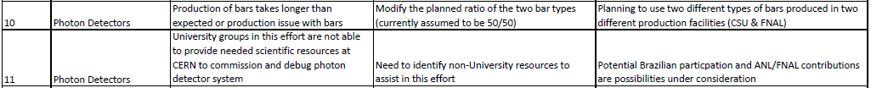
Project Risks
Risk FD-073 Photon light yield too low
  Far detector Risk, mitigate by showing sufficient light yield in the prototype – protoDUNE-SP, mitigate by enhancement to light collection efficiency, double-ended readout, mirroring bars, increasing light yield, cathode plane radiator, xenon doping, more detectors
Risk FD-089 Photon detector SiPMs are not qualified for cryogenic use
  Far detector Risk, mitigate by testing – see talk, mitigate by allowing flexibility of design to swap photon detector, not only one to make 6mm SiPM, mitigate by making a large prototype detector – protoDUNE-SP
Risk FD-098 ProtoDUNE-SP Degraded Photon Detectors
  Prototype detector risk, mitigate by handling controls – shielded lighting during construction and installation specified already, protect during shipping and handling
Risk FD-117 ProtoDUNE-SP Photon Detector monitoring software is unavailable for commissioning
  Mitigate by being prepared, learning from lessons-learned from 35T detector, utilize software developed there, much longer assembly period for this prototype detector to enable testing and commissioning.

Slide 16
Lessons Learned
Pre-learned
  Don’t freeze technology before needed
    Install photon detectors after APA has been wound to maximize flexibility
Operating conditions were not defined for PD modules
  Perform and record (electronically QA test data for use at detector)
Software not available
  Define tests ahead of time
  3 months of integration testing before install in cryostat – longer than entire 35T run
DUNE-DOC-913

Slide 17
Schedule
Integrated resources loaded schedule has been produced
Monthly Status reports on each task
Key links to other protoDUNE-SP subproject activities are included
Milestones updated and tracked

Slide 18
Schedule II
Integrated resources loaded schedule has been produced
Monthly Status reports on each task
Key links to other protoDUNE-SP subproject activities are included
Milestones updated and tracked

Slide 19
Schedule III
Integrated resources loaded schedule has been produced
Monthly Status reports on each task
Key links to other protoDUNE-SP subproject activities are included
Milestones updated and tracked

Slide 20
Conclusions
System designed
Requirements clear
Lessons learned
Shedule done
Risks addressed
Review is passed

