Slide 1
Planning for Proto-DUNE PD Installation and Cabling at CERN
David Warner
Colorado State University
August 2, 2016

Slide 2
Outline
Shipping and Delivery to CERN
Pre-installation checkout
PD Installation
Post-Installation checkout (Cold box)
Labor required
Safety
Conclusions

Slide 3
Shipping to CERN (initial estimates)
Shipping
  PD components will begin to arrive at CERN in March 2017, with most components on-site by June 2017
  The PD modules will ship to CERN by air in 6 crates, approximately 85cm X 85cm X 250cm, weighing ~ 200 kg
    10 PDs + 2 spare per crate
  Electronics (24 modules?) will ship to CERN a currently unspecified number of containers, but the total volume should be ~ 2 or 3m³
  Cables will ship in 6 crates (1 per APA) ~ 85cm X 85cm X 85cm, weighing ~ 100kg each
  PD QC scanner will ship in a crate ~ 1.2m X 1.2m X 3m, weighing ~250kg
  Help will be required from CERN to receive, store and transport the crates on site
  PD components will need to be stored in a dry, environmentally-controlled area
No on-site assembly or fabrication of PDs is expected at this time

Slide 4
PD Pre-Installation Testing
PD pre-installation testing will occur in a full-length dark box with a scanning VUV light source capable of scanning 2 PDs at once (Identical to the warm scanner used during fabrication of PD modules).
Approximately 2 hours will be required per PD scan. (Details of scanner and scan in Buchanan QA presentation)
A PD pre-installation testing area approximately 2m X 5m is required.
The assembly area should be a class 100,000 clean assembly area, with UV filtering (<450 nm) on ambient light.
Following removal from packaging, and throughout PD installation and testing, the APAs must be protected from prolonged exposure to unfiltered light at all times.
Humidity control may also be required, which is currently under investigation

Slide 5
CERN Installation:
Clean Room

Slide 6
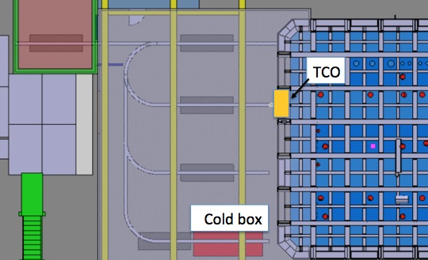
TPC Installation Clean Room
Possible TPC
Installation Areas

Slide 7
PD Installation in APAs
Installation of PDs is planned to happen with the APA frames rotated vertically
Installation follows the following rough outline:
  PD is tested in PD scanner (while previous installation is occurring)
  Beginning at the top position, a PD cryogenic cable is pulled through the frame using “Fish tape” positioned in frame during assembly
  PD to be installed is positioned in “PD lift” and lifted to position.
  PD is slid into APA frame and fastened into position
  Short haul cable is connected & connectivity tested at far end of short haul cable.
  PD installation lift is lowered to ground position and process repeated
  After 5 PDs are installed in one side of APA, the PD installation structure is moved to the other side of the APA (or the APA is moved) and the process is repeated

Slide 8
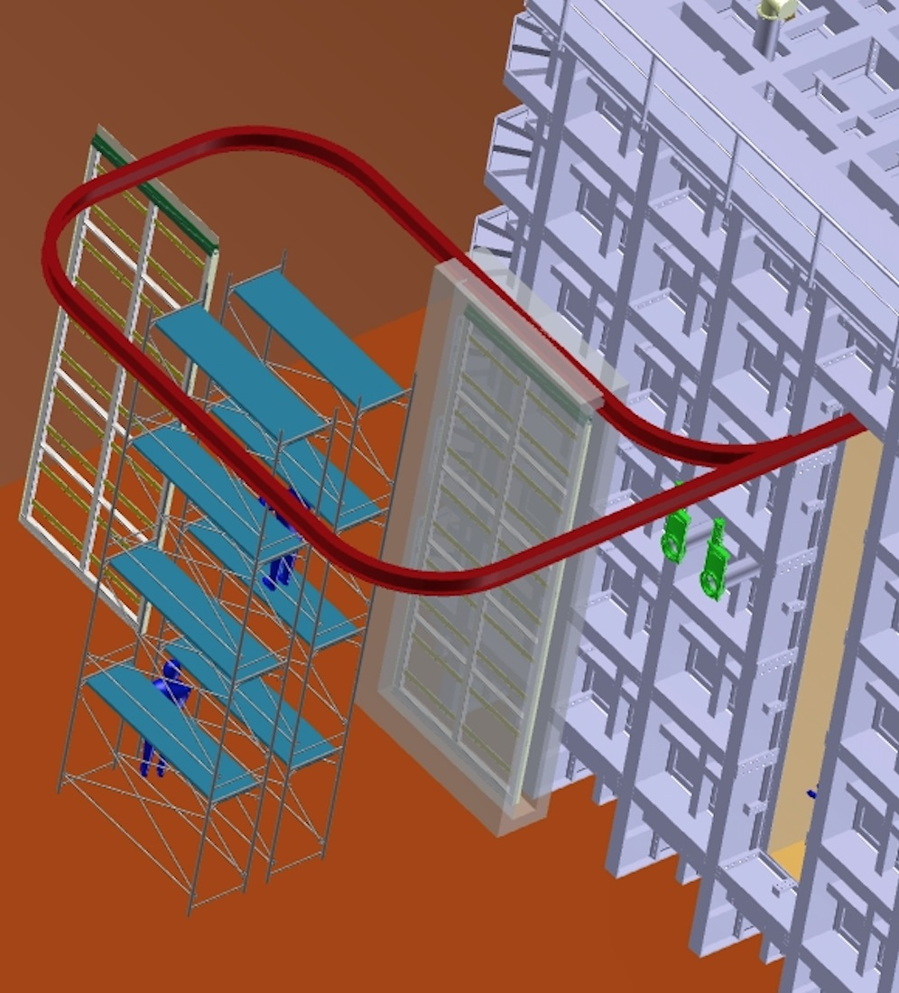
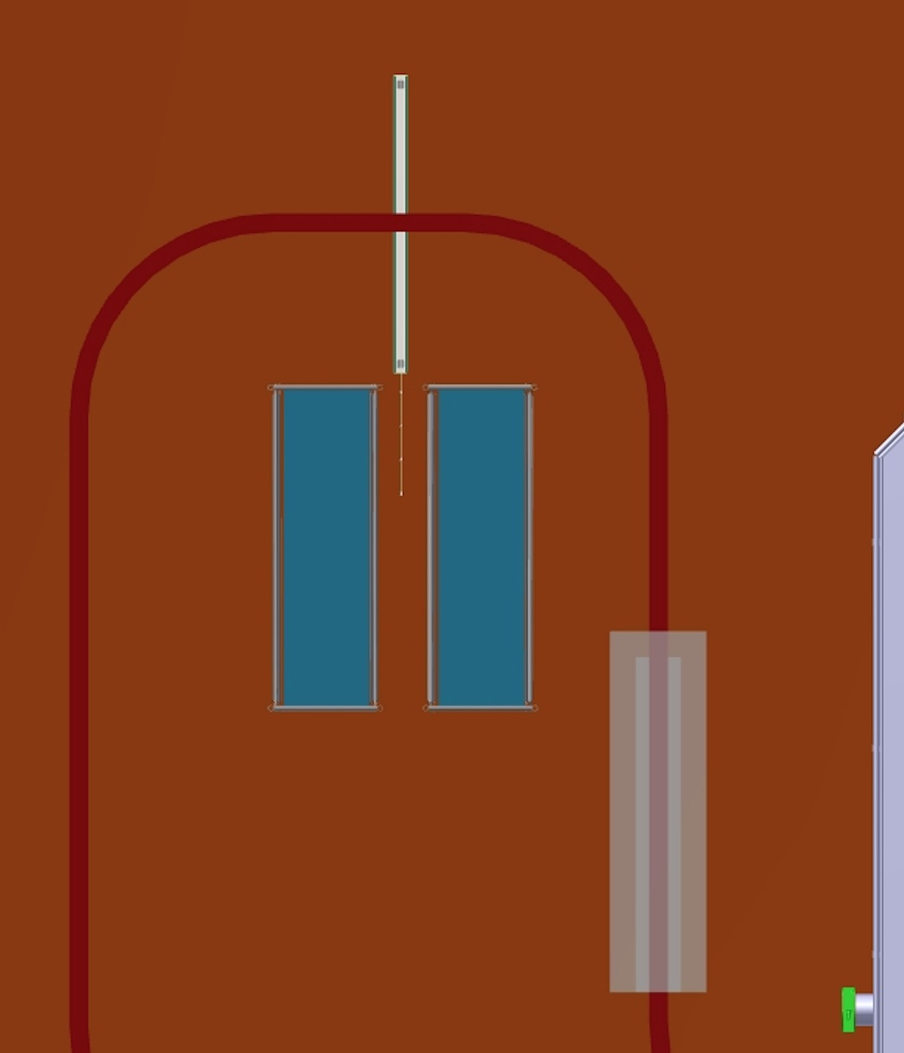
PD Installation in APAs
~5m
~2m
Plan view in cleanroom

Slide 9
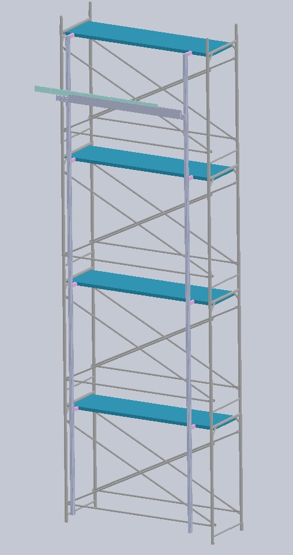
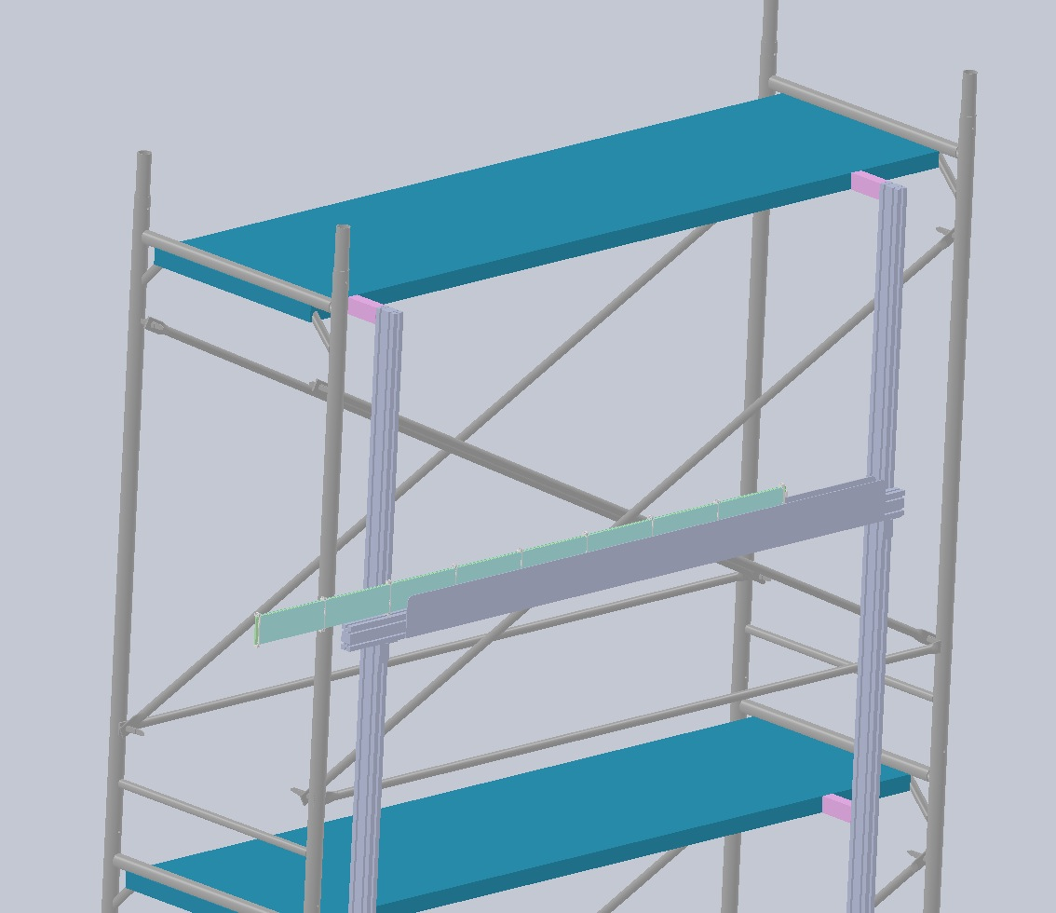
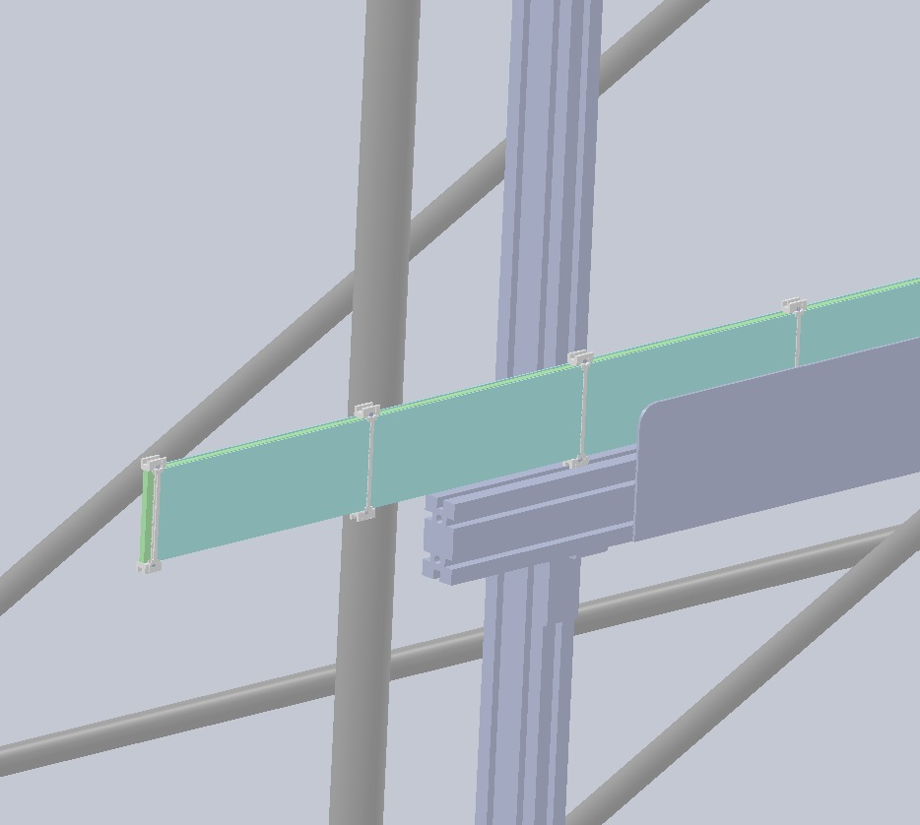
PD Installation “Elevator”
“Elevator” is fabricated from extruded slotted aluminum bars (“80/20 extrusion”) with a horizontal vertically-adjustable insertion tray.
Elevator is supported by a scaffolding separate from the one occupied by installation personnel to minimize vibration during installation.

Slide 10
PD Cabling
PD cabling will occur concurrently with APA cold electronics installation.
Each APA will have 10 Cat-6 PD cables to connect (5 in each of the APA side tubes)
Immediately upon connection continuity checks to the SiPMs must be made.

Slide 11
Post-Installation Checkout (Cold Box)
Following installation of PDs (and APA cold electronics) the APA will be moved into a cryogenic “Cold box” for testing prior to installation in the cryostat
The cold box will be light-tight, and will allow for operational testing of the PDs in a cold environment prior to installation.
It will be possible to install VUV LEDs in the cold box to allow illuminated checkout.
This test is planned to allow for full integration testing of the SSPs into the DAQ system, using all the cables which will be used in operation.

Slide 12
Labor Requirements for PD installation/QC
3 persons will be required for installation of the PDs
  1 scientist (Post doc)
  2 technicians (1 PD expert, 1 CERN technician for local support)
Allowing for inefficiencies and our uncertainties remaining for vertical APA installation, perhaps as many as 5 days are required to install the PDs in 1 APA (2/day).
In addition, materials handing support to receive, store and transport components. Intermittent scientist and technician support will be required during APA installation into the cryostat to confirm cable connectivity while action can be taken to rectify problems (perhaps 1 hour total following APA installation).

Slide 13
Safety
Installation and operation of the PD into the APA requires several potentially hazardous operations which must be coordinated with CERN Safety
  Initial testing may utilize a Po source to generate VUV photons
  Installation of PDs requires working at heights of up to 8m
  Installation of PDs requires a simple lifting platform for holding the PD during installation.
  Post-installation checkout is a cryogenic operation requiring approval from CERN
PD modules are serialized upon fabrication and the tracking information is silk-screened onto the SiPM PCB to allow tracking. This serialization and traceability requires approval at CERN
All materials used in the PDs will need to be approved for use at CERN.
  Special consideration will be given to materials such at TPB coated bars and acrylic, which may pose a health or fire hazard.
The PD Team is in contact with Olga Beltramello at CERN who is acting as the ProtoDUNE interface with CERN safety. We will work closely with her to insure all CERN safety requirements are met.

Slide 14
Conclusions
The majority of PD components are scheduled to arrive in March through June 2017
  CERN help will be needed to receive the equipment
  We will require something like 4m X 4m for storage until we are ready to install
PD testing into the APAs will require a clean, light-filtered area approximately 2m X 5m
APA oriented vertically during installation
The PD group will send over a test scanner to allow us to re-test all APAs prior to installation
  Testing & installing a single PD will require ~ 2 hours
  Installing the PDs in a single APA will require 5 days
Approximately 3 people will be required to install PDs
  1 scientist (Post-doc level)
  1 expert technician (PD specific)
  1 local (CERN-supplied) technician

Slide 15
Special Testing Tools
The PD group will ship a dark box/automated scanner to CERN
  The dark box requires approximately 2.5m X 0.7m floor space, 0.45m tall (sits on table)
  Needs ~2.5m space in front for sliding in PD module
The automated scanner will require some space (~ 0.8m X 2m) desktop space for stand-alone DAQ
All PD modules will undergo final checkout in the scanner box (inside the clean room) immediately prior to installation
The scanner contains an automated moving scanner head which is planned to illuminate the PD module under test with a VUV spot
  Scanner head will generate VUV light using gaseous argon, with either laser ionization or alpha source activation.
  CERN safety procedures for handling small radioactive check sources (100 kBq Po 210) and/or UV lasers (power currently unspecified) need to be checked.

