Slide 1
Proto-DUNE Single-Phase PD Design, Assembly, APA Interface and Cabling
David Warner
Colorado State University
August 2, 2016

Slide 2
Outline
PD basic design
  PD design
    IU Design
    MIT/FNAL design
  Overview of components
Support and installation in APA frame
  Stainless frame structure
  Testing at CSU and PSL
Cable Routing and Management
  Connecting cables and strain relief
Engineering Calculations
  Thermal Expansion
  Mount Deflection
Assembly Tooling
Safety
Summary

Slide 3
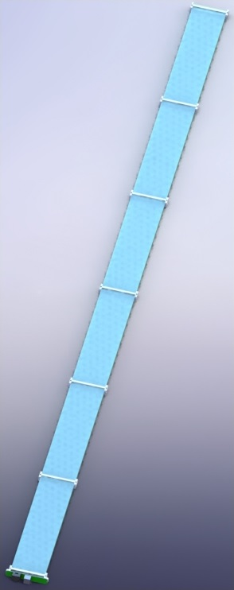
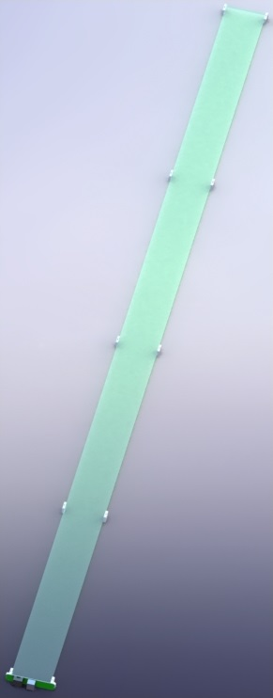
Modular PD Concept
IU design (Radiator)
MIT/FNAL design (Dipped)
The reference PD design for both ProtoDUNE and the single phase FD call for 10 individual PD modules per APA frame, installed following APA assembly
Module dimensions:
  2108mm long X 107mm wide X 18 mm thick (outside)
  2086mm long X 95mm wide X 14.5mm thick (Inside APA)
  PD Dimensions driven by available installation slot in the APA (108mm long X 19mm tall)
Modules masses:
  IU design: 2.03 kg
  MIT/FNAL design: 1.34 kg
Modular design and post-APA assembly installation allows for testing of different PD design concepts
Two principle designs: IU design with radiator plates, MIT/FNAL design with TPB-dipped light guide bar

Slide 4
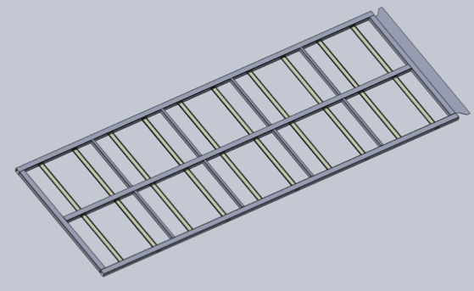
PDs Mounted in APA Frame
10 PDs per APA Frame
PD active area 2086mm X 84mm (each)
APA Frame area (Outside) 6060mm X 2300mm
PD Coverage fraction: ~12.5%
5 modules install
From this side
… And 5 from the other side

Slide 5
Design Summary
Current plans call for 2 principle designs to be tested in Proto-DUNE, with the possible addition of a limited number of promising alternate designs (e.g. ARAPUCA):
  Radiator plate (IU) Design consists of 12 TPB-coated plastic radiator plates (to convert the 128nm scintillation light to blue light) mounted over a secondary light guide (Y-11-like bar, to convert the blue light to green and transport it to the SiPMs) (30 in ProtoDUNE)
  “Wonderbar” (MIT/FNAL) design calls for a single TPB-dip-coated wavelength shifter/light guide bar to shift the scintillation light and transport it to the SiPMs (30 in ProtoDUNE)
  N.B.: The modularity of the PD design, as well as the fact that they are installed into the APA frame immediately before the APA is installed into the cryostat at CERN, allows for other proposed designs (such as ARAPUCA)
Modules of both designs are supported inside the APA frames in stainless steel rails, and are inserted into the APA frames after the frames are wire-wrapped. Both PD modules fit within the same APA support structure
Both designs are read out with 12 sensL 60035 C-series SiPMs. The same readout board is used for both designs
SiPMs are grouped into sets of 3, and signals are carried through shielded twisted pair.
  Cables are custom PTFE-jacketed Cat 6 cables, with 4 twisted pairs per cable (1 cable per PD module)
  Cable connectors are standard RJ-45 Cat-6 connectors
  Two cable segments per readout path:
    Cryogenic (6m to 11m long depending on the PD position in the APA) from the SIPM PCB to the cryostat flange
    External cables (~2m long), from the cryostat flange to the readout electronics (SSPs
Custom readout electronics (SSPs) used to read out SiPM signals are mounted on top of the cryostat to minimize cable length.

Slide 6
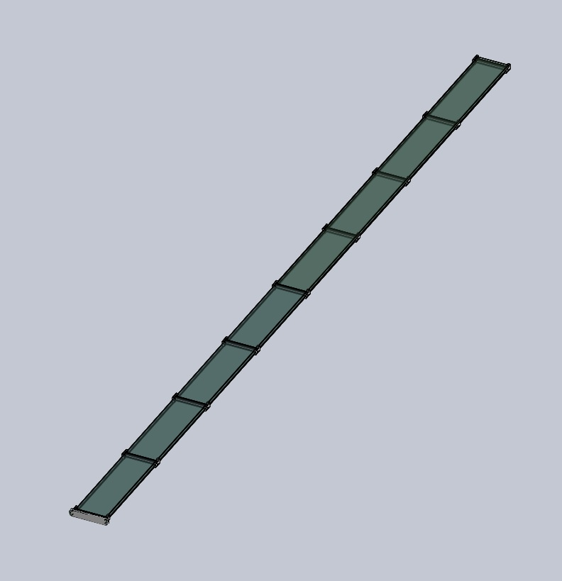
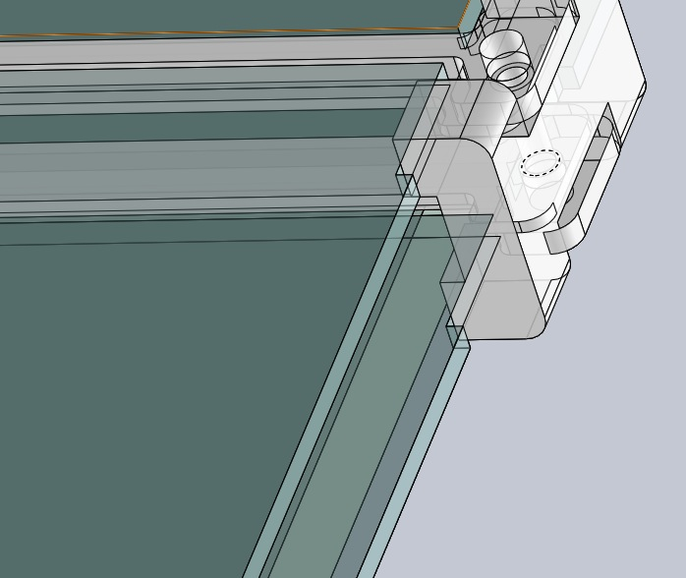
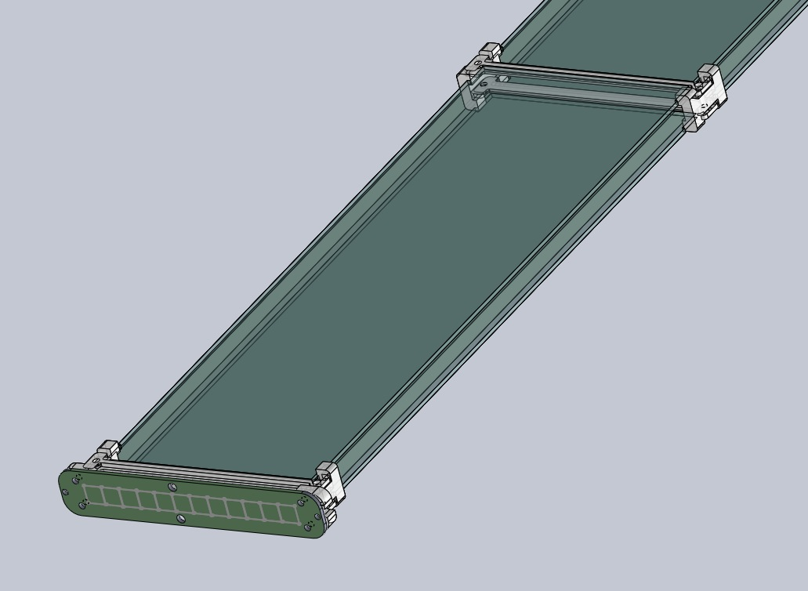
Indiana University PD Design
2.03 kg total mass
Radiator
Plates
Light Guide
Middle Guide Block
(X6)
Readout End
Guide Block

Slide 7
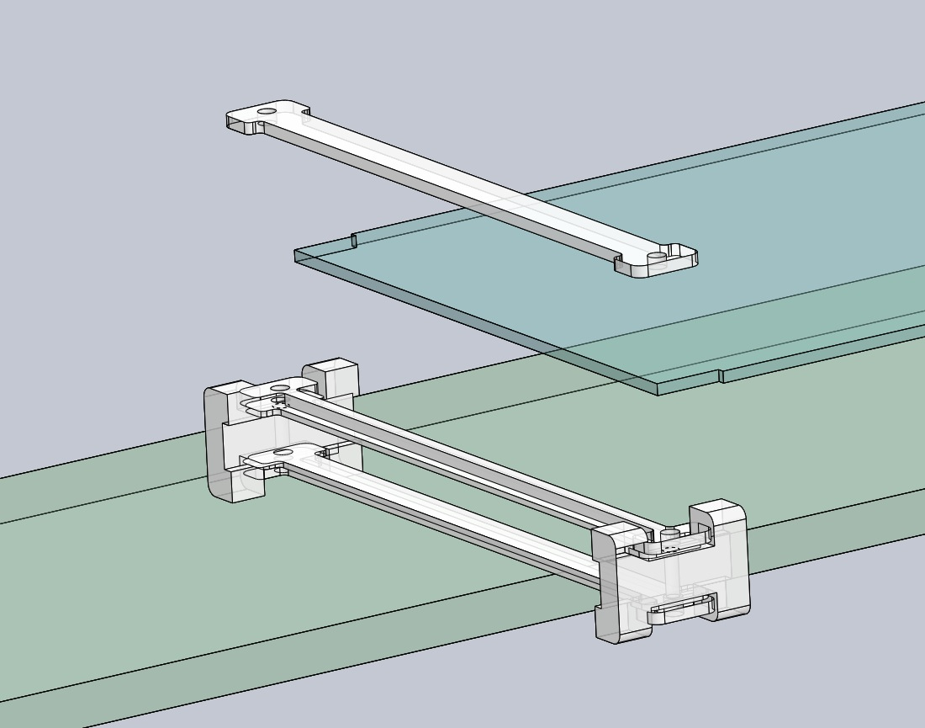
Radiator Mounting Plate Detail
~2.5% of PD covered with
Radiator support clamps
Radiator plate free
To slide in clamp
Clamp epoxied to
Side of WLS bar

Slide 8
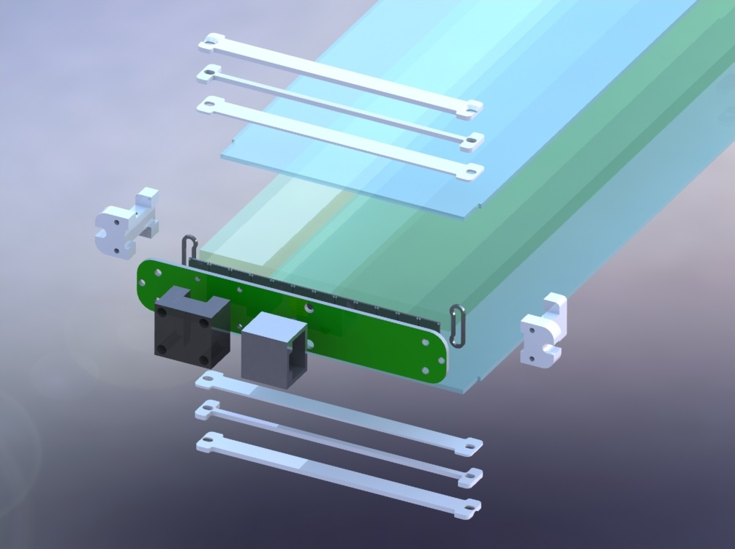
Readout End Detail
Cable Tie
Fixing Block
SiPM Spacer

Slide 9
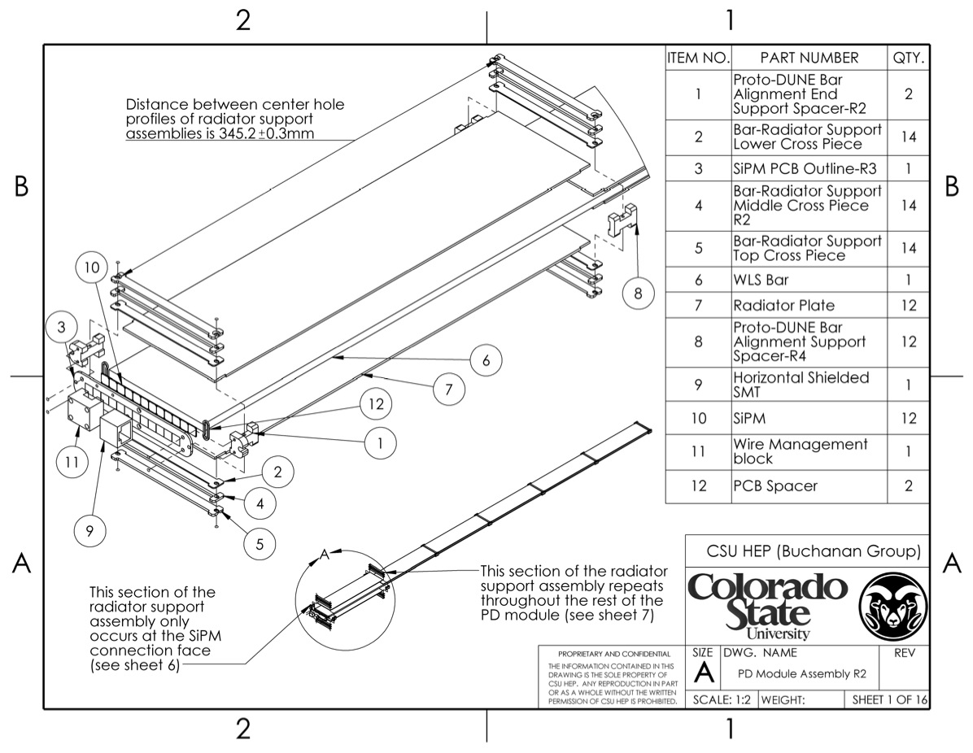
Exploded View of PD Assembly

Slide 10
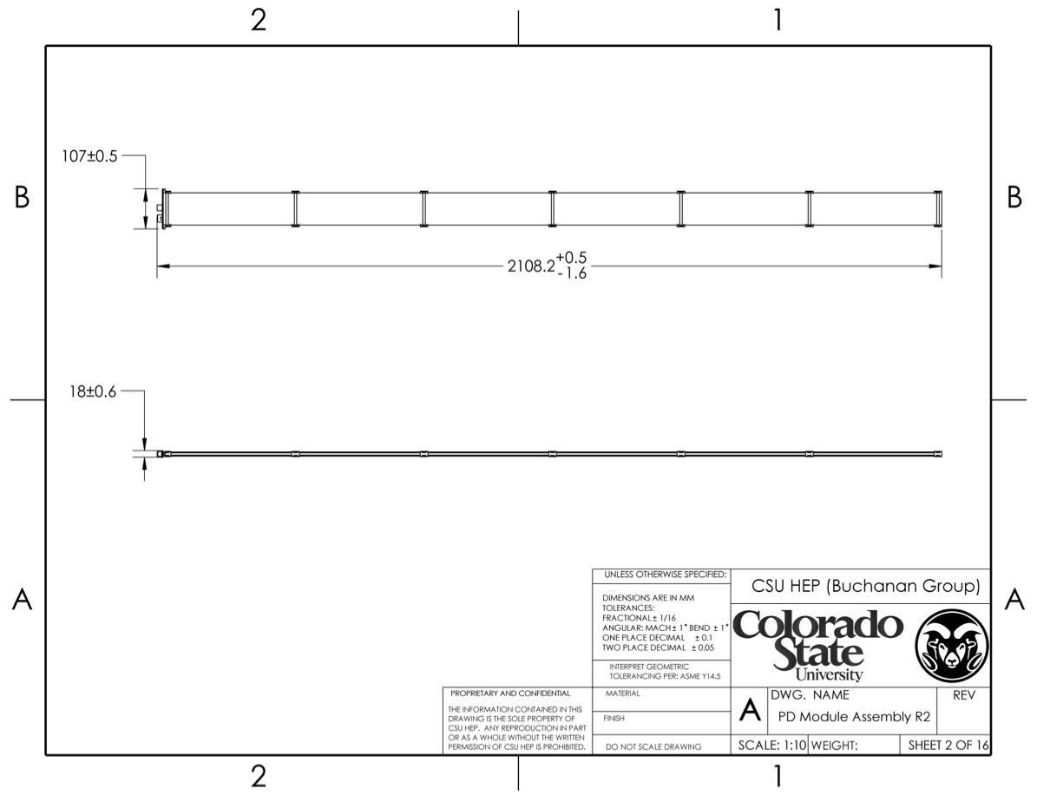
IU Module Max. Dimensions
7 sets of support blocks
Attached to light guide with epoxy

Slide 11
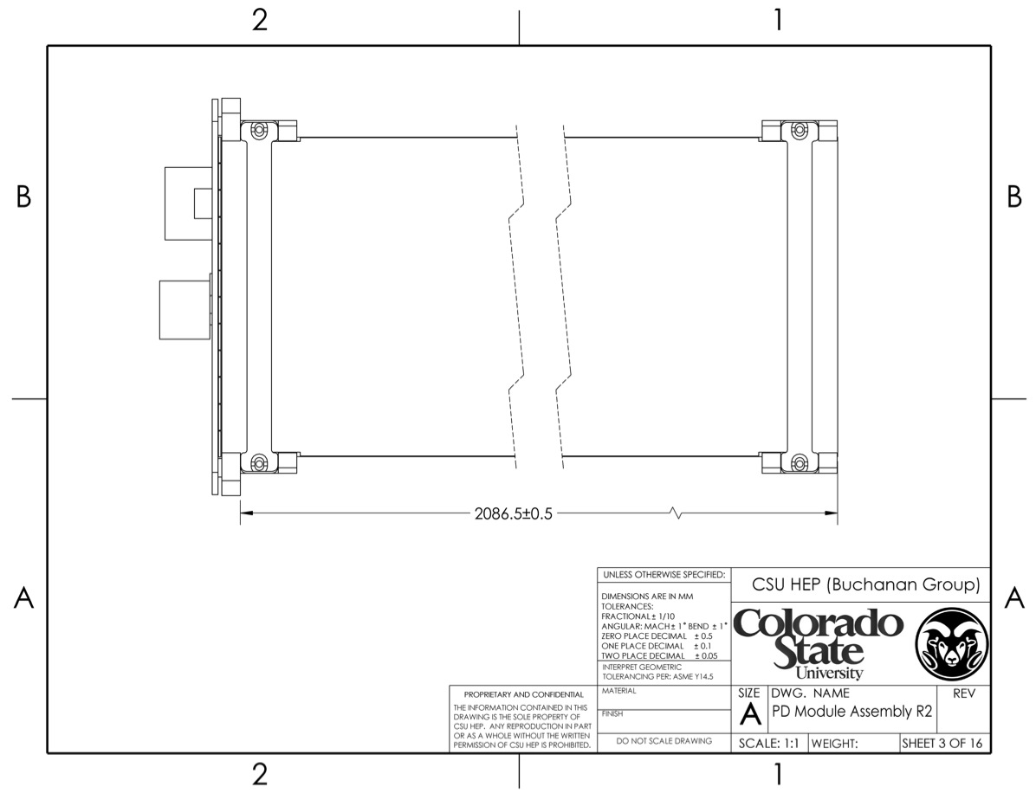
Module Length Inside APA
95 +/- 0.4mm

Slide 12
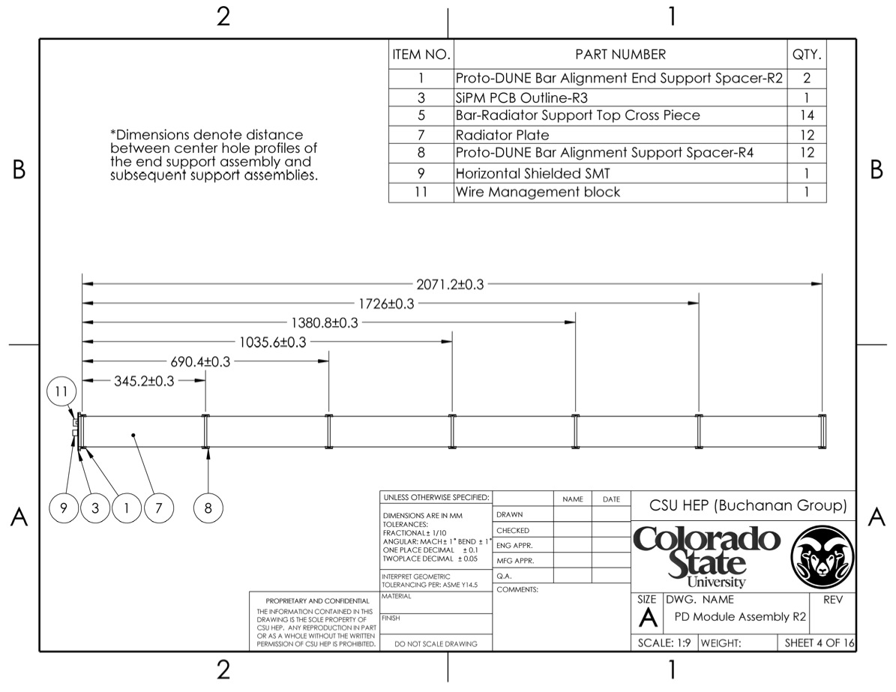
Positions of Radiator Supports

Slide 13
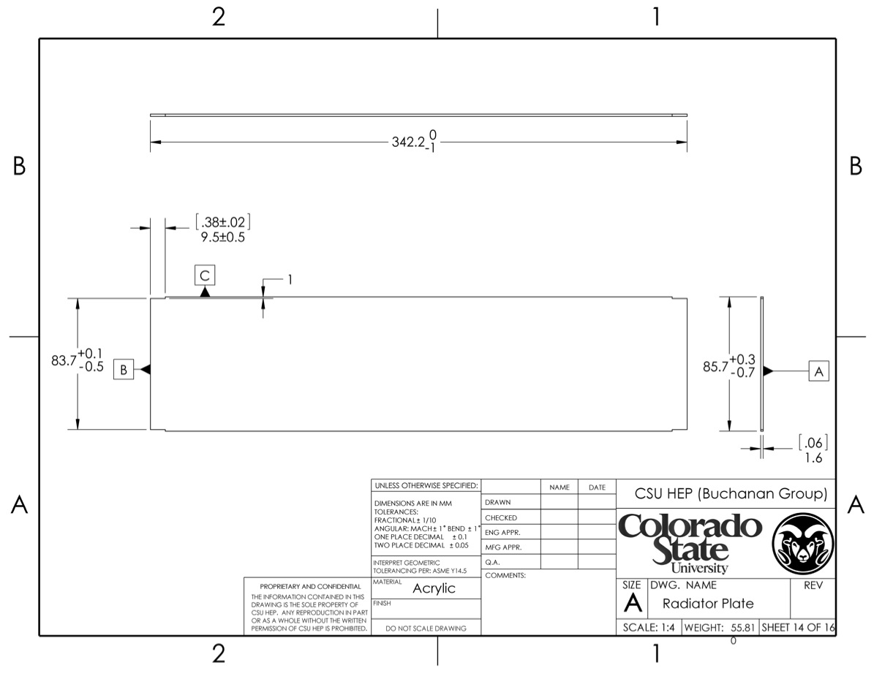
Radiator Plate
1/16” UVT Acrylic

Slide 14
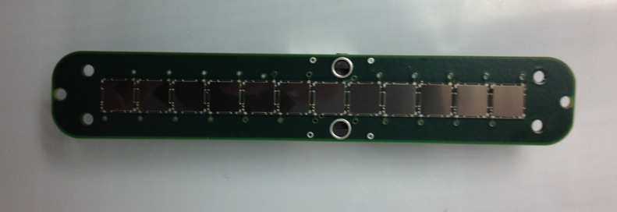

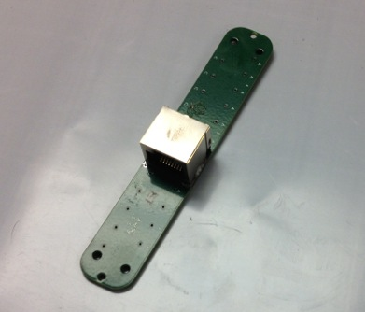
SiPM Mount PCB
Active area
Provides ~84%
Bar end coverage
12 SiPMs, 0.2mm separation
SMT RJ-35 connector
0.4mm gap
SiPM/Light Guide
Standoff

Slide 15
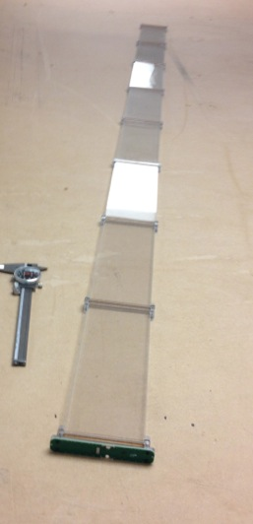
Photo of IU PD Prototype
N.B: Early prototype with 8 radiator plates per side
Current design has 6 plates per side

Slide 16
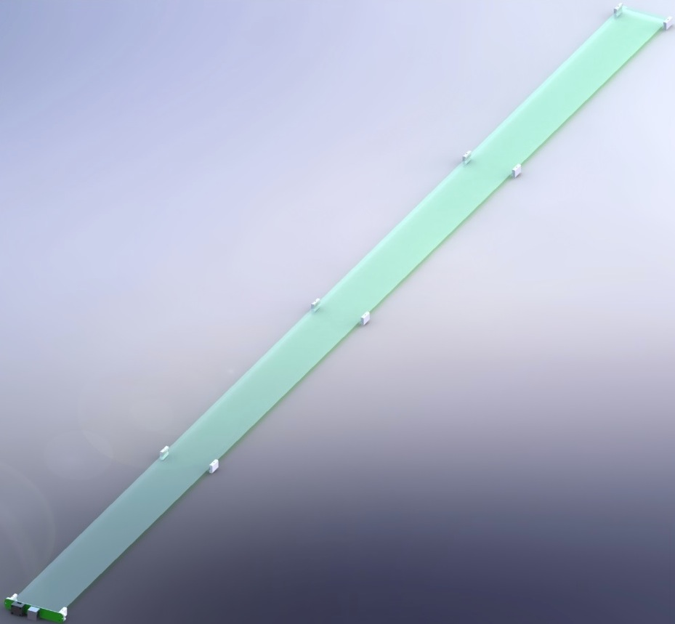
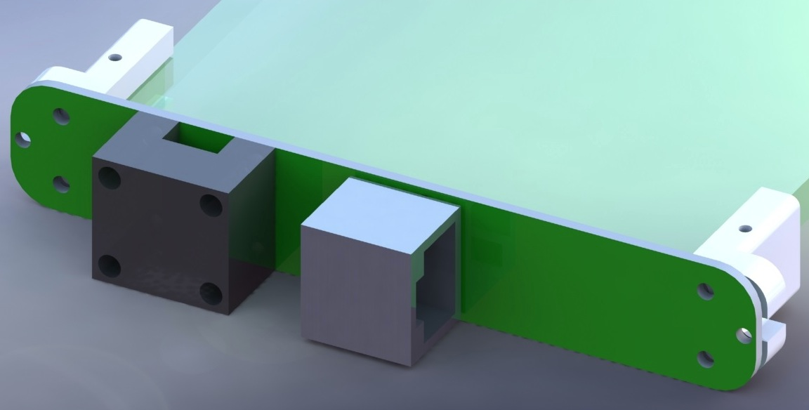
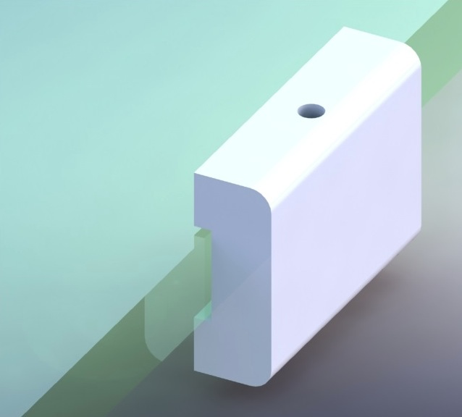
MIT/FNAL Design (Dipped Bar)

Slide 17
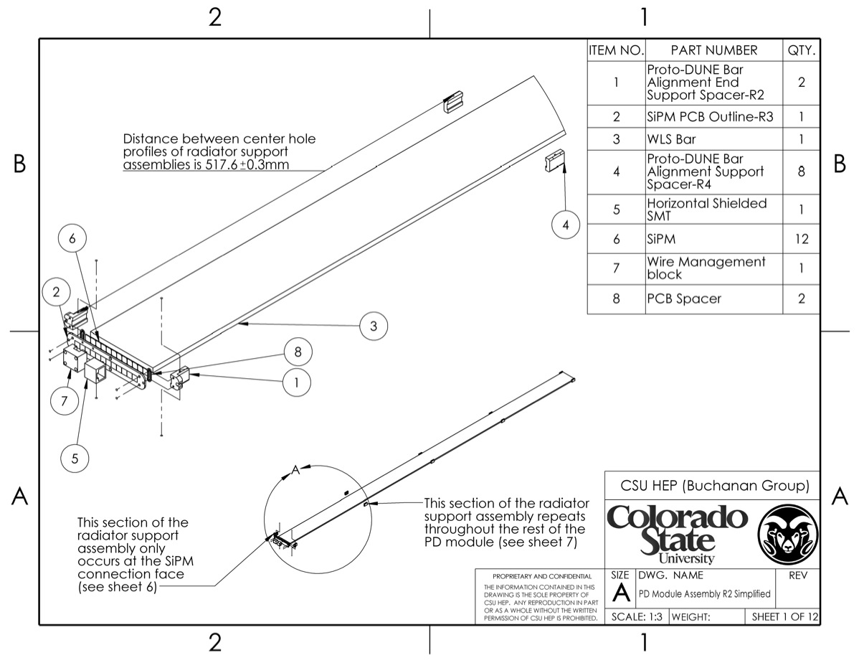
MIT/FNAL Design Drawings

Slide 18
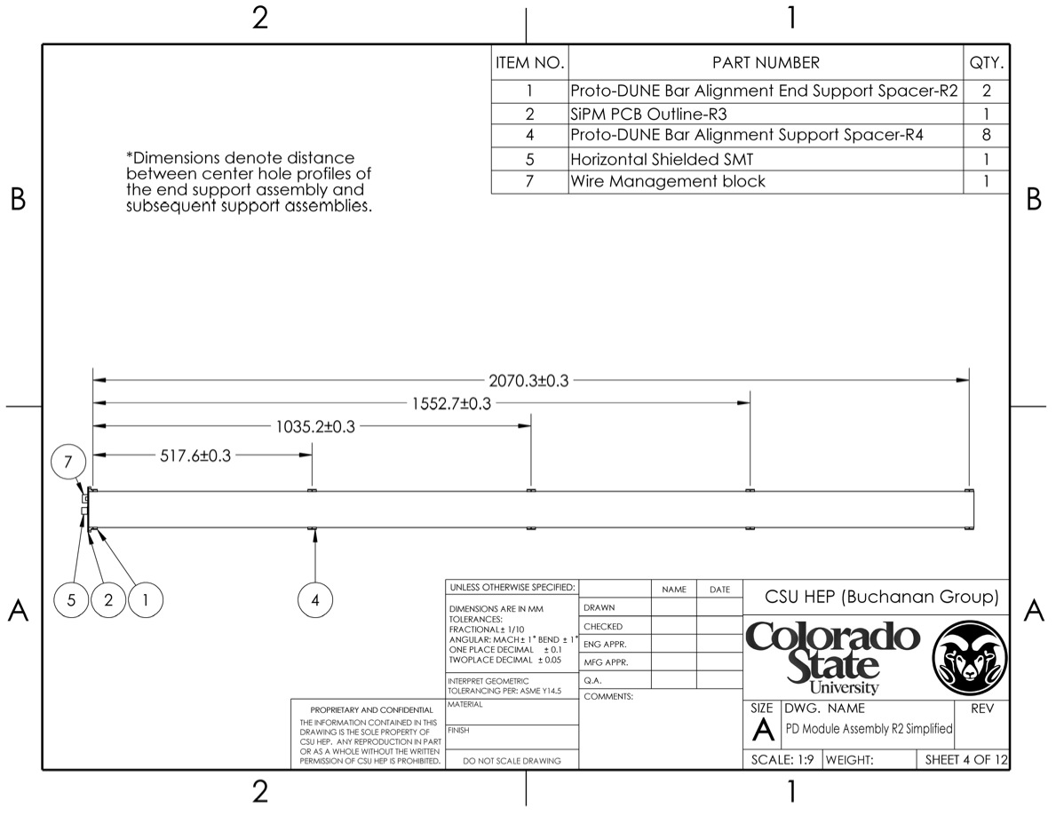
Positions of support points (5)
N.B.: Only 5 sets of
Support blocks

Slide 19
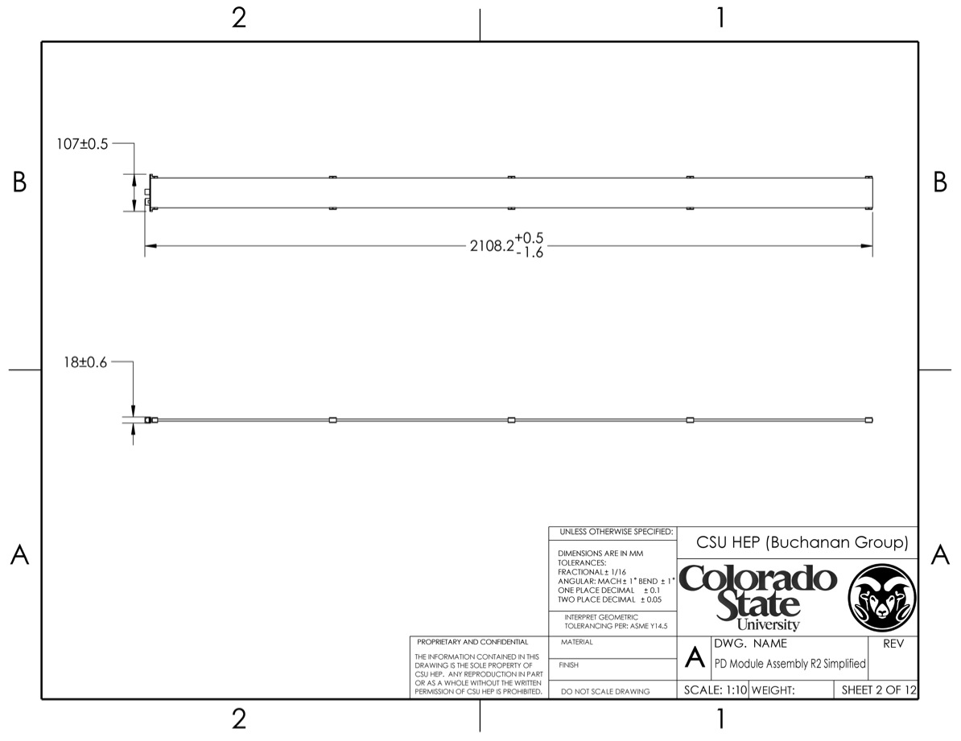
Maximum Module Dimensions

Slide 20
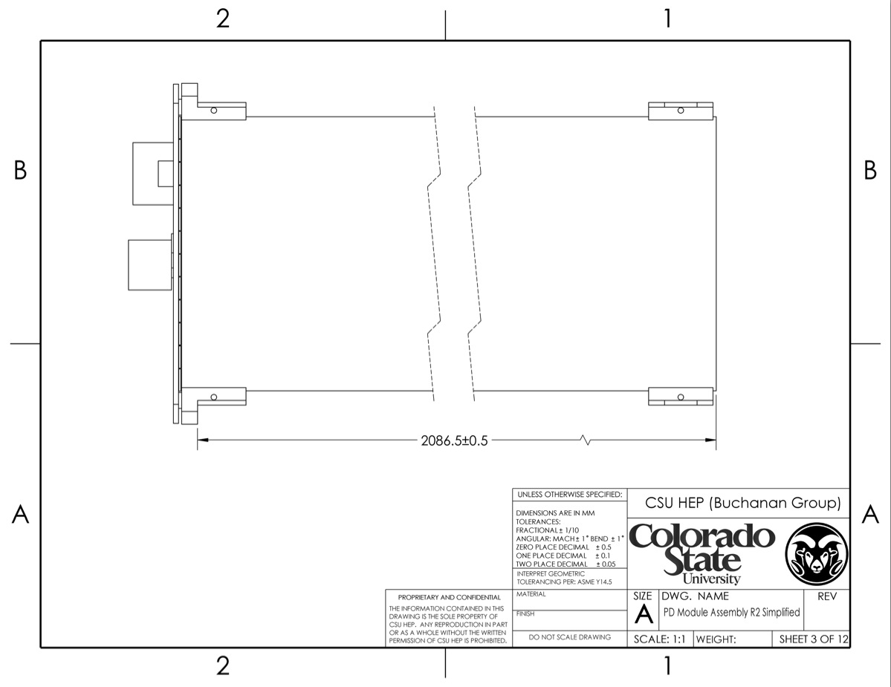
Module Length Inside APA

Slide 21
PD Detector Component Counts (not including spares)
Component | Description | Number (for Proto-DUNE) | Number (for 10 kt)
Light guide bar (IU) | Light guide (2 m × 6 mm × 83 mm) | 30 | 1,500
TPB-coated radiator plate (IU) | Plastic base material TBD | 360 | 24,000
Light Guide Bar (Dipped, MIT/FNAL) | Acrylic | 30 | 1,500
SensL MicroFC-60035-SMT | Silicon photo-multiplier | 720 | 18,000
SiPM mount PCBs | Boards SiPMs mount to in PD module | 60 | 1,500
Cryogenic cables w/connector | Readout cables from PD to cryostat flange | 60 | 1,500
External cables W/ connectors | Cryostat flange to SSP rack | 60 | 1,500
SSP Modules | 4 SSP/APA (Including spare channels) | 24 | 600

Slide 22
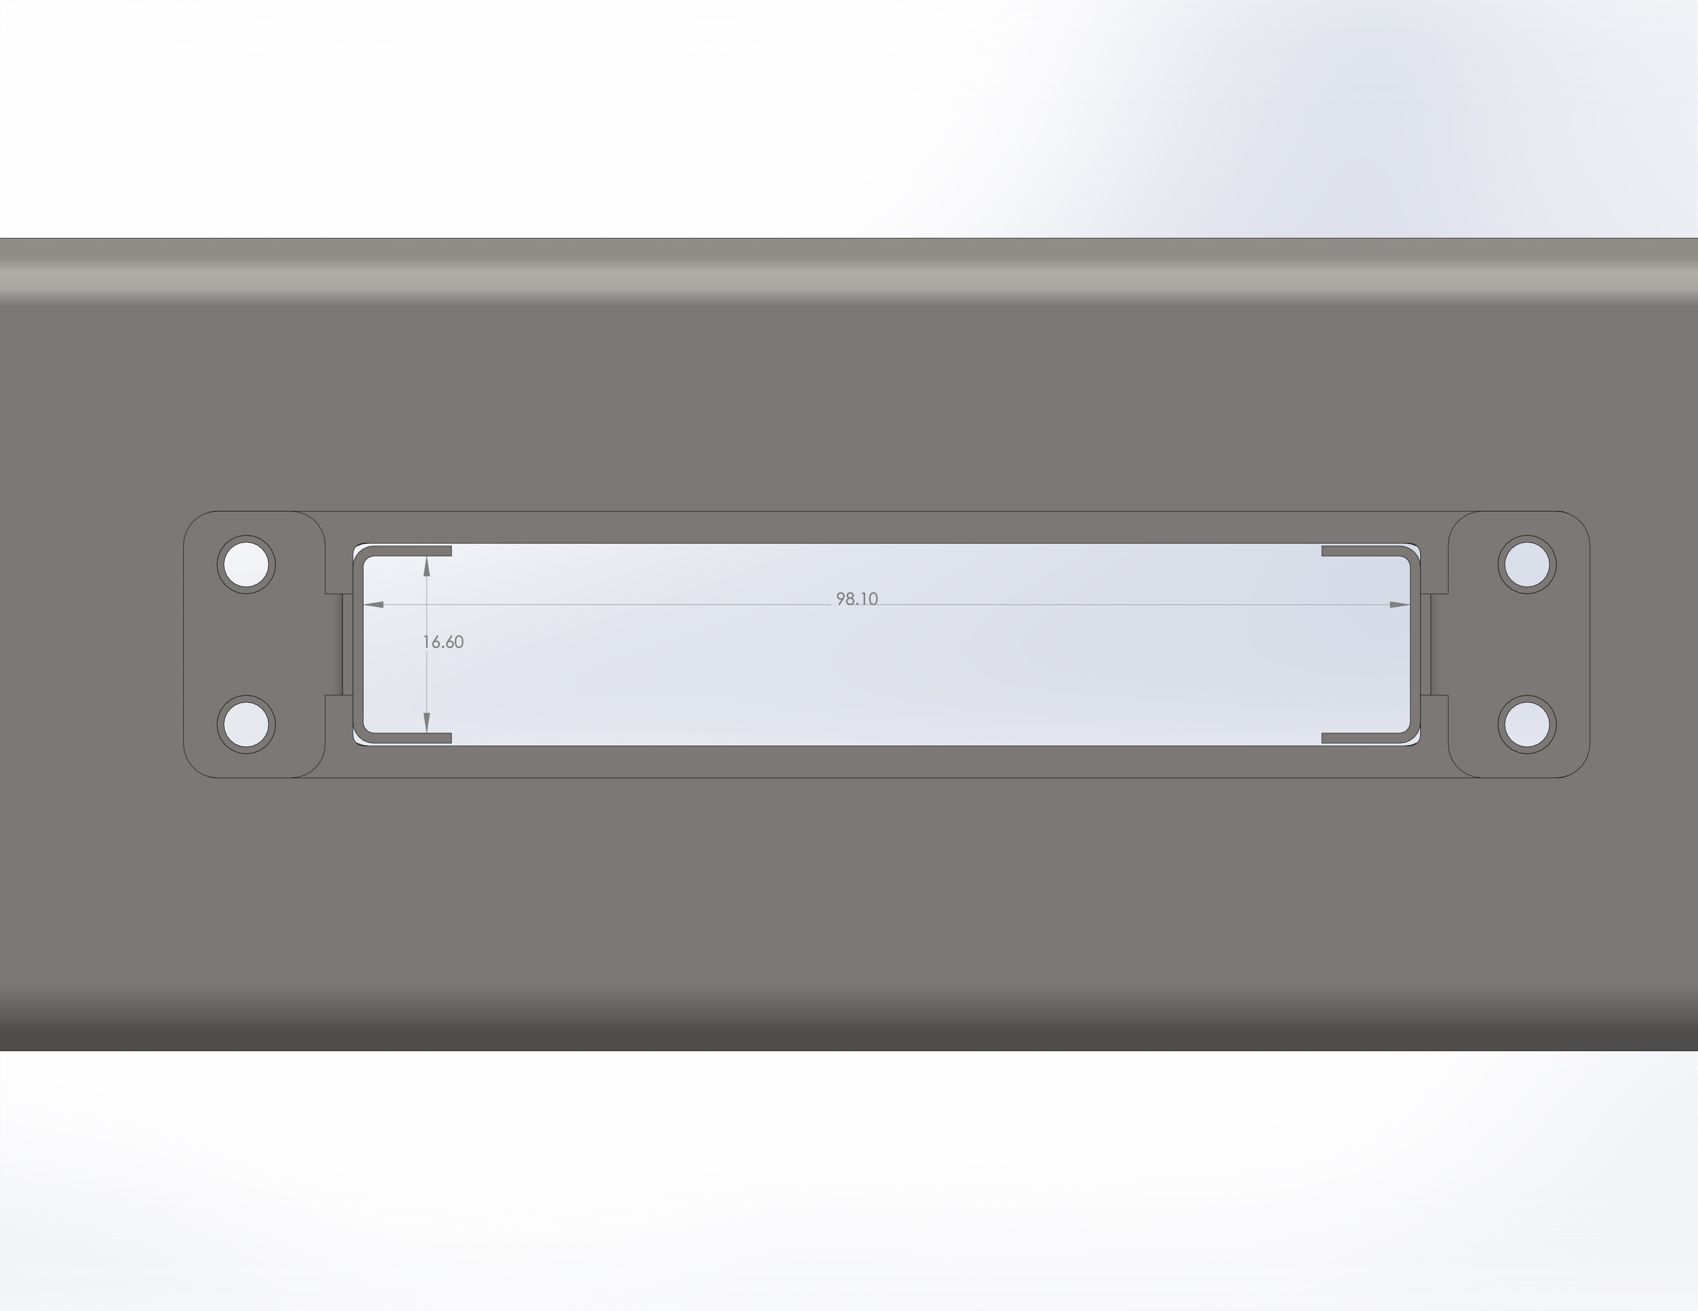
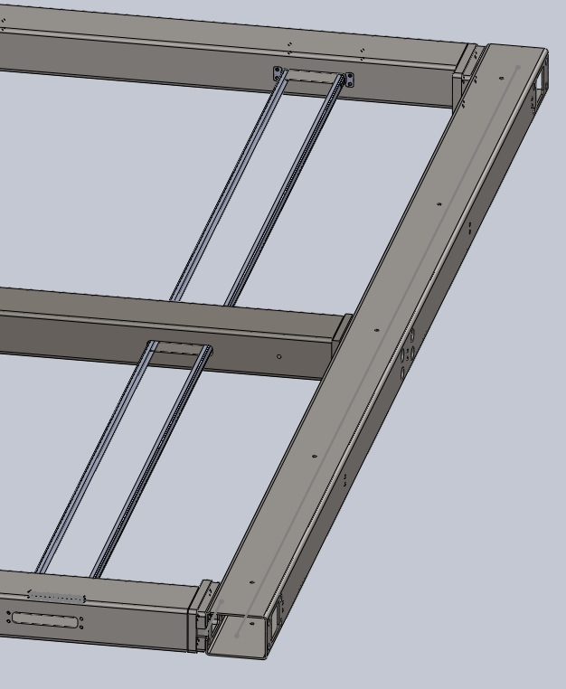
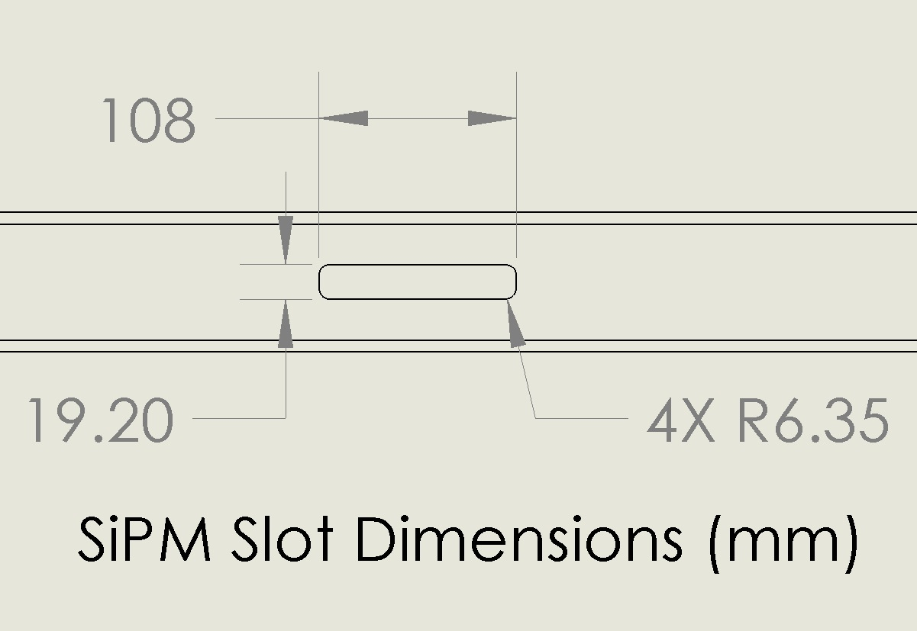
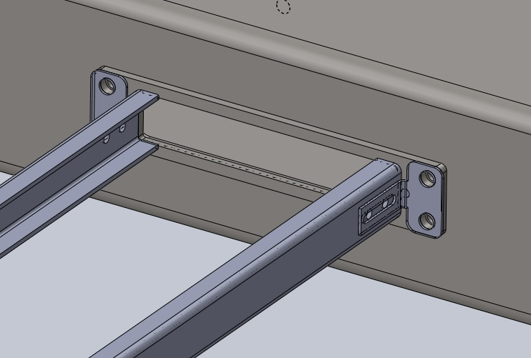
PD/APA Mounting Structure
Frame inside length 2096.8mm
96.83mm wide
16mm tall (Inside)
Mounting Frame Inside Dimensions
98.1mm wide X 16.6mm tall

Slide 23
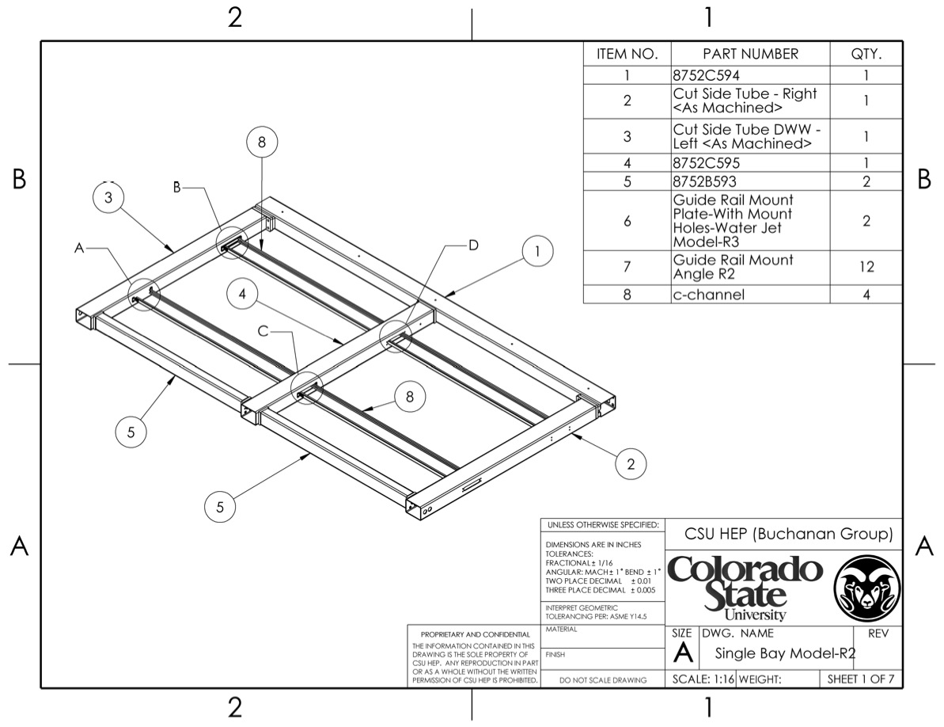
1 “Bay” of APA Frame

Slide 24
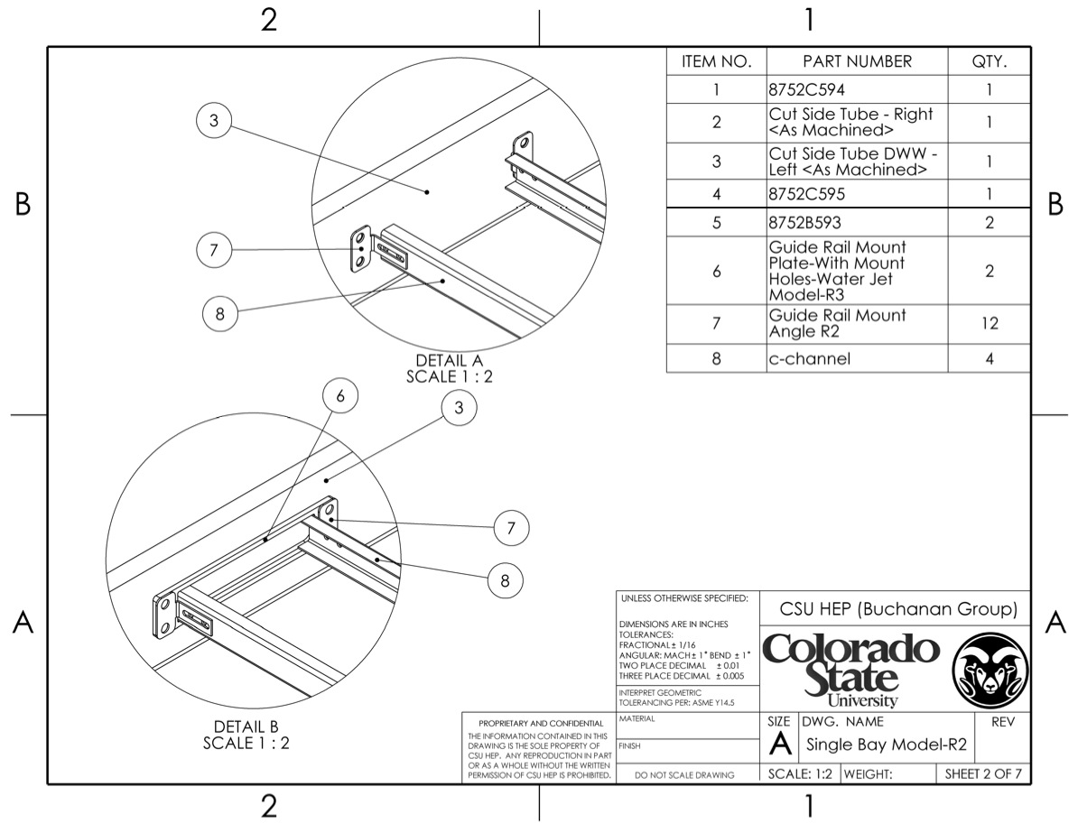
Ends of Frame attached to APA

Slide 25
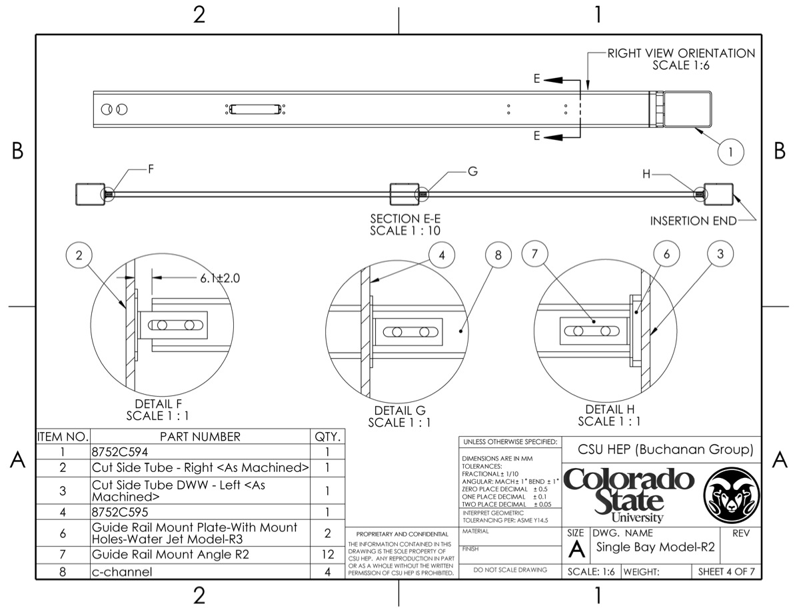
PD C-Channel Rails Mounted
Slots in mount angles
Line up with holes in rails
6mm gap between tail
And APA Frame

Slide 26
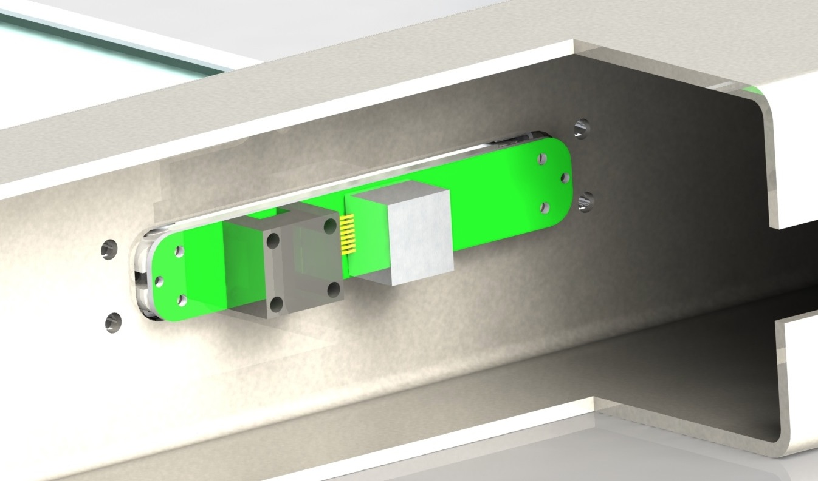
PD Module Attachment to APA
Captive Screw Holes
- PD module attaches to APA frame using 2 captive screws through SiPM PCB
Into APA
PD module is pushed into place in APA, then technician reached through slot
(~100mm) to tighten screw with ball driver.

Slide 27
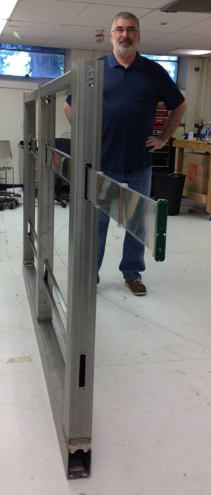
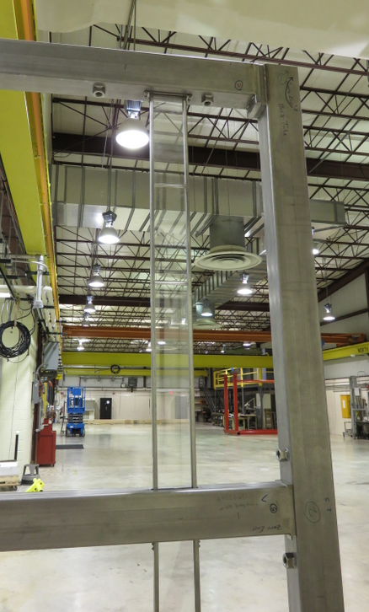
Test Installations at CSU, PSL
CSU test Installation
PSL test Installation (Full-Size APA)

Slide 28
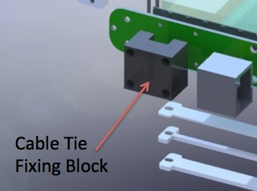
PD Cabling
The PD cryogenic cables will be installed at the same time as the PDs.
Each APA will have 10 Cat-6 PD cables to connect (5 in each of the APA side tubes)
Each PD cable will be pulled through the side tube from the top (APA oriented vertically during PD insertion) using a “Fish tape,” and be connected to the PD immediately following PD insertion.
PDs will be inserted starting at the top so higher cables do not block later PD insertions.
Following insertion of all 5 cables in one APA tube, Pre-installed cable ties will be used to cinch tot cable bundles to the PDs.
Immediately upon connection of a PD cable continuity/diode behavior of SiPM checks to the must be made.

Slide 29
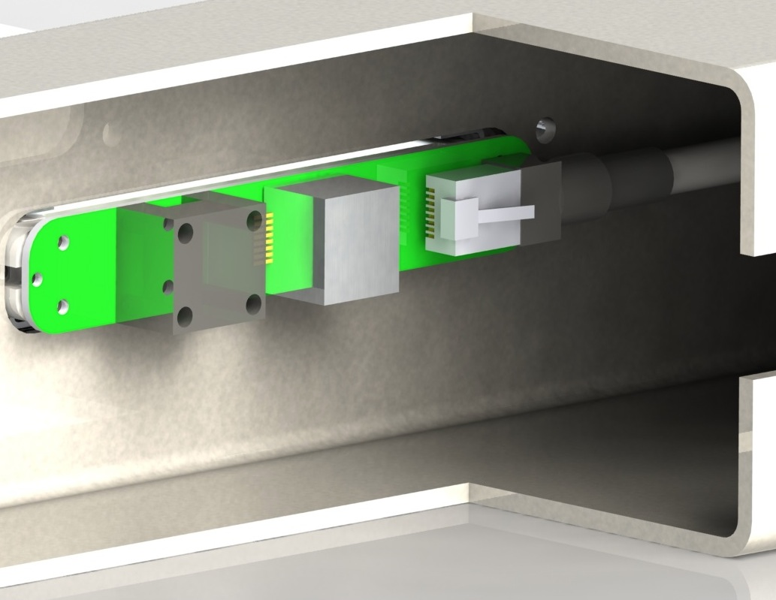
Cat 6 Connection to SiPM PCB
RJ-45 connector on
Cryogenic connector
Plugging in

Slide 30
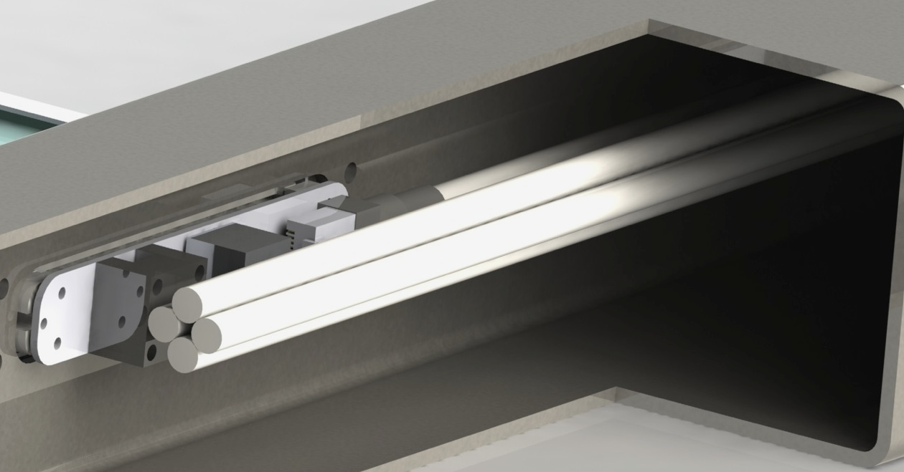
PD Cable Strain Relief
Cable Tie 2 places

Slide 31
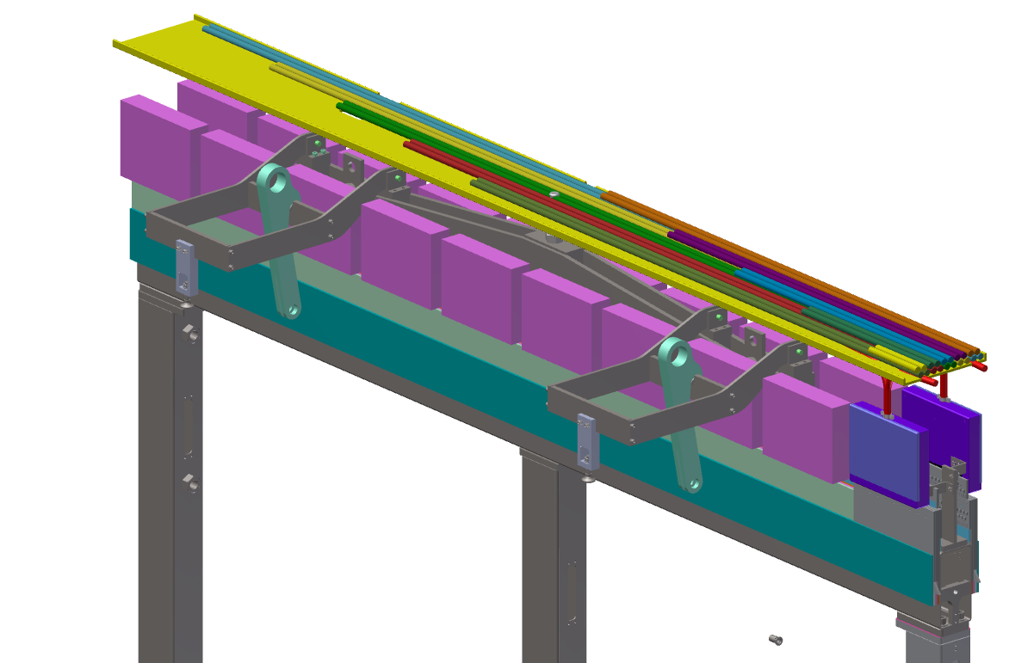
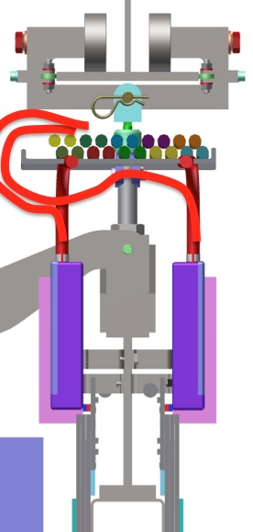
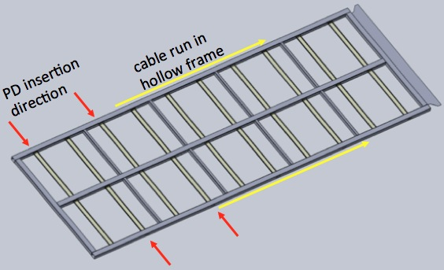
Shared Cable Tray
PD Cables Run Up
Into APA Cable
Tray (5 each side)

Slide 32
CTE Calculations
Thermal Contraction Coefficients
Material | Shrinkage factor (m/m, 206K Drop)
Stainless Steel (304) | 2.7 X 10⁻³
FR-4 G-10 (In-plane) | 2.1 X 10⁻³
Polystyrene (Average) | 1.5 X 10⁻²
Critical Relative Motions
Interface | Relative change (mm)
Length of PD to Frame Width | PD length shrinks 25.7mm more than frame (!)
Width of PD in PD Mount Slot | PD width shrinks 1.2mm more than frame
Width of SiPM Mount Board to Stainless Frame Mount Holes | Stainless frame mounting hole separation shrinks 0.06mm more than G-10 hole separation
All differential shrinkage factors accounted for in design

Slide 33
Mount Channel Deflection
Will contain plot of FEA deflection calculation (vertical orientation)--
Will contain plot of FEA deflection calculation (horizontally oriented)

Slide 34
PD Module Assembly
Module assembly consists of the following steps:
  Epoxy the PD Support blocks to the light guide bar (3M Scotch Weld 2216 B/A)
    Use positioning pins through holes in support blocks, held in universal fixture (see next slides), followed by 12 hour cure
  Attach radiator plates (if appropriate) and SiPM PCB
  QC checks: Go-nogo gauge at all mounting points, check SiPM/light guide gap (est. 2 hours)
  Scan module in warm scanner to test response
  Immerse PD into LN2 bath for 8 hours, flash with LED, check SiPMs (total cycle time ~48 hours)
  QC Check: Physical inspection of light guides, radiators (if appropriate), all epoxy joints for integrity and lack of crazing/damage
  Re-scan module in warm scanner (est. 2 hours)
  Check all QC against standards
  Pack in light-tight, airtight shipping shipping bag
Total assembly cycle requires ~ 4 days (4 PDs moving through cycle in batches)
Batches can overlap, so 4 PD modules can be completed every 3 days.
All assembly and testing to occur in class 100,000 clean assembly area
1 lead technician and 2 technicians required for assembly operations

Slide 35
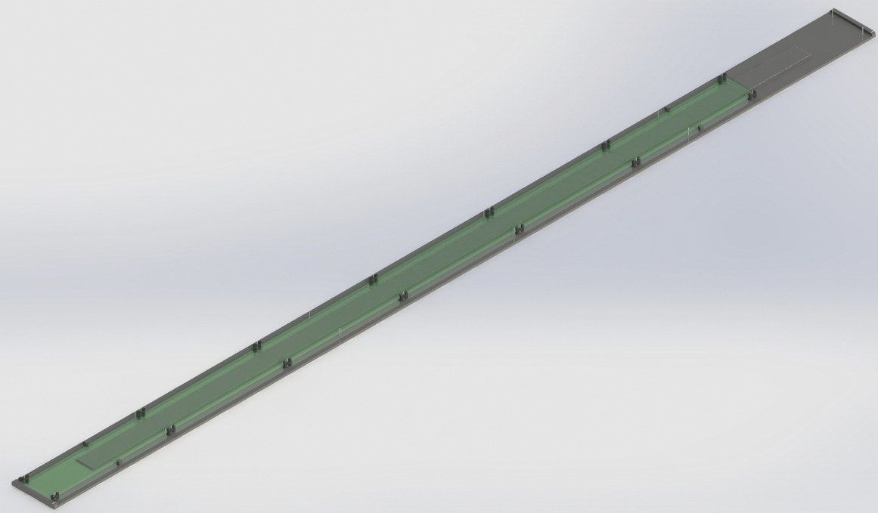
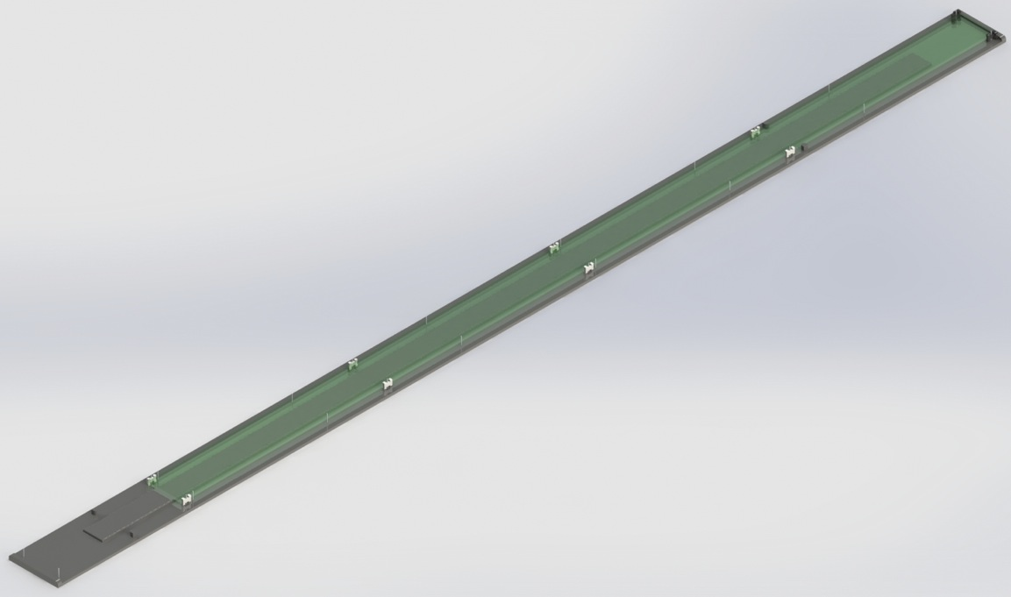
Assembly Tooling
Assembly Fixture
Used or IU PD Design
SiPM Mount End
Assembly Fixture
Used or MIT/FNAL Design
SiPM Mount End

Slide 36
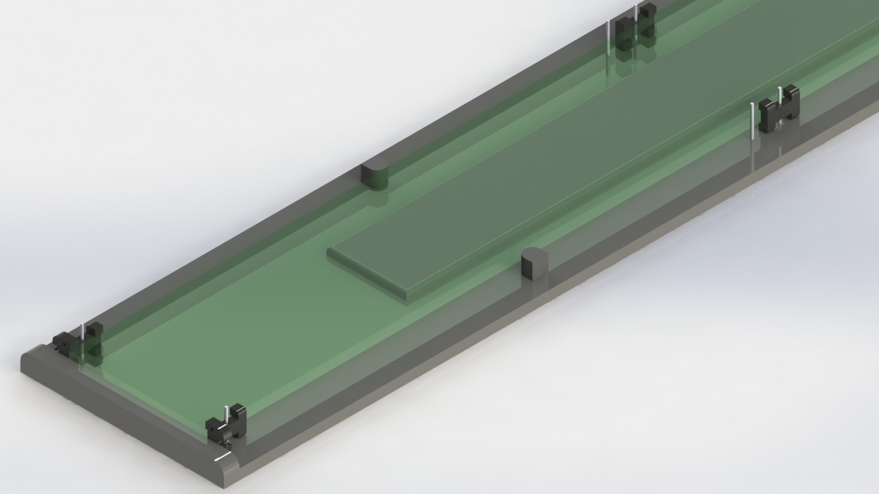
PD Supports Pinned to Fixture for Assembly
Mid-PD Module Support
Light Guide Side Positioner Block
Unused pins (for other
Design)
Light Guide Vertical Support
PCB mount PD Supports (Module end)

Slide 37
Safety
All aspects of PD fabrication and testing are require safety plans in place prior to beginning.
Principle safety concerns for module assembly and testing include:
  Cryogenic testing: CSU cryogenic safety plans were examined by both CSU ES&H and by LBNE/DUNE project management
    Results posted at LBNE DocDB 9169-V1. Recommendations from that review were implemented
  Epoxy application: Operation will occur in a well-ventilated clean assembly area.
    Epoxy MSDS available
  Test apparatus: Cryogenic testing of completed modules will require operating at heights up to 4m above the floor. Standard CSU procedures for operating at height (including safety belts) will be observed.
  All workers will undergo task-specific training prior to beginning work.

Slide 38
Conclusions
PD module design is well advanced, with ProtoDUNE designs for both radiator plate (IU Design) and dipped bar (MIT/LBNE design) currently prototyped.
Plans for incorporating PDs into APA frames are progressing, and installation testing into a sample APA frame section underway at CSU.
SiPM mounting PCBs and cabling planning are well-advanced, and prototypes have been fabricated.
Engineering studies of relative thermal contraction and rail deflection have been completed and taken into consideration in the design.
Assembly tooling for both types of detector have been designs and conceptual testing completed.
The PD group is actively involved in installation planning for Proto-DUNE.
The schedule (not addressed here) is very challenging, but should be possible to meet.

