Slide 1
ProtoDUNE‐SP CPA/Field Cage/HV System Overview
Bo Yu
Mini Review of the HV Test at PC4
July 28, 2016

Slide 2
Outline
Scope of the CPA/FC/HV System
Resistive CPA
Modular Field Cage with Metal Profiles
HV Components
Summary

Slide 3
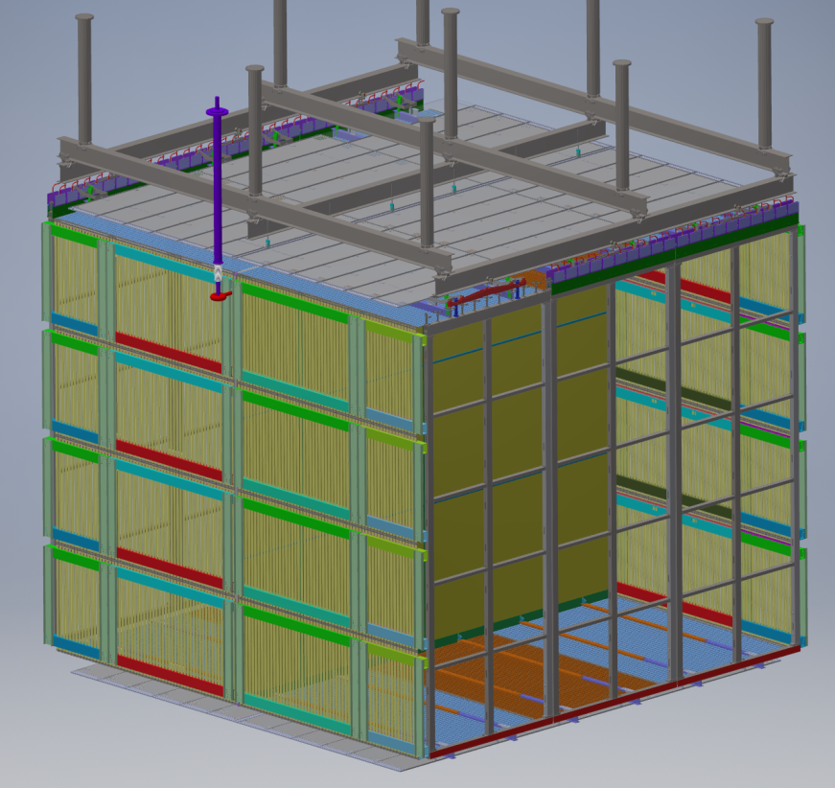
The Current NP04 TPC Model
Top field cage modules with ground plane
HV feedthrough
CPAs
Bottom field cage modules with ground plane
APAs
End wall field cage modules

Slide 4
The Scope of the CPA/FC/HV System
The entire cathode plane with the integrated HV distribution bus
6 (wide) x 3 (high) array of CPA module
HV feedthrough receptacle
The field cage
6 top modules with ground planes
6 bottom modules with ground planes
16 end wall modules
The HV system
Power supply
Cables and filters
HV feedthrough
Interface with
APAs, PDs, DSS, Cryostat

Slide 5
The Need for a New Cathode Design
Before the final assembly of MicroBooNE, a comprehensive series of studies were conducted to understand the various HV related issues in MicroBooNE. This also led to similar works on analyzing the transient behavior of the HV components in the event of a breakdown.
The study shows that if the cathode plane is made from a good conductor, its voltage would collapse very quickly, injecting high current into the cold electronics through the long wires, risking damage to the front end ASICs.
To minimize these risks, we have designed a cathode plane out of insulating material with a highly resistive coating (up to GΩ/□). This will greatly reduce the peak power transfer to the cryostat and peak current injection into the front-end ASICs in a HV discharge.

Slide 6
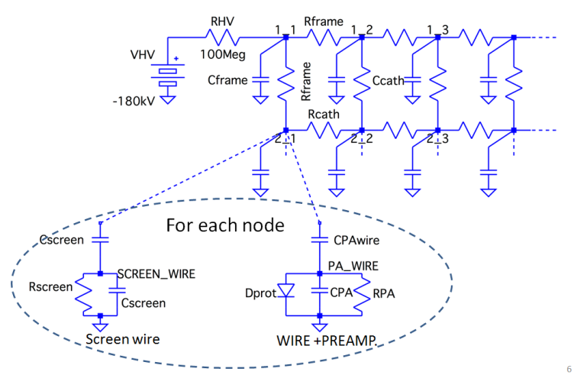
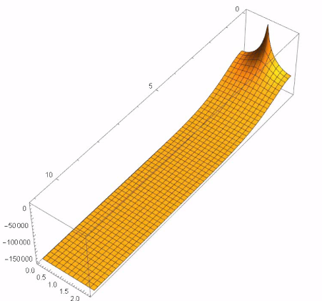
Study of the Charge Injection to the Electronics in a HV Discharge
By Sergio Rescia (LBNE docdb 10749,10865)
@200ms, 85% energy remains
Negligible charge injection
Divide 12mx2.3m Cathode into 10cmx10cm “cells” i.e. 120x23=2760 (or 2904 nodes) Each cell modeled as resistors to neighbors and capacitor to ground
SPICE simulation C: 8737, R: 5668, total: 14419

Slide 7
Evaluation of Resistive Materials
Carbon loaded Micarta
Zelec ESD powder mixed with polyurethane binder
ESD surface conducting G10 from Current Composite
Screen printed resistive ink on G10 substrate
DuPont resistive Kapton film on G10 substrate
Bonding strength
Resistivity uniformity, stability
Resistance to sparks, abrasion
See summary by Francesco Pietropaolo: https://indico.fnal.gov/getFile.py/access?contribId=35&sessionId=10&resId=0&materialId=slides&confId=11632

Slide 8
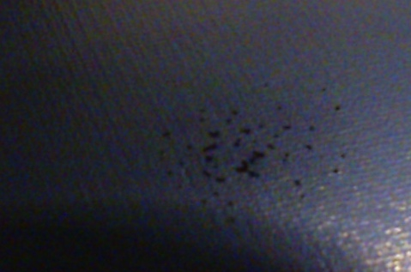
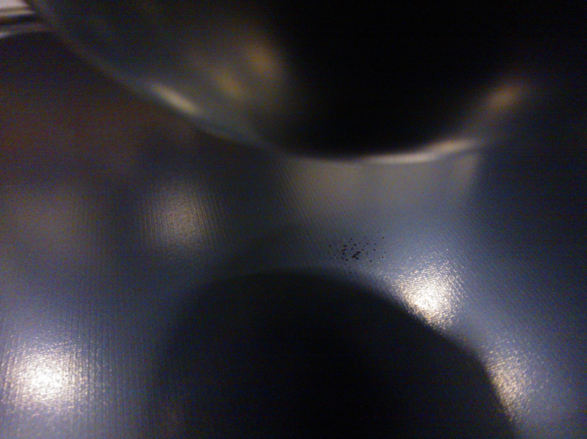
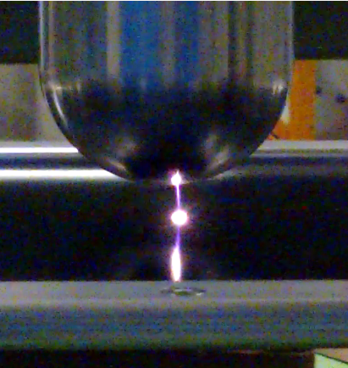
Evaluation of Resistive Materials: resistance to sparking
Discharges from 45 kV/cm, 1-2 Hz rate ( depending on current limit)
Sparks are point-like
Localized “carbonization’’ on material surface,
at the spark position.
No change in average resistivity

Slide 9
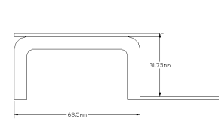
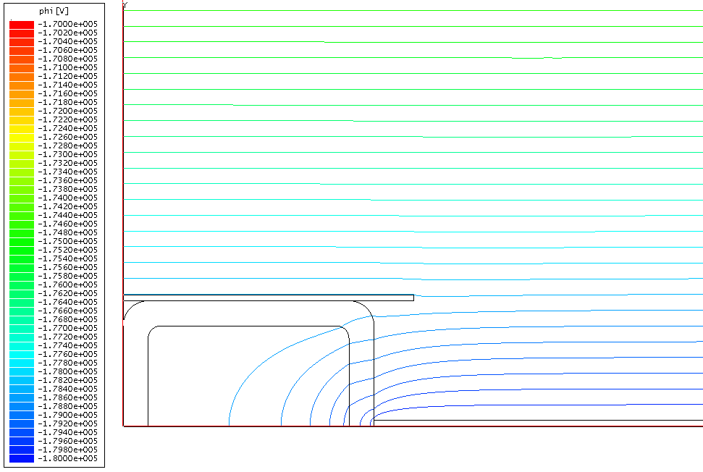
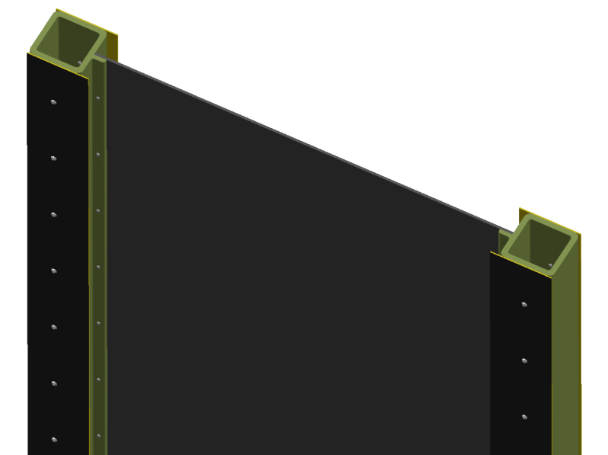
Cathode Plane: Thin with External Frame
Similar module sizes and assembly
Majority of the cathode surface area is only about 3mm thick
The thicker frame has outer resistive surface electrodes biased at a different voltage to improve the external drift field.
Fiberglass channel (63x63x6mm)
Vc+1587V
Resistive panel (3mm thick)
Resistive strips with a different bias
Vc
1.15m
Solid G10 frame version to avoid trapped volume

Slide 10
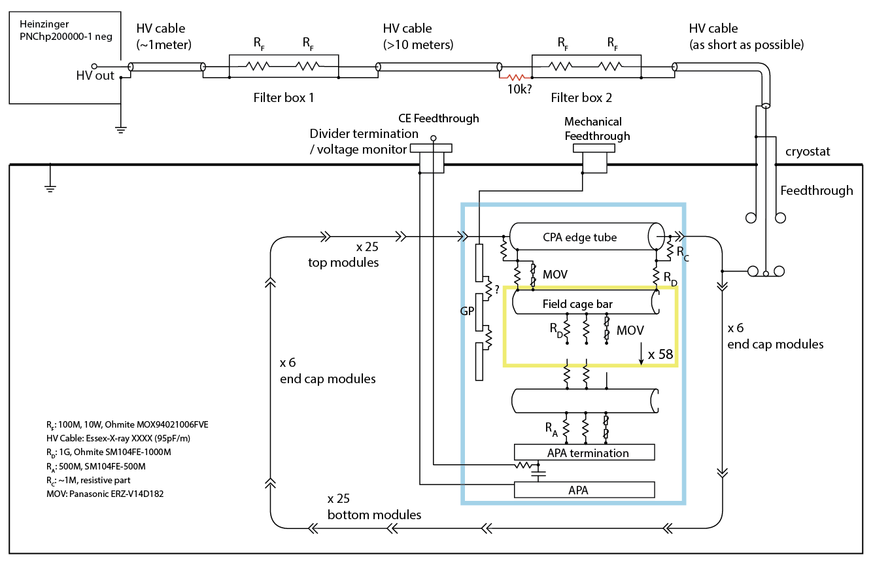
HV System Schematic Diagram (to be updated)

Slide 11
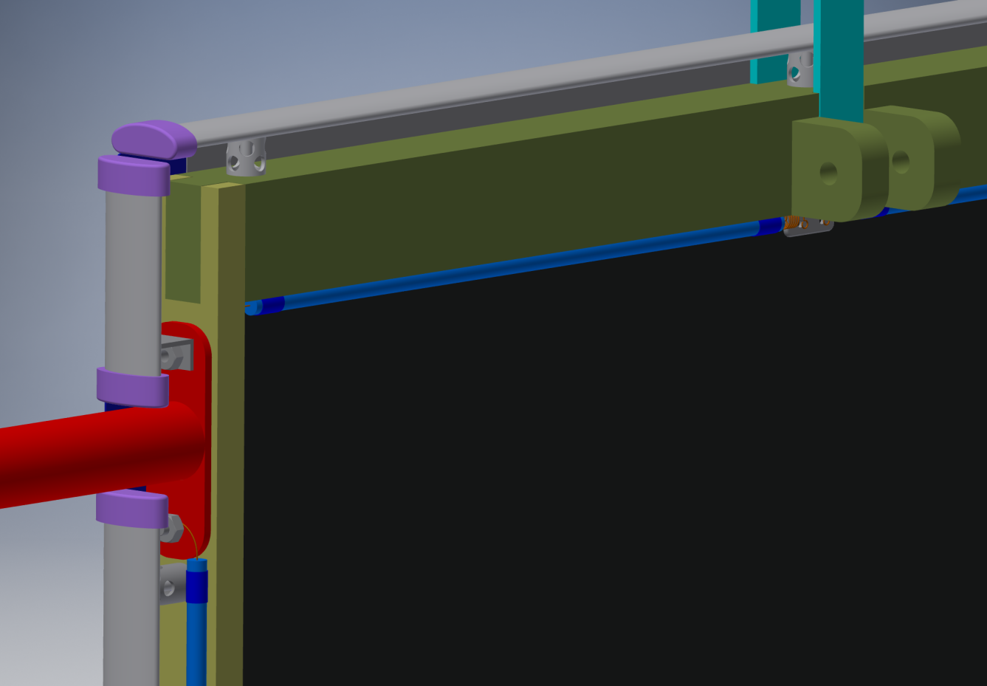
A Tubeless CPA Design with HV Bus
CPA lifting bars
Outer resistive tubes replaced with FC profiles
Field cage hinge
Connection to the resistive sheet
HV bus cable
HV cup mount
Once installed, the CPA appears to be part of the field cage looking from outside.
HV bus cable

Slide 12
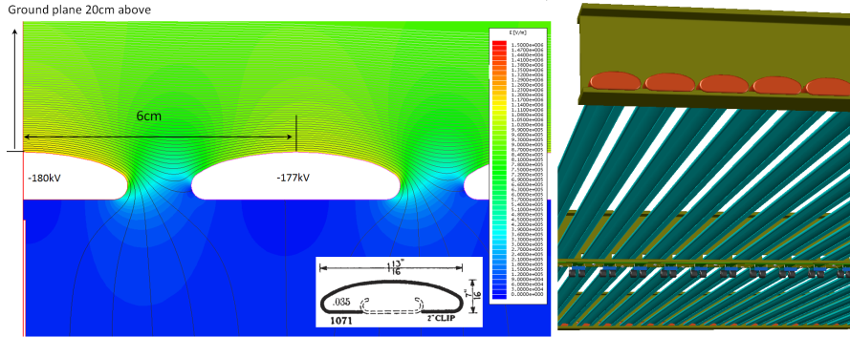
A New Field Cage Design
The PCB based field cage module used in 35ton is expensive and fragile. A more robust field cage can be constructed with roll-formed metallic profiles. The example below shows the electric field on the highest biased field cage electrodes can be controlled to under 12kV/cm using this profile even with only a 20cm ground clearance. To further limit the peak energy transfer from the field cage in a HV break down, the field cage is constructed from electrically isolated modules. The electrical isolation is achieved through UHMW PE caps at the ends of each profile.

Slide 13
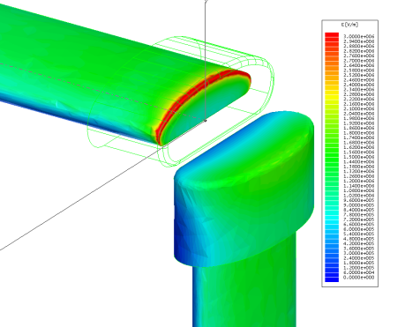
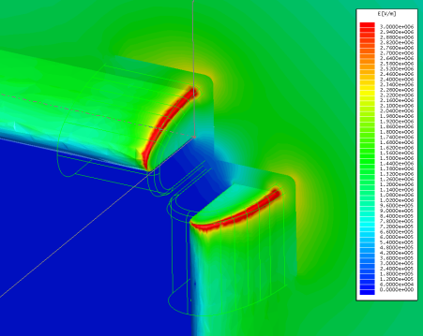
FEA of the field cage corner with PE Caps
20cm ground clearance, -180kV, UHMW PE cap thickness: 5mm
The exposed field in the LAr is ~ 25kV/cm
Plot of the E field on the symmetry plane bisecting the metal profiles
The field in the LAr is ~ 50% higher than the PE cap surface due to dielectric constant difference

Slide 14
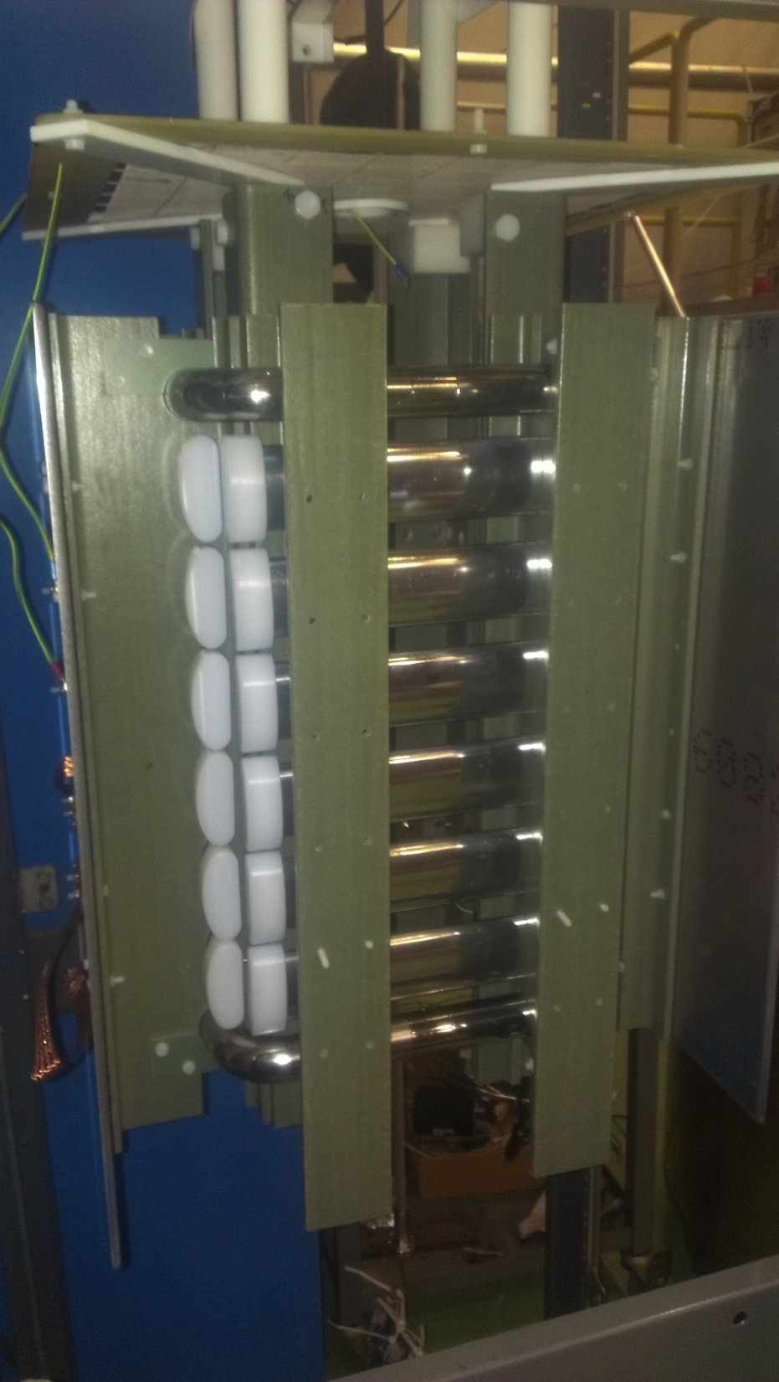
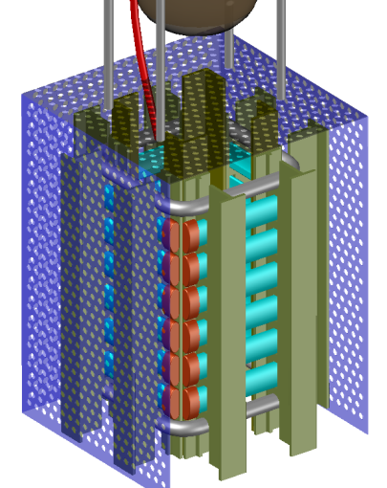
Roll-Formed Field Cage Test Setup
To validate the field cage concept in pure LAr
Designed to fit in the ICARUS 50 liter cryostat
Roll-formed metal profiles with UHMW PE caps
Choice of metal (Al, SS) and surface finish
Pultruded fiberglass I-beams form 4 mini panels
All profiles are at same potential to simplify HV connection
Ground planes only 66mm away
Requires ~1/3 of FD bias voltage to reach same E field
Ground planes can be connected to external amplifiers to monitor micro-discharges
Video camera to monitor bubbles and sparks
Holding 100kV
Summary by Francesco Pietropaolo: https://indico.fnal.gov/getFile.py/access?contribId=35&sessionId=10&resId=0&materialId=slides&confId=11632

Slide 15
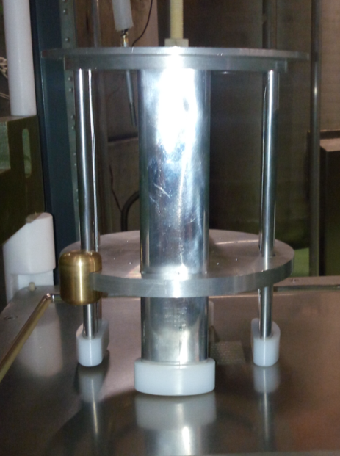
Roll-Formed Field Cage Test Setup @CERN
Test Results
Polished Aluminum Profiles:
Held voltage up to 100kV in clean LAr.
Scratched Al profiles:
Held voltage up to 100kV in open dewar
End Caps Breakdown Test
Held 150kV in open dewar

Slide 16
The Field Cage Components
Top and bottom field cage modules have integrated ground plane panels to shield the high voltage from entering the top and bottom service regions:
Top: gas ullage and rails
Bottom: cryogenic pipes
End wall field cage modules have no accompanying ground planes.
Beam plugs and calibration laser windows are integrated into specific end wall modules
Each field cage module has its own resistive divider network to maintain a linear voltage distribution along its length.
The field cage profiles are electrically isolated between modules to minimize peak energy dump in case of sparks
All field cage modules can be reconfigured between 2.5m and 3.6m drift lengths.
Top/bottom x3u wide
End wall x4u high

Slide 17
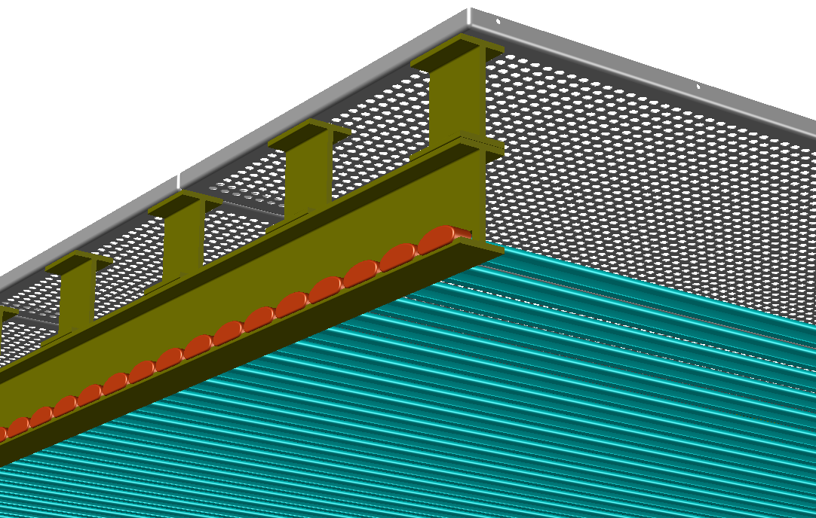
The Addition of Ground Planes
The use of metal profiles opens up the possibility of reducing the field cage to cryostat distance and therefore a reduction in unused liquid argon.
However, if the field cage is placed close to the gas ullage, the E field in the gas would be high and increase the risk of arcing in the gas.
The solution is to place a ground plane just under the liquid surface, to shield the high E field around the TPC from entering the ullage.
Similar ground plane may be needed if we also push to reduce the TPC to cryostat floor distance.
The current ground plane consists of multiple tiles of perforated stainless steel tiles mounted 20cm above the field cage.
The edges of the tile and the rounding radius of the holes must be carefully controlled to avoid local high field.

Slide 18
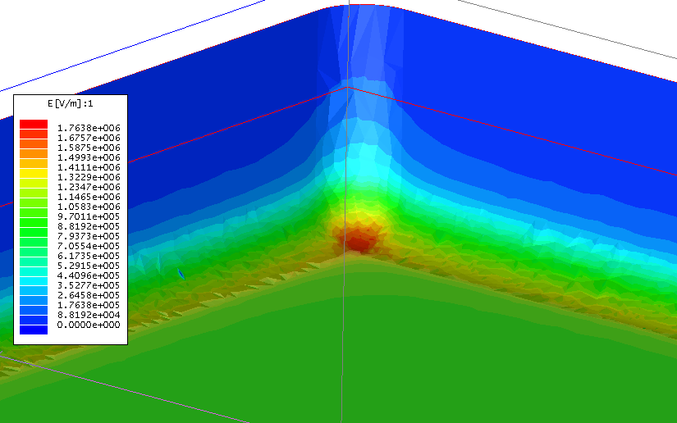
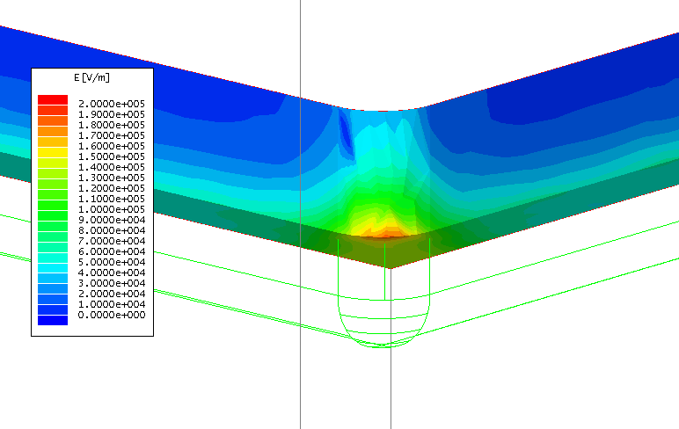
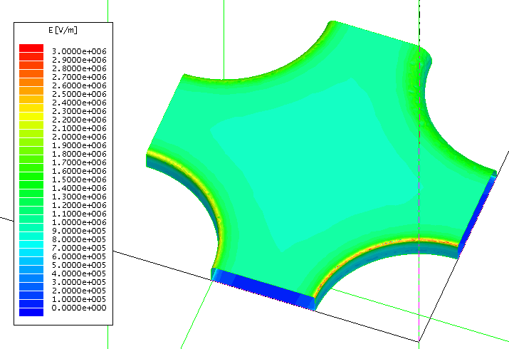
Electrostatic FEA of Ground Plane Features
180kV over 20cm, 5mm radius of curvature, 1cm gap between tiles, gas pocket 1cm above ground plane bottom surface. Max E at corner: 18kV/cm
Gas pocket 1cm above bottom of ground plane. Max E field <2kV/cm
10mm holes at 15mm center, square pattern, 1mm thick
4 rounding radii: 0.8mm, 0.4mm, 0.2mm, 0.1mm
Max. E field at R=0.1mm hole is about 30kV/cm

Slide 19
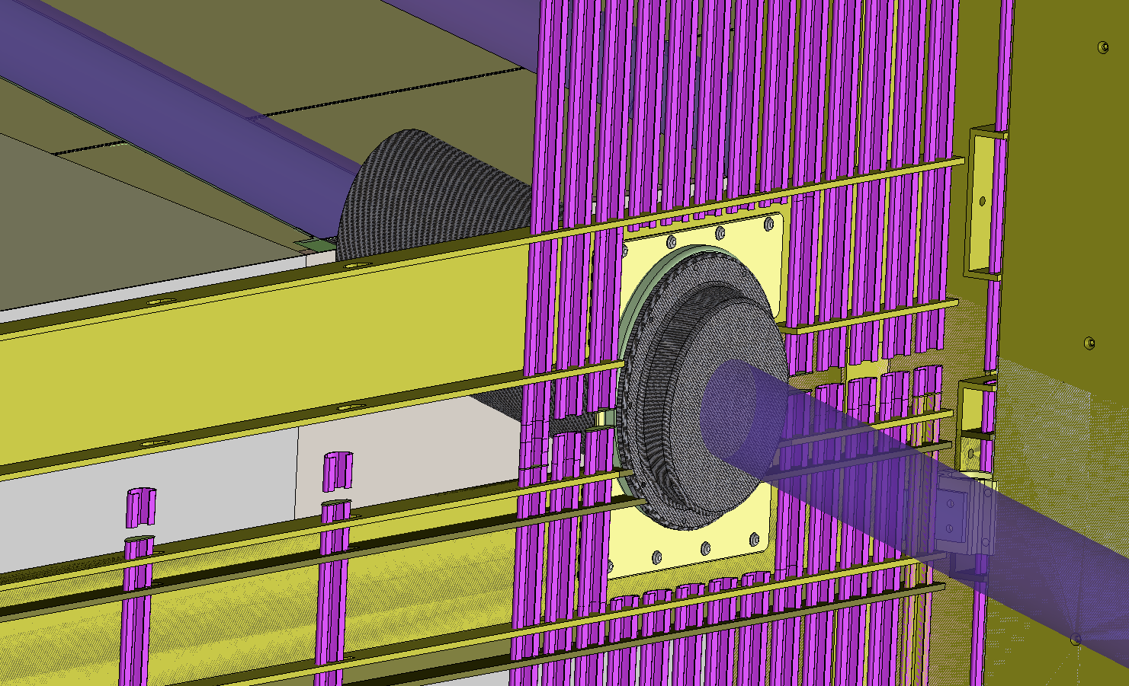
The Conceptual Design of the Beam Plug
The beam plug is constructed from a fiberglass can filled with nitrogen gas (pressure balanced in LAr)
It will have field shaping electrodes both on the beam exit window surface, and the cylindrical surface of the can (FC to cryostat wall)

Slide 20
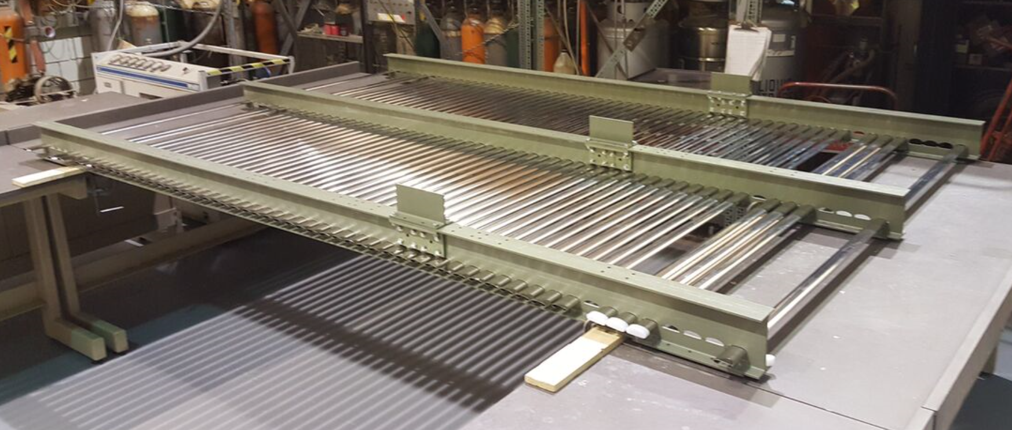
Field Cage Mockup @ SBU
A full scale ProtoDUNE top/bottom field cage mechanical mockup is being constructed at SBU.
2.3m wide x 3.6m long (2.5m + 1.1m sections to accommodate change in drift length)

Slide 21
WA105 HV Feedthrough Design
HVFT for 300kV with Rogowsky profile electrodes

Slide 22
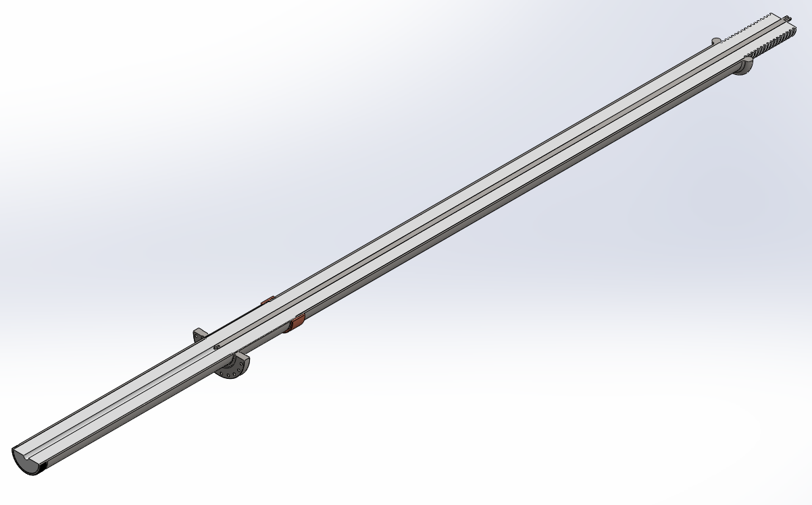
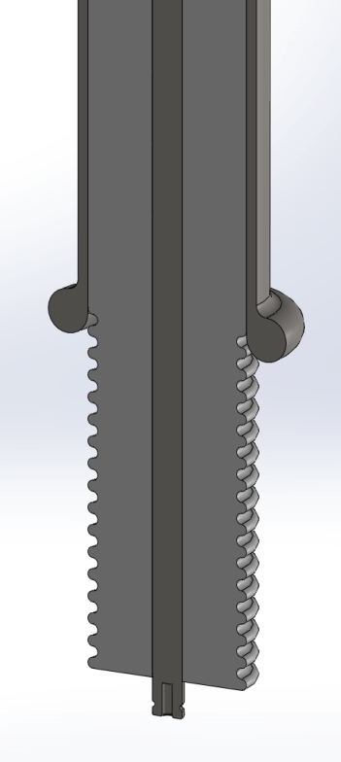
Proposed design of DUNE HV FT (UCLA)
Total length: 3 meters (30 inch airside, 88 inch argon side)
UHMW-PE Insulation: OD= 4in, ID = 0.75 inch
OD Stainless steel tube precision bored by gun barrel drilling company
UHMW-PE ID drilled by same same company
Inner conductor using solid core to avoid gas pockets:
10 inch long
cryo-fit seal
8 inch long grooved tip
Cable plug scaled from
existing plug design (not shown)
Integrated guide ring

Slide 23
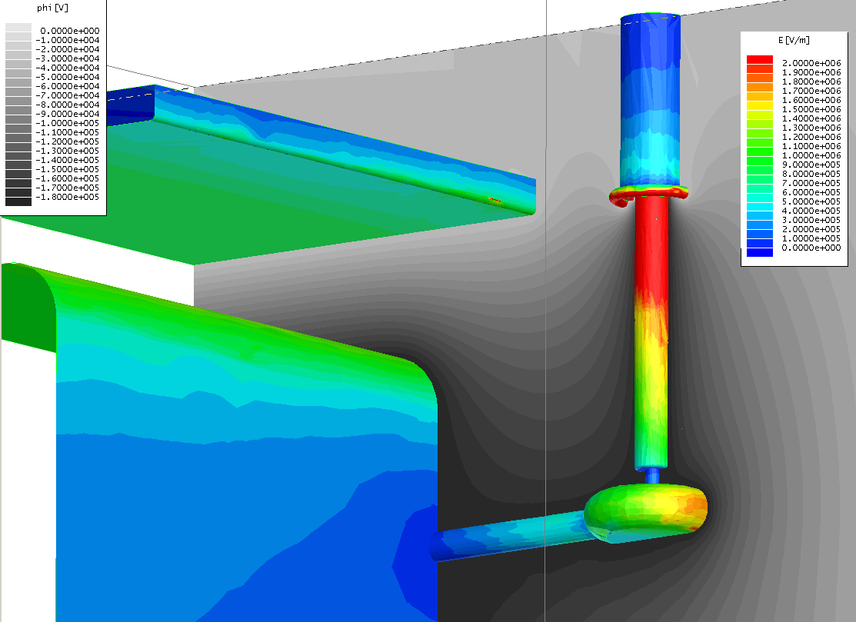
Surface Field Near the HV Feedthrough
Wall to FC distance 1m, FT center to FC: 44cm, FT shield rim lined up with ground plane.

Slide 24
HV System Filtering Requirements
The Heinzinger PNChp power supply has a ripple spec of 10⁻⁵. In order not to inject significant charge to the ASIC (<100e ENC), we need to have a filter network between the power supply and the HV feedthrough with an attenuation factor of >2000 at the ripple frequencies.
ENC of ASIC | 600 | e
max noise injection | 100 | e
 | 1.6E-17 | c
capacitance of an APA to CPA | 5.09E-11 | F
capacitance of a G wire to CPA | 8.48E-14 | F
capacitance of a U wire to CPA | 1.70E-14 | F
maximum ripple voltage | 9.43E-04 | V
Cathode Voltage | 180000 | V
Power supply output ripple @ 1E-5 | 1.8 | V
attenuation factor needed in the filter | 1908

Slide 25
Summary
Current CPA design uses 3mm G10 sheets with double sided resistive Kapton film mounted in G10 frames. Field shaping resistive electrodes keep the drift field uniform near the G10 frames. A HV bus forms a loop around the edges of the cathode, provides bias voltage to the cathode and all field cage modules
The field cage is constructed from independent modules each with its own resistive divider. Adjacent modules are electrically isolated from each other (except at the CPA and APA ends) to minimize energy transfer in case of a discharge
Both technologies are new in the LArTPC application. The field cage concept has been verified at a smaller scale (1/3 ground clearance) in clean argon with promising results.
We’d like to verify the CPA+FC assembly designed for ProtoDUNE can successfully hold the resigned voltage

Slide 26
Backup Slides

Slide 27
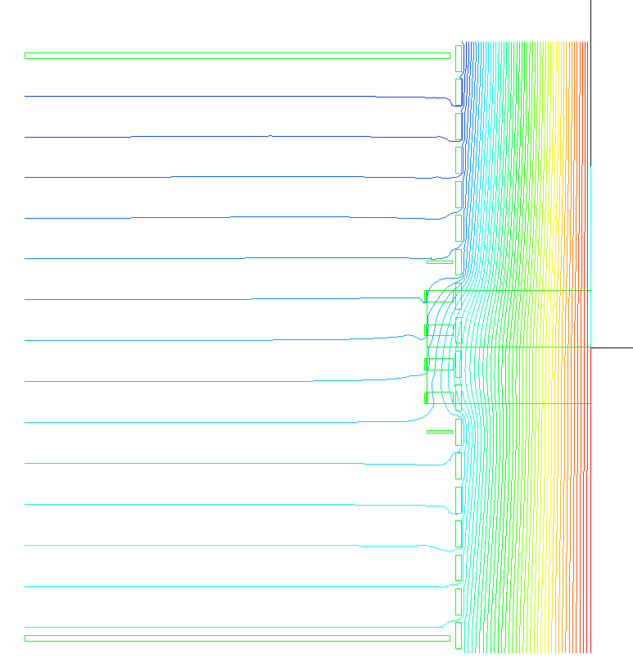
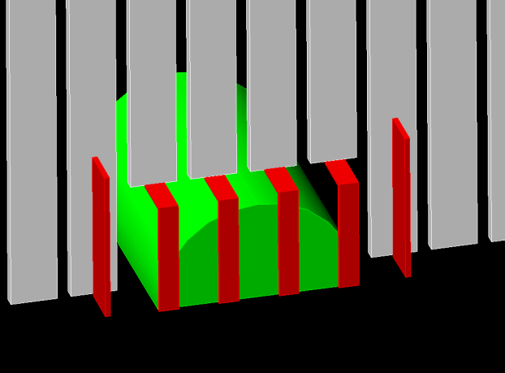
Potential Contours at Beam Window Center Plane with Field Shaping Strips over the Beam Plug

Slide 28
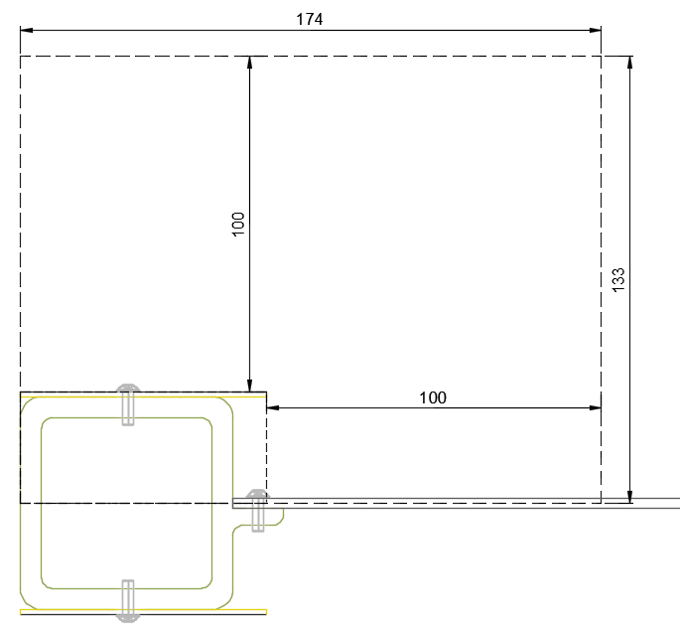
Fiducial Cut on the Thin CPA Design
If we apply a fiducial cut of 100mm around the frame*, the area of 174mm x 133mm would be the cut at the cathode every 0.58m (half of the new half width CPA).
This averages to ~40mm over 0.58m instead of ~110mm in the case of the double walled configuration.
*See presentation by Paola Sala:
https://indico.cern.ch/event/495284/contributions/2015803/attachments/1226404/1795570/cathode.pdf

Slide 29
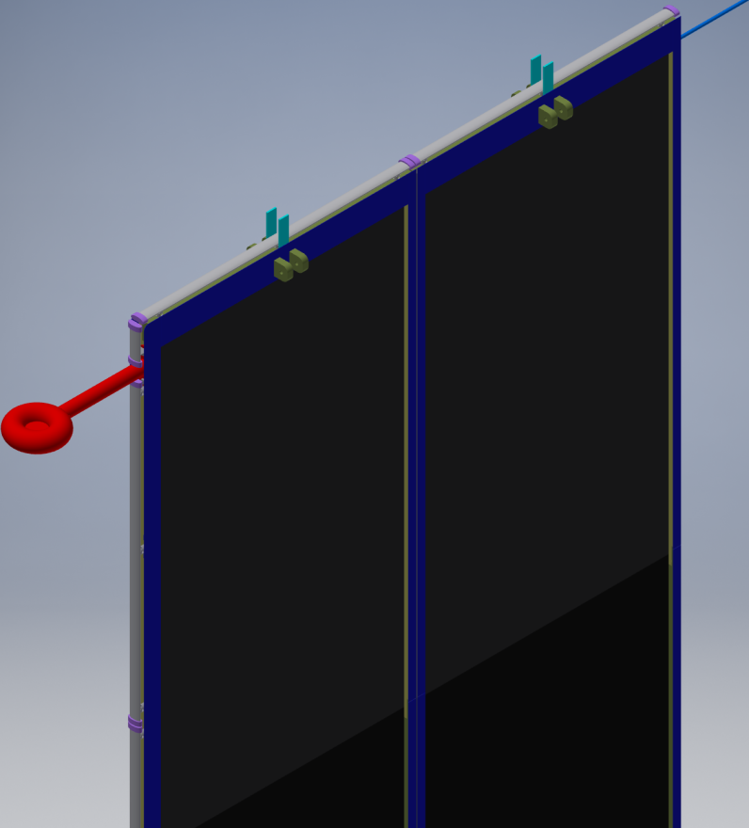
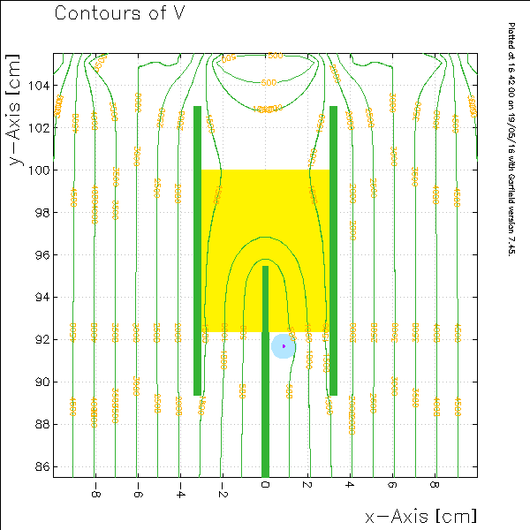
From Glenn Horton-Smith

Slide 30
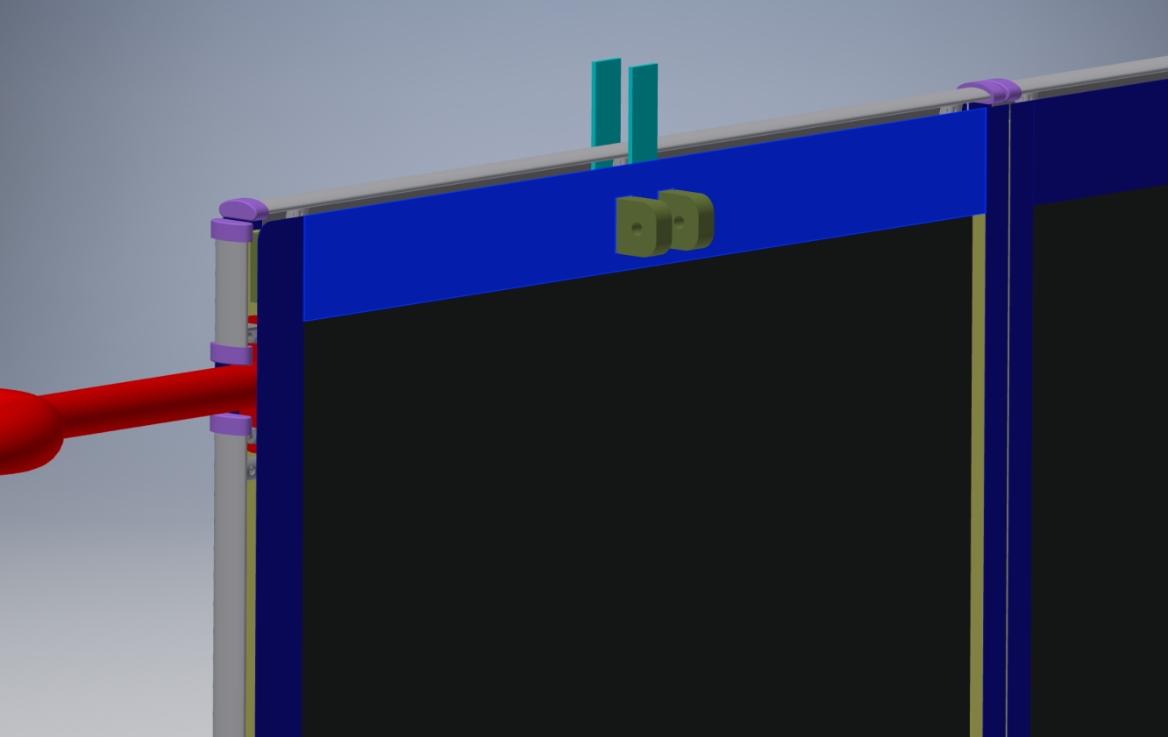

Slide 31
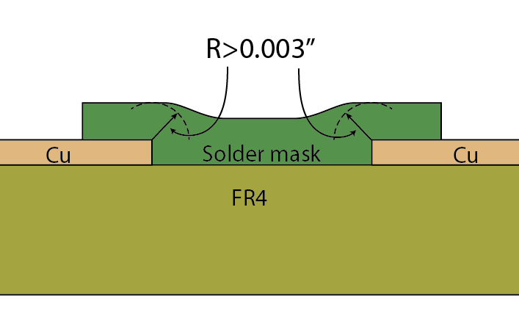
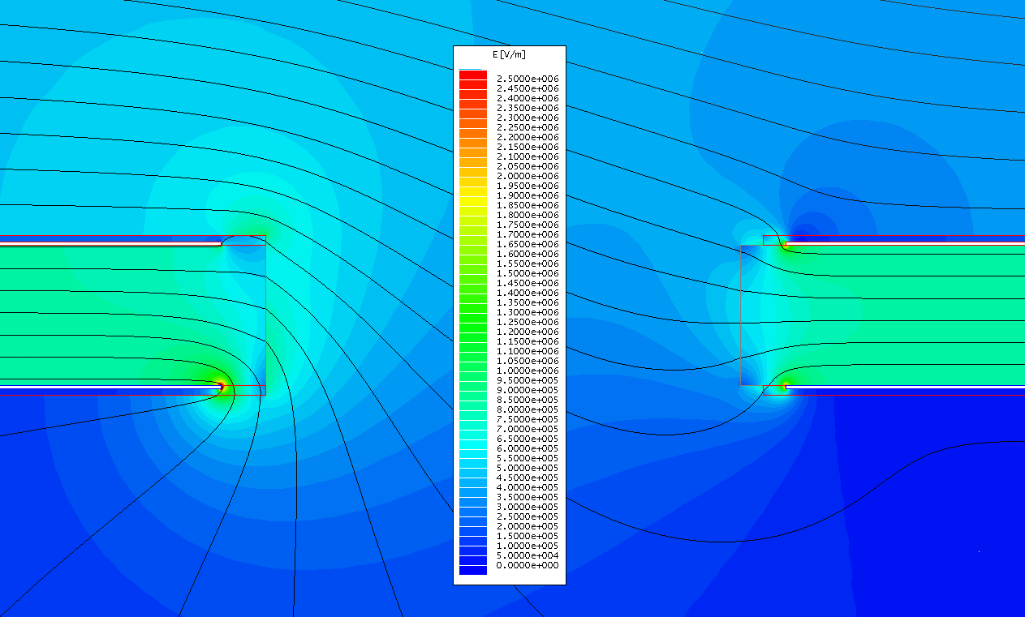
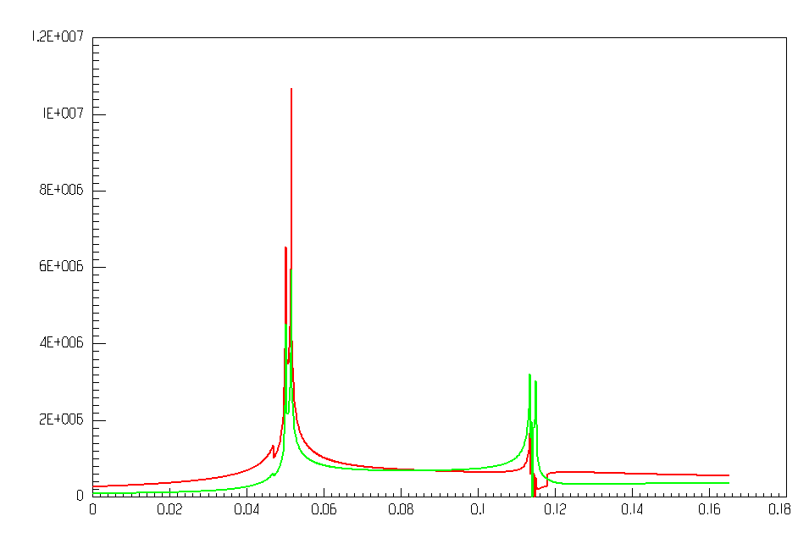
Field cage of the 35ton TPC
In order to avoid exposing the high electric field at the edges of the copper strips, the solution for the 35ton TPC is to cover the edges of the copper strips with solder mask, a standard PCB fabrication technique. The catch is that we need a thicker layer than on typical PCBs.
The standard solder mask material for rigid FR4 boards are not very resilient in thick sections and may be damaged during assembly.
External E field: 4.4kV/cm
Electric field along a line at the edges of the copper strips
Red: left edges Green: right edges
Slot in the PCB
Maximum E field in liquid ~ 15kV/cm
Electric field [V/m]
lower strip upper strip

Slide 32
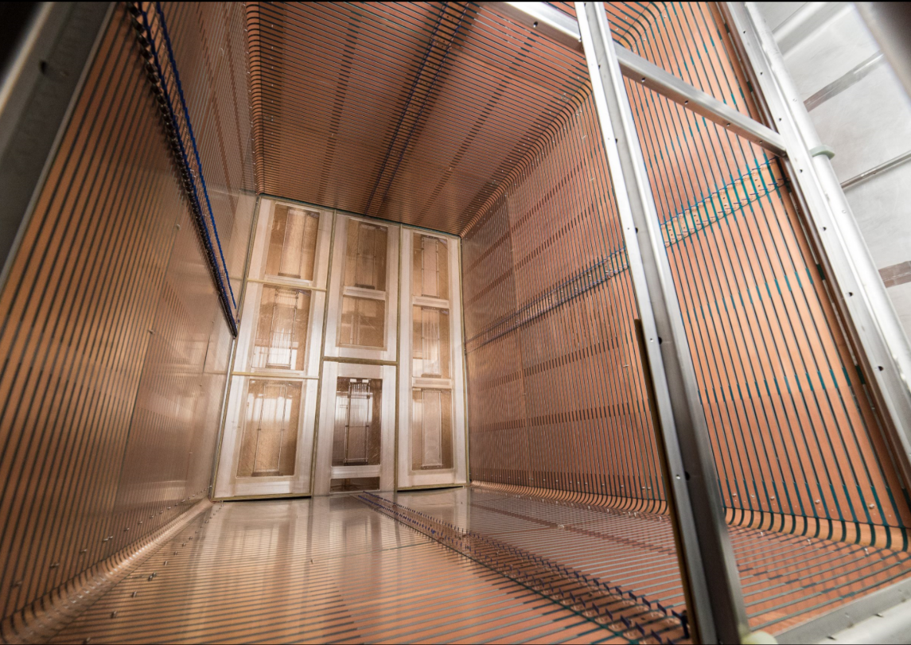
35ton Field Cage
Held 130kV in contaminated LAr

Slide 33
Apply a Similar Design to DP TPC?
Two meetings were held (April 28 & May 19) among SP/DP scientists and engineers to discuss adapting the SP FC design to NP02.
Action items from the first meeting @ CERN:
1) Mechanics: Adamo obtain SP TPC/FC 3D model, adapt the design and check the mechanical stress. Adamo will get some information from Vic on the US manufacturers of the FR4 I-beams and check for their procurement in Europe.
2) Electrostatic simulations: Bo provide the 3D model of the elements and the current Maxwell input files so that further simulations can be performed on the specific points concerning the DP design. The end cap design will also have to be adapted to the DP configuration and the field corresponding to 600 kV operation.
3) Electrical circuit diagrams: Bo providing the circuit diagrams for the panels + references to the resistors and the surge arrestors
4) Future tests: A tests in DP electric field conditions to be arranged with Francesco+ Laura by using the 300 kV power supply + FT in the large dewar foreseen to be used for the HV FT tests once these will have been completed.
5) Vic can also provide some information on the transportation strong-back for the existing panels.

Slide 34
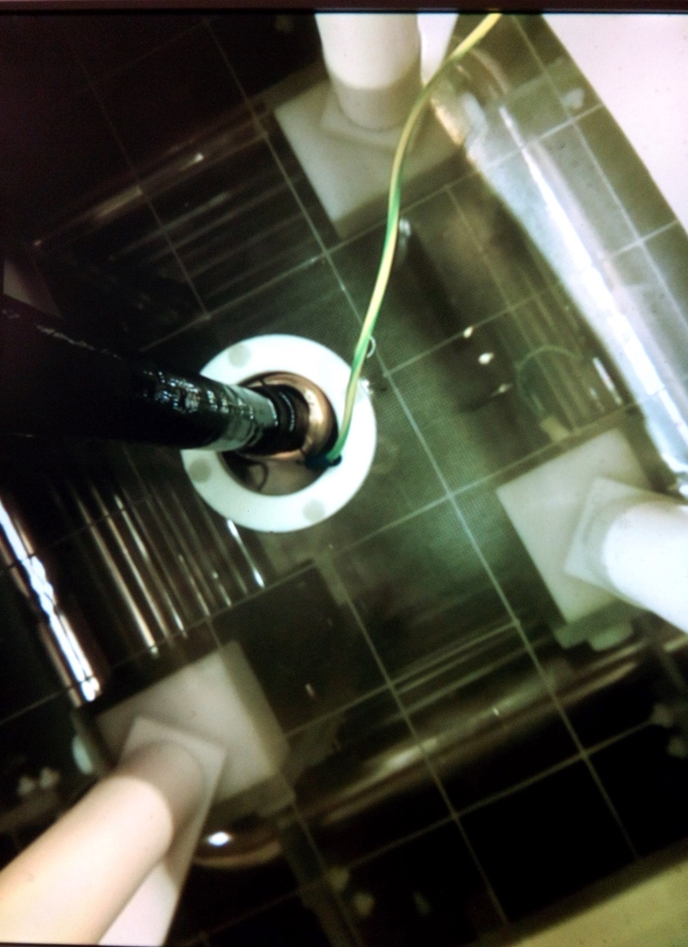
Test of the Cage in Purified LAr
More recently the cage was mounted in the 50 liter cold vessel and evacuated for few days. Filling and purification performed with usual procedure.
LAr was found very quite if outer LAr bath is full; heat input only from top flange (~10 W) and from HV cable:
Bubble formations appear when LAr bath lever lowers (with heat input up to ~80 W also from side walls of LAr vessel)
HV applied after filling, once the LAr is thermalized HV kept continuously on for 7 days.
Two regimes have been studied:
Thermal LAr bath completely covering the 50 liter vessel walls (no visible bubble formation): no sparks ever recorded up to 100 kV.
With bubbles appearing to form around the detector elements, few random sparks (one every few hours) appeared but only above 80 kV (visually they seem to develop again around the HV cable and not between the field cage and the ground plates).

Slide 35
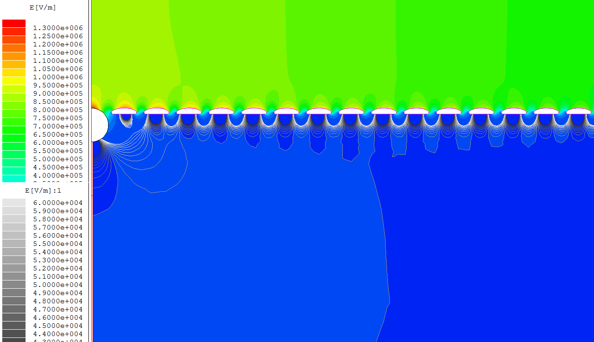
Drift Field Uniformity Near FC Edge
Gray contours: 2% of nominal drift field
Profiles at 6cm pitch, ground plane 20cm above
Active volume is 5cm away from the inside surfaces of the metal profiles

Slide 36
CPA Requirements
Provide equipotential surfaces at -180kV nominal bias voltage
Maintain a flatness better than 1cm*
Use materials with comparable CTEs to that of stainless steel
Limit the electric field exposed to LAr to under 30kV/cm
Prevent damage to the TPC including its readout electronics In case of a HV discharge anywhere on the cathode
Provide constant bias voltage and current to all attached field cage resistor divider chains
Support half of the weight of the field cage
Constructed in modular form that can be easily installed in the cryostat
Accommodate PD calibration features
*base on the requirement of “the fiducial volume of the detector shall be known with a precision of at least 1%”. Other requirements based on multiple scattering and vertex finding precisions are being formulated.

Slide 37
Changing the CPA Width
The cryostat roof deforms ?mm between the extreme operating conditions:
Filled but with no over pressure inside
Empty but with maximum pressure inside
As a result, the anchor points for the CPAs may move up and down ?mm between adjacent columns.
To avoid stress and damage to the CPAs, each CPA column is allowed to move independently.
A CPA column is lifted by a single point in the middle
Due to the dry weight of the CPA, plus the combined weight of 4 field cage modules during installation, the CPA width is halved compared with the APA width: 1160mm wide.
The FC hinges are aligned with the CPA lifting point to minimize moment load to the CPA.
For NP04, we have 6 columns x 3 rows of CPA modules

Slide 38
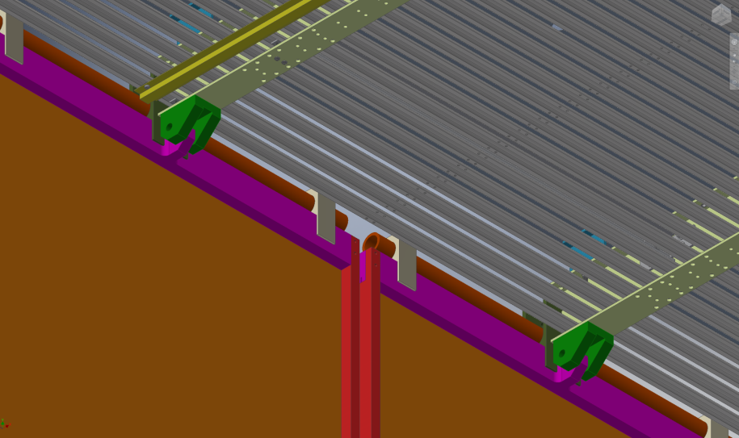
The Connection between Top/Bottom Field Cage Module and CPA

Slide 39
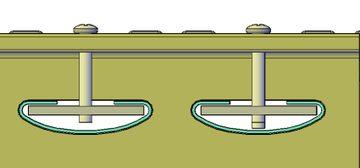
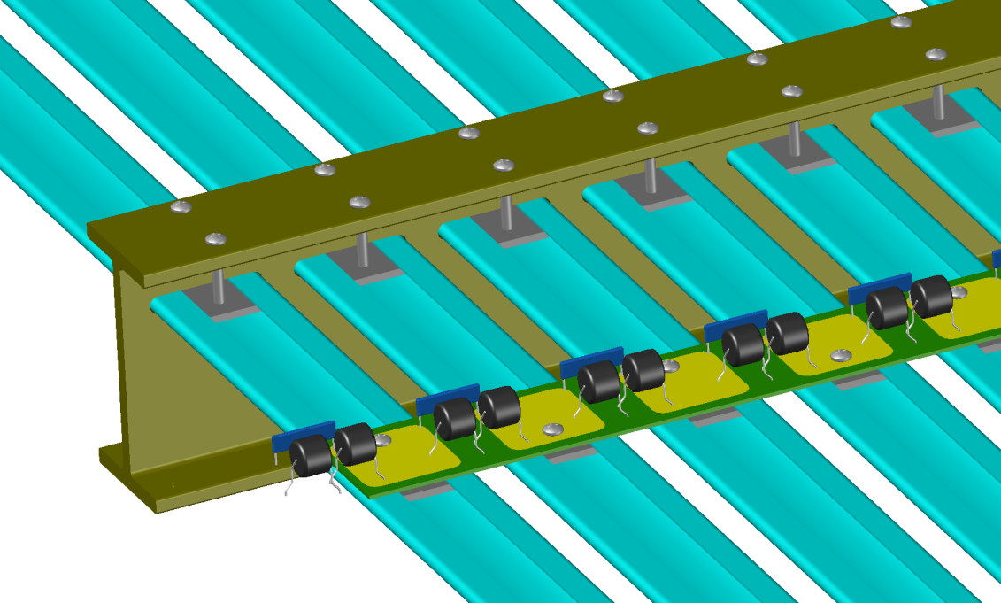
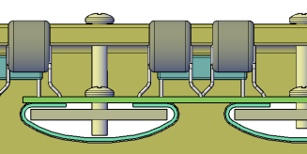
Resistive Divider Network
We need to use 3 such varistors in series between profiles if we want to have the ability to reach more than 500V/cm drift field in ProtoDUNE.
Two resistors in parallel to provide redundancy.

