Slide 1
All Experimenters’ Meeting
Daniel Johnson
Accelerator Complex Status
25 July 2016

Slide 2
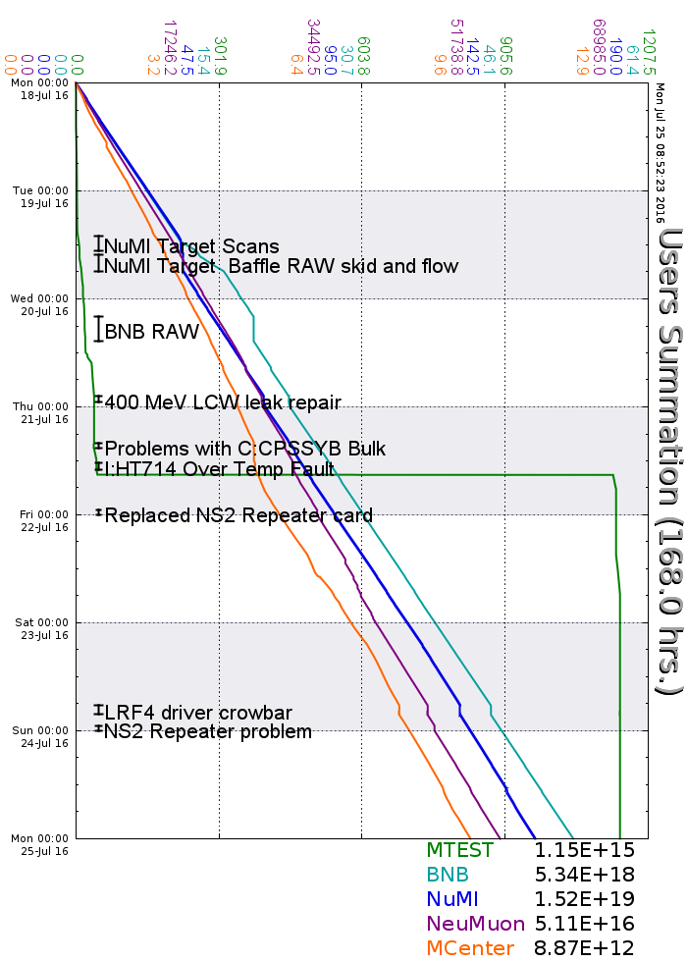
Accelerator Operations Summary
From: July 18, 2016 (0000 hours)
To: July 25, 2016 (0000 hours)
Calendar Week # 29
NuMI Weekly Integrated Intensity 1.52 E19 protons
Beam Hours To NuMI 153.3 hours
BNB Weekly Integrated Intensity 5.03 E18 protons
Beam Hours To BNB 155.3 hours
NMuon Weekly Integrated Intensity 5.11 E16 protons
Beam Hours To NMuon 154.8 hours
MTest Weekly Integrated Intensity 6.67 E13 protons
Beam Hours To MTest 59.9 hours
MCenter Weekly Integrated Intensity 8.60 E12 protons
Beam Hours To MCenter 160.8 hours

Slide 3
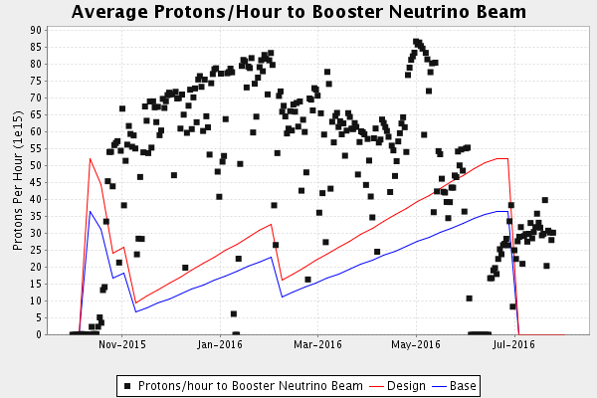
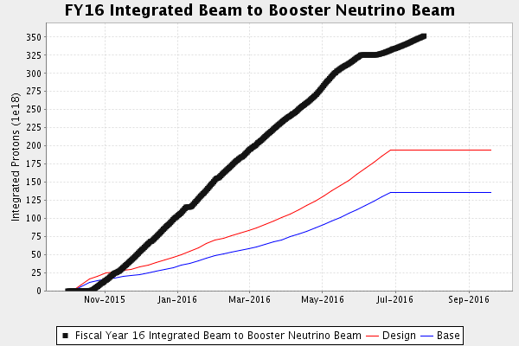
Performance measures: BNB

Slide 4
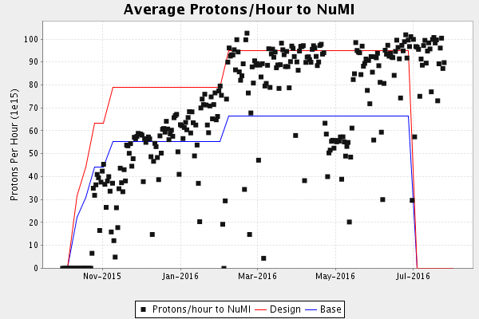
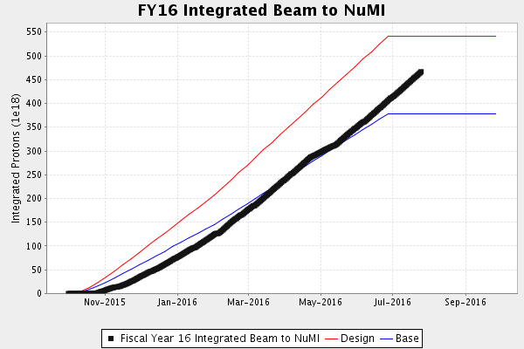
Performance measures: NuMI

Slide 5
Complex Status
LINAC
  Running well
Booster
  Booster rate: ~11 Hz
  Tuning up / studies
    Beam to Main Injector
MI/RR
  Delivering beam to NuMI & Switchyard
  Standard operation: 2As (1.33 Sec MI ramp rate) with 6+6 slip stacking
NuMI
  Using beam
    Beam Power ~550 kW (6+6)
Booster Neutrino Beamline (BNB)
  Using Beam
Switchyard
  Meson beam
    MTest using beam
    MCenter using beam
  SeaQuest
    Using beam
General
  No plans to reduce beam intensity prior to the beginning of the Summer Shutdown.
  Finishing measurements and low loss studies
  Saturday, July 30th @ 0001
    Beam off
    Prepare for Summer Shutdown
  Monday, August 1st
    Start Date of Summer Shutdown
    MI/RR Fire Horn tests (0600-0800)
    Keys available at 0800

Slide 6
Outages - Power

Slide 7
Outages – Power & Cooling

Slide 8
Controlled Accesses
Controlled Access Event (3/01/2016)
  Four people performed a controlled access into Booster
  One had the wrong key (Verification is important)
  Enclosure dropped as training requires
  Similar to incident in 2014
  Controlled accesses were not permitted
Controlled Access Modification (3/02/2016)
  No more group controlled accesses
  Controlled accesses can resume in pairs
  Each person must manipulate their key for entry
  Interim procedure until investigation has been completed, corrective actions identified/implemented

Slide 9
Schedules and Links
Schedule can be accessed from the Operations Home Page
  - Schedules -> Operations Schedule
Direct link to schedule
  - http://www-ad.fnal.gov/ops/schedule.html

