Slide 1
LCC Physics and Detector
Status Report
LCC physics and detector WGs
Concept groups
LC workshops
LCB Meeting, August 7, 2016
Hitoshi Yamamoto

Slide 2
LCC Physics and Detector WGs

Slide 3
X750 @Santander (June, 2016)
ATLAS:
13 TeV data, spin-0
2.0σ (global) 3.9σ (local)
Consistent with 8 TeV at 1.2σ
CMS:
13/8 TeV data, spin-0
3.4σ (local at 750 GeVl)

Slide 4
X750 @ ICHEP2016
ATLAS:
2016 only
CMS:
2016 only
No significant signals …

Slide 5
X750 and LC
It is an excellent exercise opportunity for LC
  Response to LHC results at higher energy
  Intensive discussions at Santander
  LCC Physics WG produced a document:

Slide 6
ILC500 Precision Measurements
ILC500 (H20 running scenario) can distinguish variety of new physics
that may be behind X750

Slide 7
X750 Production at LC
Possible ways 1 TeV ILC or CLIC can produce X750
γγ→X750
  gamma-gamma collider option
  Almost guaranteed production
e+e- → X750 γ
  X750-γγ vertex should exist
  Production rate has uncertainty
No concrete proposal is advocated for actual upgrade/option scenarios.

Slide 8
LC and X750: summary
LC can elucidate the physics behind X750 by precision measurements on Higgs, top etc.
LC may be able to discover new particles related to X750 within its energy reach
With energies ~1 TeV and above, LC could produce X750 directly through e+e- at high energy or future γγ option
This is essentially what we have been advocating:
LC provides excellent complementarity to LHC

Slide 9
ICFA Letter to MEXT Committee
Excerpts
If the LHC discovers a new particle, this will imply the presence of new laws of physics, but the nature of this new physics will not be clear. To learn about the underlying physics, we will need precision measurements of particle properties, which are in many cases challenging at the LHC and hence require the ILC.
If the LHC discovers light new particles beyond the SM, this would open the door to new and unknown laws of physics, and the ILC provides great capabilities to discover different new particles related to the LHC discovery.
If the LHC discovers heavy new particles beyond the SM, this will imply the presence of unknown new laws of physics. The ILC has great capabilities to uncover these new laws, by the discovery of further new particles or through new measurements qualitatively different from those at the LHC.
This case study verified the value of (I)LC

Slide 10
Physics Brochure
Target audience
  Intelligent general public
Authors
  Communicators
    Barbara Warmbein, Rika Takahashi
  Physics Working Group conveners
    Keisuke Fujii, Christophe Grojean, Michael Peskin
One-page description of keywords
  Higgs, SUSY, top quark, etc.
Illustrations by professional designers
→ web (cross referenced) & paper copies

Slide 11
ICHEP Talks
LC physics and detector talks (w/o CLIC specific talks)
Coordinated by the conference talks group of LCC
Measurement of the Higgs self-coupling at the ILC (Jan Strube)
Naturalness and light higgsinos: a powerful reason to build ILC (Howard Baer, Jenny List)
WIMP Searches at the International Linear Collider (Moritz Habermehl)
Precision Electroweak Measurements at a Future e+e- Linear Collider (Graham Wildon)
500 GeV ILC Operating Scenarios (Jim Brau)
SUSY model and dark matter determination in the compressed-spectrum region at the ILC (M. Berggren)
The SiD Detector for the International Linear Collider (Andy White)
Impact of Theory Uncertainties on the Precision of the Top Quark Mass in a Threshold Scan at future e+e- Colliders (Frank Simon)
Studies of Micro Pattern Gas Detector modules of a Large Prototype TPC for the ILC (Alain Bellerive)
The ILD/CALICE Silicon-Tungsten Electromagnetic Calorimeter: status and potential (Kostiantyn Shpak)
Top physics at CLIC and ILC (Marcel et al.) : Combined CLICdp / ILC
Quite a comprehensive list!

Slide 12
Low-energy operation of ILC
ILC parameter WG
A machine document produced by N. Walker
  Electron energy needs be 150GeV or more to accelerate the same number of positrons as electrons
  With the baseline undulator (147m-long), Ecm ~ 250 GeV requires 10Hz operation (230m-long would make 5Hz possible)
  For Ecm = 90GeV (Giga-Z) or 160 (W pair), 10Hz operation becomes intractable → segmented linac proposed
ILD and SiD are asked about the need for calibrations at Z-pole

Slide 13
Detector R&Ds
LCC Detector R&D Liaison
Detector R&D document
  Close to be ready for release (it has been so for some time…)
ILC Technical R&D Review
  Arranged by ECFA
    ECFA selects 4~5 core members who will assemble review committees as requested by ILC community etc.
    Approved by ECFA
    The core members are now being selected
  Actual review will take place at a lab (e.g. DESY)
    A la ECFA panel headed by Yannis Karyotakis

Slide 14
PDAP
(Physics and Detector Advisory Panel)
3-member ‘light weight’ panel
  Paul Grannis (chair), Junji Haba, Sandro Palestini
First review meeting held at LCWS2015 (Whistler)
  Produced a review report (Nov, 2015)
    Reported at the last LCB
Next meeting will be held at LCWS2016 (Morioka)

Slide 15
Concept Groups

Slide 16
CLICdp
Detector model
  Started out as CLIC adaptations of ILD and SiD (CLIC-ILD and CLIC-SiD)
  Now one model has been developed (CLICdet-2015)

Slide 17
CLICdp
Synergies with ILC
Software
  Renewed common ILC/CLIC software tools now up and running
    Generic detector description toolkit DD4hep
    Track reconstruction
    PandoraPFA (via DDMarlinPandora)
    LCFIplus for flavour tagging (with Kalman filter)
    Grid production with ILCDIRAC for both ILC and CLIC
Physics
  Top physics etc.
Hardware
  Calorimeters (CALICE) etc.
Detector model
  ILD adopts CLICdet as one of the options

Slide 18
ILD
New Institutions: now 70 institutions total
  CPP Marseilles, France
  Kiev University, Ukraine
  Lebedov Institute, Russia
New organizational structure in place and running
New ILD logo is being solicited

Slide 19
ILD
Technical working groups defined

Slide 20
ILD
Optimization: two detector models:
  Model 1:
    Based on the DBD design – ‘large’ (3.5T solenoid)
  Model 2:
    Close to CLICdet model – ‘smaller’ (4T solenoid)
    All-silicon trackers
Define a new ILD baseline detector with options
  Based on detailed optimization studies
  Based on in–depth comparison of the few benchmark models
  Demonstrate the performance of the new ILD baseline
  Document the process and the results in a note
  Time scale ~ 2 years
General Goals:
  Make the scientific case for the ILC
  Develop and optimize the ILD detector
  Adapt the ILD design for the Japanese site

Slide 21
SiD

Slide 22
SiD
Baseline Design
  Validated and costed
  Meets or exceeds the ILC specifications
Reasons for updating the design
  Machine parameters are being updated
  Technological advances (e.g. HCAL: RPC to SiPM)
  Site-specific design (assembly method etc.)
  Optimization workshop: Sep 21-23, at PNNL
Software
  Stoppage of support for software expert is hurting
  Try to use ILD/CLIC software
Member institutions
  Trying to increase Asian members
  Now the Tohoku group has applied to join SiD (in addition to ILD)
    Beneficial for a US-Japan funding request
    So far, strongly supported by both ILD and SiD – official answer by SiD expected in 2 days

Slide 23
Funding Situations
Europe
  AIDA2020
  E-JADE: approved (for exchanges only)
    For accelerator efforts, but now can be used for detector efforts
    Japanese institutions are KEK and U. of Tokyo only
  RANDALF: will know if accepted soon (for exchanges only)
    Like E-JADE but for physics and detector efforts
Japan
  Application for a large JSPS ILC detector funding failed for 2016
    Trying again this year
  Two JSPS programs for ILC approved
    Top physics, ~$80K/yr for 5yrs (1 postdoc)
    Dark matter, ~$80K/yr for 5yrs (1 postdoc)
  US/Japan grants
    Software and computing (small)
    A new larger one will be tried this year
US
  Very limited…
  Need to use generic R&Ds?

Slide 24
LC Workshops

Slide 25
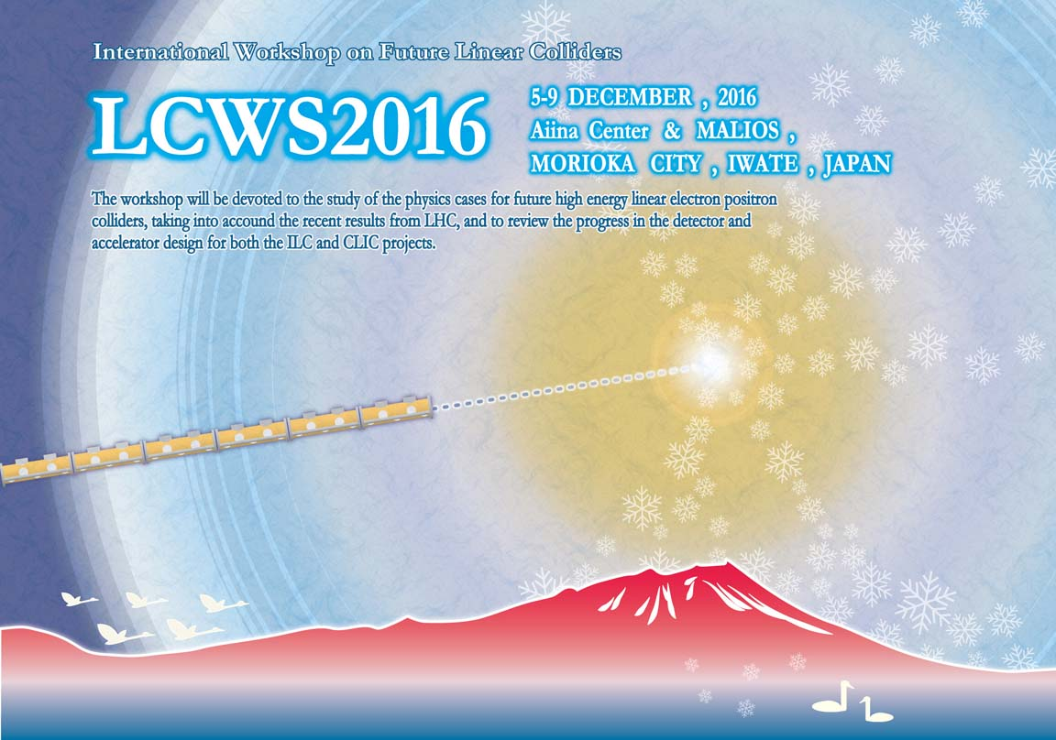
LCWS2016
Dec 5(Mon) - 9(Fri), 2016
Morioka, Iwate Prefecture, Japan
  Venues near the Morioka station
Near the Kitakami candidate site
  Site visit excursion
  http://lcws2016.sgk.iwate-u.ac.jp

Slide 26
LCWS2016
http://lcws2016.sgk.iwate-u.ac.jp
Organized by LCC (+ ‘experts’)
International Organizing Committee
  - Observer -
  Lyn Evans
  Hitoshi Murayama
  - Associate Directors -
  Steinar Stapnes/Phil Burrows
  Mike Harrison
  Hitoshi Yamamoto (chair)
  - regional directors -
  Brian Foster
  Harry Weertz
  Akira Yamamoto
  - concept reps -
  Ties Behnke
  Andy White
  Frank Simon
  - Physics and Detector regional reps etc.
  Dmitri Denisov (North America)
  Fuan Fuster (Europe)
  Keisuke Fujii (Asia)
  Philip Roloff (CLICdp)
  Maxim Titov (IEEE, Det RDs)
  - Theorists -
  Michael Peskin
  Christophe Grojean
  -accelerator -
  Kaoru Yokoya
  Michizono
  Nick Walker
  Jie Gao

Slide 27
LCWS2016
International Advisory Committee
(symbolic list showing support)
Marcel Demarteau (ANL)
Francois Le Diberder (IN2P3)
Yuaning. Gao (Tsinghua University)
Dinakar Kanjilai (IUAC)
Eckhart Elsen (CERN)
Wei-Shu. Hou (National Taiwan University)
Halina Abramowicz (ECFA)
Andy Lankford (UC Irvine)
David MacFarlane (SLAC)
Victor Matveev (JINR)
Joachim Mnich (DESY, ICFA)
Hugh Montgomery (Jefferson Laboratory)
Mitsuaki Nozaki (JSPS, KEK)
Yasuhiro Okada (KEK)
Ritchie Patterson (Cornell University)
Lenny Rivkin (PSI)
Masa Yamauchi (KEK)
Geoffrey Taylor (University of Melbourne)
Yifang Wang (IHEP Beijing)
Sachio Komamiya (University of Tokyo)

Slide 28
LC Workshops
2010 Mar 26-30, IHEP, Beijing, China
2011 Mar 19-23, Eugene, Oregon, USA
2011 Sep 26-30, Granada, Spain
2012 Apr 23-27, Daegu, Korea
2012 Oct 22-26, Albuquerque, Texas, USA
2013 May 27-31, DESY, Germany
2013 Nov 11-15, Tokyo U., Japan
2014 May 12-16, Fermilab, USA
2014 Oct 6-10, Belgrade, Serbia
2015 Apr 20-24, KEK/Tokyo, Japan (omnibus)
2015 Nov 2-6, Whistler, Canada
2016 Jun 1-5, Santander, Spain (omnibus)
2016 Dec 5-9, Morioka, Japan
2017 spring, Regional LC workshop (omnibus) in North America (?)
Not indented: LCWS (fall)
Indented: regional (spring)
Rotated over:
Red: Europe
Green: Asia
Blue: Americas
Recently, regional ones are ‘omnibus’

Slide 29
Summary
Overall, a good level of activities are maintained for the physics and detector efforts
ILD has re-organized and membership is increasing, but funding is decreasing at an alarming rate
Situation with SiD is quite serious due to lack of funding
The preparation for LCWS2016 is progressing well, but the success will depend on strong supports of major labs
There is uncertainty for the next spring LC workshop

