Slide 1
All Experimenters’ Meeting
Duane Newhart
Accelerator Complex Status
01 Aug 2016

Slide 2
Accelerator Operations Summary
From: July 25, 2016 (0000 hours)
To: Aug 01, 2016 (0000 hours)
Calendar Week # 30
NuMI Weekly Integrated Intensity 1.01 E19 protons
Beam Hours To NuMI 99.8 hours
BNB Weekly Integrated Intensity 3.08 E18 protons
Beam Hours To BNB 99.8 hours
NMuon Weekly Integrated Intensity 3.03 E16 protons
Beam Hours To NMuon 99.2 hours
MTest Weekly Integrated Intensity 1.46 E13 protons
Beam Hours To MTest 30.5 hours
MCenter Weekly Integrated Intensity 4.60 E13 protons
Beam Hours To MCenter 86.3 hours

Slide 3
Performance measures: BNB

Slide 4
Performance measures: NuMI

Slide 5
Performance measures: FY16 comparison

Slide 6
Complex Status
LINAC
Ran well last week
Booster
Booster rate: ~11 Hz
Tuning up / studies
Beam to Main Injector & RR
Ran well last week
Until the flood
MI/RR
Delivering beam to NuMI & Switchyard
Standard operation: 2As (1.33 Sec MI ramp rate) with 6+6 slip stacking
NuMI
Ran well last week
Beam Power ~550 kW (6+6)
Booster Neutrino Beamline (BNB)
Ran well last week
Switchyard
Meson beam
MTest Ran well last week
MCenter Ran well last week
SeaQuest
Ran well last week
General
Saturday, July 30th @ 0001
Beam off
Prepare for Summer Shutdown
Find a unusual way to begin the Shutdown early
Done
Monday, August 1st
Start Date of Summer Shutdown

Slide 7
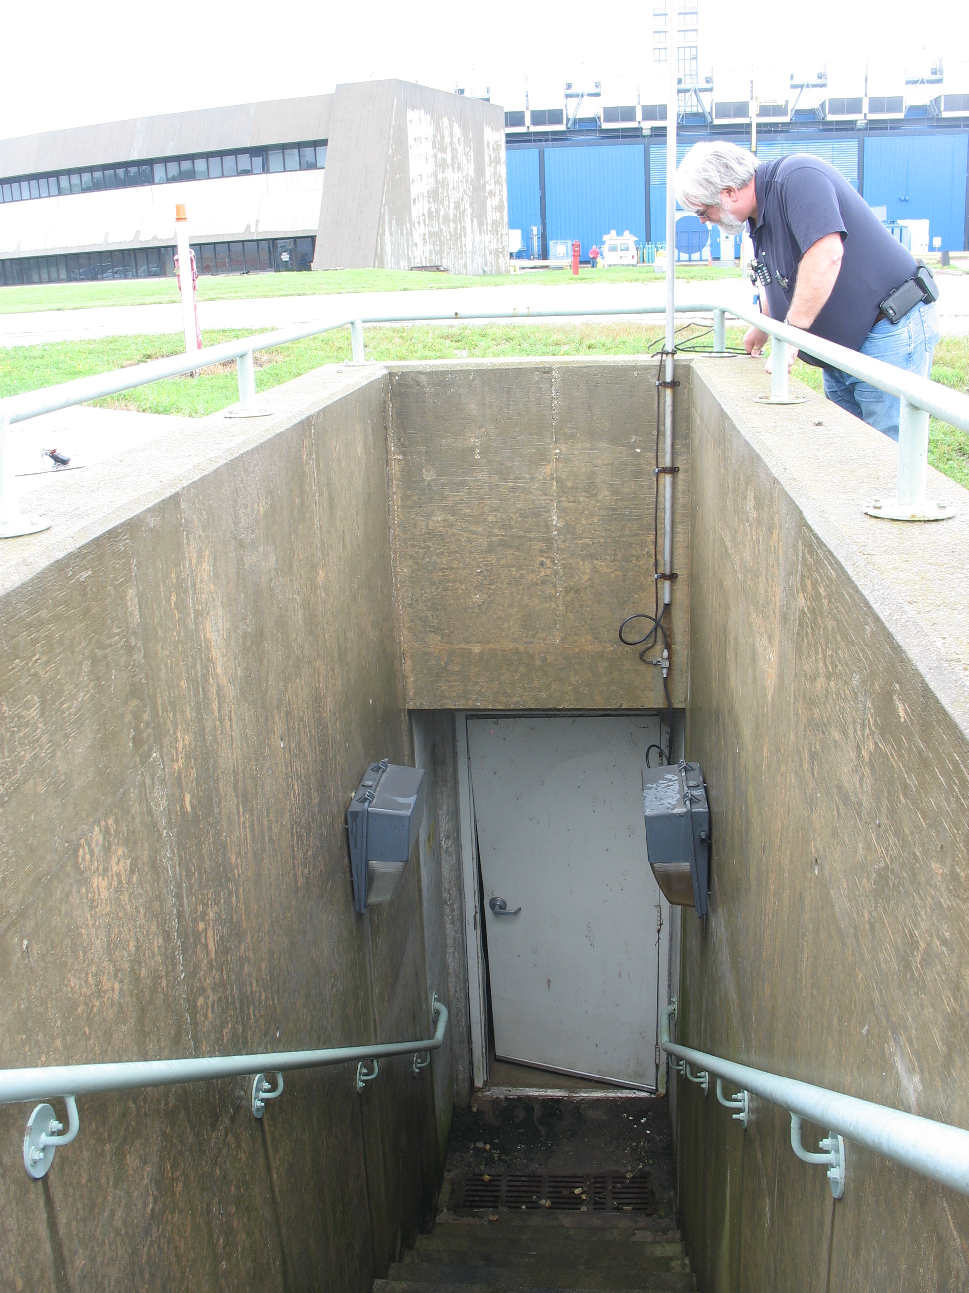
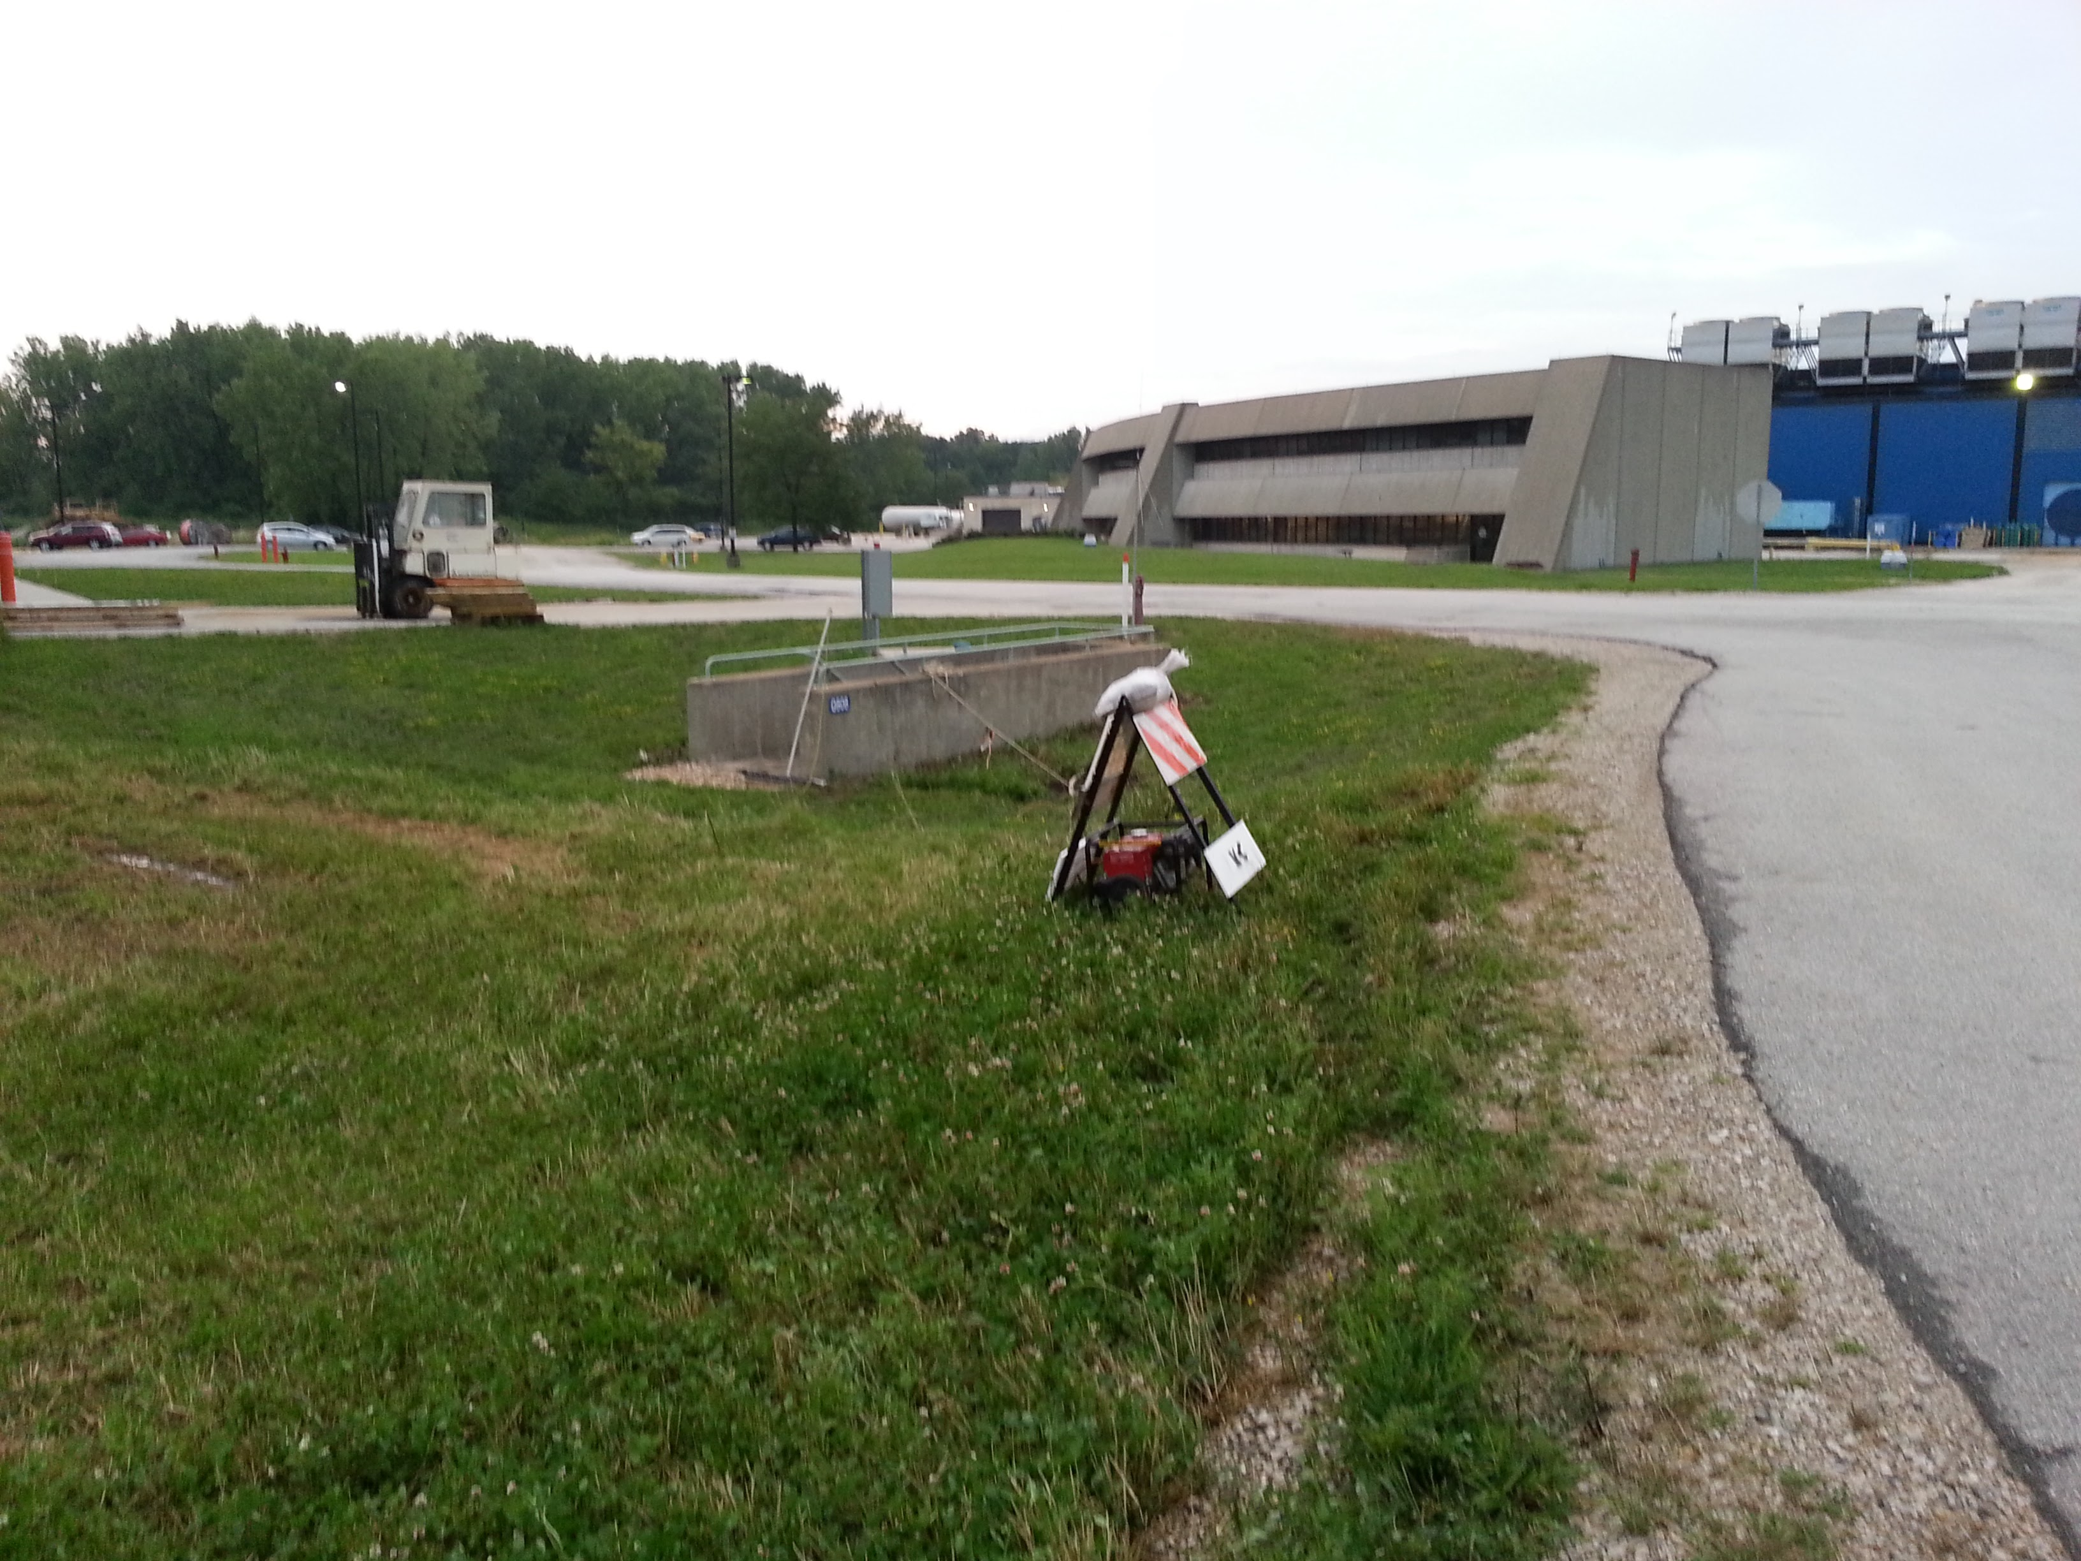
Unusual way to begin the Shutdown
Booster Exit Door vs. Flood water: Door Lost

Slide 8
Outages - Power

Slide 9
Outages - Power

Slide 10
Controlled Accesses
Controlled Access Event (3/01/2016)
Four people performed a controlled access into Booster
One had the wrong key (Verification is important)
Enclosure dropped as training requires
Similar to incident in 2014
Controlled accesses were not permitted
Controlled Access Modification (3/02/2016)
No more group controlled accesses
Controlled accesses can resume in pairs
Each person must manipulate their key for entry
Interim procedure until investigation has been completed, corrective actions identified/implemented

Slide 11
Schedules and Links
Schedule can be accessed from the Operations Home Page
- Schedules -> Operations Schedule
Direct link to schedule
- http://www-ad.fnal.gov/ops/schedule.html

