Slide 1
Search for dark matter using Mono-Higgs Events in the four lepton final state at CMS
By: Jairrin Dickens (Florida A and M University, USA)
Supervisor(s): Dr.Pushpa Bhat (Fermilab, USA) and Dr.Nicola De Filippis (Bari, Italy)

Slide 2
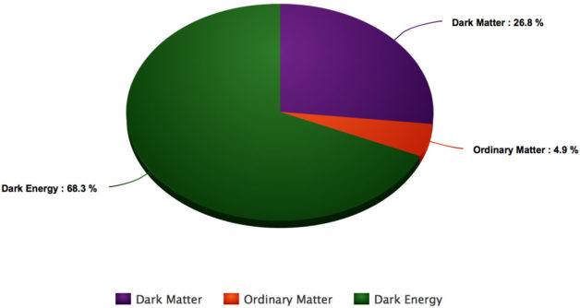
Dark matter seems to outweigh visible matter, making up about 27% of the universe.
We can only detect dark matter from its gravitational effects.
If such particles interact non-gravitationally with standard model particles detecting it through high-energy collisions at particle accelerators is one of the most promising avenues towards identifying the specific nature of its detailed interactions.
*Photo credit: http://newscenter.lbl.gov/2016/05/24/3-knowns-3-unknowns-dark-matter/

Slide 3
Dark matter particles could be produced at the Large Hadron Collider, but would escape detection being stable and weakly interacting.
The standard model Higgs boson can provide an additional probe beyond the Standard Model into the dark matter sector.
Experimentally, these “mono-Higgs” events are characterized by the presence of a Higgs boson and non negligible missing transverse momentum due to the undetected dark matter particles.

Slide 4
In order to plot and analyze the data, background, and signal distributions ROOT version 6.06/01 was used.
ROOT is an object-oriented program and library developed by CERN. It is mainly written in C++ but integrated with other languages such as Python and R.
*photo credit: root.cern.ch

Slide 5
TNtuples with various calculated variables were provided to work with.
A TNutple is a TTree restricted to a list of float variables.
A TTree consists of a list of independent branches, and each branch has its own definition and list of buffers.

Slide 6
The study focused on the decay of the standard model-like Higgs boson to two Z bosons both decaying to charged leptons. (H→ ZZ → 4l)
The TNtuples were separated into the three different decay channels of the leptons.
Two electrons two muons (2e2mu)
Four electrons (4e)
Four muons (4mu)
2015 data was collected from CMS for this study had a luminosity of 2.8 fb⁻¹

Slide 7
Background processes
gg→ttH→ttZZ→4l+X
tt→2l2v2b
qq →Hqq →ZZqq →4lqq
WJets →lv
qq →W⁻H →W⁻ZZ →4l+X
qq →W⁺H →W⁺ZZ →4l+X
WW →2l2v
WZ →3lv
qq →ZH →ZZZ →4l+X
Z →ll, H →2lvv, l=e, µ
qq →ZZ →4l
Z →ll+jets
gg →H →ZZ →2e2mu
gg →H →ZZ →2e2tau
gg →H →ZZ →2mu2tau
gg →H →ZZ →4e
gg →H →ZZ →4mu
gg →H →ZZ →4tau

Slide 8
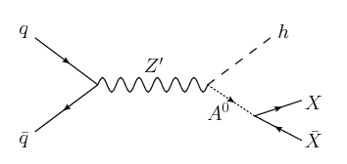
Signal: Two Higgs Doublet Model (2HDM)
Simplified Model
A standard model state decaying to dark matter is highly constrained.
However dark matter-standard model particle interactions mediated by a pseudoscalar particle (Z’) are possible, evading constraints from direct detection experiments.
Z’ decays to a Higgs plus an intermediate state which decays to a dark matter pair.

Slide 9
The models used in my study differed in the mass of the Z’ with A⁰ set to 300GeV.
Z’ = 600GeV, 800GeV, 1000GeV, 1200GeV, 1400GeV, 1700GeV, 2000GeV, 2500GeV

Slide 10
Results

Slide 11
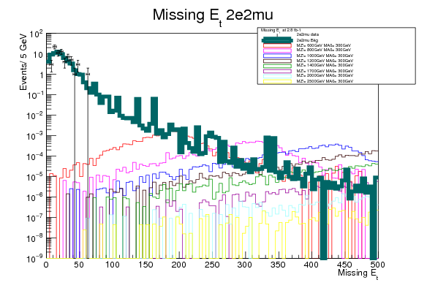
E_{T}
Backgrounds and signal models are weighted to 2.8 fb⁻¹
Number of events(data) per channel
2e2mu=70
4e=20
4mu=49
The Missing E_{T} of the data is negligible and explained by the Standard Model

Slide 12
Missing E_{T} events at 2.8 fb⁻¹
Signal
 | MZ’=600GeV | MZ’=800GeV | MZ’=1000GeV | Background
ME_{T} > 150 | 0.02148 | 0.01108 | 0.008606 | 0.40146
ME_{T} > 250 | 0.00171 | 0.00909 | 0.008158 | 0.06187

Slide 13
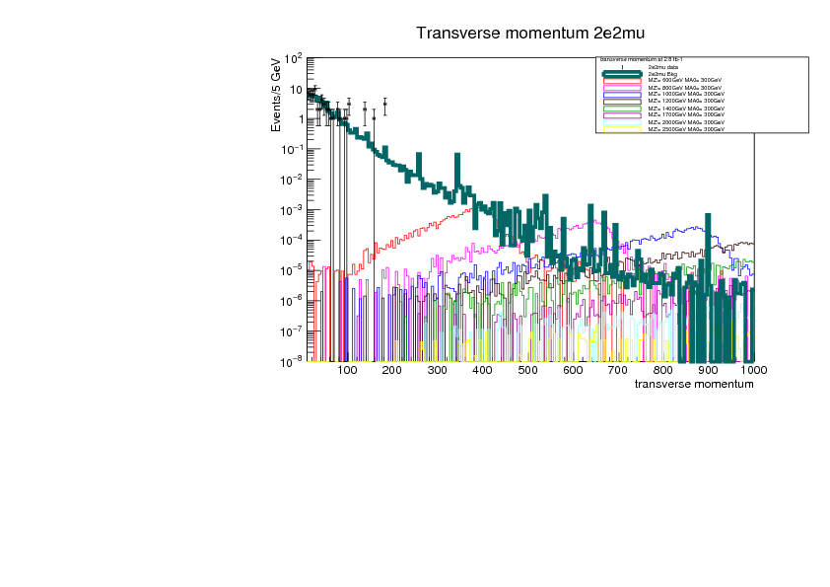
Events (data) do not extend into the range modeled by the signal models

Slide 14
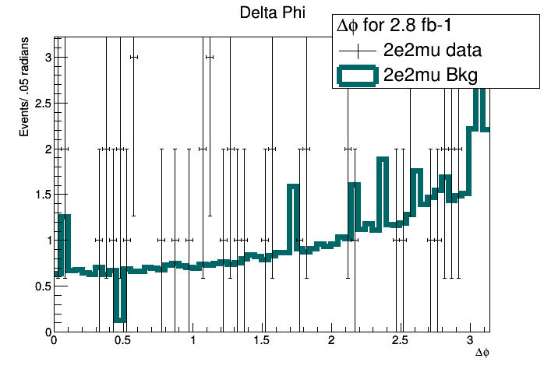
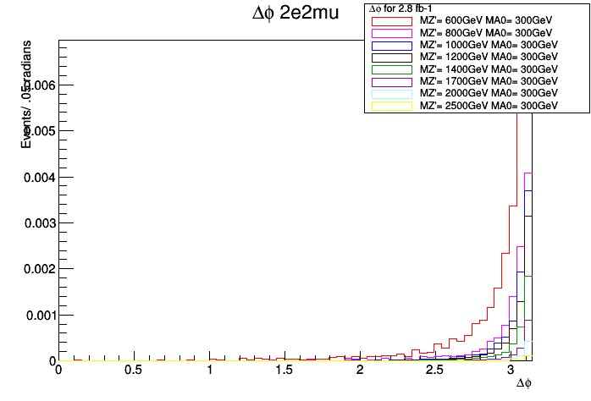
There is a significant amount of the signal after ∆φ>2 radians while the background has an even distribution
Making a cut at ∆φ>2 radians will allow for significant amount of background rejection while at the same time allowing for a significant amount of the signal to remain

Slide 15
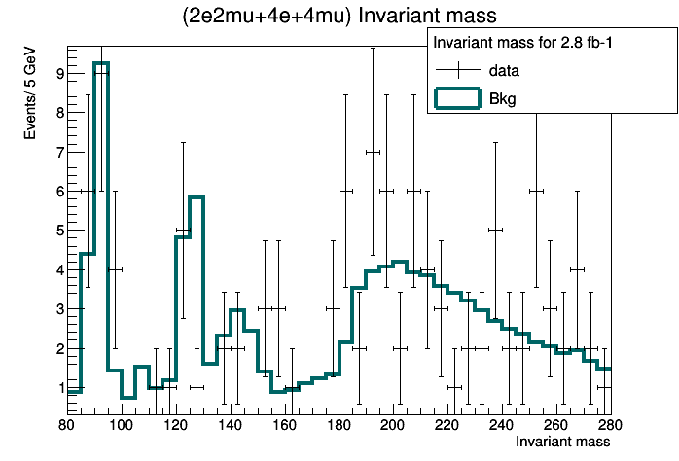
Invariant mass of the four leptons
The peak at 125GeV suggest Higgs production

Slide 16
Conclusion
There is no significant missing E_{T} in the 2015 data
The data is well modeled by the standard model background
We need a lot more data to have significant sensitivity in this channel
Advanced Multivariate Analysis should improve signal/background separation and sensitivity

Slide 17
Acknowledgments
Supervisors:
Dr. Pushpa Bhat
Dr. Nicola De Filippis
My Mentors
Mr. Gustavo Cancelo
Mr. David W. Peterson
Ms. Sandra Charles
Ms. Judy Nunez
Dr. Elliott Mcrory
Dr. Leonard Spiegel
Dr. Harrison Prosper
My fellow SIST interns
And my carpool

Slide 18
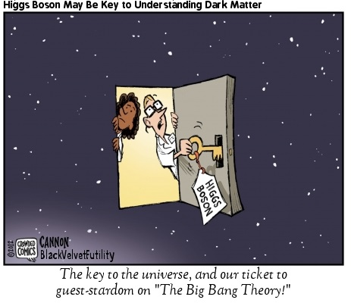
Questions?
*photo credit: www.crowdedcomics.com

