Slide 1
Modeling Quark Compositeness at the Compact Muon Solenoid
Amanda Farah, University of Pennsylvania
Dr. Lenny Spiegel and Dr. Pushpa Bhat
FNAL, CMS

Slide 2
Outline
2
Introduction:
What is compositeness? How do we find it?
How much energy does it take to see compositeness?
Methods:
Invariant mass spectra
Collins-Soper Angle
Figuring out the minimum energy it must take to see compositeness
Concluding remarks and acknowledgments

Slide 3
Introduction
3
What is compositeness and How do we find it?
Notes:
I’m sure you’ve all heard about CMS and that other people have talked/will talk about it, so I’m not going to go into it. But basically it is a huge detector at the LHC that is really good at detecting muons that come out of collisions

Slide 4
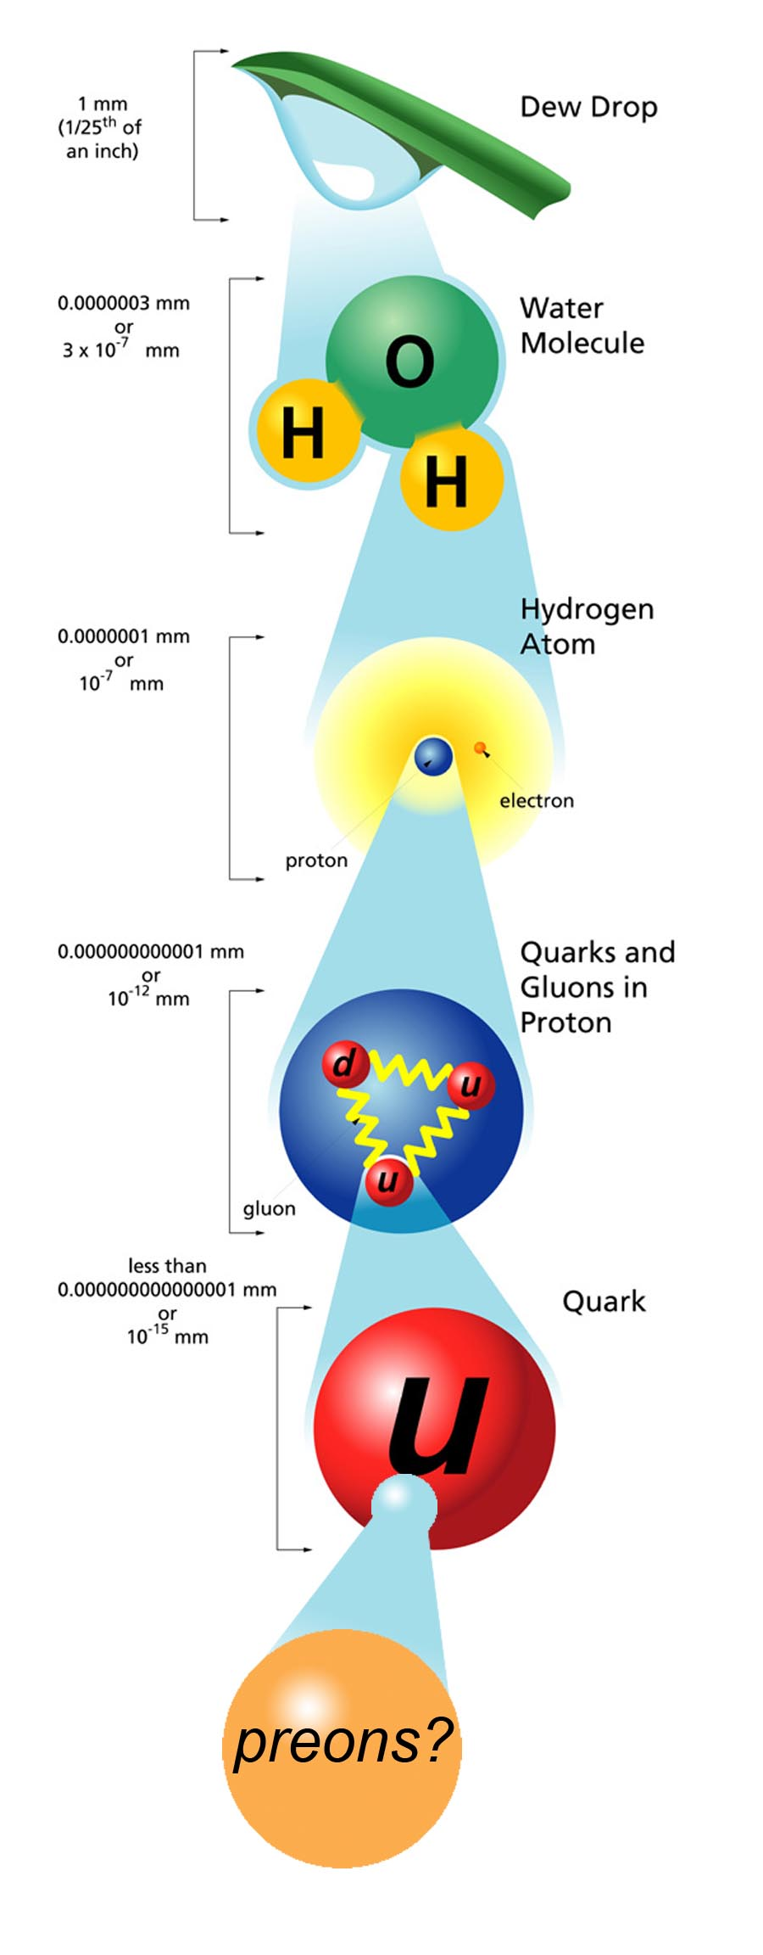
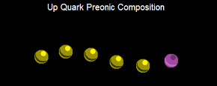
Compositeness is the idea that quarks and leptons are made up of even smaller particles
4
A A A A A B
These smaller particles are called preons.
Notes:
Why haven’t we found preons yet? They must be held together very strongly. It takes a certain amount of energy to pull them apart

Slide 5
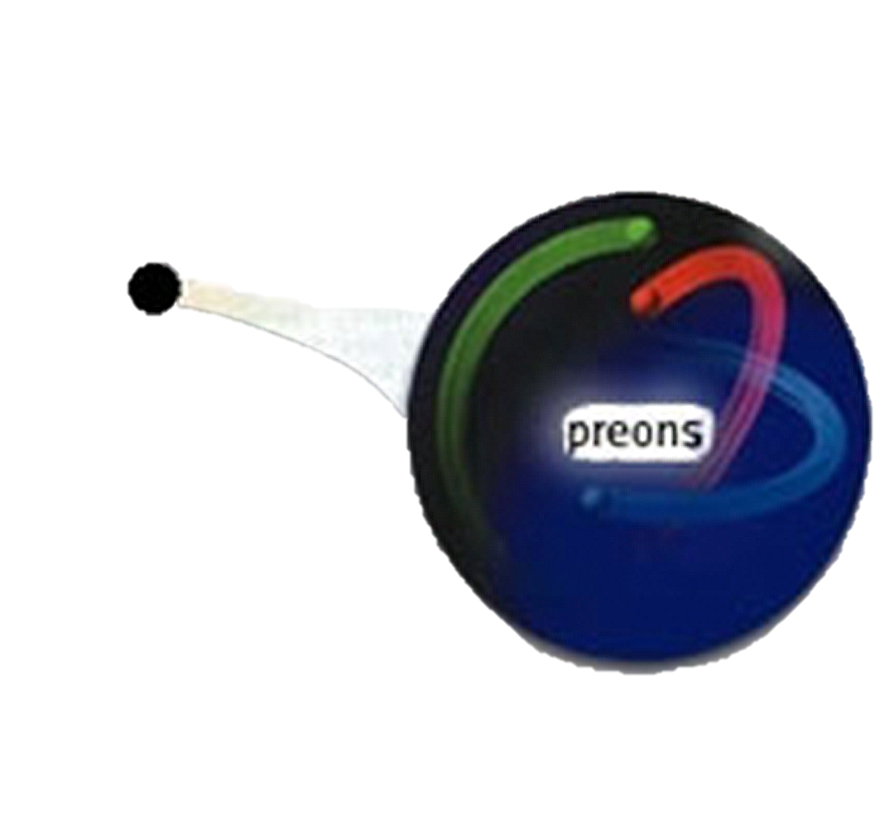
Λ : Compositeness Energy Scale
5
Similar to the energy that it takes to pull quarks apart into preons
Energy at which we can detect evidence of
compositeness
quark
Notes:
Energy at which we can detect CI
Kind of like activation energy or binding energy

Slide 6
What Compositeness Predicts
6
Contact Interactions (CI)
Instead of transferring a particle, preons make direct contact with each other
Quark and antiquark each give a preon, which interact to give a muon and antimuon
If CMS finds CI, this shows that compositeness exists
time

Slide 7
Background: Drell-Yan
7
Drell-Yan (DY) process is the main background
Also has $q\overline{q}→μ\overline{μ}$
Cant see Z/γ*
Find other methods to differentiate

Slide 8
Methods
8
How Do we use computer simulations to Learn about contact interactions?

Slide 9
Invariant Mass Spectra
9
Mass of the two muons
CI makes more high mass events than DY
Invariant mass is related to energy

Slide 10
Λ : Compositeness Energy Scale
10
Similar to the energy that it takes to pull apart quarks into preons
Energy at which contact interactions occur
Unknown
Different values of Λ predict different signals for CI
quark
Notes:
Energy at which we can detect CI
Kind of like activation energy

Slide 11
Invariant Mass Spectra
11
If Λ is high, there are fewer high mass events and the invariant mass spectrum for contact interactions is hard to distinguish from that of the Drell-Yan process.
Need to look at high mass events to see the difference

Slide 12
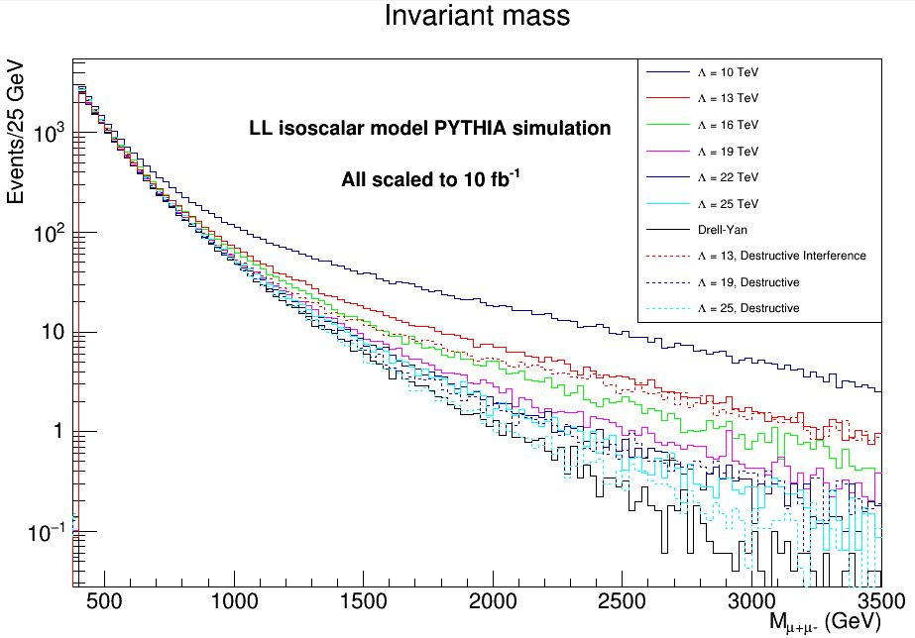
Limiting Λ
12
Want to find highest Λ that we would be able to differentiate from DY given our systematics and number of events
Look at background to signal ratio (r)
If r = 1, can’t tell apart background (DY) and signal (CI)
signal
background
Notes:
In the case that we don’t see CI
Lambda = 19.1 TeV

Slide 13
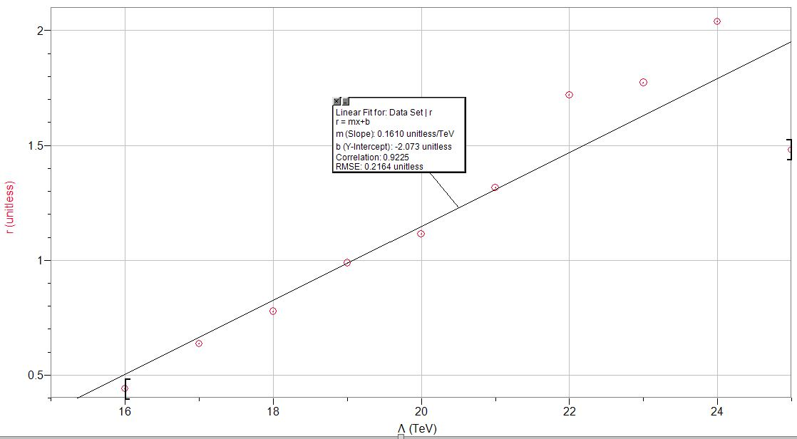
Limiting Λ
13
r vs. Λ
Λ = 19.01 TeV
Notes:
Table in backup slides
This is an estimate that only takes in one kind of signal (the mas spectrum) into account. We can look at other signals as well – Collins-soper frame angle

Slide 14
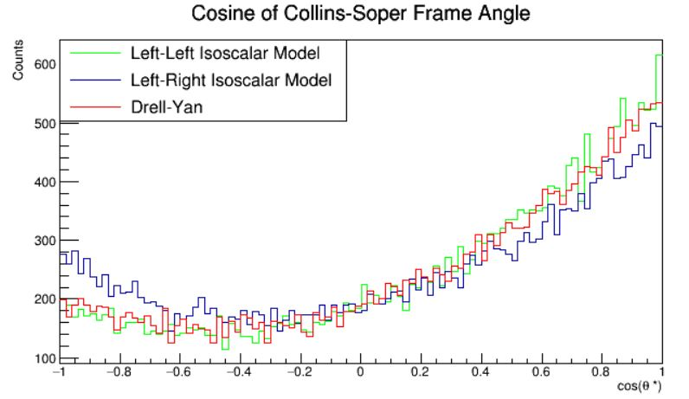
Collins-Soper Frame Angle θ
14
x
μ-
x
θ
μ-
z
μ+
θ
z
Not symmetric around zero (more positive events than negative ones)
LL and DY look similar, but LR looks different
This difference is more exaggerated at higher mass events
μ+
25k events per line
Λ = 14 TeV
Minimum mass cut of 400 GeV
Notes:
CS frame is a “reference frame” its just like pretending we are moving along with the two muons so they look like they have the same speed as each other but in opposite directions.
The CS angle is the angle that the negative muon makes with the z axis in the CS frame.
this asymmetry is more pronounced for Drell-Yan events than for LR contact interaction events
Determining the asymmetry of $\cos\theta$ for dimuon events can aid in differentiating between CI and DY in the case where the LR model is true.

Slide 15
Forward-Backward Asymmetry
15
Measure of cosθ asymmetry around zero
$A_{FB}=\frac{N_{F}−N_{B}}{N_{F}+N_{B}}$
$N_{F}$ = number of events with cos(θ) > 0
$N_{B}$number of events with cos(θ) < 0
CI (signal) and DY (background) are most differentiable at high mass events, so we plot $A_{FB}$ as a function of mass
Notes:
it is necessary to define a quantity called the forward-backward asymmetry, A_{FB}, which is a measure of the asymmetry of the CS angle distribution
This will help us spot CI if the LR model is true
CI and DY are most differentiable at high mass events
We therefore plot $A_FB$ as a function of mass
this gives a clear distinction b/w DY and LR model of CI if we have high mass events
If we are lucky and nature happens to work this way (i.e. if things are composite and LR) then this will be a good signal. However, if we don’t see this, it does not mean that compositeness doesn’t exist or help us put a limit on it – it could still be LL or RR

Slide 16
Concluding Remarks
16
Notes:
Code I am leaving

Slide 17
Acknowledgements
17
My supervisors, Dr. Lenny Spiegel and Dr. Pushpa Bhat
Judy Nunez, Sandra Charles, Dr. Elliot McCrory, Mayling Wong-Squires, Charles Orozco, and the rest of the SIST program
Dr. Steve Mrenna, an author of PYTHIA
Also a shout-out to Shawn Zaleski
Tamra - my cubicle buddy!

Slide 18
Modeling Quark Compositeness at the Compact Muon Solenoid
Amanda Farah, University of Pennsylvania
Supervisors: Dr. Lenny Spiegel and Dr. Pushpa Bhat
FNAL, CMS

Slide 19
References
22
Kottachchi, Chamath. "SEARCH FOR CONTACT INTERACTIONS USING THE DIMUON MASS SPECTRUM IN P-P COLLISIONS AT √ S = 8 TeV AT CMS." Diss. Wayne State U, 2014.
Nagashima, Yorikiyo. 2013. Elementary Particle Physics Vol.2: Foundations of the Standard Model. Weinheim, Germany: WILEY-VCH.
The ATLAS Collaboration. 2014. Search for contact interactions and large extra dimensions in the dilepton channel using proton-proton collisions at √s = 8 TeV with the ATLAS detector. Eur. Phys. J. C. (2014) 74:3134

Slide 20
Limiting Λ
Λ (TeV) | 16 | 17 | 18 | 19 | 20 | 21 | 22 | 23 | 24 | 25
CI Yield (events) | 92.741 | 80.183 | 75.120 | 70.202 | 68.155 | 65.725 | 62.493 | 62.181 | 60.874 | 64.157
DY Yield (events) | 52.095 | 52.095 | 52.095 | 52.095 | 52.095 | 52.095 | 52.095 | 52.095 | 52.095 | 52.095
Difference in Yield (events) | 40.645 | 28.088 | 23.025 | 18.106 | 16.060 | 13.630 | 10.397 | 10.086 | 8.779 | 12.062
r = noise/signal (expected) | 0.440 | 0.635 | 0.777 | 0.988 | 1.113 | 1.316 | 1.719 | 1.773 | 2.039 | 1.481
Λ = 19.01 TeV

Slide 21
Collins-Soper Frame Angle θ
12
Tells us about the “angular distribution” of the muons’ momentum
This distribution is different for different models of compositeness
One of these models has a different distribution than the background does
But what is this angle?

Slide 22
Collins-Soper Frame Angle θ
13
C
C
2
Two Lorentz boosts:
Proton center of mass frame to * frame
Boost along z-axis
Eliminate muon z-momentum
* frame to center of mass frame of dimuon system (Collins-Soper frame)
Boost along opposite direction of muon transverse momentum (Q_{T})
Eliminate rest of muon momentum
θ Is the angle that the muons make with the z-axis of the Collins-Soper (CS) frame
1
A
B
Notes:
Cliff notes: if you didn’t understand the SR, just know that the CS frame is a special point of view and theta is an angle in that point of view that depends on which direction the muons are going in

Slide 23
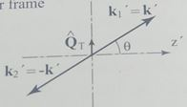
Collins-Soper Frame Angle θ
Lepton -
Total lepton
momentum
Lepton +
Lepton +
Proton 1
Proton 2
Lepton -
Lab Frame
Collins-Soper Frame
θ Is the angle that the muons make with the z-axis of the Collins-Soper (CS) frame
*Nagashimi, Elementary Particle Physics

Slide 24
Collins-Soper Frame Angle θ
14
Want to be able to calculate it in of lab frame variables
Things the CMS detector can directly measure from its point of view
Notes:
Pz is the dilepton momentum in the z direction
P1, p2 +/- are related to the z momentum and E of the individual leptons

Slide 25
Forward-Backward Asymmetry
16
Sea quarks have less z momentum than valence quarks
Valence quarks: up, down quarks that “make up” structure of proton
Sea quarks: quarks that briefly pop in and out of existence within the proton
Antiquark always comes from sea (no anti valence quarks)
Notes:
Kinematics are complicated and hard to explain, but this is the basic idea. CS angle is always defined wrt the negative lepton

Slide 26
Workflow
19
Event Generation
PYTHIA
Presentation
ED Analyzer
Analysis
Histogram Maker
Notes:
Cliffnotes version

Slide 27
Importance of Simulation
7
In order to properly analyze real data when it is available, need to understand what we would expect to see in every scenario
This study was entirely simulation based
Verify software works before simulate whole detector
Develop analysis methods using simulated data and then use them on real data
Know what we expect to see, provides objective checks

Slide 28
Goals
8
Short Term (summer)
Long Term (CMS’ future)
Gain strong understanding of backgrounds
Strengthen methods to look for signal
Create and analyze simulation against which to compare real data
Verify software in order to submit full-detector simulation request
Develop statistical tools to use for later analysis of real data
Find evidence for compositeness
OR
set a strong lower limit on the energy scale at which it will be detectable

