Slide 1

Analysis of Beam Emittance for the Booster at Injection and Extraction
Demetrius Andrews
Virginia Tech/SIST
August 16, 2016

Slide 2
Introduction to Particle Accelerators
Machines that use electromagnetic fields to propel charged particles
Particles can travel near the speed of light
Typically classified into two categories:
  Linear Accelerators
  Circular Accelerators
Acceleration in linear accelerators comes from electrostatic fields or RF (radio-frequency) cavities
Movement in circular accelerators are more magnet dependent, while acceleration still comes from electrostatic fields or RF (radio-frequency) cavities

Slide 3
Fermilab Accelerator Complex
RF quadrupole (RFQ) -Provides particle beam for accelerators
  Accelerates 35 keV to 750 keV
LINAC-Linear Accelerator
  Increases energy to 400MeV
Booster- Synchrotron
  Max energy up to 8 GeV
Recycler- Staging area for the beam
  Beam combined into batches of protons
Main Injector- Directly below the Recycler
  Energy rises from 8GeV to 120GeV
Muon Delivery Ring- Proton beam used to produce pions
  Will be used for Muon g-2 and Mu2e experiments
Fermilab Accelerator Science and Technology(FAST) Facility

Slide 4
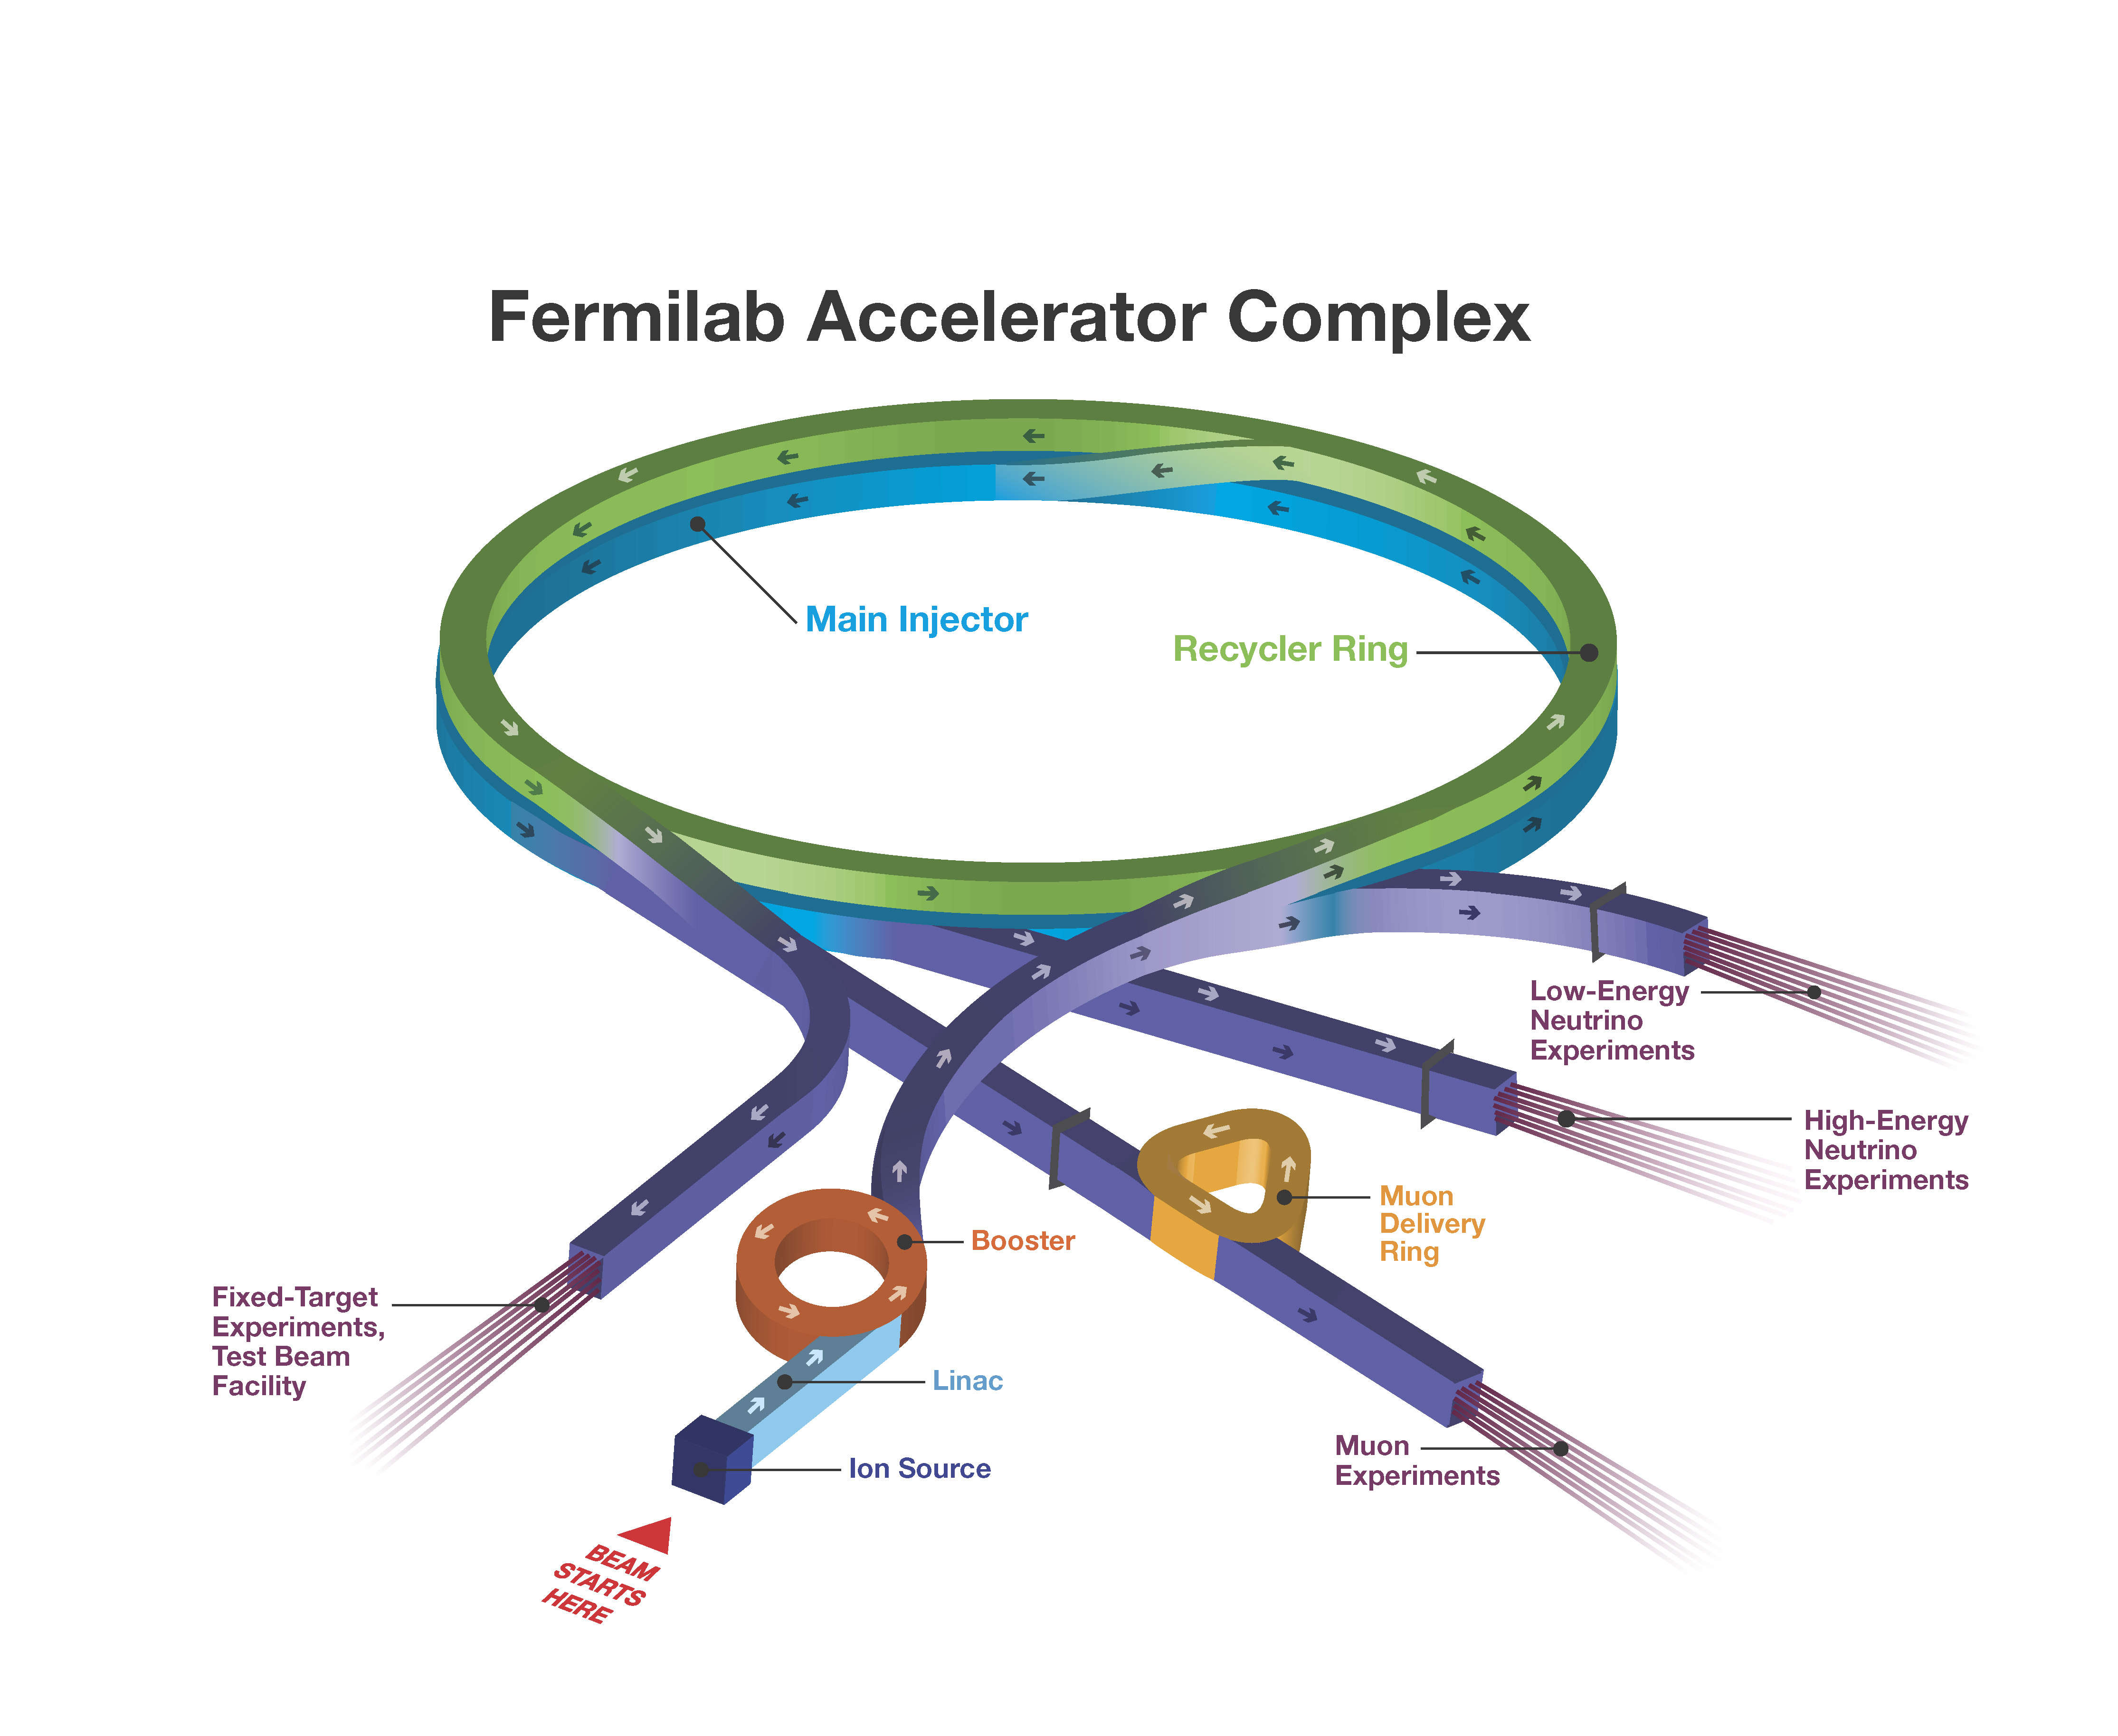
Accelerator Complex Diagram

Slide 5
Booster Overview
The Booster is placed after the LINAC
Accelerates charged particles from 400 MeV to 8 GeV
Provides beam for MicroBooNe and the Recycler
Will provide beam for Muon g-2, and Mu2e
A form of a circular accelerator called a synchrotron
Synchrotrons accelerate particles by using varying RF and Magnetic fields
Important feature of synchrotrons is phase focusing

Slide 6
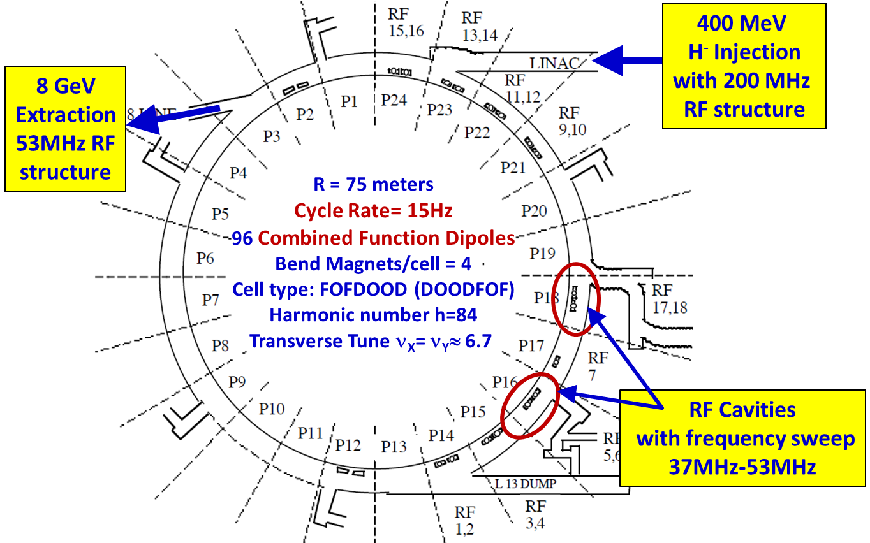
Schematic for the Booster
Beam stays for 33 us
Travels around in 2 us

Slide 7
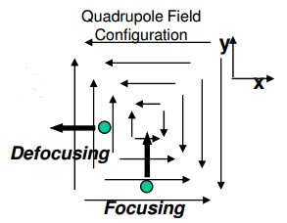
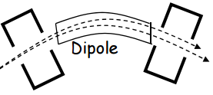
Phase Focusing
Combination of dipole and quadrupole magnets
Dipole magnets are used to bend the beam
Quadrupole magnets are used to focus the beam both vertically and horizontally
Higher order magnets can also be used

Slide 8
Aspects of Longitudinal Beam Dynamics
Coasting Beam with Energy E₀±ΔE
Bunch Compression
Closed Orbit
Beam
Storage Ring
Beam Pipe &
the Beam
Ω
Ω
Bunched Beam
Phase-space Area of a Bunch is
Longitudinal Emittance
Measured in eVs
RF Cavity
RF
Buckets
AC
RF Buckets
Sinusoidal
AC
Sinusoidal
AC
Vrf
RF Bucket
Boundary
Sinusoidal
Vrf
Vrf
Vrf
ΔE
t
ΔE
t
ΔΕ
t
t
Beam
ωrf= hωrev
harmonic number h=2
t
ω_{rf}= hω_{rev}
harmonic number h=2
ω_{rf}= hω_{rev}
harmonic number h=1
Vrf
A contour of
constant Hamiltonian
Synchronous Particle
From Dr. Chandra Bhat
WCM Data
WCM Data
8/16/2016
Demetrius Andrews | Analysis of Beam Emittance at injection and extraction

Slide 9
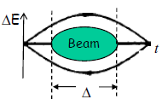
Beam Emittance
Property of a charged particle beam
Measures the average spread of particle coordinates in position and momentum phase space
Area of ellipse containing 95% of particles in the interior
Measured in eV-s

Slide 10
Project Overview
Goal was to write a Python and ACNET application program to measure longitudinal emittances at inj. and ext.
Written in Python coding Language
Take 2 traces of raw data from the Booster scope at 3 channels
  Wall Current Monitor (WCM)
  RF Voltage
  Radial Position
Locate proper position on WCM to be analyzed at injection and extraction
Fast Fourier Transform (FFT) to find frequency and period
Find Bunch Length
Calculation of longitudinal emittance

Slide 11
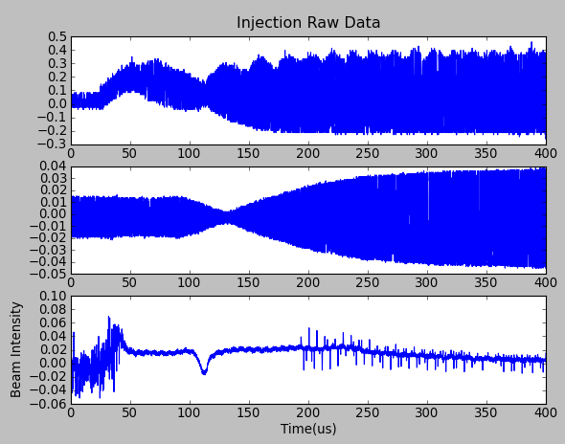
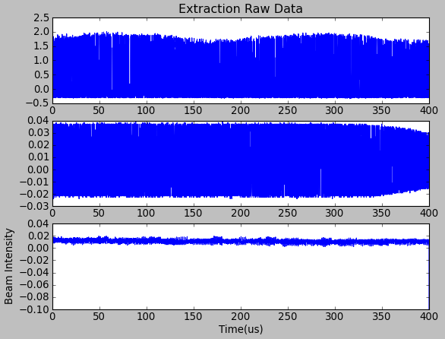
Plots of Raw Data

Slide 12
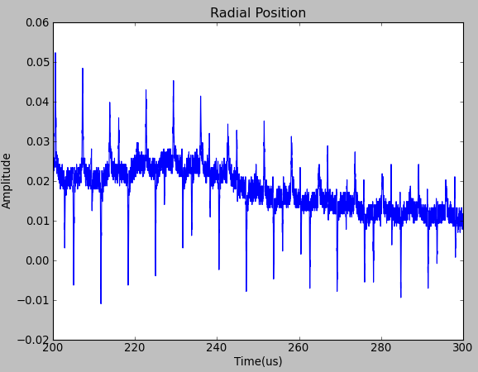
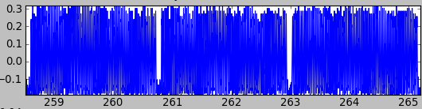
Magnified View of Raw Data
Radial position that locates injection region of WCM
Shows where the bunch notches are formed
Example of Bunch Formation
Dip due to Radial Position

Slide 13
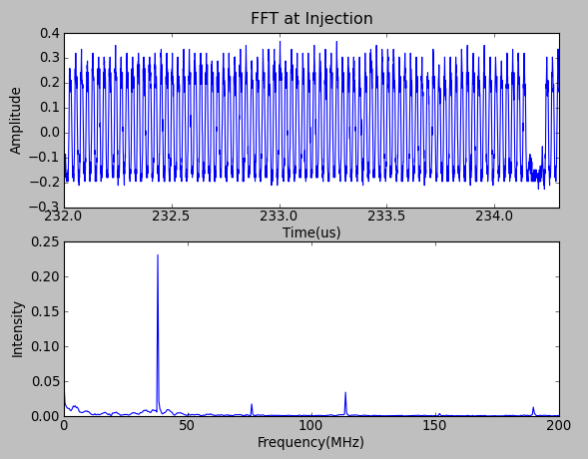
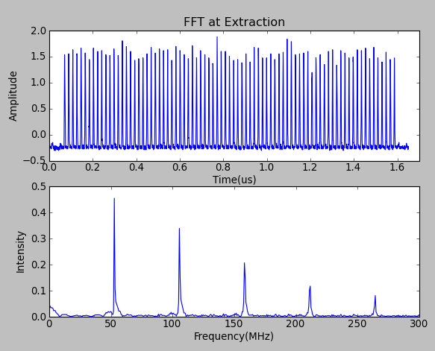
Magnified View of Raw Data cont.
Injection: Freq = 37.9MHz, Trev = 2.21 us
Extraction: Freq =52.7MHz, Trev = 1.59 us

Slide 14



Equations
Bunch Length Formula:
Longitudinal Emittance:
= 4*sigma
Bucket Height:
Beam Height:
To = rev period
Lambda = 3
= Voltage magnitude
BH = Bucket Height X sin( )

Slide 15
Results
Booster Turns | Emittance(eV-s) |  | Beam Height(MeV)
 | Injection | Extraction | Injection | Extraction
8_1 | 0.027 | 0.101 | 1.535 | 16.633
8_2 | 0.0274 | 0.1042 | 1.54 | 16.882
10_1 | 0.02603 | 0.1037 | 1.503 | 16.856
10_2 | 0.02686 | 0.1051 | 1.525 | 16.953
12_1 | 0.02552 | 0.1163 | 1.489 | 17.838
12_2 | 0.02525 | 0.1104 | 1.481 | 17.367
13 | 0.02 | 0.1347 | 1.327 | 19.162
14_1 | 0.02531 | 0.1311 | 1.483 | 18.918
14_2 | 0.02607 | 0.1208 | 1.504 | 18.151
16_1 | 0.02664 | 0.1248 | 1.519 | 18.459
16_2 | 0.02686 | 0.1271 | 1.525 | 18.629
18_1 | 0.02685 | 0.1387 | 1.525 | 19.436
18_2 | 0.027 | 0.132 | 1.529 | 18.983
Intensity | Emittance(eV-s) |  | Beam Height(MeV)
 | Injection | Extraction | Injection | Extraction
2.64E12ppc | 0.027 | 0.103 | 1.5 | 16.8
Half Deviation | 0.0002 | 0.0016 | 0.0025 | 0.1245
3.38E12ppc | 0.026 | 0.104 | 1.5 | 16.9
Half Deviation | 0.000415 | 0.0007 | 0.011 | 0.0485
4.02E12ppc | 0.025 | 0.113 | 1.5 | 17.6
Half Deviation | 0.000135 | 0.00295 | 0.004 | 0.2355
4.78E12ppc | 0.026 | 0.123 | 1.5 | 18.5
Half Deviation | 0.00038 | 0.00515 | 0.0105 | 0.3835
5.26E12ppc | 0.027 | 0.126 | 1.5 | 18.5
Half Deviation | 0.00011 | 0.00115 | 0.003 | 0.085
5.58E12ppc | 0.027 | 0.135 | 1.5 | 19.2
Half Deviation | 7.5E-05 | 0.00335 | 0.002 | 0.2265

Slide 16
Acknowledgements
Supervisors:
  Dr. Chandra Bhat
  Brian S. Hendricks
SIST Mentors
  Jodi Coghill
  William S. Freeman
SIST Committee

Slide 17
Questions?

