Slide 1
ADC Transmission
Mauricio Villa
GEM Fellow, Duke University
16 August, 2016

Slide 2
Outline
ADC Introduction
ADC Transmission Options
BRECOFlex Belts
NEXEN Roller Pinion Gear
Conceptual Design of Motor Platform
Questions

Slide 3
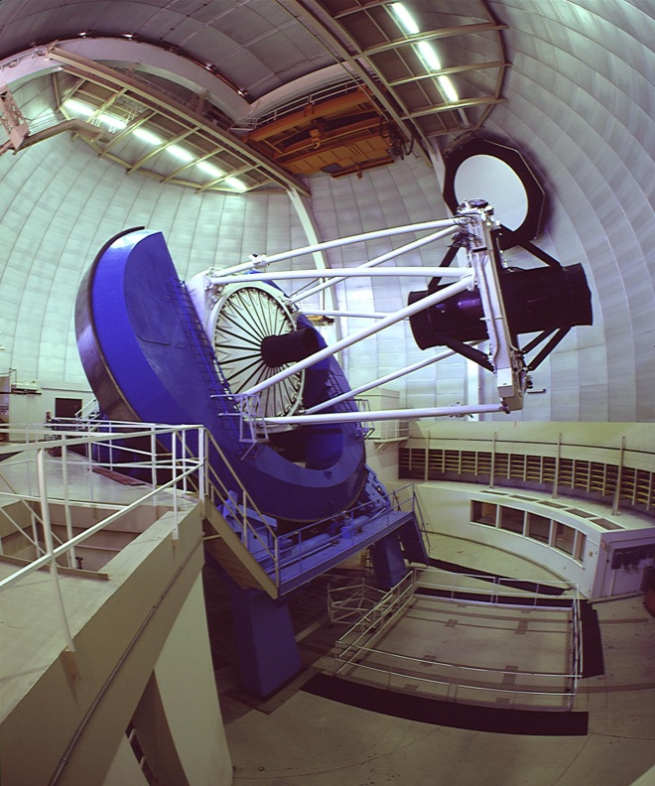
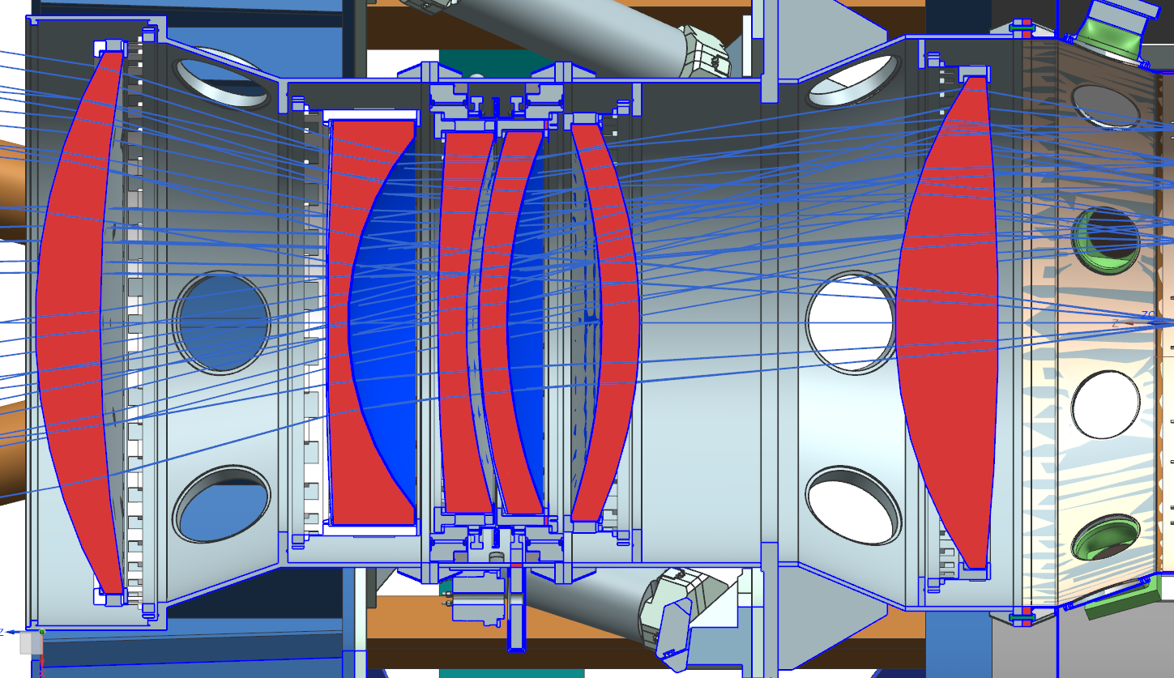
ADC Introduction
DESI -- Dark Energy Spectrographic Instrument
Mayall Telescope at Kitt Peak, AZ
ADC -- Atmospheric Dispersion Corrector lens
There are 2 lenses used to correct for light dispersion caused by the atmosphere

Slide 4
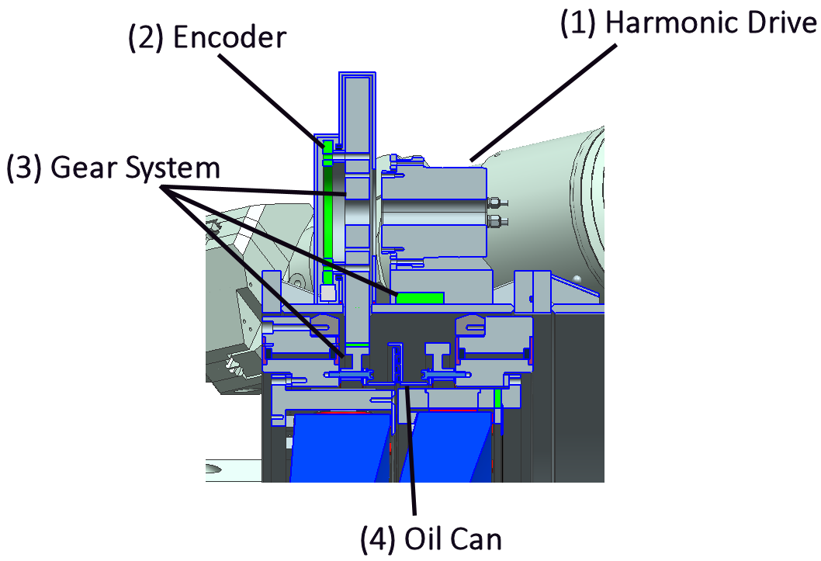
ADC Introduction: Specifications
Harmonic Drive
Bearing
Bearing
Lens
Lens

Slide 5
ADC Introduction: Specifications
Description | Value
Rotational Load (ADC lens, cell, bearing and fasteners) | Weights = 214 kg (472LBS) wr^2 = 40.8 kg-m^2 (968 Lb-ft^2)
Starting Torque | 100 Nm (885 LB-in)
Running Torque | 80 Nm (708 LB-in)
Driven Gear Rotation Speed range | 0 to 10 degrees/sec (0 to 1.7 rpm)
Rump-up/down | Max 3 seconds
Lifetime | 155,000 duty cycles over a 5 year period
Idle time | months
Accuracy on the rotation | +/- 0.1 degree
Tangential Backlash | NONE if possible
Gear centers distance | 584mm +3mm/0 or (23.000” +0.125”/0)
Driven gear addendum diameter | 951mm 0/-3mm or (37.450” +/-0.125”)
Material | Steel/Plastic
Protection from corrosion | Required
Minimum safety factor against Yield, fracture or buckling | 4.0
Optimization of weights | required
Maintenance/cleaning of gears from outside of barrel | No lubrication is HIGLY preferable

Slide 6
Outline
ADC Introduction
ADC Transmission Options
BRECOFlex Belts
NEXEN Roller Pinion Gear
Conceptual Design of Motor Platform
Questions

Slide 7
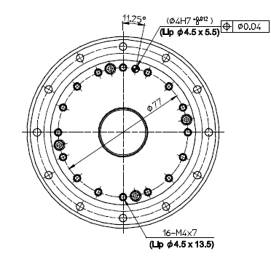
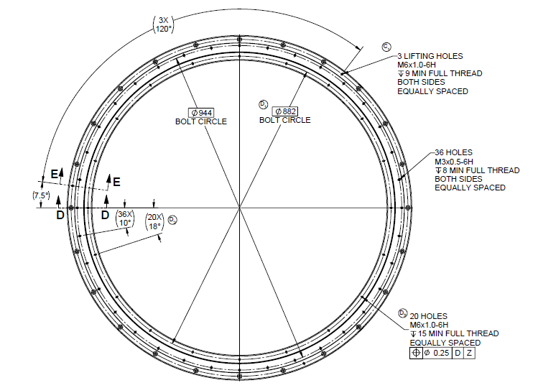
Mating specifications for Pinion and Gear
From HarmonicDrive SHA series manual
SHA25A-SG : bolt circle, bolt sizing and tolerances
From KAYDON Spec Drawing
DWG 19691A01: bolt circle, bolt sizing and tolerances

Slide 8
BRECOFlex Transmission System Components

Slide 9
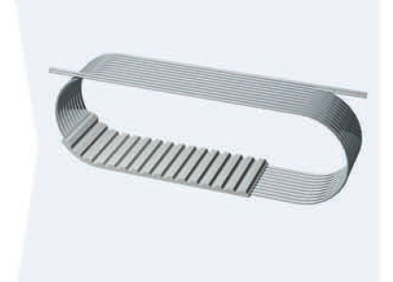
BRECOFlex Considerations
Allowable Tensile Strength
Tooth Shear Strength
Belt stiffness
Backlash, Slipping teeth
Pretension
Space constraints
Size of idlers
Width of belt

Slide 10
BRECO Flex Drive: ADC layout Configuration based on the std sizes.
allow for a belt length of 3350mm

Slide 11
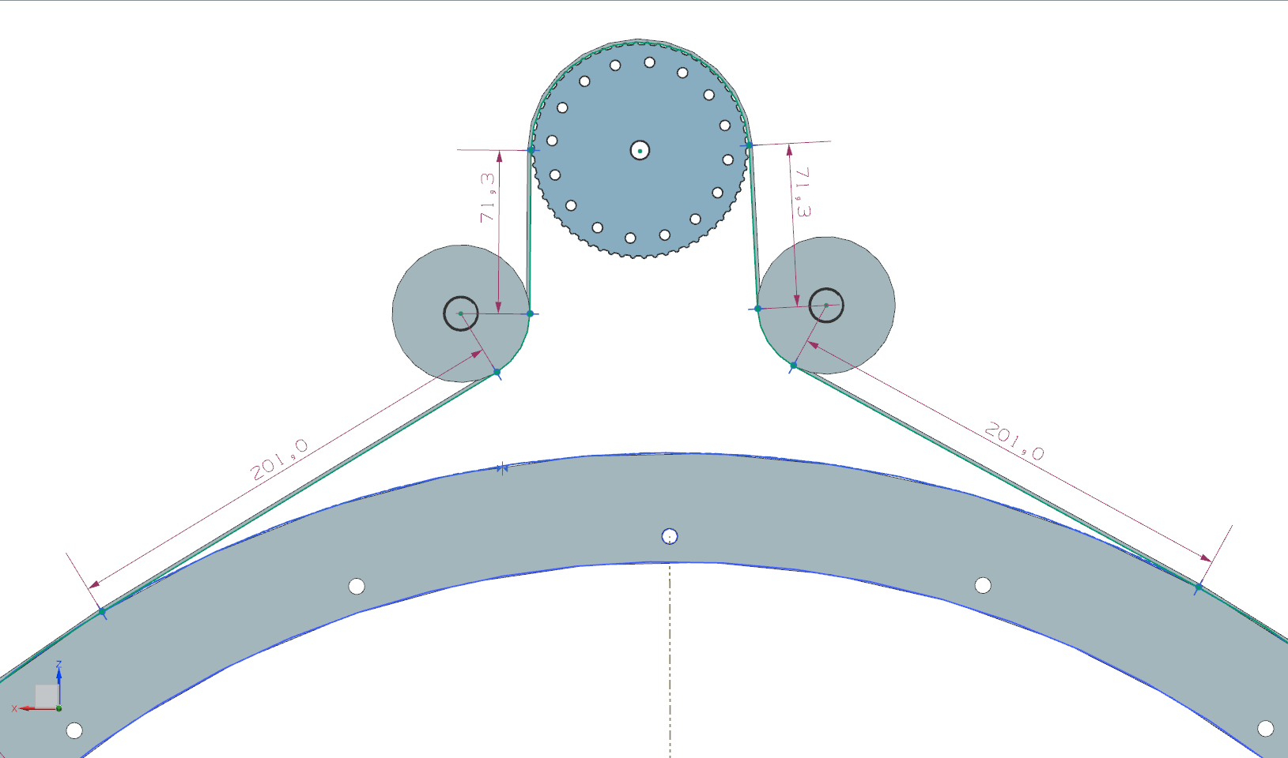
BRECO Flex Drive: ADC layout Configuration

Slide 12
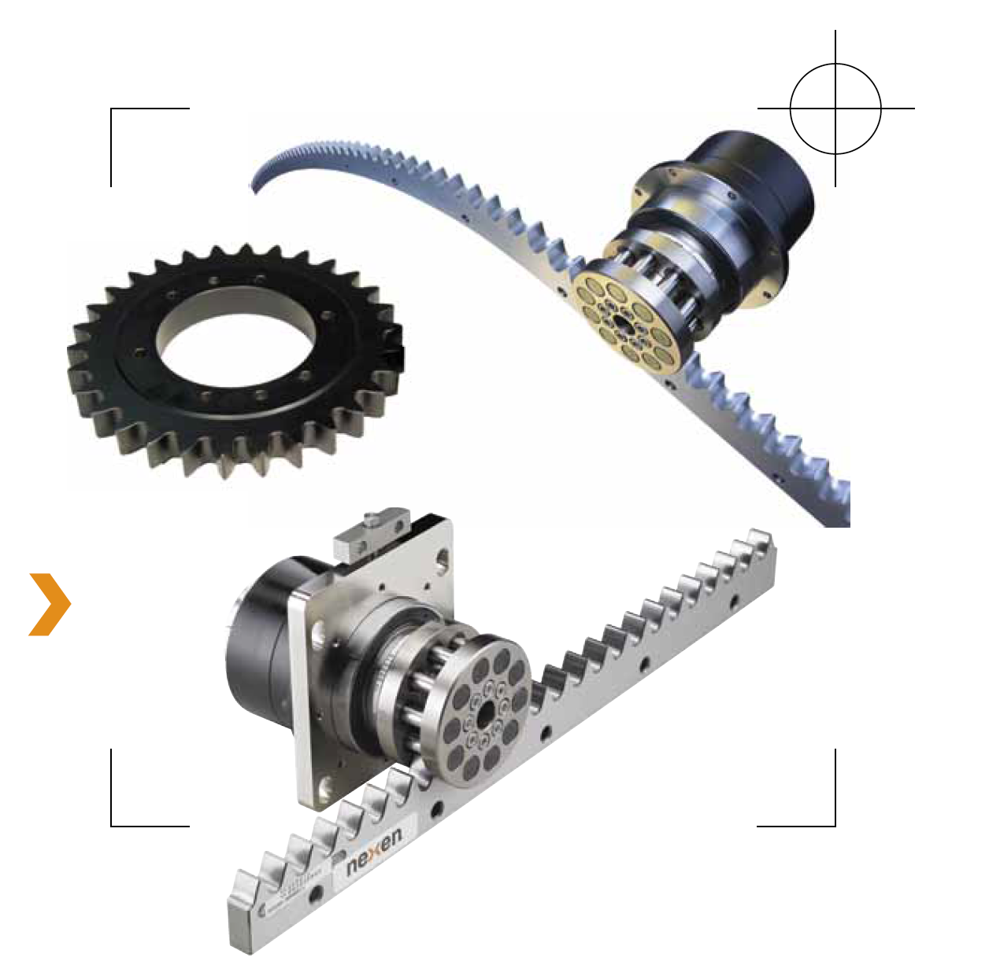
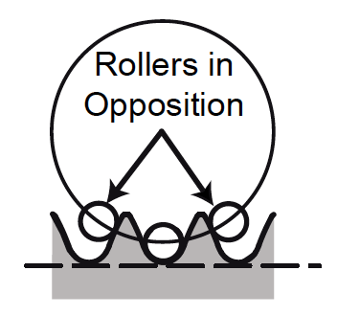
NEXEN Transmission System

Slide 13
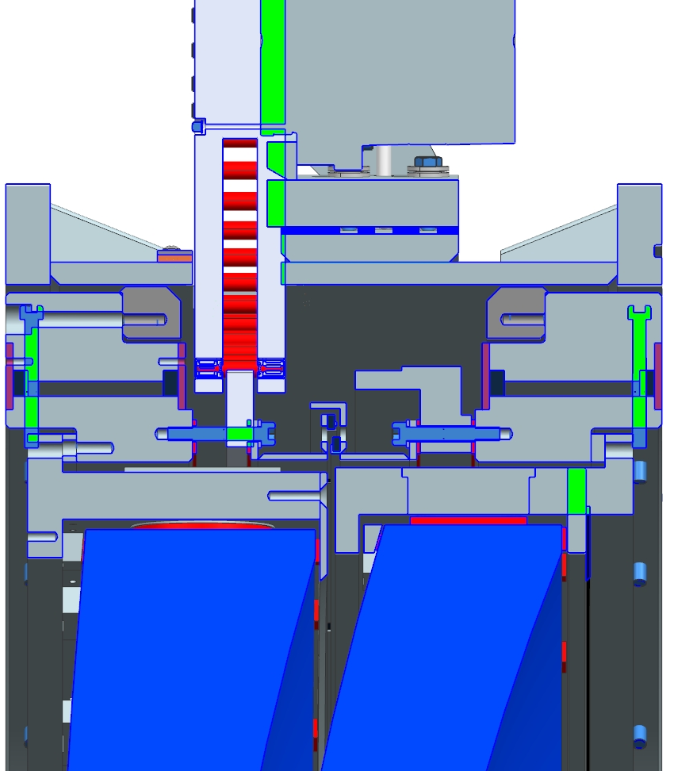
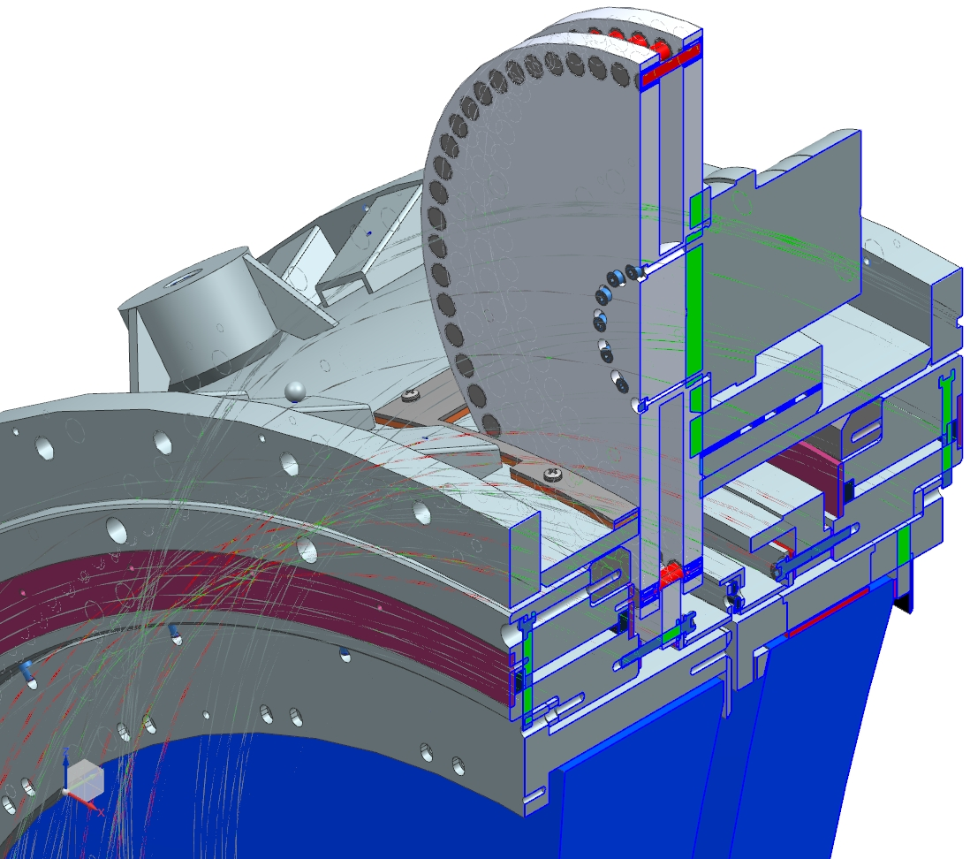
NEXEN Transmission System
NEXEN catalog options do not satisfy our size requirements.
Worked with NEXEN to develop a custom design

Slide 14
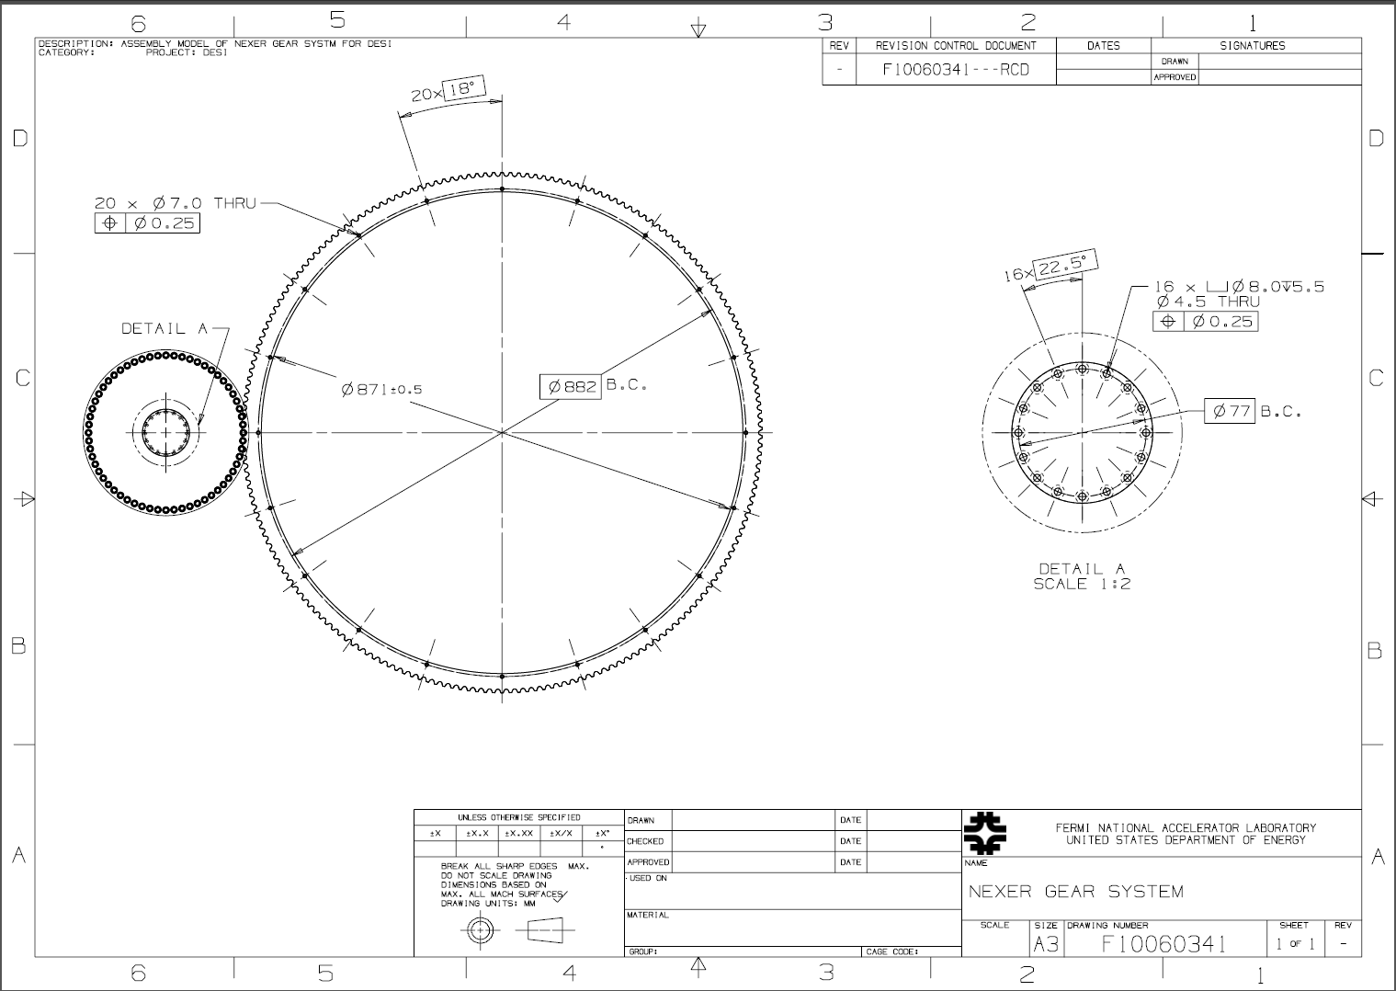

Slide 15
NEXEN and BRECOflex General Comparisons
NEXEN
Advantages
No middle section changes
High positional accuracy (up to 30 µm)
“Near zero backlash”
Easy to assembly and to do maintenance
Pinions can be replaced easily
Lifetime of 200 years of operation
Disadvantages
Gear will be done in segments
Addressed by reconfiguring oil can.
Rely on a specific company
BRECOflex
Advantages
No middle section changes
Multiple manufacturers
Disadvantages
Belt replacement poses challenges
No solid information on
Re-tensioning frequency
Belt lifetime
More components
Installation more difficult

Slide 16
NEXEN
Number of Sets | Price Per set | Total Price wo extra pinion | Price Extra Pinion per Unit | Total for this item ($k)
2
3
10-12 week delivery
Fermilab Designer – ~2 weeks (1 FTE)
Two motor and two controllers
Total
Prices are confidential!
Costs for these system are about that for a luxury car, with a difference of about $15-20k
BRECO flex
Number of Sets | Price Per set | Total Price wo extra pinion | Price Extra Belt | Total for this item ($k)
3
8 week delivery
Fermilab Designer – ~6 weeks (1 FTE)
Three motor and two controllers
Total

Slide 17
Outline
ADC Introduction
ADC Transmission Options
BRECOFlex Belts
NEXEN Roller Pinion Gear
Conceptual Design of Motor Platform
Questions

Slide 18
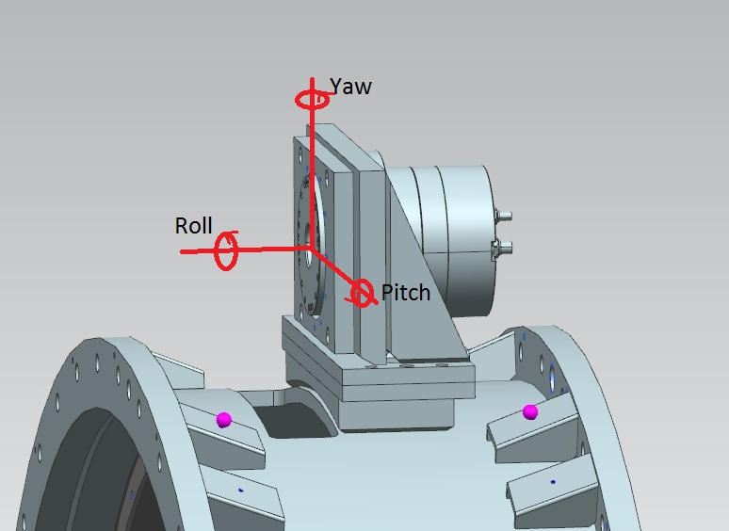
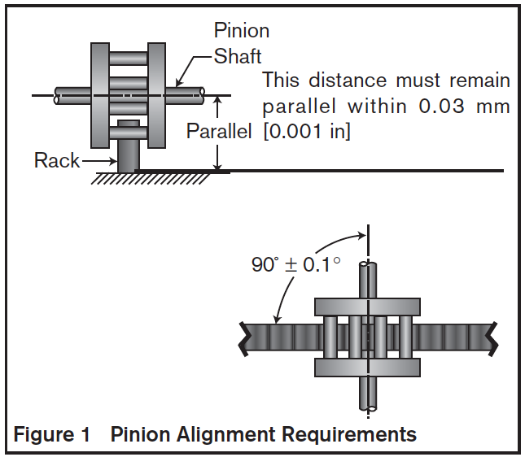
Definitions
Need to align Motor/Pinion within parallelism specifications required by Nexen
(see “How to align Nexen gear and pinion system” from Aug 1,2016 )
Within this presentation, the “Fixed plate” refers to the block already welded to the Middle Section

Slide 19
Conceptual Idea #1: Pros and Cons
Pros:
Mating with Fixed plate is straightforward
Plenty of space for connecter bolts and precision pins
Cons:
Structural strength/rigidity a concern if tack welding shims/Blue plate/Yellow bracket
Aligning Pitch and Roll simultaneously be distributing shims may prove time consuming/difficult

Slide 20
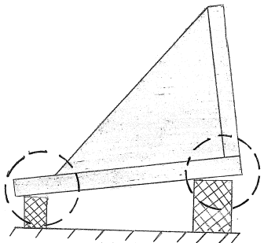
Conceptual Idea #2: Pros and Cons
Pros:
Improved structural rigidity between Yellow bracket and Blue Plate
Adjusting Pitch and Roll simple with bolt method
Cons:
Need to reduce length and width of blue plate (and Yellow bracket) to facilitate tack welding the blocks*
Determining height of blocks will require a potentially iterative process

Slide 21
QUESTIONS?
Special Thanks to…
Giuseppe Gallo and Gaston Gutierrez
Sandra Charles and Judy Nunez
The National GEM Consortium
Joe Howell and Dave Pushka
Skills Learned this summer
CAD modeling proficiency improved
Understanding of mechanical design of precision parts improved
Professional skills required in working with engineers improved
Learned how to make not-soggy (instant) oatmeal

Slide 22
http://www.gemfellowship.org/
The National GEM Fellowship…
For underrepresented US citizens in STEM
PAYS FOR GRADUATE SCHOOL
Apply during your senior year of undergrad
Valuable internships with Employer Sponsors
PAYS FOR GRADUATE SCHOOL
Fellowships for both Masters and PhD students
Living stipend during the school year
Your Fermilab network has plenty of GEM people you can talk to!
(Sandra Charles, Maurice Ball, Charlie Orozco, Chris Cameron, Miguel Marchan, Me and many other alums/employees)
mauricio.villa@duke.edu

