Slide 1
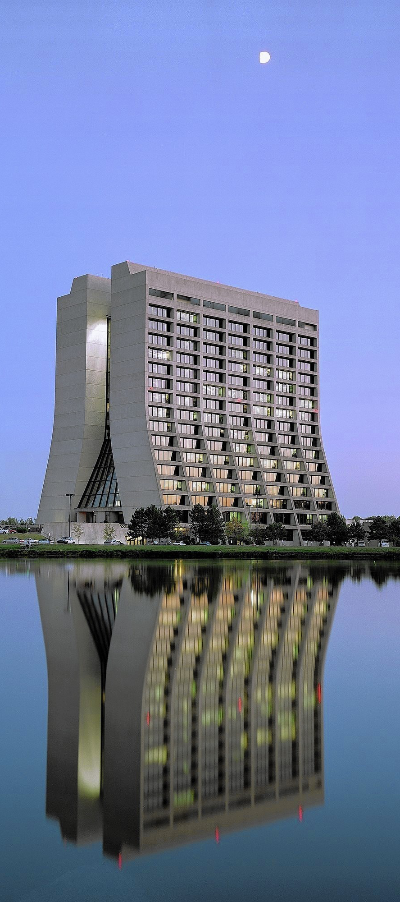
Liquid Argon Time Projection
Chamber In a testbeam
The little detector that could.

Slide 2
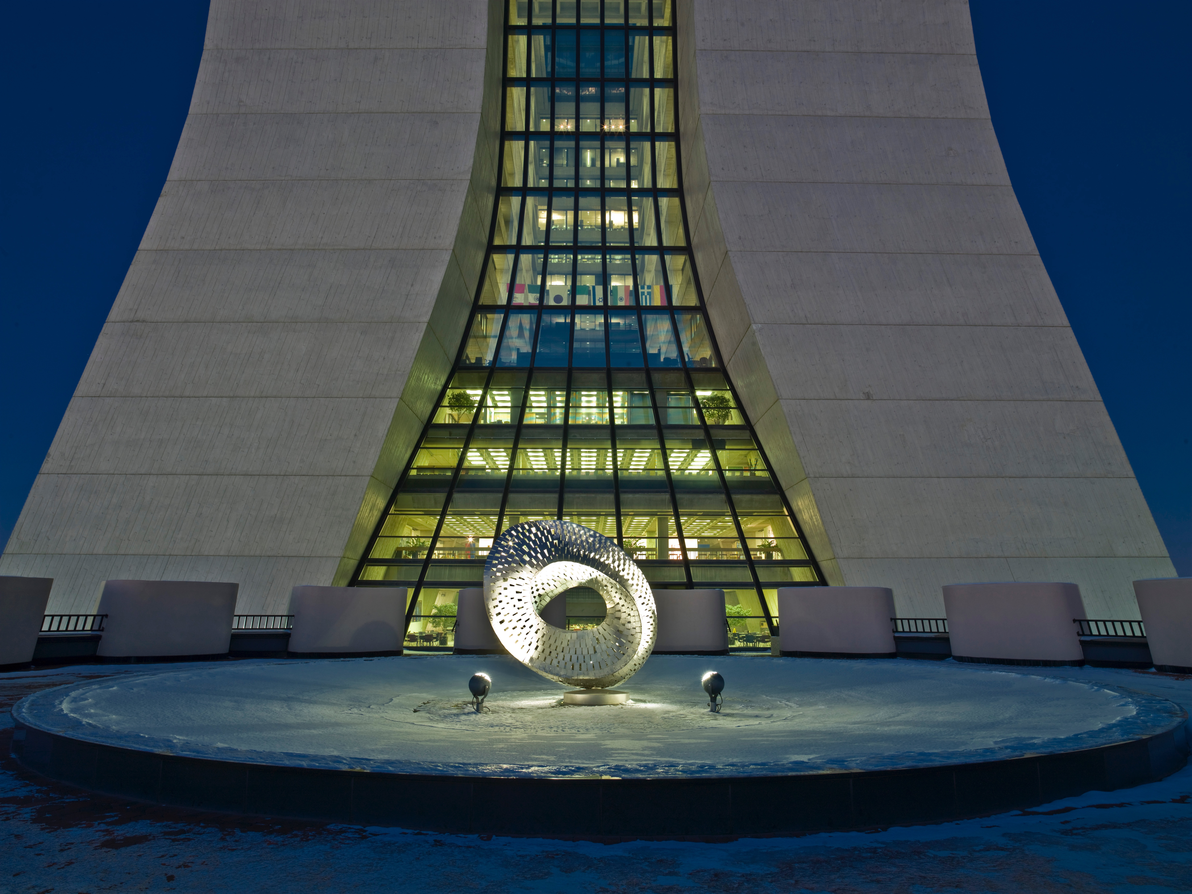
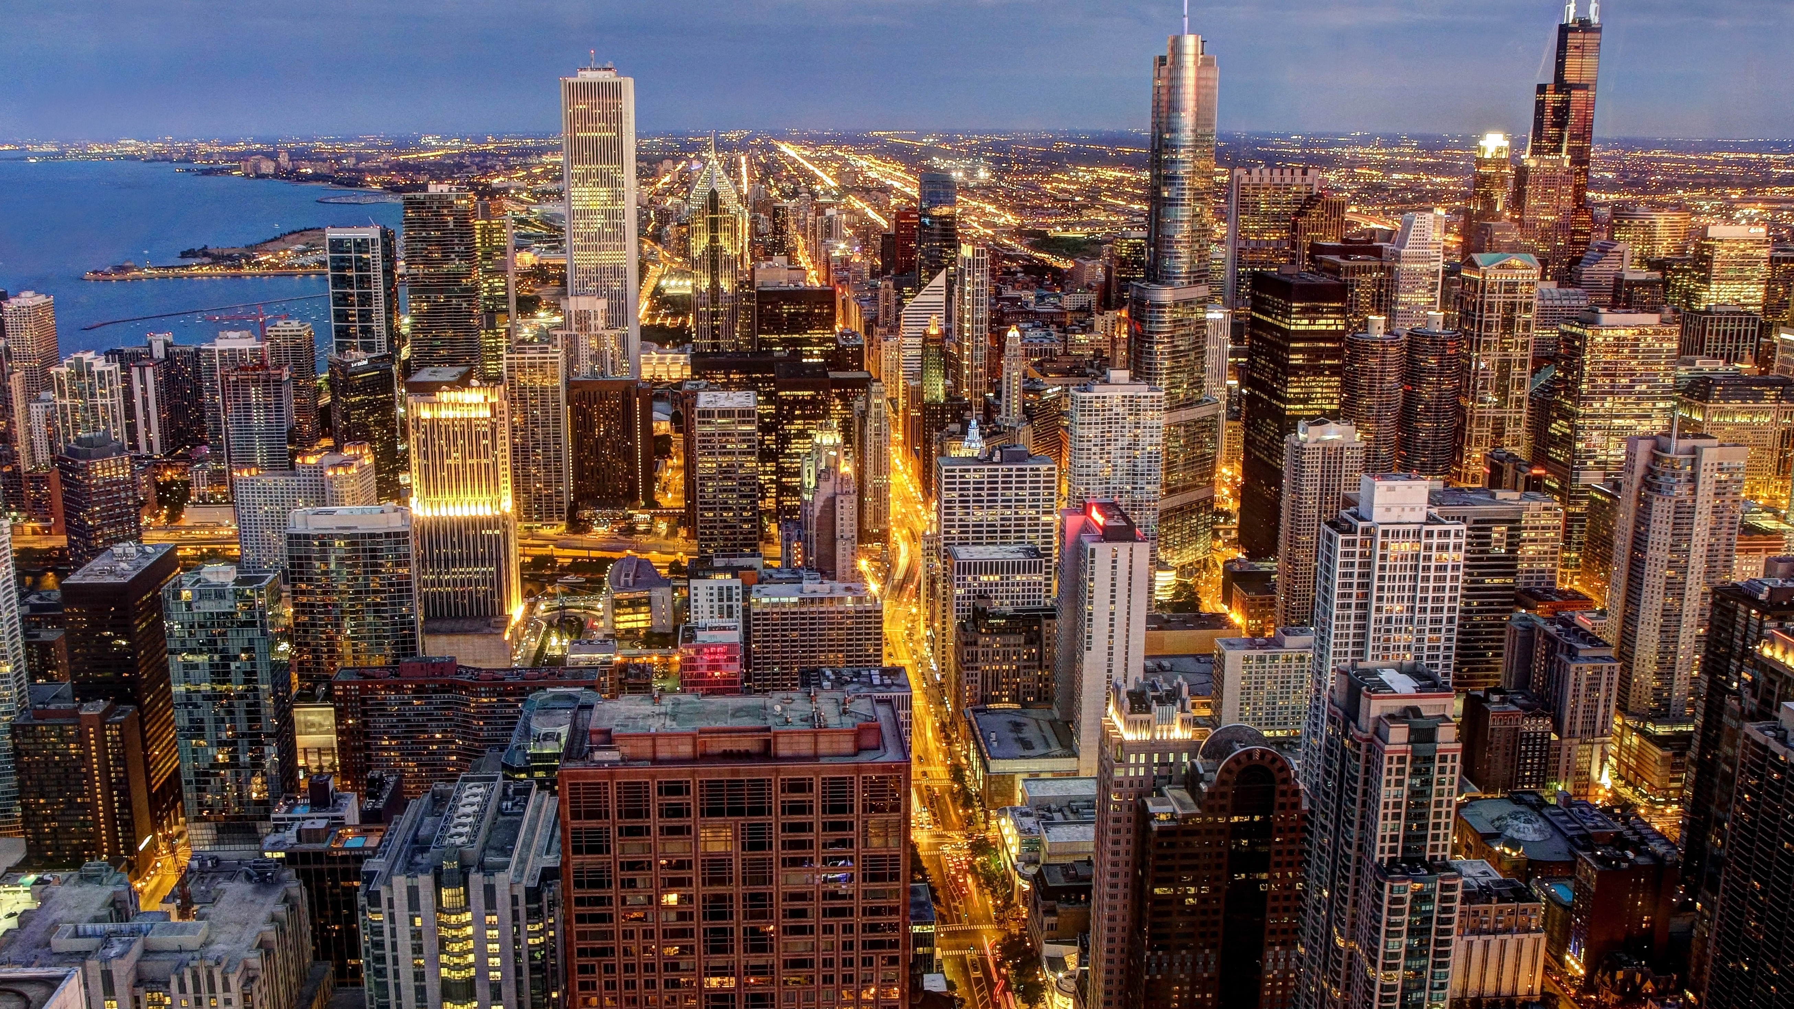
particle classification using Neural networks
Samuel Mathias Borer
The University of Maine - Orono

Slide 3
Liquid Argon in a testbeam
01
The little detector with a big heart.
“A billion Neutrinos go swimming: one gets wet.”
michael kamakana
current particle identification methods
02
Deep Learning
03

Slide 4
Liquid argon Time projection chamber in a testbeam

Slide 5
Why liquid argon?
Abundance
Argon makes up 1% of the atmosphere
Density
Liquid argon is 40% more dense than water.
Ionization
Argon can be readily ionized.
Electron Lifetime
Greek name means “inactive”
Scintillation
Produces light and is transparent to the light produced.

Slide 6
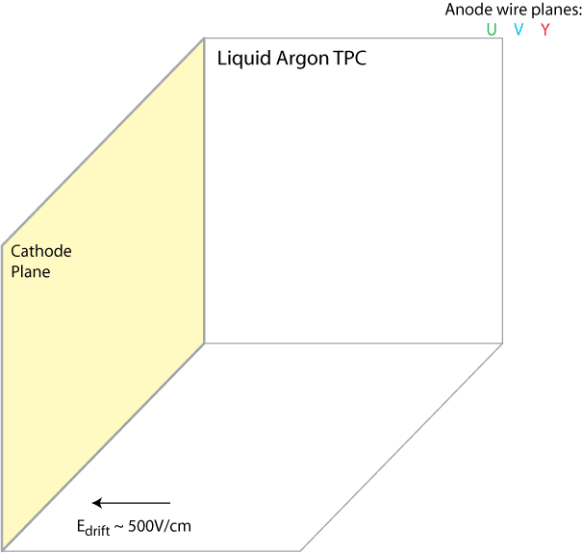
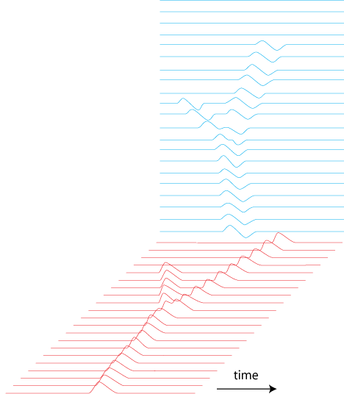
6￼
Liquid
Argon
Time
Projection
Chamber
Electron drift: 1.6mm/µs

Slide 7
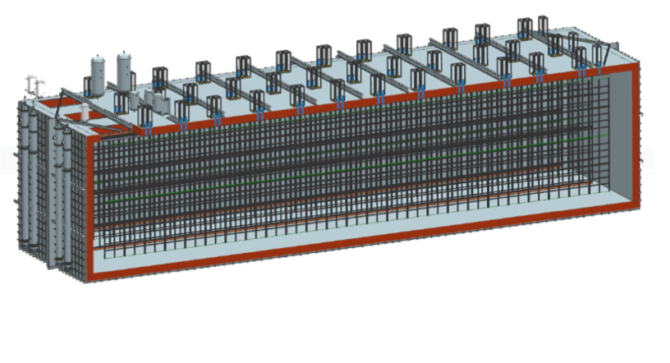
Liquid
Argon
Time
Projection
Chamber
One 10kT DUNE LArTPC Module
18m x 19m x 66m

Slide 8
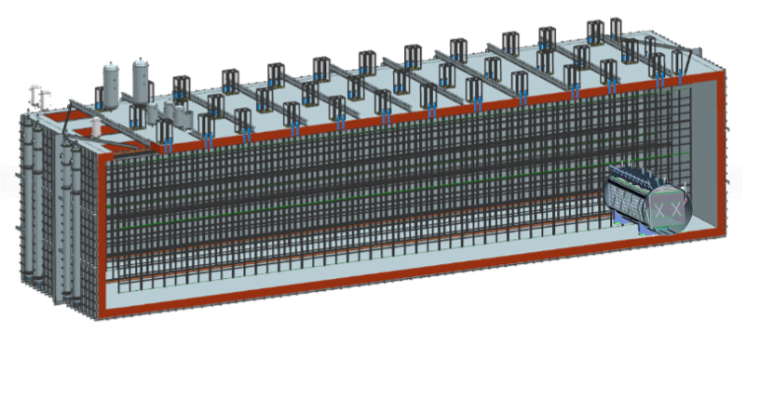
Liquid
Argon
Time
Projection
Chamber
MicroBooNE TPC (80 tons)
2.2m x 2.5m x 10m

Slide 9
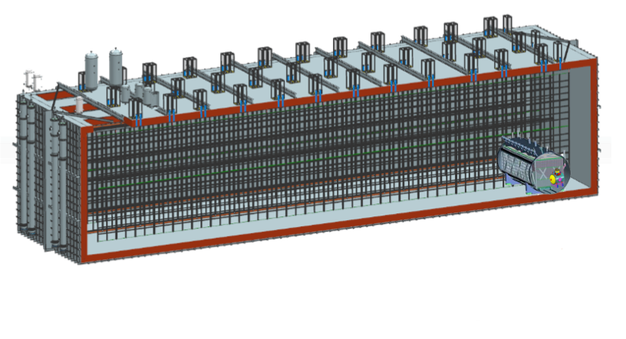
Liquid
Argon
Time
Projection
Chamber
LArIAT TPC (0.25 tons)
0.4m x 0.47m x 0.9m

Slide 10
Current particle identification methods

Slide 11
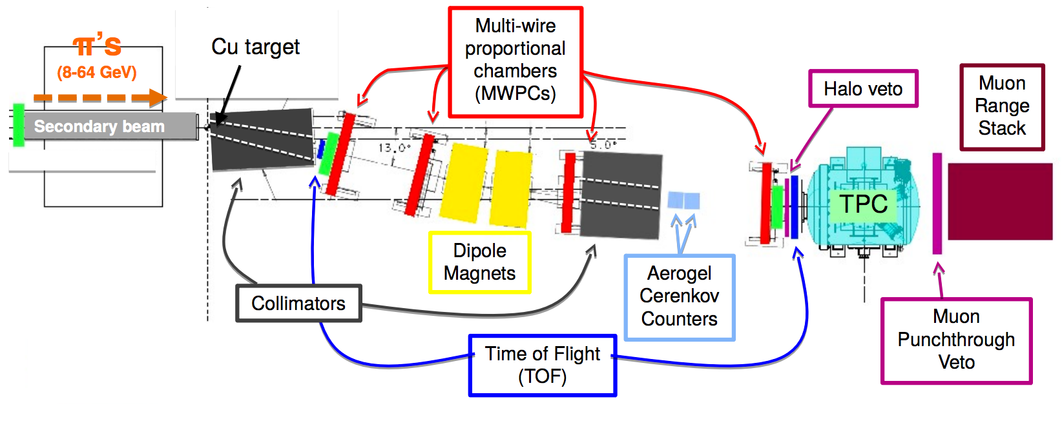
Liquid
Argon
In
a
testbeam

Slide 12
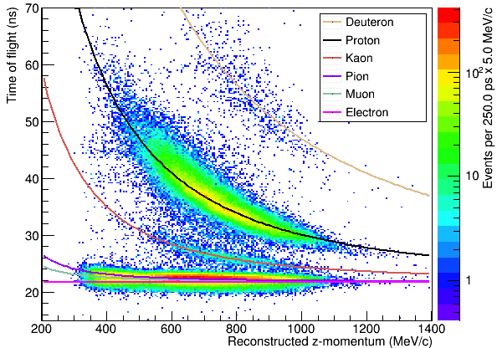
Liquid
Argon
In
a
testbeam

Slide 13
Deep Learning

Slide 14
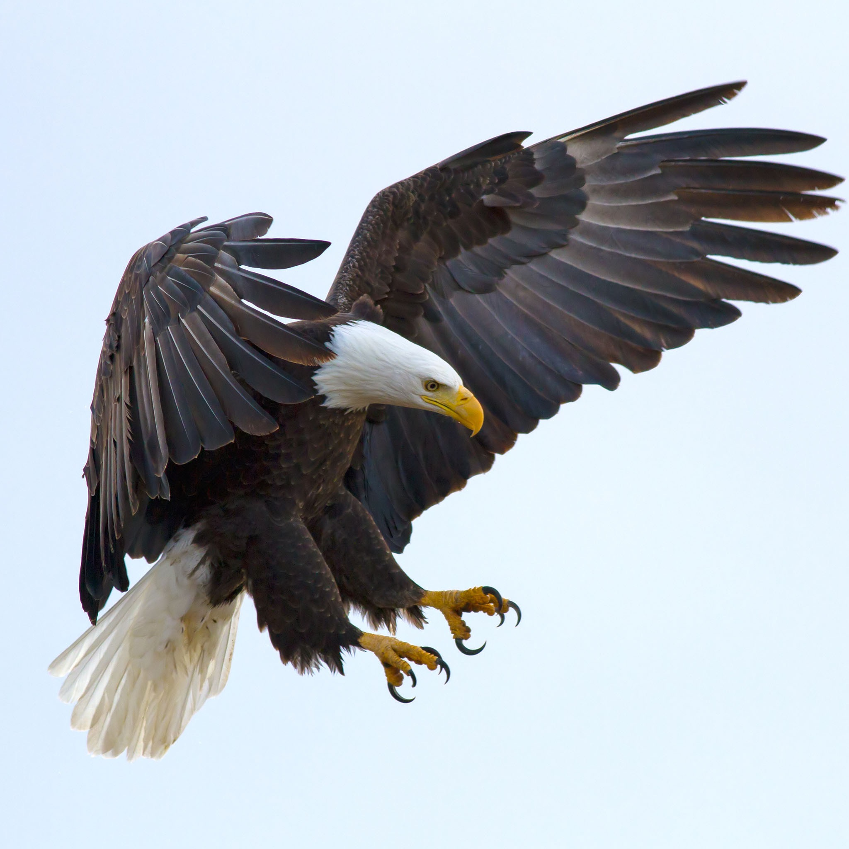
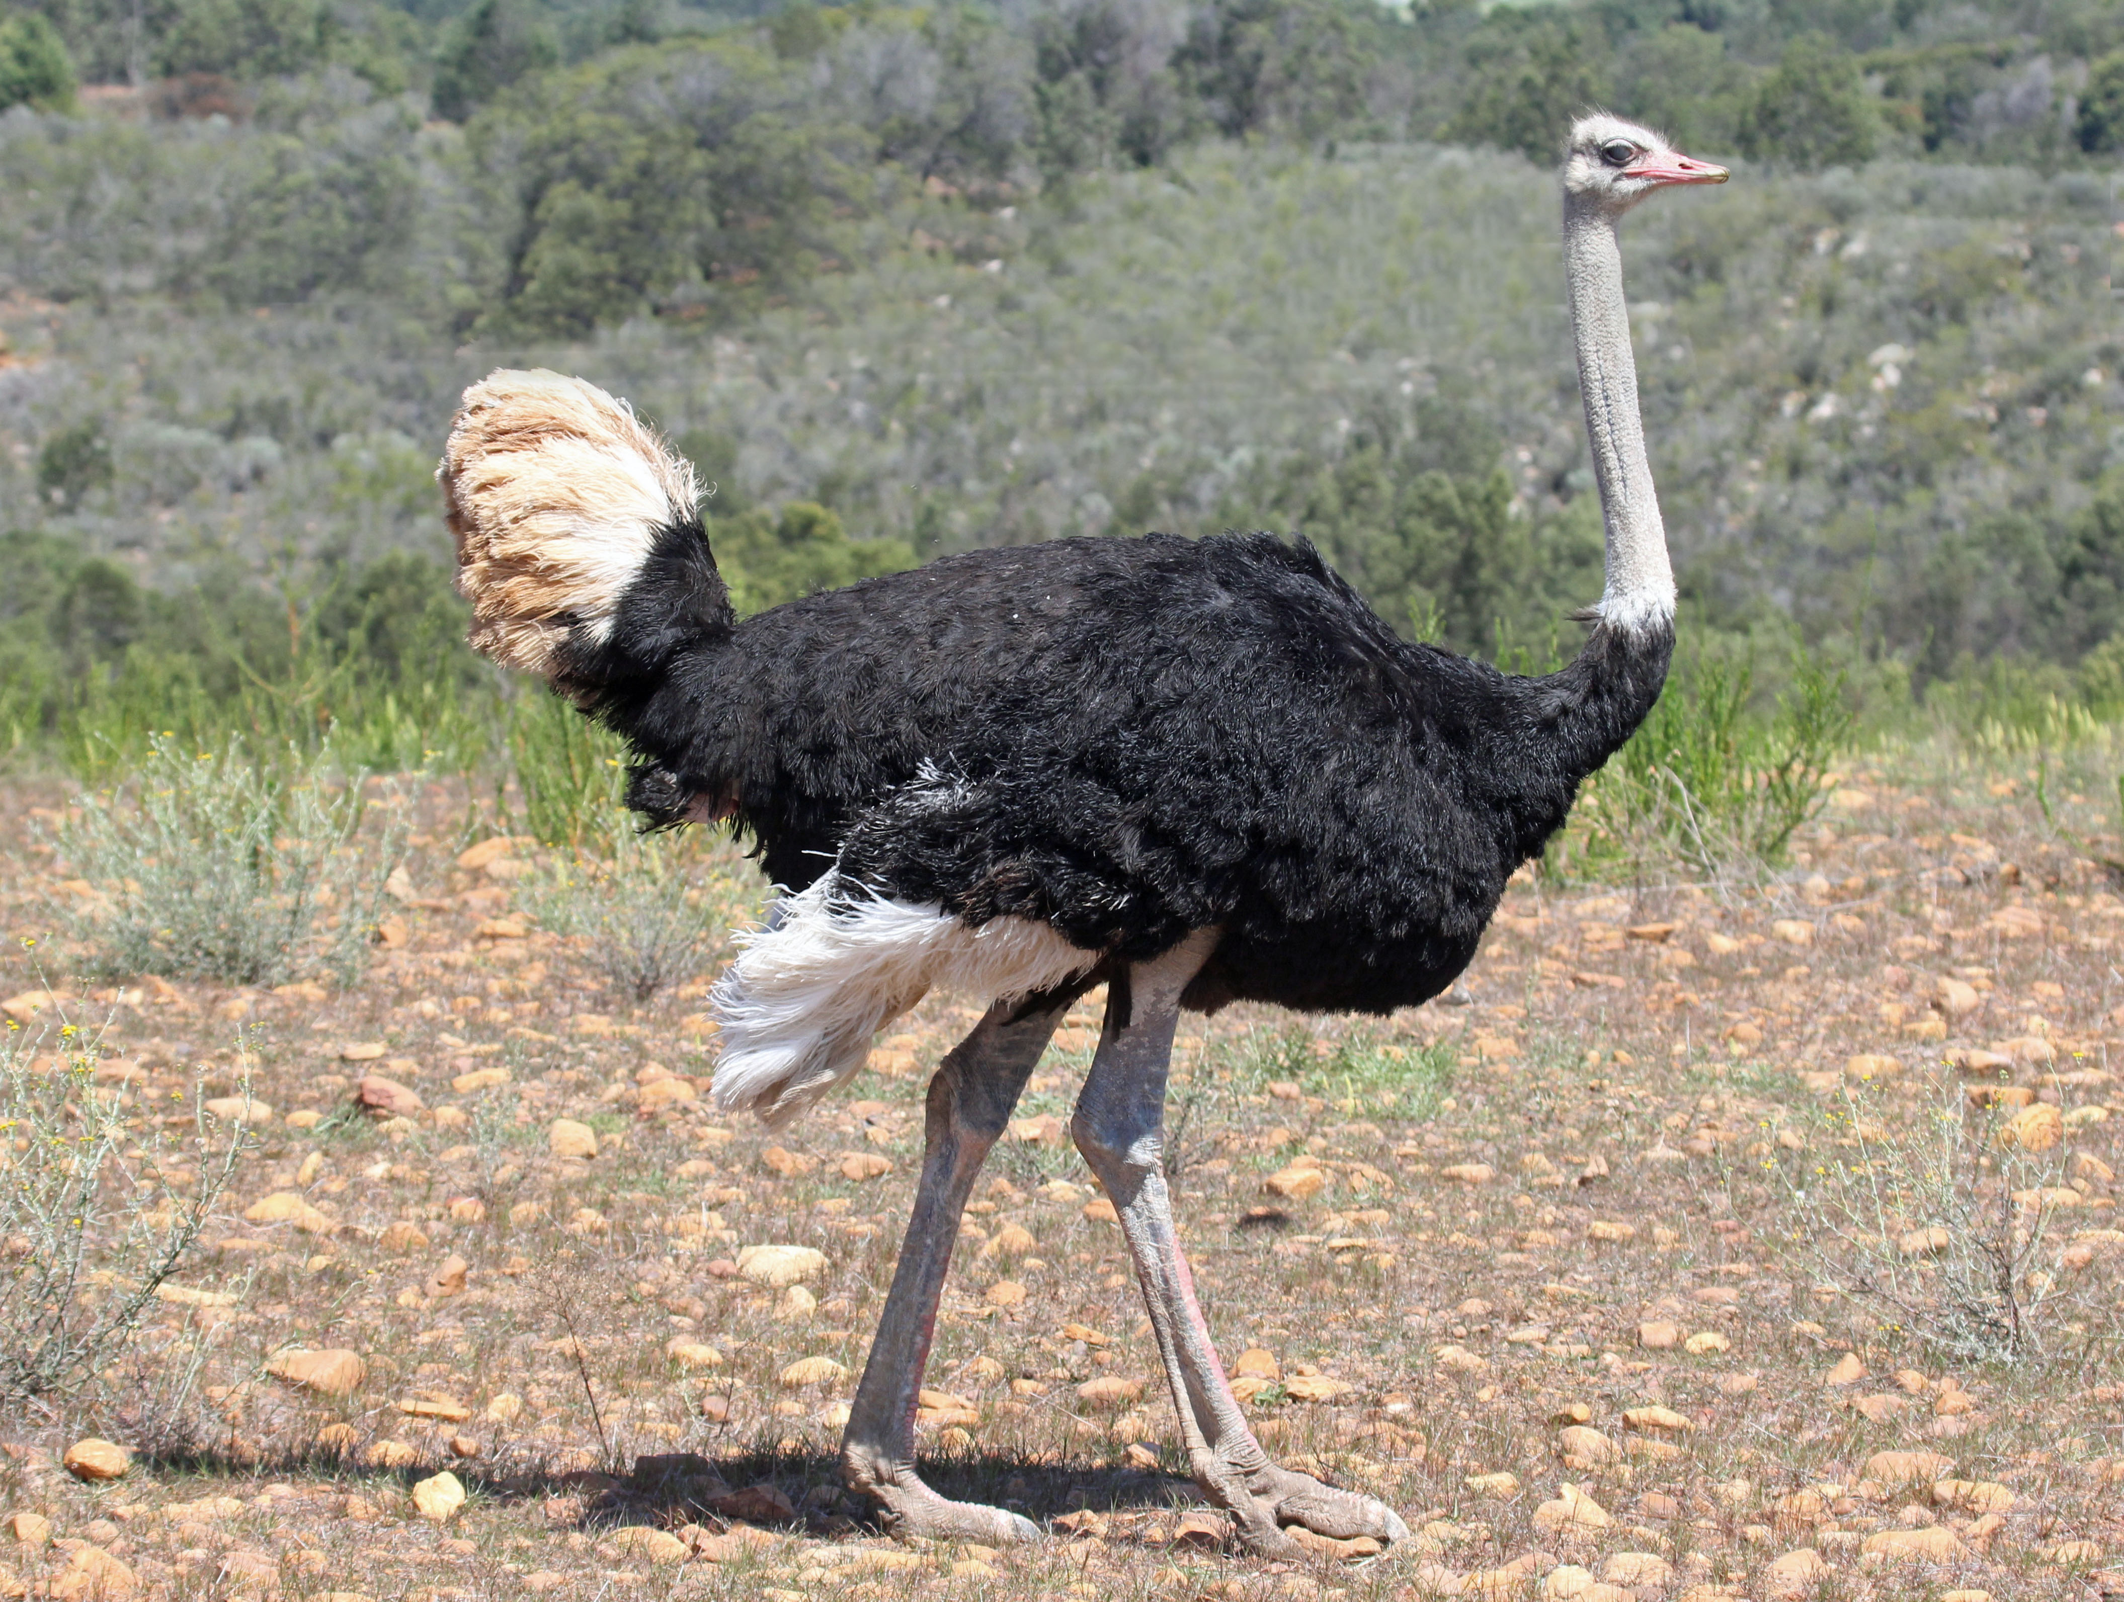
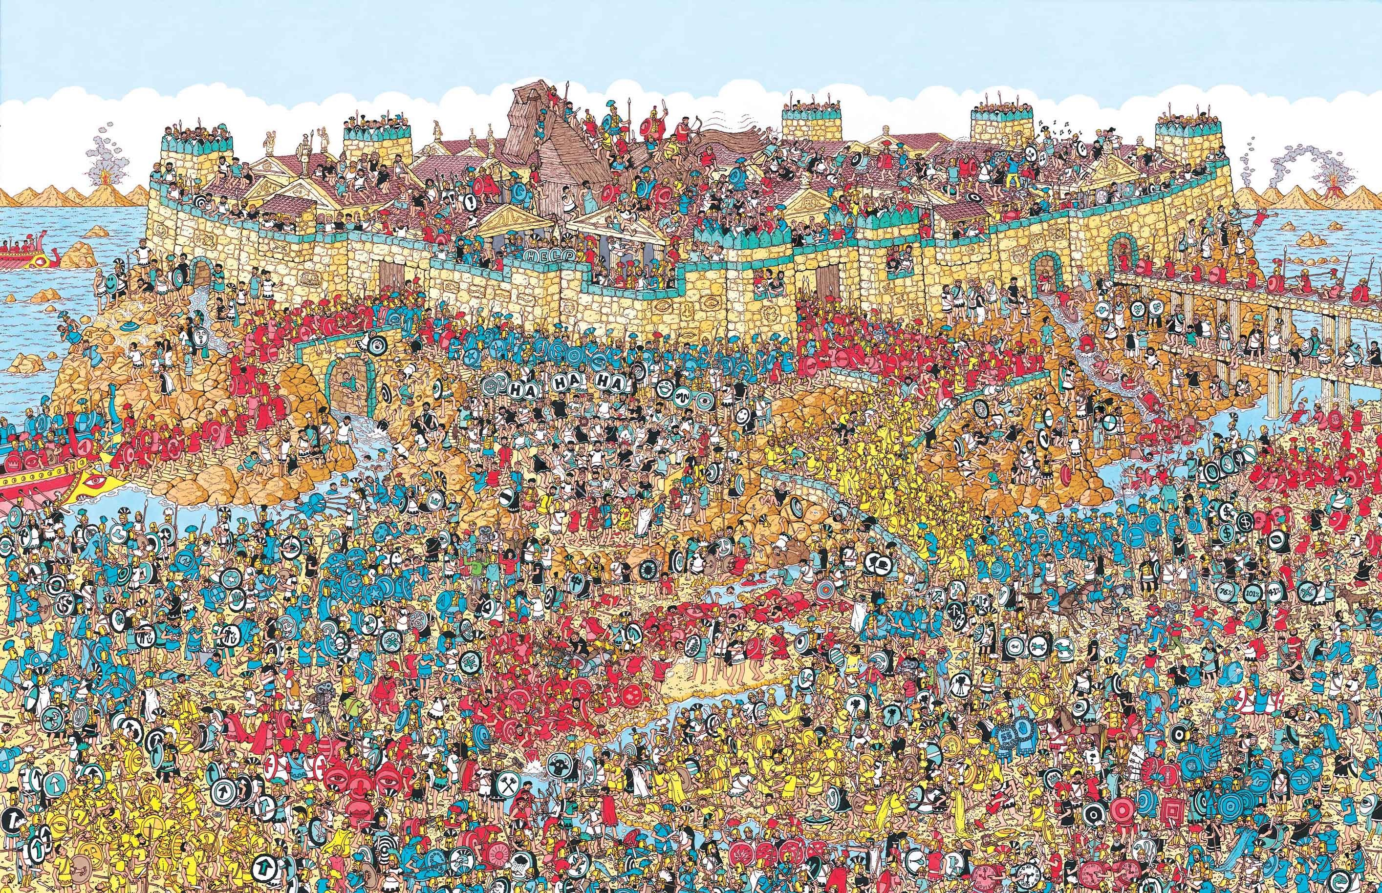
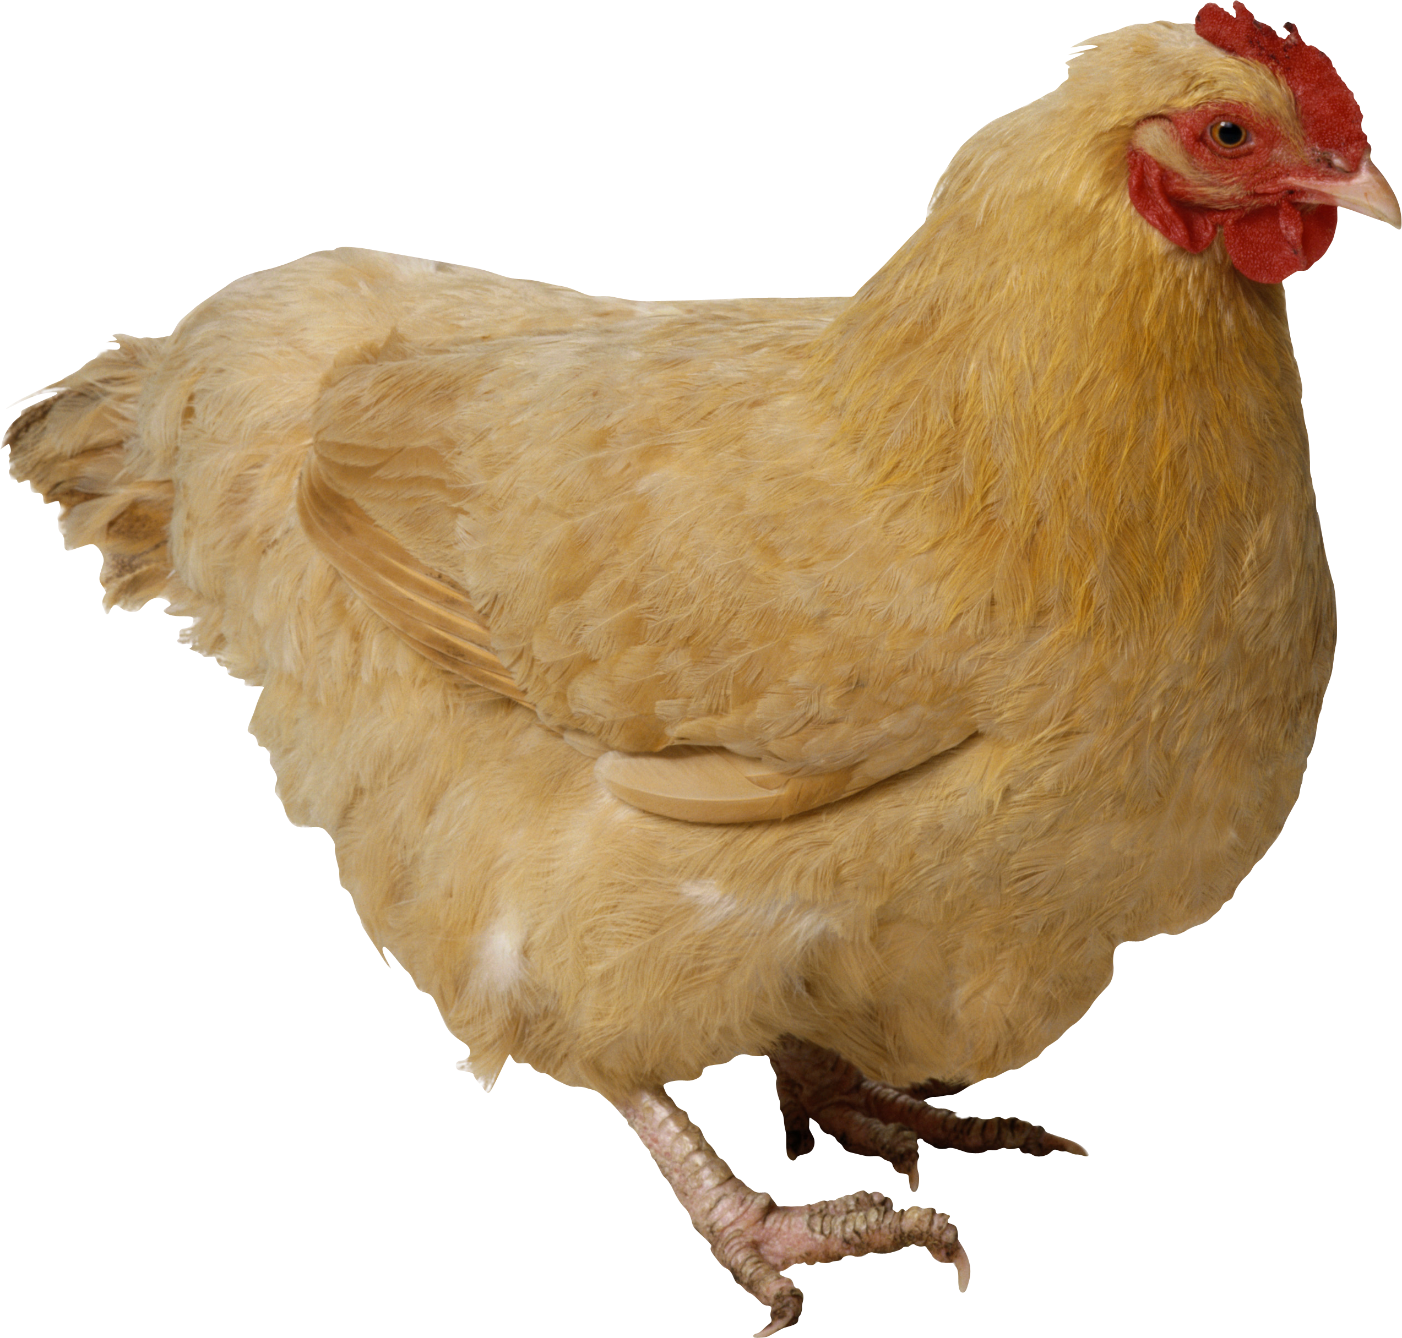
Pattern Recognition
A A A A A
Template Matching
Prototype Matching
Feature Analysis

Slide 15
Two kinds of machine learning

Slide 16
Supervised Learning
output relationship
In supervised learning, we are given a data set and already know what the correct output should look like.
Regression
In regression problems, we are trying to predict results within a continuous output.
Example: An output trying to predict the price of houses based on the real estate market
Classification
In classification problems, we are trying to predict results with a discrete output.
Example: An output to determine whether a house will sell for more or less than the asking price.

Slide 17
UnSupervised Learning
No desired output
In unsupervised learning, we can approach problems with no particular idea of what our results will look like.
Our structure will cluster data based on undefined variables to find patterns and relationships.
clustering
Say you were handed a stack of note cards with pictures and words on them. You could feed them into an unsupervised learning software and it will try to find a way to group these notecards based on features it sees.

Slide 18
Our Problem
I want to be able to feed our event display images into a neural network who will then classify the tracks into specific particles.

Slide 19
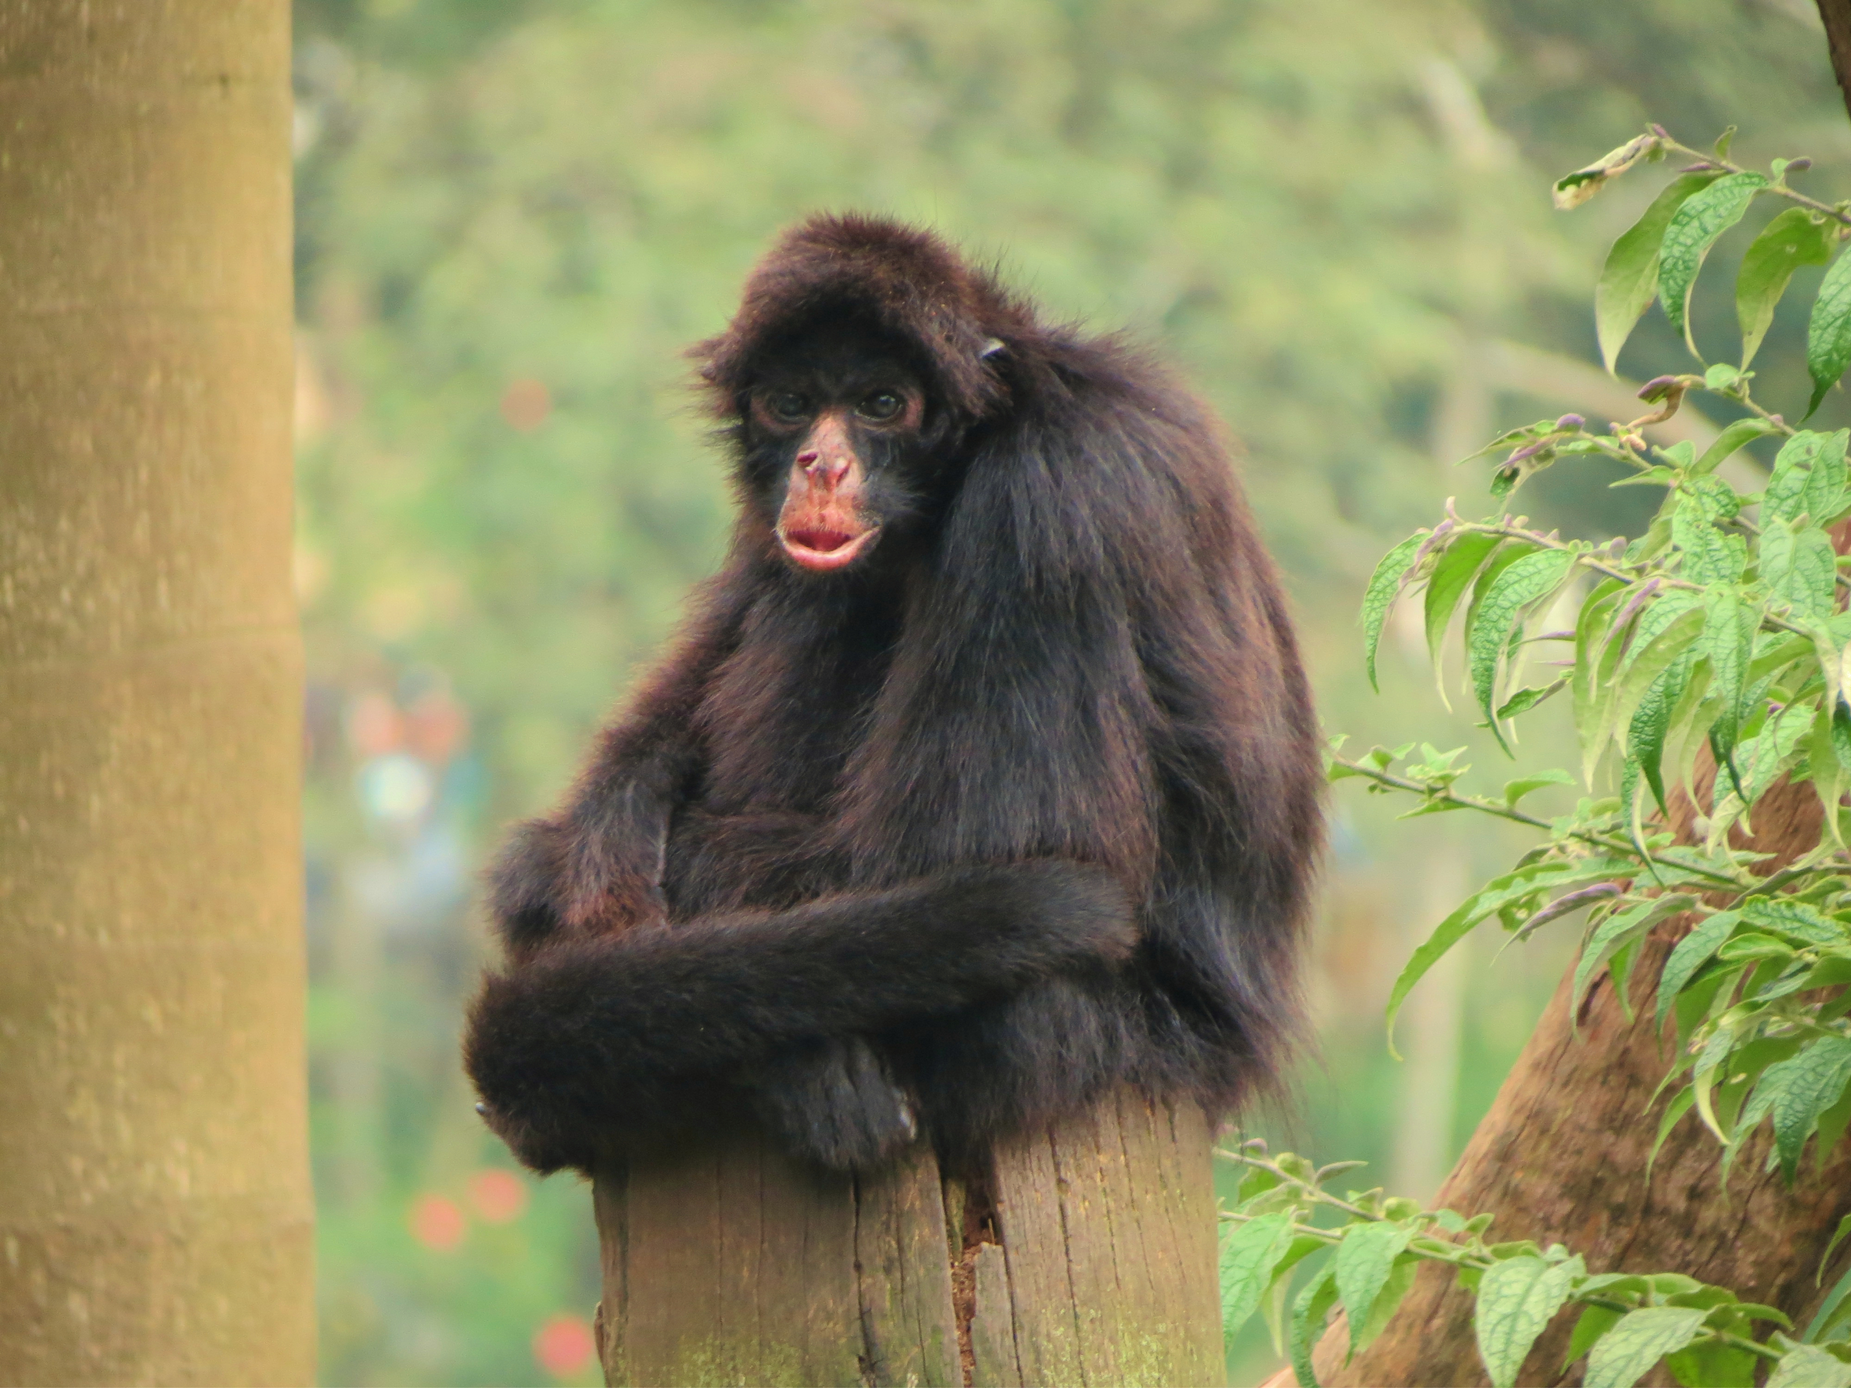
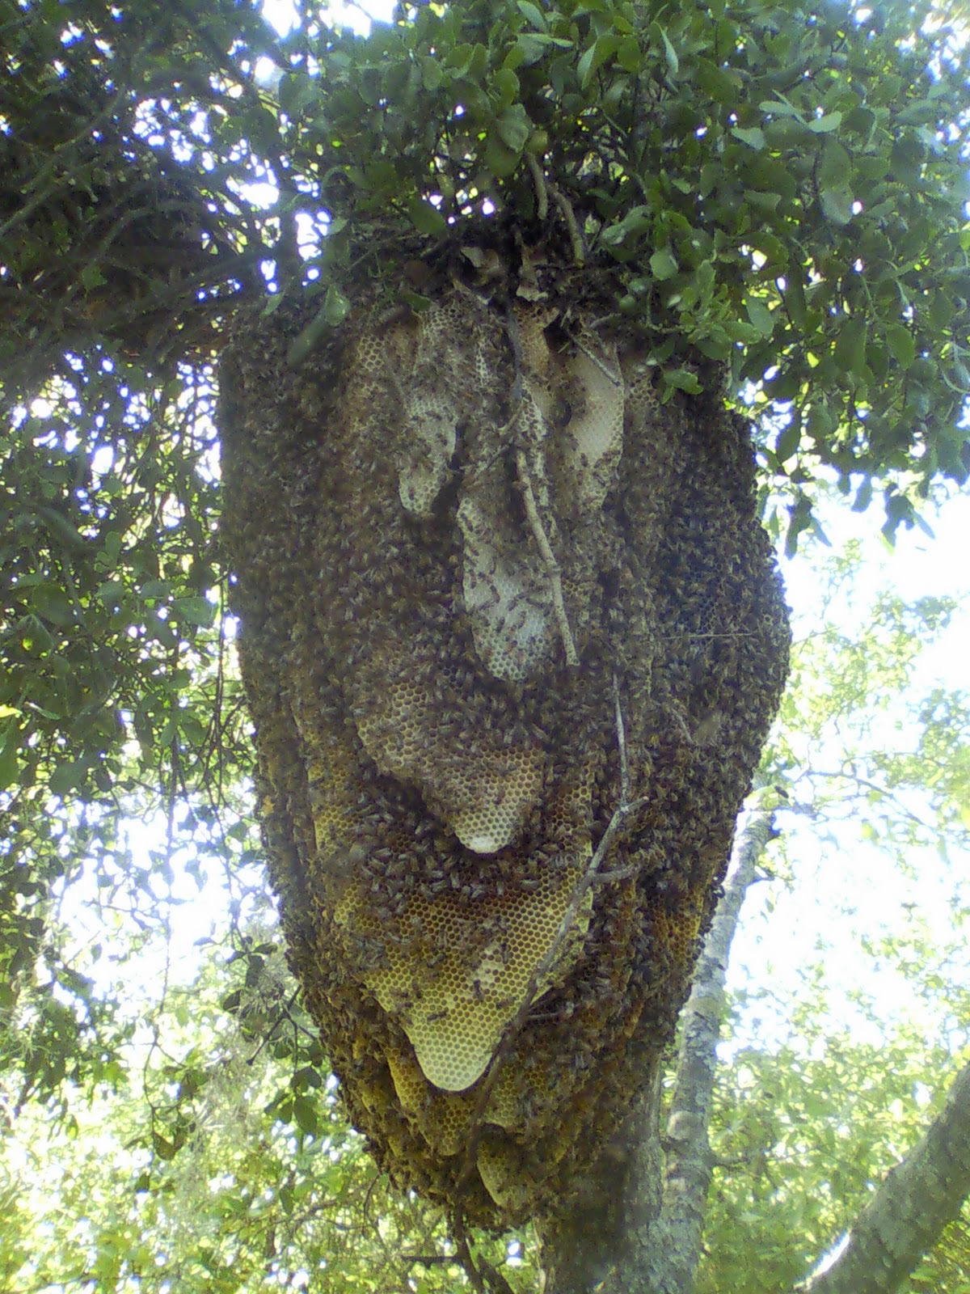
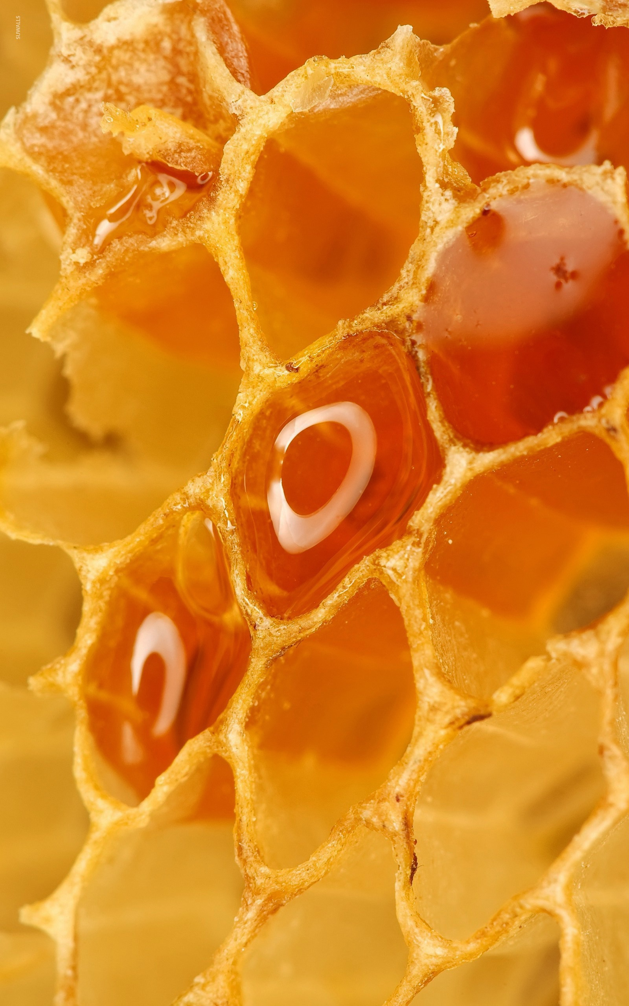
Complex & Hypercomplex
Convolutional Neural Network
Convolutional Neural Networks are based off of biology. A study conducted at Harvard Medical School on macaque and spider monkeys found three classifications of the cells of the visual cortex.
Simple Cells

Slide 20
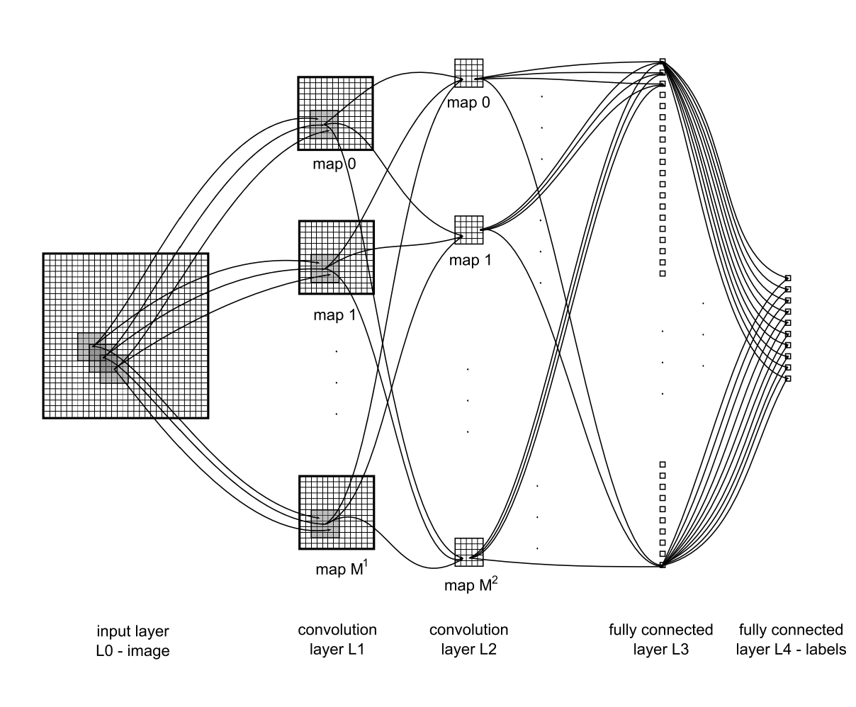
Receptive
Fields
D. Ciresan, IDSIA

Slide 21
Shared
weights
Each input is modified by a weight, which is the relative amplitude of the connection between two nodes and it defines the amount of influence one node will have on the other.

Slide 22
Tensor flow & keras
We have designed a way to take reconstructed TPC images and convert them to an input for TensorFlow. We are currently in the process of designing the multi-layered structure of the CNN to test the first run of training.

Slide 23
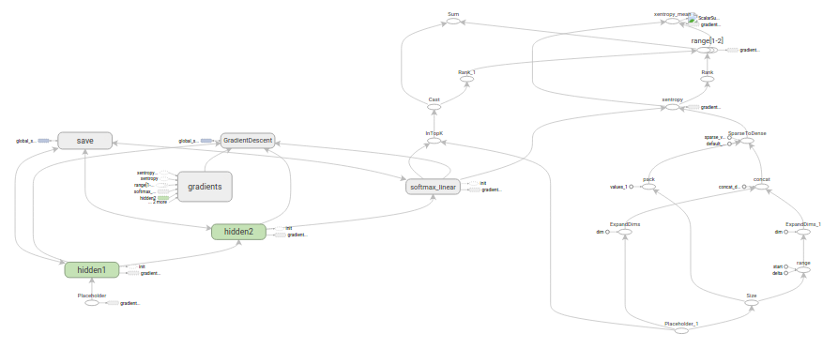
Tensorflow & keras

Slide 24
Next Steps
Currently, we are working to build the framework of our Convolutional Neural Network and use training sets we have created from our data to teach it to classify each particle interaction. By using LArIAT data with known inputs and outputs we can then prepare our CNN for future liquid argon neutrino experiments such as DUNE.

Slide 25
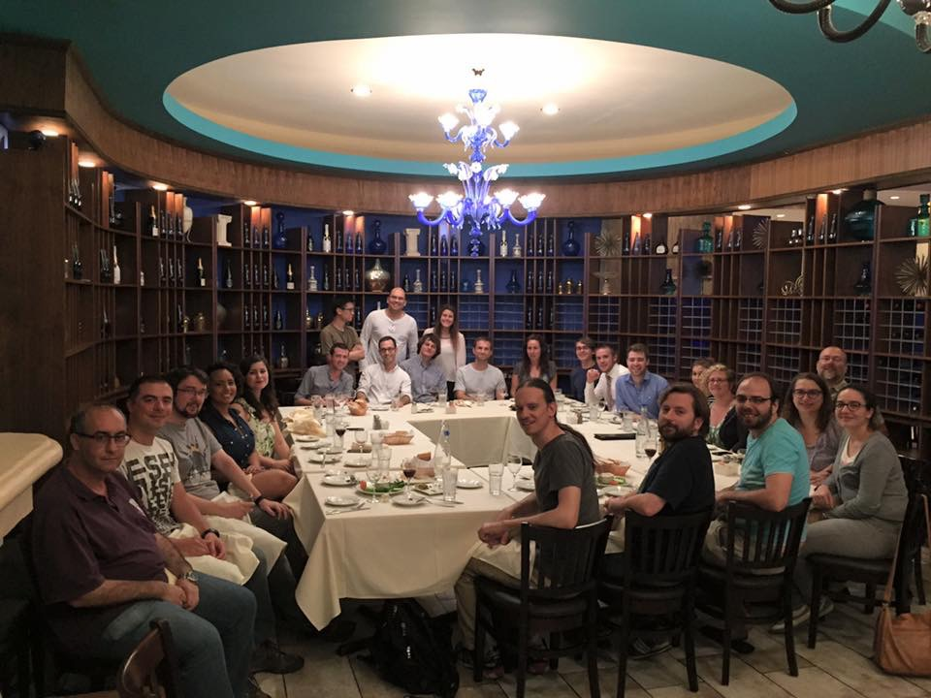
To the LArIAT Collaboration,
Dr. Jennifer Raaf,
Dr. Jason St. John,
Dr. Roberto Acciarri,
Gregory Pulliam,
Daniel Smith,
Derek Walker,
and the SIST Committee.
thank you!

