Slide 1
Beholder: Automated Scanning and Detection System

Slide 2
Beholder Overview
Comprehensive integration of cybersecurity detectors, scanners and blockers
Takes output from various sensors and assigns output to appropriate blocking and reporting utility
Sensors detect network and application vulnerabilites
Written in Ruby utilizing the Rails framework
Developed by Jason Ormes at Fermilab starting in 2013

Slide 3
Layout of the Active Scanner Farm

Slide 4
New Hosts Arrive on the Network

Slide 5
Inventory Scans

Slide 6
Critical Vulnerability Scans

Slide 7
Offsite Web Service Detector

Slide 8
Onsite Web Service Detection

Slide 9
Web Service Vulnerability Detector

Slide 10
Reporting And Blocking

Slide 11
Exemptions

Slide 12
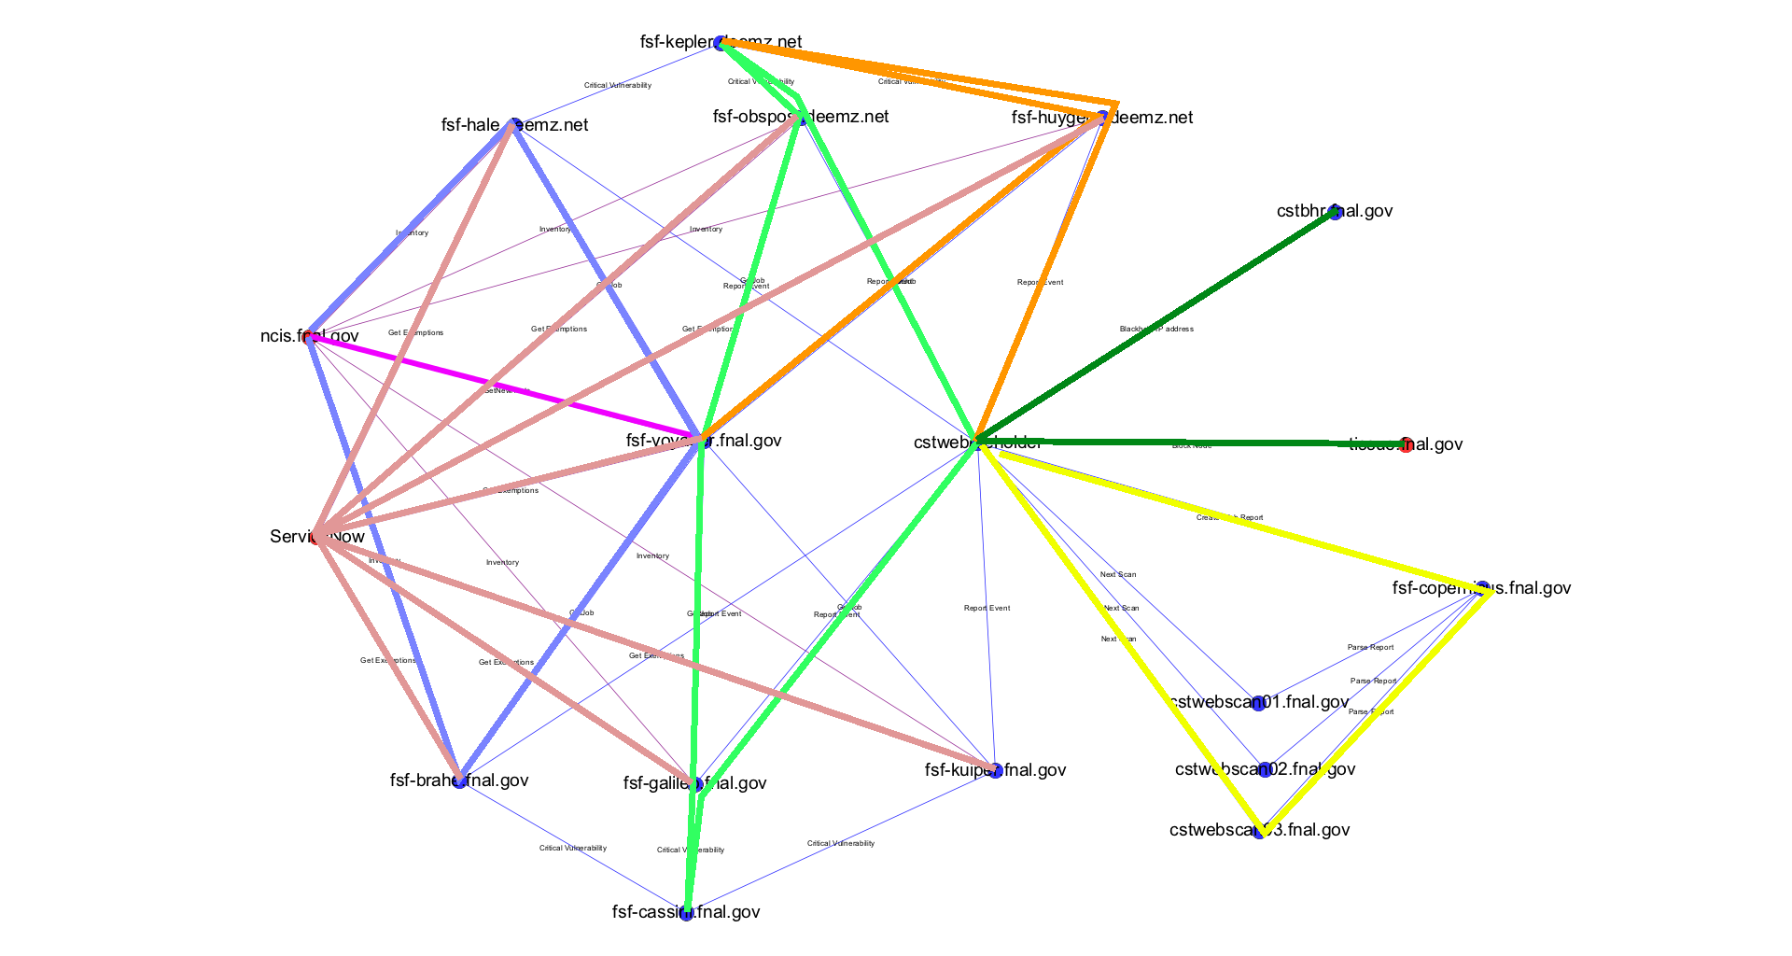
All Together Now

Slide 13
Beholder Dashboard Live Demonstration
Beholder

Slide 14
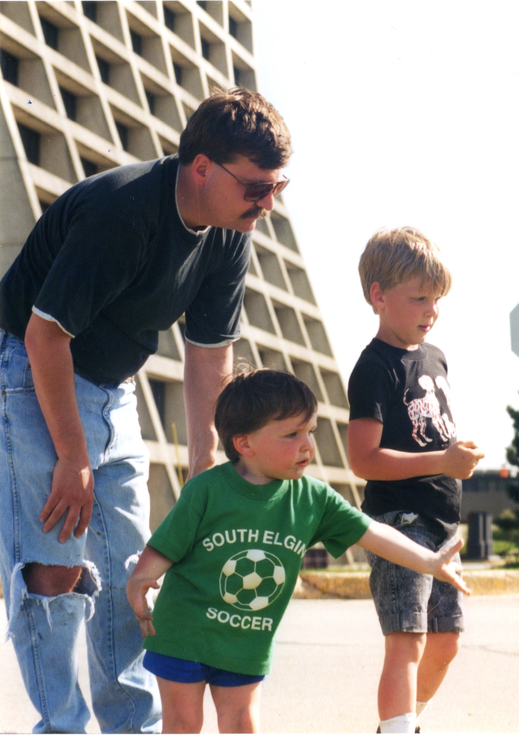
Acknowledgements
The Computer Security Team:
Jason Ormes, Greg Cisko, Wayne Baisley, Arthur Lee, Joe Klemencic
The SIST Committee:
Elliot Mccrory, Sandra Charles, David Peterson, Gustavo Cancelo
Steve White

