Slide 1
WG-1: Performance Frontier
“Nitrogen infusion” in Niobium model system
Guilherme Dalla Lana Semione
X-Ray Physics and Nanoscience
DESY Nanolab
TESLA Technology Collaboration
21-24 February 2017
Facility for Rare Isotope Beams, East Lansing, MI, USA

Slide 2
Cooperating groups
DESY Nanolab group
Manuel Abuín Herráez
Björn Arndt
Annika Böhme
Marcus Creutzburg
Dirk Franz
Simon Geile
Elin Grånäs
Thomas F. Keller
Konstantin Krausert
Satishkumar Kulkarni
Pirmin Lakner
Johannes Pfrommer
Henning Runge
Roman Shayduk
Arti Dangwal Pandey
Heshmat Noei
Vedran Vonk
Susanne Weigert
Prof. Dr. Andreas Stierle
DESY Nanolab (FS-NL)
Prof. Andreas Stierle
DESY Linear Accelerator Technologies (FLA)
Nicholas Walker
Prof. Brian Foster (Humboldt/Universität Hamburg)
DESY MHF-SL
Wolf-Dietrich Möller
Detlef Reschke

Slide 3
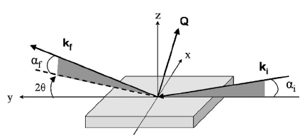
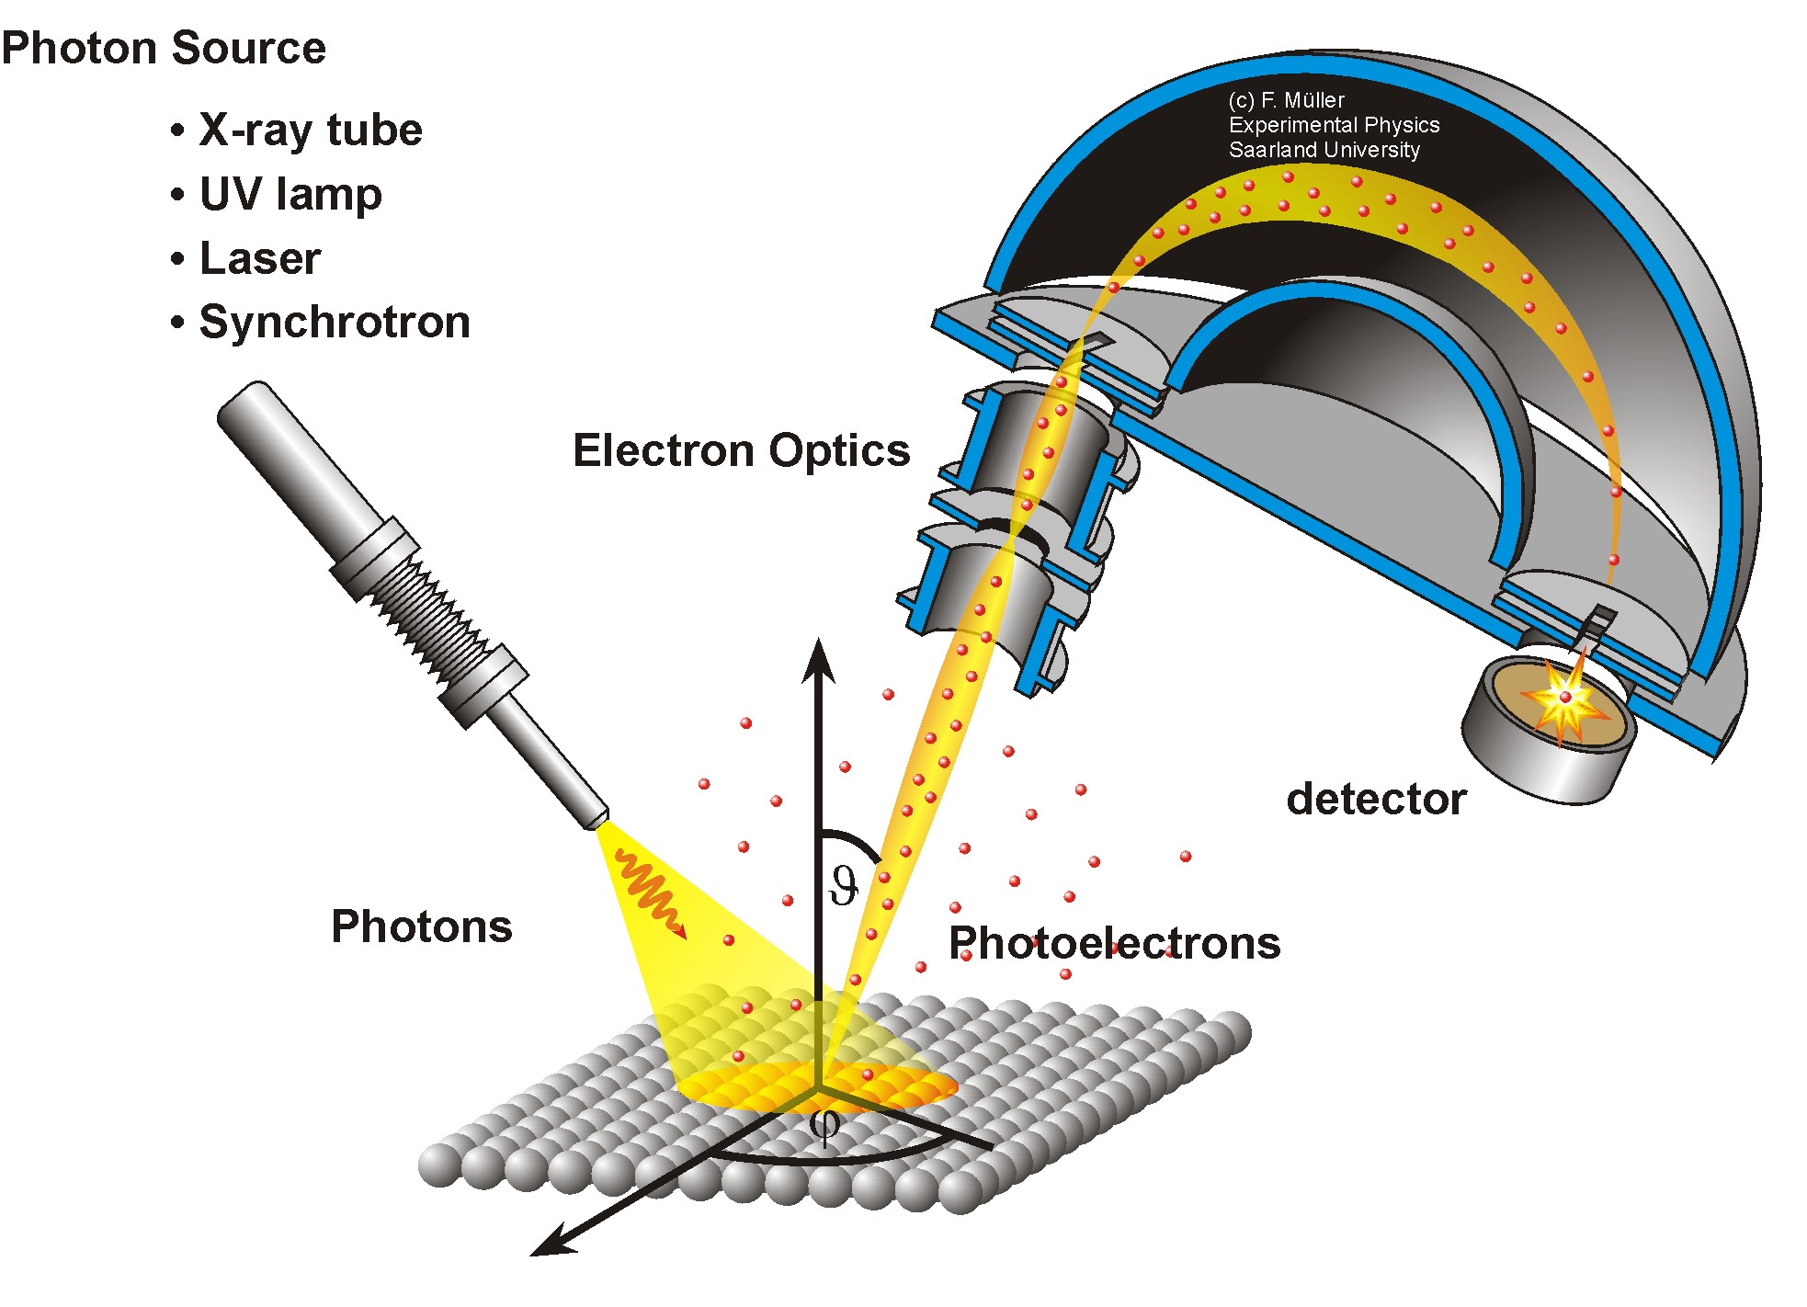
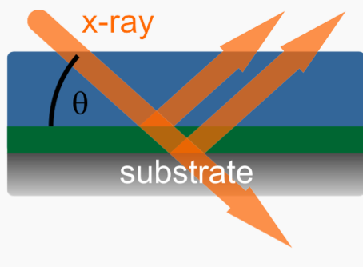
Motivation
Physical and chemical understanding of the role of nitrogen;
Determine changes in the niobium surface layer;
Evolution of native oxide layers, nitrogen concentration and chemical state
Optmization of treatment procedures;
GIXRD
XPS
100nm
Wang et al. Phys. Rev. B 74, 235304
XRR
http://jacobs.physik.uni-saarland.de
Nb
http://www.mpip-mainz.mpg.de/62518/Scattering_methods

Slide 4
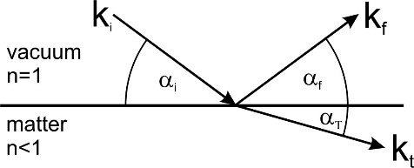
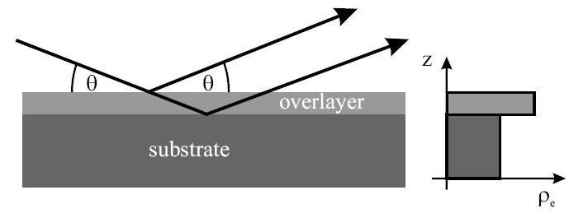
Experimental method
X-Ray Reflectivity
$$qz=\frac{4π }{λ}sinθ$$
Constructive interference
between layers
Thickness (d)
Layer density profile (ρ_{e})
Surface or interface roughness (σ)
Independent of crystalline state
Electron density
profile

Slide 5
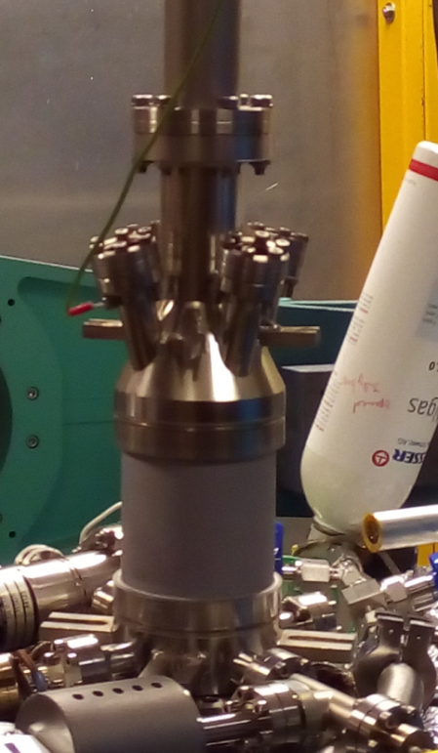
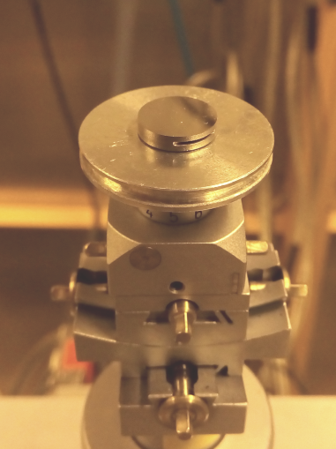
Experimental procedure
In-situ tracking of the nitrogen infusion process:
X-rays
Cu K_{α}
Detector
Heat up to 800°C, keep for 2 hours
P₀ = 3.6x10⁻⁹ mbar / P₈₀₀ = 8.0x10⁻⁷ mbar
Cooldown to 120°C (P₁₂₀=2.10⁻⁸ mbar)
Insert 25 mTorr (0.033 mbar) of N₂ (99.999%)
Keep for 23 hours
Record successive XRR scans
Nb(100) single crystal: 10 mm wide
4 mm thick

Slide 6
Results: XRR
In-situ infusion
Air-exposure
High Pressure Water Rinsing
RT
Nb₂O₅
~4.7nm
NbO₂
NbO
Nb
800°C/2h
~4.2nm
NbO
Nb
Infusion
~14nm
NbO_{x}N_{y}
NbO
~1nm
Nb

Slide 7
Results: XRR
In-situ infusion
Air-exposure
High Pressure Water Rinsing
As-received crystal
Nb₂O₅
NbO₂
800°C/1h - UHV
NbO
+ air exposure
~ 36 days
Nb
Mo K_{α}
Cu K_{α}
“Infusion”
+ air exposure ~ 35 days
NbO_{x}N_{y}
Natural oxide layers suppressed
Protective layer - passivation
NbO
Nb
Mo K_{α}

Slide 8
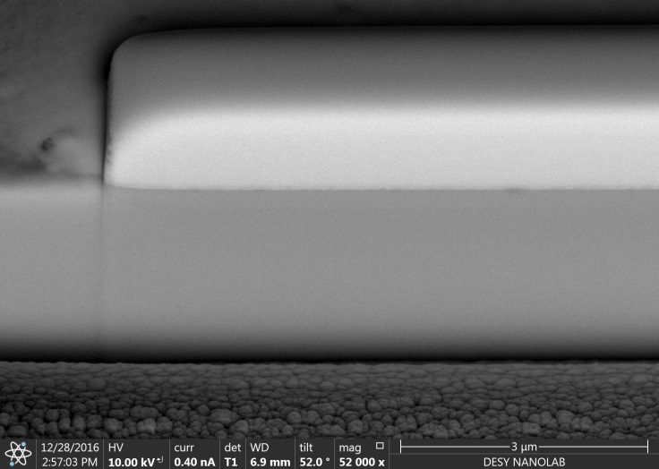
Results: SEM, FIB
In-situ infusion
Air-exposure
High Pressure Water Rinsing
400 nm
Rough surface
Without precipitates
Contrast change – irregular layer visible, 15 to 40 nm thick
3μm
3μm
32.53 nm
22.06 nm

Slide 9
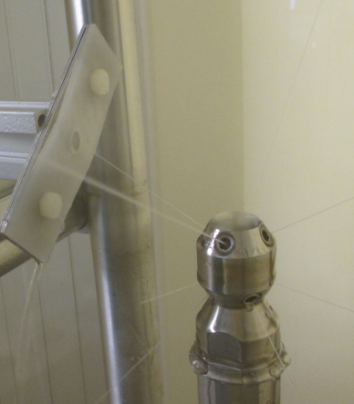
Results: XRR, SEM
In-situ infusion
Air-exposure
High Pressure Water Rinsing
Sample position
NbO_{x}N_{y}
~4.5nm
Layer | σ (Å)
NbO | 20
Nb | 2.5
NbO
Nb
SEM
Before
400 nm
After
500 nm
Notes:
670mm

Slide 10
Conclusions
The infusion process creates an overlayer within the first hour of treatment. No significant changes are observed after longer N₂ exposure.
The growth of the natural oxide layers in the surface due to air exposure is suppressed by the infusion process.
No precipitates were found, most notably absent is the β-Nb₂N phase.
Passivation still remains after High Pressure Water Rinsing.

Slide 11
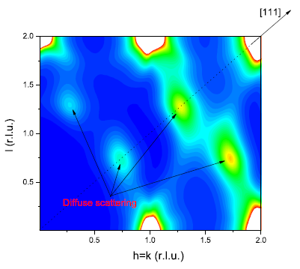
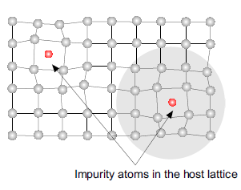
Future Work
Reproduce the experiment, also with longer infusion time (48 hours)
Different Single-crystal orientations;
Large Grain samples;
XPS sputtering profile
Composition of layers;
Diffuse Scattering X-Ray measurements
Nitrogen concentration
Trapping effects
NbO_{x}N_{y}
NbO
O, N interstitials
Bulk contribution
Nb
M. Delheusy, 2008

Slide 12
Acknowledgements
Special thanks to:
Nicolay Krupka
Detlef Reschke
Axel Matheisen
Marc Wenskat
Alena Prudnikava
Arti Dangwal Pandey
Heshmat Noei
Vedran Vonk
Prof. Andreas Stierle

Slide 13
Thank you!

Slide 14
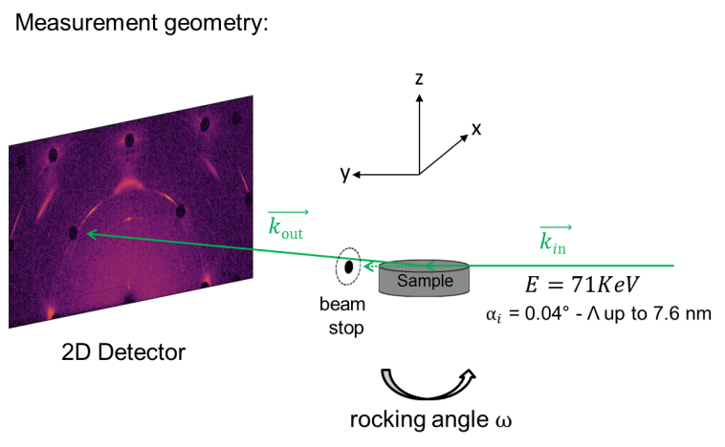
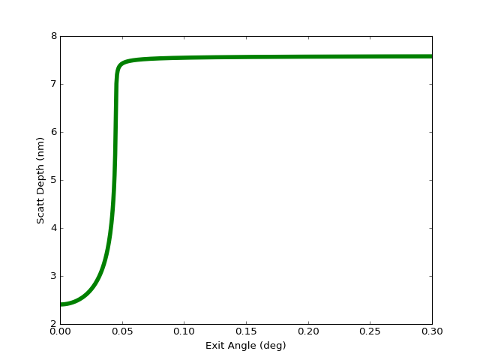
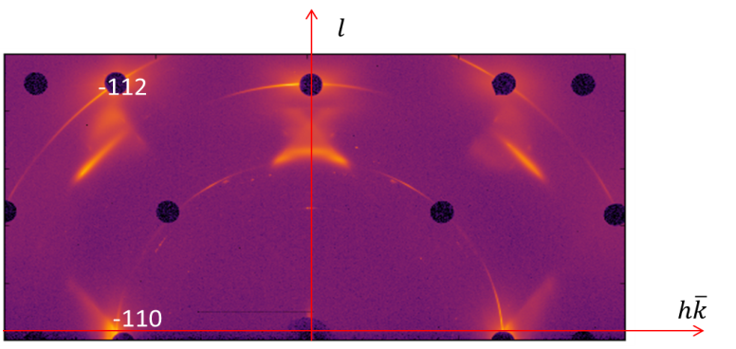
GIXRD – P07 Beamline, Petra III
NbO
(022)

Slide 15
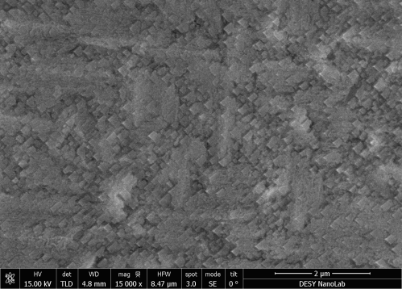
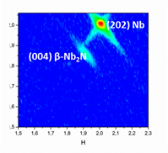
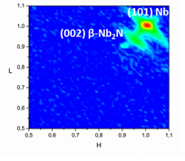
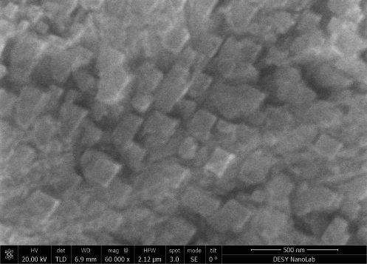
“Doping” Sample
At Nb coordinates 1.1 0 0.74 (HKL)
Nitrogen doping @900°C
Large grain Nb(100)
Outgassing at 900°C/2 hours (1.0x10⁻⁵ mbar)
Nitrogen supplied for 20 min (0.04 mbar - 30mTorr)
Further 30 min anneal without Nitrogen
SEM
GIXRD – Cu K_{α}
Epitaxial β-Nb₂N and NbO

Slide 16
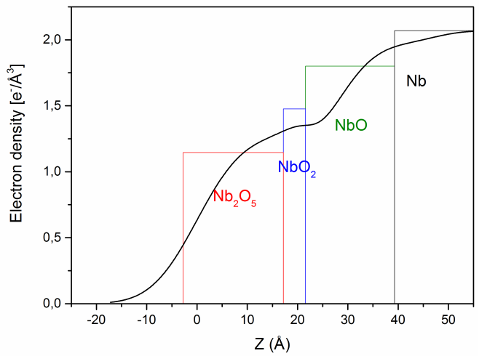
XRR
X-Ray Reflectivity
$$n=1−δ−iβ$$
$$δ=\frac{λ^{2}r_{e}ρ_{e}}{2π}$$
$$β=\frac{λμ }{4π}$$
$$qz=\frac{4π }{λ}sinθ$$
$$α_{c}=\sqrt{2δ}=λ\sqrt{\frac{r_{e}ρ_{e}}{π}}$$

Slide 17
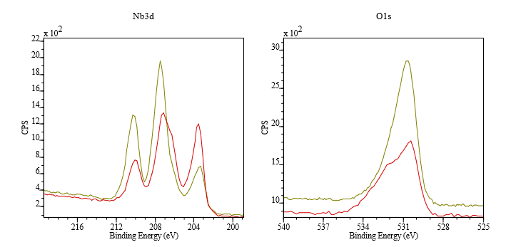
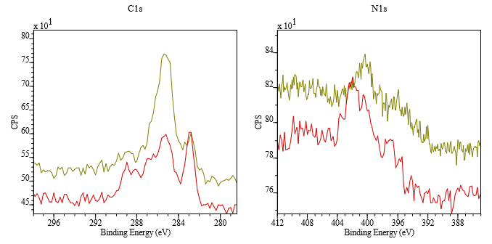
XPS results – Infused Sample
Red: Before HPR
Green: After HPR

