Slide 1
FRIB Tour Thursday, 23 February 2017
2 FRIB tours available – MUST be registered for tour no later than Tuesday afternoon. Sign up at registration desk
Tour #1
1:45pm Departure from Kellogg Hotel & Conference Center
2:00pm Arrive at the FRIB Facility
3:30pm Departure from the FRIB Facility
Tour #2
4:00pm Departure from Kellogg Hotel & Conference Center
4:15pm Arrival at the FRIB Facility
5:30pm Departure from the FRIB Facility
Must have tour number and tour group code on name tag to go on tour
At FRIB tour site
Photos, videos, bags larger than 18” x 14” x 7”, food or beverages, high heel shoes, open toe shoes and sandals, and minors under the age of 16 are not allowed
All visitors must wear long pants (no shorts, capris, or dresses), a high-visibility vest, hard hat, and safety glasses (provided by FRIB). Persons equipped with a pacemaker, defibrillator, electronic medicine dispenser, hearing aid or metal implant, persons with reduced mobility or otherwise incapacitated, and persons suffering from claustrophobia should contact the organizers as some areas may be restricted during the tour. Participation in the tour is at the visitors’ own risk. Please secure all belongings as you will remain fully responsible for their safety

Slide 2
Logistics and Emergency Exits
Banquet
Working
Groups
Plenary
Emergency Exits

Slide 3
Location and Time
Plenary Sessions
Auditorium - Tuesday and Friday morning
Coffee breaks outside auditorium
Presentation computers are provided in the Auditorium, there will not be an opportunity for speakers to use their own equipment
Please upload your presentations to the InDiCo site or save it in the folder on the desktop of the presentation computer
Working Groups
1 & 4 – Tuesday afternoon, Wednesday morning
2 & 3 – Wednesday afternoon, Thursday morning
Coffee breaks outside rooms
Presentation computers are provided in the Auditorium, there will not be an opportunity for speakers to use their own equipment
Please upload your presentations to the InDiCo site or save it in the folder on the desktop of the presentation computer
Lunch
On your own

Slide 4
Lunch Information
Many options for lunch: Kellogg Center, Brody, Downtown East Lansing
Brody is recommend

Slide 5
Hotel Shuttles
Tuesday, 21 February 2017 Hyatt Place: Pick up for Kellogg- 7:30am Return from Kellogg- 5:40pm Towneplace and Residence Inn: Pick up for Kellogg- 7:30am Return from Kellogg- 5:40pm Wednesday, 22 February 2017 Hyatt Place: Pick up for Kellogg- 7:30am Return from Kellogg- 5:40pm Towneplace and Residence Inn: Pick up for Kellogg- 7:30am Return from Kellogg- 5:40pm Thursday, 23 February 2017 Hyatt Place: Pick up for Kellogg- 7:30am Return from Kellogg- 9:00pm Towneplace and Residence Inn: Pick up for Kellogg- 7:30am Return from Kellogg- 9:00pm Friday, 24 February 2017 Hyatt Place: Pick up for Kellogg- 7:30am Return from Kellogg- 12:30pm Towneplace and Residence Inn: Pick up for Kellogg- 7:30am Return from Kellogg- 12:30pm

Slide 6
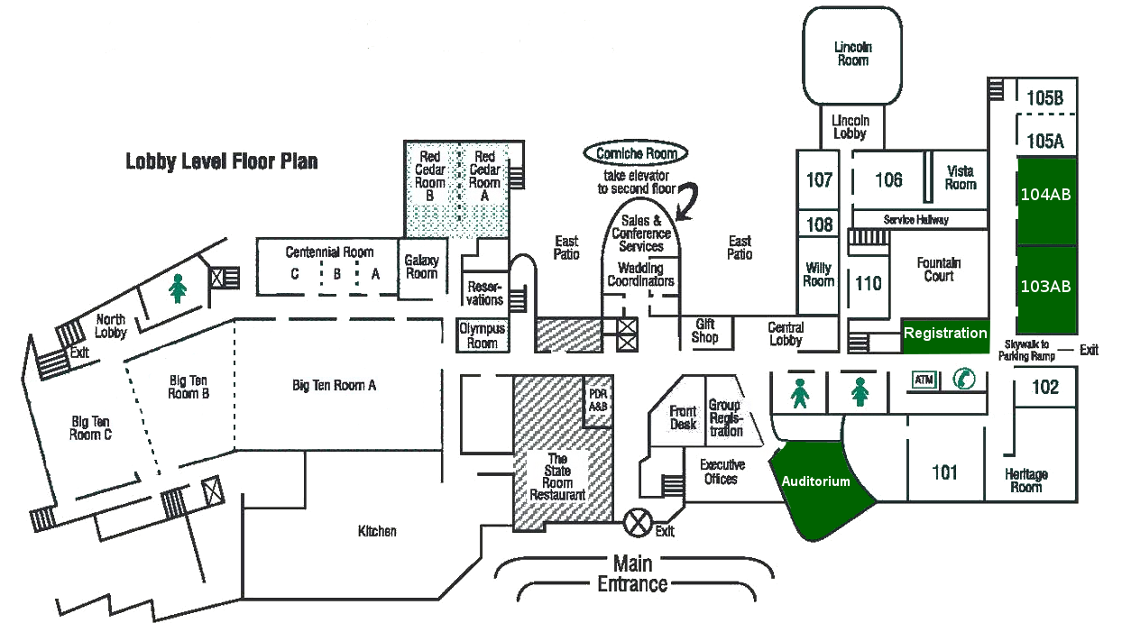
Banquet
The banquet will be held on Thursday, February 2017 at 7:00pm at the Kellogg Hotel and Conference Center in Red Cedar A/B
There is a $40.00 fee for the dinner, please make payment at registration desk
Limited space is remaining if you have not signed up previously
Banquet

Slide 7
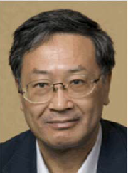
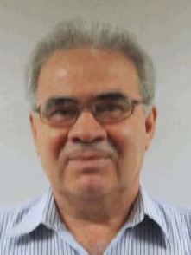
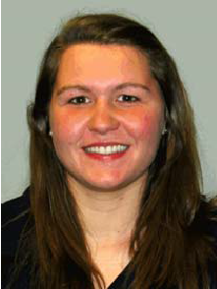
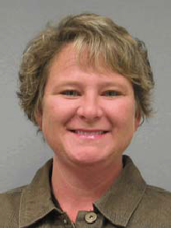
Other Important Information
Website: http://indico.fnal.gov/event/2017TTC
Name badges must be worn at all times
Please do not leave any personal items unattended
Group photo: Tuesday, in the Auditorium at 12:30pm (before leaving for lunch)
In case of emergency, find the closest exit and go to a safe place outside
Emergency phone number: 911
TTC Staff at Kellogg
Kenji Saito
Peter Ostroumov
Kathryn Fillinger
Amy McCausey

