Slide 1
CM Installation Planning
Robert Coy - SLAC
Tesla Technology Collaboration
22 February 2017

Slide 2
LCLS-II Facility Overview
5 Linac Strings Containing 37 Cryomodules
35 Cryomodules 1.3 GHz
2 Cryomodules 3.9 GHz
Longest String 12 CMs (L2)
Scheduled Delivery 1 CM every ~3 weeks

Slide 3
LCLS-II Schedule Overview
SLAC Receive 1st CM
SLAC Install 1st CM
SLAC Install Last CM

Slide 4
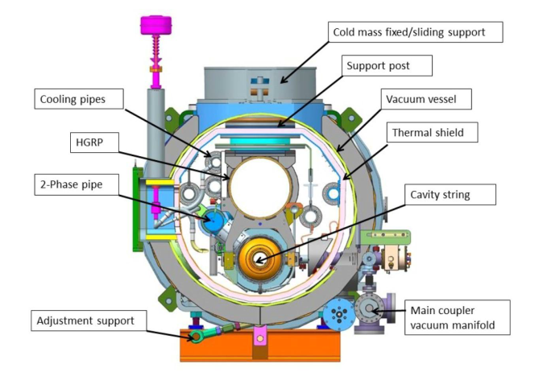
CM Installation Workflow
Acceptance Testing
Physical Install
Alignment
HGRP Weld & Exam
2” Pipe Weld & Exam
Cryo Pipe Leak Test
Pressure Test - Full String
BLA Install
BLA Pump Down & Leak Test
MLI & Heat Shield Install
Insulation Vacuum Pump and Leak Test
5 Major Install Phases
Receiving / Acceptance Testing
  Criteria Established
Physical Install / Alignment
Welding Cryo Pipes
  Serial Install and Exam
  Pressure Testing per String
Particle Free Beamline Install
  Following String Welding
Insulation Vacuum

Slide 5
CM Acceptance Tests
Acceptance Testing
 | SLAC Spec | XFEL Spec | XFEL Typical
Mechanical - Inspection | No Visible | No Visible | Minor Issues
Shock Logger Review | < 1.5 G | < 1.5 G | ~ 1.5 – 2.0 G
Beam Vacuum | < 10⁻⁵ mBar | < 5*10⁻⁵ mBar | ~ 10⁻⁵ mBar
Coupler Vacuum | < 10⁻⁵ mBar | Reference Check | ~ 10⁻⁷ mBar
Alignment | < 0.5 mm ∆ | < 0.2 mm ∆ | ~ 0.3 - 0.5 mm ∆
RF Cavity Check | < 10 kHz ∆ | < 10 kHz ∆ | ~ 3 kHz ∆
Electrical Tests | No open / short | No open / short | Rare Issues
Leak Test (CM iso-vac) | < 10⁻⁵ mBar-L/sec | ~ 10⁻⁸ mBar-L/sec | Rare Issues
Leak Test (Big Bellow) | < 10⁻⁹ mBar-L/sec | < 10⁻⁸ mBar-L/sec | Issues with some welds

Slide 6
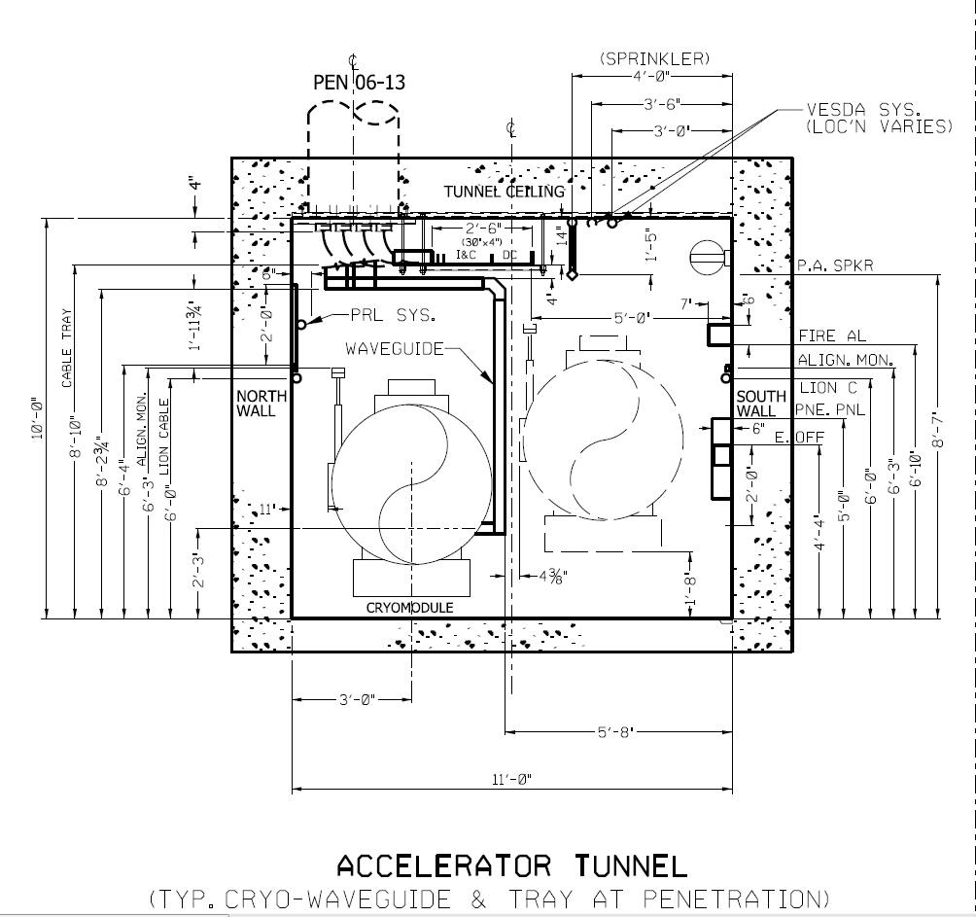
Typical Tunnel Cross Section
Physical Install
Cryomodule
Being
Transported
Installed
Cryomodule
60” Stay Clear

Slide 7
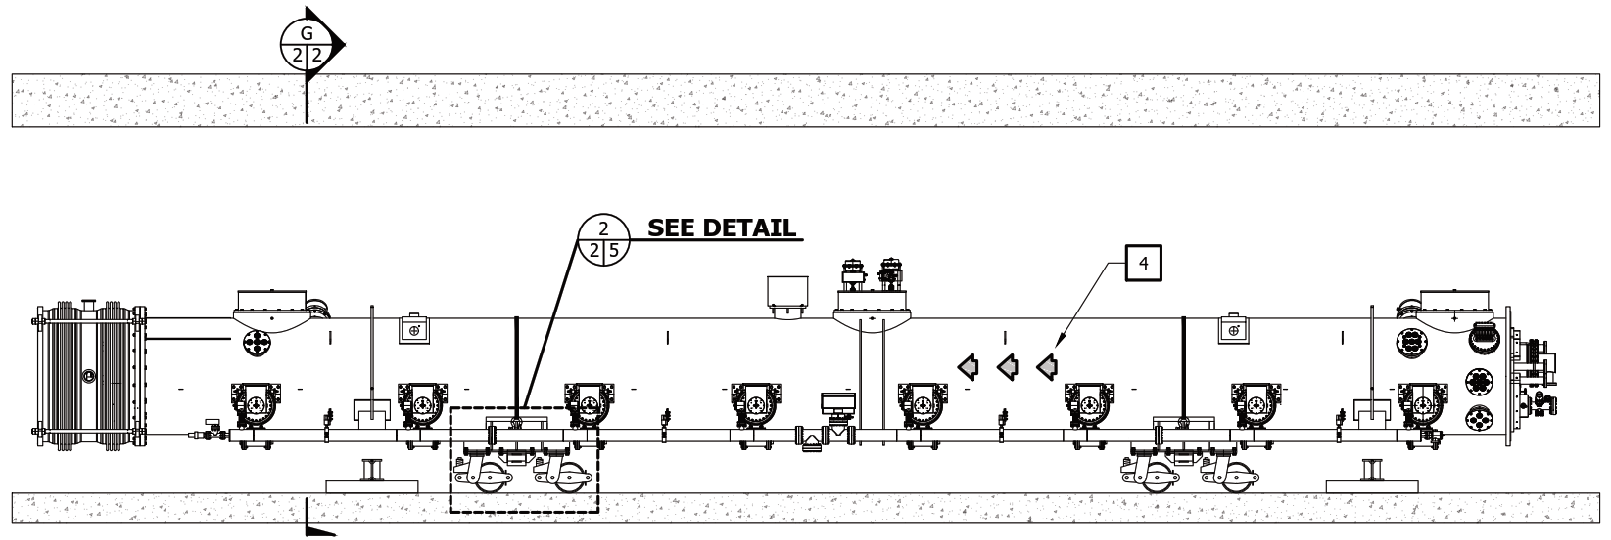
Physical Install / Alignment
Physical Install
Requirements:
Transport Thru Tunnel
Positioning on Supports
Protecting all CM
  Minimizing Shock
  Collision Opportunities

Slide 8
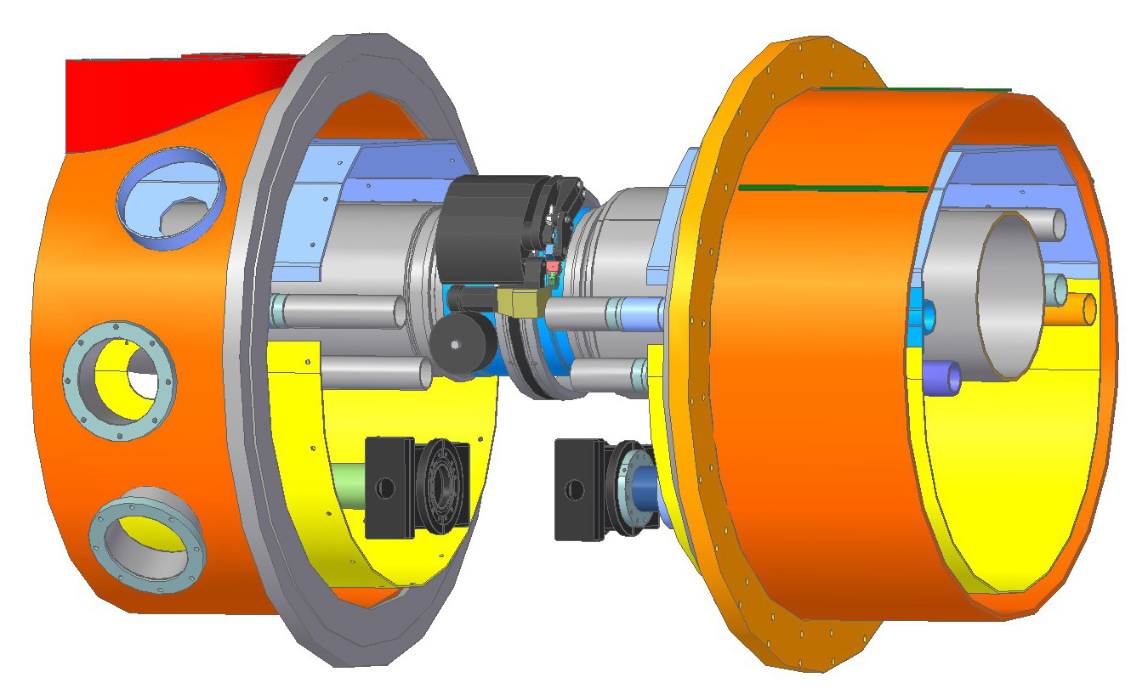
CM Welding – Orbital Welding
HGRP Weld & Exam

Slide 9
CM Welding
Compliance Strategy
HGRP Weld & Exam
2” Pipe Weld & Exam
Pressure Test - Full String
Cryo Pipe Leak Test
ASME Process Piping - B31.3
 | HGRP (300 mm) | 2” Pipes
Weld Machine | Tractor Head (Model 15) | Fusion Head ( Model 9)
Weld Filler | ER308 | None
Examination | Weld Coupons | Weld Coupons
 | In Process Examination | In Process Examination
 | Visual (with Borescope) | Visual (with Borescope)
Testing | Helium Leak Test | Helium Leak Test
 | Pneumatic (2.3 Bar-g) | Pneumatic (22 Bar-g)
Last Welds | Insert Rings | Insert Rings
 | Alternate Examination (UT) | Alternate Examination (UT)

Slide 10
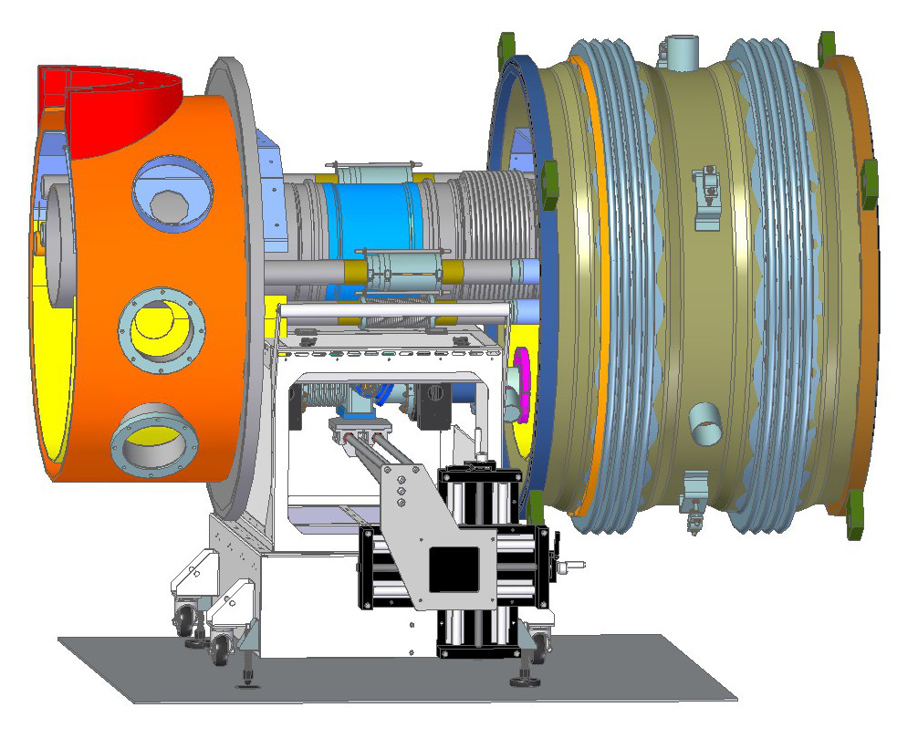
CM Beamline Install – Clean-Zone
BLA Install
BLA Pump Down & Leak Test
Cryomodule Beamline:
BLA Install - Particle Free Clean
Beamline Components Arriving PF Clean
Very Limited Space for
Clean-Zone

Slide 11
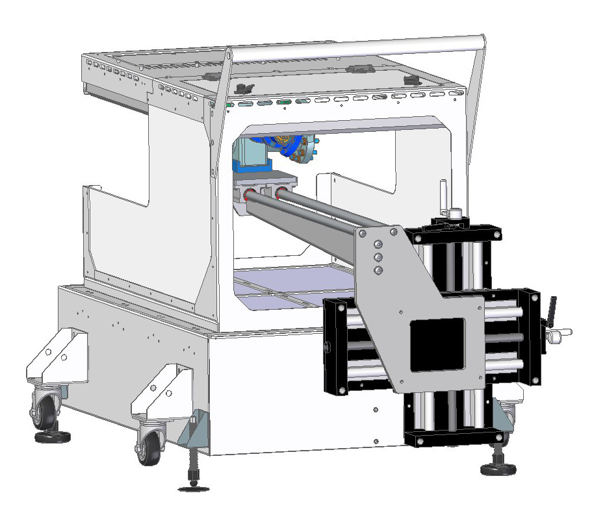
CM Beamline Install – Mechanism
BLA Install
BLA Pump Down & Leak Test
Fan Blowing Up
Cantilevered Holding Mechanism
Adjustment Parts Mostly Outside Clean Space
Frelon based Bearings Inside

Slide 12
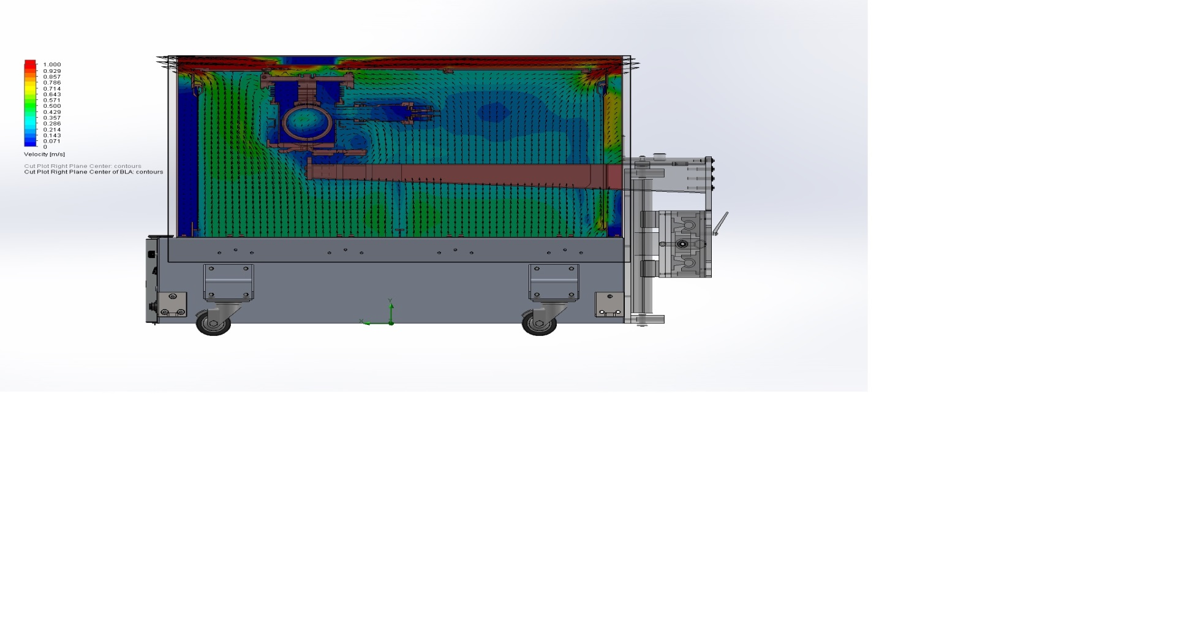
CM Beamline Install – Air Flow
BLA Install
BLA Pump Down & Leak Test
Air Velocity Plot through Center of Clean Zone
Curtesy of Intelligent Enclosures

