Slide 1
LCLS-II cavity procurement strategies and status
Ari Palczewski for the JLab Cavity Procurement Team
Most slides from Frank Marhauser
TTC MSU 2017 – Feb 22 2017

Slide 2
Outline
Key Procurements
Cavities
Niobium (and NbTi) Material – skipping, QC by DESY 6 months late because of customs
see WG1 talks Gonnella, Posen, Palczewski
Parts in Circulation (PIC’s) – skipping, 133 total set (1/2 total) requires efficient use
In Procurement Phases and Milestones
Vendor Qualification (Phase I)
First Articles (Phase II)
Production (Phase III)
Exercise Options for more cavities plus spares (Phase IV)
Cavity Quality Assurance and Control
Acceptance Levels/Hold Points
Procurement Timeline
Change Requests for Cavity Processing Recipes
VTA Performance Summary
Summary

Slide 3
Key Procurement
266 LCLS-II 1.3 GHz cavities
Procured and managed by JLab from 2 industrial vendors in Europe:
Ettore EZ, S.p.A. (EZ), Italy
RI Research Instruments, GmbH (RI), Germany
LCLS-II project mitigates risk to critical procurements by awarding to multiple vendors
This covers 33 cryomodules (33 x 8 = 264 cavities) in addition to the 2 prototype cryomodules currently assembled at partner laboratories
Each vendor will provide 50% of the cavities per present contract
Note: 2 cavities are replacement cavities for FNAL (no spares initially)
Optional 32 extra cavities available for procurement
FNAL and JLab share the work load of cryomodule (CM) assembly
16 CMs at FNAL, 17 CMs at JLab
Plus 1 prototype CM at each laboratory

Slide 4
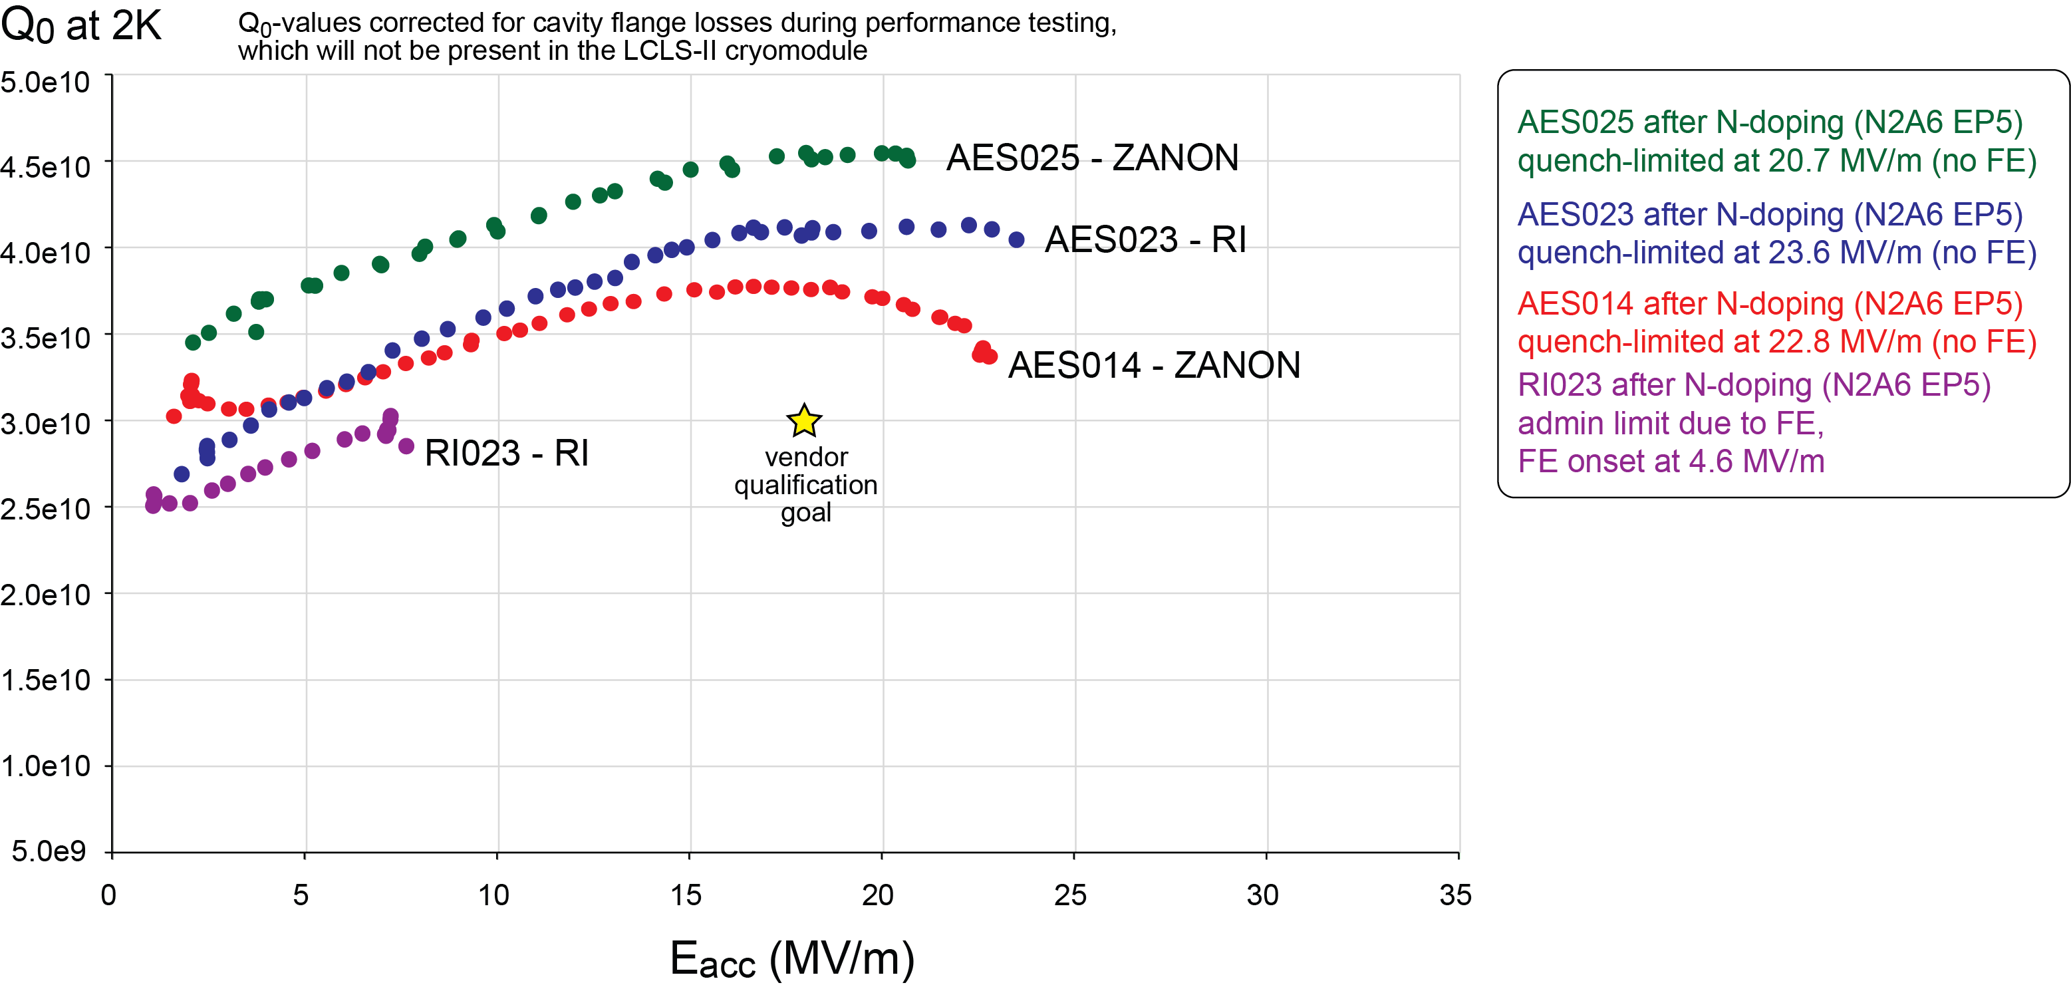
Phase I - Vendor Qualification (VQ) – N-Doping Technology Transfer
Technology transfer to industry successful, furnace and doping Good

Slide 5
Vendor Qualification Results Phase II – First Articles
Vendor A was delayed because of material so only 8 first articles. Second 8 were sort of “second articles” after 900/200. Not really true first articles in the sense that production didn’t wait on testing results. All cavities were material type 2 with Low Qo and low quench fields, see end slides/Gonnella Talk. In addition multiple had very early FE onset. Many question were left open because of material questions, possible HV welding temperatures and other issues. – Partial release after first 8/16 cavities. FE reduction changes were also implemented.
Vendor B completed first 16 cavities before Vendor A, all Material 1. 12 of 16 had Field emission with many with Early onset which required re-rinse. All cavities reached 19MV/m or more after re-rinse. - released for full production with recipe changes and FE reduction changes after test cavities were put though system (cavities 17-20)

Slide 6
Procurement Milestones
No changes to project milestones since last year, but scheduling changed.
One Vendor production stopped twice to send test cavities going through the system. The other Vendor stopped once for recipe change cavities
Partial third restart in progress on Vendor A. Rework R&D ongoing (for first half cavities cavities)
Phase | Purpose | Cavity Count | Planned Duration | Actual Duration
I | Vendor Qualification | 2/2 | 6 months May 2015 – Nov 2015 | 7-8 months May 2015 – Dec 2015 (Vendor A) Jan 2016 (Vendor B)
II | 1st Articles | 16/8 | 7 months Nov 2015 – June 2016 | delayed start 6 months Feb 2016 – August 2016
III | Full Production | 250 | 15 months June 2016 – Sep. 2017 | delayed start Nov 2016 Ongoing one vendor Production hold on other
IV | Optional Units | 32 | Begin at end of production line for any vendor | NA

Slide 7
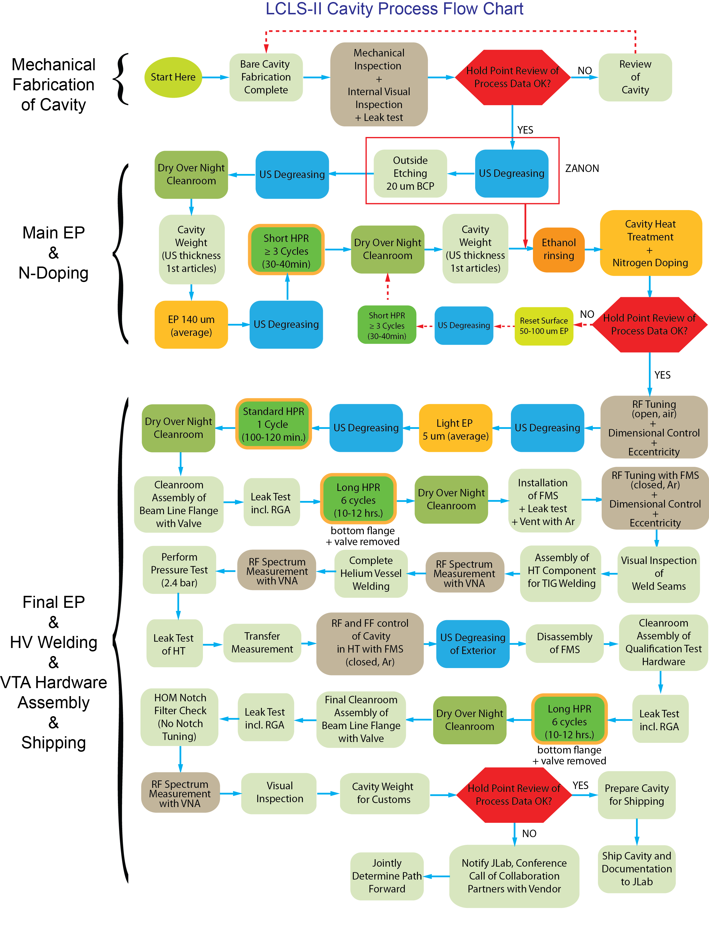
Quality Assurance and Control
Vendor change requests partially accepted
Ethanol rinsing is introduced after bulk EP
Weight of fully dressed cavity must be recorded for customs documentation/release
HPR rinse times follow XFEL recipe (mitigation of field emission), additional ethanol rinse added after final EP as well
We have weekly meetings for more than 1 year with both vendors to talk about production and technical issues

Slide 8
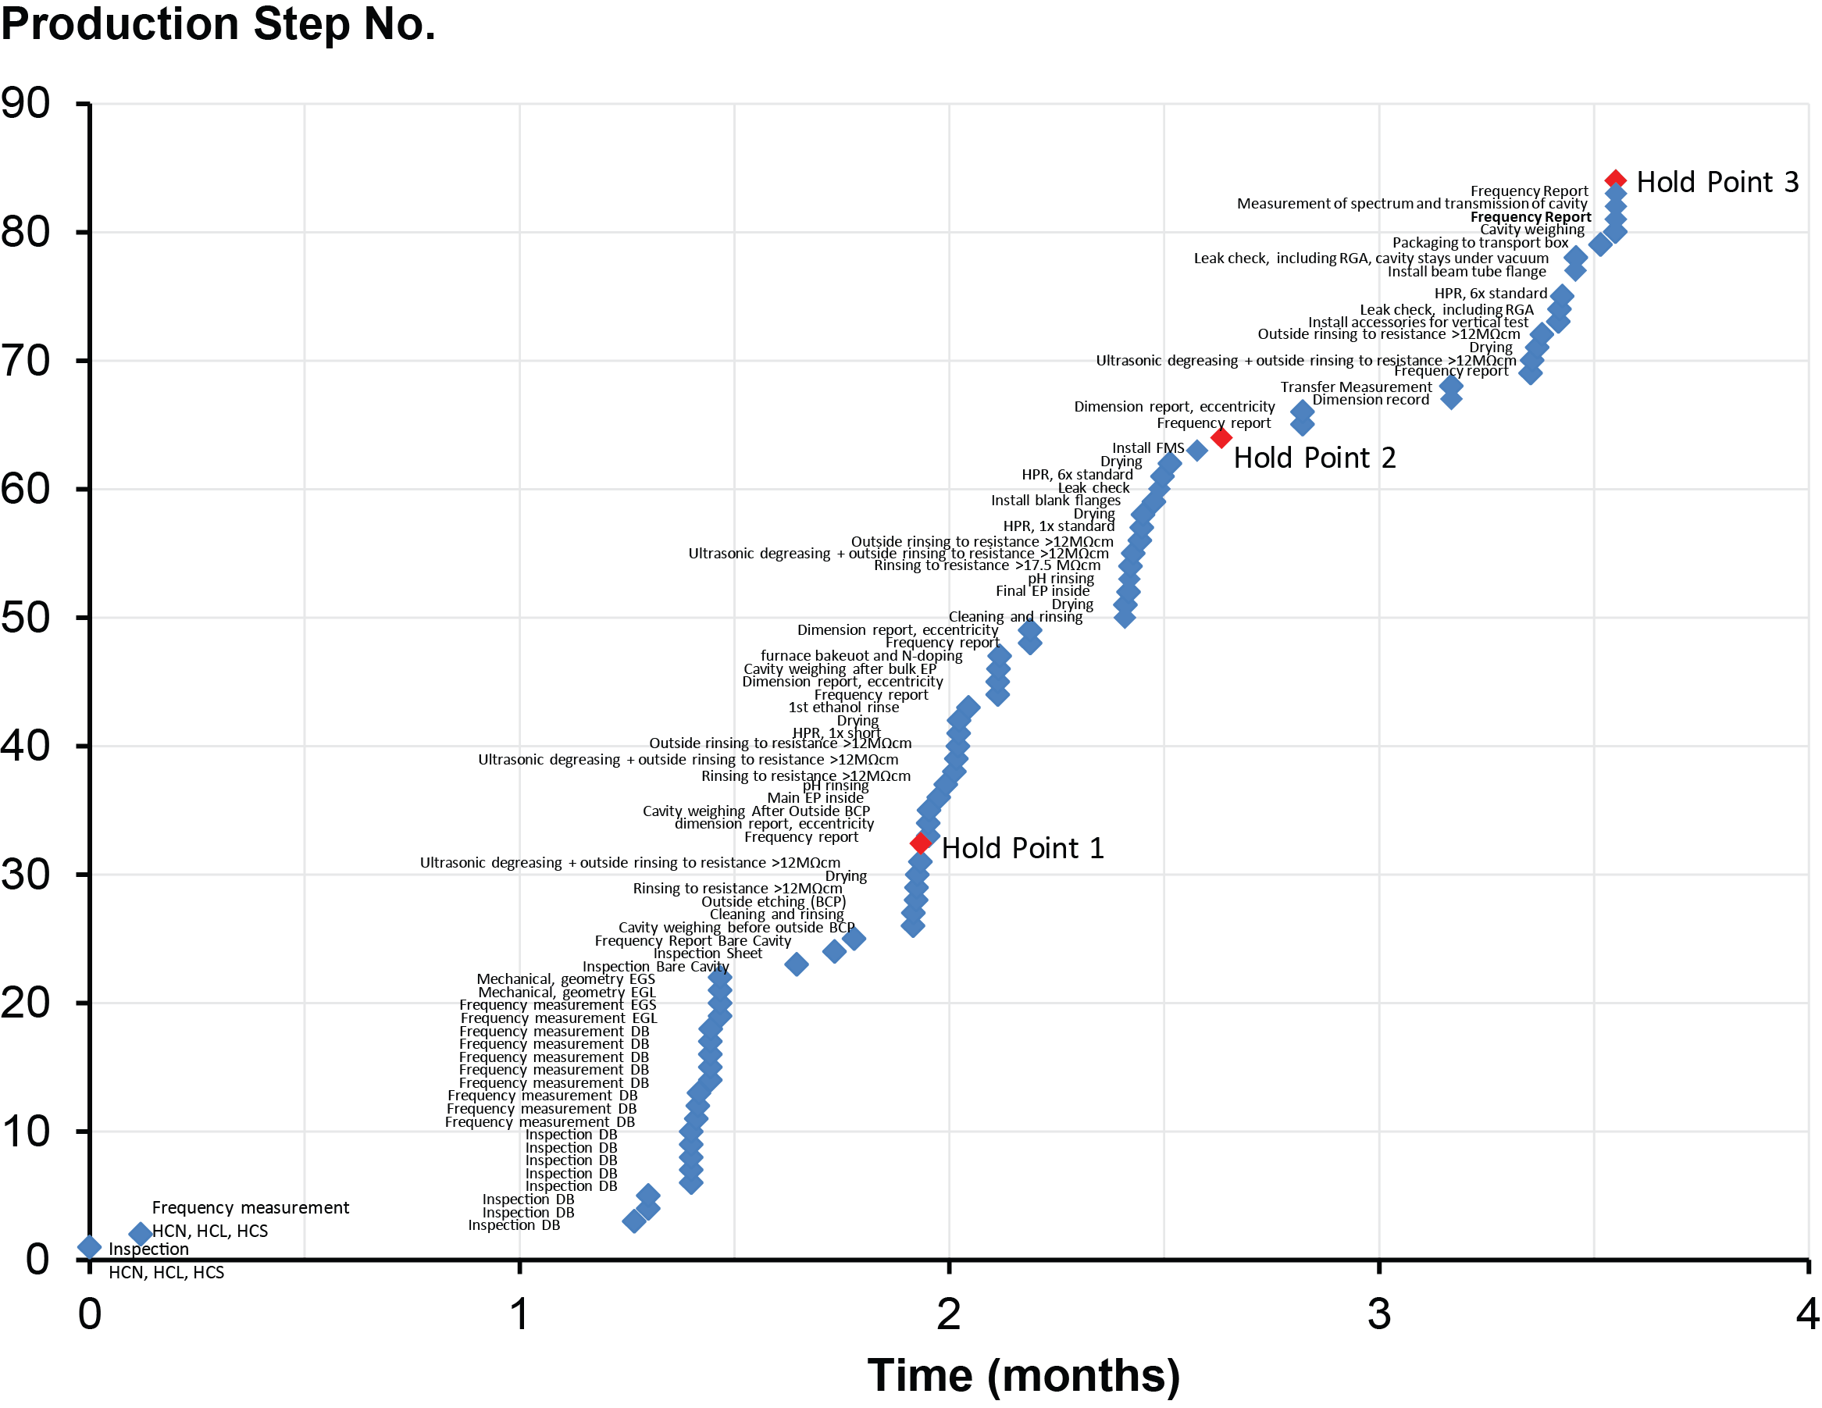
Hold Point Data Review
Vendors deliver QC documents for all main production steps reviewed at the 3 Hold Points
Hold point data is review by FNAL/JLab/SLAC staff with redundant personal now. All final releases go though JLab.

Slide 9
Current Statues – receipt inspection
~ 35% of cavities shipped, ~ 20% qualified
Vendor A delayed because of material delay and now production issues

Slide 10
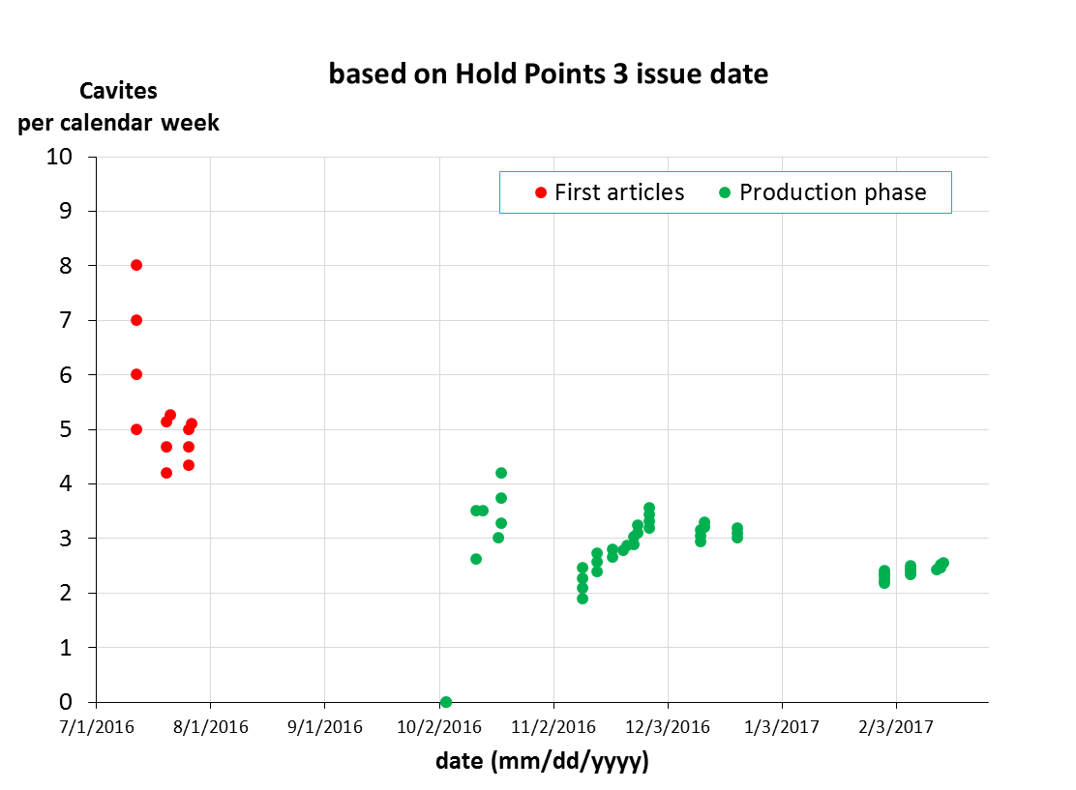
Vendor B rate – Hold point 3 release, not delivery
Recipe change
hold
Shutdown
In contract, no issues
reason released later

Slide 11
Major Change Requests during production
Baseline recipe (800°C/3 hrs. and N2A6 doping recipe) did not provide the expected high Q₀-values <Q₀> = 2.3e10 at 2K @ 16 MV/m and with more FE than expected
Improvement implemented into production
1) Change from 800°C to 900°C annealing to remedy poor flux expulsion of production material (both material), with CAPS
2) Increase bulk removal by Electro-polishing (from 140 um to 200 um) to minimize residual resistance (added cost and time)
3) Added Second Ethanol rinse after Final EP
4) Field emission reduction techniques (cleanroom protocols) introduced to both Vendors, twice.
5) Implementation of material sorting by flux expulsion was implemented for material 1
Risk mitigation was pursued by testing nine-cell cavities with new recipe for material 2
Two bare cavities + 2 fully dressed cavities delivered by Vendor B (tested at FNAL/JLAB) – material 2 (added two week delay)
8 dressed cavities (cavities # 9-16) from Vendor A – material 1
New recipe is approved, i.e. restarted production Nov. ’16
Risk mitigation is pursued by testing nine-cell cavities with new recipe for Material 1
Two bare cavities (975°C)+ 2 fully dressed cavities to be delivered by Vendor B

Slide 12
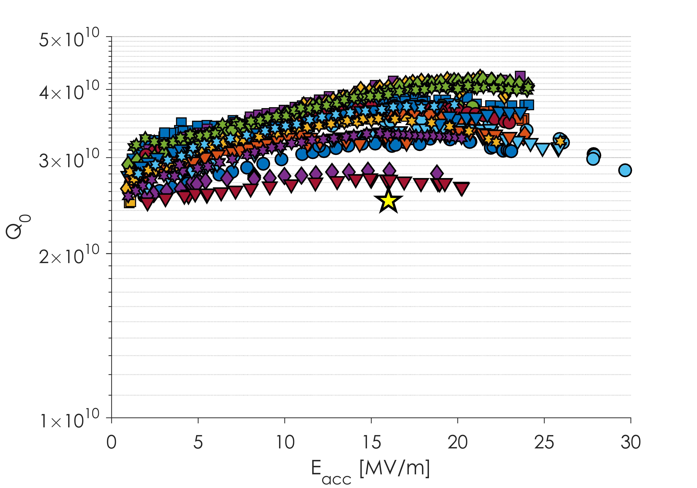
Vendor B Results – New recipe Material 2
Majority of Cavities Now above 3x10¹⁰
Almost all Vendor B Cavities Quench above 22 MV/m
Subset of Vendor B Cavities after Recipe Change
All Material 1
Magnetic field in VT Dewars no longer actively compensated – most of these tests in >5 mG

Slide 13
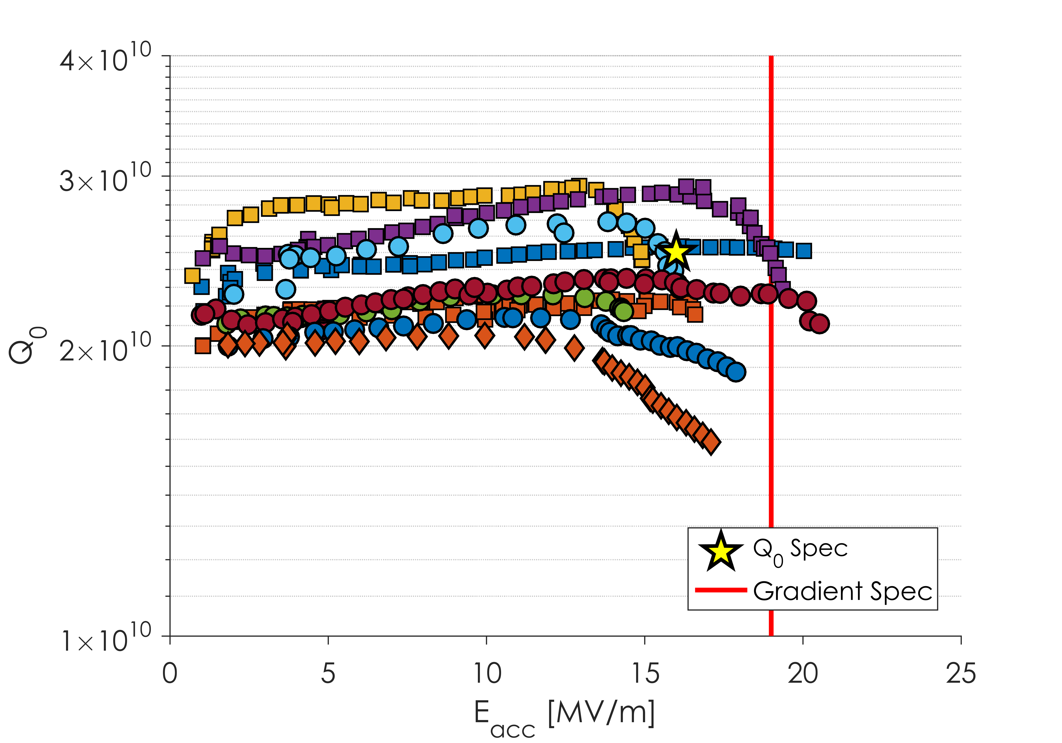
Vendor A Results –new and old recipe Material 2
Spread in Q Due to Change in Recipe
All Material 2
Large Q Slope present in some cavities leading to quench below the spec of 19 MV/m
Related to material?

Slide 14
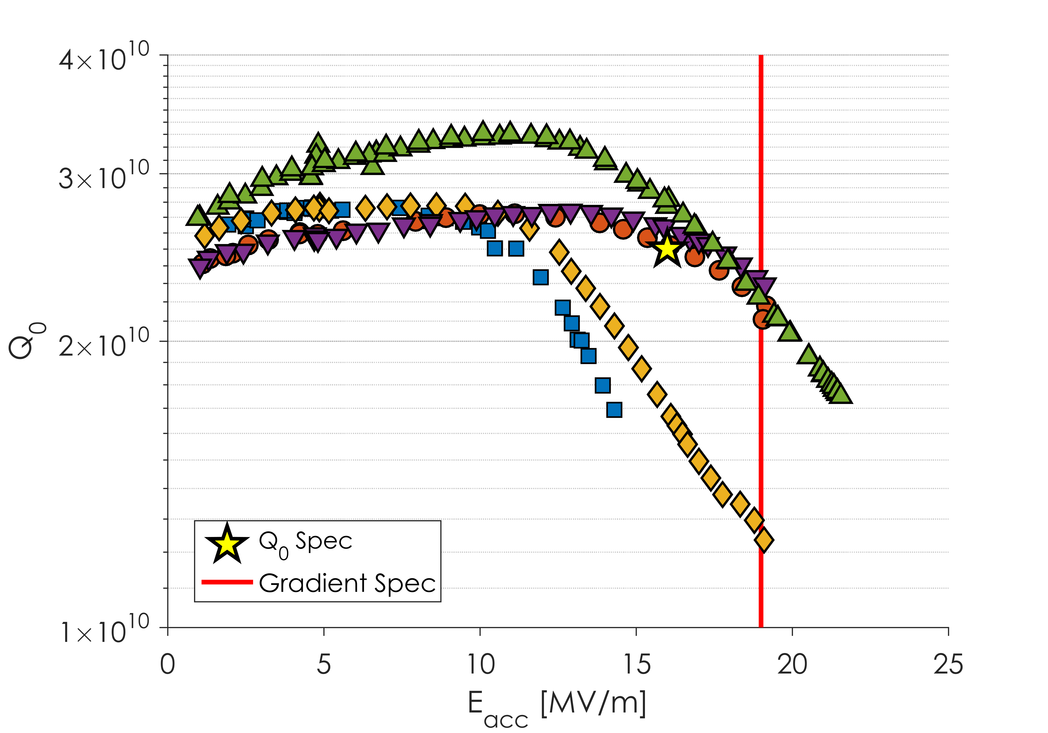
Vendor A Results – new recipe, Material 1
All Material 1
Gradient limitation not related to material type

Slide 15
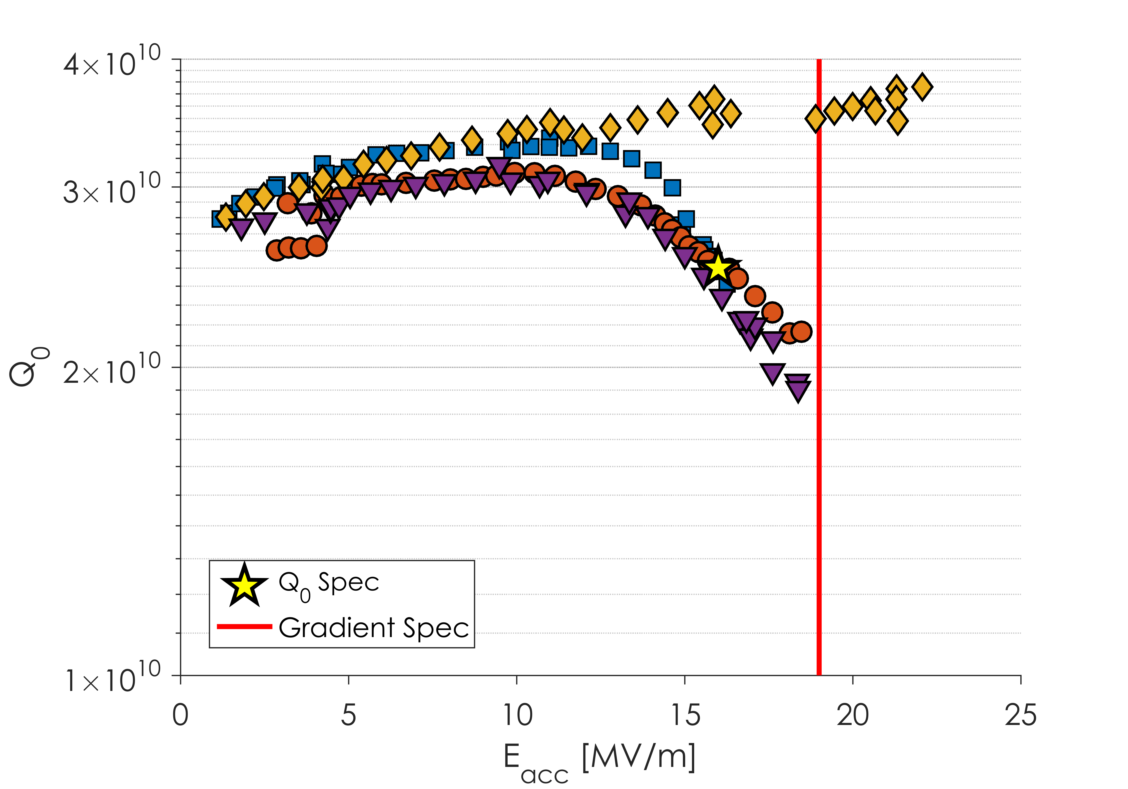
Vendor A – Improved EP, new recipe, Material 1
Q Slope and gradient limitation still present

Slide 16
Summary
Phase I and II completed by both vendors
Phase III underway both vendors, although one on hold because of RF performance issues
So far hold point data analysis with multiple input from FNAL/JLab/SLAC is going very well
~20% of LCLS-II cavities qualified, with ~ 35% shipped.
Feedback to both vendors now weekly or bi-weekly.

Slide 17
Backup Slides

Slide 18
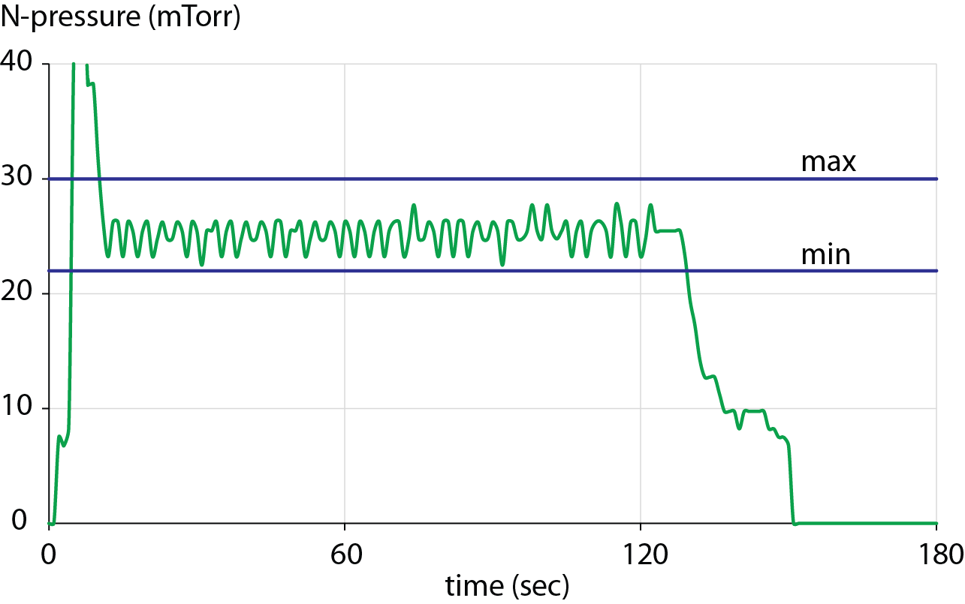
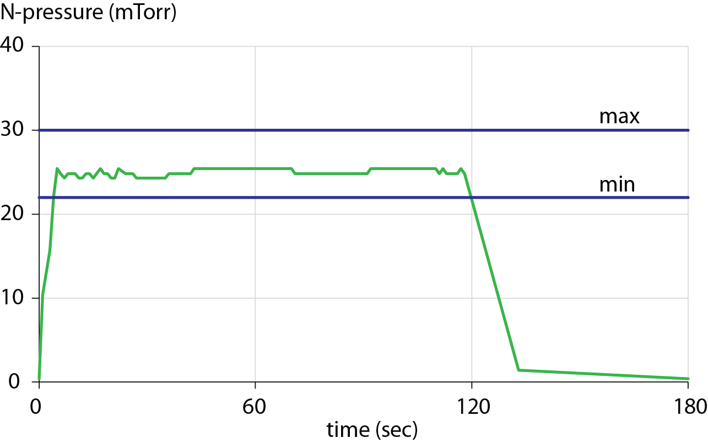
Phase I - Vendor Qualification (VQ) – N-Doping Technology Transfer
Each vendor had to successfully N-dope 2 bare VQ cavities (delivered from project) in sequence to show the characteristic rise of the Q₀ due to the N-doping
All 4 VQ cavities were shipped back under vacuum to JLab with vertical test hardware for high power RF tests to verify success of N-doping
Pressure control well demonstrated by both vendors within required limits
Step | Temperature (°C) | Duration | N-Pressure (mTorr)
H degassing | 800 ± 10 | 180 ± 5 min | 0
N-Doping | 800 ± 10 | 2 min ± 6 sec | 26 ± 4
Annealing | 800 ± 10 | 6 min ± 6 sec | 0
800 deg. C annealing for 3 hours
‘N2A6’ doping recipe
VQ cavity AES014
VQ cavity AES023
avg. 25.2 mTorr
avg. 25.0 mTorr

