Slide 1
CADS Linac Beam Operation
Linac Team of China ADS
Y. He, Y.M. Li, J.H. Zhang, S.H. Zhang, Z.J. Wang, W.M. Yue
Institute of Modern Physics, Chinese Academy of Science
W.M. Pan, Y.L. Chi, R. Ge, F.S. He, F. Yan
Institute of High Energy Physics Chinese Academy of science

Slide 2
Outlines
Introduction of ADS Project of China
Progress of 162.5 MHz Injector
Progress of 325 MHz Injector
Summary

Slide 3
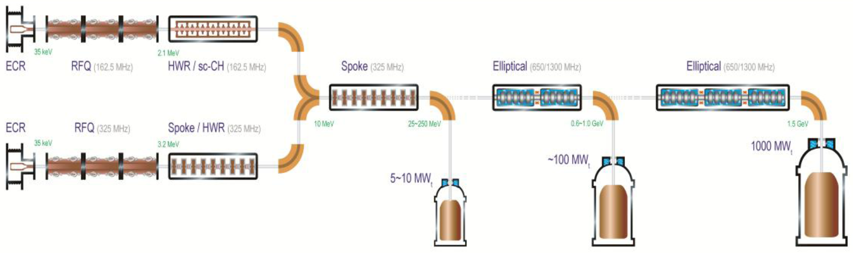
Roadmap of ADS project in China
Injector II, 162.5 MHz
Goal in 2017.06, 25 MeV
Injector I, 325 MHz
Stage 1: Research facility (CIADS)
(600 MeV, 10 mA, 10 MWt)
Y2017-2023, ~2.8 B CNY
“Strategic Technology Pilot Project”
of the Chinese Academy of Sciences
Key technology R&D
Y2011-2017, 1.78 B CNY
Stage 2: Demo facility (CDADS)
(~1.0GeV, 10~25 mA, 500 MWt)
Y2030

Slide 4


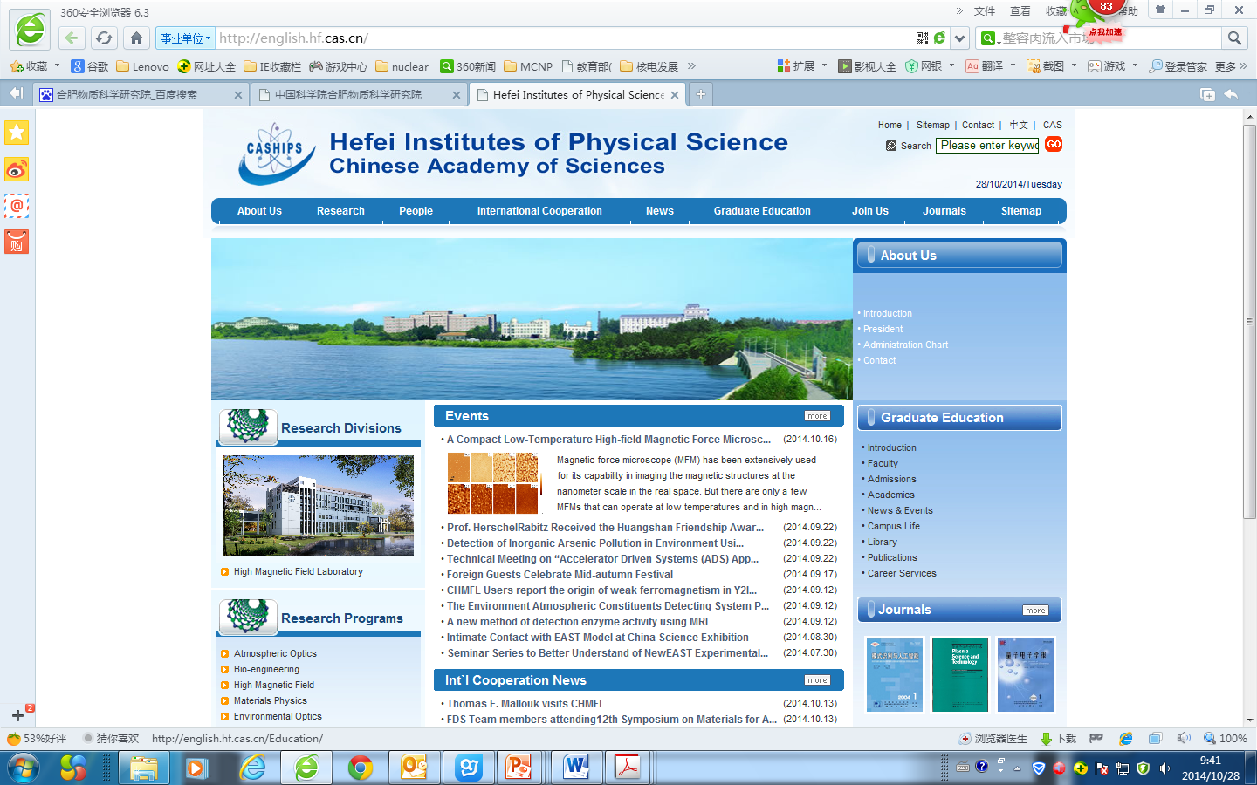
The CAS ADS Program (2011-2017)
The program of “Advanced Nuclear Fission Energy --- the Accelerator Driven Sub-critical System ” was initiated by CAS under the frame of “Strategic Technology Pilot Project” in 2011
The ultimate goal is to build an industrial-scale demo facility for the development of advanced fission energy
The budget is Ұ1.78 billion for a five-year period
IMP is the leading institute to carry out the research in cooperation with a number of participants.
IMP
IHEP
The CAS ADS Program
CASHIPS
Notes:
Driven by the national demand for safe disposal of nuclear waste as well as the potentials for nuclear fuel breeding and advanced energy generation, CAS initiated the China Accelerator Driven Sub-critical System (ADS) program in 2011, which is incorporated into the program of “Advanced Fission Energy” under the frame of “Strategic Technology Pilot Project”.

Slide 5
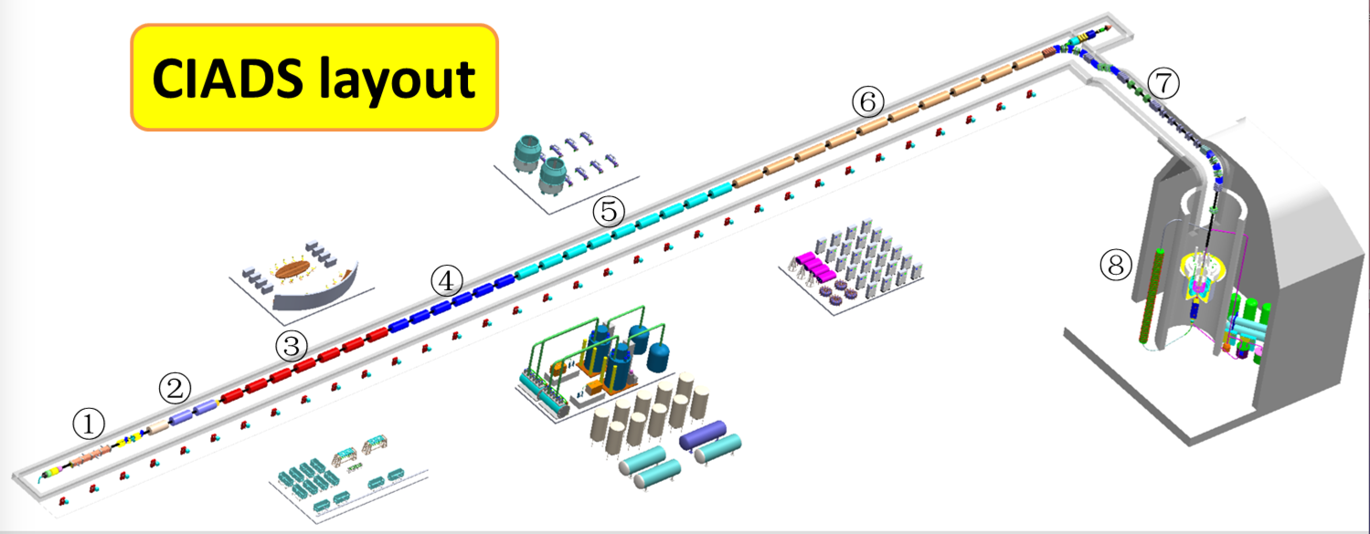
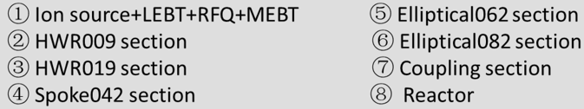
New Project CIADS (2017-2022)
China Initiative Accelerator Driven System
Budget: ~1.8 B CNY(Central Gov.)+1.0 B CNY(Local Gov.)
Location: Huizhou, Guangdong Prov.
Spallation Target:
  granular flow
  >2.5 MW
Proton LINAC:
~600 MeV
10 mA
CW mode
Sub-critical core:
  LBE coolant
  <10 MWt

Slide 6
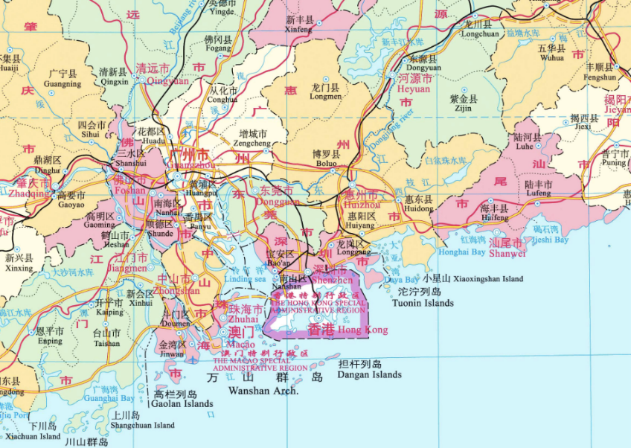
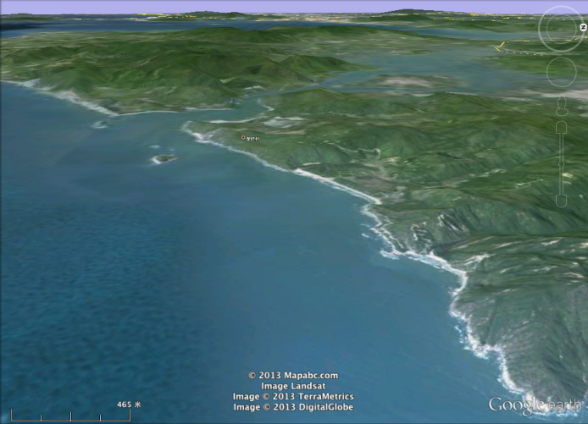
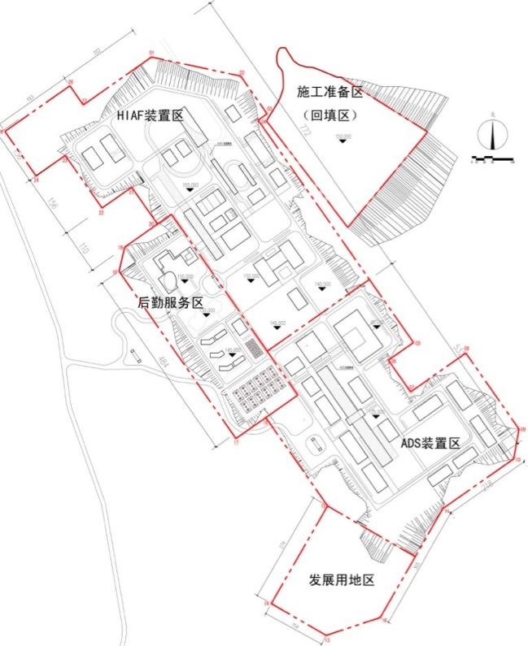
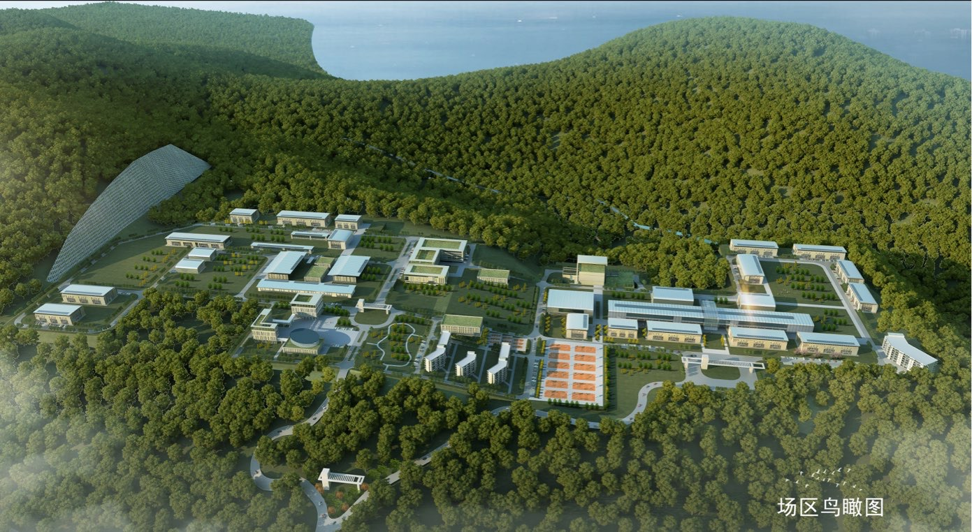
Location of CIADS
CIADS site
A new site, which locates in Huizhou, Guangdong, was selected
This new site is nearby the planed Huizhou nuclear power plant

Slide 7
Outlines
Introduction of ADS Project of China
Progress of 325 MHz SRF Linac
Progress of 162.5 MHz SRF Linac
Summary

Slide 8
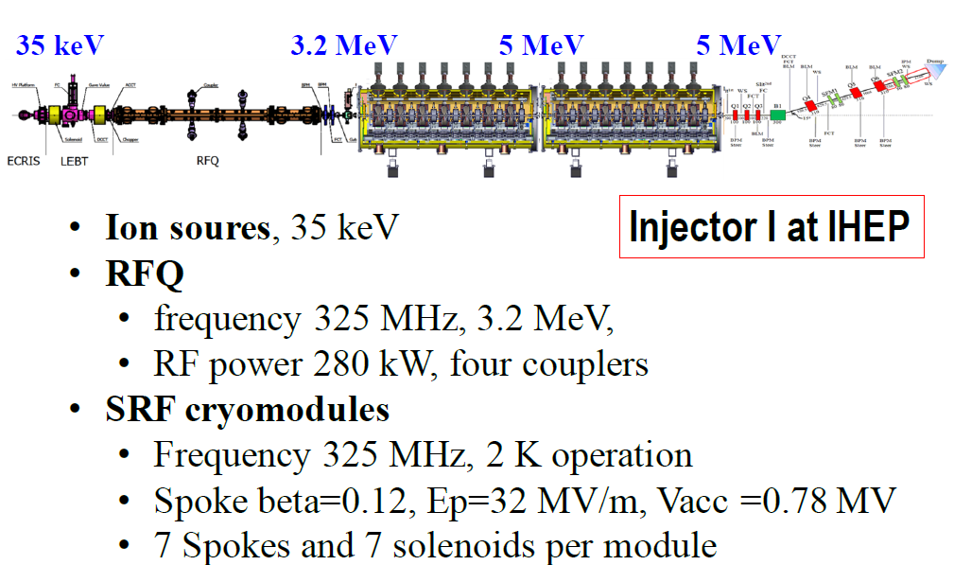
325 MHz SRF Linac @ IHEP
10 MeV

Slide 9
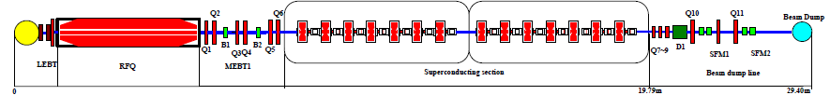
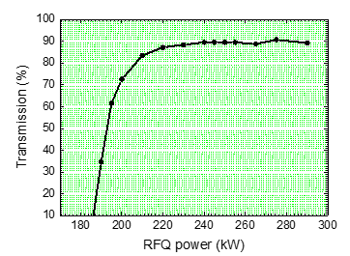
Pulse mode Operation
a) The transmission of the new RFQ
Injector-I RFQ
f= 325MHz
Cavity power dissipation: 273kW
1Hz/20us
ACCT1 current at the RFQ entrance: 2mA
RFQ Max. transmission: 90%@>240kW
@2mA
 | α_{x} | β_{x} | ε_{norm.x} | α_{y} | β_{y} | ε_{norm.y}
 |  | _{mm/mrad} | _{π.mm.mrad} |  | _{mm/mrad} | _{π.mm.mrad}
Measurements | -0.788 | 0.098 | 0.06 | 1.79 | 0.157 | 0.102
Simulated | -1.34 | 0.105 | 0.2 | 1.19 | 0.116 | 0.2
Courtesy Prof. Weimin Pan

Slide 10
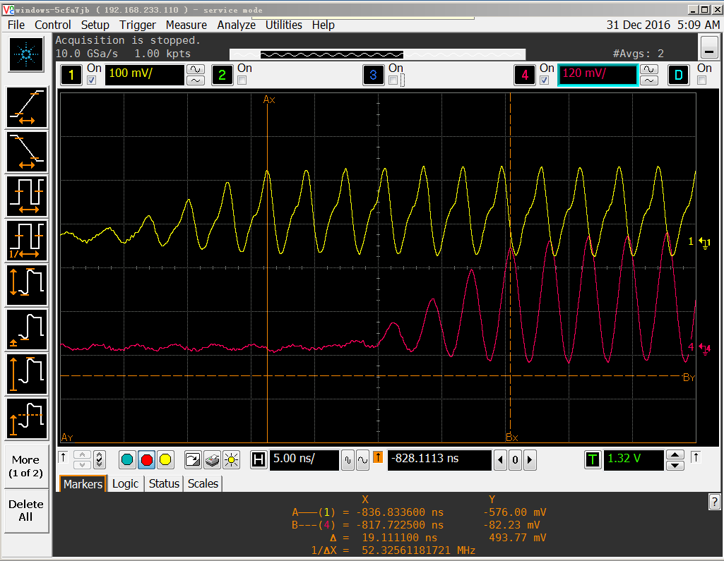
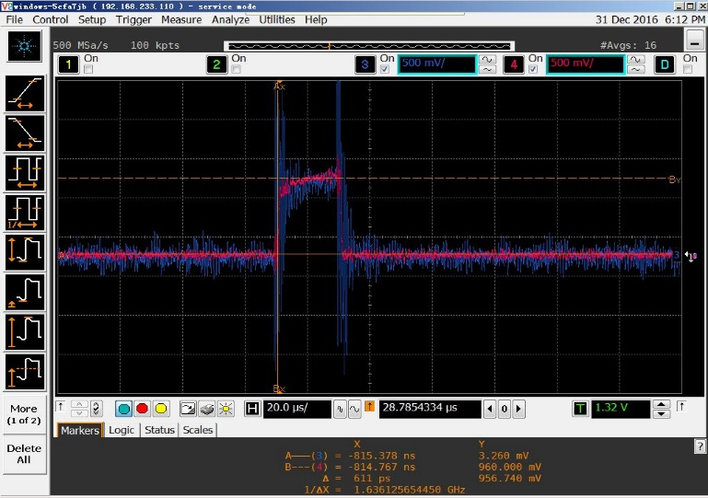
Pulse mode Operation
b) Achieved 10MeV proton beam at the exit of the CMs
Operating gradient of 14 Spoke cavitie @10.08MeV
Cav. | #1 | #2 | #3 | #4 | #5 | #6 | #7
Ep(MV/m) | 16.5 | 23.9 | 25.0 | 26.5 | 29.1 | 24.3 | 20.3
Cav. | #8 | #9 | #10 | #11 | #12 | #13 | #14
Ep(MV/m) | 24.5 | 18.1 | 29.6 | 24.7 | 27.6 | 26.1 | 21.8
upstream
Blue:ACCT2
downstream
Red:ACCT3
The Energy is measured by upstream FCT1 (yellow curve) and downstream FCT2 (red curve)
The transmission of the beam From the entrance of the CM1 to the exit of the CM2：100％

Slide 11
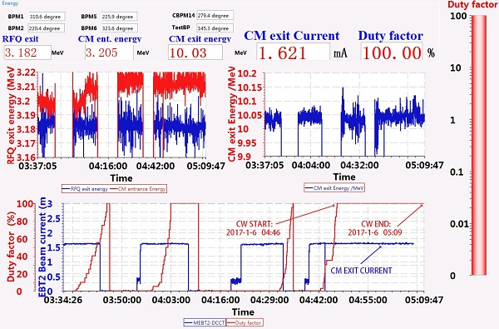
Long pulse／CW commissioning
2016-12-28, increasing the duty factor to 100% gradually, 9.1 MeV@ 2.2 mA first CW proton beams was obtained!
2016-12-31, 17:51 10MeV/1.83mA CW beam obtained!
2017-1-4, 10MeV/2.1mA CW proton beam operated for 155s！
2017-1-6, 10MeV/1.6mA CW proton beam operated for 23 minutes!!!

Slide 12
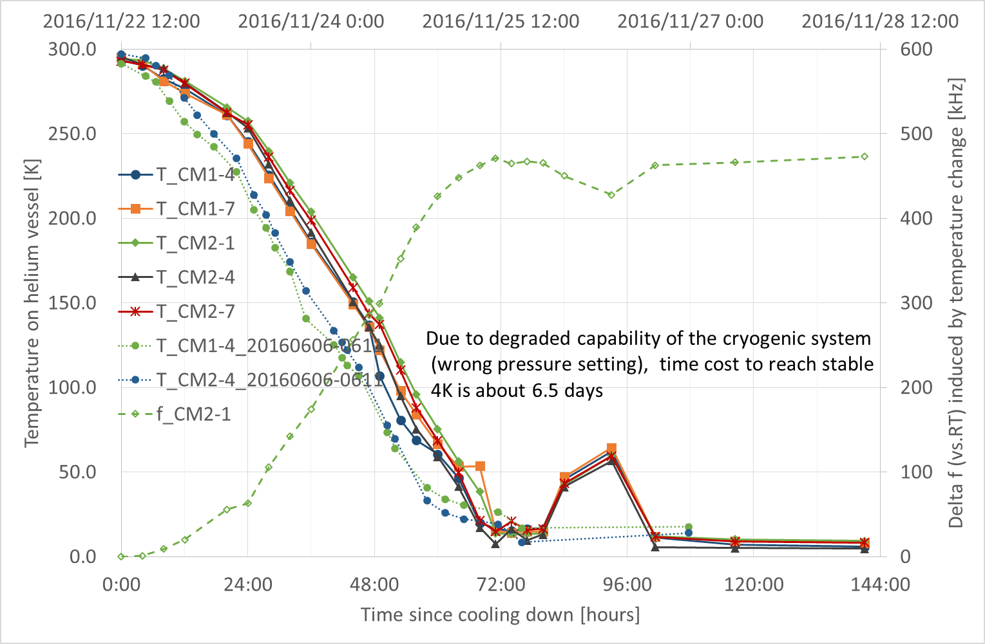
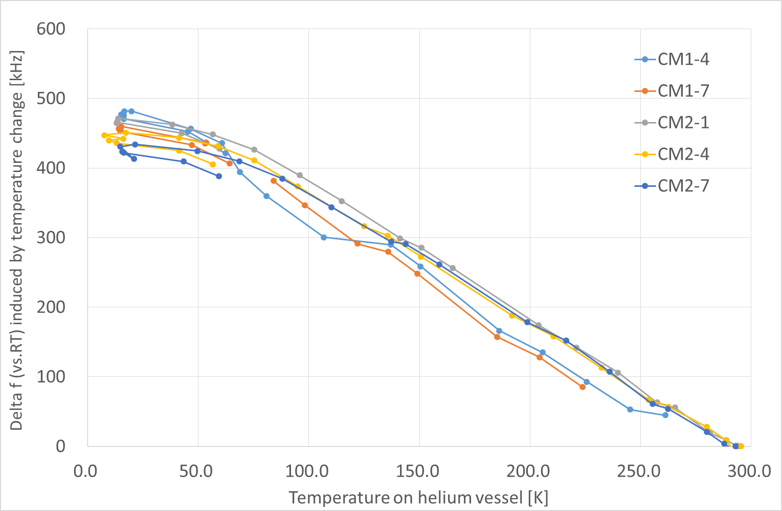
Cryomodule and cavity measurements
It takes about 6 days to reach 4K stable operation
Cooling from 4K to 2K usually takes 0.5-2 hours
Measured df/dp is about -130Hz/mbar for CM1 cavities,
-83Hz/mbar for CM2 cavities; LFD factor is about -13 Hz/mbar.
Cavity_ID | 1 | 2 | 3 | 4 | 5 | 6 | 7 | 8 | 9 | 10 | 11 | 12 | 13 | 14
df_4KvsRT [kHz] | 546 | 523 | 540 | 462 | 509 | 557 | 496 | 408 | 428 | 511 | 323 | 572 | 519 | 553
df/dp [Hz/mbar] | -157 | -129 | -134 | -150 | -131 | -119 | -91 | -66 | -47 | -96 | -82 | -75 | -97 | -119
LFD [kHz] | -14 | -12 | -11 | -13 | -12 | -10 |  | -13 | -13 | -9 | -10 | -12 | -9 | -16

Slide 13
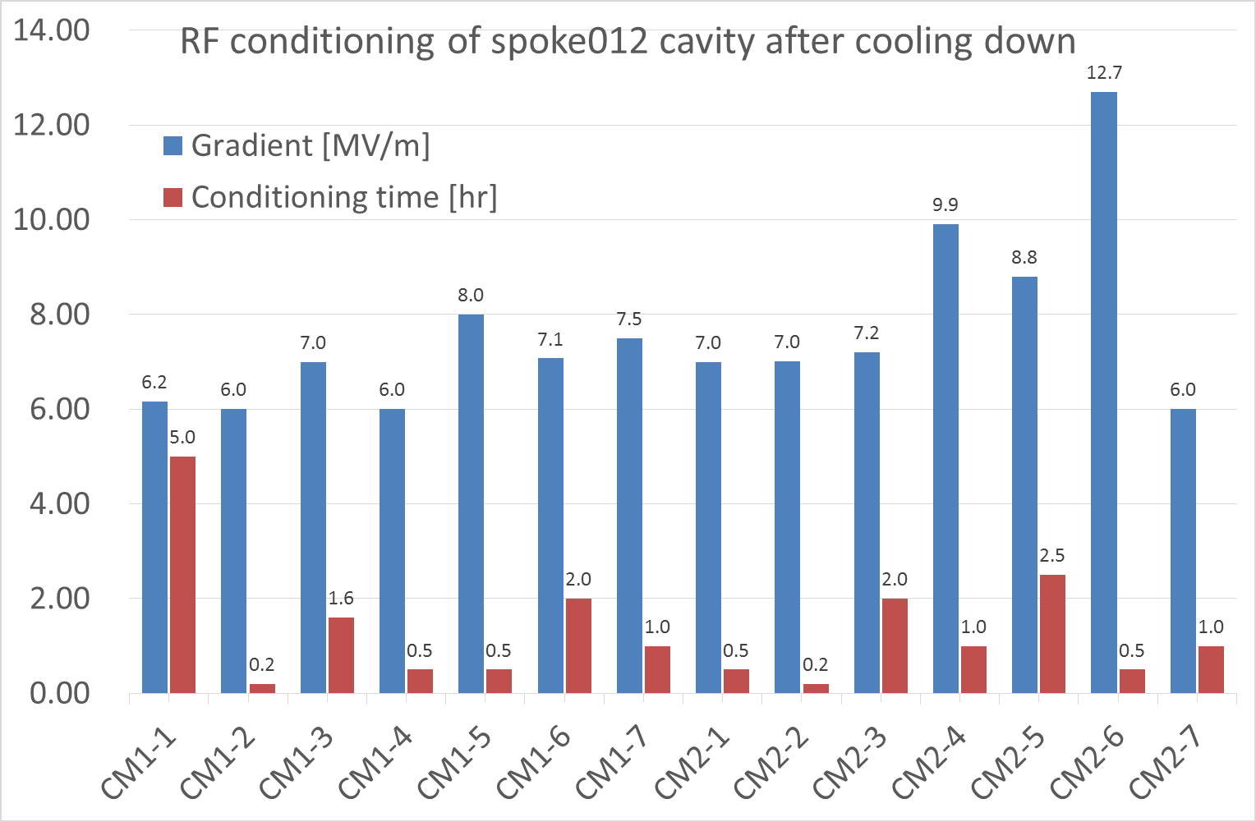
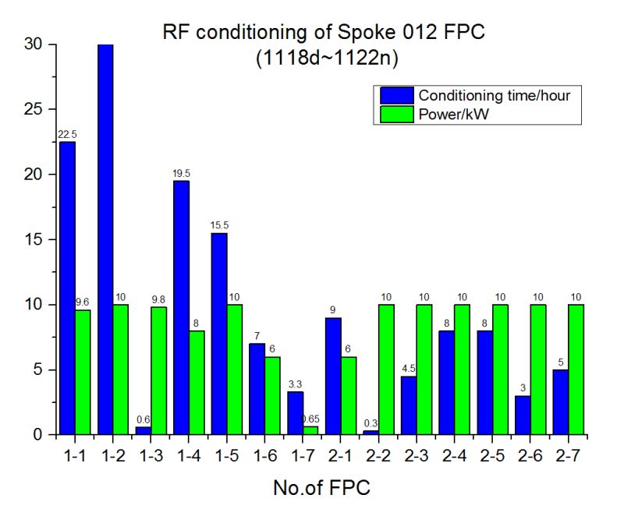
Cavity and coupler conditioning
During maintenance period, gate valves outside cryomodule are typically closed, and vacuum in the cavities is typically 1e-2 to 1e-3 Pa
Coupler RT conditioning typically takes more than 4days due to low pumping speed from beam pipe
Cavity conditioning at 4K typically takes 1-2 days

Slide 14
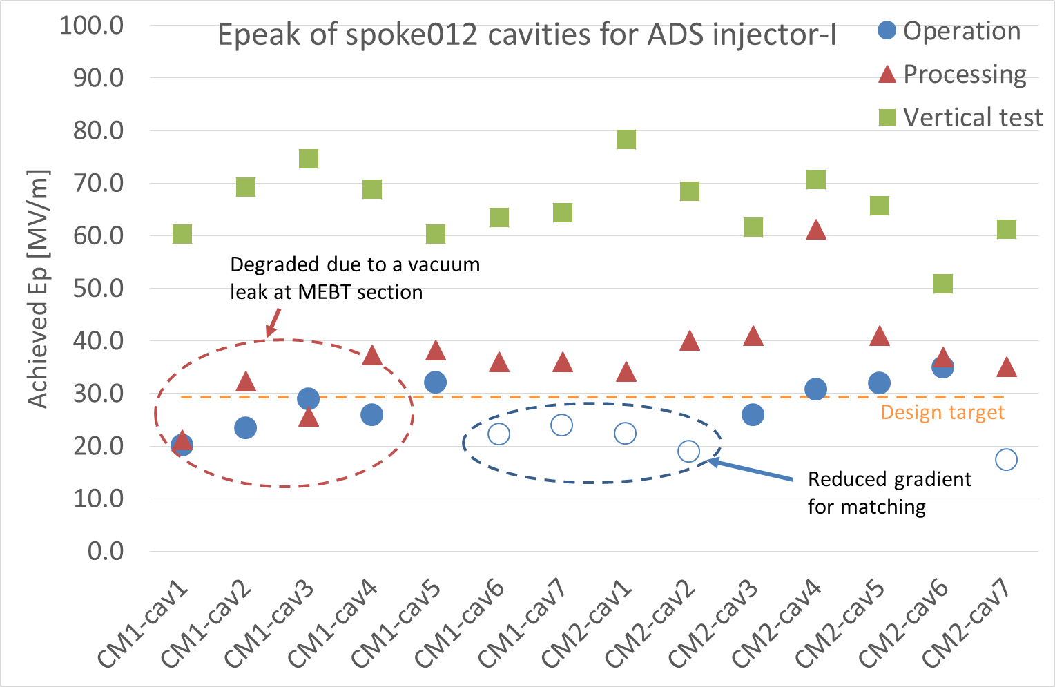
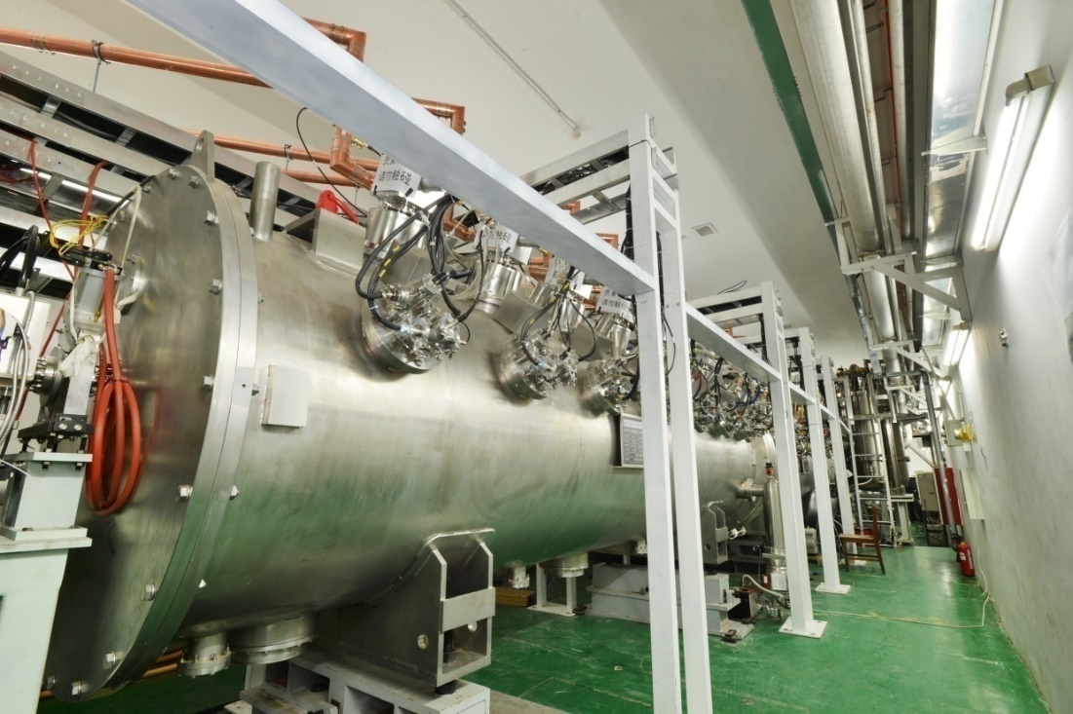
Cavity performance during beam operation
Cavity was conditioned to 7-8MV/m before beam operation (FE for cav 1-4#, administrative for Cav5-14#)
On beam operation of 10MeV mode, average cavity gradient is 6MV/m, i.e. Ep~27MV/m
Cav1-4# degraded significantly after an vacuum leak in the RFQ section.
9.1MeV

Slide 15
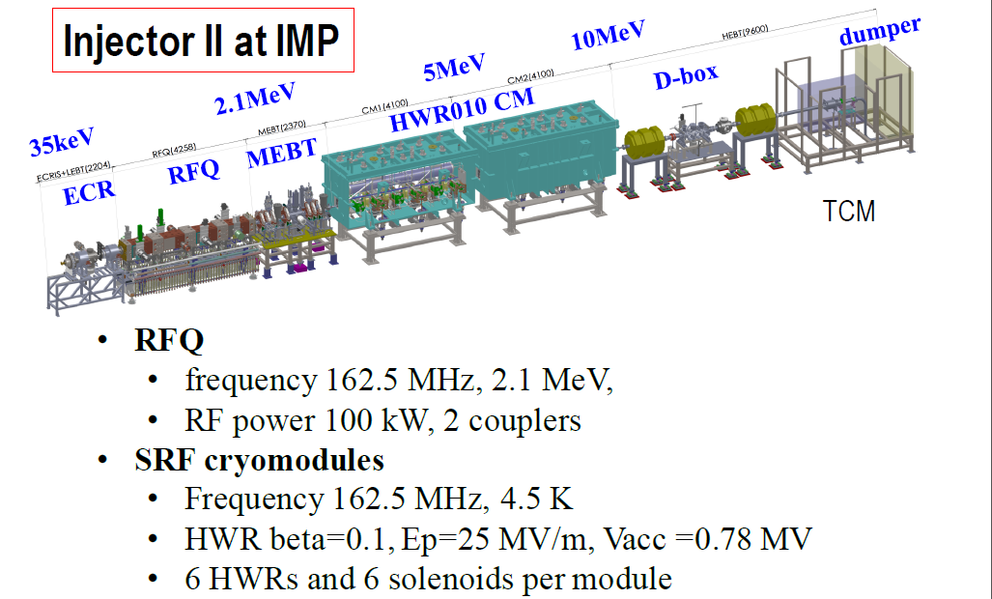
162.5 MHz SRF Linac @ IMP

Slide 16
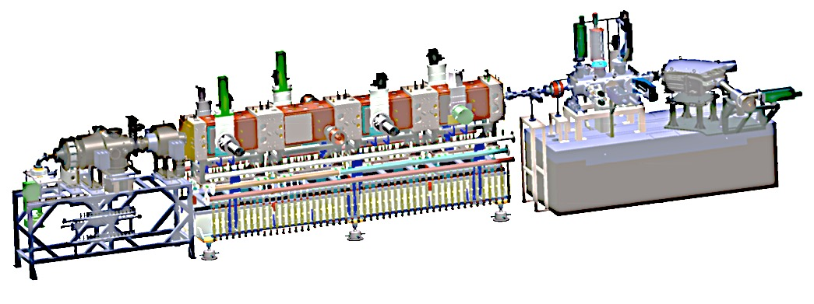
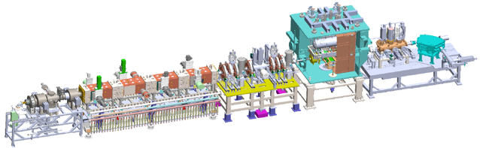
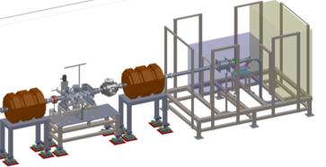
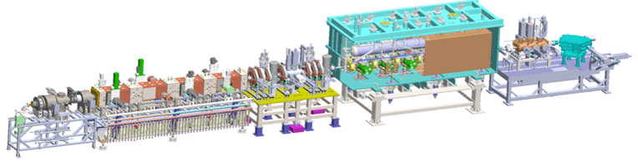
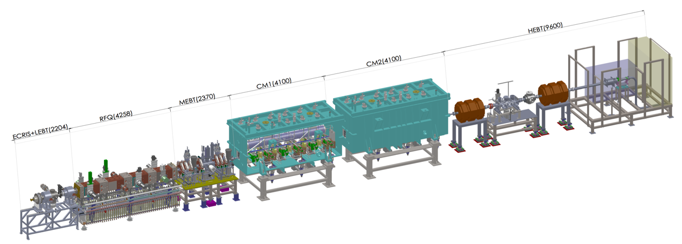
Commissioning of Injector II
ECR + RFQ
Energy is 2.15 MeV
First beam June 6th, 2014
1
162.5 MHz RFQ
ECRIS + RFQ + MEBT + TCM (single HWR)
Energy is 2.5 MeV
First beam October 1st, 2014
2
162.5 MHz HWR010
ECRIS + RFQ + CM1
Energy is 5 MeV
First beam June 6th, 2015
3
162.5 MHz HWR010
4
ECRIS + RFQ + CM1 + CM2
Energy is ~10 MeV
First beam September 15th, 2016
162.5 MHz HWR010

Slide 17
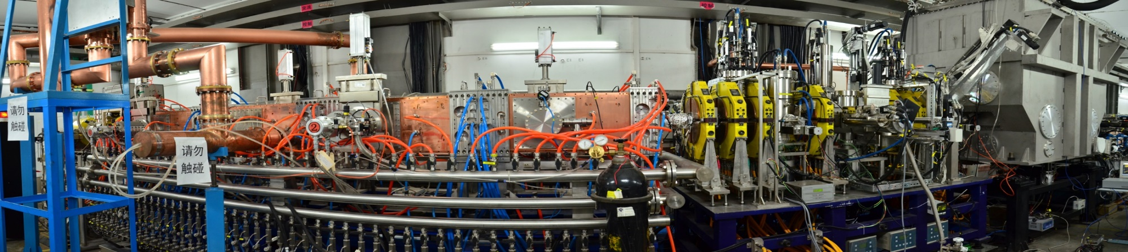
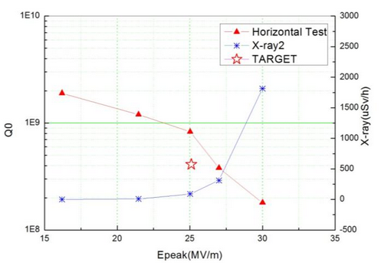
Commissioning of HWR test module
CW 11mA
Qo @ 25MV/m >8E8
Oct. 1st, 2014, first beam, 2.6 MeV, 2.3 mA
Feb. 4th, 2015, 4.2~10.8 mA, 2.5MeV, CW
Nov.25th, 2014, first CW, 3.4 mA ~ 6 hours.
Feb. 23rd, 2015, 2.55MeV/~11mA/28kW, 1 h
Total operation time was ~ 200 hours.

Slide 18
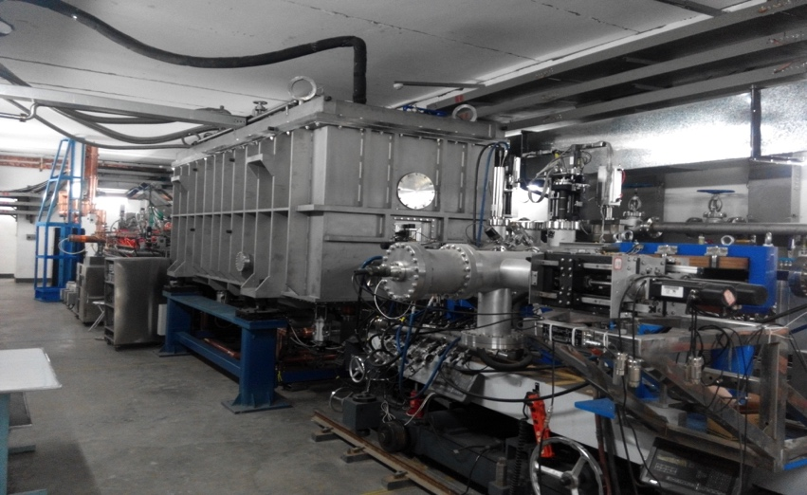
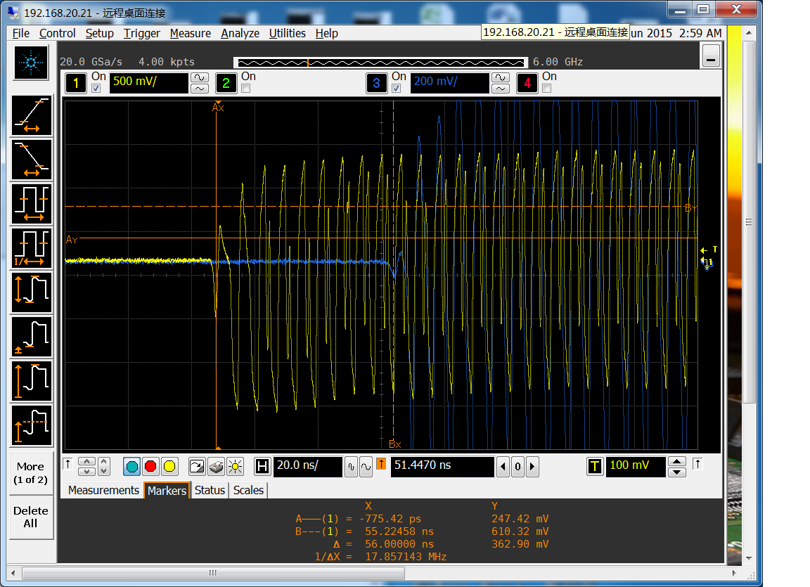
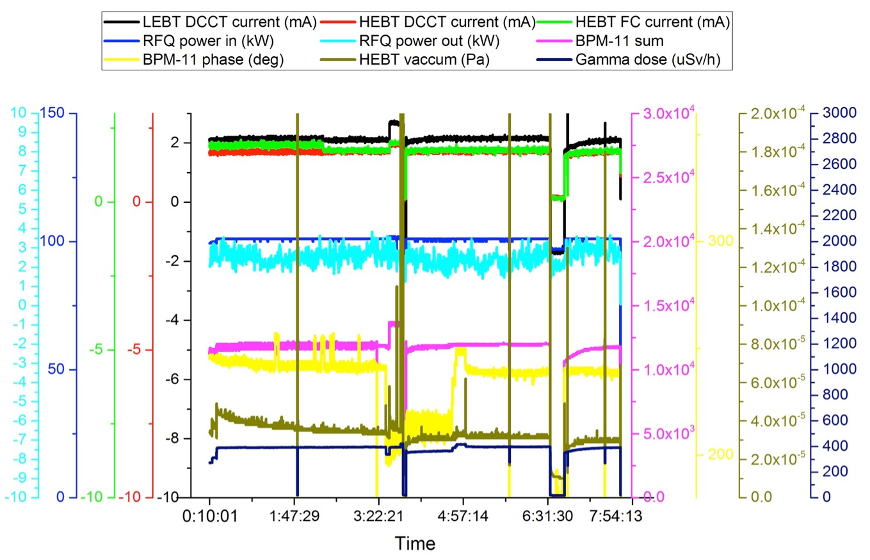
Commissioning of 5 MeV Linac
June 6th, 2015, 5.2 MeV, 10.2 mA, short pulse, 100us@1Hz; MPS upgrade
June 12th, 2015, 5.1 MeV, 2.7 mA, 100ms@1Hz ; radiation protection upgrade
June 24th, 5.3 MeV, 2.7 mA, CW, 5 min, MPS upgrade
Dec 27th, 2015,4.6MeV/4mA/CW/40min；4.6MeV/3mA/CW/50min
Jan 2th,2016, 4MeV/1.7mA/CW/6.8kW,7.5 h
Beam energy: 5.2±0.1MeV

Slide 19
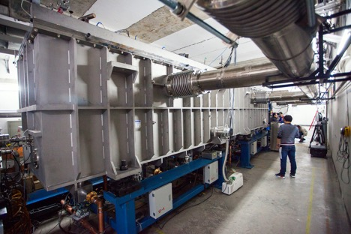
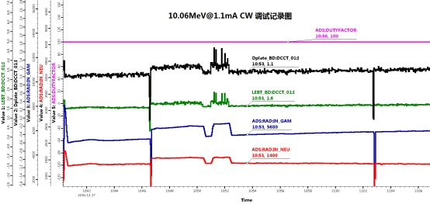
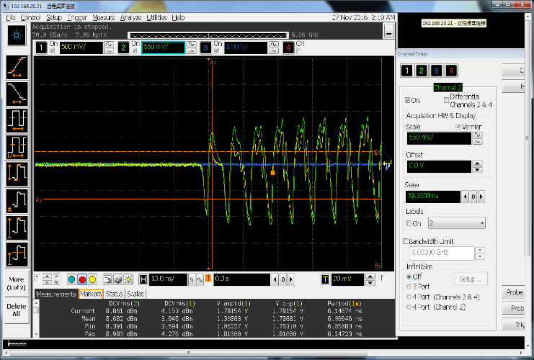
Commissioning of 10 MeV Linac
Sept. 15, 2016, 7 MeV/10 mA, pulse
Sept. 24, 6.5 MeV/ 1 mA, CW
Oct. 31, 10.2 MeV/ 10.3 mA, pulse
Nov. 27, 9.55 MeV/ 2.7 mA, CW
Dec. 17, 2016, 10.06MeV/1.16mA/CW 28 min, 10.06MeV/11.7mA/pule
Beam energy =10.06MeV

Slide 20
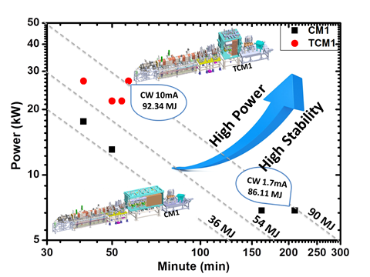
Summary of CW Commissioning
Summary of Commissioning from Jun. 6, 2014 ~ Sept. 24, 2016
Accelerator segments | First CW beam | Maximum (MeV) | Beam time (hours) | CW beam time Total (hours) | CW Current Max (mA) | CW Power Max (kW)
RFQ | Jun. 21, 2014 | 2.15 | 2036 | 70 | 11 | 23
TCM1 (1 HWR) | Nov. 24, 2014 | 2.55 | 208 | 22.5 | 11 | 28
CM1 (6 HWRs) | Jun. 24, 2015 | 5.3 | 400 | 20 | 4 | 21
CM1+CM2 (6 + 6 HWRs) | Sept. 24, 2016 | 10.2 | 327 | 11 | 2.7 | 26
Tens of kilowatt CW beam achieved in superconducting front-end of Chinese ADS.
The tuning procedures of high power CW beam has been demonstrated successfully.
The front-end demo Linac will be finished in 2017.
Higher power and higher stability will be demonstrated in the future.

Slide 21
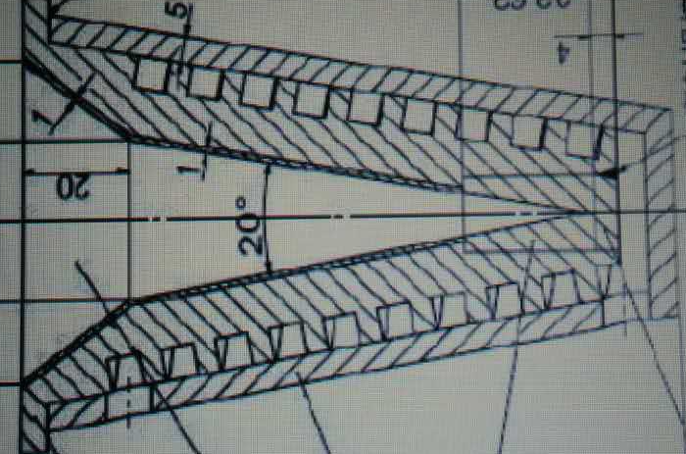
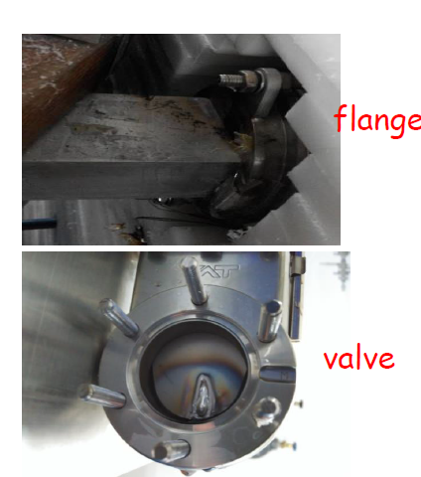
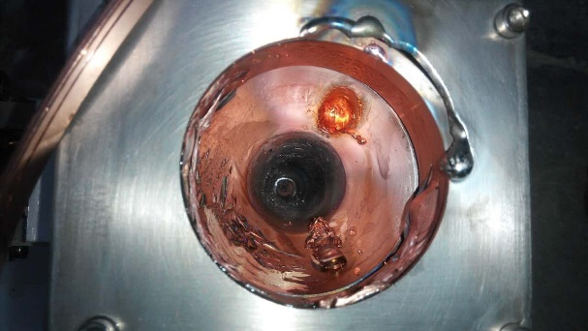
Summary of Cryomdule Performance
5 MeV Linac
Unit:MV/m
Beam hitting on the Value
Cavity Gradient degradation
Beam Drilled a Hole
in Faraday Cup
Cavity | Stage1 | Stage2 | Stage3
1# | 11.5 | 13.54 | 16.33
2# | 19 | 14.21 | 16.00
3# | 19 | 12.84 | 11.88
4# | 18 | 16.02 | 14.00
5# | 17 | 14.92 | 14.98
6# | 18 | 14.46 | bypass
Ave | 17.1 | 14.3 | 14.6

Slide 22
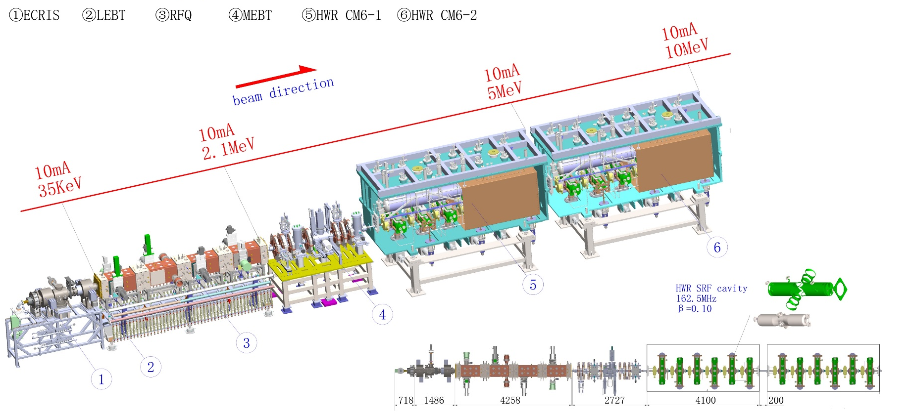
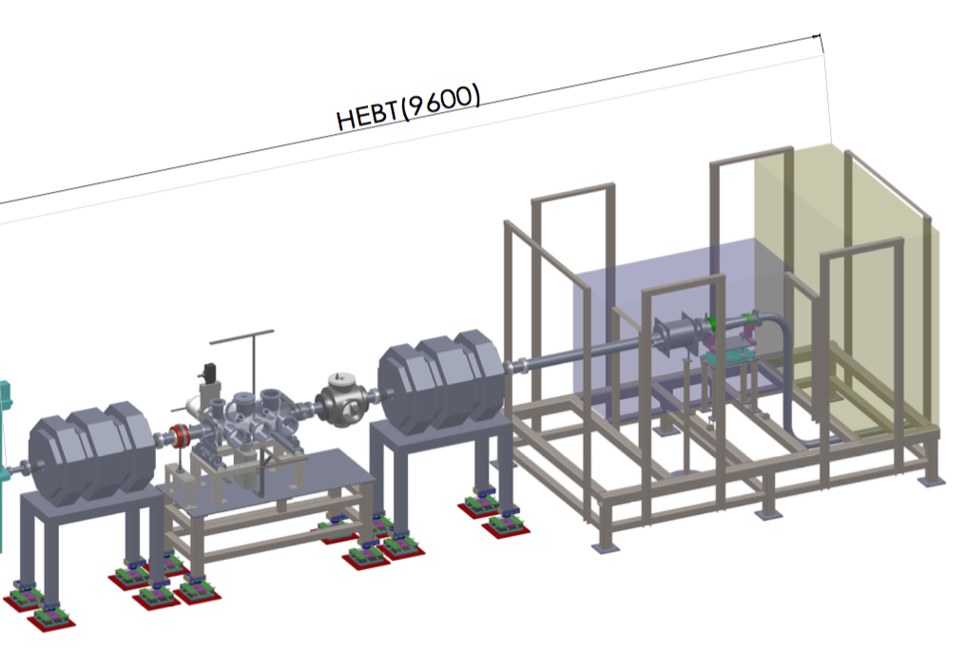

Summary of Cryomdule Performance
10 MeV Linac
First cooling down and conditioning of coupler on May 3rd, 2016
4 couplers (single-window) were broken in May
Four broken couplers were replaced by double-window in tunnel in one week.
Second cooling down in August. First beam was achieved on Sept. 15th, 2016.

Slide 23
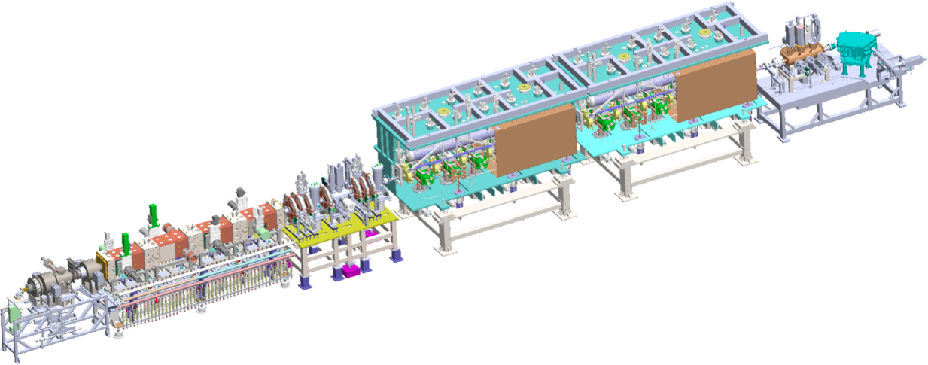
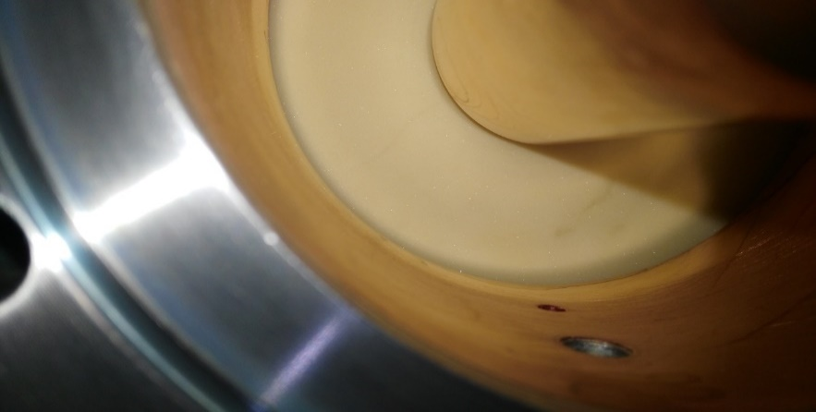
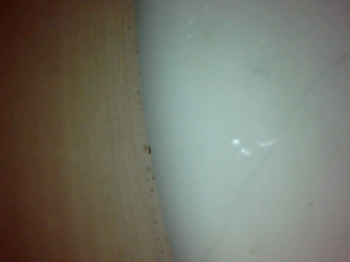
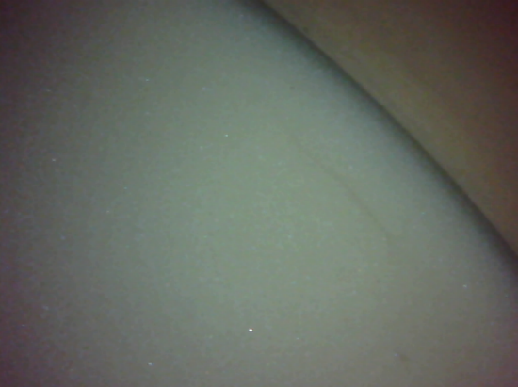
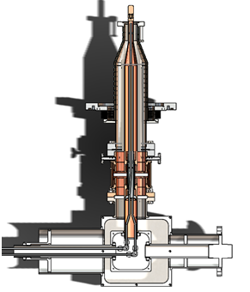
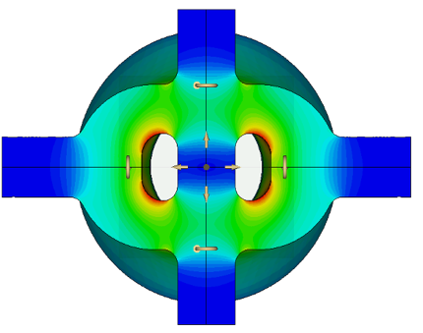

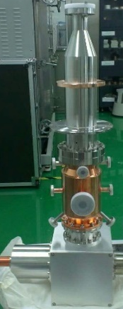
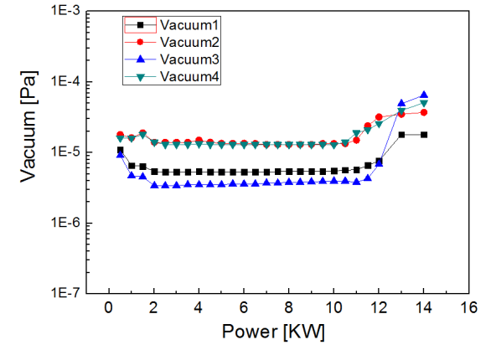
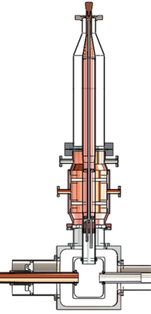
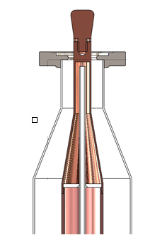

10 MeV Coupler
Crack of ceramic window
10 MeV operation for 2 months, ceramic windows of 2 couplers were leaking each CM.
Field emission e from the cavity hitting on the ceramic window
Ceramic window
New dual-window coupler was developed and passed the power test
windows

Slide 24



HWR010 Coupler Replacement online
Temporary Clean room for coupler replacement
coupler replacement
New couplers has worked for more than 3 monthes, no leak was found, and the new couplers work very well.

Slide 25



Helium Processing
After windows were cracked, cavities was contaminated and FE is very strong.
Before Helium Processing：
Sept., 2016 beam energy 7 MeV
After Helium Processing:
Oct. 2016, Beam energy 10.06MeV
Epeak
Field emission onsite after HP
Field emission onsite before HP
X-ray
Helium Processing, X-ray VS gradient
Gradient Gain After Helium Processing

Slide 26
Cavity Performance
Ep calibration with beams
 | 2016/10/31 | 2016/11/27 | 2016/12/11 | 201/12/13
CM1-1 | 22 | 19.77 | 18.95 | 18.99
CM1-2 | 20.7 | 20.7 | 20.43 | 20.94
CM1-3 | 22.2 | 16.56 | 22.2 | 20.22
CM1-4 | 23.6 | 22.36 | 22 | 23.22
CM1-5 | 18.33 | 18.69 | 18.66 | 20.25
CM1-6 | 21.18 | 22.16 | 18.67 | 19.67
CM2-1 | 18.77 | 16.9 | 15.47 | 16.56
CM2-2 | 22.7 | 20.79 | 20.55 | 23.3
CM2-3 | 32.15 | 19.98 | 21.87 | 23.6
CM2-4 | 24.9 | 22.76 | 21.67 | 23.8
CM2-5 | 28 | 24.43 | 24.22 | 26.55
CM2-6 | 36.1 | Missing | 35 | 27.8
Limited by
Pt cable
leaking
Limited by
coupling
Beam
bombard

Slide 27

Summary of Cavity Gradient
lost one data
▲
CM1
■
CM2
Processing
Operation
TCM1
TCM6
CM1+CM2
Achivable gradient grow up with new cryomodules. Cavity Gradient will degrade with long time operation ( leaking, beam lost… ???).

Slide 28




The Demo 25 MeV SRF Linac
IMP+IHEP Joint Team
HEBT
IMP
162.5 MHz Taper HWR
162.5 MHz HWR015
162.5 MHz HWR010
RFQ
MEBT
ECRIS
325 MHz Spoke
IHEP
The Demo Linac will be commission June, 2017
 | RFQ/IMP | CM1/IMP | CM2/IMP | CM3/IMP | CM4/IHEP
status | Ready | Ready | Ready | Cavity string | Ready

Slide 29
Summary
10 MeV of both Injector I and Injector II has been commissioned and got 10mA pulse beam and around 1~3 CW beams.
The MPS and beam dumper need to be upgraded to get more higher power beams.
A demo SRF linac with 25 MeV/10 mA/CW has been constructed almostly, and will be commissioned in June 2017.
Chinese Initiative ADS project (CIADS) will be approved. 250 ~ 600 MeV SRF proton linac, Granular target and 10 MWt subcritical LBE FR are chosen.

Slide 30

Thanks for your attention
Linac Team of China ADS
Thanks for the helps
LBNL, J-Lab, TRIUMF, ANL, FNAL, MSU/FRIB, ORNL,
SINAP, HIT, PKU, THU, RIKEN, CEA/Saclay, IPN/Orsay, IAP ……

Slide 31

Thanks for your attention
Welcome to SRF2017 in Lanzhou
http://srf2017.csp.escience.cn

