Slide 1
First Results of LCLS-II Prototype Cryomodule Tests
M. Drury / Ed Daly / Tom Powers / Bob Legg
18 February- 2017

Slide 2
Contents
Cryomodule Overview
Testing Facilities
Cool Down
Performance Requirements
Results
Summary

Slide 3
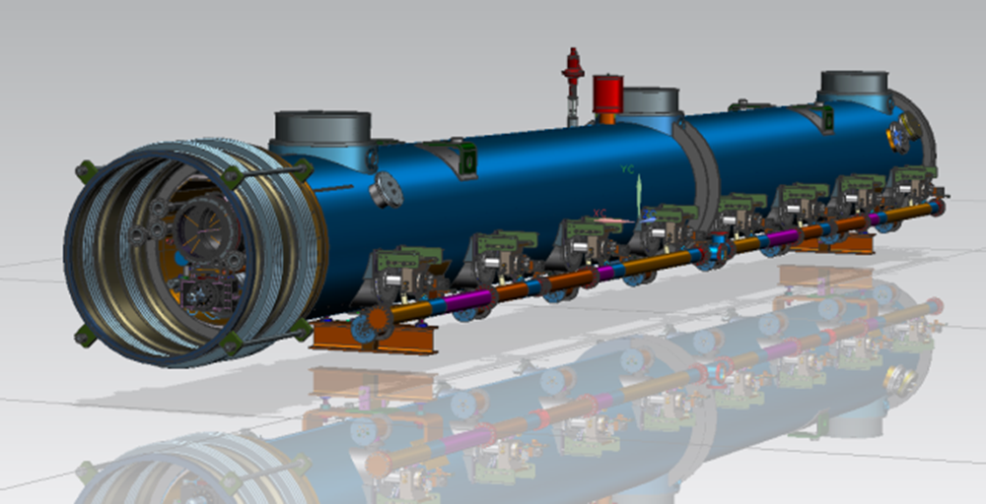
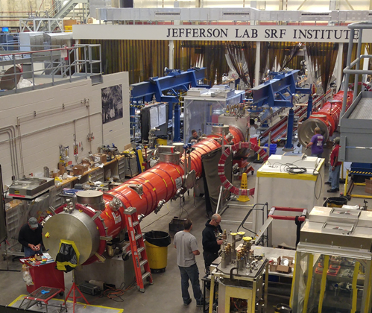
LCLS-II Cryomodule Design
Eight nine-cell SRF cavities (2K - nominal operating temp)
Eight individual helium vessels (titanium)
Co-axial power couplers
Cavity tuners
  Cold drive components
XFEL Supply/Return cryogenics (no end-caps)
  Three cryogenics circuits

Slide 4
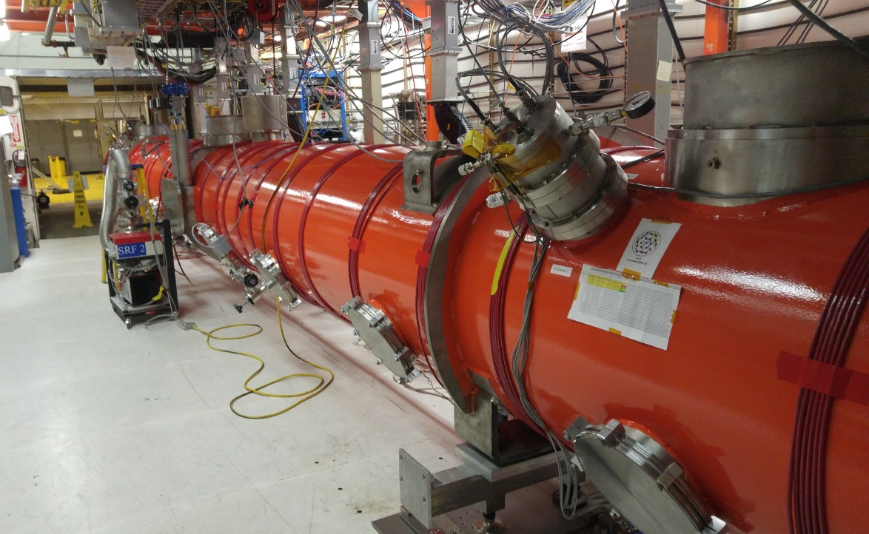
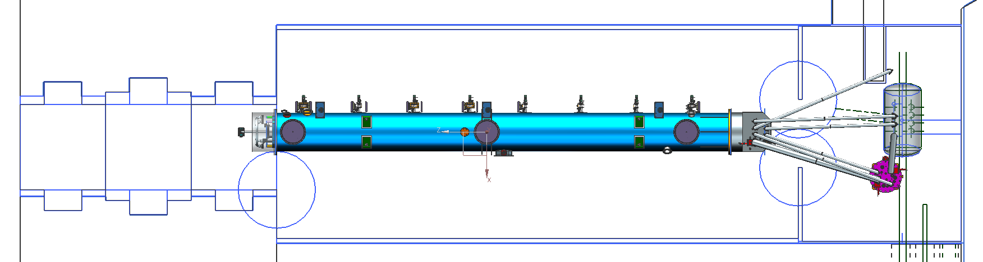
CM Test Facility – pCM in Testing
    Dedicated shielded cave with Personnel Safety System (PSS)
      Radiation shielding – 4.5 ft thick concrete walls and 3 ft. concrete roof.
      Magnetic shielding – magnetic fields in the vicinity of the cryomodule of 50 mG or less.
Roll up equip doors

Slide 5
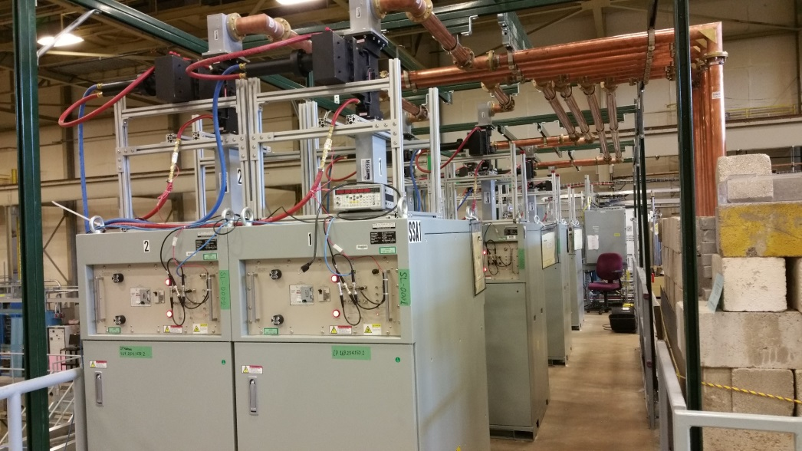
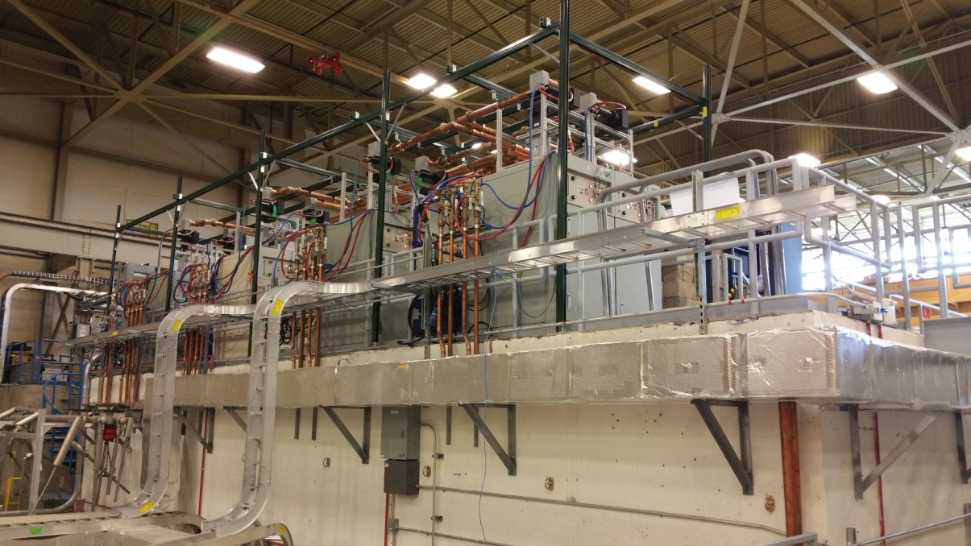
CM Test Facility - LCLS II-HPRF
Eight 1.3 GHz, 3.8 kW Solid State Amplifiers
New 1.3 GHz coaxial hardline RF network
Integrated into Personnel Safety System

Slide 6
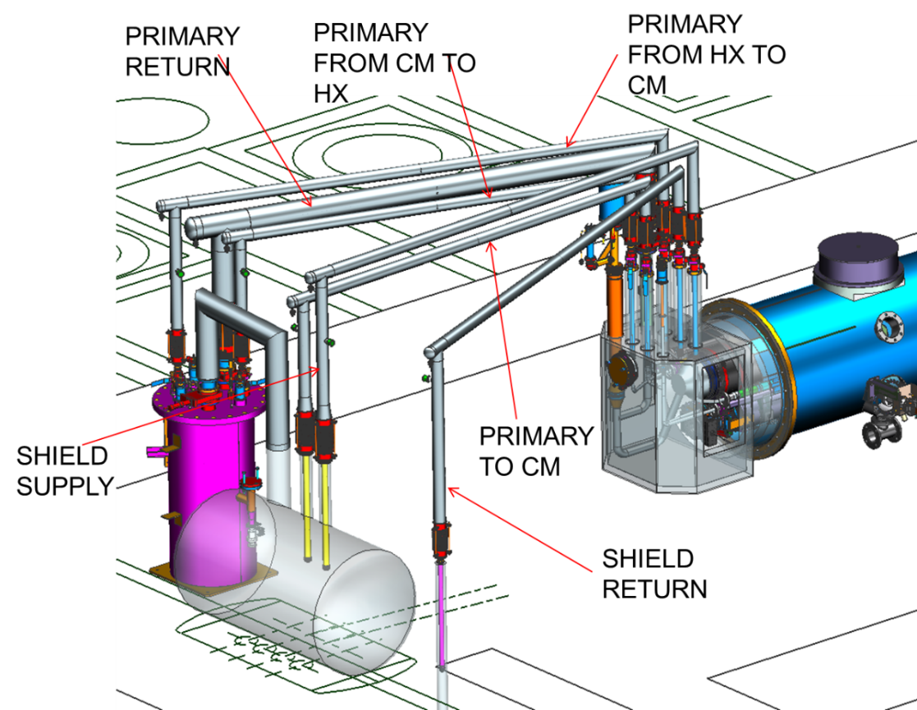
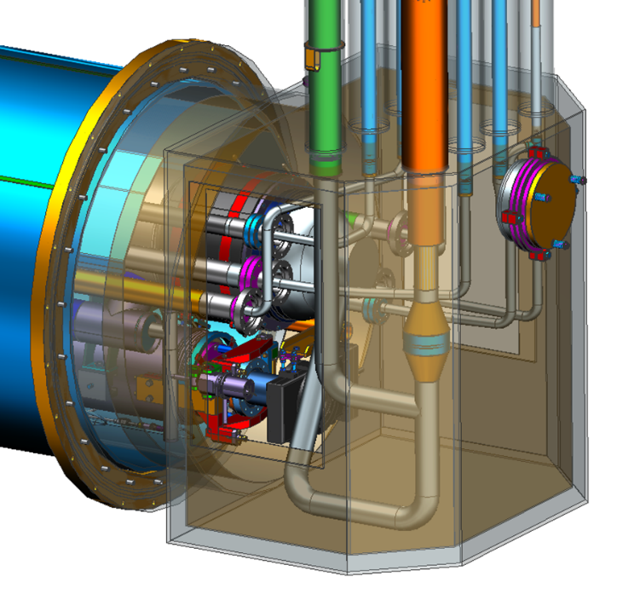
LCLS II – End Cans
End Cans (2 sets to support CM production rate)
Connects CM to CTF valve box via u-tubes
  Interfaces for valves, LL and diodes to monitor and control helium flow/inventory
  Provides reliefs for primary circuit, shield circuit and insulating vacuum space
  CTF is a Closed loop 2K helium refrigerator shared with the Vertical Test Area (VTA)
      Primary circuit supply up to 7-8 g/s 2.8 Bar 4K supply for cool-down, steady state ~2-3 g/s
      50 K shield circuit, several g/s (not a limit to operations)

Slide 7
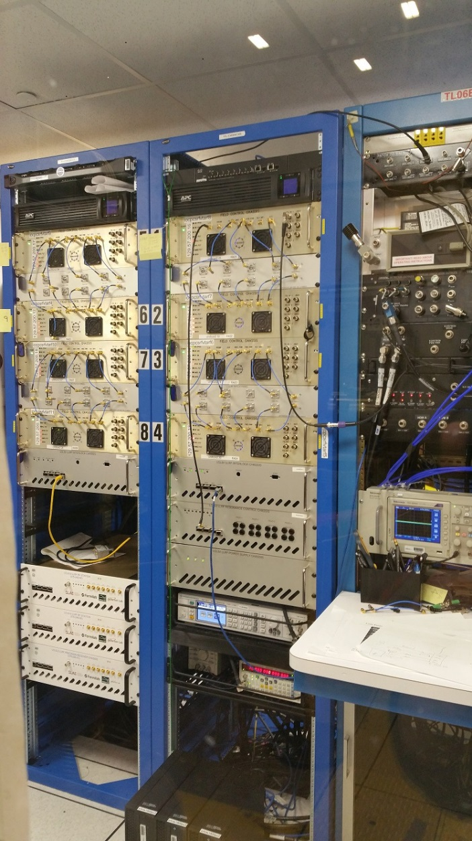
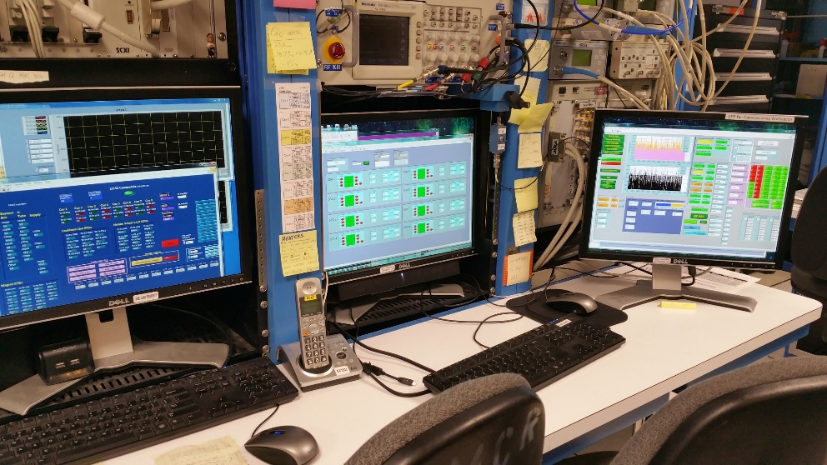
Cryomodule Test Facility
Instrumentation includes:
Eight Field Control Chassis
Interlock and Resonance Control Chassis (partial install)
Six channels RF Power Measurement
Ten Channels Portable GM tubes
Gamma / Neutron Probes (owned by Safety Systems Group and part of Personnel Safety System)
Network Analyzers and Spectrum Analyzers
Variety of Scopes, Waveform Generators, etc…
Various Temp Monitoring devices, Vacuum gauges, Pressure Transducers, Cameras, etc…

Slide 8
CM Cooldown Preparations
  30-NOV pCM moved into CMTF
  Work completed in cave prior to cooldown
    Cabling for instrumentation
    Connecting waveguides to FPCs
    Performed warm vibration measurements (hammer test)
    Verifying readbacks to CMTF data acquisition (pressure, temperature, vacuum, magnetic fields, etc.)
    Verifying cryo controls for valves (pCM, HX and warm gas supply)
    Leak checks on insulating vacuum
    Final welding/leak checking and pressure testing of u-tubes
    Verified magnetic fields in cavities - <2 mG average, 4.5 mG peak (1 location)
  15-DEC Cooldown started
    U-tubes installed between pCM Bayonet Box, HX and Junction box
    Vacuum levels – 3E-10 torr (beamline), 1E-09 torr (coupler), 1E-5 torr (InsVac)
    Cooldown started at about 3 PM

Slide 9
CM Cooldown (Saga)
  15-DEC Cooldown started
    Monitored temperatures, pressures and vacuum levels
    Maintained limits on GHRP and thermal shields - Temp differences - <15 K vertical, < 50K axial
    Proceeded slower than expected due to unexpected pressure drops (1 – 2 K/hr !)
      Bypass valve in HX was suspected (Cv – 0.35)
      Qo valve in return u-tube was checked and initially ruled out
  26-DEC Collected liquid at ~ 0.055 atm (above lambda, unstable)
    Re-checked installation of Qo valve actuator installation procedure recommended by mfgr.
    Valve was partially closed - once fully opened, return pressure improved
    Vacuum levels – 1E-11 torr (beamline), 1E-09 torr (coupler), 1E-06 torr (InsVac)
  28-DEC Collected liquid and controlled at ~0.048 atm (at lambda, stable)
    Stable liquid level control over several days
    Return pressure improved but capacity was still limited
    Debugged faulty liquid level readbacks
  03-JAN Achieved stable liquid level control at pressure ~0.035 atm
    Kinney pump control settings modified to improve return pressure
  04-JAN Began debugging interlocks in advance of cavity testing

Slide 10
CM Cooldown - Observations
  Maintained limits on Gaseous He Return Pipe (GHRP) and thermal shield
    Need to verify mixed gas cooldown capability
  Cavity cooldown rates from 40K through Tc ranged up to 2K/min
  Magnetic field levels at cavities are very good
    ~ 1 mG average, 4.5 mG peak at one location
  LL readbacks are intermittent at times
    Possible interaction between CD & JT valves and LL behavior
  As at FNAL, observed high heat load on JT valve
  Cooldown rate will proceed more quickly (Target is 10K/hr)
    Unexpected pressure drops were eliminated
    Plan to use warm gas mixing during next cooldown from 300K
  Note: The unexpected duration of cool down and the scheduled maintenance down of the CTF significantly reduced time available for Acceptance testing.

Slide 11
pCM Performance Requirements
Criteria | Minimum for Acceptance
Beamline vacuum | Cold: 1 x 10⁻¹⁰ torr Warm: 1 x 10⁻⁸ torr
Center frequency | 1.3000000 GHz +/- 20 kHz
Cavity Eacc | ≥ 16 MV/m (Minimum CW Voltage for CM = 128 MV)
Field Emission Onset | ≥ 14 MV/m
Verify BPM | No shorts/opens. Cross-talk ≤ -30 dB. Difference in S21 < 1dB (0.5 GHz < f < 2.5 GHz)
Average CM Qo | ≥ 2.5 x 10¹⁰ (all cavities at 16 MV/m and couplers at thermal equilibrium)
HOM Qext | ≥ 5 x 10¹¹ Max measured power 1.5 W (E = 16MV/m, Fwd Pwr = 2.5 kW, thermal equilibrium)
Tuner Range | Slow (mechanical) 450 KHz; Fast (piezo) 0-500 Hz
Magnet | No shorts / opens. 20 A without quench.
FPC Qext | Nominal 4x10⁷, tunable from 1x10⁷ 1 to 6x10⁷
Measure total heat load | All cavities operating at 16 MV/m

Slide 12
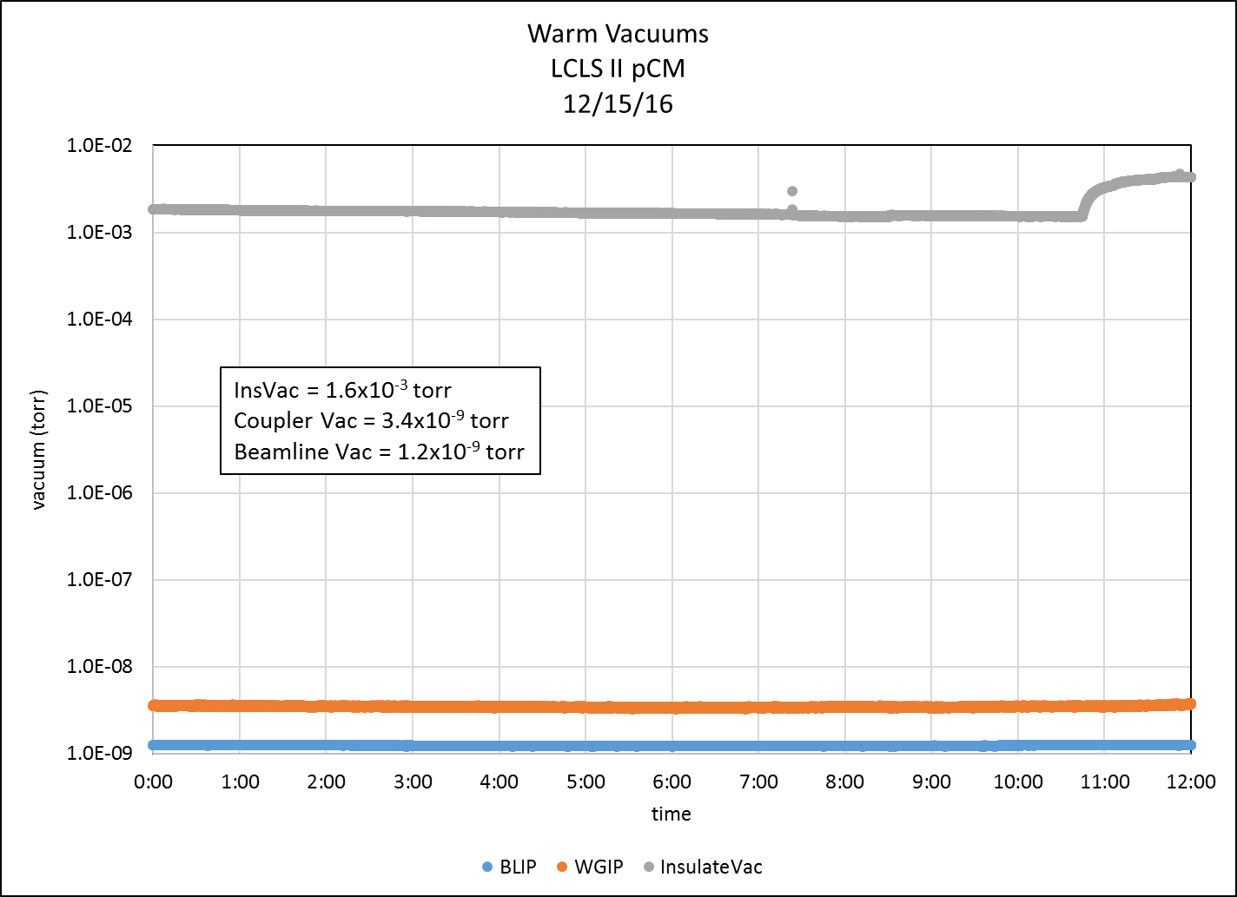
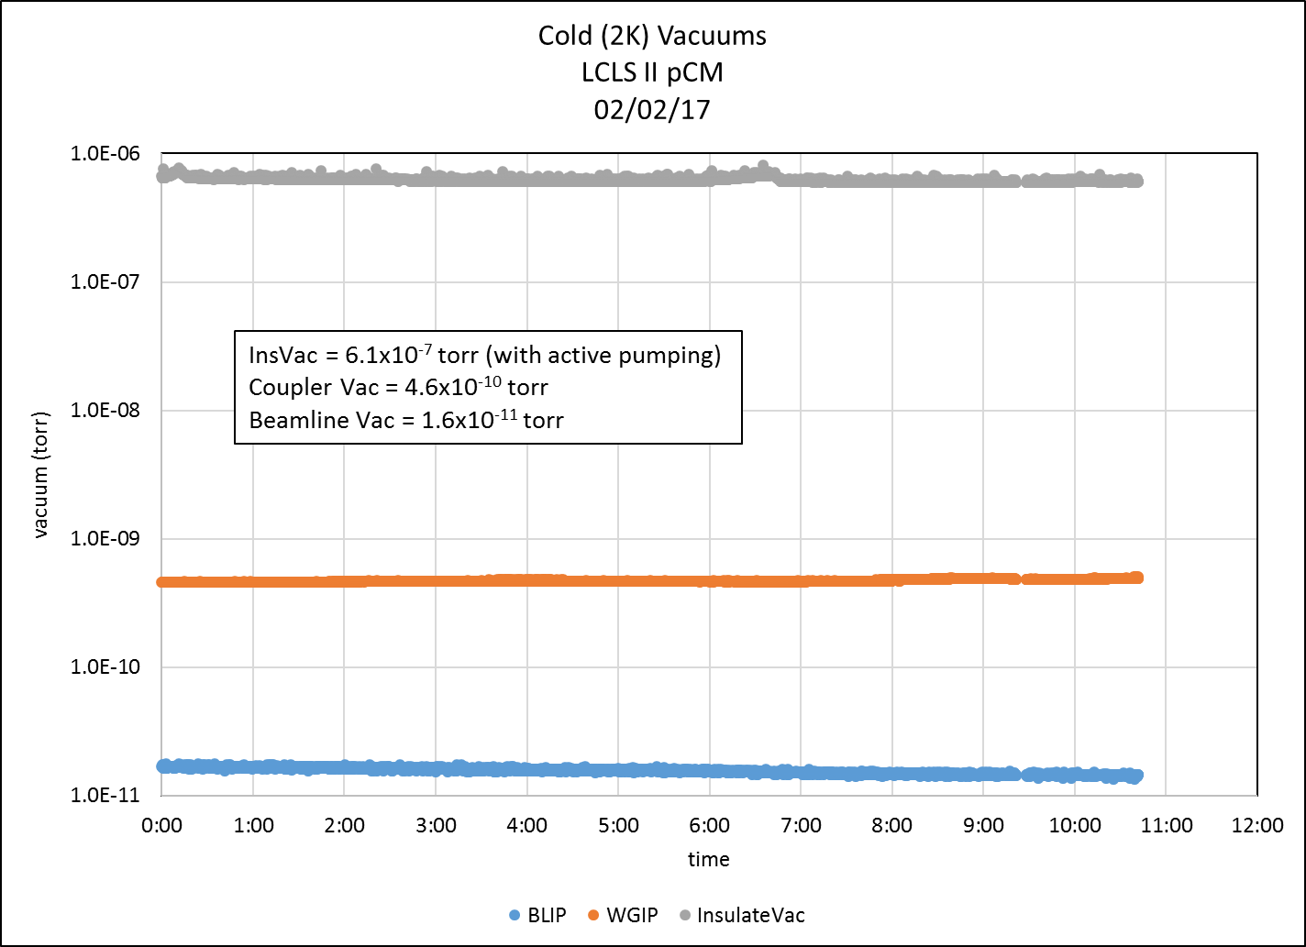
Performance - Cryomodule Vacuums

Slide 13
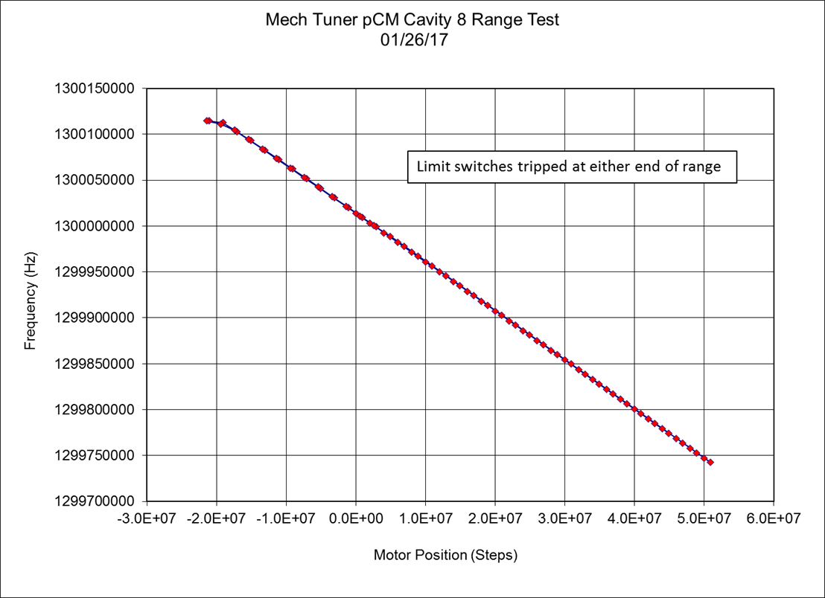
Performance - Frequencies and Tuners
Mechanical Tuner Performance
Cavity Position | Cav 1 | Cav 2 | Cav 3 | Cav 4 | Cav 5 | Cav 6 | Cav 7 | Cav 8
Serial Number | AES031 | AES029 | AES030 | AES032 | AES033 | AES034 | AES036 | AES035
Range (kHz) | 369 | 379 | 395 | 378 | 379 | 381 | 379 | 372
Min Frequency (MHz) | 1299.724 | 1299.768 | 1299.745 | 1299.787 | 1299.781 | 1299.804 | 1299.896 | 1299.742
Max frequency (MHz) | 1300.092 | 1300.147 | 1300.140 | 1300.165 | 1300.161 | 1300.186 | 1300.275 | 1300.114
df / dstep (Hz /step) | -0.0052 | -0.0053 | -0.0051 | -0.0052 | -0.0052 | -0.0053 | -0.0051 | -0.0051
Max hysteresis (Hz) | 225 | 206 | 338 | 278 | 263 | 201 | 573 | 220
Avg Hysteresis (Hz) | 24 | 45 | 74 | 76 | 81 | 45 | 188 | 80
Initial Cold Frequencies
Cavity Position | Serial Number | π | delta from center frequency (kHz)
1 | AES031 | 1300.0343 | 34.3
2 | AES029 | 1300.0868 | 86.8
3 | AES030 | 1300.0786 | 78.6
4 | AES032 | 1300.0940 | 94
5 | AES033 | 1300.0938 | 93.8
6 | AES034 | 1300.1251 | 125.1
7 | AES036 | 1300.1747 | 174.7
8 | AES035 | 1300.0200 | 20.0
All untuned cavities were within 175 kHz of 1300 MHz.
All cavities were tunable to 1300 MHz with slow tuners.
None of the slow tuners met the 450 kHz range requirement.
Worst case tuning range = 1300 MHz +104 kHz / -92 kHz.

Slide 14
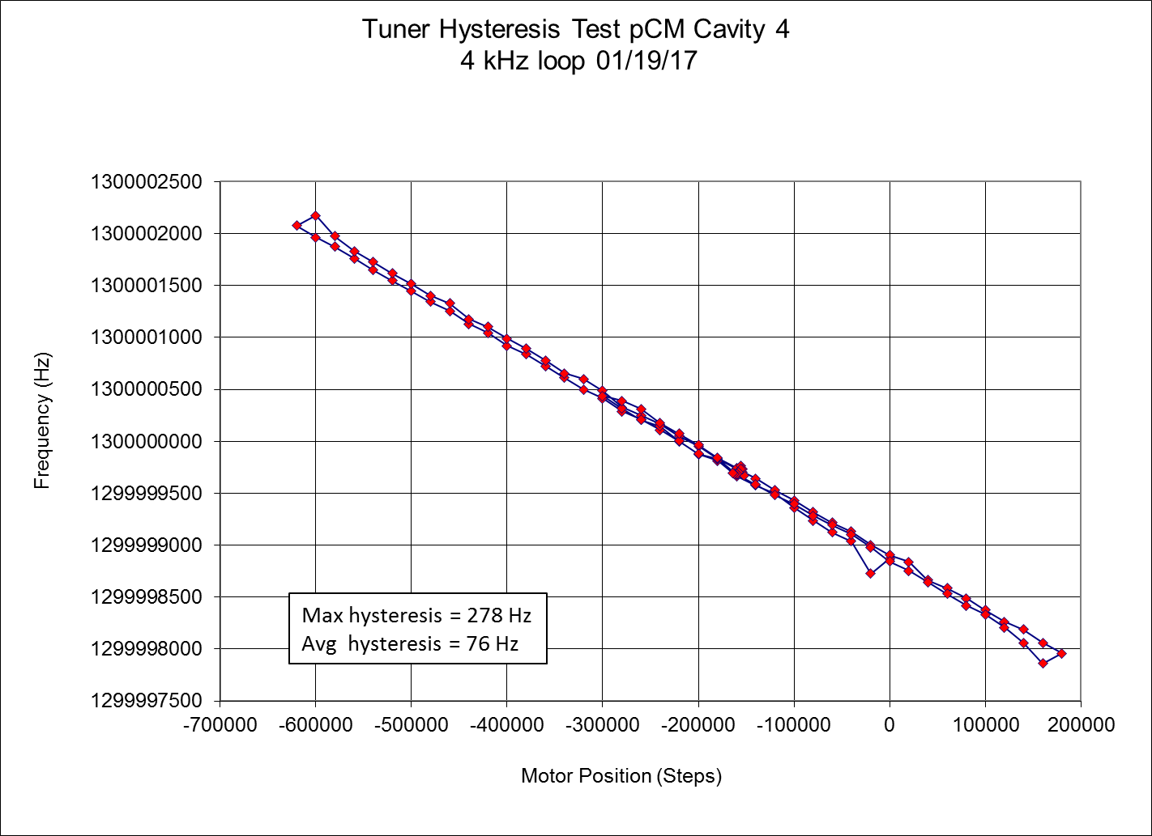
Performance - Frequencies and Tuners
Hysteresis = f₂-f₁
Maximum hysteresis across eight cavities = 573 Hz
Average hysteresis across eight cavities = 77 Hz

Slide 15
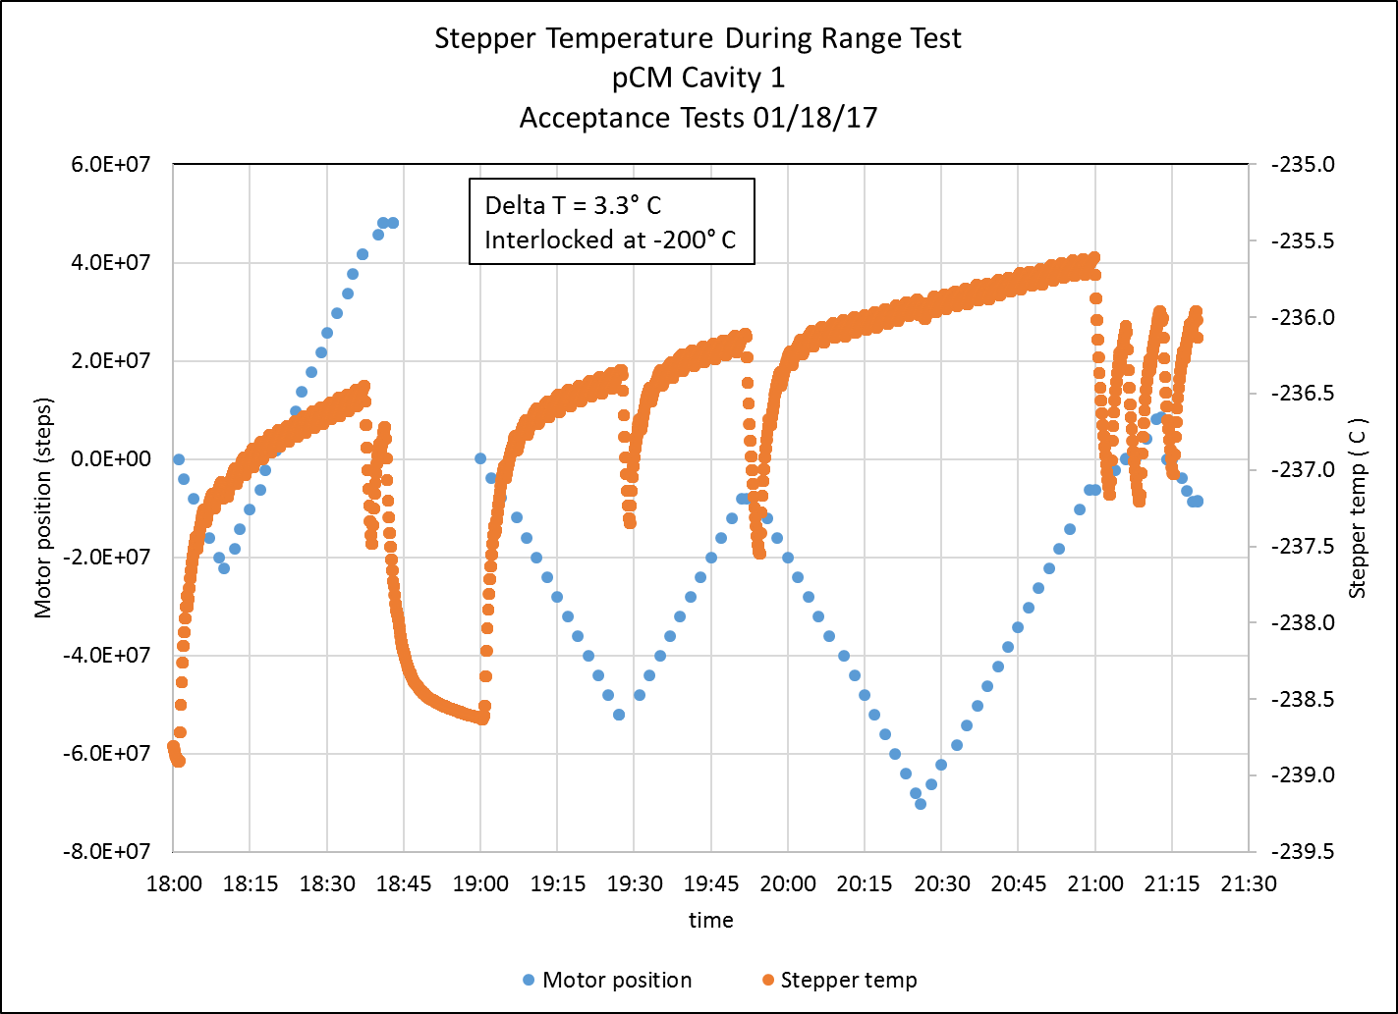
Performance - Frequencies and Tuners
0.00010 deg C/s

Slide 16
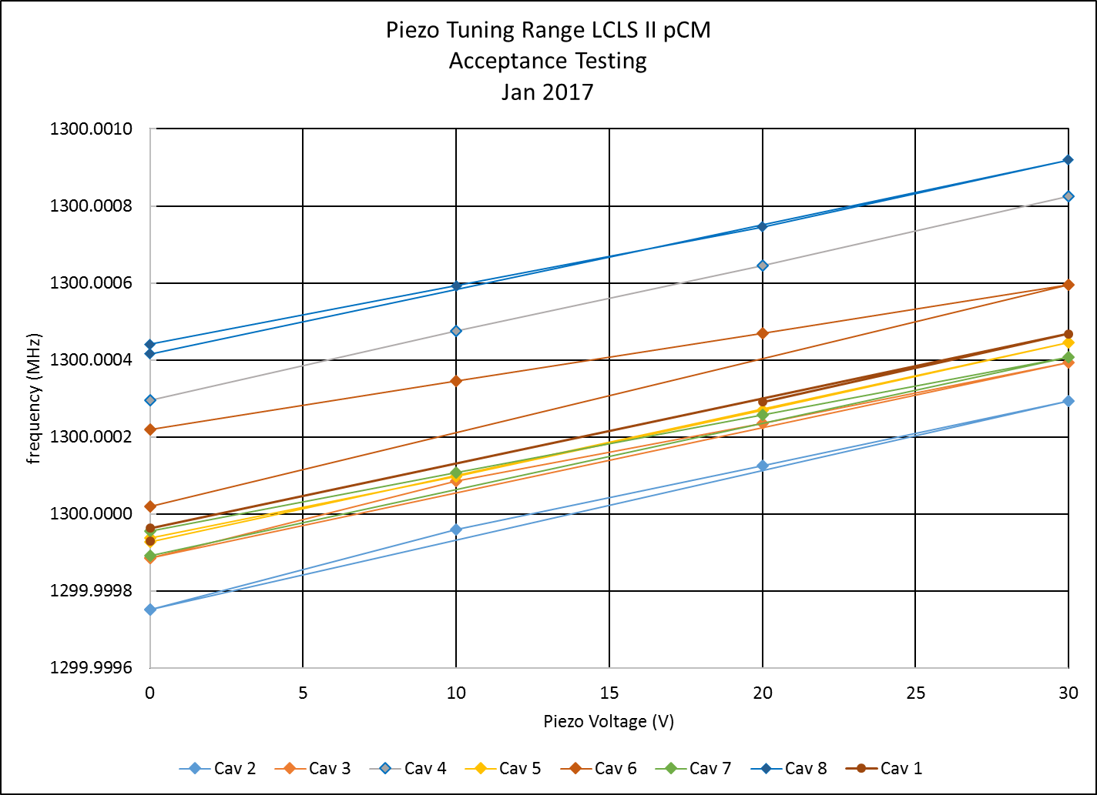
Performance - Frequencies and Tuners
Cavity 6 piezo needs closer look during next round of testing
Cavity position | Cav 1 | Cav 2 | Cav 3 | Cav 4 | Cav 5 | Cav 6 | Cav 7 | Cav 8
Serial Number | AES031 | AES029 | AES030 | AES032 | AES033 | AES034 | AES036 | AES035
 |  |  |  |  |  |  |  |  | min range (Hz) | 375
Range (Hz) | 538 | 541 | 507 | 531 | 508 | 375 | 453 | 479 | avg range (Hz) | 492
 |  |  |  |  |  |  |  |  | max range (Hz) | 541
Hysteresis (Hz) | 33 | 0 | 0 |  | 11 | 200 | 63 | 25 | avg hysteresis (Hz) | 47

Slide 17
Performance – Coaxial Couplers
Cavity | QextFPC | Remark
cav1 | 4.00E+07 | QextFPC tunable
cav2 | 1.87E+07 | QextFPC not tunable 3-stub tuner used for this round of testing
cav3 | 4.01E+07 | QextFPC tunable
cav4 | 3.95E+07 | QextFPC tunable
cav5 | 4.04E+07 | QextFPC tunable
cav6 | 1.03E+07 | QextFPC not tunable 3-stub tuner used for this round of testing
cav7 | 3.09E+06 | QextFPC not tunable 3-stub tuner used for this round of testing
cav8 | 3.59E+06 | QextFPC not tunable Use of 3-stub tuner not successful

Slide 18
Performance – Coaxial Couplers
Four couplers, 2, 6, 7 and 8, had low measured Qext’s and had also suffered loss of Qext adjustment capability.
Couplers on cavities 5 – 8 produced by different vendor and of slightly different design.
  Shorter center pin
  Vendor that provided couplers 1 – 4 will provide production couplers.
3-stub tuners were used to raise Qext’s on cavities 2, 6 and 7.
This allowed for Emax determinations and field emission characterizations for cavities 2, 6 and 7
Several attempts were made to configure stub tuner on cavity 8
  Stub tuner induced heating led to coupler vacuum degradation that limited gradient to < 9 MV/m (pulsed low duty cycle RF)

Slide 19
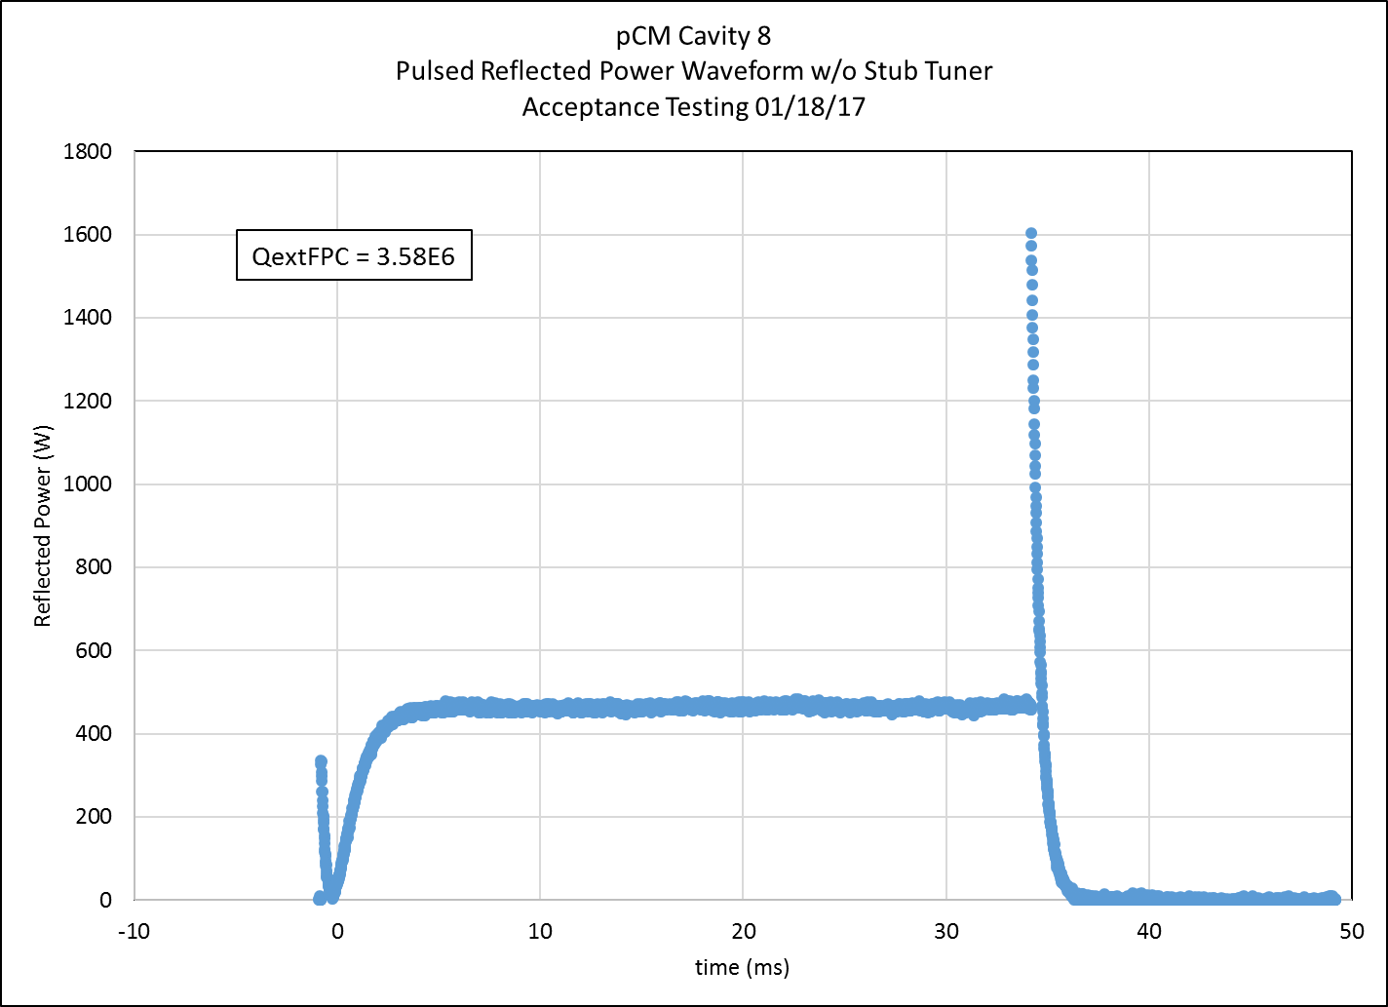
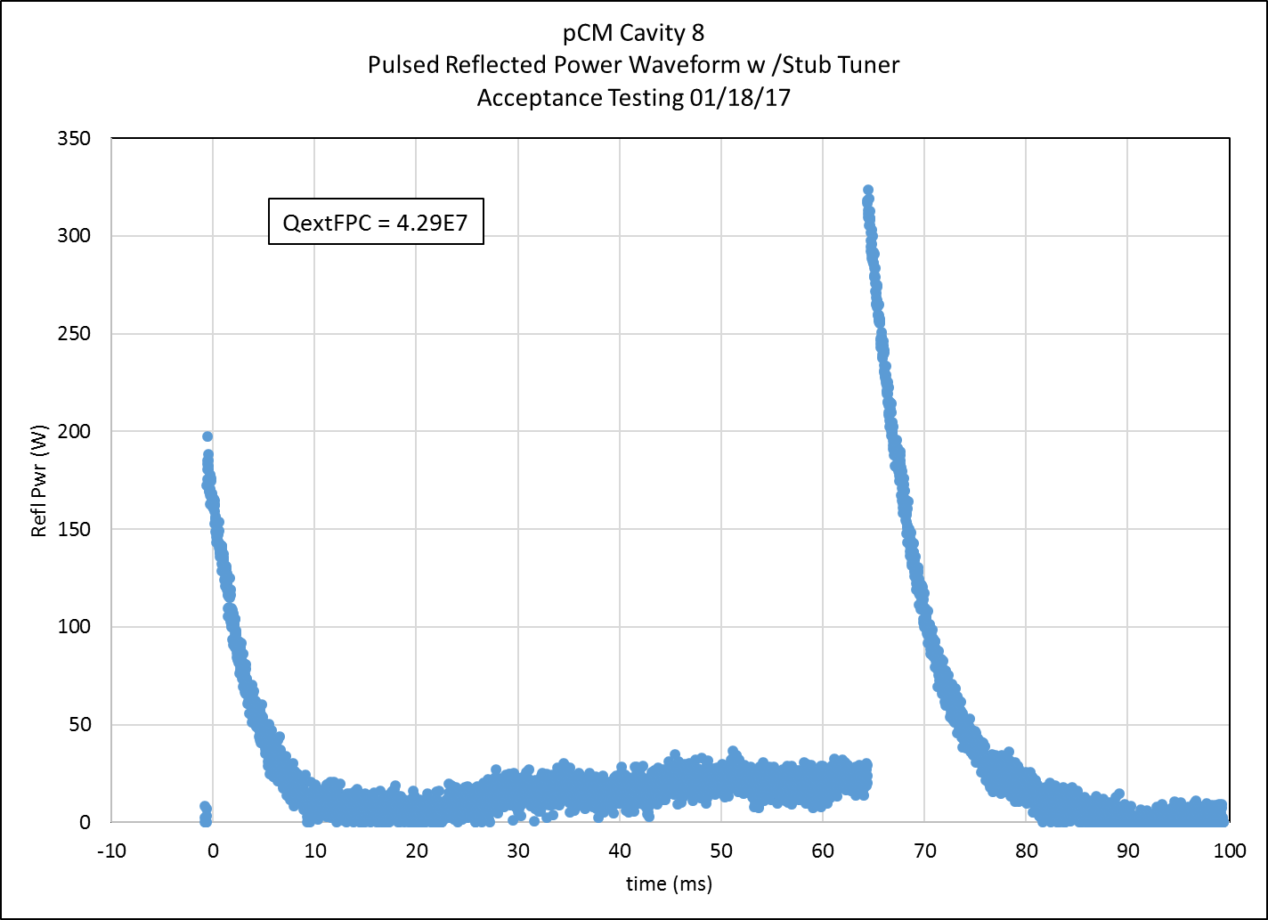
Performance - Couplers
Attempts to set QextFPC of Cavity 8 led to anomalous results.
Stub tuner heating and resulting vacuum degradation limited gradient.
Highest gradient reached = 9.6 MV/m with 20% duty cycle RF.
  Highest gradient was not sustainable or repeatable.
Further work on cavity 8 was abandoned.

Slide 20
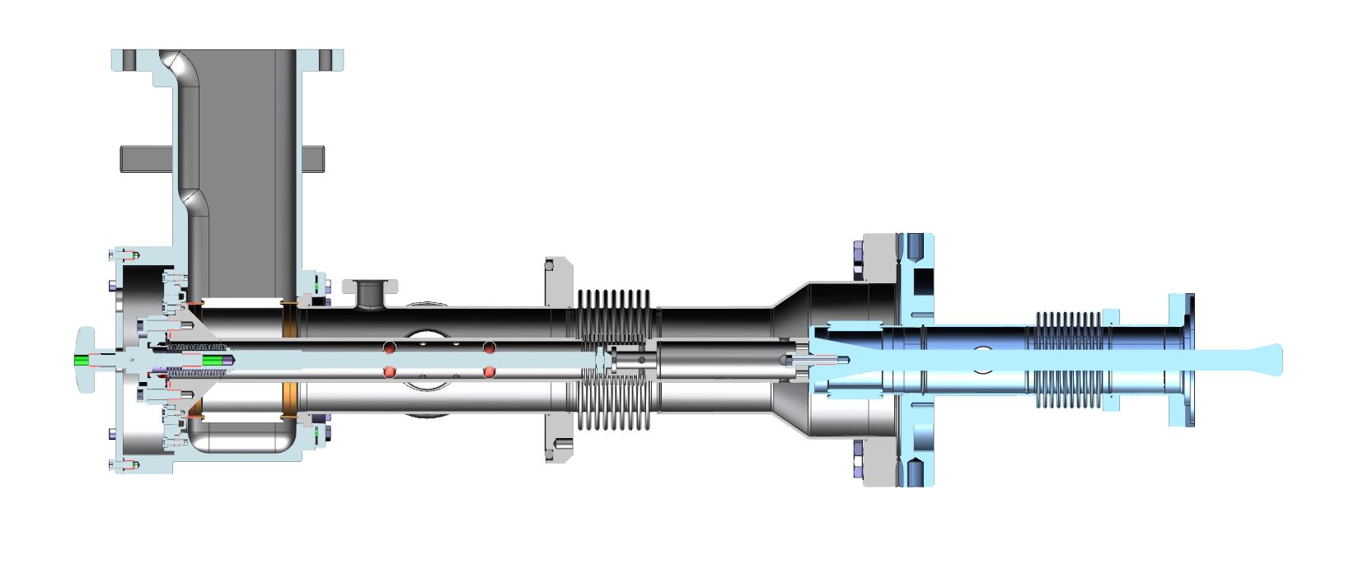
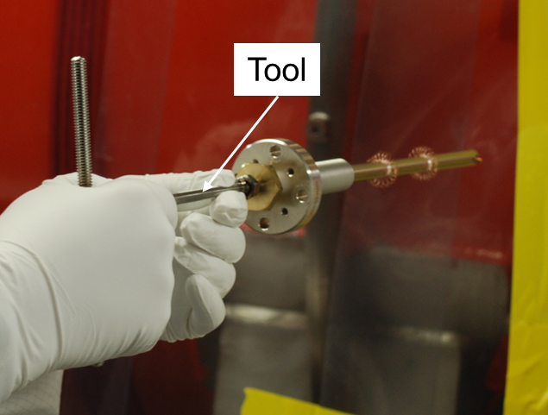
Coupler post mortem
Loss of adjustment due to disengaged pushrods.
Probable cause – pins not fully inserted into slot during initial assembly.
  Pushrod bellows was not correct length
  Pins slipped past slot in cold coupler and caught on edge
  Seemingly engaged but not fully engaged.
Going forward:
  New tool in use ensures correct and consistent pin engagement.
  Verification of inner conductor engagement with network analyzer
TTC 10-11 January 2017

Slide 21
pCM Testing
Cavity Performance (Preliminary)
Cavity | Serial # | QxtFPC | Qprobe | QHOMA | QHOMB | Emax CM / VTA | FE Onset CM / VTA | Limit CM
1 | TB9AES031 | 3.88E+07 | 3.42E+11 | 4.77E+11 | 1.46E+12 | 16.7 / 19.8 | N/A / 15.3 | Quench
2 | TB9AES029 | 3.87E+07 | 5.39E+10 | 5.61E+11 | 8.01E+11 | 20.8 / 23.7 | N/A / N/A | Quench
3 | TB9AES030 | 3.80E+07 | 4.50E+11 | 7.20E+11 | 1.40E+12 | 19.0 / 21.0 | N/A / N/A | Quench
4 | TB9AES032 | 3.87E+07 | 4.01E+11 | 5.17E+11 | 8.25E+11 | 18.8 / 23.0 | N/A / N/A | Quench
5 | TB9AES033 | 3.91E+07 | 1.35E+11 | 1.58E+11 | 2.24E+11 | 16.2 / 21.3 | N/A / N/A | Quench
6 | TB9AES034 | 3.88E+07 | 4.30E+11 | 3.90E+11 | 4.97E+11 | 20.5 / 20.2 | 12.0 / 19.0 | Quench
7 | TB9AES036 | 4.27E+07 | 1.36E+11 | 1.72E+12 | 4.73E+11 | 20.8 / 19.8 | N/A / N/A | Power
8 | TB9AES036 | 4.29E+07 | 1.20E+12 | 8.29E+11 | 1.10E+11 | TBD | TBD | TBD
QextFPC’s for Cavities 2, 6, 7 and 8 measured with stub tuners in place
One hour CW run completed on Cavity 1 at 16.1 MV/m
Cavities 2, 6 and 7 Emax’s are pulsed.
  CW operation limited by stub tuner related heating and coupler vacuum degradation.
  Cavity 6 reached 17.5 MV/m CW.
    Coupler Heating -> Qext droop -> diminishing returns for Fwd Power
Cavity 3 Quench at 20.5 MV/m pulsed / 19.0 CW
Average Gradient = 16.6 MV/m with Cavity 8 Emax = 0

Slide 22
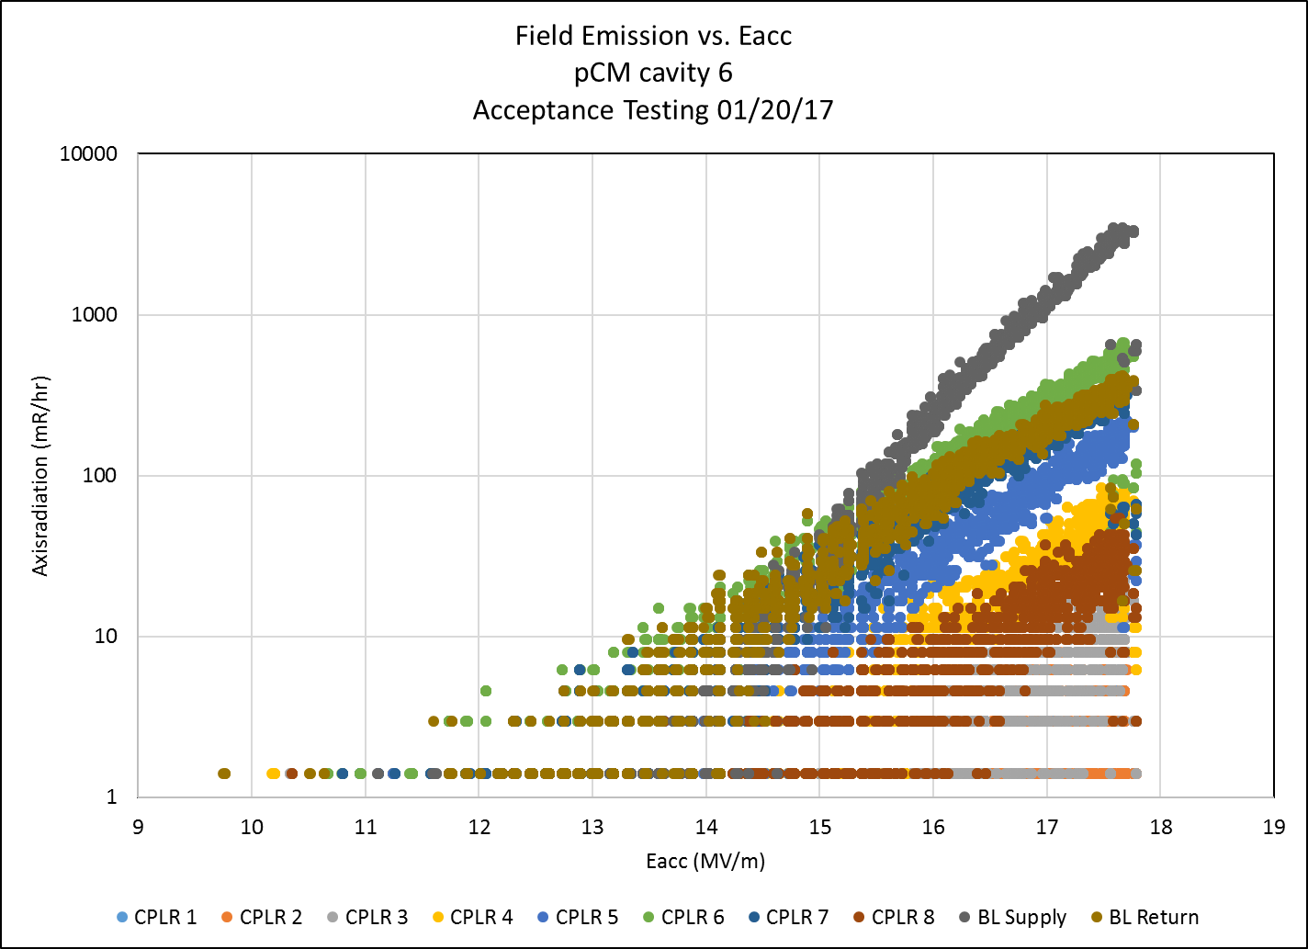
Performance - Cavities
Cavity 6 is only cavity with sustained field emission

Slide 23
Performance – Cavities - Qo Measurement
  Using isolated volume, dpressure/dt technique was not successful,
    Due to valve configuration, volume included Heat Exchanger and 5K circuit had high heat load
    Transients were not steady
  Attempted control volume measurement with steady state conditions
    Lock supply valve trying to obtain constant mass flow, liquefaction and return pressure
    Monitor liquid level rate of change at various heater powers (0, 10, 15, 20, 25 W)

Slide 24
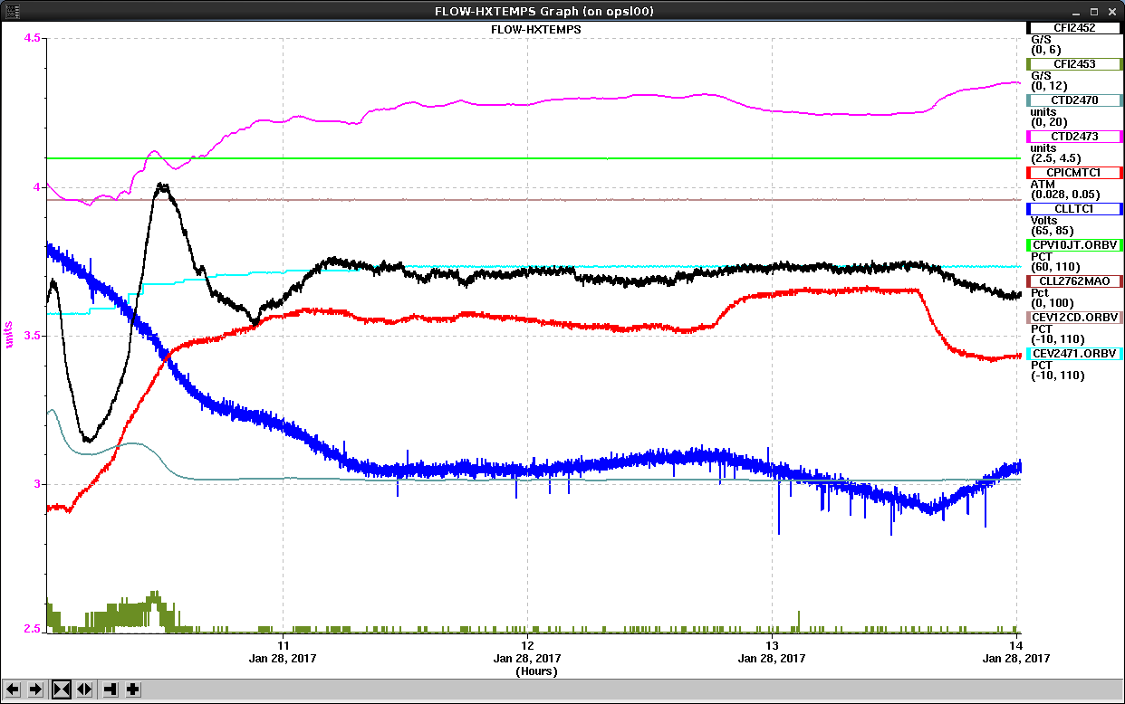
Performance – Cavities - Qo Measurement
JT Inlet Temperature
Mass flow
Pressure
Liquid Level
20 W
10 W
15 W
25 W
0 W

Slide 25
Discussion
Mass flow varies between 3.4 and 3.6 g/s during test – need to recover data from archiver and analyze; current data set has too few significant figures
Return pressure varied ~0.001 atm, relatively steady
  Noted change during 25 W run initially; transient effect when going from 10 W to 25 W (need to wait longer?)
JT Valve inlet temperature relatively steady but variation would affect assumption of steady mass flow
Threw out heater run at 20 W – first data set; suspect transient effects impacted data
Combining 10 & 15 W data produced most believable results

Slide 26
Qo Summary
Preliminary results indicate Qo ~ 4.0 x 10¹⁰ from average heat load of two cavities at 16 MV/m
  Most stable case yields Qo ~ 3.5 x 10¹⁰
    Cavity Temp ~2.08 K -> Qo at 2.0 K ~ 4x10¹⁰
Comparison with VTA needed for 1 & 4
  Cavity 1 – 2.7x10¹⁰ @ 16 MV/m and 2.0 K
  Cavity 4 – 3.9x10¹⁰ @ 16 MV/m and 2.0 K
  Average = 3.3x10¹⁰ @ 16 MV/m and 2.0 K
Static heat load is ~ 27 W
  Includes BB, End Caps, HX and U-tubes
  Includes 5K heat load
Uncertainty in measurements leads to large error bars
  Thermodynamic conditions main contribution

Slide 27
Performance - Microphonics Studies
Performed a set of single strike location / multiple sensor location impulse hammer testing to better characterize modes of the structure.
Measured background microphonics in all cavities. Six were tested in both “good” and “bad” states.
  Cavity 1 gave the worst “bad state” results so far. Cavity 5 microphonics were only measured in a low power state.
Bad state - microphonic frequency shifts several times larger than the 10 Hz peak spec.
Good state for microphonics requires a cryogenic configuration not compatible with normal operations.
Background microphonics shows a consistent 29.8 Hz and 41/42 Hz harmonic lines. Likely driven by external motor vibrations.
Transfer functions taken from the beam pipe (cavity 8 end) to the cavity frequency shift for all 8 cavities.
  Many modes between 25 Hz and 100 Hz / dominant mode at ~48.4 Hz
Successful GDR operation was demonstrated running two cavities (1 and 4) simultaneously at 16 MV/m.
  Two operators chased detuning with manual stepper operation
  CM both level and tilted.
  Successful test required off-normal cryogenic configuration

Slide 28
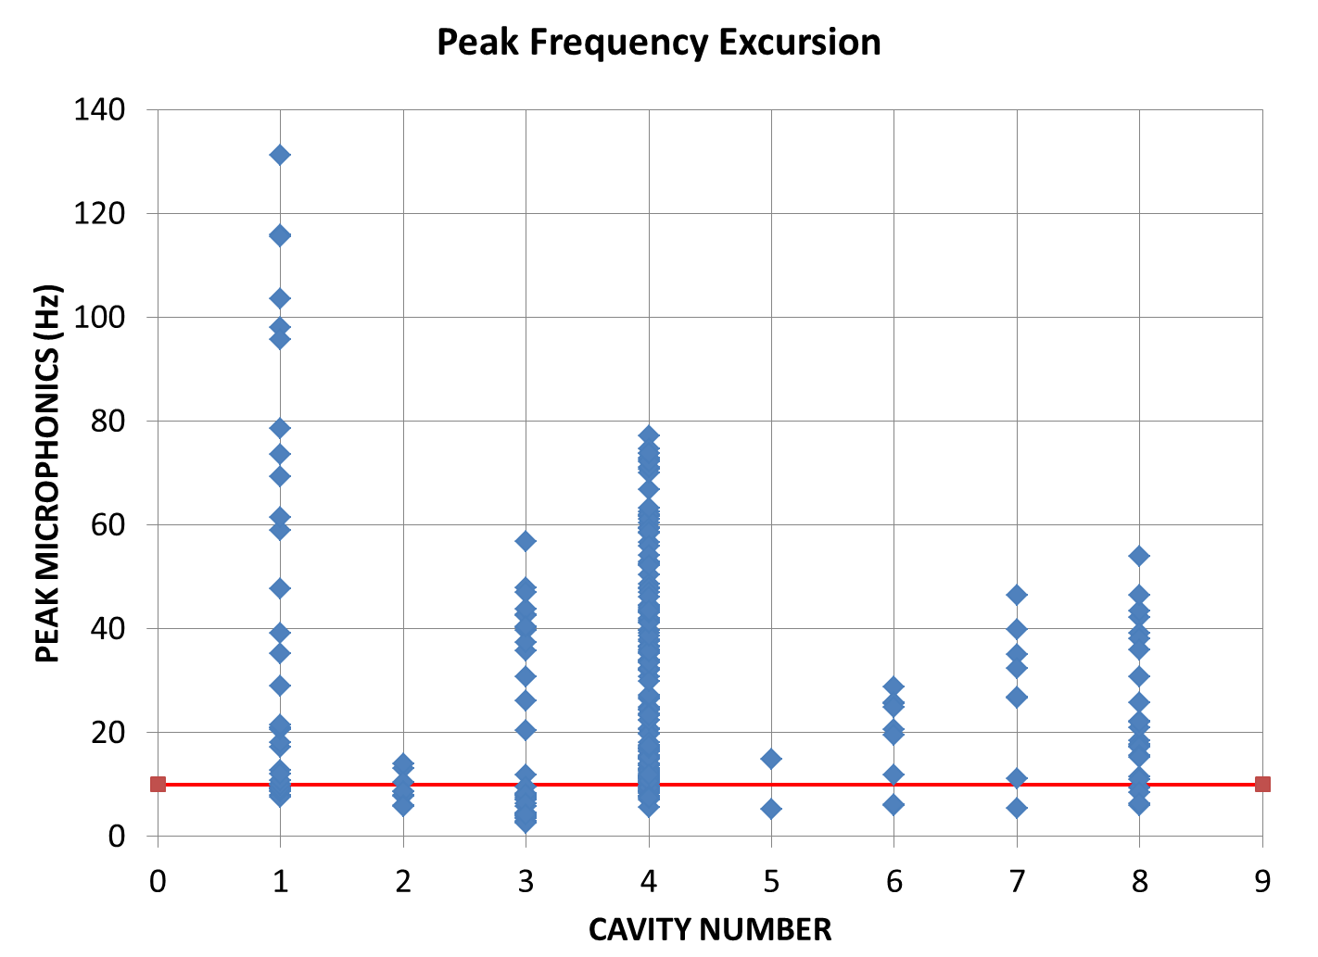
Measured Peak Microphonics on a Cavity by Cavity Basis
Summary of data taken as of 25 Jan
Peak detuning spec = 10 Hz
All cavities were not measured under a under a variety of cryogenic states. (Cavity 5 in particular)
Cavity 1 appears to have the highest peak detuning (~130 Hz)
Cavity 2 appears to have lowest peak detuning (~15 Hz)

Slide 29
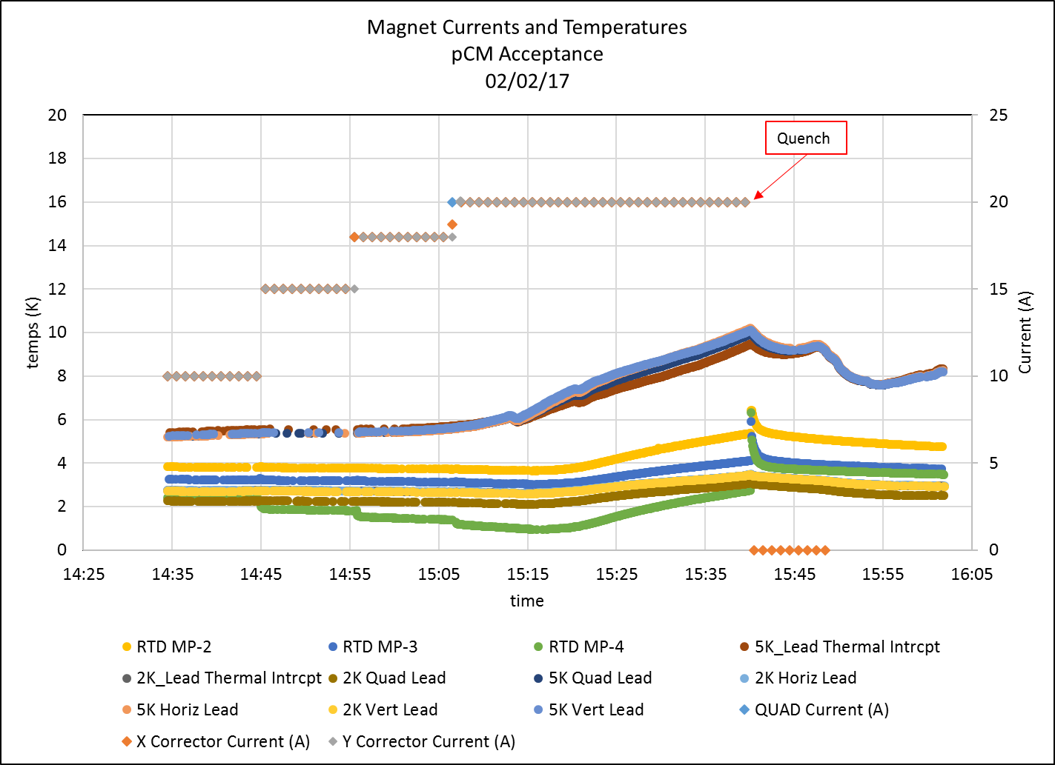
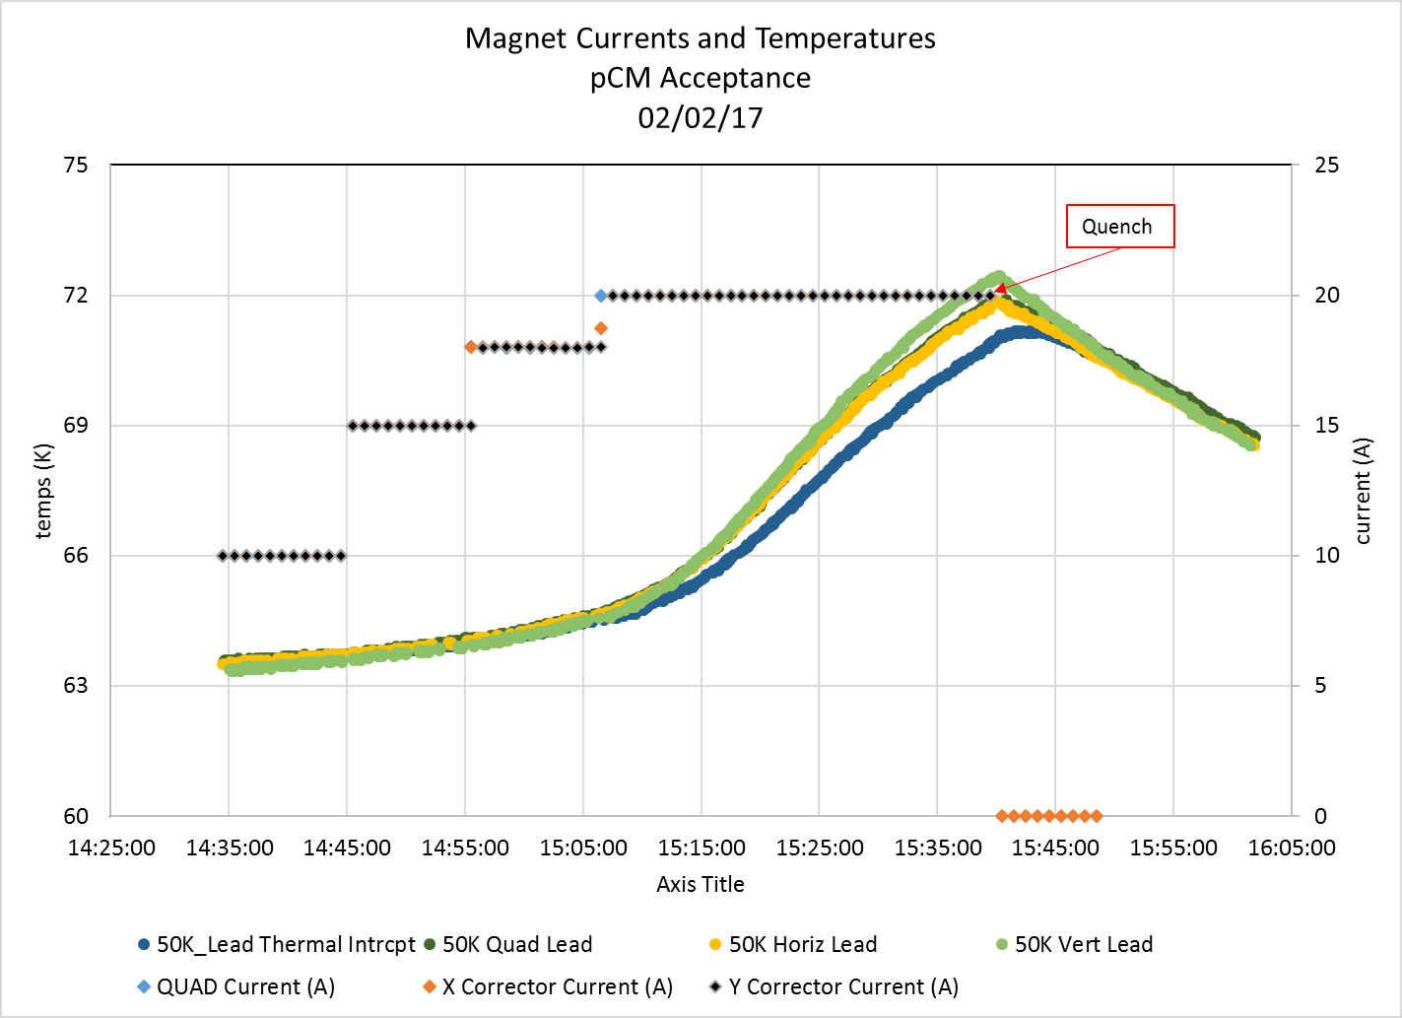
Performance - Magnets
Current stepped up on all three magnets -10 minute intervals
Quench after 33 minutes at 20 A.

Slide 30
Cavity Performance in Prototype Cryomodule at Fermilab
Cavity | Cryomodule Max Gradient* [MV/m] | VTS Max Gradient [MV/m] | Usable Gradient** [MV/m] | FE onset [MV/m] | Cryomodule Q₀ @16MV/m*** Fast Cool Down | Q₀ @16MV/m at VTS
TB9AES021 | 21.2 | 23.0 | 18.2 | 14.6 | 2.6e10 | 3.1e10
TB9AES019 | 19.0 | 19.5 | 18.8 | 15.6 | 3.1e10 | 2.8e10
TB9AES026 | 19.8 | 21.5 | 19.8 | 19.8 | 3.6e10 | 2.6e10
TB9AES024 | 21.0 | 22.4 | 20.5 | 21.0 | 3.1e10 | 3.0e10
TB9AES028 | 14.9 | 28.4 | 14.2 | 13.9 | 2.6e10 | 2.6e10
TB9AES016 | 17.1 | 18.0 | 16.9 | 14.5 | 3.3e10 | 2.8e10
TB9AES022 | 20.0 | 21.2 | 19.4 | 12.7 | 3.3e10 | 2.8e10
TB9AES027 | 20.0 | 22.5 | 17.5 | 20.0 | 2.3e10 | 2.8e10
Average | 19.1 |  | 18.2 | 16.5 | 3.0e10 | 2.8e10
Total Voltage | 154.6 MV |  | 148.1 MV
Acceptance = 128 MV
* Administrative limit 20 MV/m
** Radiation <50 mR/h
*** TB9AES028 Q₀ was at 14 MV/m
Unit test heat load was consistent with the single cavity measurement
G. Wu in WG2 for Cool Down Studies

Slide 31
Summary
Mechanical tuners did not meet 450 kHz range spec
  Actual ranges should be sufficient for normal operation
3 / 8 piezo tuners did not meet 500 Hz range spec
  Worst case – cavity 6 at 75 % of range
Several couplers had very low Qext’s
  Confined to older design that will not be used in production
Four couplers could not be tuned
  Changes in assembly procedure should eliminate future occurrence.
  Limited data for cavity 8
All coupler problems repairable for next round of testing
One cavity of seven tested did not meet gradient spec
  Cavity 5 would have to be operated no higher than ~15.8 MV/m
Only one cavity of seven tested showed any sustained field emission
Standard Qo measurements unsuccessful
  High uncertainty measurement for two cavities puts us on right side of spec
Cavity detuning due to microphonics exceeds spec
  Successful GDR run accomplished with a stable pressure regime
  Cavities 1 and 4 running at 16 MV/m
  Microphonic detuning minimized using methods not applicable to normal operations
  Behavior of steppers suggest that piezos preferable to compensate detuning
Magnets reached 20 A but extended operation at 20 A not accomplished
Module will be subjected to extensive retest after road trips.

Slide 32
Thanks for your attention!
Questions?

Slide 33
Backup Material

Slide 34
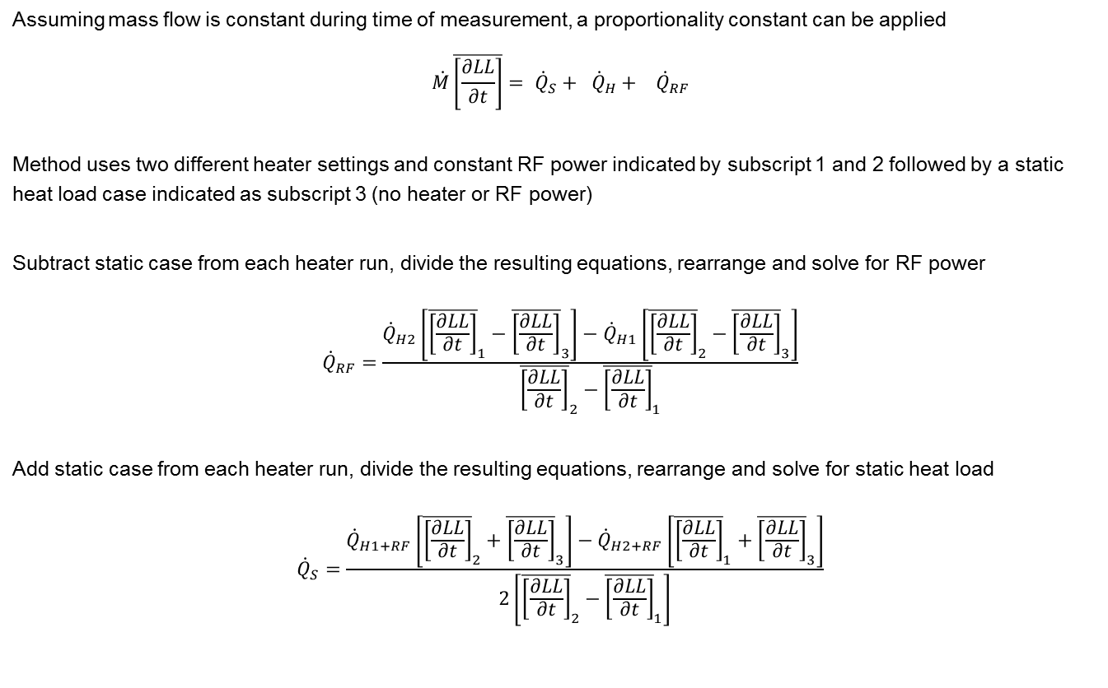
Qo Calculations
Assuming mass flow is constant during time of measurement, a proportionality constant can be applied
$$\dot{M}\overline{\left[\frac{∂LL}{∂t}\right]}=\dot{{ Q}_{S}}+\dot{{ Q}_{H}}+\dot{{ Q}_{RF}}$$
Method uses two different heater settings and constant RF power indicated by subscript 1 and 2 followed by a static heat load case indicated as subscript 3 (no heater or RF power)
Subtract static case from each heater run, divide the resulting equations, rearrange and solve for RF power
$${\dot{Q}}_{RF}=\frac{{\dot{Q}}_{H2}\left[{\overline{\left[\frac{∂LL}{∂t}\right]}}_{1}−{\overline{\left[\frac{∂LL}{∂t}\right]}}_{3}\right]−{\dot{Q}}_{H1}\left[{\overline{\left[\frac{∂LL}{∂t}\right]}}_{2}−{\overline{\left[\frac{∂LL}{∂t}\right]}}_{3}\right]}{{\overline{\left[\frac{∂LL}{∂t}\right]}}_{2}−{\overline{\left[\frac{∂LL}{∂t}\right]}}_{1}}$$
Add static case from each heater run, divide the resulting equations, rearrange and solve for static heat load
$${\dot{Q}}_{S}=\frac{{\dot{Q}}_{H1+RF}\left[{\overline{\left[\frac{∂LL}{∂t}\right]}}_{2}+{\overline{\left[\frac{∂LL}{∂t}\right]}}_{3}\right]−{\dot{Q}}_{H2+RF}\left[{\overline{\left[\frac{∂LL}{∂t}\right]}}_{1}+{\overline{\left[\frac{∂LL}{∂t}\right]}}_{3}\right]}{2\left[{\overline{\left[\frac{∂LL}{∂t}\right]}}_{2}−{\overline{\left[\frac{∂LL}{∂t}\right]}}_{1}\right]}$$

Slide 35
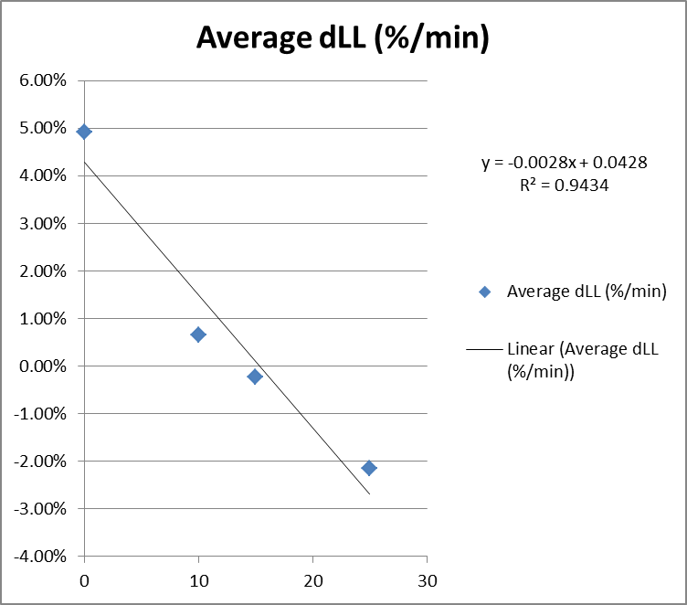
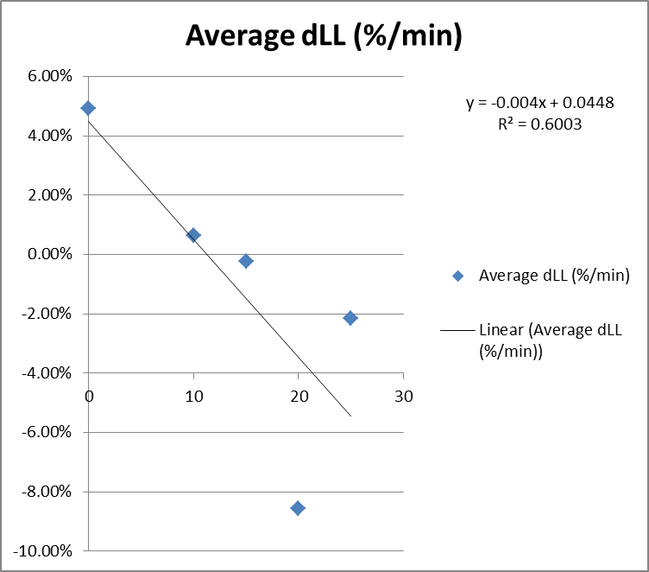
Analysis of LL rate of change
Plot and curve fit not including Run 1 – reasonably good linear fit
Plot and curve fit including Run 1 – suspect transient variation

Slide 36
Results – Cavities 1 & 4 at 16 MV/m During Run
  Run is the time when valve and heater power are constant
  A combines the 10 & 25 W runs (3, 4) and static (5)
  B combines the 25 & 15 W runs (4, 2) and static (5)
  C combines the 15 & 10 W runs (2, 3) and static (5)
    Two most stable conditions when inspection time history

Slide 37
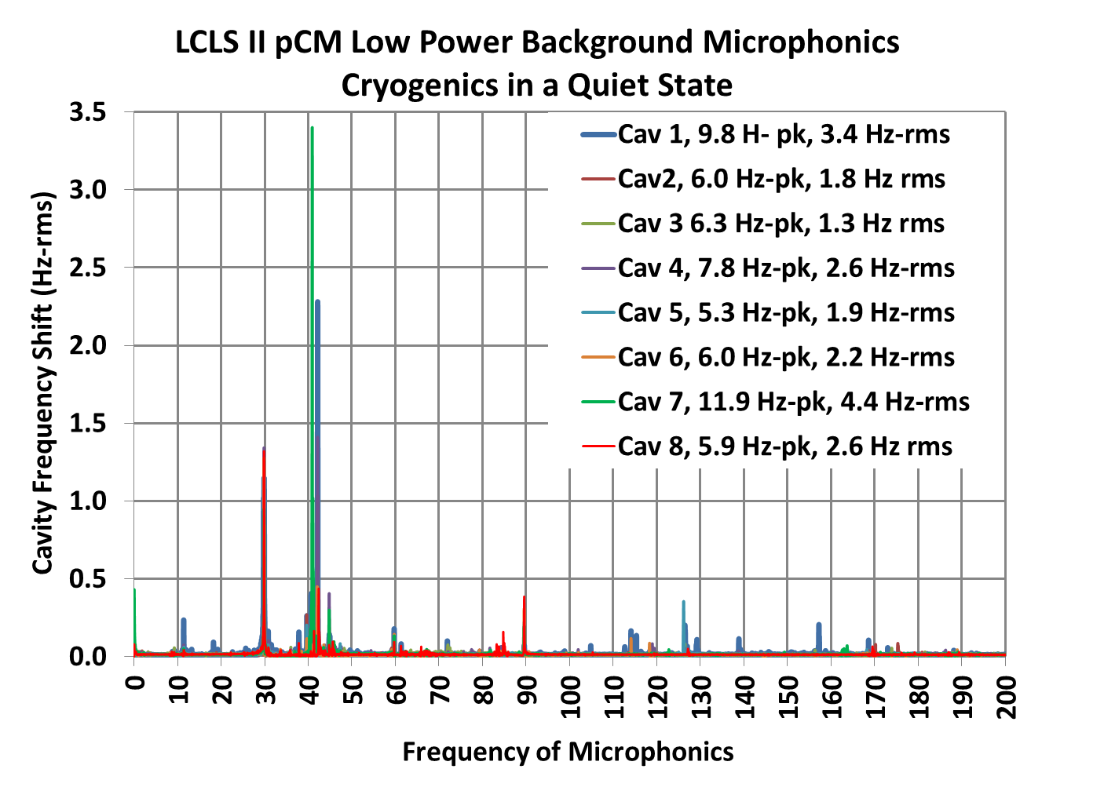
Performance - Microphonics Studies
29.8 Hz is probably from 1800 rpm motors.
41/42 Hz modes MAY be a variable speed motor in the CTF, which is <30 m away from the cryomodule. Still being investigated.

Slide 38
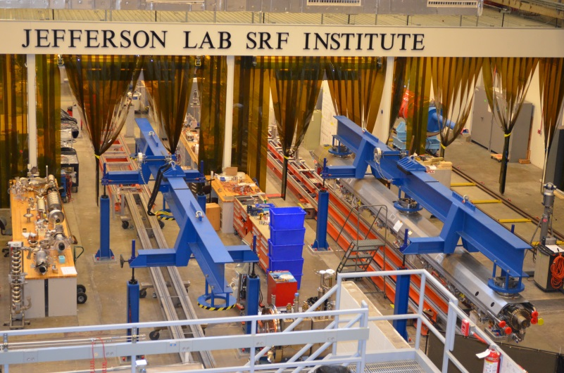
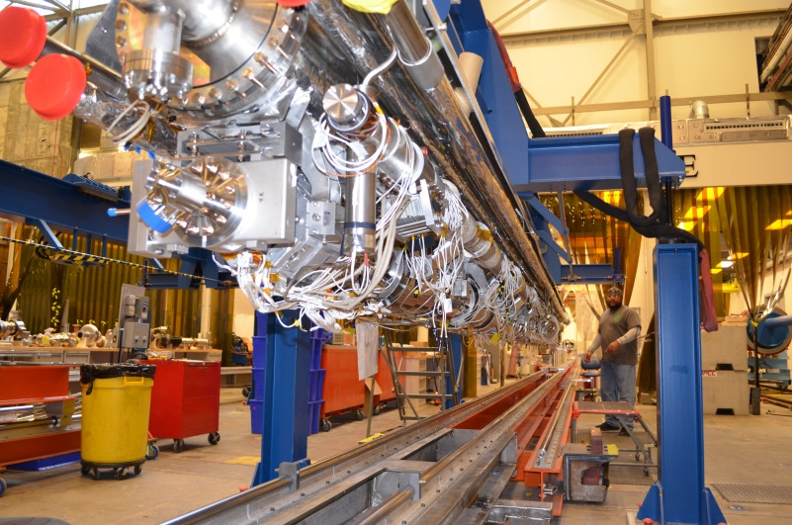
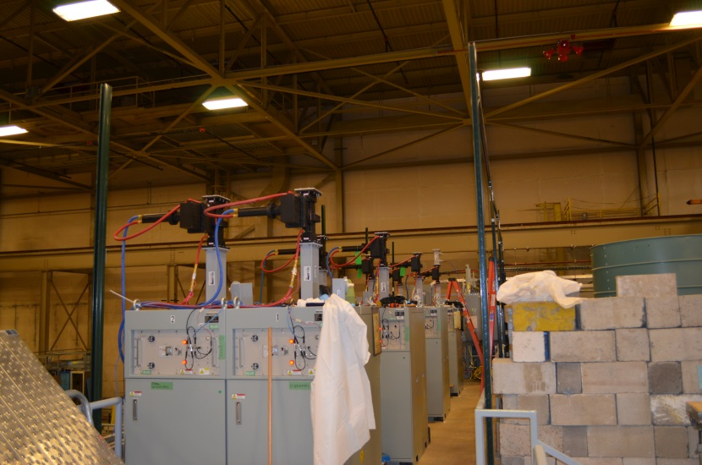
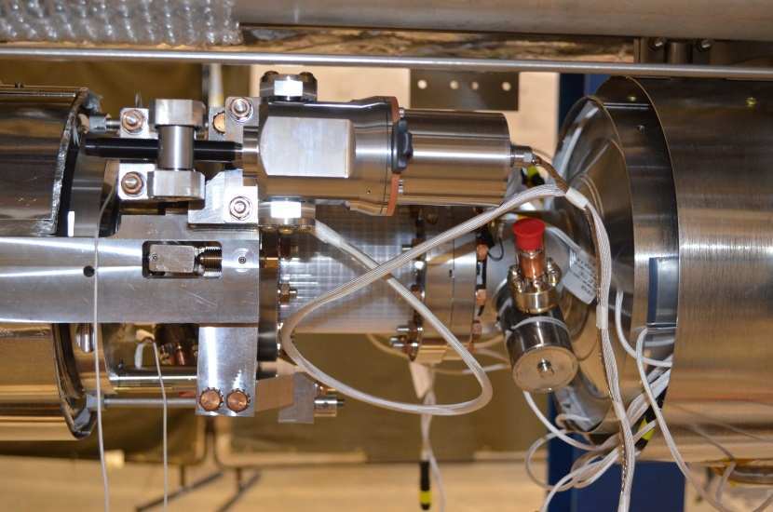
Cryomodule Hardware
Test Lab Assembly Facility
pCM Cold Mass Assembly
LCLS II Solid State Amplifiers
pCM Cavity Tuner Assembly

Slide 39
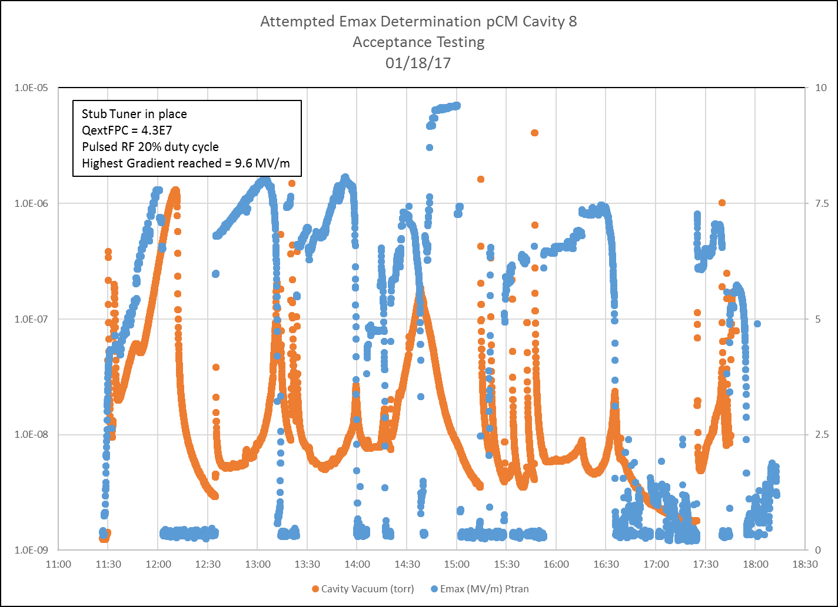
Cavity 8

