Slide 1
Multipacting Free Coupler Design and Commissiong for FRIB
Zhihong, Zheng 02.23.2017

Slide 2
Outline
Motivation of FRIB FPC optimization - severe multipacting observed
Failure of magnetic coil trial to suppress multipacting in FPC
Analytical model to reveal multipacting mechanism at FRIB FPC and potential mitigation method
Structural optimization of FRIB FPC and further upgrade before prototype
Comparison tests between original and optimized coupler (MPF)
Summary

Slide 3
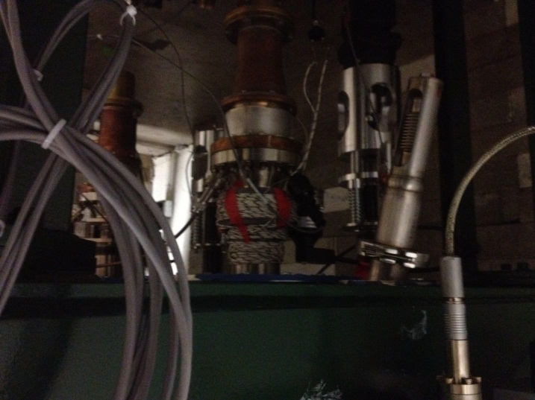
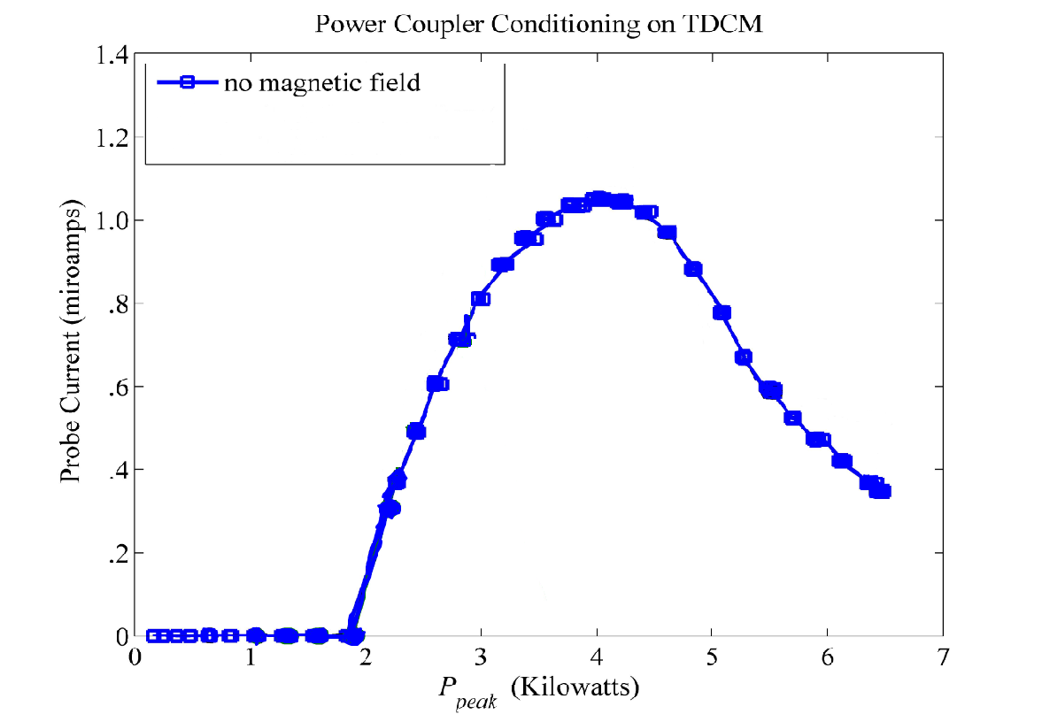
Motivation of FRIB FPC optimization
Due to heavy multipacting, coupler input power was stopped at 2 kW CW, while operating power was up to 5kW CW.
With magnetic coil we can suppress multipacting when cavity is detuned.
Magnetic coil did not help while cavity was on resonance (Failed).
Magnetic coil
coil
Current probe
probe
Multipacting current vs. peak RF power (pulse) while cavity is detuned.

Slide 4
Questions after Cryomodule Test
Question 1: What leads to multipacting in coupler?
Simulations shows that it is caused by the coaxial structure in coupler
The multipacting appears at region of peak transverse electric field
Question 2: Why can we suppress coupler multipacting by magnetic coil when cavity is detuned, but failed when it is on resonance?
When cavity is on resonance, coupler is short at transmission end
When cavity is detuned, coupler is open at transmission end
Take away taper
Whole coupler
Take away bellows
antenna coupler with strong over coupling
Transmission end.

Slide 5
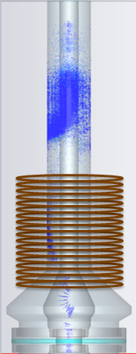
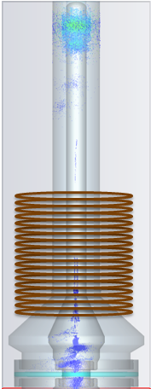
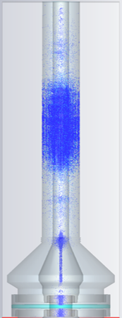
Why Magnetic Coil Method Does Not Work?
Multipacting appears at region of peak transverse electric field ($E_{peak}$).
Case | Node 1 | Node 2 | Node 3
Cavity detuned (open circuit) | Epeak(weak) | Bpeak | E_{peak}(heavy)
Cavity resonance (short circuit) | Bpeak | E_{peak}(heavy) | Bpeak

Slide 6
Analytical Model for Multipacting
Developed model^{[1]} to predict RF power at which coupler has two-point multipacting:
(1)
Impact energy of electron:
(2)
P₁ is more sensitive to structure.
Table 1: Model verification by three different coaxial couplers (Yes=has multipacting, No=no multipacting)
Coaxial couplers | Operating power | Predicted P1 | Predicted K1 | Prediction | Multipacting test results
SNS coupler | 0~550 kW (pulse) | 898 kW | 13.5keV | No | No problem
Dewar test antenna | 0~0.2 kW (CW) | 5 kW | 1.49keV | No | No problem
FRIB HWR coupler | 0~5 kW (CW) | 2.1 kW | 0.679keV | Yes | Heavy (2~6.5 kW)
X
X
X
X
√
X
√
√
√
Increase coupler impedance to increase P1 to avoid multipacting.
[1] Z. Zheng et al, “Prediction and Suppression of Two-Point 1st Order Multipacting”, Nucl. Instr. Meth. Phys. Res. A 735 (2014) 596-601
Notes:
where $r_{1}$, $r_{2}$ are the inner and outer conductor radius, e is electron charge, m is electron mass, ω is RF circular frequency, n is the order of two-point multipacting, η is the wave impedance in vacuum (377Ω), A is 1 for traveling wave and 0.25 for standing wave (superposition theorem).

Slide 7
Draft of MPF Coupler Design
Taper is made near the 3-3/8’’ flange which connects coupler to cavity.
Baseline coupler: R=50Ω,r2=21mm,r1=9mm.
Node 3
Node 2
Node 1
P_{1_node3}=14kW.
P_{1_node2}=17kW.
P_{1_node1}=7kW.
λ/4 match section impedance: $Z=\sqrt{75∗50}=61.2 Ω$
VSWR ≈ 1.08 for 75Ω load at transmission end.
Notes:
Based on the analysis of cryomodule test, it is known that heavy multipacting will appear at node 2 while cavity is on resonance.

Slide 8
Multipacting Comparison between Original and MPF Coupler
With beam, operating power=2.5kW(standing wave)+2.5kW(traveling wave). It is 3.125kW equivalent standing wave power.
Without beam, operating power=2.5kW standing wave.
Normalized multipacting intensity
Simulated by CST.
Coupler RF power (standing wave in coupler) /kW
MPF coupler should be MP free in the operating power range!
Notes:
Multipacting comparison between baseline coupler and optimized one. These four curves are from CST simulations, number of primary electrons are set the same. Multipacting intensity stands for the total number of secondary electrons in 8 RF cycles. Peak value is normalized to 1.

Slide 9
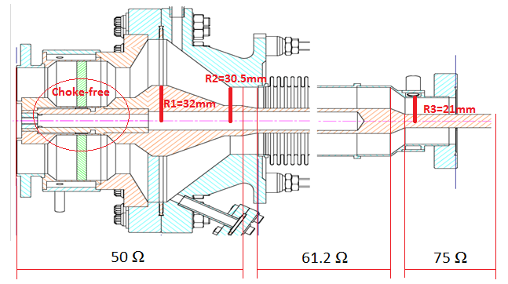
Further Upgrade of the New MPF FPC Prototype
To further improve its performance, we decided to remove the choke and optimized the structure to keep the RF window away from electron impact.

Slide 10
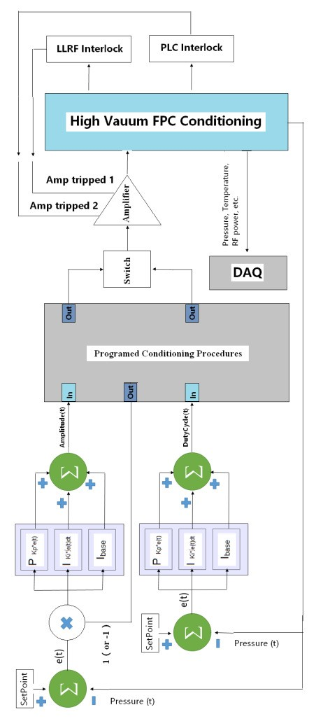
Automatic Conditioning System
Since multipacting conditioning is time consuming, an automatic conditioning system based on PI algorithm was developed to improve the conditioning efficiency and save effort. Several interlocks were applied in order to keep the system safe when running 24 hours without people onsite.

Slide 11
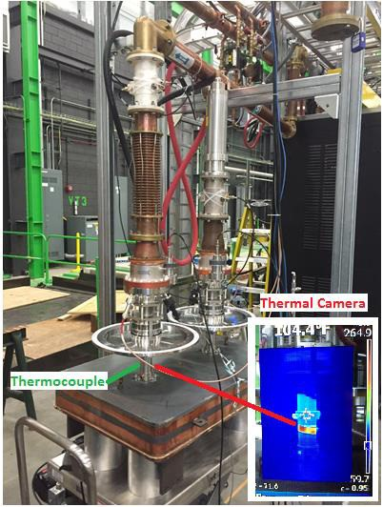
Original FPCs Room Temperature Conditioning
40 hours RF condition to reach 20kW 20% duty cycle.
RF power = 8kW
Heat Load ≈ 80W!
The Evidence for MP.

Slide 12
MPF FPCs Room Temperature Conditioning
Even though we had a spark inside the resonator during the conditioning, it took only 18 hours to achieve 20 kW 20% duty cycle. Multipacting-free design saved 22 hours conditioning time compared to original design couplers.
More importantly, there was no heating problem on multipacting-free couplers which was an evidence for multipacting absence.
Toshiba MP-free FPC-001
Toshiba MP-free FPC-002

Slide 13
Following Tests
Another 8 original FPCs were tested after the comparison test. As a summary for the original design of the couplers, the average conditioning time for one run was about 60 hours, only three of ten couplers had no heating problem after RF conditioning.
In addition, one of the multipacting-free prototypes was tested with HWR53 cavity at 2K in a vertical Dewar as a final integrated validation test, which was a success.

Slide 14
Summary
Comparison tests proved that MPF coupler significantly reduces the conditioning time compared with original-design coupler.
After comparison tests, we did conditioning for the rest of original-design couplers, only 3 of 10 has no heating problem.
As a result, FRIB decided to use MPF-FPC design as the fundamental power couplers for more than 200 HWR cavities.

Slide 15
Thank You !

Slide 16
Backup Slides
Simplified model to get an multipacting principle
If we assume E(r) is constant along the radius to get an estimation, thus
$E_{r}=\frac{U}{d}=\frac{\int_{r_{1}}^{r_{2}}{\frac{2πr_{1}E_{0}}{2πr}dr}}{d}=\frac{E_{0}r_{1}}{d}In\frac{r_{2}}{r_{1}} ⇒Acceleration: a(t)=\frac{eE_{r}}{m}sin(ωt+φ_{0})$
Integrating twice and imposing the condition that s(0) =0 and $φ_{0}=0$. The electron’s position at time t: $\left.s(t)=\frac{eE_{r}}{ω^{2}m}(ωt−sinωt)=\frac{eE_{0}r_{1}}{ω^{2}md}In\frac{r_{2}}{r_{1}}(ωt−sinωt\right)$
Condition for two point MP occurs: $s(t=\frac{\left(2n−1)π\right.}{ω})=d$ $⇒E_{0}r_{1}=\frac{ω^{2}d^{2}m}{\left(2n−1)πe\right.}{\left(In\frac{r_{2}}{r_{1}}\right)}^{−1}$
Since $I_{n}=\frac{2πE_{0}r_{1}}{η}$; Then we get the RF power at which coupler has MP:
$P_{n}$=0.5${I_{n}U}_{n}={{(E}_{0}r_{1})}^{2}\frac{π}{η}In\frac{r_{2}}{r_{1}}=\frac{Aω_{}^{4}{\left(r_{2}−r_{1}\right)}^{4}m^{2}}{\left.{\left(2n−1\right)}^{2}πηe^{2}In(\frac{r_{2}}{r_{1}}\right)}$ (For TW, A=1; for SW, A=0.25;)
$⇒P∼f^{4}{\left(r_{2}−r_{1}\right)}^{4}Z^{−1}$ (Z: impedance; f: frequency)
Since $v\left(t\right)=\frac{eE_{r}}{ωm}(1−cosωt)$;
So impact energy at $t=\frac{\left(2n−1)π\right.}{ω} :$
$K_{n}=\frac{mv^{2}}{2}=\frac{2mω^{2}d^{2}}{{\left(2n−1\right)}^{2}π^{2}}⇒K_{n}∼f^{2}{\left(r_{2}−r_{1}\right)}^{2}$

Slide 17
Backup Slides
E. Somersalo’s scaling law:
$$P_{two−point}∼{\left(ωr_{2}\right)}^{4}Z^{2}$$
$$K_{n}∼{\left(ωr_{2}\right)}^{2}$$
Self-derived principle:
(1)
(2)
Figure 12: Comparison of the Eq. (1) results (orange line) and E. Soersalo’s scaling law (green line) for two-point 1st order multipacting in the FRIB coupler, as we change the impedance. Outer radius is 21mm.
Figure 13. Multipacting bands in coaxial line

Slide 18
Backup Slides
Increase impedance by enlarging outer radius. Inner radius=9mm.
Figure 14: Comparison of the Eq. (1) results (orange line) and E. Soersalo’s scaling law (green line) for two-point 1st order multipacting in the FRIB coupler, as we change the impedance. Inner radius is 9mm.

Slide 19
Backup Slides
(1) Coupler with bellow and taper
These three couplers are all 580mm long and simulated in open circuit .They all have multipacting at the same position(L≈0.47m).
Wave length
λ=c/f=0.93m
So, λ/2=0.466m ≈L
Conclusion: The FRIB coupler’s MP is caused by its coaxial structure, MP occurs at the peak E-field
(2) Coupler with taper and without bellow
(3) Coupler without bellow and taper
L≈0.47m

Slide 20
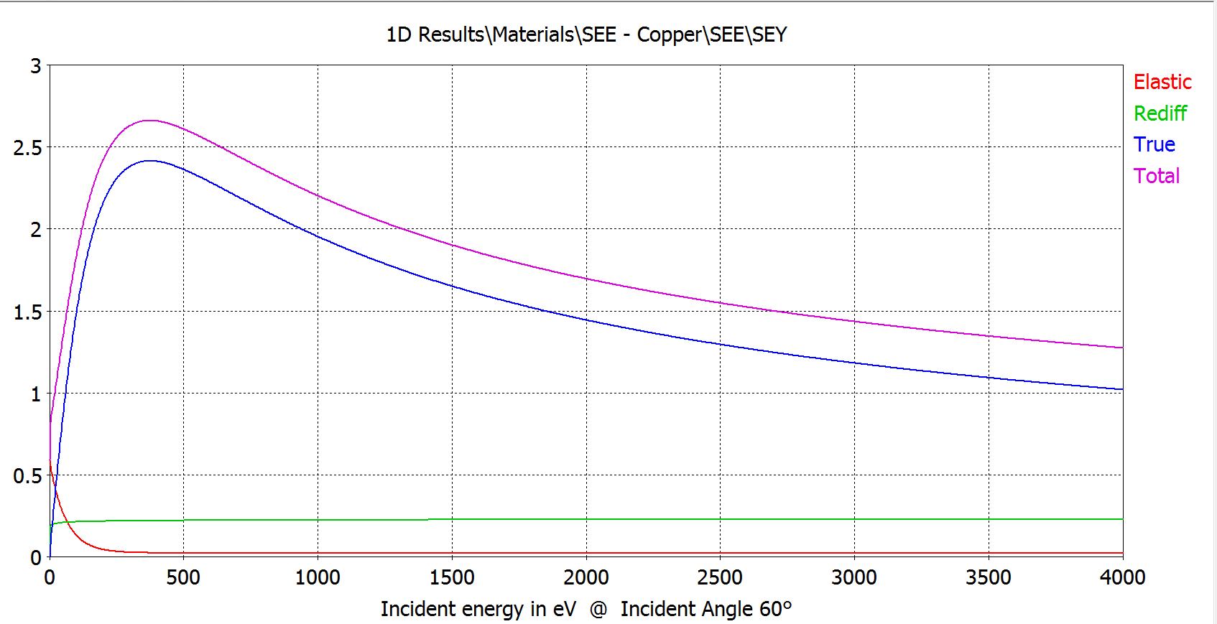
Backup Slides
SEY used for coupler

Slide 21
Backup Slides
Why small magnetic field increase multipacting for cavity detuned case?
For cavity detuned case, we found that small magnet will increase multipacting. But multipacting disappeared when coil current was around 5A. This phenomenon is also found in CST simulation.
Explanation: small magnetic field will increase impact angle $θ_{0}$, thus SEY increases. Large magnetic field will change resonance trajectory, thus multipacting is suppressed.
Normalized multipacting
Coil current /A
Figure 15. Three mechanism for SEY
Figure 16. Multipacting vs. coil current. Each case is simulated in 5 RF cycles. Peak value is normalized to 1.

Slide 22
Backup Slides
Model of True Secondary Yield${\text{ (}\text{δ}}_{ts})$

Slide 23
Backup Slides
Small magnetic field increases MP
Y
X
θ1 =tan-1(Vy/Vz) =tan-1(0.75/1.7) =24 °; θ2=tan-1(Ly/Lz) =tan-1(3mm/21mm) =8 °; impact angle: θ=θ1-θ2=16°
K2/K1=1 ≤ (L2/L1)^2≤(21.4mm/21mm)^2=1~1.04
K1=0.68keV, K2=0.68~0.71keV (in simulation, K2≈0.8keV, see picture left up)
Without coil, K1=0.68keV, θ=0°: SEY=1.78
Coil current=3A, K2=0.68~0.71keV, θ=16°: SEY=1.82~1.83
MP intensity ratio=(1.78/(1.83~1.82))^10≈0.8 (about 0.7 in simulation, see figure 4)
Simulated by CST.

Slide 24
Backup Slides

Slide 25
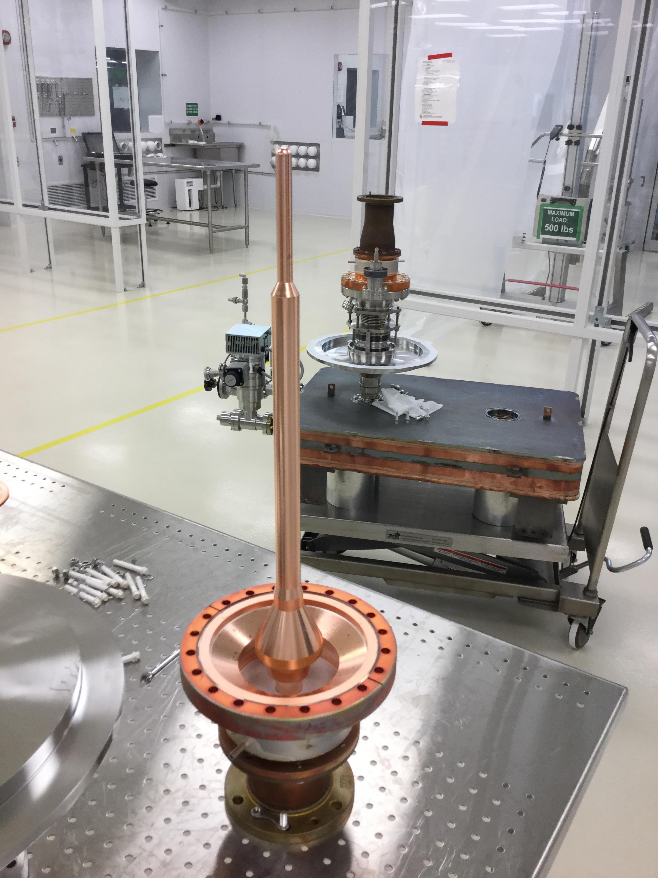
IC and OC are Beautiful
The inner conductor is very beautiful, no stain marks and no electron bombarding spots.
Tapered area of outer conductor (close ceramic, vacuum side) is also beautiful but found very light electron bombard spots (maybe ten spots), which is not serious.

Slide 26
One Electron Bombarded on Gasket

Slide 27
Brown Spots around RF Window and Brazing
It doesn’t look like electron bombarded mark.
Conclusion: we could not find a big sparking mark in the coupler vacuum side. Big spark mark probably is inside conditioning box.

Slide 28
MPF FPC Conditioning with New Box

Slide 29
Original FPC Conditioning with New Box

Slide 30
THANK YOU!

