Slide 1
FRIB HWR TUNER DEVELOPMENT
S. Stark SRF Coupler and Tuner Team Leader

Slide 2
Abstract
During the last three years the HWR pneumatic tuner development at FRIB evolved from the first prototypes to the final production design.
A lot of warm testing and several cryogenic integrated tests with cavity were performed to optimize the tuner features.
The main challenges included the bellow bushings binding and very tight space limitations for the assembly on the rail.
The final design, based on the acquired experience, was prepared in collaboration with ANL and entered the preproduction phase.

Slide 3
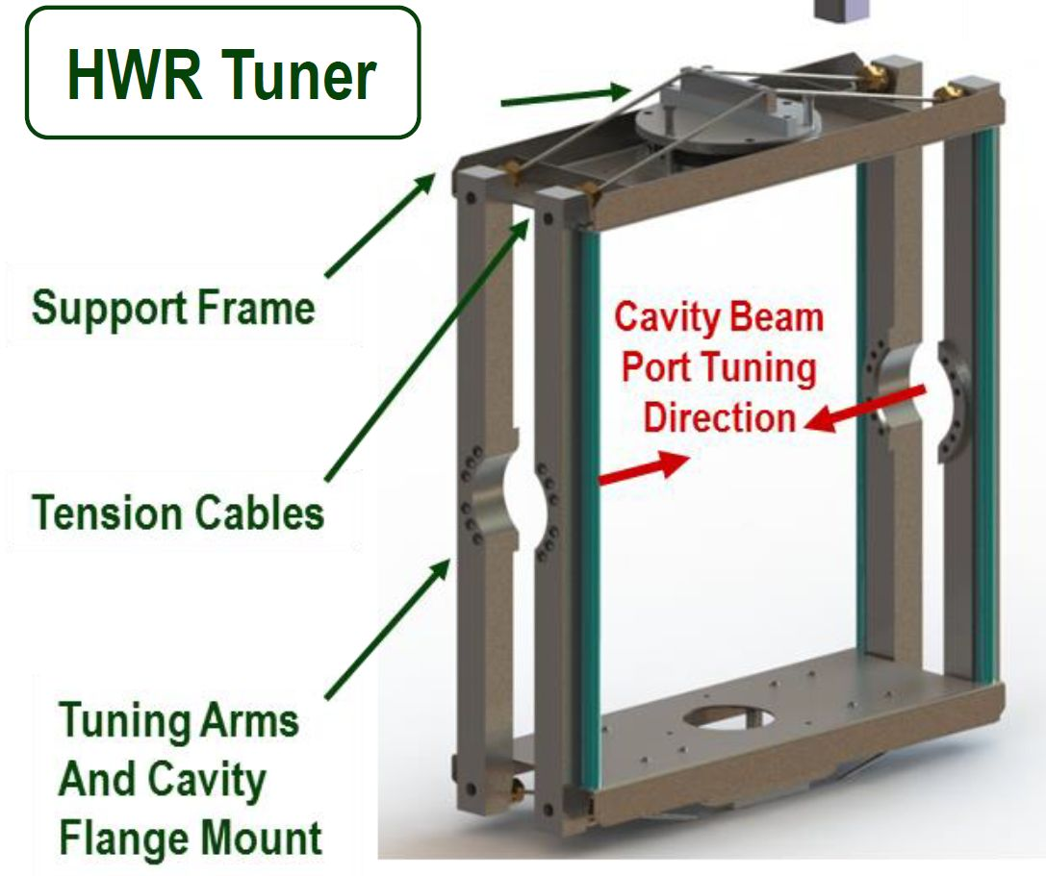
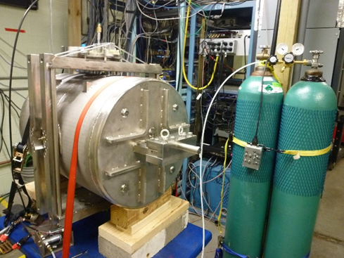
First Pneumatic Tuner Prototype at FRIB
First pneumatic tuner prototype was prepared in spring 2014
The design followed ANL guidelines. We started the systematic study of the tuner in June 2014 using a HWR53 cavity.
We used FRIB LLRF controller interfaced with PC to drive the valve system and acquire helium gas pressure and frequency data. For evaluation purposes we developed 3 types of sequences:
Full range scanning with frequency and pressure registration up to 15 cycles per hour (can be executed in superconducting state and nearly critical coupling at room temperature)
Full range scanning up to 150 cycles per hour with pressure registration
Small range (1-2 psi) scanning 1800 cycles per hour with pressure registration.

Slide 4
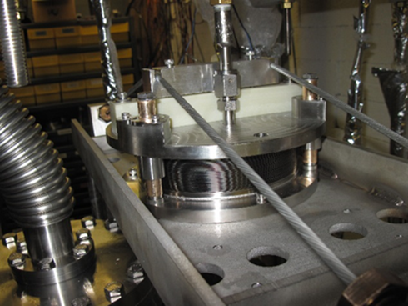
Testing Experience
During the first warm testing runs the main part of tuning mechanism including frame, arms and cables seemed to work fine and to be under control.
We only had to reinforce the planes as they were flexing and enlarge the spacing for frame to move without touching the arms.
We had to concentrate on the bellows lifetime as the most critical parameter for FRIB project.
We started with the bellows with 3 guides for the movable flange.

Slide 5
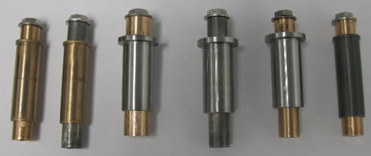
Main Problems
We have got one of the bellows broken in the first convolution after 500 full cycles. After that all new bellow flanges are EB welded instead of TIG to reduce the over-heating and bellows damage probability, and the profile for welding had been modified.
The main problem we encountered was the friction and binding between the guides and the flange.
Used testing sequence consisted of about 200-300 full range cycles and about 2000 each small range cycles in at least 3 pressure regions.
Several guide bar-bushing combinations and solutions were tested.
Nitronic bar and bushing
Nitronic bar and Bronze bushing
Nitronic bushing and Bronze bar (ANL style)
Nitronic bushing and Bronze bar of larger diameter
Nitronic/Dicronite bushing and Bronze bar
Nitronic/Dicronite bar and bushing
Nitronic/Dicronite bushing and Nitronic bar
The last demonstrated the best performance. (Dicronite - Tungsten Disulfide (WS2))

Slide 6
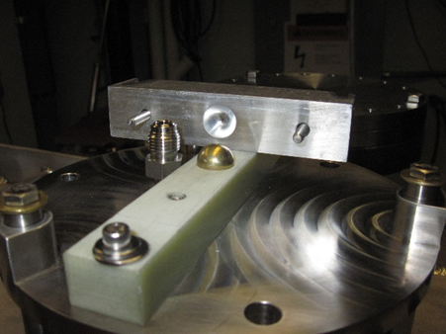
Further Solution Development
We tested single and double spherical washers, advised by ANL, to facilitate the guide bars alignment. The single washers gave noticeable improvement. The double ones made the configuration unstable.
We made adjustable the G10 pushing block position on the bellow flange for better centering and added the decoupling ball to compensate for the small differences in cable tension.
The alignment and fixing of guide bars had been done in bellows closed position as suggested by ANL. This position is reached tightening the cables to create some initial pretension.

Slide 7
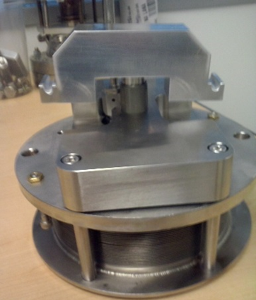
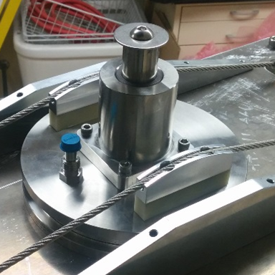
Single Bar Solution
Anyhow, even putting all these improvements together, binding was still occurring at some point.
FRIB and ANL independently moved to a single guide bar solution development and testing.
Even in these configurations binding was still present after a certain amount of time.

Slide 8
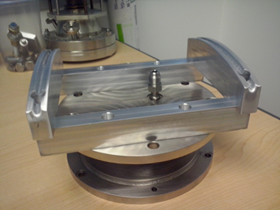
Bellows Without Sliding Elements
ANL proposed to try bellows without sliding elements.
Prototype was prepared and warm tested at FRIB.
We performed 1500 full cycles and 25000 small range cycles. The bellows remained stable with no performance degradation.
We decided to accept and develop this solution

Slide 9
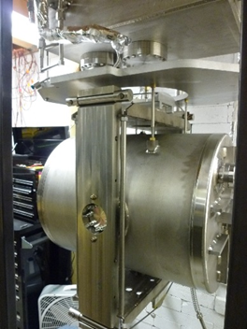
Tuner Arms Development
The arms used for the first prototype were not compatible with cryomodule rail spacing requirements. The distance between the cavities was too small to insert the screws connecting the arms to the cavity.
We solved this problem by modifying the design to allow installation of the two arms by sliding them from the side, and connecting them together to clamp two bolts already in place on the cavity beam port external flanges.
We performed the cold test to validate this configuration.

Slide 10
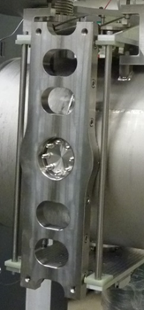
Collaboration with ANL on Production Design
At certain point the conceptual design of the tuner had been defined and we decided to open the collaboration with ANL to prepare the final design and production drawings.
ANL proposed different arms design and the way to assemble the arms on the rail. The aluminum intermediate flanges had to be bolted first and the arms were assembled supported by the pins in the aluminum flanges.
This configuration appeared more stable, but we had to add another pair of pins on each side to stabilize the arms.
It was proposed to use the ANL model of single bar bushing for the bellows, but we decided to use the bellows without sliding elements.

Slide 11
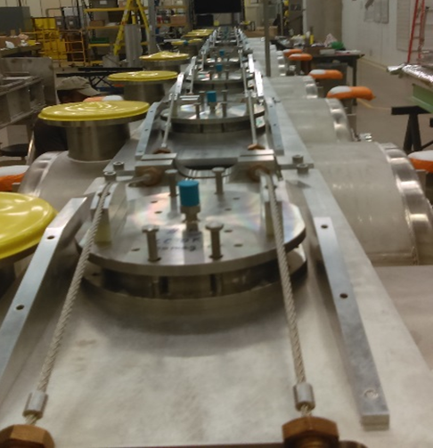
First HWR53 Cryomodule Tuner Setup
The assembly and pretuning went smoothly on prototype cryomodule
We developed the procedures for the tuners preloading and testing, before shielding is put on, based on ANL recommendations.
We keep preloading at 200 pounds in two steps.
There appears some relaxation of the tuner after the first training of 20 cycles at 20 psi and 20 cycles at 50 psi of about 40 pounds

Slide 12
Conclusions
During the last three years FRIB has been continuing the development of the tuner for HWRs.
We moved from the original mechanical tuner solution to pneumatic one, adopting the technology developed at ANL.
During the warm tests on the prototypes we understood that the long term mechanical reliability is not sufficient for FRIB and tried to find alternatives in collaboration with ANL.
We developed the alternative design that have been prototyped and verified in cryogenic integrated tests in a vertical Dewar.
We have a prototype cryomodule with pre-production set of tuners under test that is confirming our concepts.

Slide 13
Authors
S. Stark, A. Facco‡, S. Miller, P. Ostroumov, J. Popielarski, K. Saito, B. Tousignant, T. Xu
FRIB, Michigan State University, East Lansing, MI 48824, USA
‡also at INFN-Laboratori Nazionali di Legnaro, Legnaro (PD), 35020, Italy
S. Gerbick, M. Kelly
Argonne National Laboratory, Argonne, IL 60439, USA
ACKNOWLEDGMENT
Special thanks go to G. Zinkann and to S. Sharamentov for advices on system operation.
REFERENCES
[1] G. Zinkann, E. Clifft, S.I. Sharamentov, An Improved Pneumatic Frequency Control for Superconducting Cavities, Proc. of PAC-2005, p.4090.
* Work supported by the U.S. Department of Energy Office of Science under Cooperative Agreement DE-SC0000661, the State of Michigan and Michigan State University

