Slide 1




Degradation and recovery of ISAC-II cavities
Tobi Junginger, Arthur Chen, Bob Laxdal, Doug Storey, Zhongyuan Yao and Vladimir Zvyagintsev

Slide 2
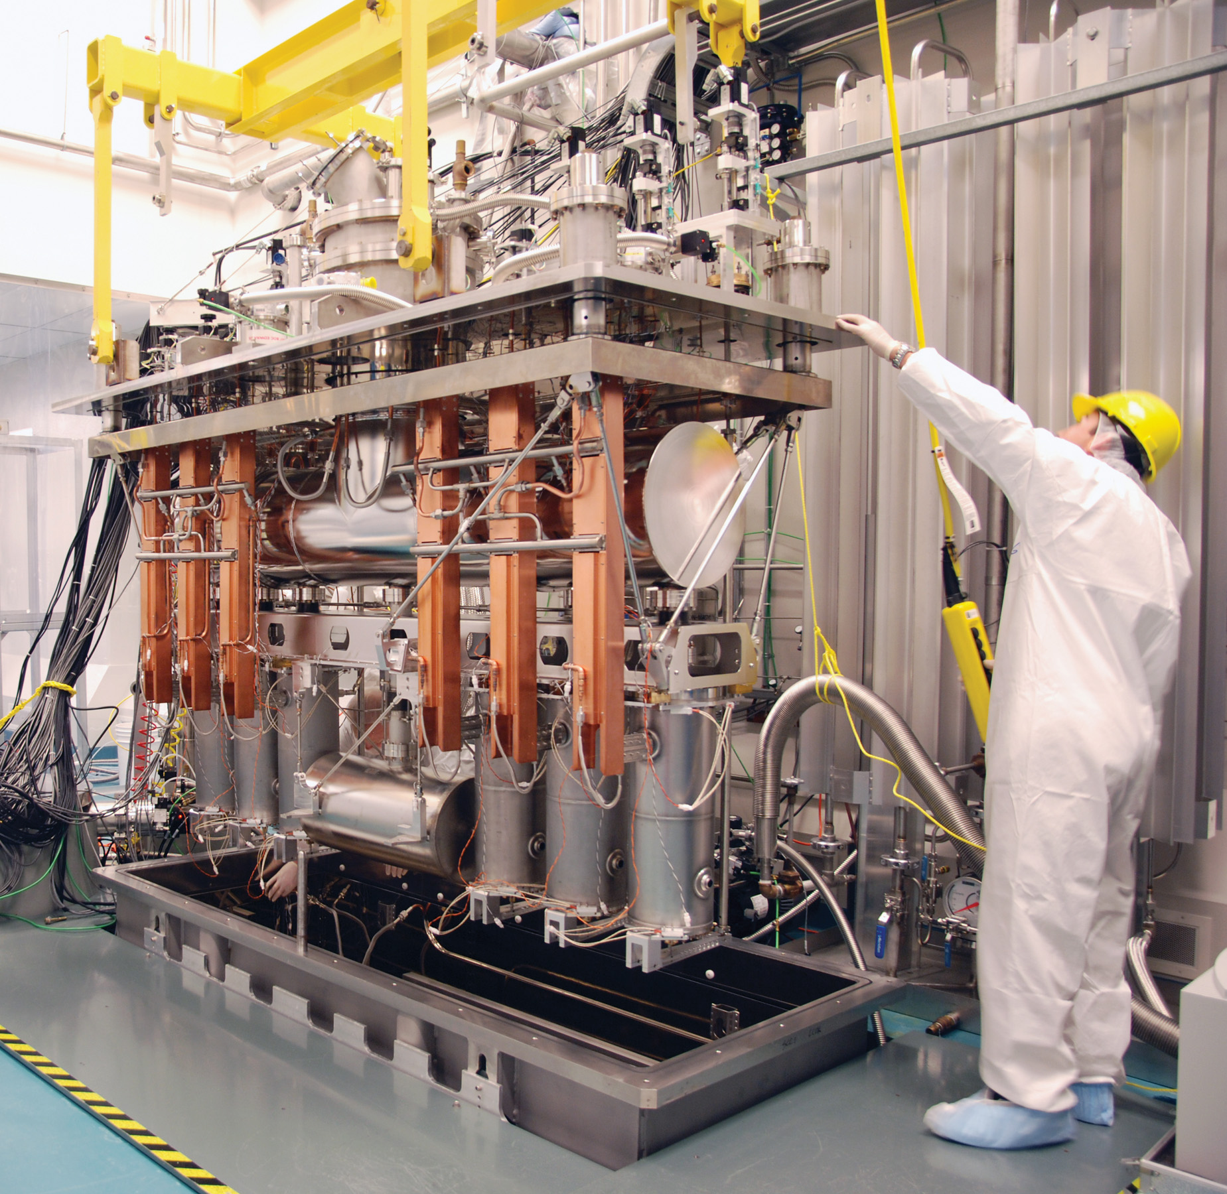
ISAC-II accelerator magnetic environment
5 low beta cryomodules with 4 QWRs each
3 high beta cryomodules with 2x6 and 1x8 QWRs
Each module contains a solenoid for focusing
Minimalist’s shielding strategy
  non magnetic materials where possible
  no shielding between cavity and solenoid – use procedures
Cavities should be insensitive to quench degradation since they have a reactor grade niobium jacket which acts as a Meissner shield
However the top and bottom plate of the cavity are single walled

Slide 3
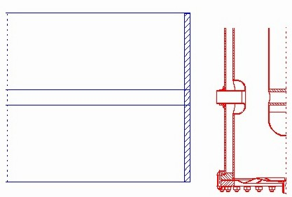
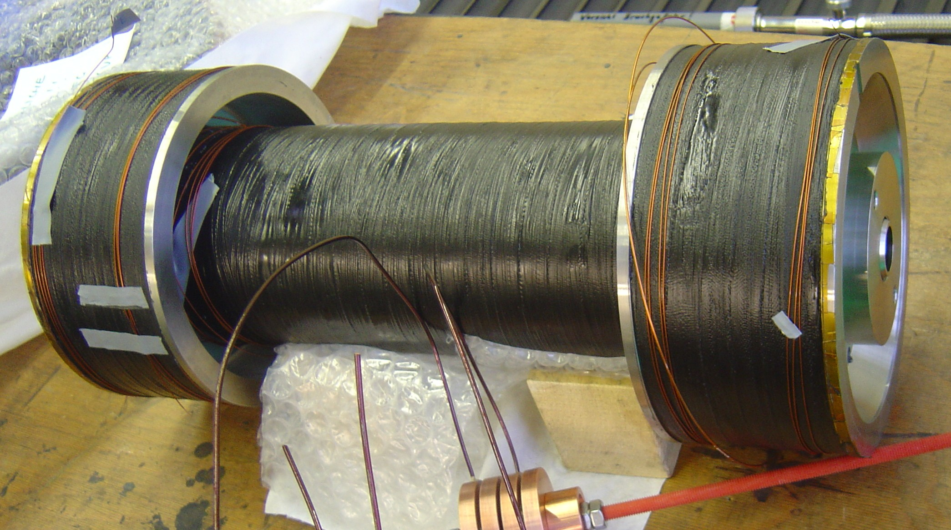
ISAC-II accelerator magnetic environment
Focusing in the SC Linac is provided by superconducting solenoids (B≤9T)
End fringe fields controlled with active `bucking’ coils (B_{cavity}≤30mT)
Cavity
Prototype Solenoid at Accel

Slide 4
Observation of cavity degradation
During operation cavities sometimes trip
In a few cases the cavity will have a largely reduced Q₀, multipacting or lower quench level afterwards
Our assumption is that the cavity has quenched and flux from the solenoid has been trapped
If Q₀ is strongly reduced the cavity cannot be operated anymore at the same gradient. It needs to be recovered or the linac needs to be retuned (downtime up to 8h depending on operator´s experience and number of cavities following the degraded one)
In general recovering a cavity could either be done by
  quenching with solenoid off (1h downtime) or
  warming up the cryomodule above T_{c} (4h downtime)

Slide 5
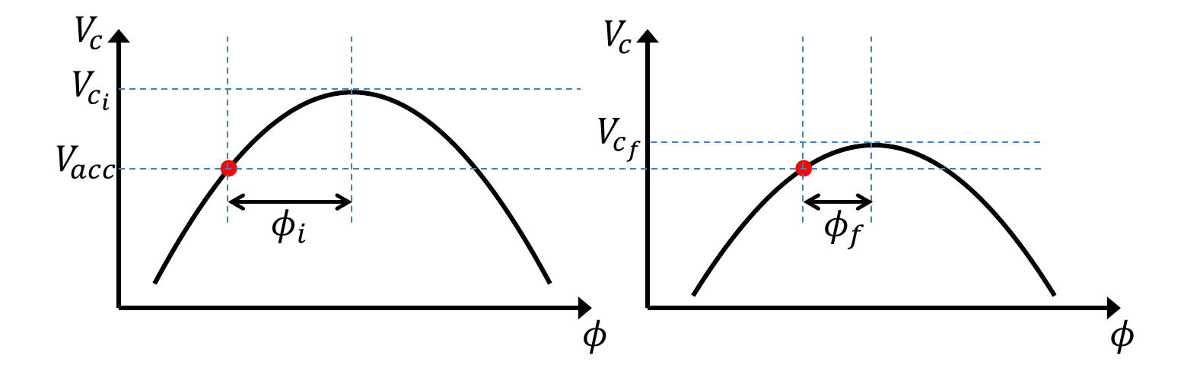
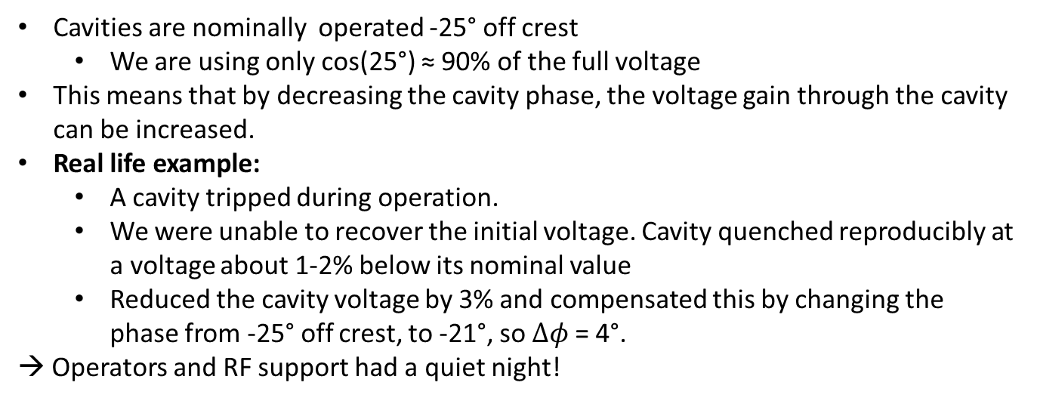

Weak degradation
Cavities are nominally operated -25° off crest
  We are using only cos(25°) ≈ 90% of the full voltage
This means that by decreasing the cavity phase, the voltage gain through the cavity can be increased.
Real life example:
  A cavity tripped during operation.
  We were unable to recover the initial voltage. Cavity quenched reproducibly at a voltage about 1-2% below its nominal value
  Reduced the cavity voltage by 3% and compensated this by changing the phase from -25° off crest, to -21°, so $Δφ$ = 4°.
→ Operators and RF support had a quiet night!
$$V_{c_{i}}\cos{φ_{i}}=V_{c_{f}}\cos{φ_{f}}$$

Slide 6
Severe degradation
SCB5-2
Sudden degradation during operation
Quench with solenoid off does not recover Q₀

Slide 7
Turn off solenoid and warm cavity up
SCB5-2
Full recovery by thermal cycling
Sudden degradation during operation
Quench with solenoid off did not recover Q₀
Warm up above Tc with solenoid off recovers Q₀

Slide 8
Undegraded cavities:
Quench cavity with solenoid on/off
SCB5-1
Distant from solenoid
SCB2-3
Close to solenoid
Quenching the cavity with RF does not yield a degradation

Slide 9
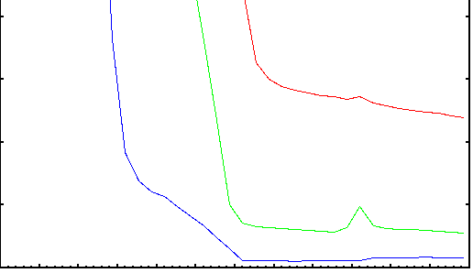
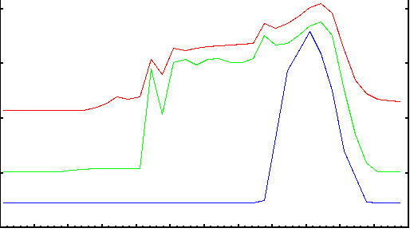
Undegraded cavities:
Effect of thermal cycling
SCB5-1
80
Initial
cooldown
Top
60
T [K]
40
Bottom
20
Inner Conductor
20
20 K cycle
15
T [K]
Top
10
Thermal cycling has no effect on undegraded cavities
Bottom
5
Inner Conductor
0
3 hours
Different cooldown dynamics

Slide 10
Why do cavities degrade during operation ?
Assumption: Cavity quenches and traps flux from solenoid while the Meissner shield remains effective
Three possible points of flux entry
  Top plate → Field from solenoid below 1µT
  Beam port → Field from solenoid below 1µT
  Bottom plate

Slide 11
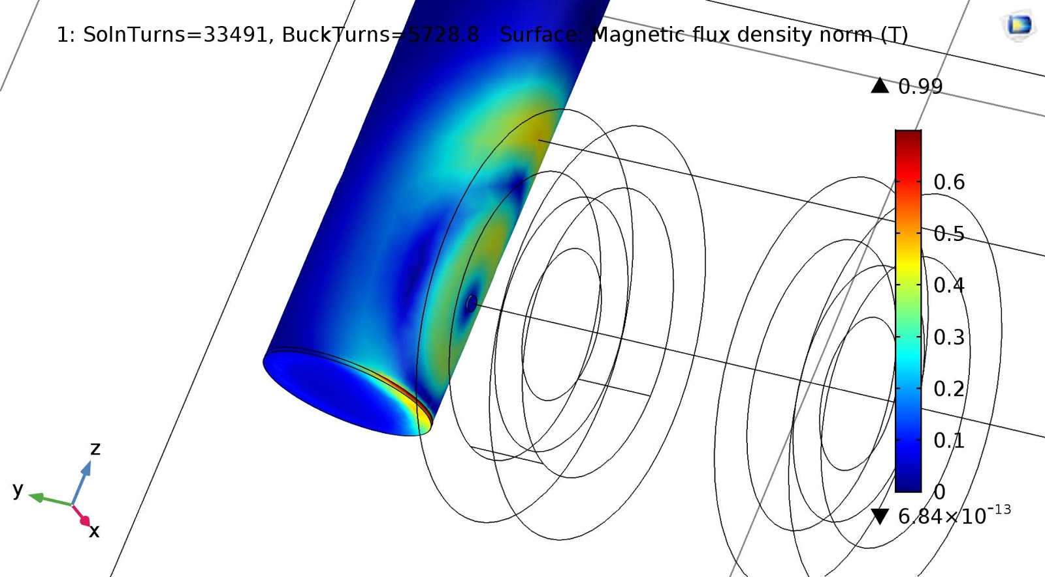
Simulation of flux from solenoid on the cavity surface

Slide 12
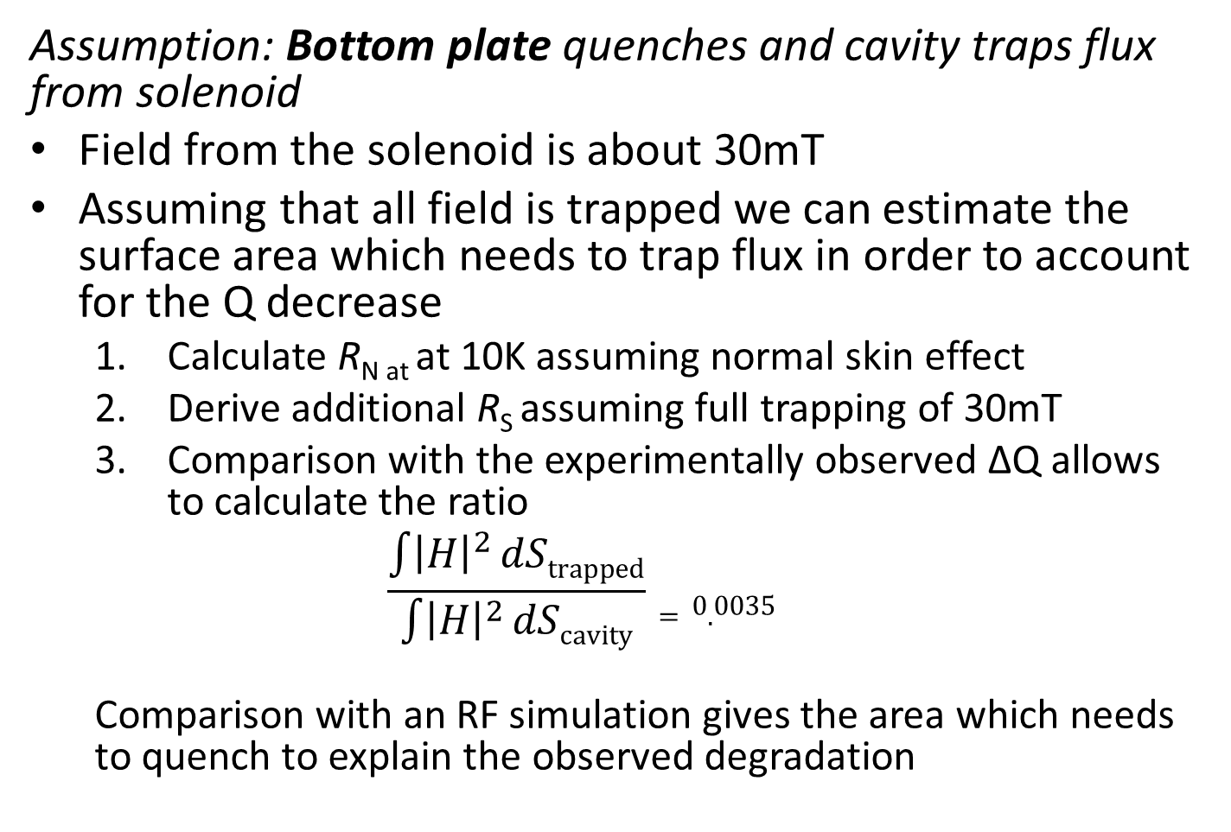
Why do cavities degrade during operation ?
Assumption: Bottom plate quenches and cavity traps flux from solenoid
Field from the solenoid is about 30mT
Assuming that all field is trapped we can estimate the surface area which needs to trap flux in order to account for the Q decrease
  Calculate R_{N at} at 10K assuming normal skin effect
  Derive additional R_{S} assuming full trapping of 30mT
  Comparison with the experimentally observed ΔQ allows to calculate the ratio
  $$\frac{\int{{\left|H\right|}^{2}}dStrapped}{\int{{\left|H\right|}^{2}}dScavity}=0.0035$$
  Comparison with an RF simulation gives the area which needs to quench to explain the observed degradation

Slide 13
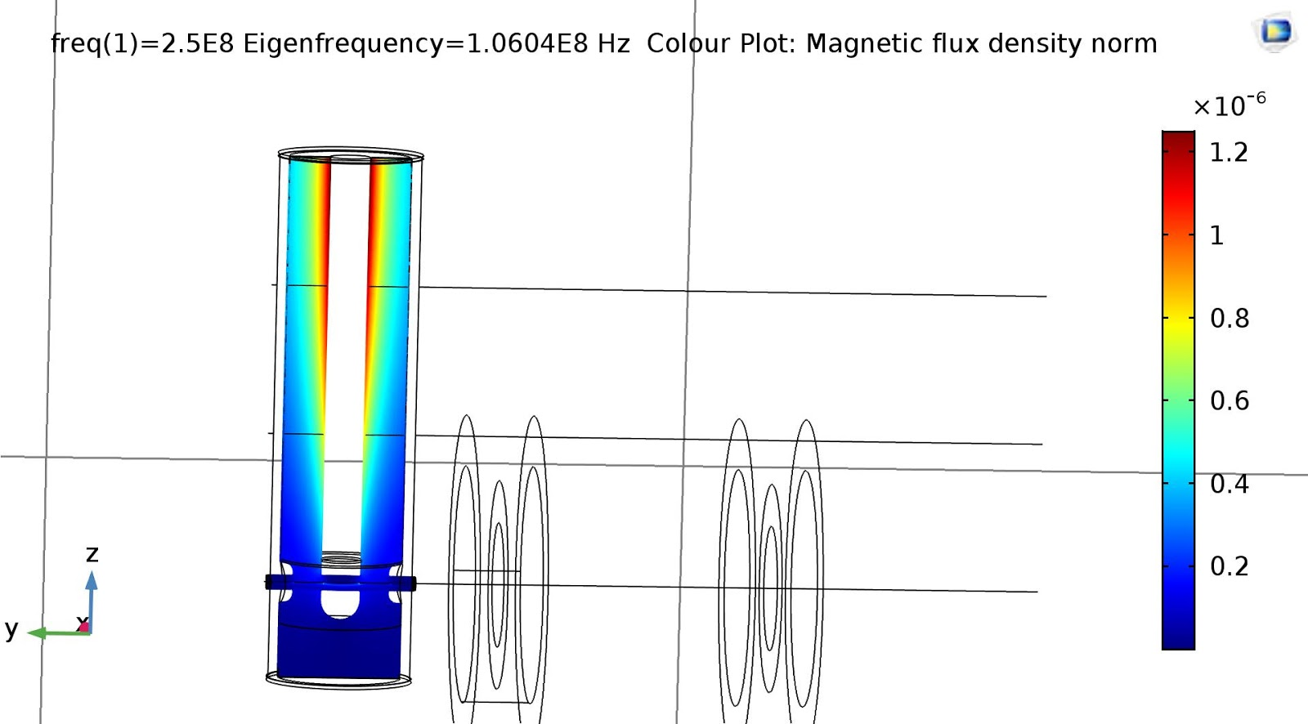
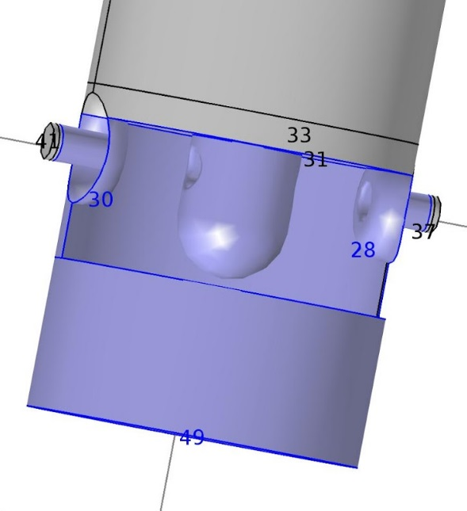
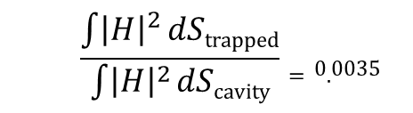
RF simulation
|B|
  $$\frac{\int{{\left|H\right|}^{2}}dStrapped}{\int{{\left|H\right|}^{2}}dScavity}=0.0035$$
Area which needs to trap 30mT to explain
Q decrease

Slide 14
Summary
Degraded cavities
  Cavity voltage drop can be compensated by rephrasing (to some extent)
  Could not be restored by quenching using RF (1/1 case)
  Can be restored by thermal cycling (4/4 cases)
  If the cavity is at the end of the linac retuning might be faster than thermal cycling
→ A case by case decision is necessary!
Undegraded cavities
  Do not degrade if quenched by RF (5/5 cases)
  Are insensitive to thermal cycling (7/7 cases)
Flux trapping from the solenoid would be a straight forward interpretation for the degradation, however
  Also cavities which are not next to the solenoid degrade (not presented)
  Substantial amounts of flux can only enter through the bottom plate, where the RF magnetic field is small and a large area would need to quench to explain the observed Q degradation

