Slide 1
LCLS-II Cryomodule Design Considerations
Chuck Grimm
TTC Meeting WG4 @ MSU
February 21-24, 2017

Slide 2
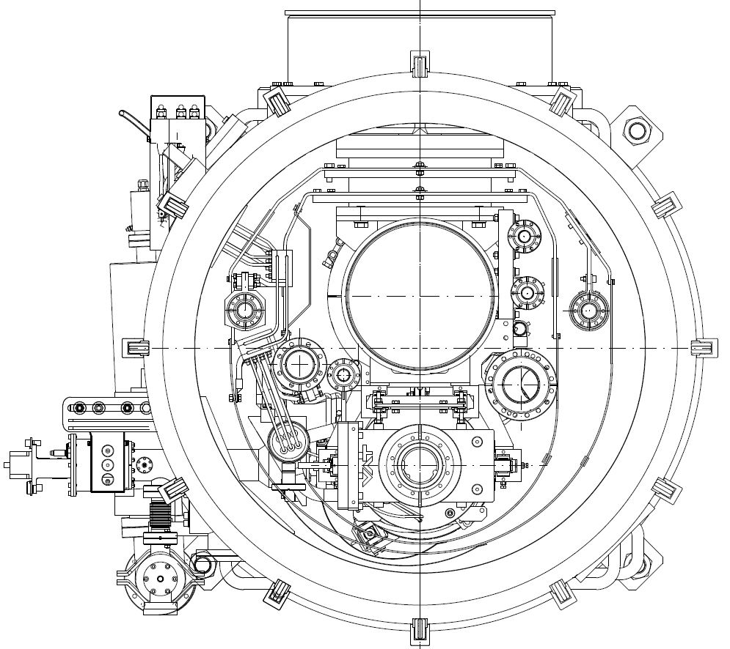
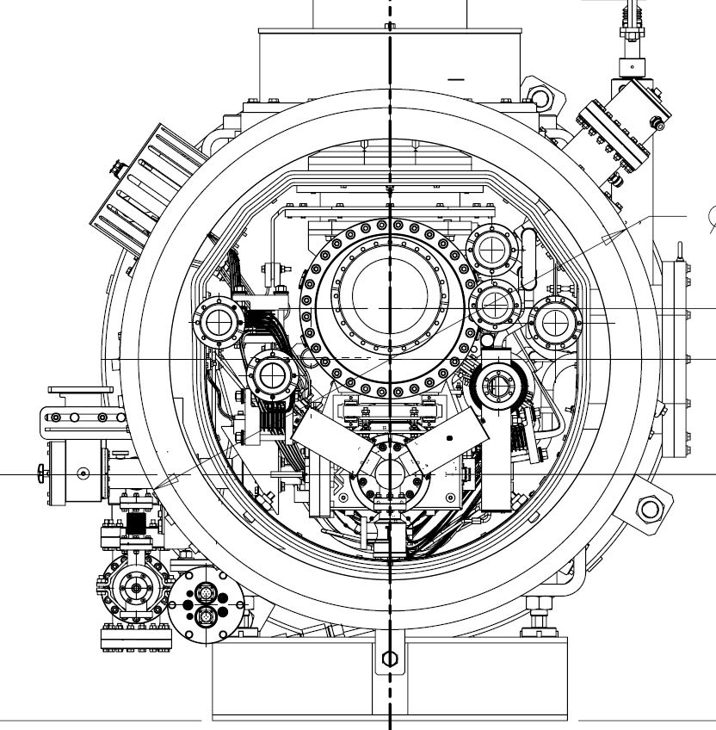
LCLS-II Cryomodule Design Considerations
XFEL 1.3 GHz Module – Pulse Machine
LCLS-II 1.3 GHz Module CW Machine

Slide 3
LCLS-II Cryomodule Design Considerations
Cavity - Helium Vessel Design
Cavity standard 9-cell Telsa style long-short
New surface treatments (i.e. N2 doping) for higher “Q”
Many talks at WG1: “Performance Frontier”
Higher heat loads due to CW operations resulted in:
Larger chimney pipe from helium to 2-phase pipe
Larger 2-phase pipe 4” O.D. (~101mm) for low velocity vapor flow
Uniform/fast cool-down means two cool-down ports in each helium vessel
Input coupler design for 7 kW CW plus some margin
A modification of an existing pulsed coupler design (TTF3) involving better heat transfer from and cooling of the inner conductor
Detailed talk by Nikolay Solyak WG3 “Cavities, Tuners and Couplers”

Slide 4
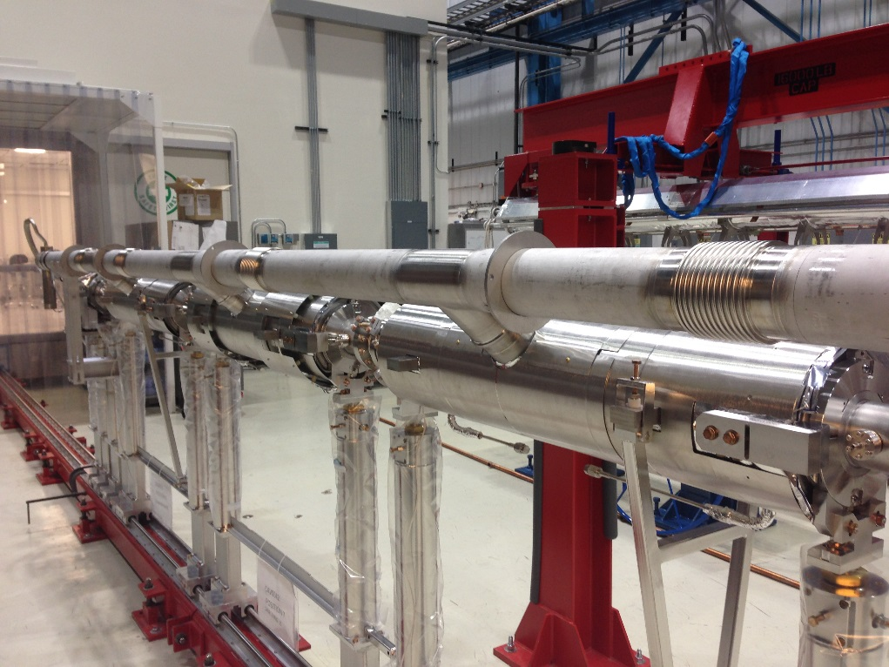
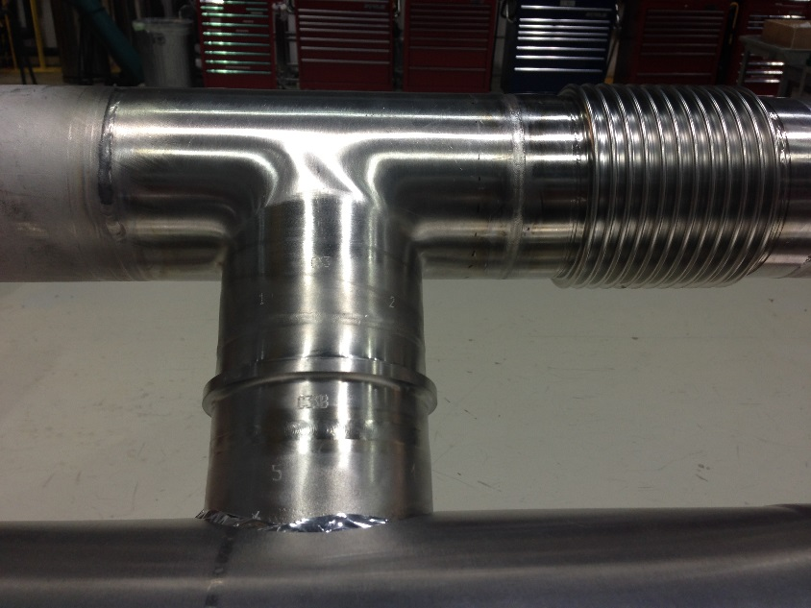
LCLS-II Cryomodule Design Considerations
Helium Vessel Design
Developed and qualified bi-metal explosion bonded joints
Grade 2 titanium at helium vessel end to 316L SS
2-phase pipe 4” O.D. now 316L stainless steel
Warm-up/cool-down lines to 316L stainless steel
Ti to SS Bi-Metal Transition
2-Phase Pipe

Slide 5
LCLS-II Cryomodule Design Considerations
Helium Vessel Design
Developed and qualified bi-metal explosion bonded joints
2-phase pipe 4” O.D. now 316L stainless steel
Warm-up/cool-down lines to 316L stainless steel
Ti to SS Bi-Metal Transition
Warm-Up / Cool-Down

Slide 6
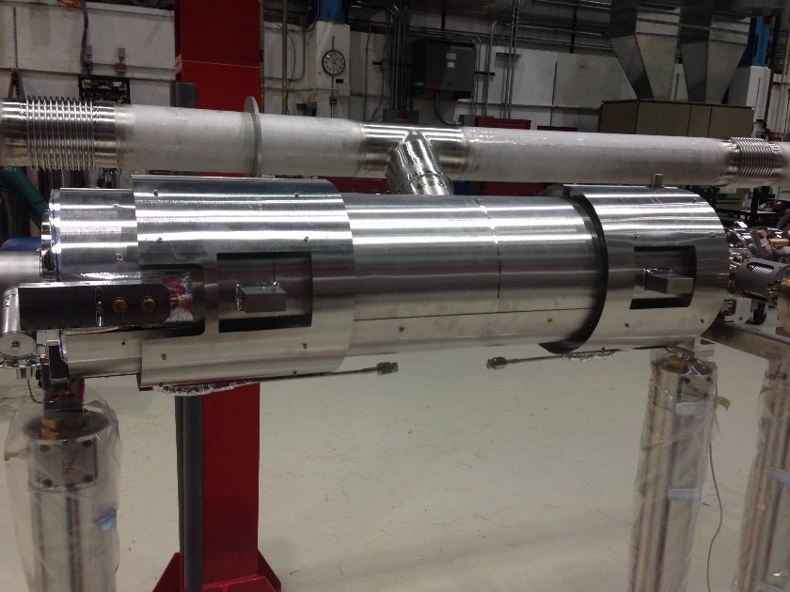
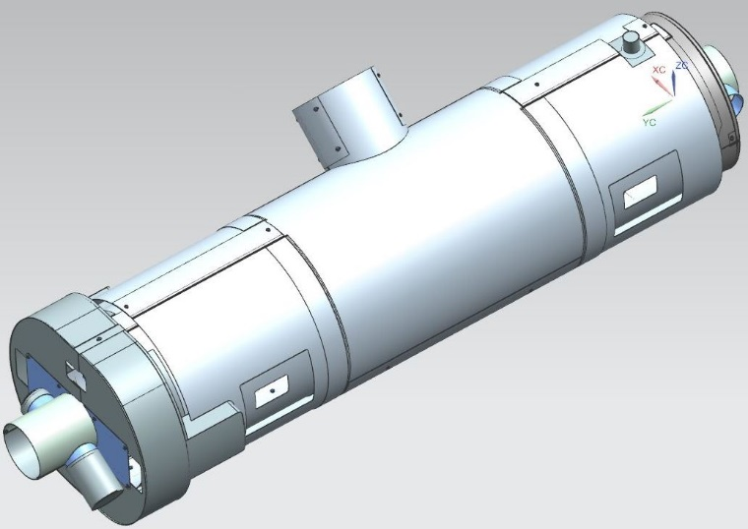
LCLS-II Cryomodule Design Considerations
Helium Vessel Design
Magnetic Shield Design
Duel layer design around helium vessel to help preserve high “Q”
Shields also cover beam tubes and HOM cans – Tuner outside
Covered in more detail by Saravan Chandrasekaran at WG2: “Performance Degradation, Cure, Beamline Quality”
Duel Layer Tank Shields
2nd Layer Center Section Removed for Clarity
All Shields Made from
Cryoperm 10

Slide 7
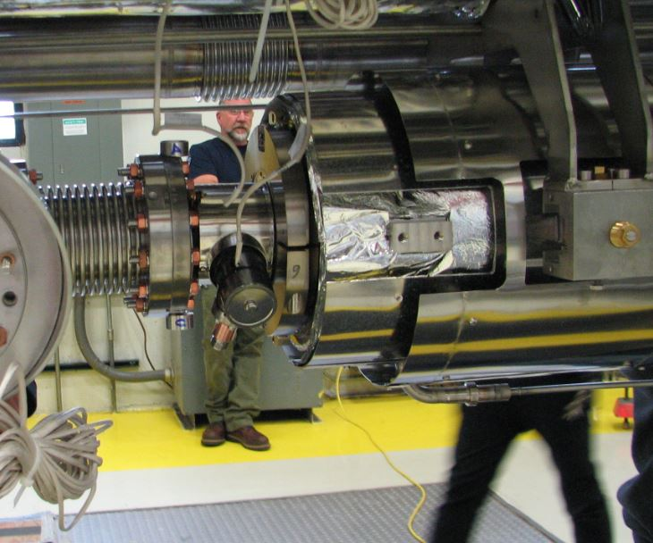
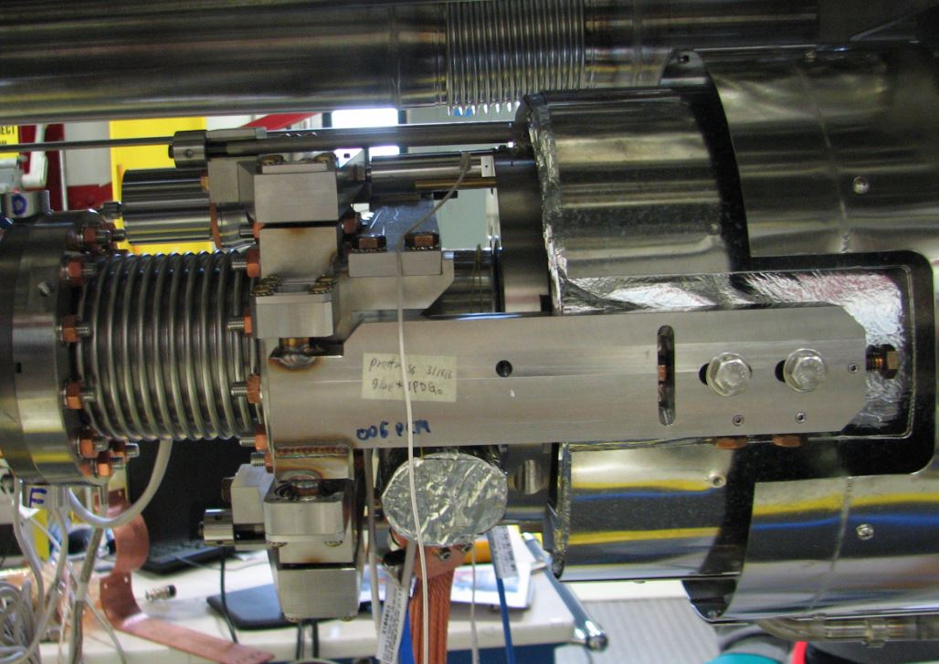
LCLS-II Cryomodule Design Considerations
Cryomodule Design
Lever Tuner Design
Two Piezo’s located at 12 and 6 o’clock
Designed for removal with access ports on cryomodule (next slide)
Access on SLAC tunnel wall side
Before Installation
Piezo
After Installation

Slide 8
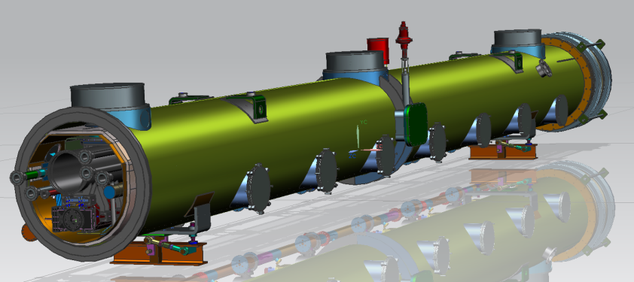
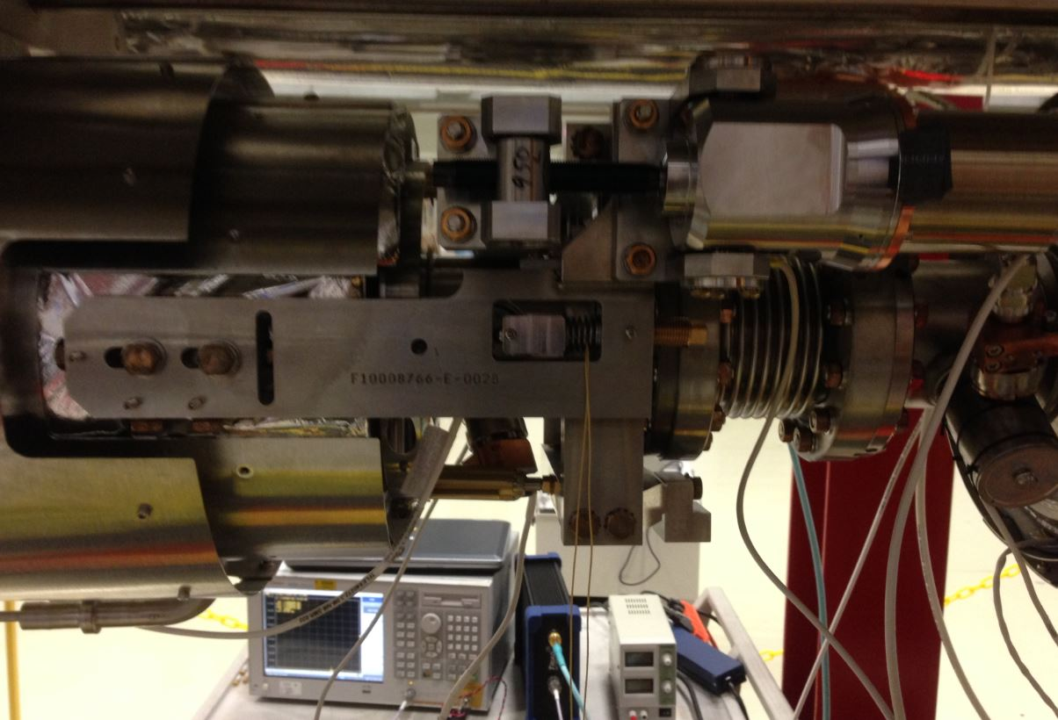
LCLS-II Cryomodule Design Considerations
Cryomodule Design
View From Rear Showing Tuner Access Ports and JT Valve Access
Motor Mounts
Piezo

Slide 9
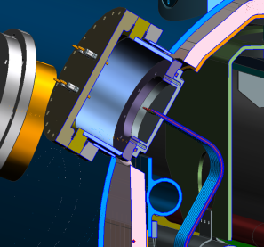
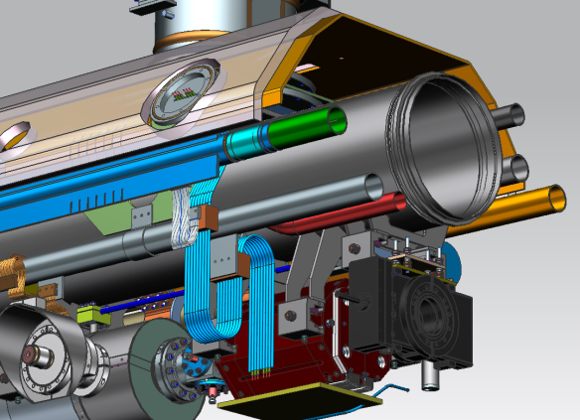
LCLS-II Cryomodule Design Considerations
Cryomodule Design – Split Quad Magnet
Conduction cooled
intercept to 2-phase He pipe
CL-SSR1 Style, 50A, quantity-6 (+2 tubes for instrumentation),
2-thermal intercepts (5K &50K)

Slide 10
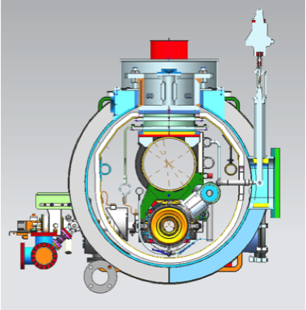
LCLS-II Cryomodule Design Considerations
LCLS-II Cryomodule Line Designation
Line A
Line B
Line C
Line F
Line E
Line D
Line G
Line H

Slide 11
LCLS-II Cryomodule Design Considerations
TESLA Style Cryomodule Comparison - 1

Slide 12
LCLS-II Cryomodule Design Considerations
TESLA Style Cryomodule Comparison - 2
No 5 K thermal shield, a simplification due to large dynamic heat at 2 K making such a thermal shield of marginal value
But retain 5 K intercepts on input coupler

Slide 13
LCLS-II Cryomodule Design Considerations
Both high heat load and the 0.5% slope of the SLAC tunnel require
Closed-ended 2-phase pipe providing separate 2K liquid levels in each cryomodule
2K JT (liquid supply) valve on each cryomodule
Upstream
End
Downstream
End
BEAM
5694
5758
+28mm
ID=97.4mm
-28mm
2-phase DS
end
2-phase middle
Illustration by Tom Peterson

Slide 14
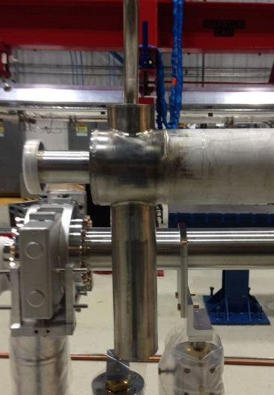
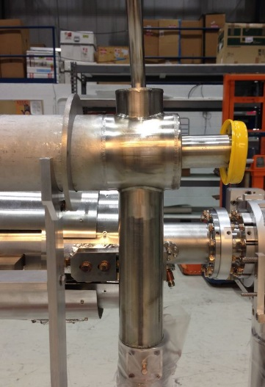
LCLS-II Cryomodule Design Considerations
Cryomodule Configuration
Illustration by Tom Peterson

Slide 15
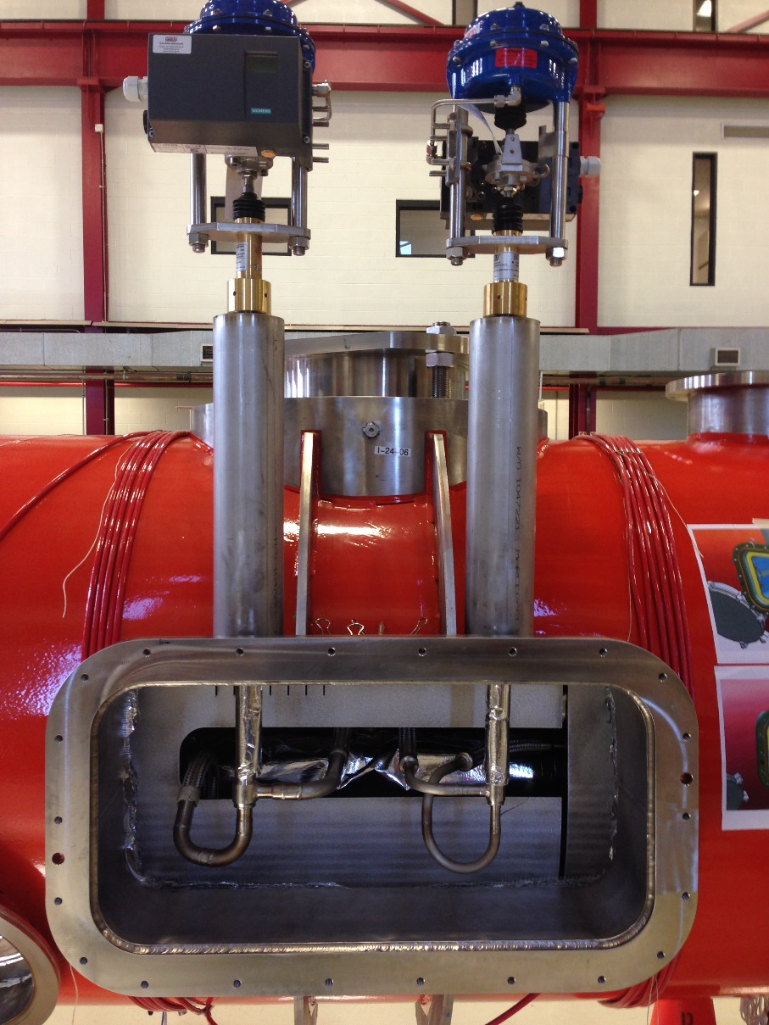
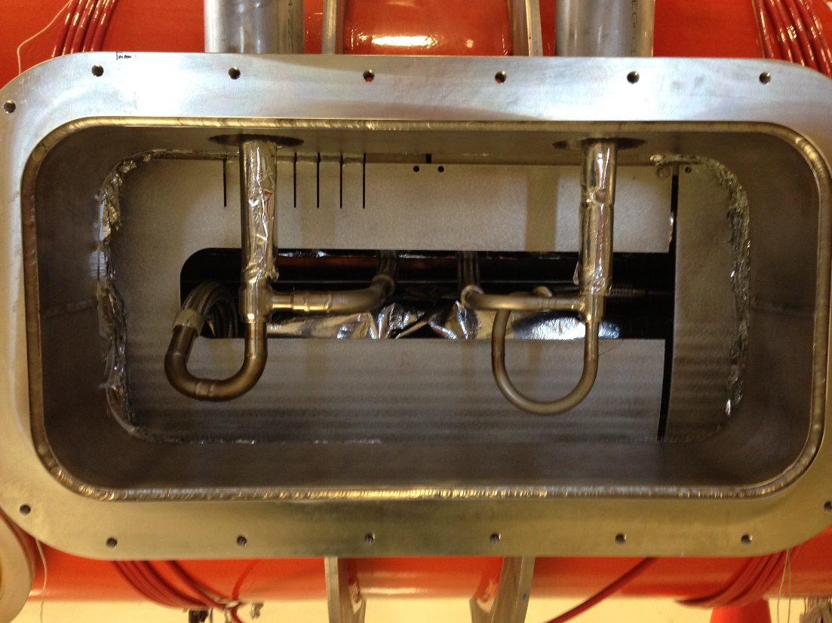
LCLS-II Cryomodule Design Considerations
JT Valve and Circuit
X-Ray Location

Slide 16
LCLS-II Cryomodule Design Considerations
Thank You!

