Slide 1
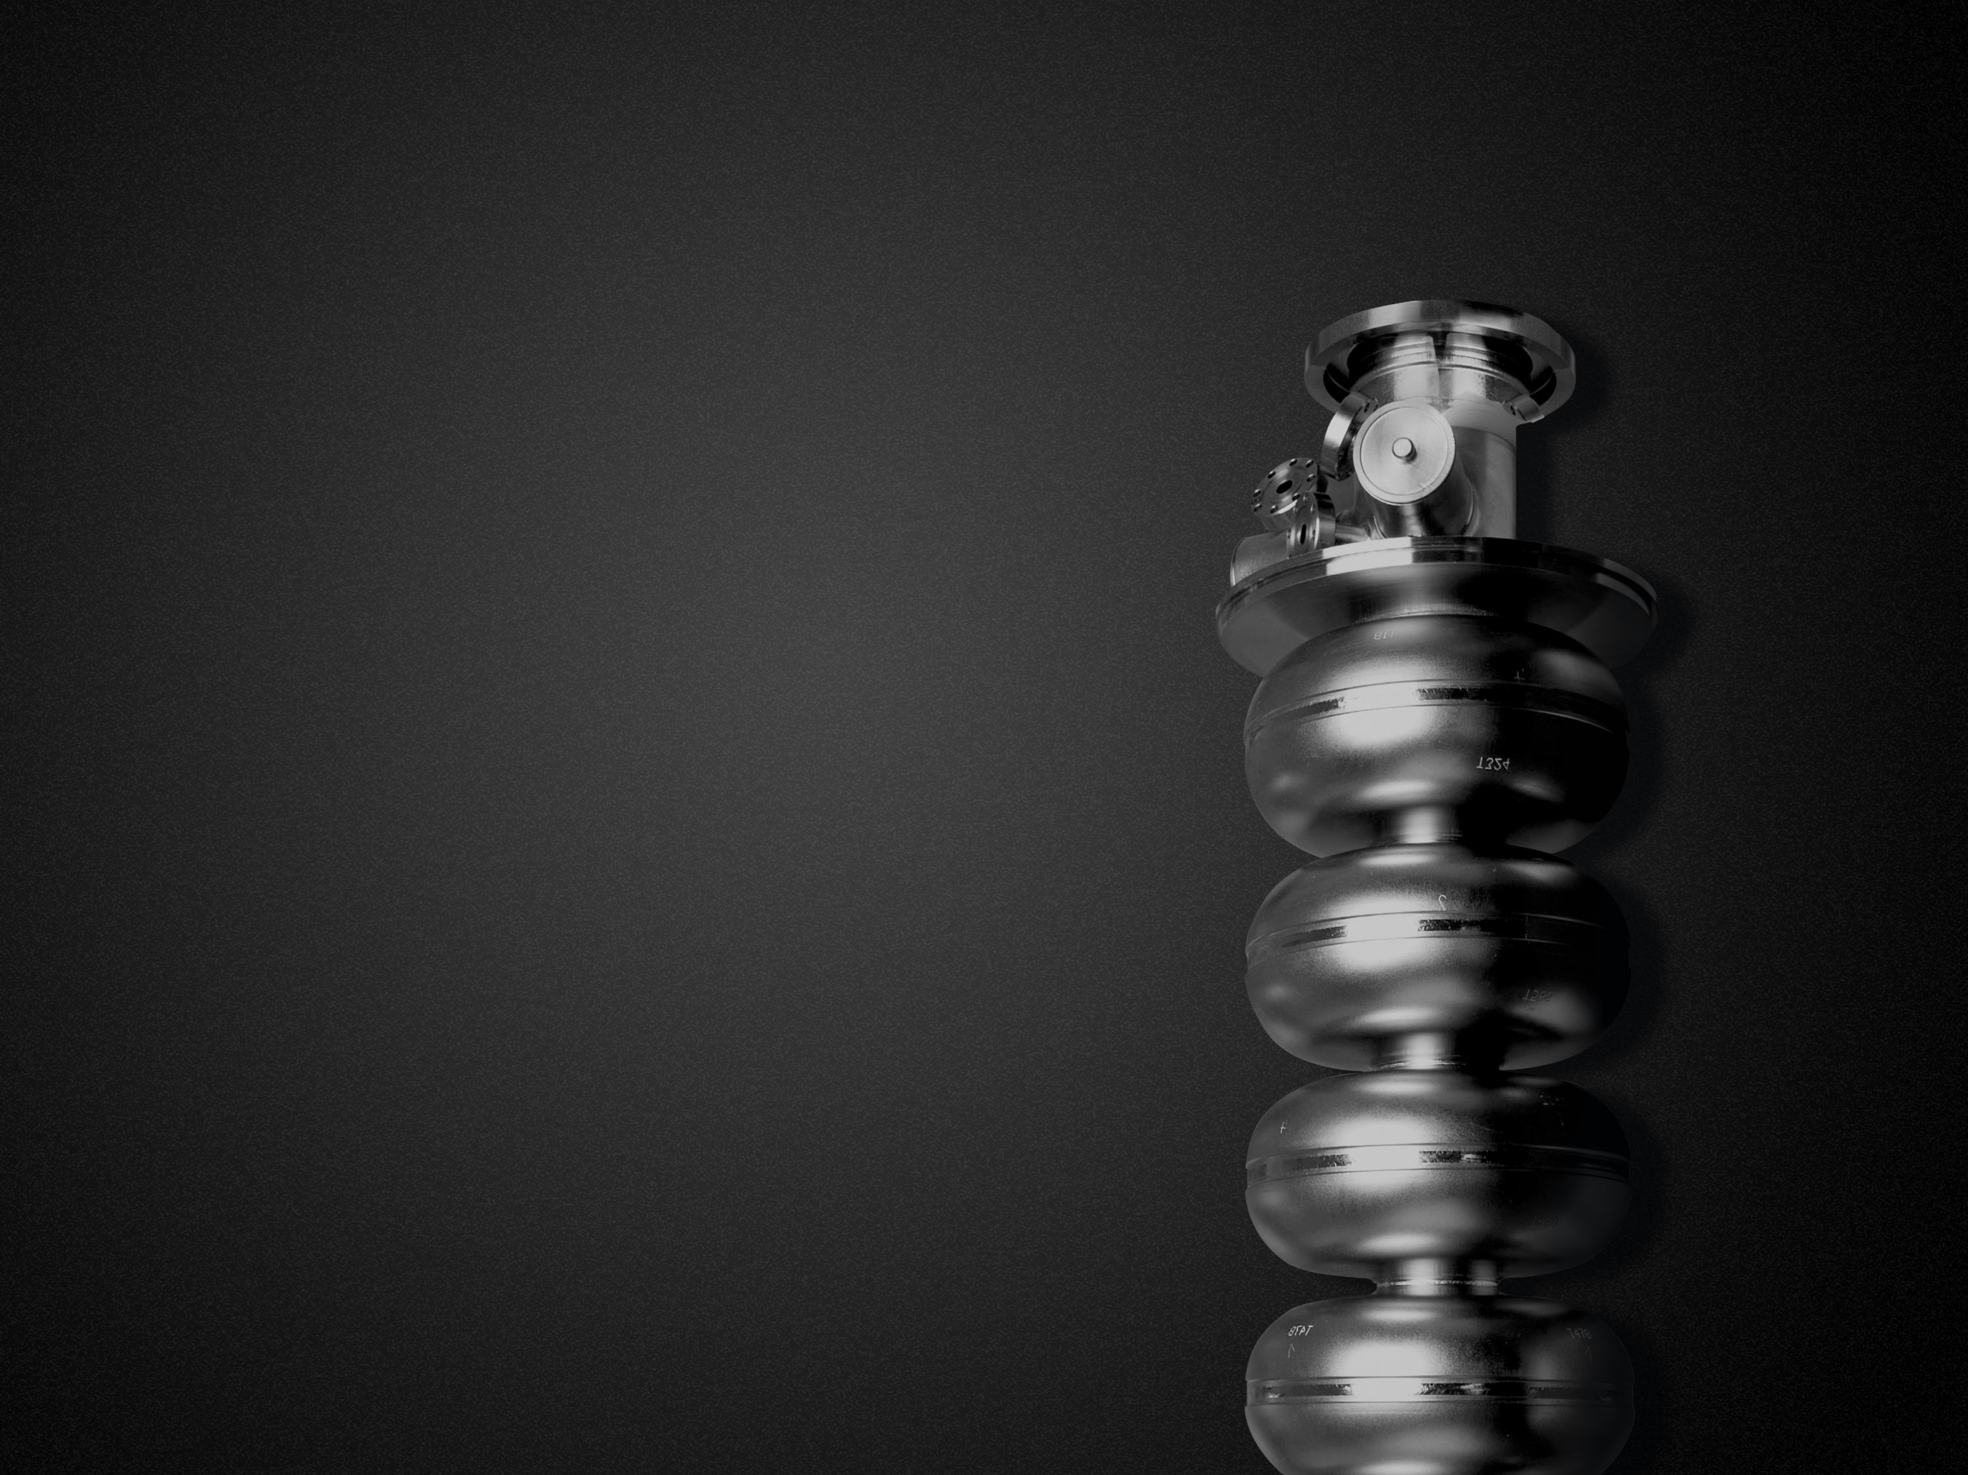
Recipe to high Q and high E_{acc}
Pashupati Dhakal, Jefferson Lab
Presented by Ari Palczewski, Jefferson Lab with additions
Notes:
Title Page

Slide 2


Background
Work started to understand the role of high field Q-slope with hydrogen (niobium hydrides) and passivation of Nb surface during heat treatment.
The improvement on Q have been observed with lower hydrogen concentrations following the heat treatments
Significant improvements on the RF cavity performance of several single cell cavities was obtained after the heat treatment at 800°C and 120°C with no post furnace chemical etching (25-100% higher Q0).
Surface nitridation for surface passivation was attempted and improvement on both Q and E_{acc} was observed.
Ciovati et al. Phys. Rev. ST Accel. Beams 13, 022002 (2010) 022002
Ciovati et al., SRF 2011
Notes:
Interior Page Design 1

Slide 3
Background
New dedicated clean induction furnace was designed and installed in order to explore the surface passivation parameters.
The furnace is capable to going higher than 2000°C in UHV environment.
The furnace is equipped with gas (N2, O2, Ar, H2) handling system.
Cavity loading in the furnace
P. Dhakal et al., Rev. Sci. Inst. 83, 065105 (2012)
Notes:
Interior Page Design 1

Slide 4
Background
Exceptionally high Q was observed on 1.5 GHz cavity when cavity was heat treated at 1400C/3hrs.
Investigation found that ~ 1 at.% of Ti was diffused with in ~2 μm on RF surface resulted in the increase in Q and more importantly the positive Q(E) dependence.
The cavity was made from medium purity (RRR~100) large grain niobium.
Reproducibility and easy of doping compared to nitrogen has stopped work for now
1.5 GHz, T = 2K
P. Dhakal et al., Phys. Rev. ST Accel. Beams 16, 042001 (2013)
P. Dhakal et al., IPAC’14, p. 2651
Notes:
Interior Page Design 1

Slide 5
Background
Fermi Lab explored the surface passivation technique and found that the nitrogen doping followed by surface removal by EP produce the similar results those were obtained via Ti diffusion.
This has been grown so fast that it became “production recipe” for LCLS-II cavities.
Even though the dramatic enhancement on Q has been observed the gradient of doped cavities are limited to medium gradient ~20 MV/m with LCLS-II recipe.
Theoretical explanation based on velocity of quasi particle (Xiao model) and broadening of density of state on dirty superconductor (Gurevich model) were proposed.
Grassalino et al., SUST 2013
Notes:
Interior Page Design 1

Slide 6
What do we know?
Doping on SRF cavities lowers the mean free path and hence the increase in Q by lowering BCS surface resistance.
The BCS surface resistance decreases logarithmic to the RF field.
Titanium or nitrogen doping on Nb effectively traps mobile hydrogen and prevents precipitation of hydrides (still no direct evidence on microscopic scale, but coming), maybe.
The quench field on doped cavities is lower than undoped cavities, at JLab.
Challenge to preserve high gradient with doping.
Notes:
Interior Page Design 1

Slide 7
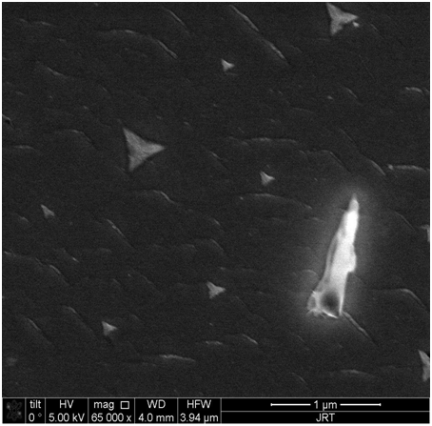
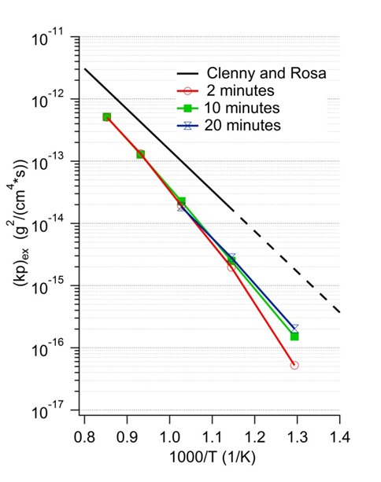
RECENT WORK AT JLAB: N-doping vs temperature
Nitride growth dominates nitrogen absorption down to 400°C, Modeling interpolation suggest absorption of nitrogen goes to ~ Zero below 200°C along with Nitride growth.
Palczewski et al. LINAC 2016 THPRC003: Investigation of Nitrogen Absorption and Nitride Growth on SRF Cavity Grade RRR Niobium as a Function of Furnace Temperature LINAC 2016

Slide 8
RECENT WORK AT JLAB
High purity fine grain Nb Cavity RDL-02 (1.5GHz low loss): After the fabrication, the cavity was given standard ILC recipe of 150 μm EP, 800 °C/2hrs furnace treatment, followed by 20 μm EP.
After each heat treatments (with caps, cleanroom assembly after HPR), the baseline measurement was done to surface reset with 10 um EP.
Rs vs T data were taken from 4.3-1.5K at B_{p}~10mT in order to extract the material parameters.
No post chemistry after the furnace treatment.
No active pumping during heat treatment.
Notes:
Interior Page Design 1

Slide 9
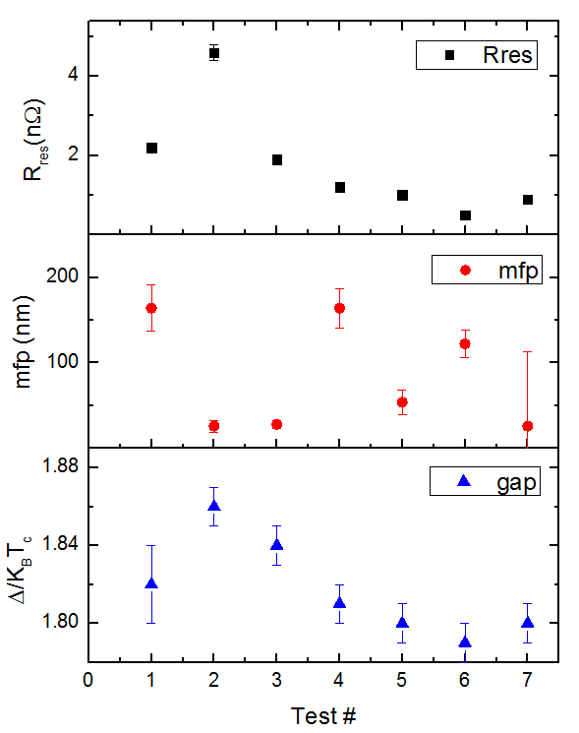
RECENT WORK AT JLAB
R vs T data from 4.3-1.5K
Test | Δ/K_{B}T_{c} | mfp(nm) | R_{res}(nΩ)
Baseline | 1.82±0.02 | 164±27 | 2.2±0.1
+120C/48h | 1.86±0.02 | 26±7 | 4.6±0.2
+800C/3h+ 120C/48h@25mtorr N2 | 1.84±0.02 | 28±5 | 1.9±0.1
+10 um EP | 1.81±0.02 | 164±23 | 1.2±0.1
+800C/3h+ 160C/48h@25mtorr N2 | 1.80±0.02 | 54±14 | 1.0±0.1
+10um EP | 1.79±0.02 | 122±16 | 0.5±0.1
+800C/3h+ 140C/48h@25mtorr N2 | 1.80±0.02 | 26±87 | 0.9±0.1
R_{res}<2 nΩ
Undoped (EP)
LTB
N2
Lower mfp after N2 infusion is similar to doped and
Conventional low temperature baked cavity
Notes:
Interior Page Design 1

Slide 10
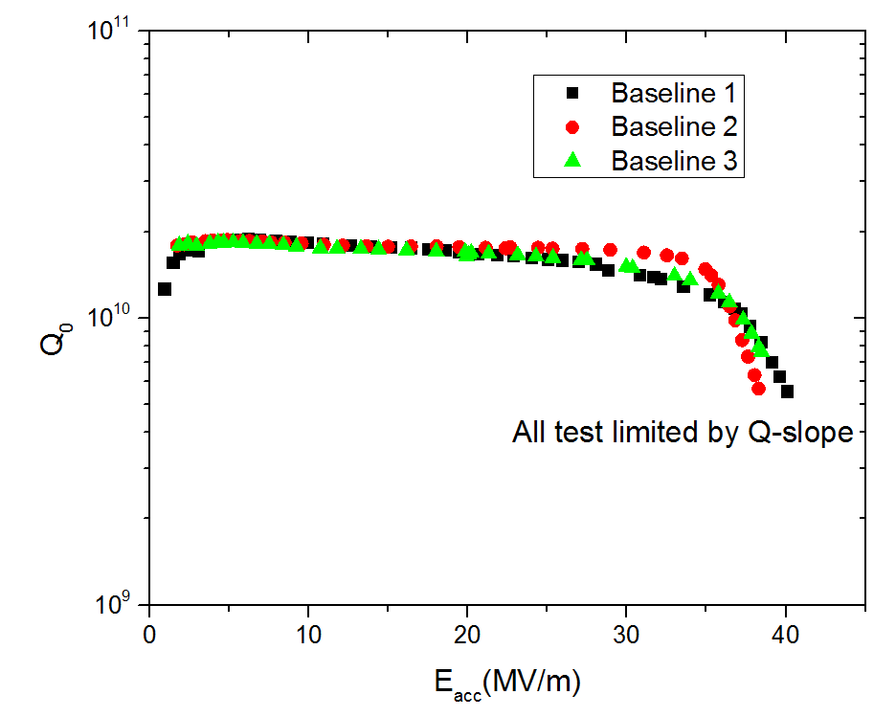
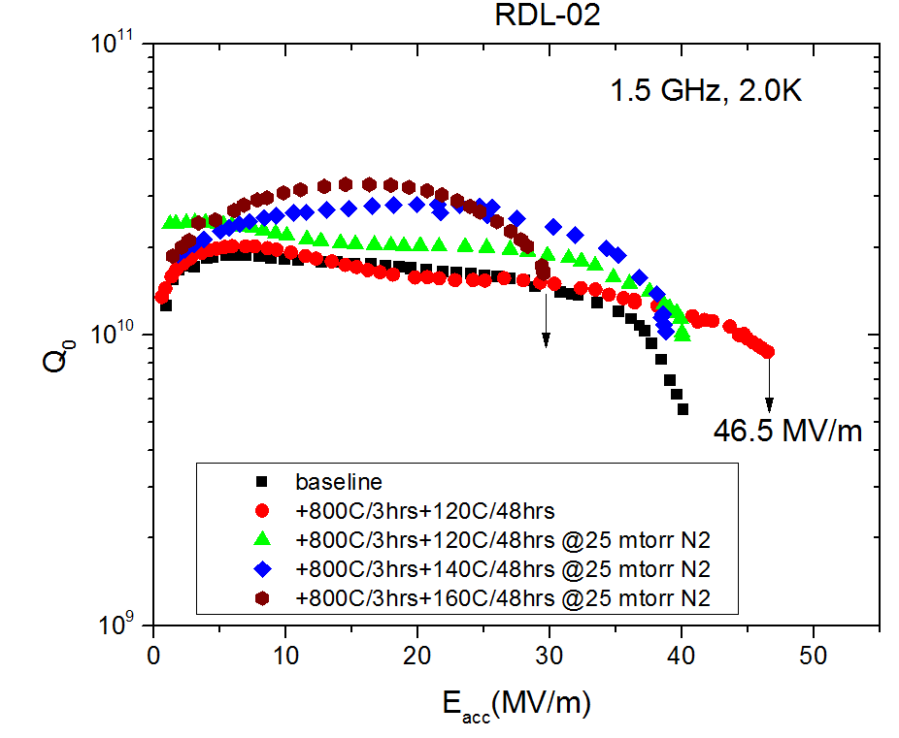
RECENT WORK AT JLAB
Baseline test results
10 um EP will reset the RF surface
Effect of Q and E_{acc} with low
temperature N2 doping
No Field emission in any test!
Notes:
Interior Page Design 1

Slide 11
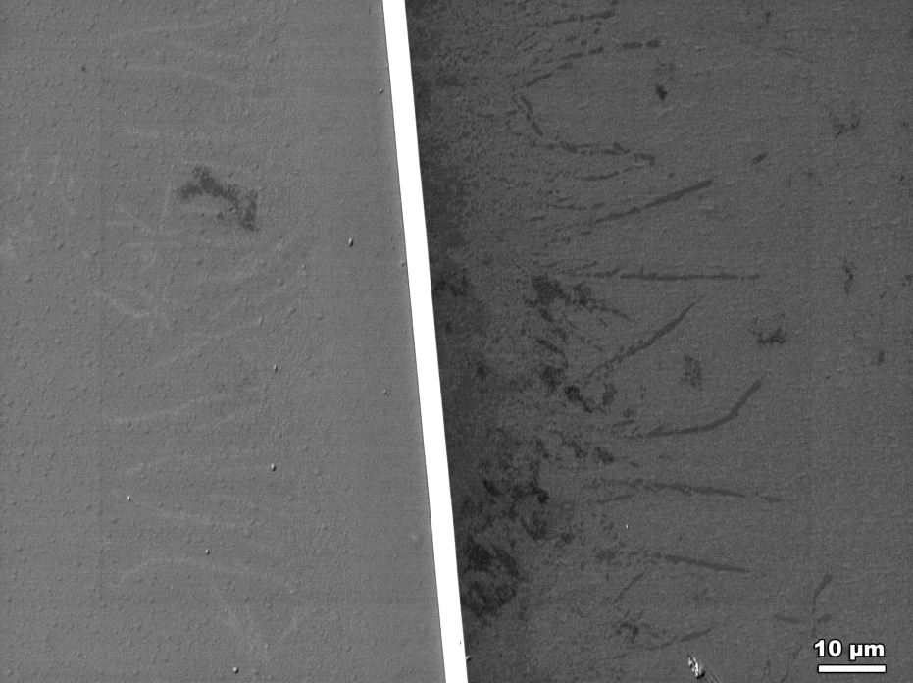
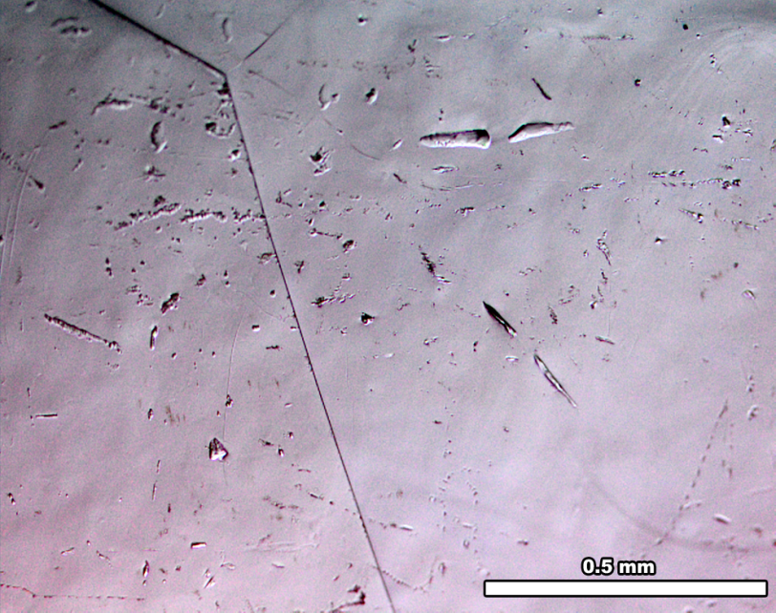
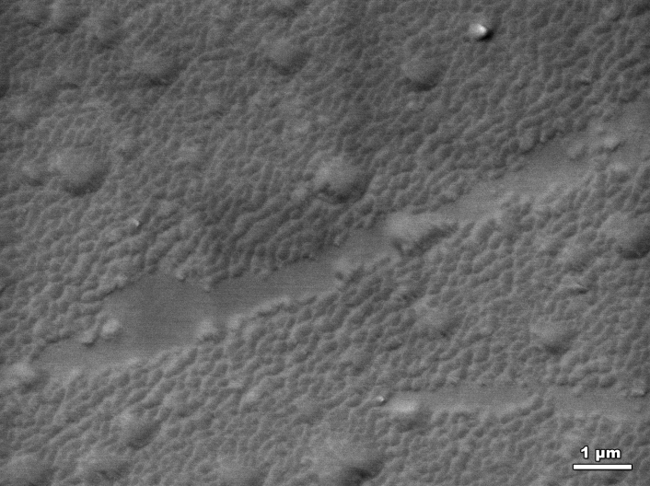
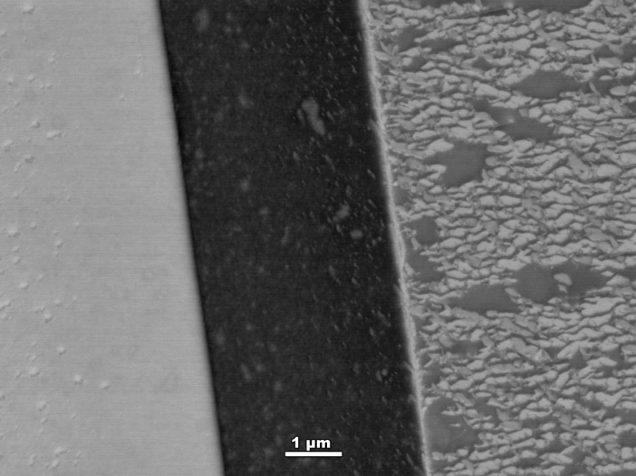
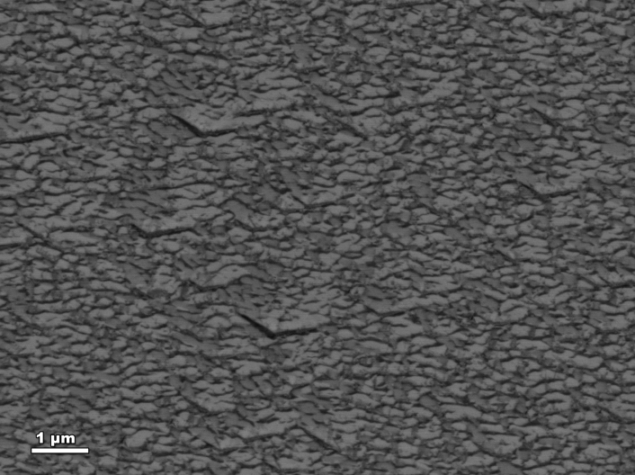
Sample L88 LG, nano-polish and BCP+ 800C/3hrs + 160C/48hrs @ 25mTorr N2 in Nb Box
ASC/FSU
Observations
SE image. The interface is not a good conductor.
Optical micrograph
The boundary thickness is surprising.
Patterns observed on the surface.
SEM images belong to this region
GB
Notes:
Interior Page Design 1

Slide 12
Conclusion
LTB in N2 works (but no high gradients)
Why? What is the mechanism? Nitride growth studies say this should not work.
Does N2 diffuse? Infuse? Or is it just a surface impurity effect from residual gasses?
Sample studies show some features on sample surface and need more investigation, and are grain dependent?
Notes:
Interior Page Design 1

Slide 13
backup

Slide 14
Now unprecedented quality factor
FNAL reported both increase in Q and E_{acc} when N2 was infused to furnace during the heat treatment at lower temperature (120C).
Q-rise phenomenon was observed on cavities when the nitrogen was infused at higher temperature (140-170°C)
Grassellino et al,arXiv:1701.06077
Notes:
Interior Page Design 1

