Slide 1
STF-2 Cryomodule Construction ~Assembly, Alignment and Installation~
Cavity Group: E. Kako, T. Shishido, Kirk
Cryogenics Group: H. Nakai, Y. Kondo, K. Hara
Alignment Group: S. Araki
Magnet Group: N. Kimura, A. Yamamoto, H. Hayano
Kirk

Slide 2
Outline
STF-2 Cyomodule Construction
Connection of Cavity String and Beampipe
Cavity Alignment
Module Alignment along Beamline
Summary

Slide 3
Brief History for STF-2 Cryomodule
Date | Content
2011 ~ 2013 | V.T. for 12 cavities / RF conditioning for 12 couplers
Jun/2013 | Cleaning up STF tunnel
Jul/2013 ~ Apr/2014 | Cavity string assembly (three times)
Oct/2013 ~ Jan/2014 | Module assembly (CM1/CM2a), Cavity/Cryomodule Alignment
Jul/2014 | Complete certification for High pressure Gas Code
Oct/2014 ~ Dec/2014 | 1st cool-down / low power test
Apr/2015 ~ Jul/2015 | 5MW Klystron / Single waveguide system completed
Jul/2015 ~ Sep/2015 | Coupler conditioning at room temperature
Oct/2015 ~ Dec/2015 | 2nd cool-down / high power test (cavity performance check)
Jan/2016 ~ Jul/2016 | Multi-beam Klystron & Waveguide system completed
Jul/2016 ~ Sep/2016 | Coupler conditioning at room temperature
Sep/2016 ~ Nov/2016 | 3rd cool-down / LFD, Q₀ measurement, 8 Cavities Operation & LLRF study
F.Y. 2017 | 4th cool-down test (?)
F.Y. 2018 ~ | Beamline construction / Beam operation starts (?)
Cavity string assembly was presented in detail in TTC Topical Workshop at CEA/Saclay in 2014.
(https://indico.in2p3.fr/event/10347/?ovw=True)

Slide 4
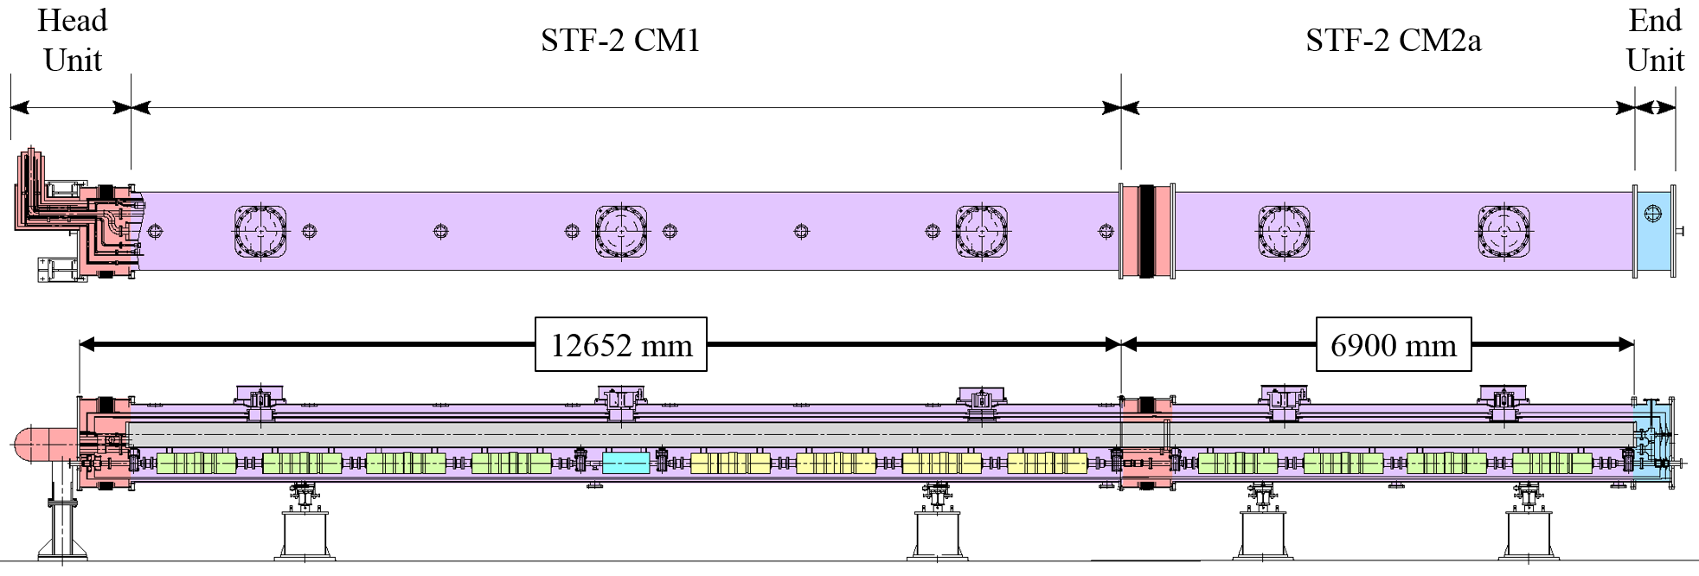
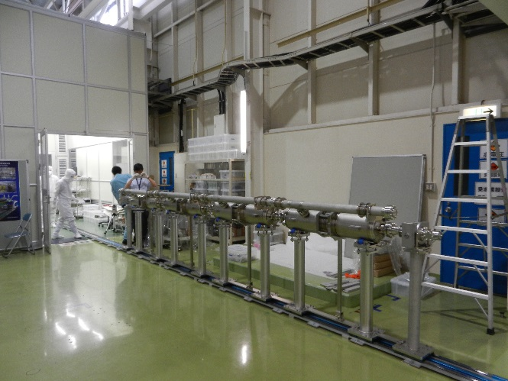
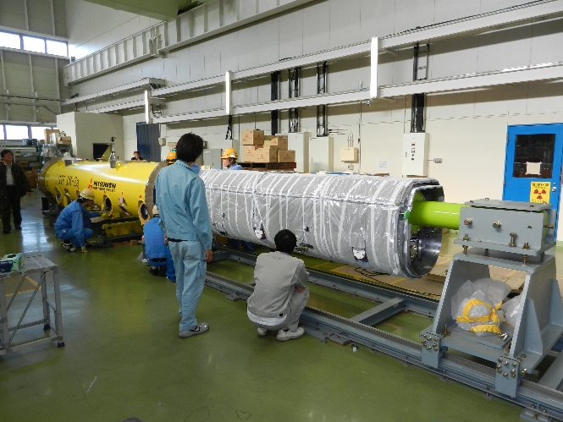
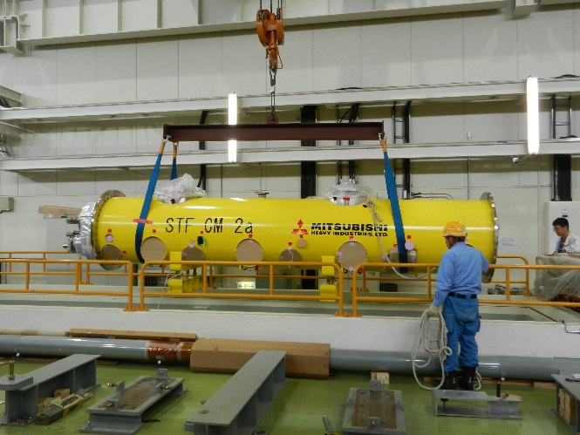
Complicated situation in CM construction
1+1/2 cryomodule
1/3 cryo-vessel
1/3 cryo-vessel
1/3 cryo-vessel
1/2 cryo-vessel
Three cavity strings (4+4+4=12)
Four cryo-vessels (1/3+1/3+1/3+1/2=1.5)
five support posts (3+2=5)
constructed in tunnel
constructed on ground floor
CM2a was constructed by the same way as S1-Global
Four cavities per string
Construction of half-size cryomodule
Tunnel hatch for half-size cryomodule

Slide 5
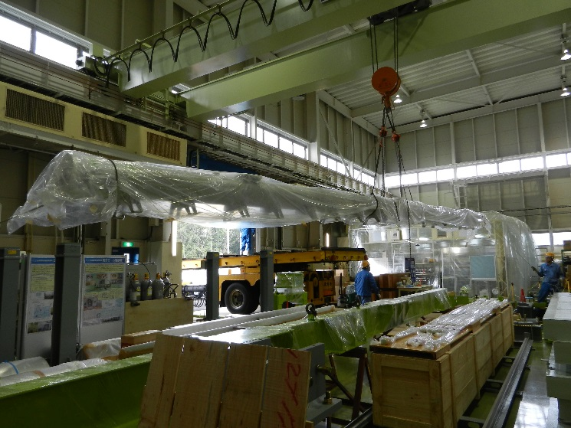
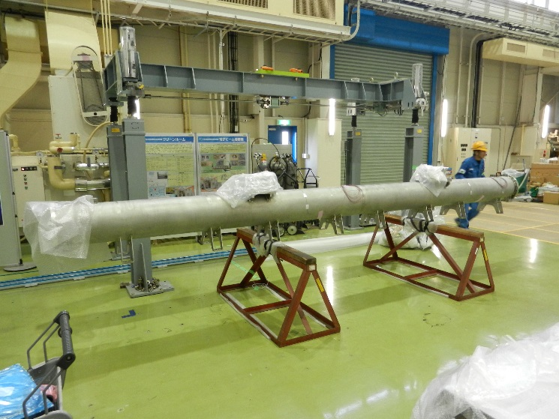
1+1/2 Gas Return Pipe
Full-size gas return pipe
Half-size gas return pipe

Slide 6
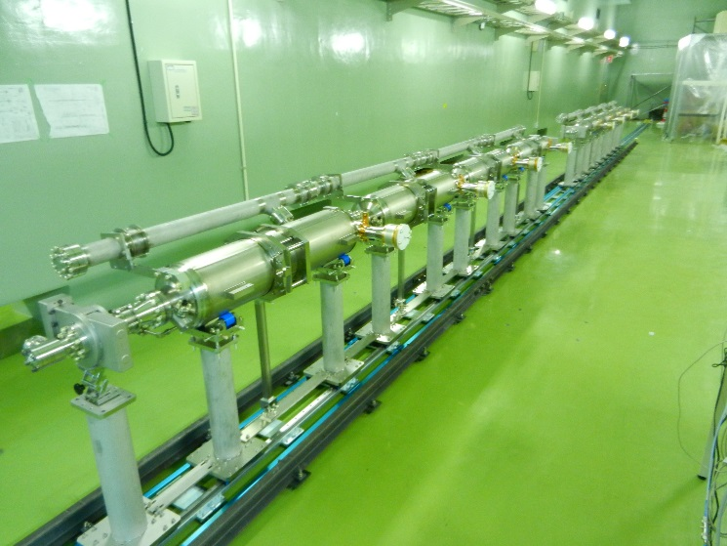
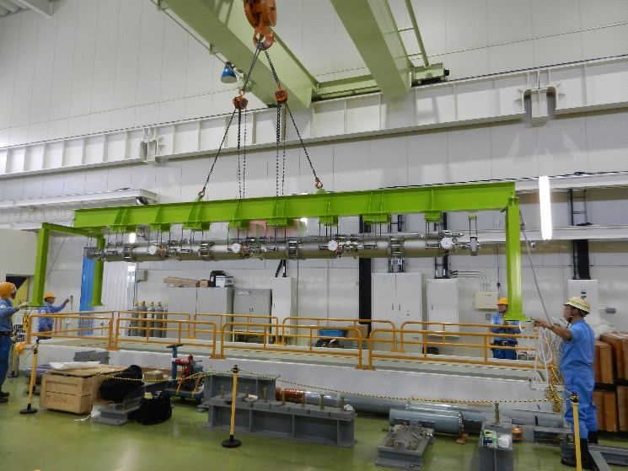
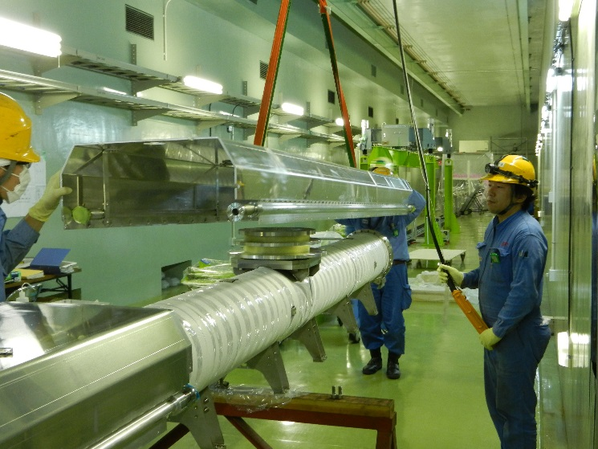
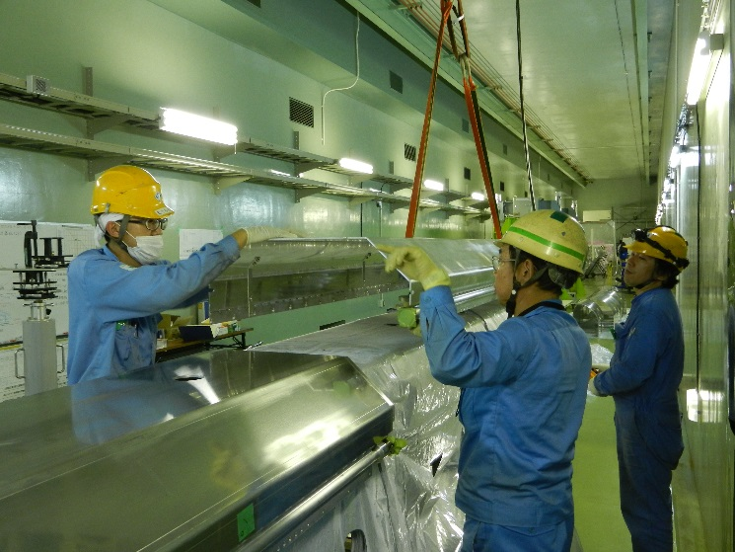
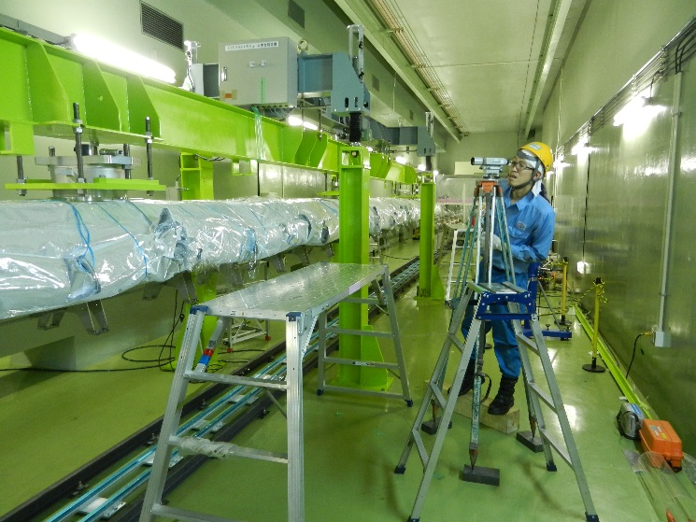
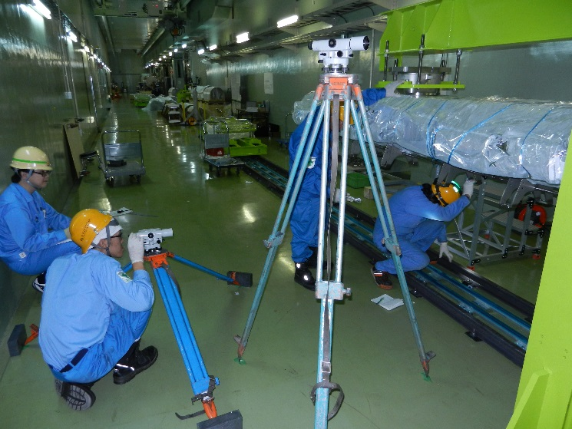
Construction of STF-2 CM1①
Lining two cavity strings on rail
Cavity string installation
Attachment of thermal shield
Leveling gas return pipe

Slide 7
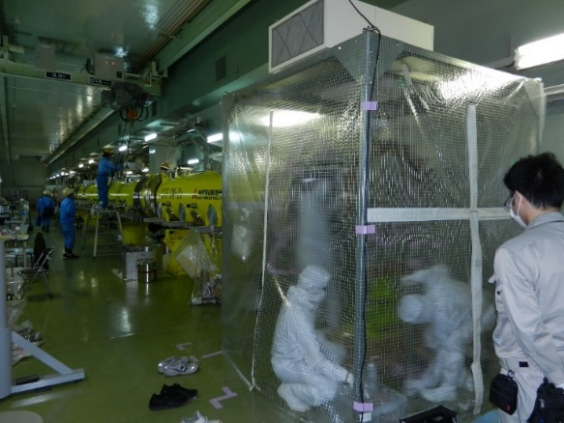
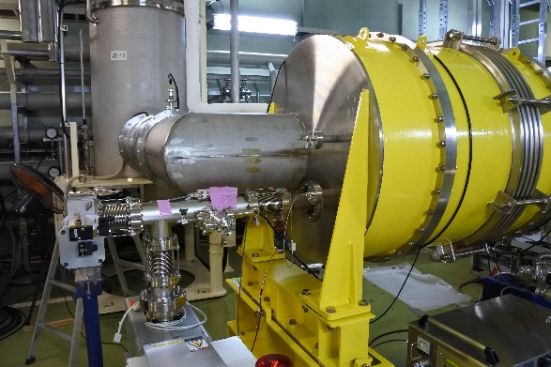
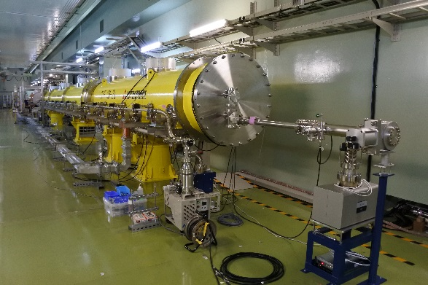
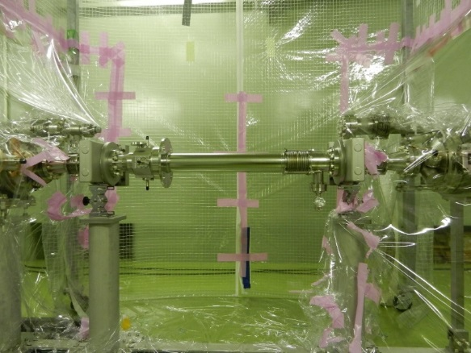
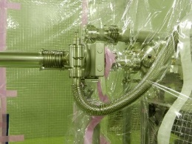
Cavity string/Beam pipe connection in clean booth
Local clean booth
Ion pump
Ion pump
Three degraded cavities in series
Use of simply local clean booth
Local clean booth was used for four beampipe connection parts
Exchange of metal valve near cavity string #2
Metal valve was a little bit bigger, disturbed thermal shield attachment
Extra Argon gas purging at gate valve opened
Usually, when gate valve opens, both sides should be under vacuum
but, we had to do Argon gas purging for the both sides
due to complicated process of cryomodule assembly
A little bit bigger metal valve

Slide 8
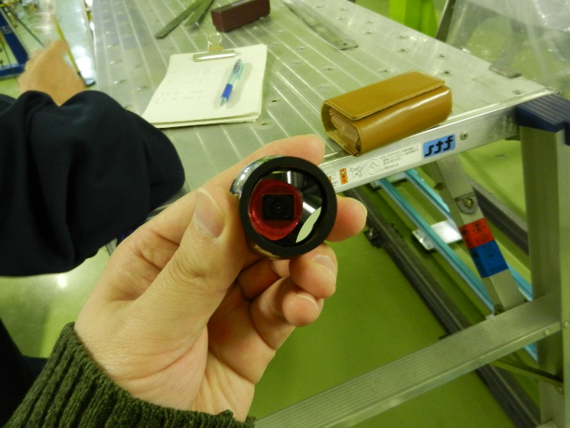
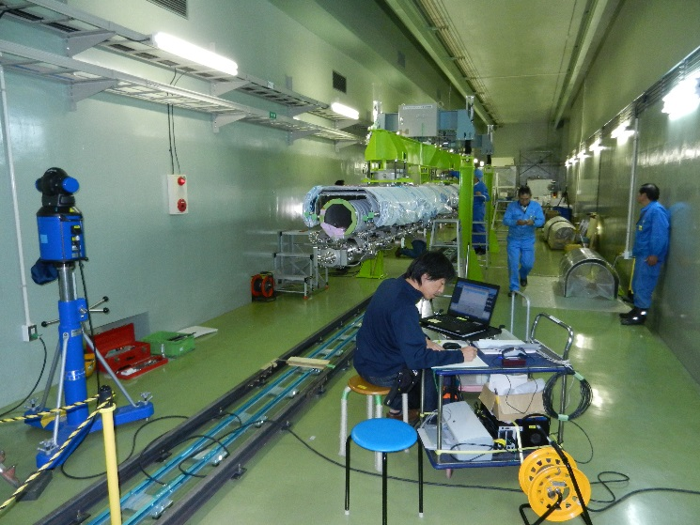
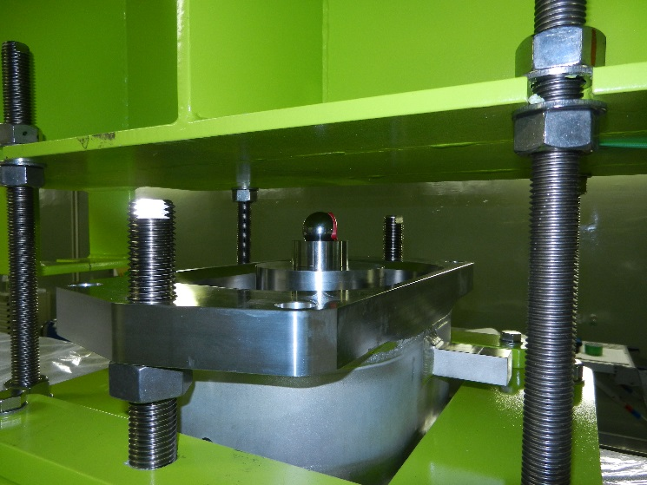
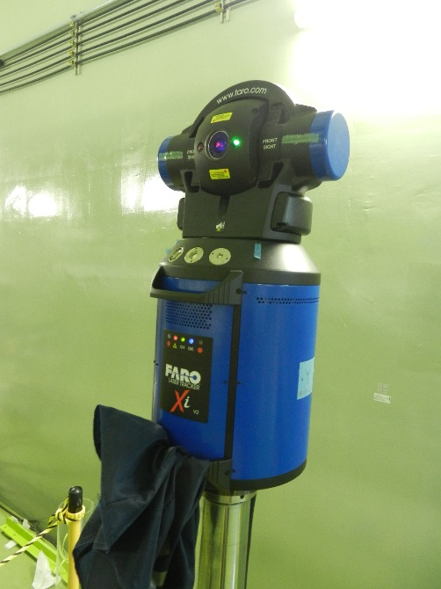
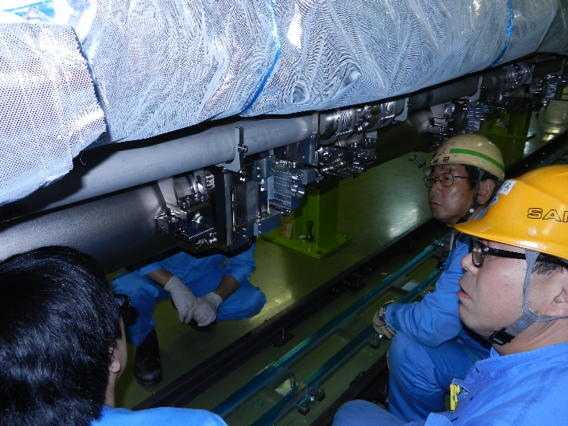
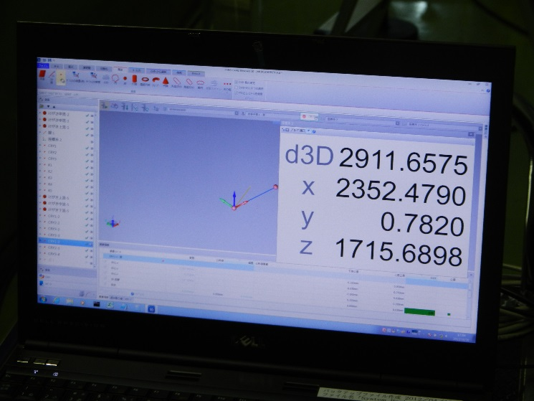
Alignment work for STF-2 CMs
Cat’s eye
S. Araki
Stand for cat’s eye near cavity
Laser tracking system
Courtesy of S. Araki

Slide 9
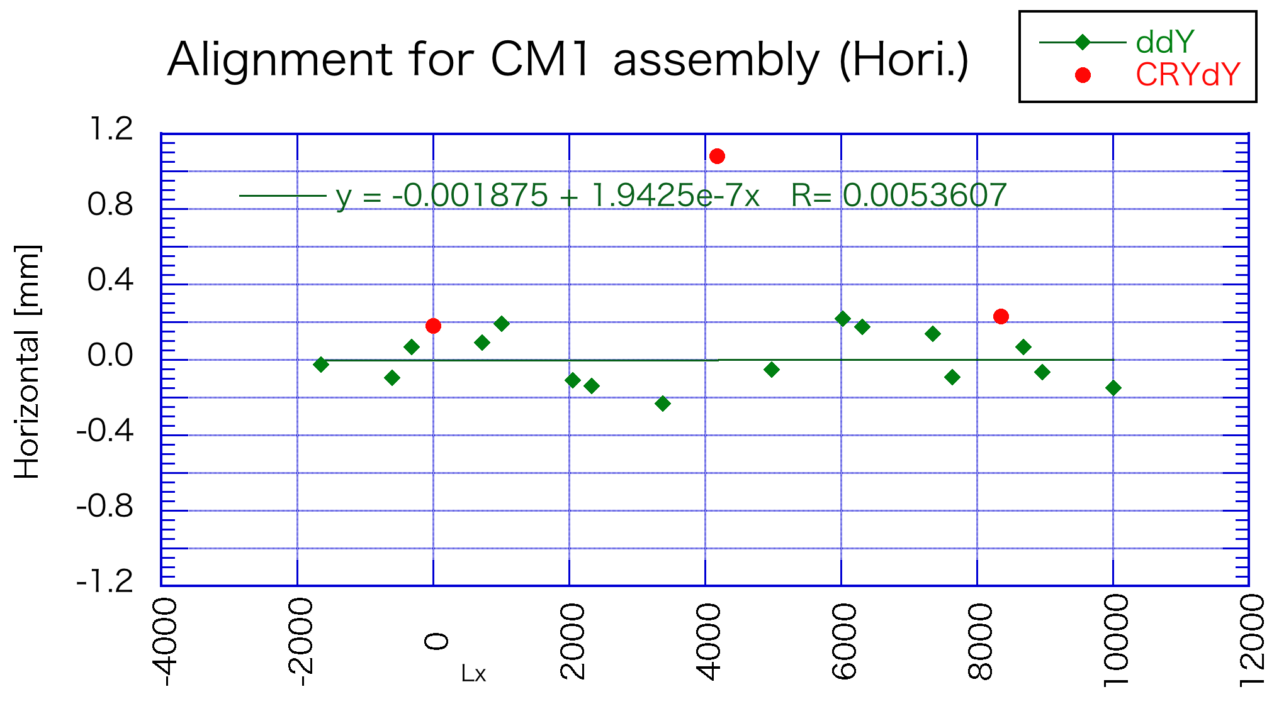
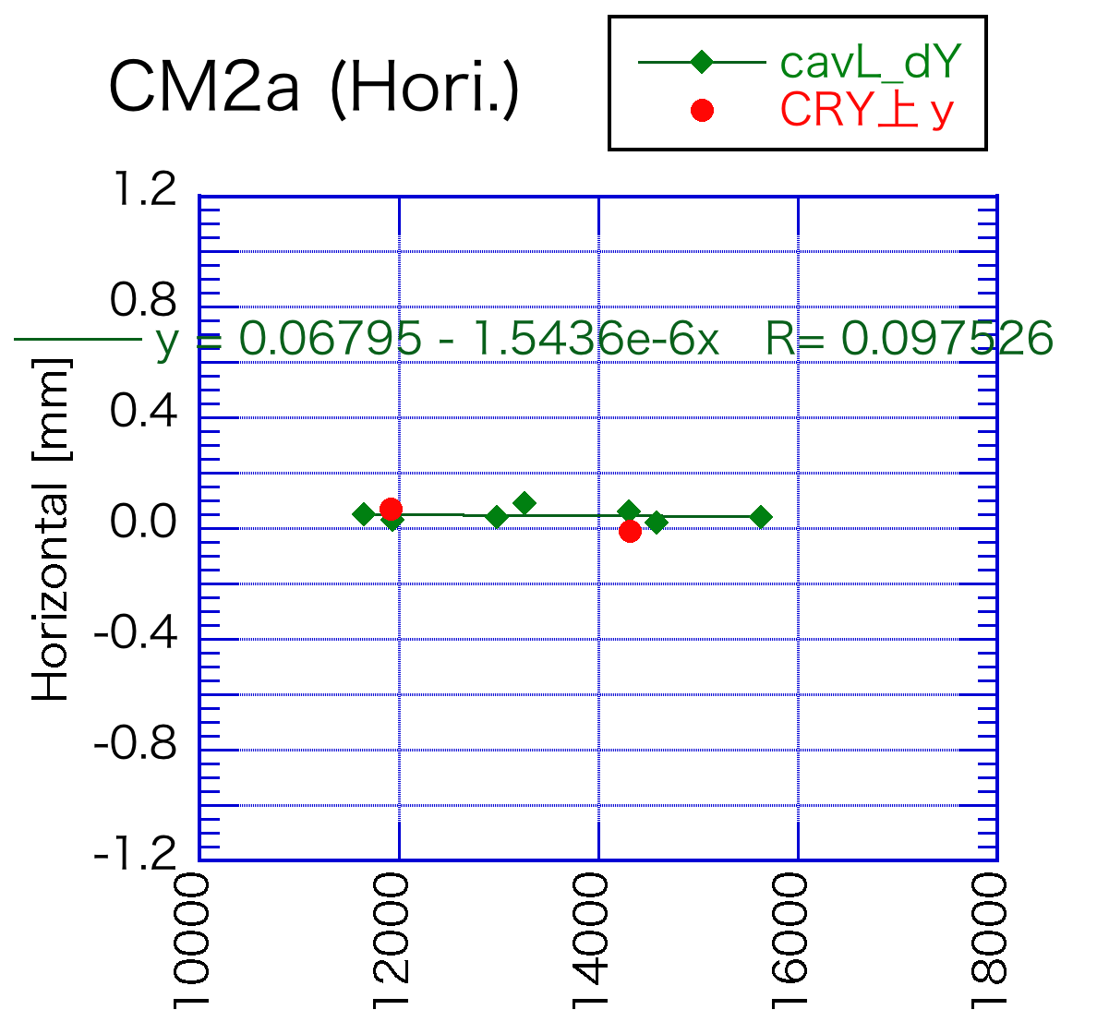
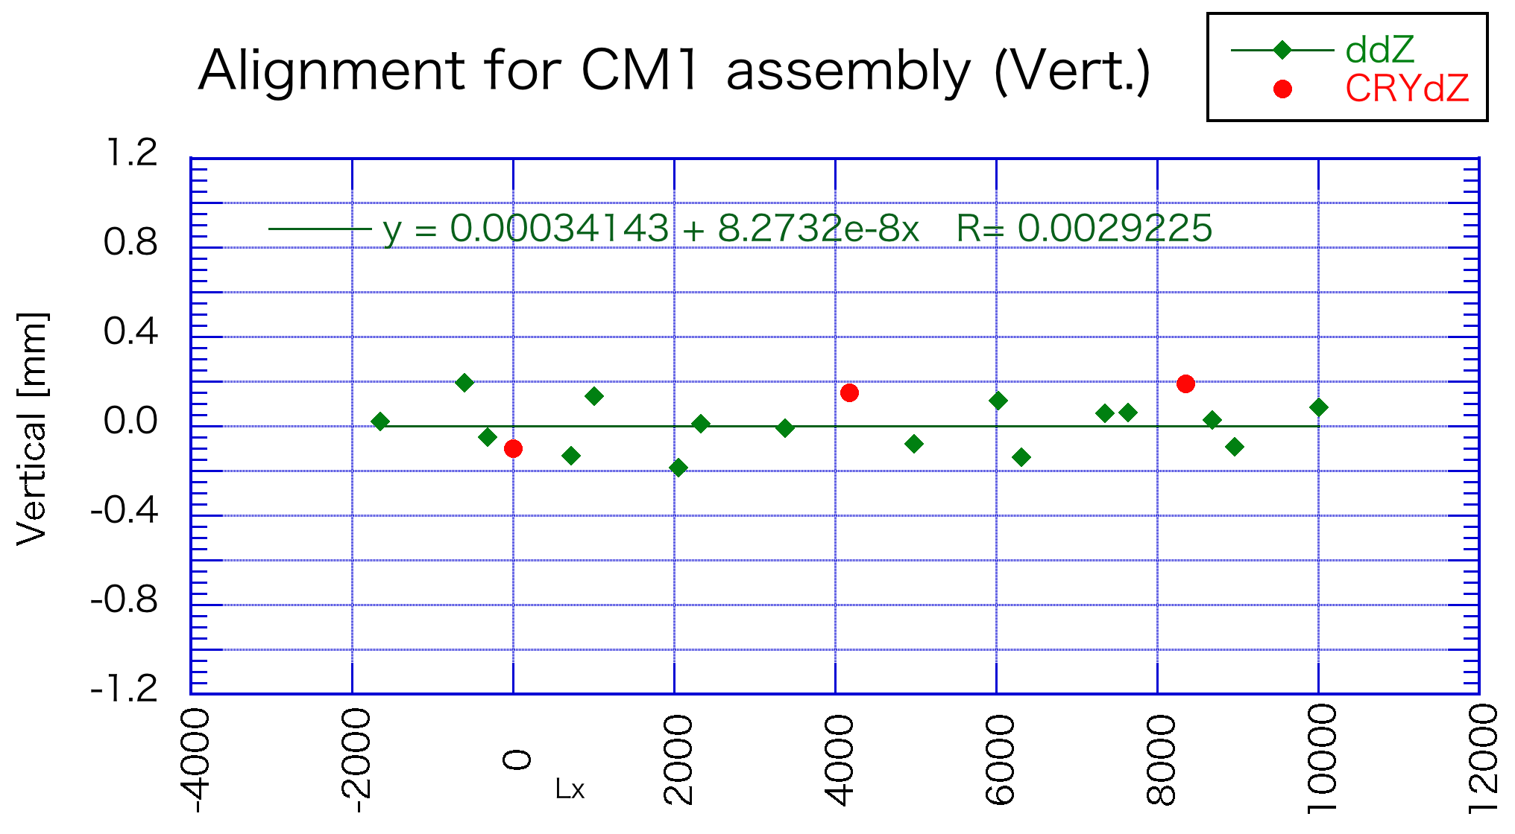
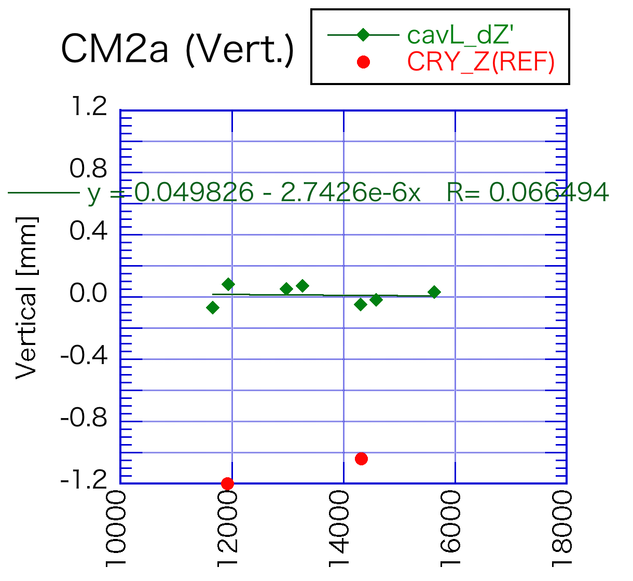
Result of cavity alignment
CM1 Horizontal
CM2a Horizontal
ILC spec.
16 points are measured for 8 cavities
Alignment result satisfied the ILC specification!
CM1 Vertical
CM2a Vertical
ILC spec.
Courtesy of S. Araki

Slide 10
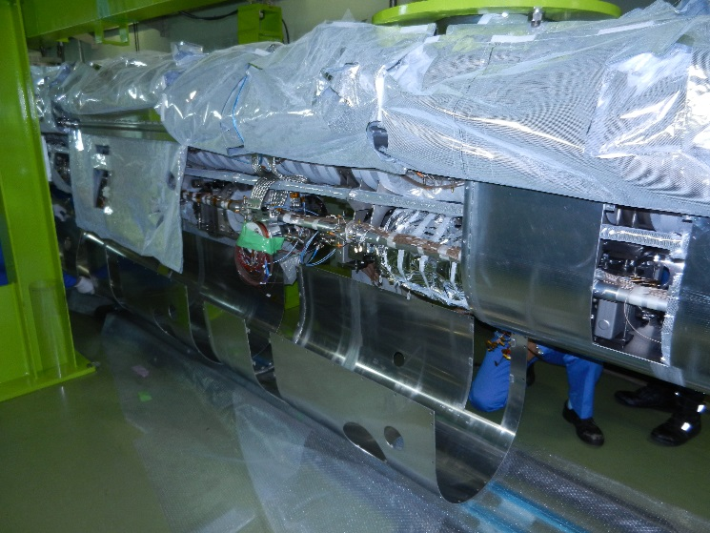
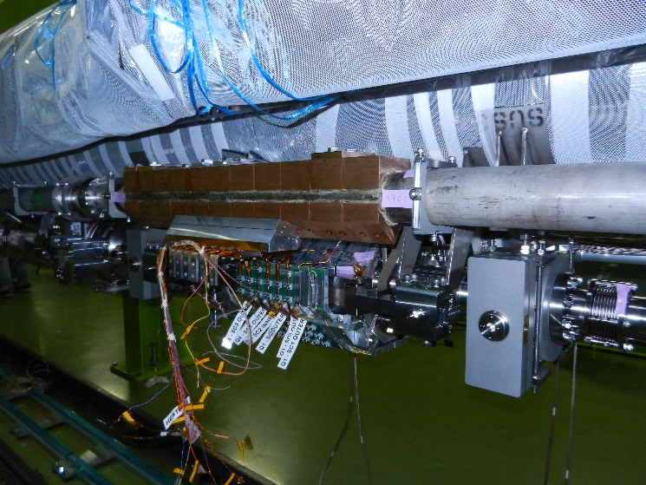
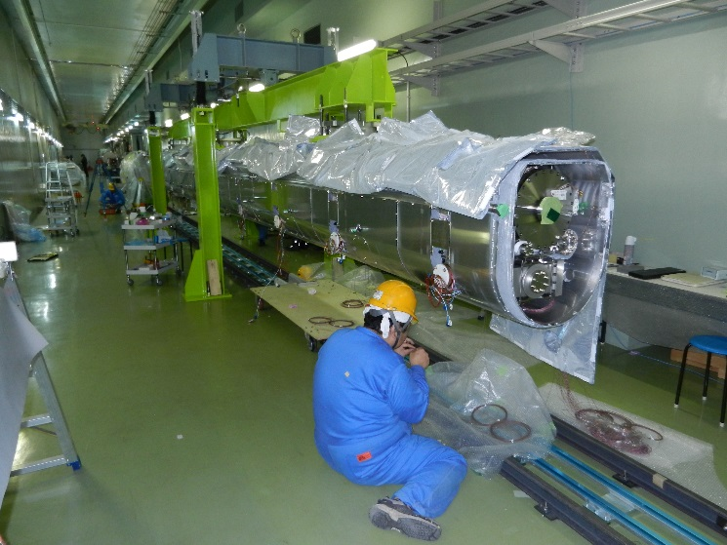
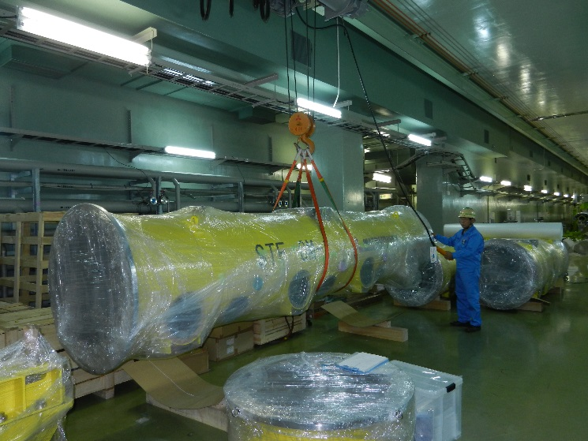
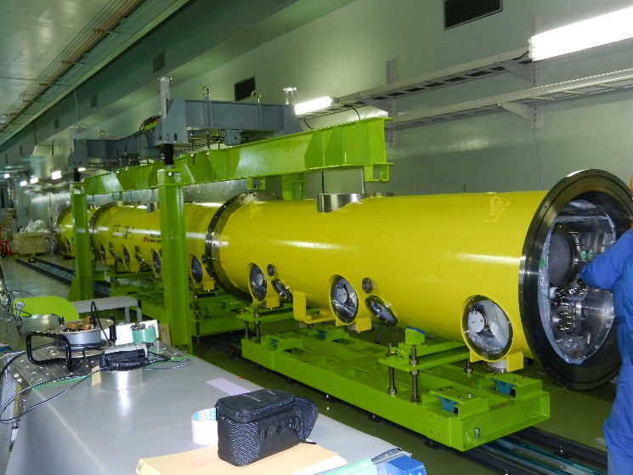
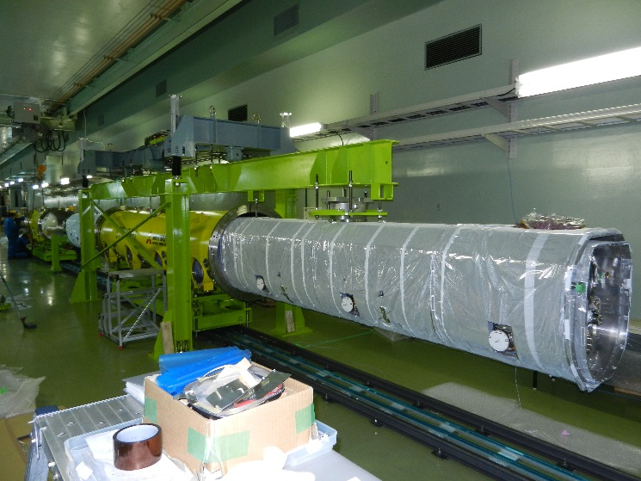
Construction of STF-2 CM1②
Q-magnet attachment
(collaboration with FNAL)
Attachment of thermal shield
Installation into cryo-vessel
Carrying cryo-vessels

Slide 11
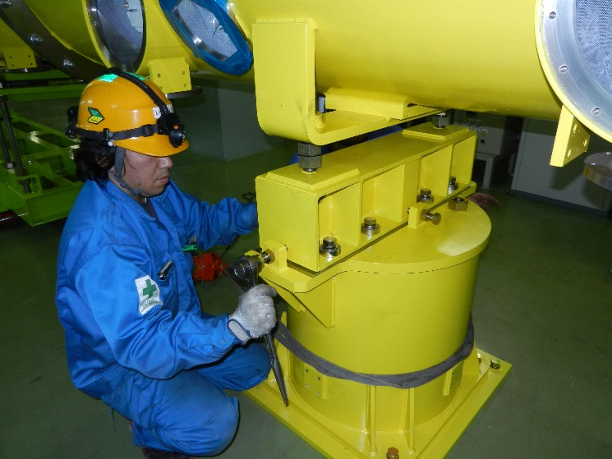
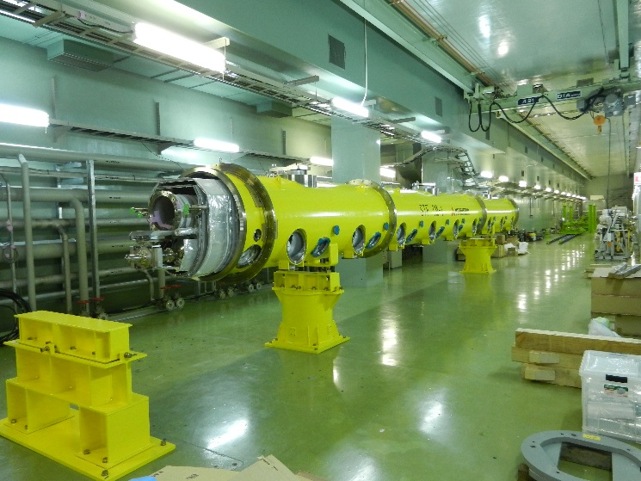
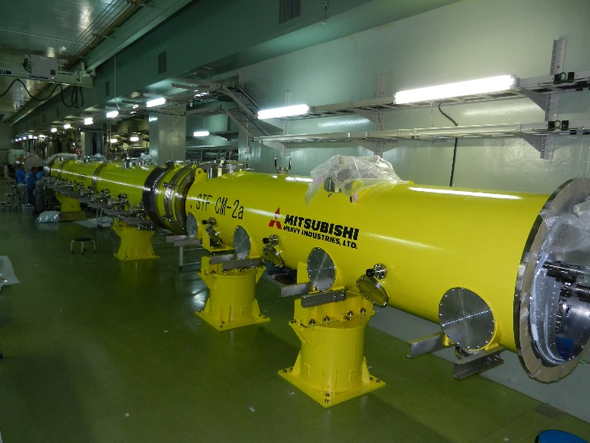
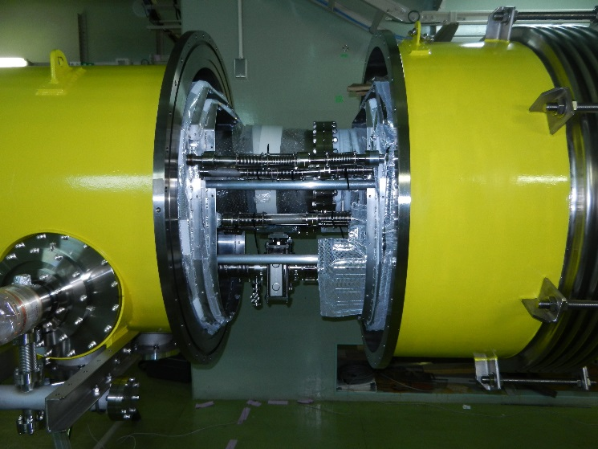
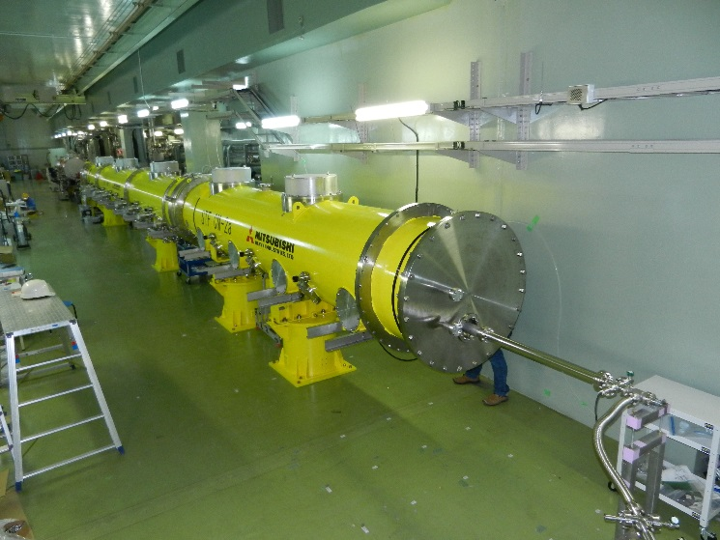
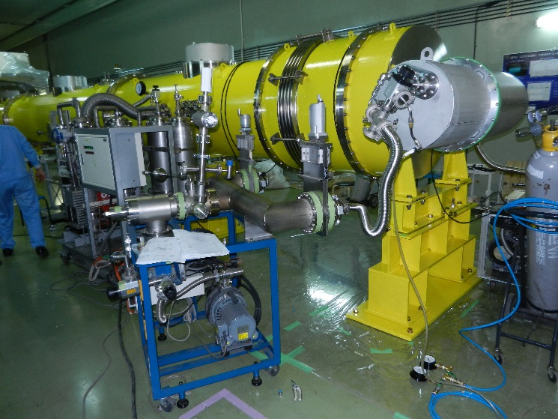
Construction of STF-2 CM1③
Putting CM2a along beamline
Adjustment of position
Putting CM1 along beamline
Construction finished
Connecting CM1 and CM2a
Integrated leak check

Slide 12
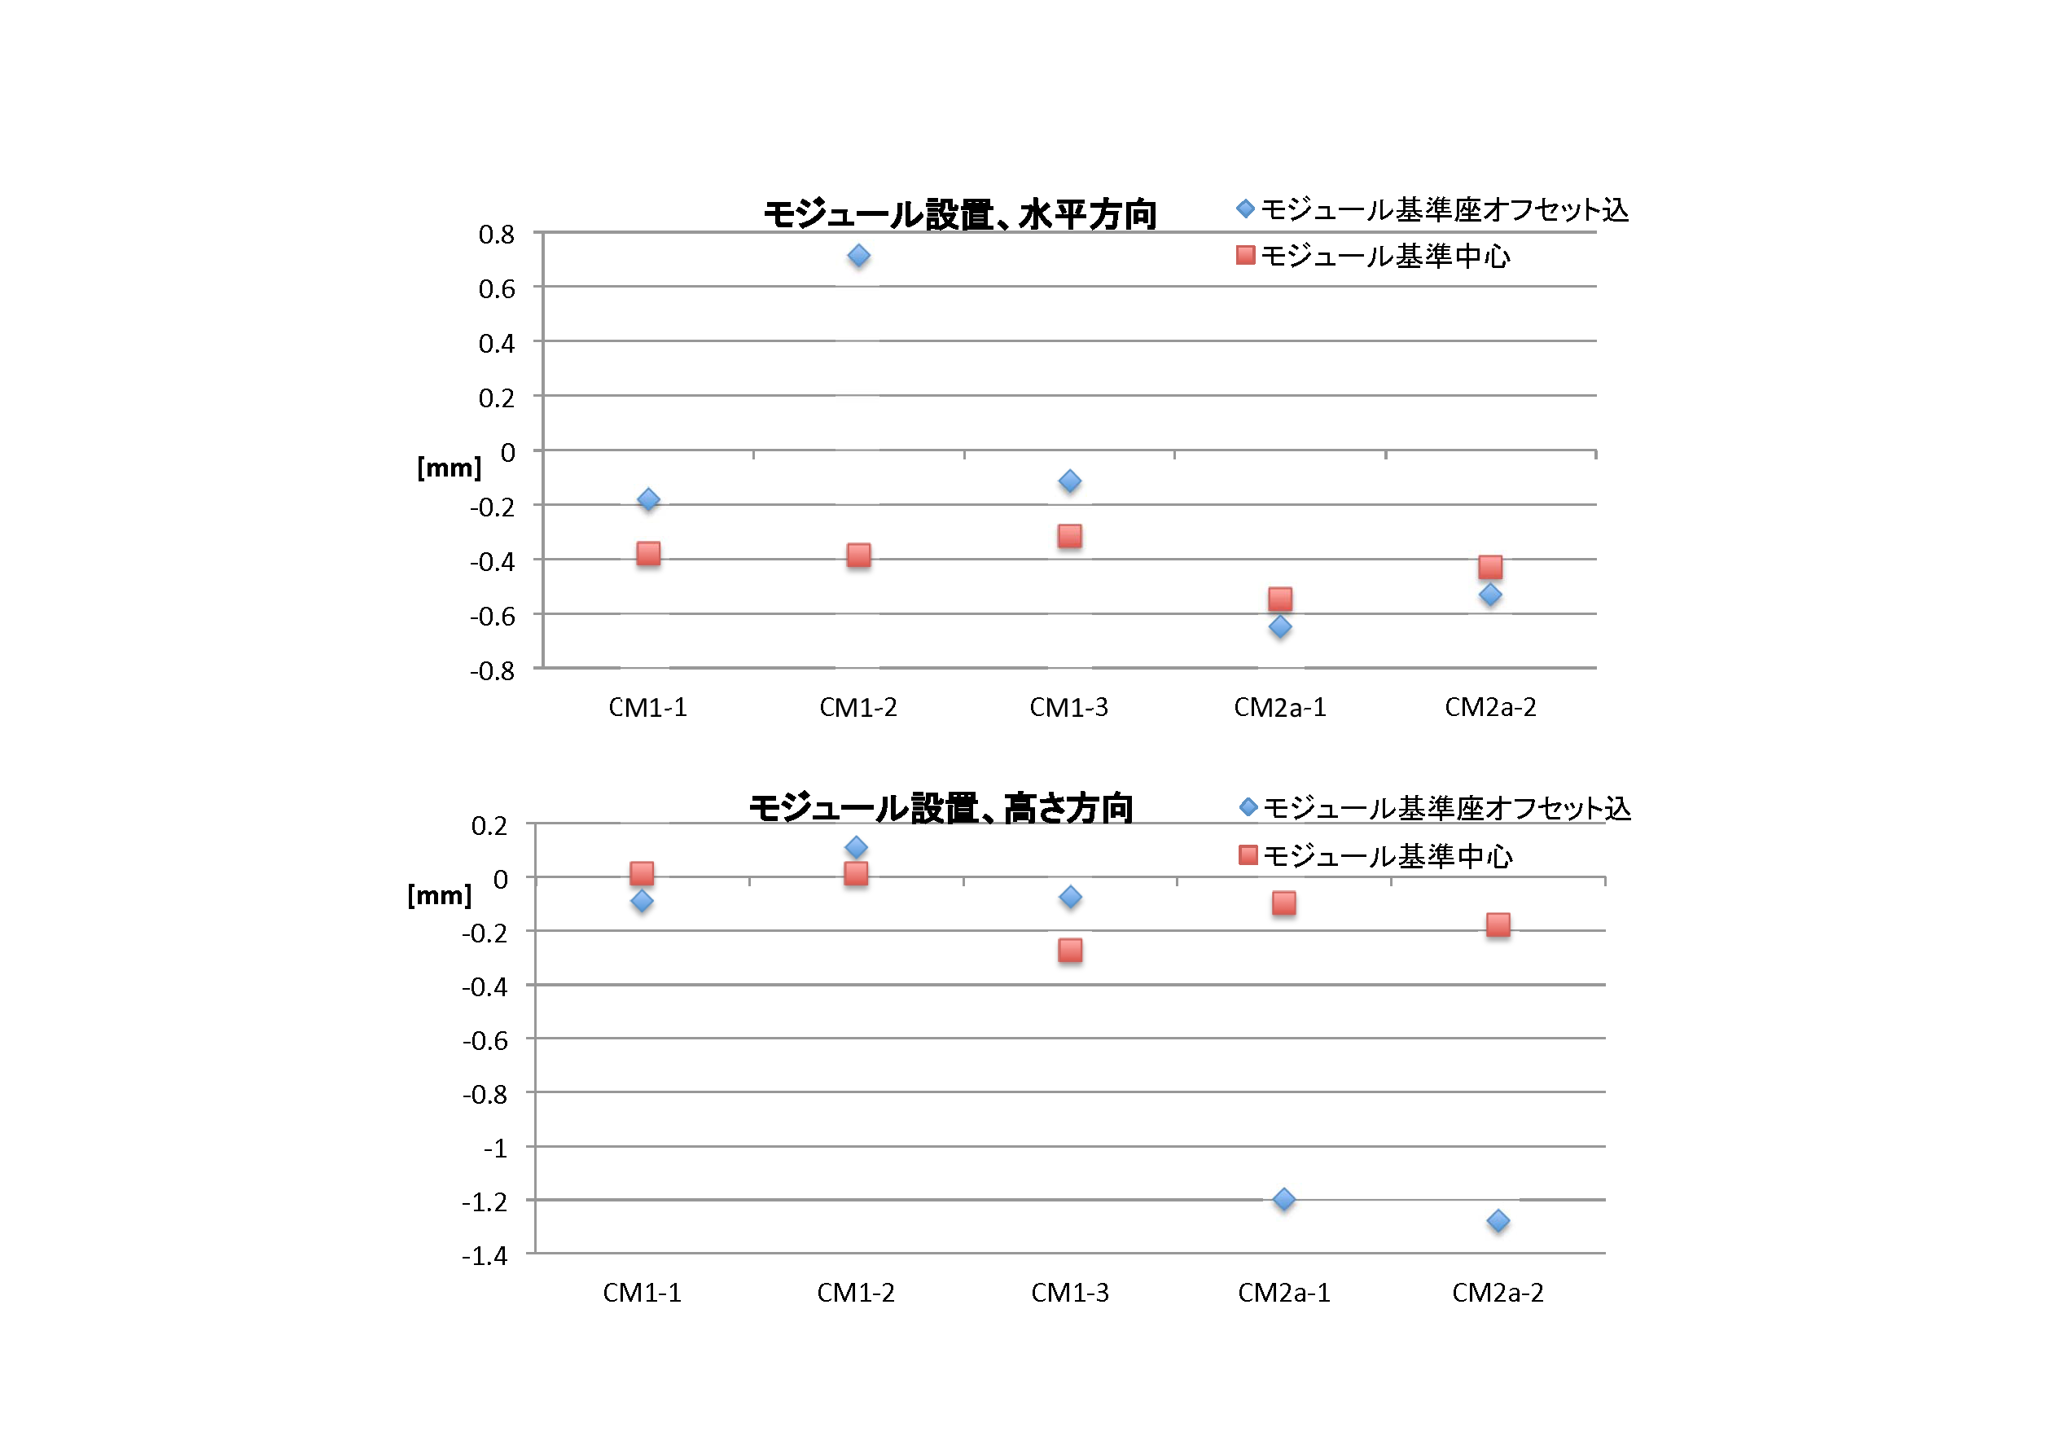
Result of cryomodule alignment
Horizontal
5 points are measured for 5 support posts
ILC spec.
Vertical
ILC spec.
Alignment result satisfied the ILC specification!
Courtesy of S. Araki

Slide 13
Summary
STF-2 Cryomodule construction was too complicated
STF-2 Cryomodule construction successfully completed
Significant problems in cavity string connection
Cavity/Cryomodule alignment successfully done

Slide 14
Back-up slides

Slide 15
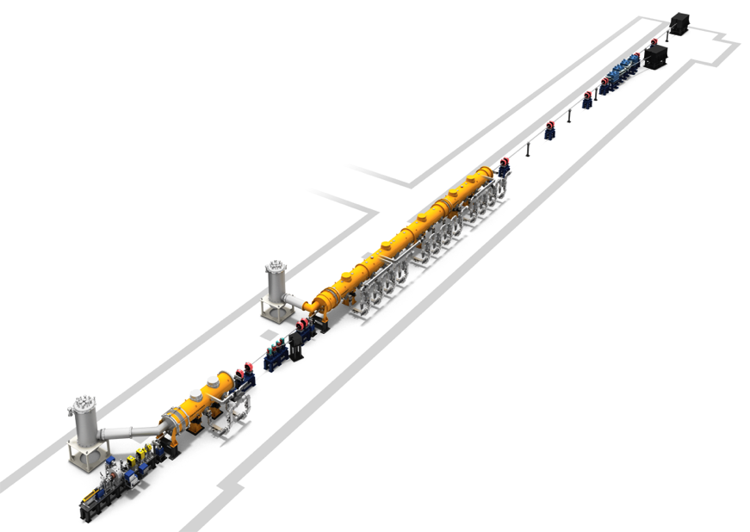
Definition of 3 axes in STF tunnel
Z
X
Y

