Slide 1
First LCLS-II Production Cavity Results with N-Doping
Dan Gonnella
2017 TTC Workshop
February 21, 2017

Slide 2
Outline
Introduction to LCLS-II
Cavity Preparation Method
Transfer of N-Doping to Production
RF Results from First Cavities
Summary

Slide 3
Outline
Introduction to LCLS-II
Cavity Preparation Method
Transfer of N-Doping to Production
RF Results from First Cavities
Summary

Slide 4
Introduction to LCLS-II
The SRF linac is closely based on the XFEL/ILC/TESLA Design
It consists of 35 cryomodules each with 8 cavities – total of 280 cavities
The 280 1.3 GHz 9-cell cavities have a very ambitious Q specification:
Additionally, cavity must reach 19 MV/m
2.7 x 10¹⁰ at 16 MV/m and 2 K
2.5 x 10¹⁰ at 16 MV/m and 2 K
Q specification lowered in VT due to addition of stainless steel blank on short side of cavity – adds ~0.8 nΩ of R_{res}

Slide 5
Outline
Introduction to LCLS-II
Cavity Preparation Method
Transfer of N-Doping to Production
RF Results from First Cavities
Summary

Slide 6
Cavity Fabrication
Two vendors were chosen to build the SRF cavities
RI Research Instruments GmbH
E. Zanon S.p.a.
Niobium sheet was procured from two vendors
Tokyo Denkai
OTIC Ningxia
For the remainder of this talk, vendor names will not be used in order to protect confidentiality

Slide 7
Cavity Preparation Method
In order to achieve the ambitious Q specification, all 9-cell cavities for LCLS-II are prepared with nitrogen-doping
Original recipe:
140 μm bulk EP
800ºC degas for 3 hours in vacuum
2 minutes at 800ºC in 20-30 mTorr of N₂
6 minutes at 800ºC in vacuum
5-7 μm light EP

Slide 8
Issues with Original Recipe
Material from both vendors showed worse flux expulsion when treated at 800ºC in single-cell cavity tests than material used during the prototyping and R&D stage
This means that magnetic field specifications would need to be tighter in order to minimize the need for efficient flux expulsion
Ambient magnetic field will be below the spec of 5 mG in the cryomodule with the current magnetic shielding design, therefore much improvement on this would be difficult
Worse flux expulsion is an independent phenomena from N-Doping – It impacts all cavity preparation methods

Slide 9
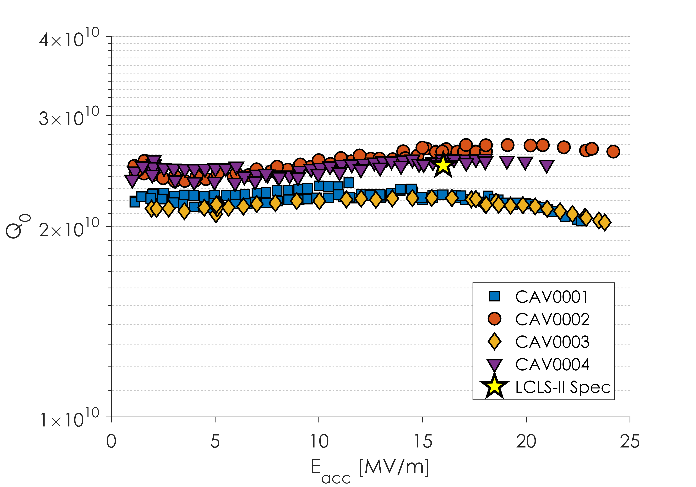
Initial Cavity Results
Some Great Cavities
Some Good Cavities
All these cavities tested in very low (0-1 mG) magnetic fields

Slide 10
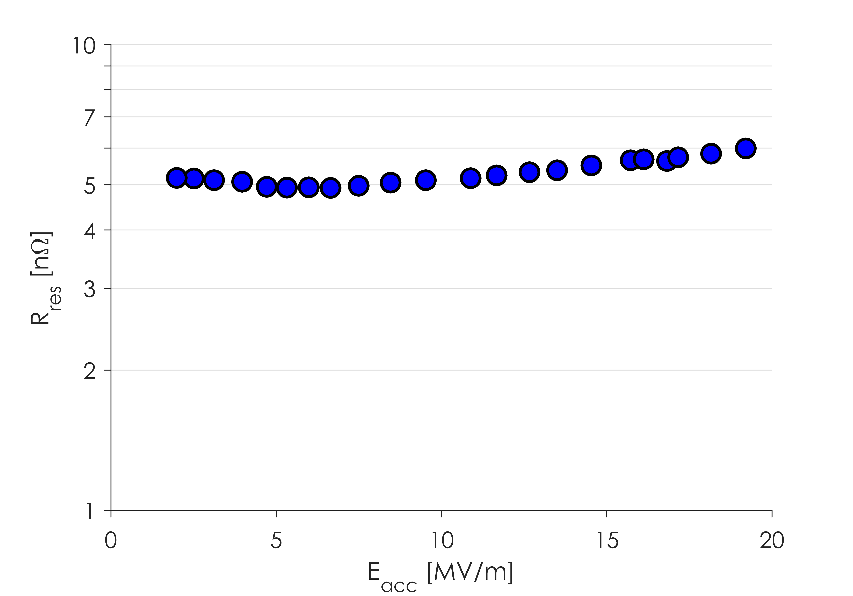
Residual Resistance
R_{res} significantly higher than in R&D Cavities

Slide 11
Cavity Preparation Method
In order to achieve the ambitious Q specification, all 9-cell cavities for LCLS-II are prepared with nitrogen-doping
Updated recipe:
200 μm bulk EP
900ºC degas for 3 hours in vacuum
2 minutes at 800ºC in 20-30 mTorr of N₂
6 minutes at 800ºC in vacuum
5-7 μm light EP
For more information on flux expulsion and the change in recipe see Ari Palczewski’s Talk

Slide 12
Residual Resistance

Slide 13
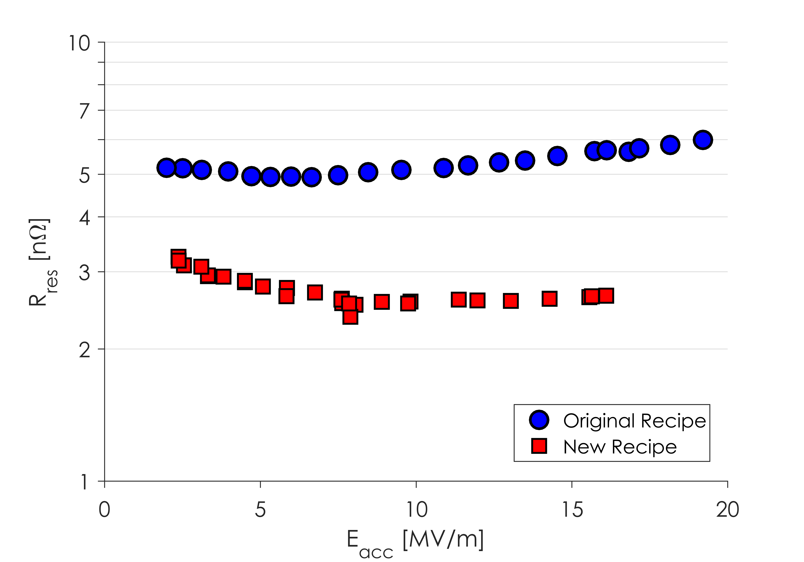
Residual Resistance
Lower R_{res} due to more bulk EP and better flux expulsion

Slide 14
Initial Cavity Results

Slide 15
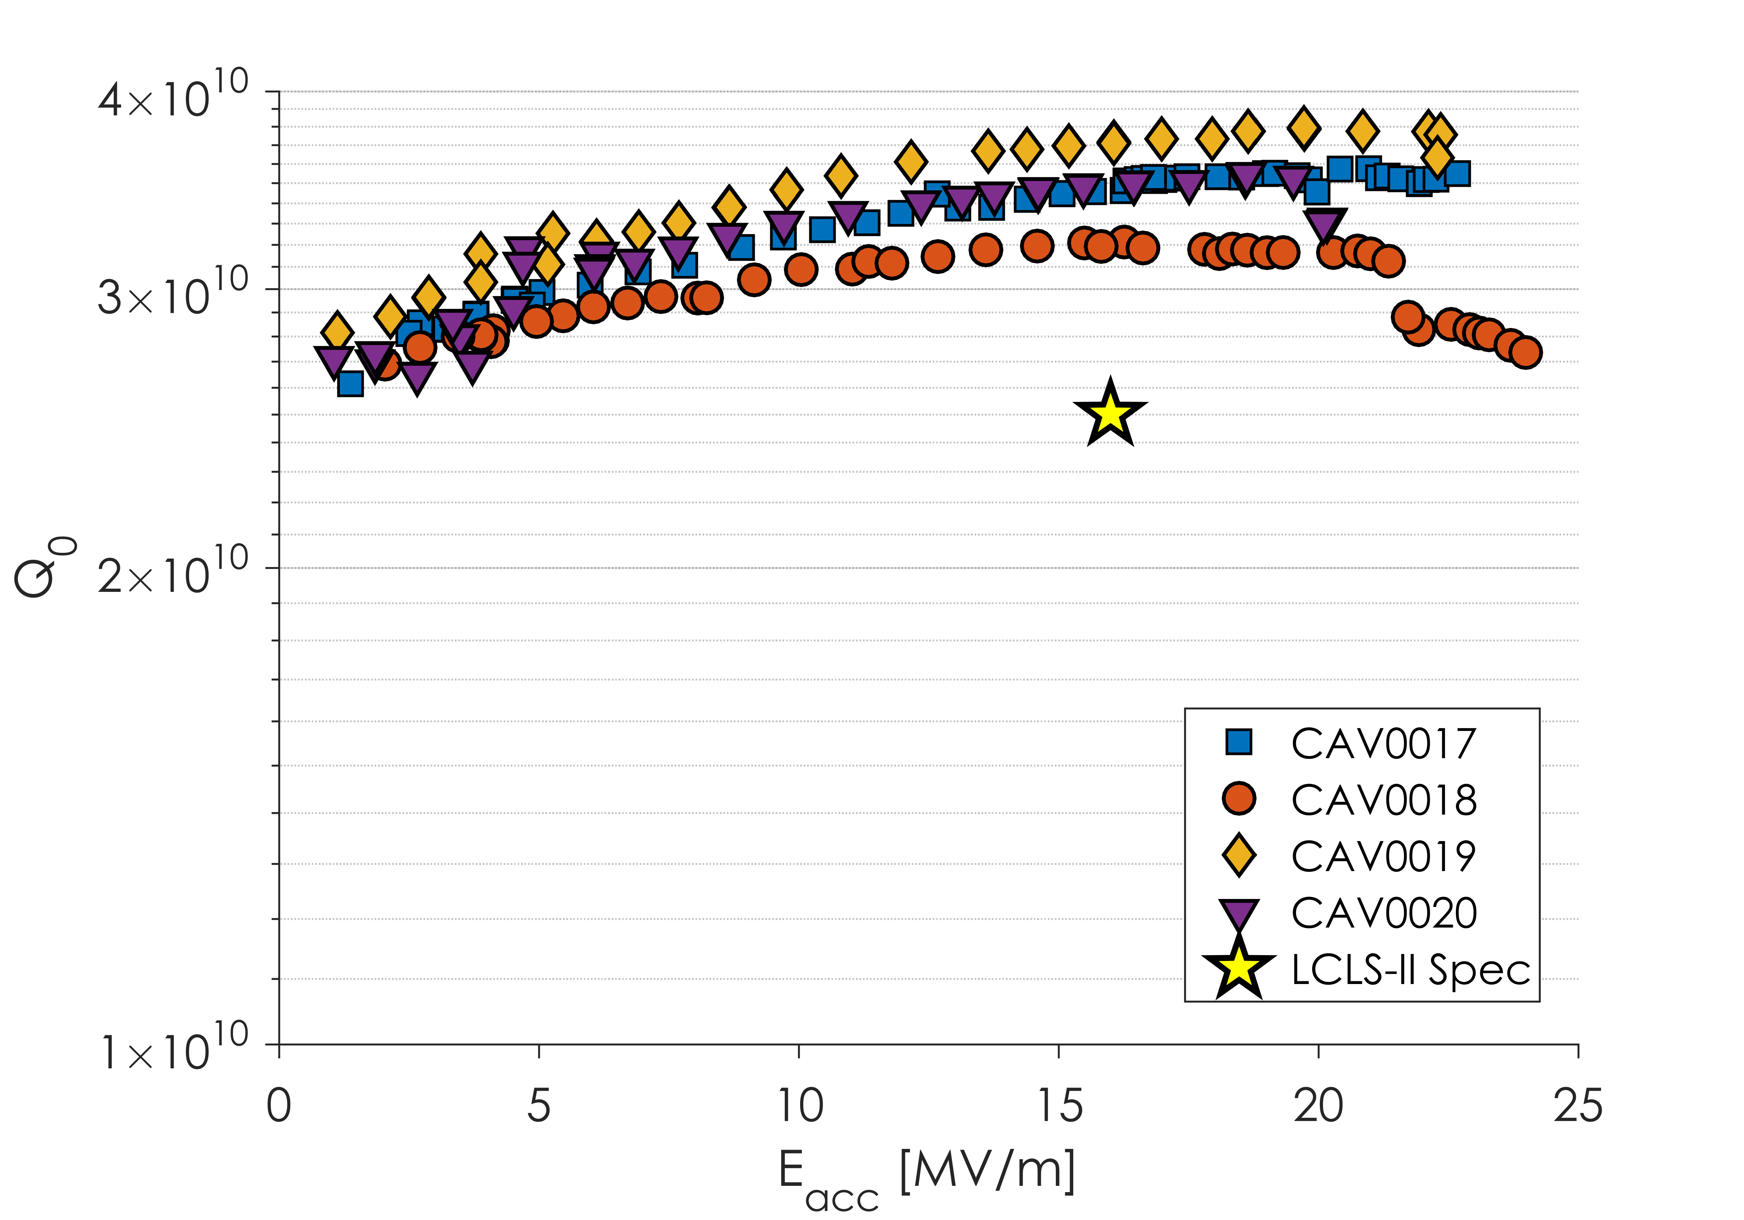
Cavity Results after Recipe Change

Slide 16
Outline
Introduction to LCLS-II
Cavity Preparation Method
Transfer of N-Doping to Production
RF Results from First Cavities
Summary

Slide 17
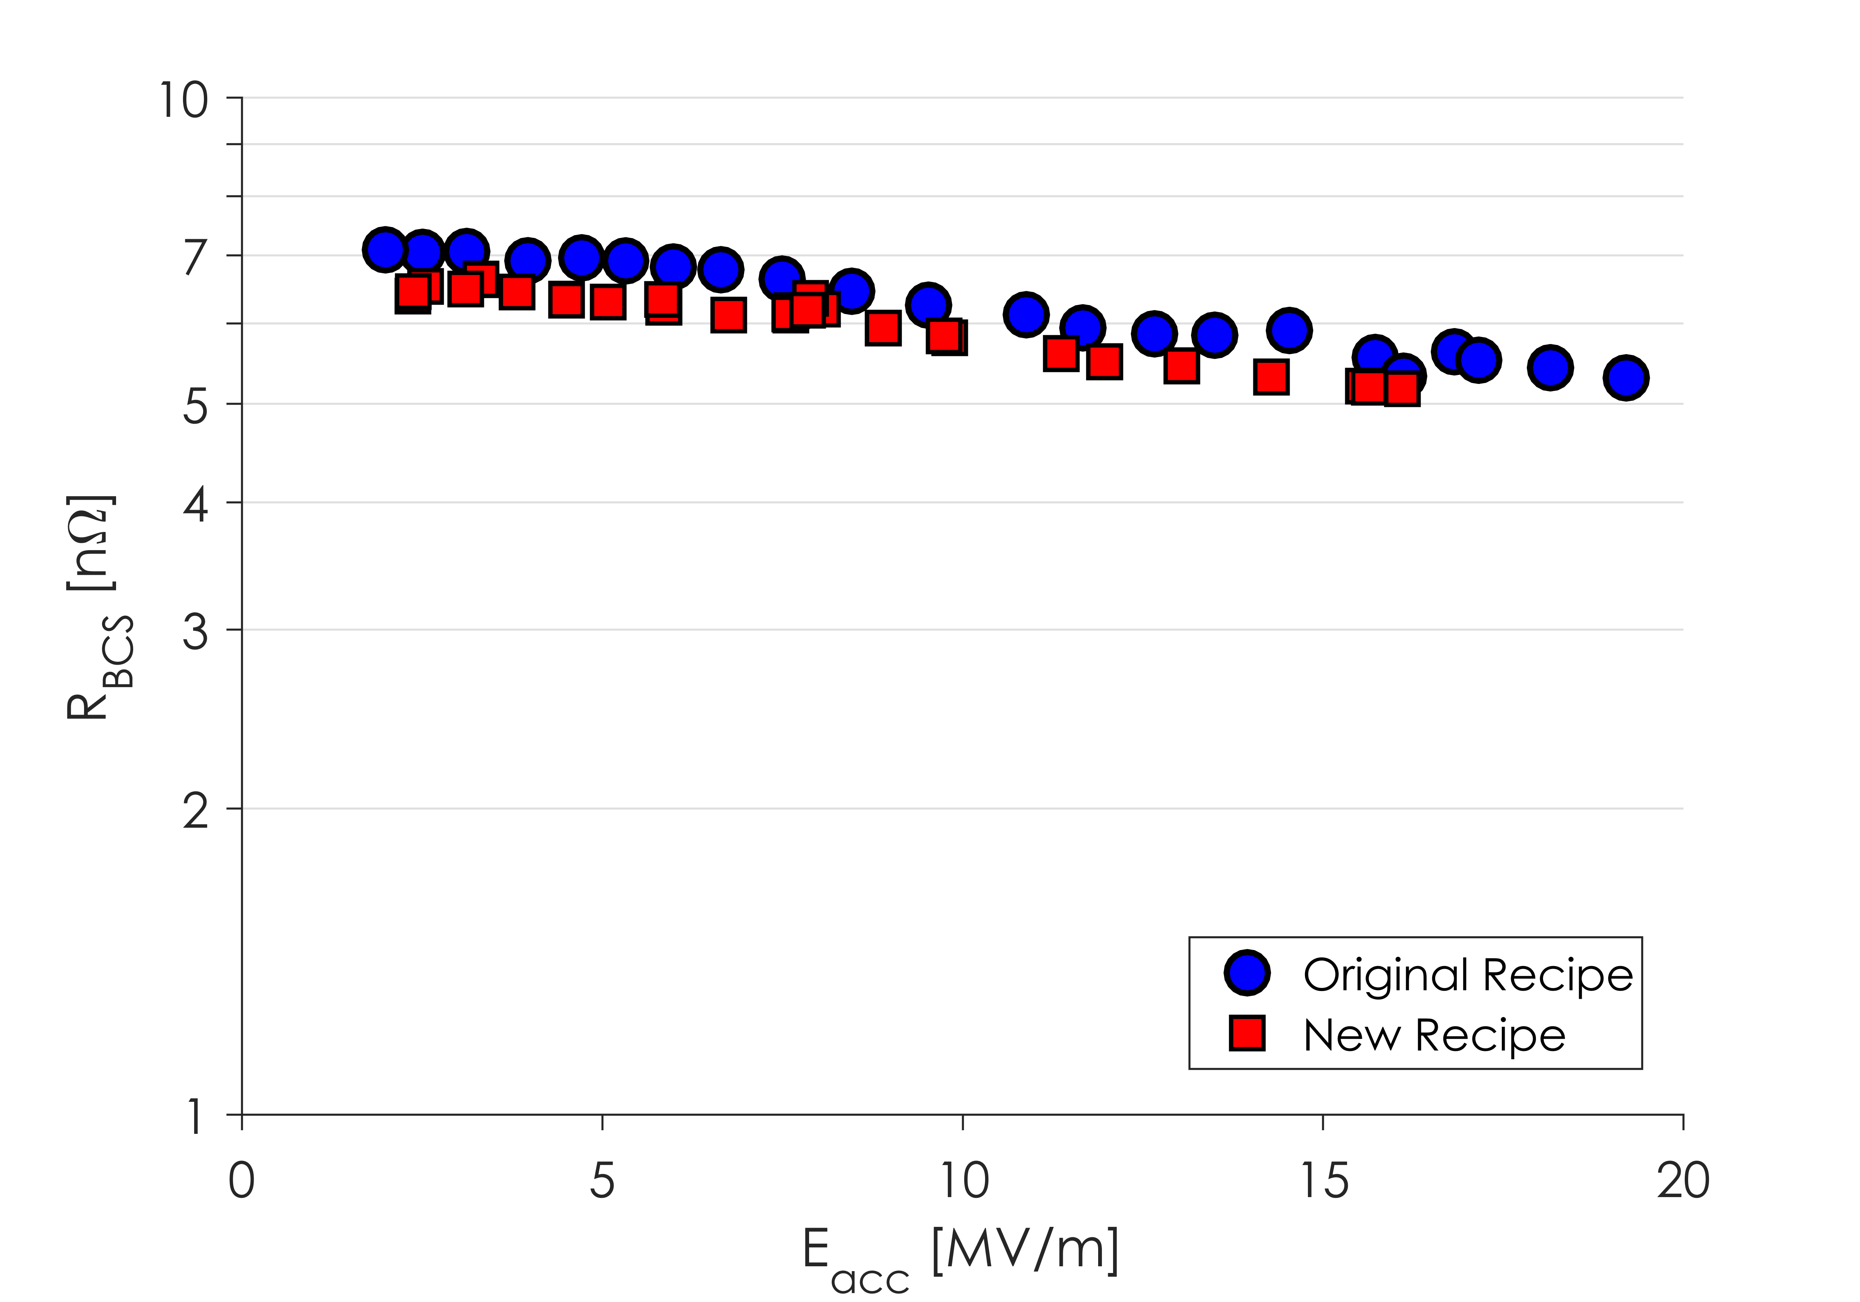
BCS Resistance in Production Cavities
R_{BCS} is a good measurement of the doping
Doping is unaffected by recipe change
R_{BCS} obtained in production cavities is similar to that obtained during the R&D phase
Doping protocols successfully transferred to vendors for production
Small Representative Subset of Cavities

Slide 18
Outline
Introduction to LCLS-II
Cavity Preparation Method
Transfer of N-Doping to Production
RF Results from First Cavities
Summary

Slide 19
Vendor Statistics
22 Cavities from Vendor A have been tested, a mix of Material 1 and 2
8 received original recipe
Remaining 14 received new recipe
44 Cavities from Vendor B have been tested, all from Material 1
16 received original recipe
Remaining 28 received new recipe

Slide 20
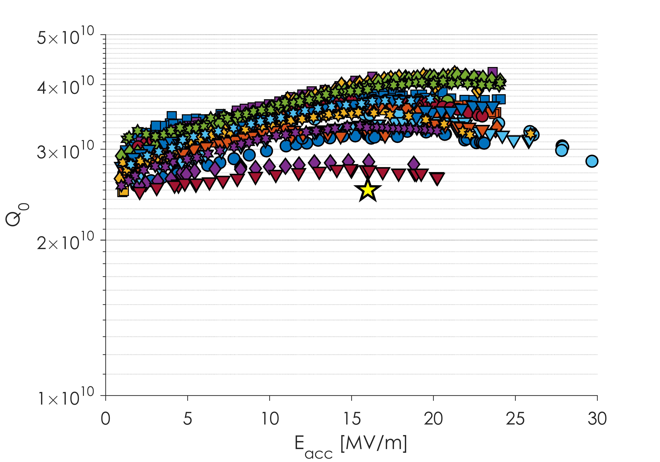
Vendor B Results
Majority of Cavities Now above 3x10¹⁰
Almost all Vendor B Cavities Quench above 22 MV/m
Subset of Vendor B Cavities after Recipe Change
All Material 1
Magnetic field in VT Dewars no longer actively compensated – most of these tests in >5 mG

Slide 21
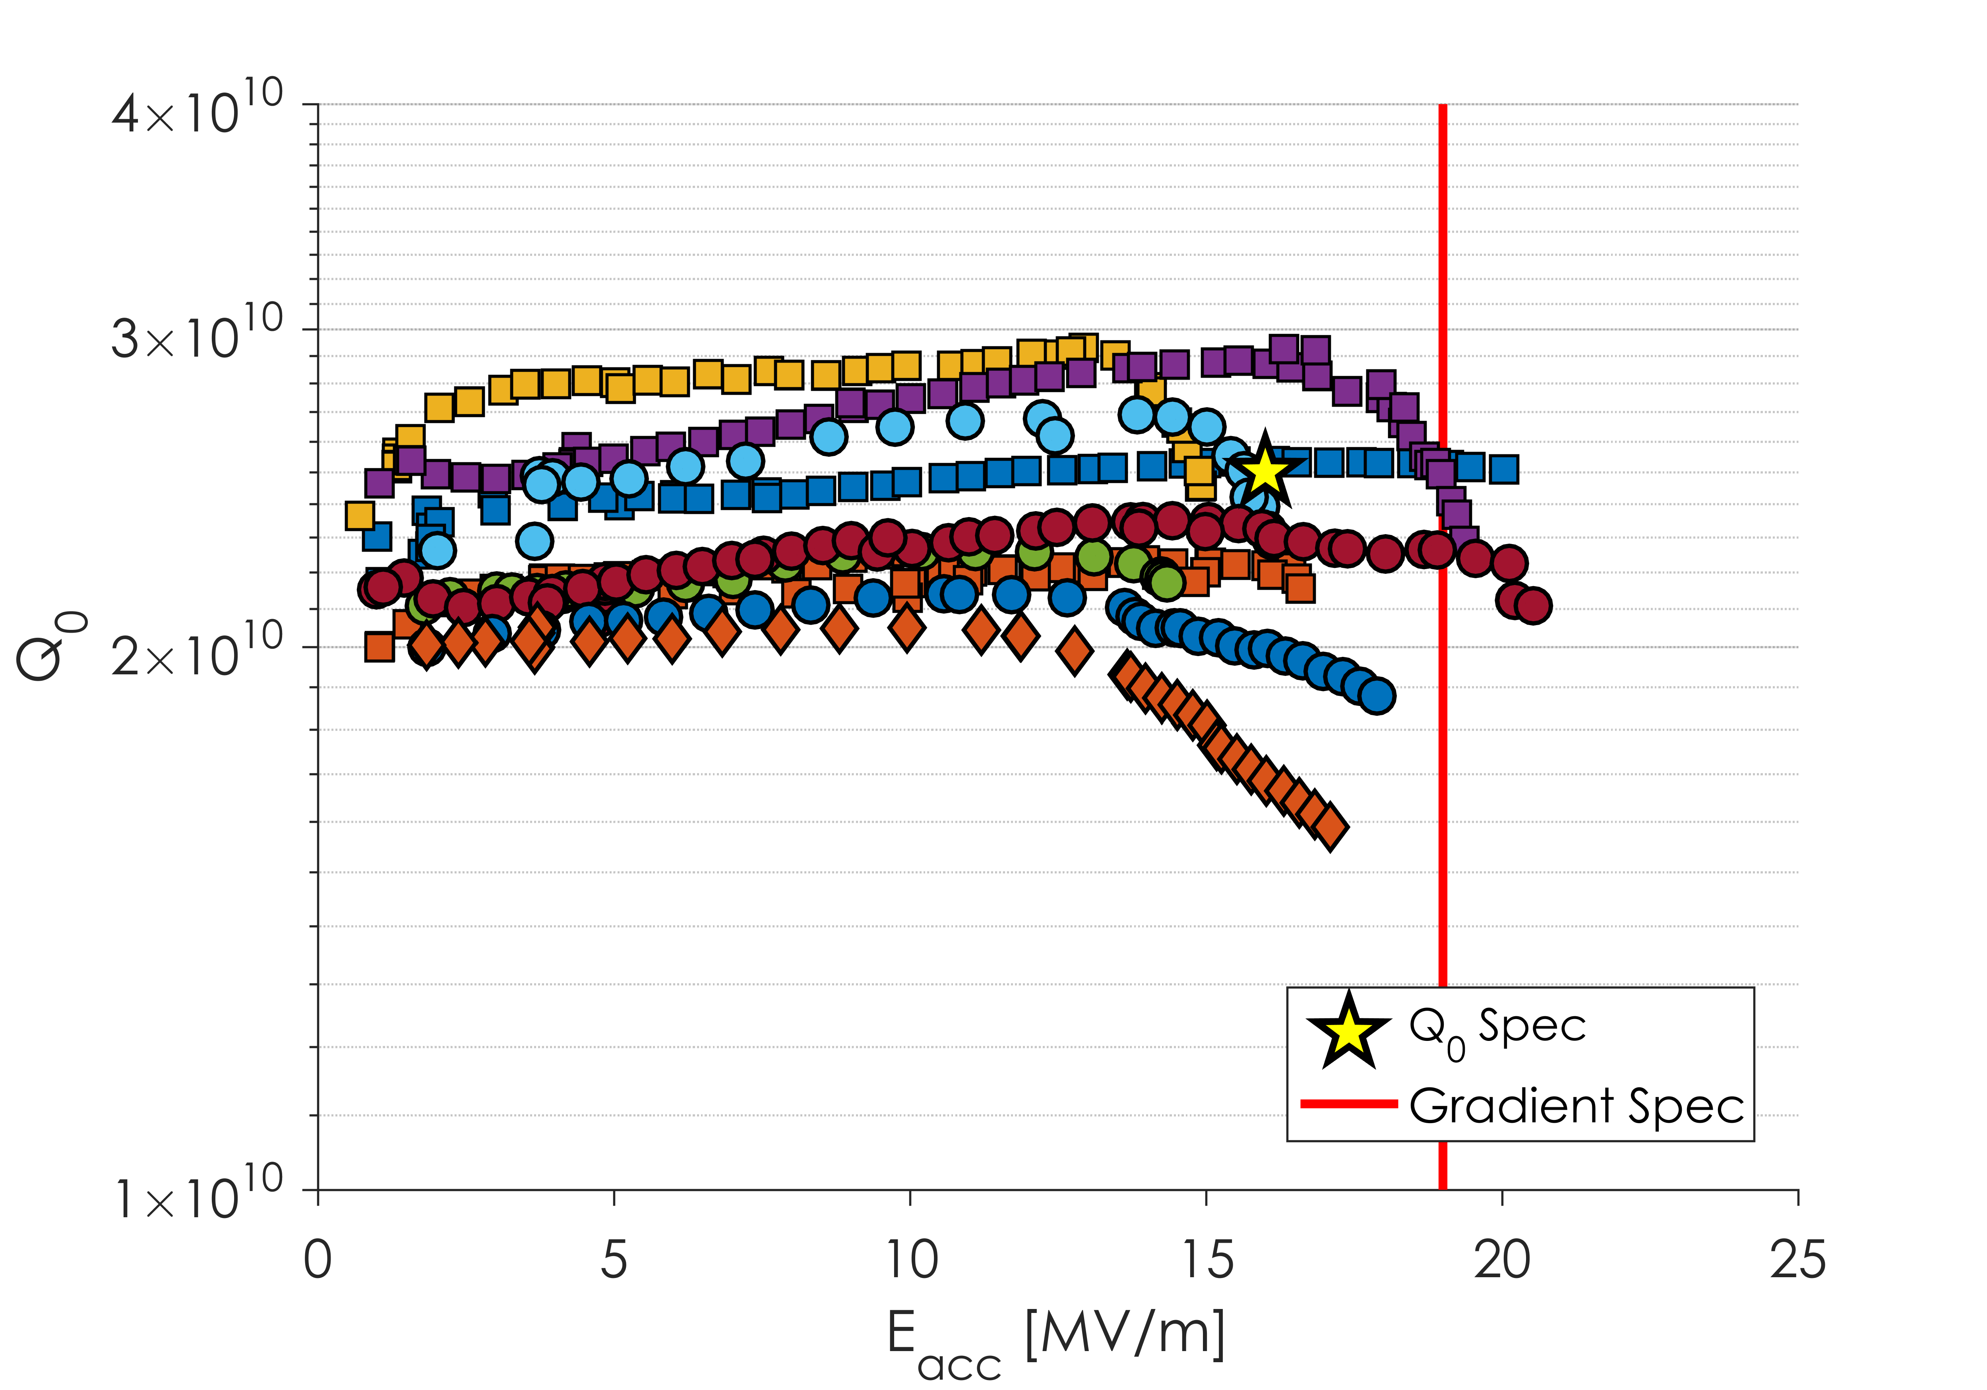
Vendor A Results
Spread in Q Due to Change in Recipe
All Material 2
Large Q Slope present in some cavities leading to quench below the spec of 19 MV/m
Related to material?

Slide 22
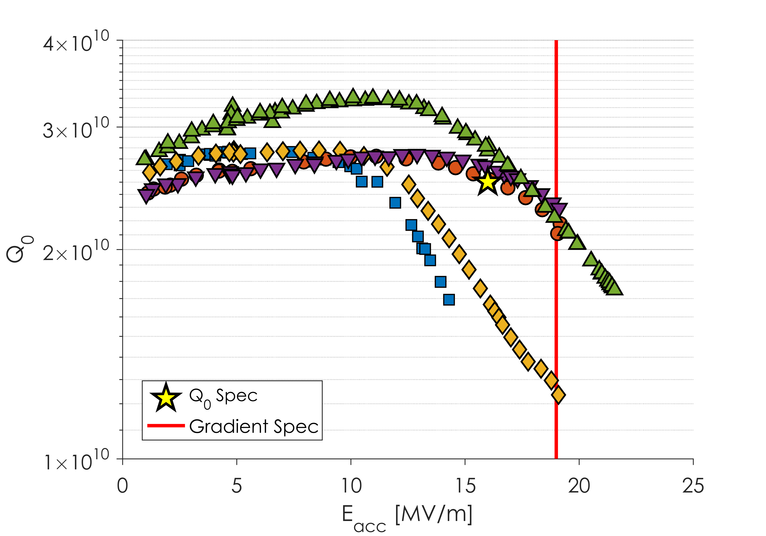
Vendor A Results
All Material 1
Gradient limitation not related to material type

Slide 23
Vendor A – Surface Roughness
This Issue was Fixed
Image courtesy of Y. Trenikhina
EP at Vendor A was producing a very rough surface
Roughness was as high as 15 μm
It was found that EP temperature was leading to the EP no longer being in the “polishing regime” but in the “etching regime”

Slide 24
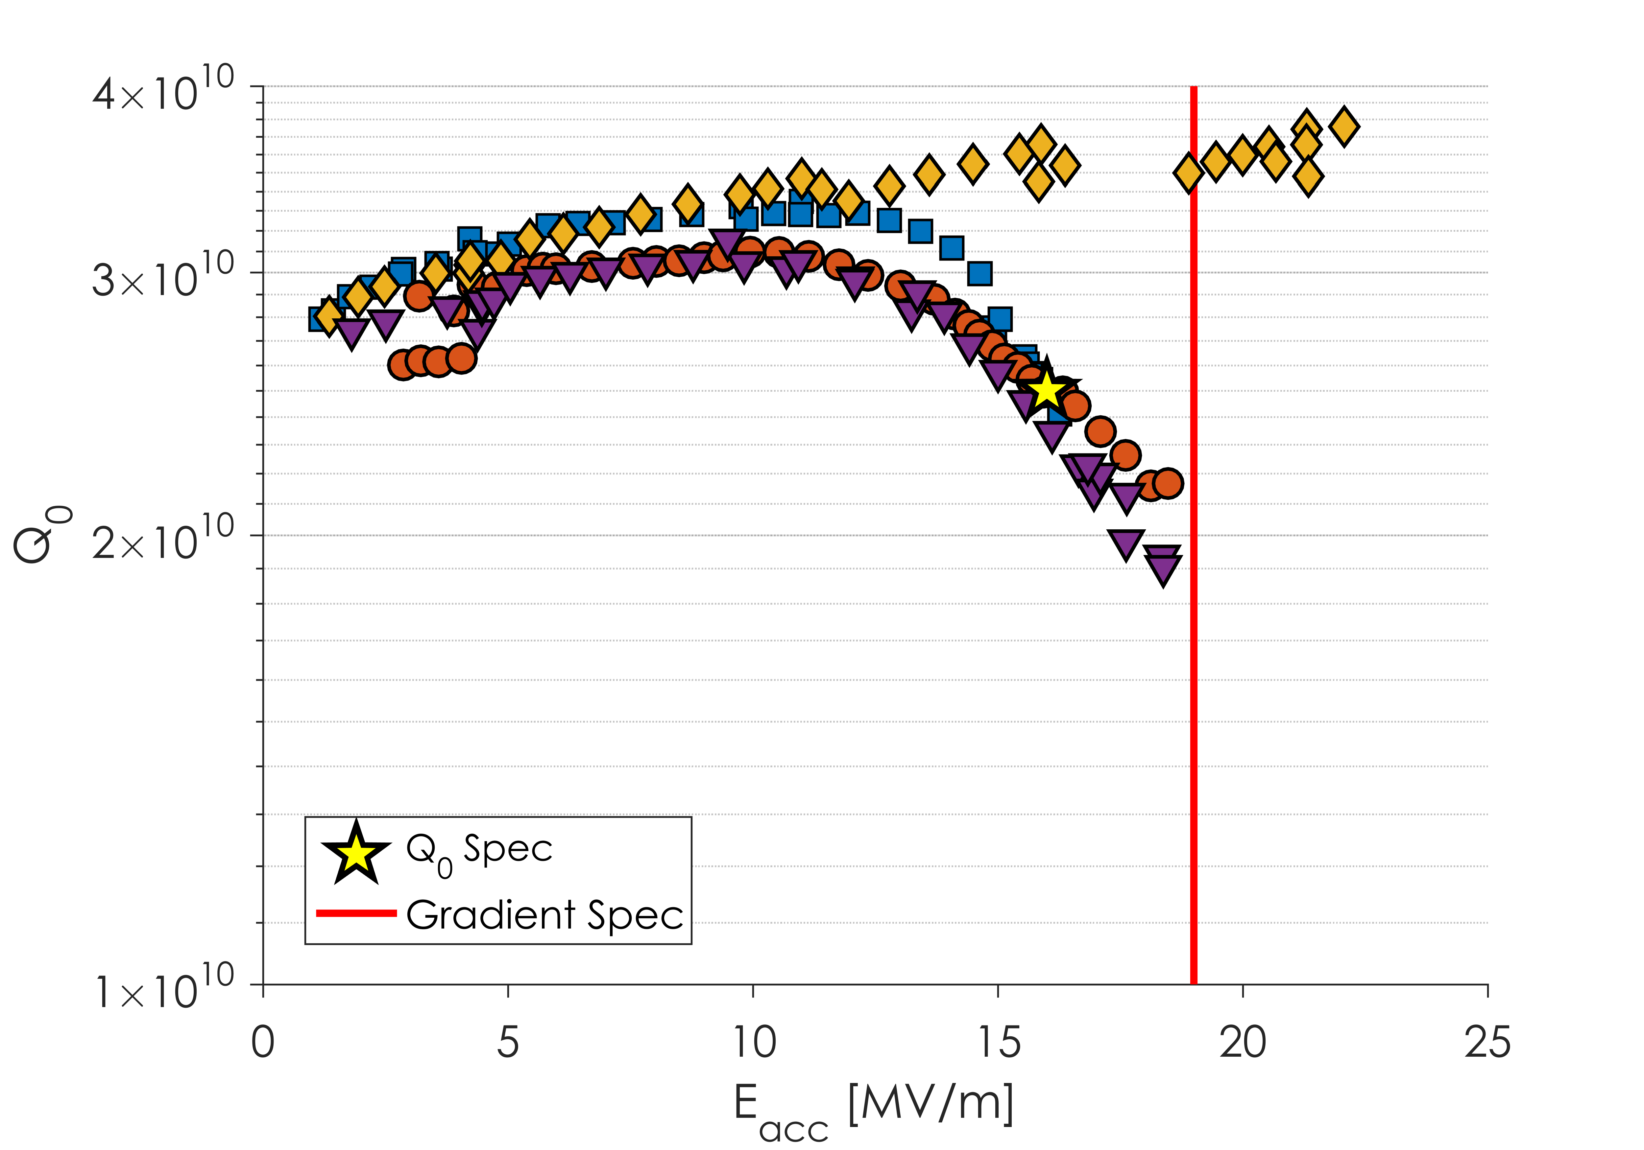
Vendor A – Improved EP
Q Slope and gradient limitation still present

Slide 25
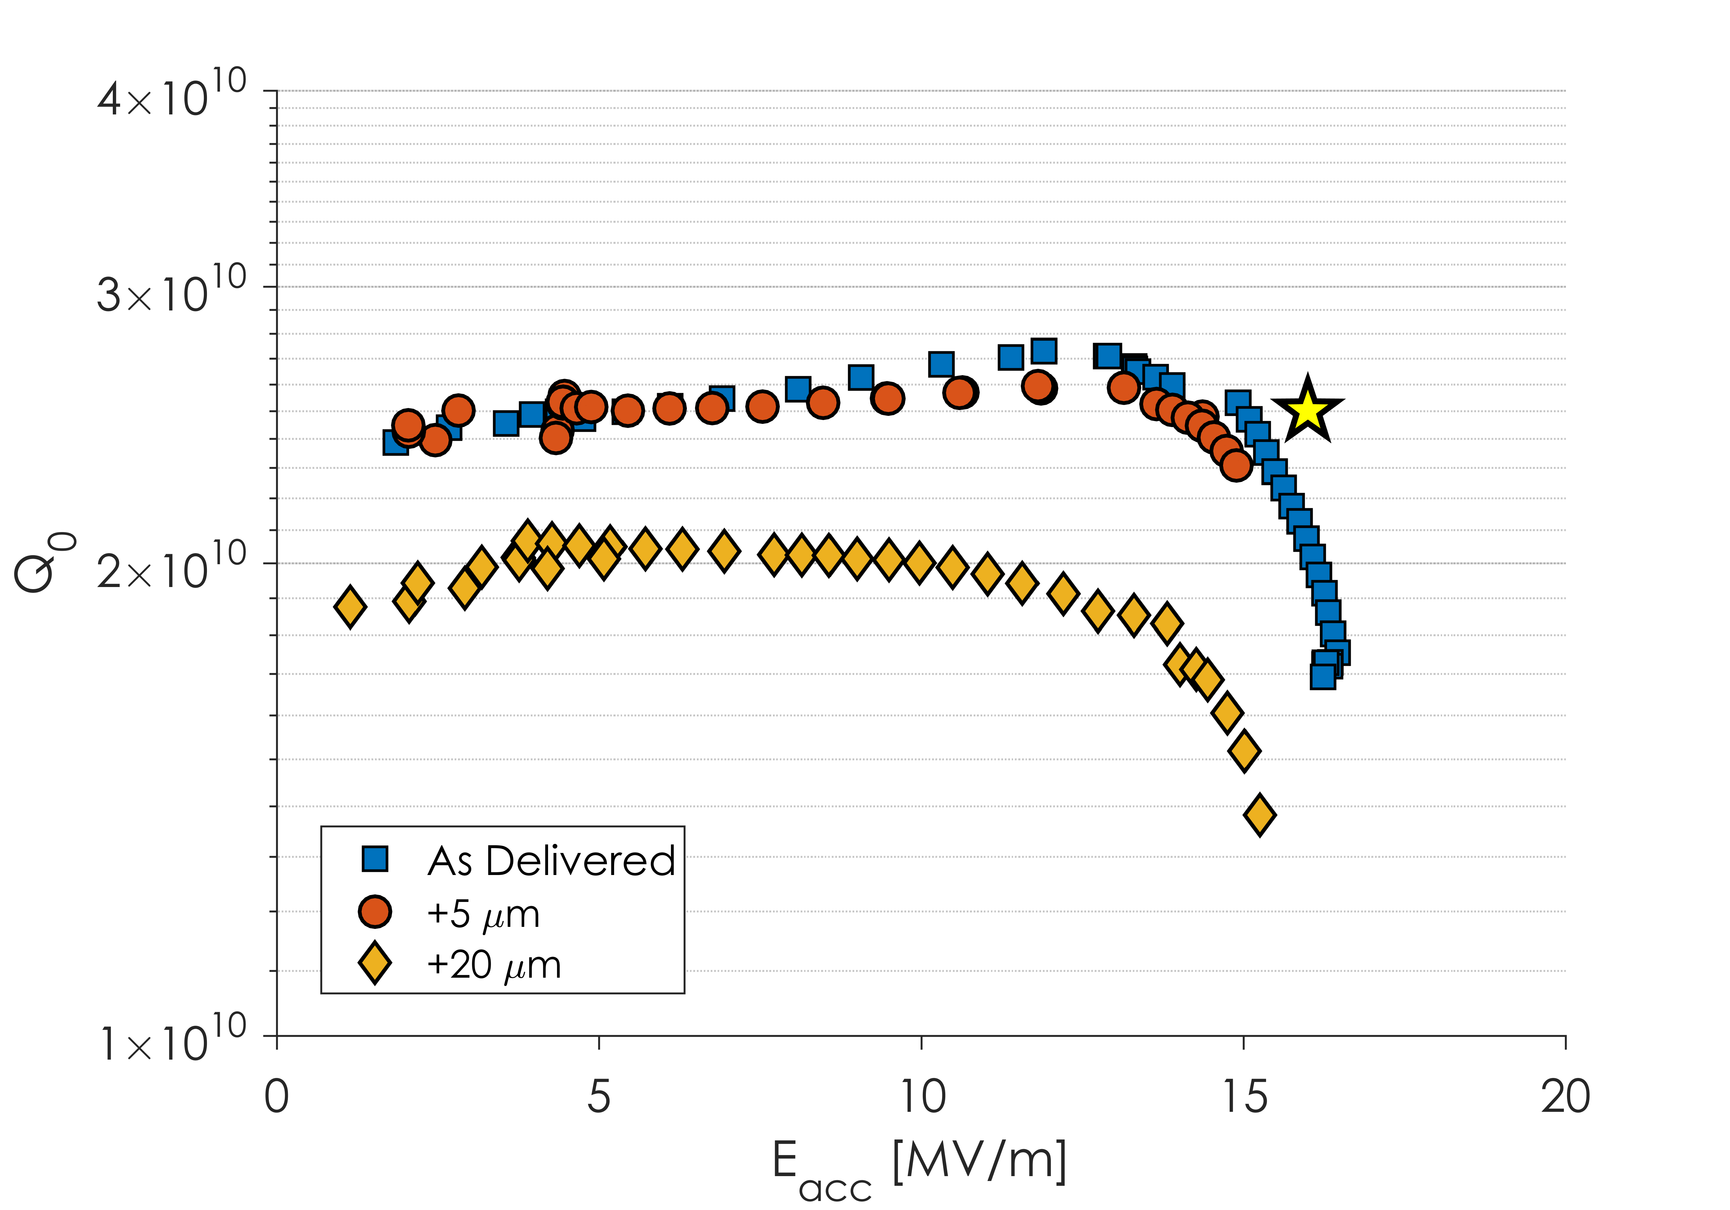
Vendor A – Increased Removal
Q slope and quench unchanged after 20 more micron removal

Slide 26
Vendor A Path Forward
We are currently working with Vendor A to improve cavity fabrication methods
Specific care is being taken to ensure that foreign media is not introduced during fabrication
In parallel, 2 cavities with poor performance are being reset to “XFEL preparation” to check if performance is improved

Slide 27
Outline
Introduction to LCLS-II
Cavity Preparation Method
Transfer of N-Doping to Production
RF Results from First Cavities
Summary

Slide 28
Summary
Nitrogen-doping has been successfully transferred to industry for production in LCLS-II
Due to flux expulsion limitation with material used, a recipe change was required mid-production
Vendor produced nitrogen-doped cavities show similar R_{BCS} as cavities from the R&D phase
Vendor B now produces cavities with Q’s on the order of 3-4 x 10¹⁰
Vendor A produces cavities with good Q at low fields but with strong Q slope leading to an early quench at or below the gradient specification
This performance is independent of material used
Work is ongoing to improve performance of Vendor A cavities

Slide 29
Questions or Comments?

