Slide 1
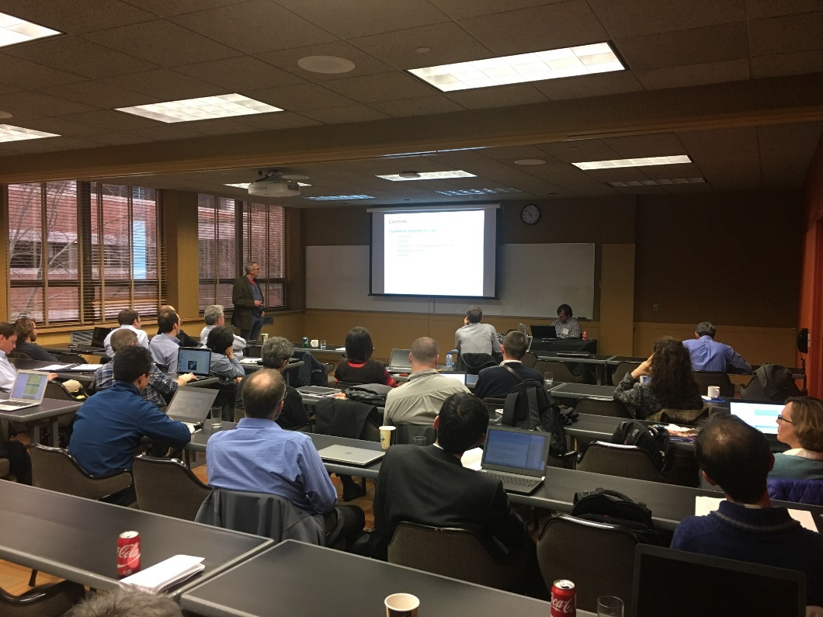
Summary report in WG4
~Cryomodule design, assembly and performance~
Chris Compton (MSU), Stéphane Berry (CEA), Yasuchika Yamamoto (KEK)

Slide 2
Contents in WG4
16 talks: Y. Yamamoto, C. Grimm, T. Arkan, S. Miller, N. Bazin, T. Trublet, D. Victory,
C. Compton, M. Drury, K. Ozeki, R. Coy, G. Wu, F. He, T. Powers
Projects: FRIB, LCLS-II, STF-2, SPIRAL 2, IFMIF, SARAF, ESS, CEBAF, RIKEN, C-ADS
Contents: FRIB module design, assembly, alignment, database (TRELLO), performance,
magnetic shield, quality check
LCLS-II module design, demagnetization, performance, slow cooldown,
installation planning, microphonics
CEBAF module microphonics
SPIRAL 2, IFMIF, SARAF module design, assembly, magnetic shield
ESS module design, assembly, quality control
C-ADS module design, assembly, commissioning
STF-2 module assembly, alignment, installation, performance
RIKEN Linac module design, assembly, magnetic shield
Discussion: Magnetic shield, Hygiene, Microphonic, Radiations

Slide 3
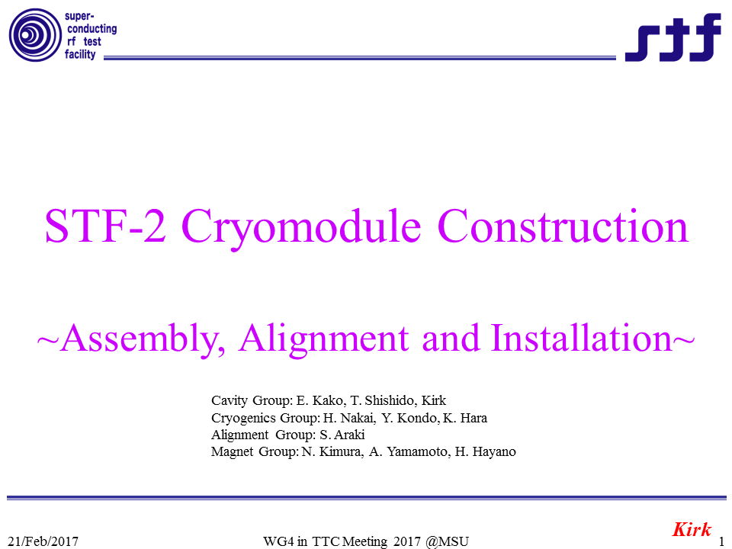
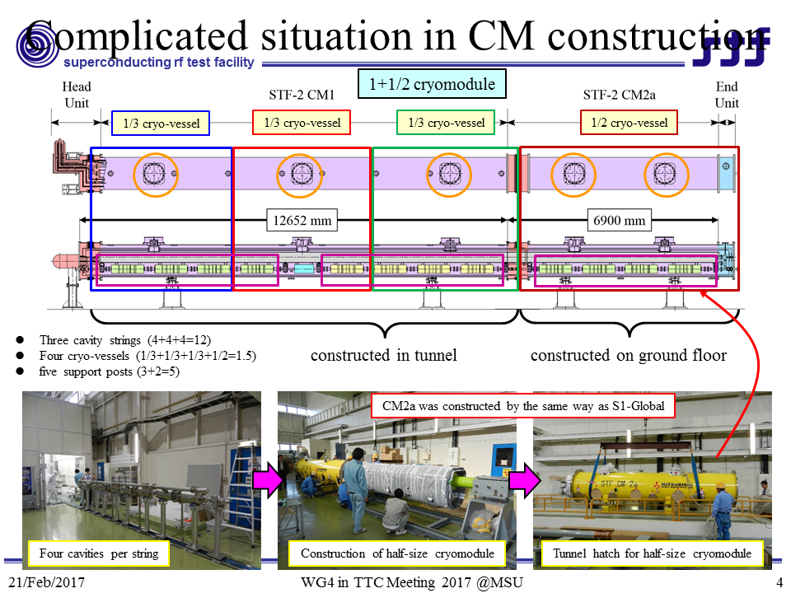
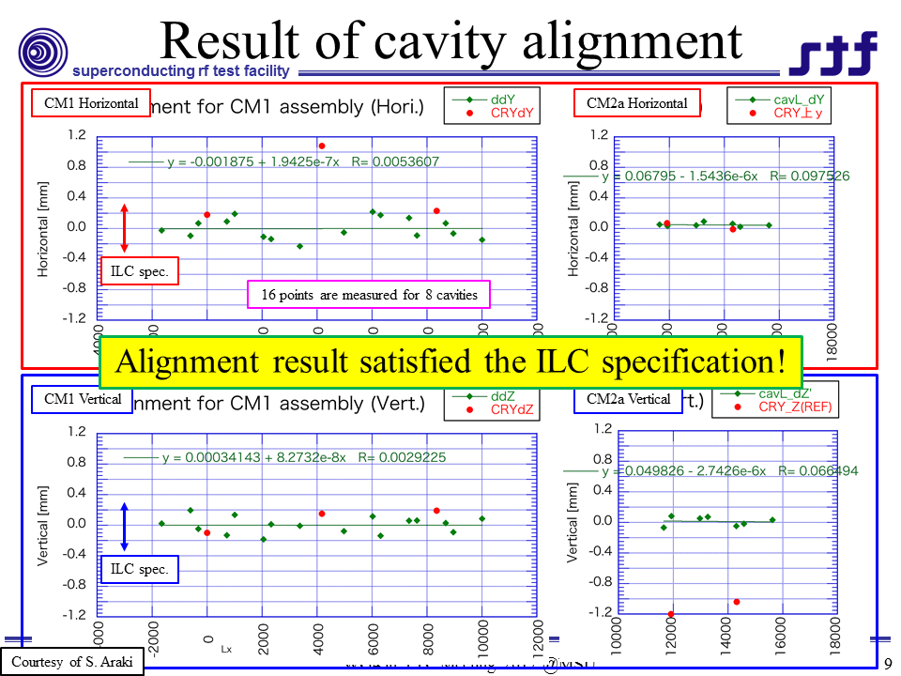
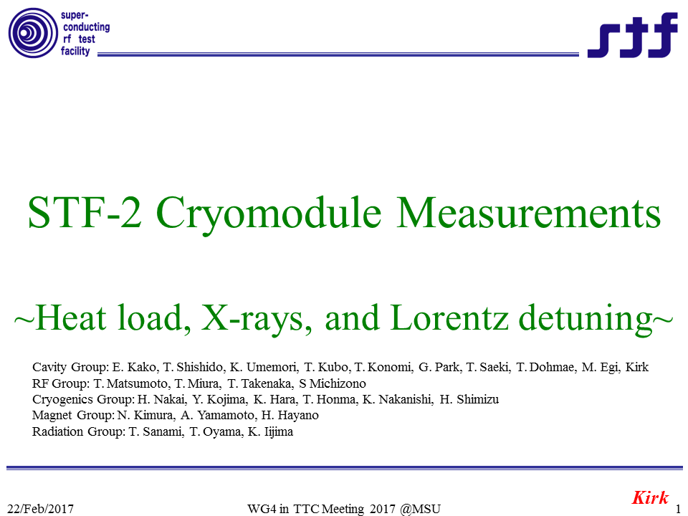
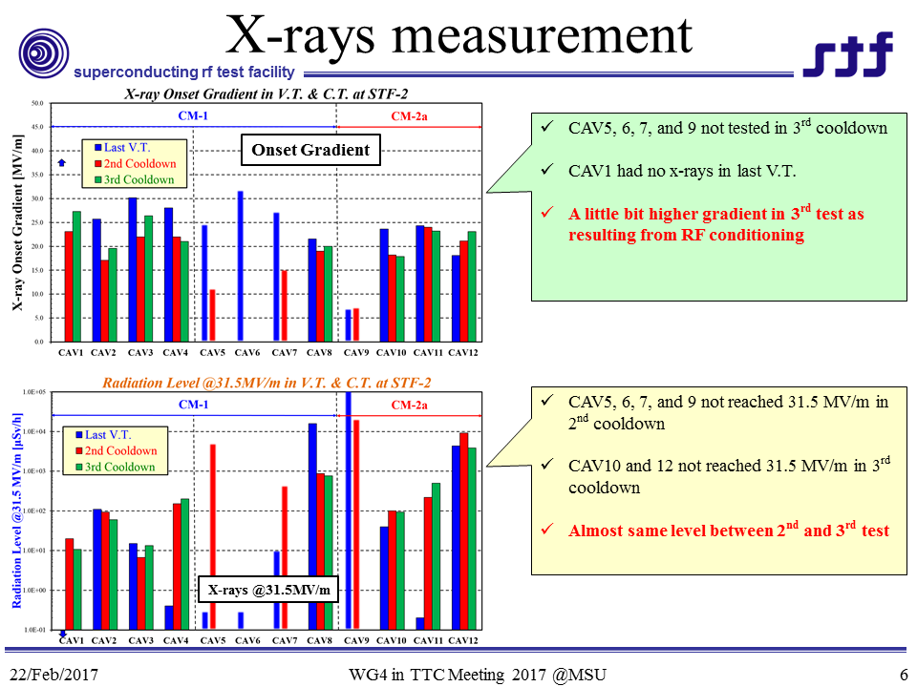
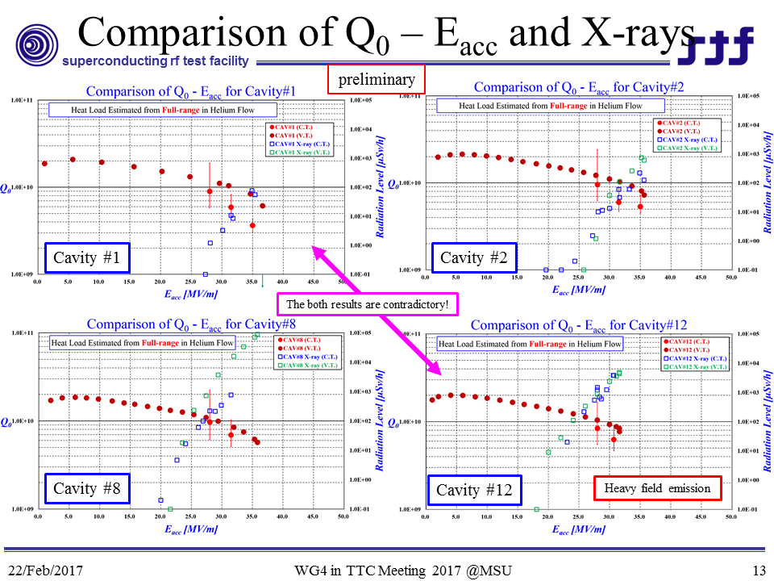
STF-2 Cryomodule Construction/Performance
Y. Yamamoto
Alignment was successfully done (<±0.3mm)
X-rays was never changed from 2nd to 3rd test
Heat load was estimated from helium mass flow
Q₀ was uniformly lowered for every cavity

Slide 4
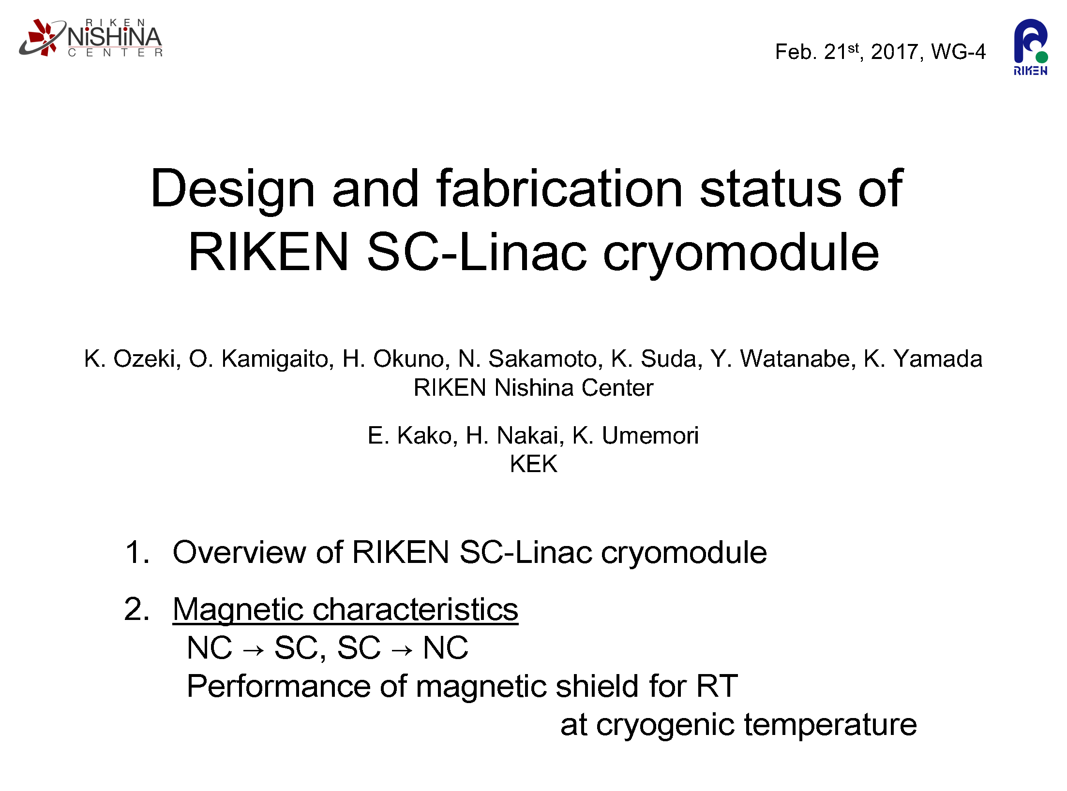
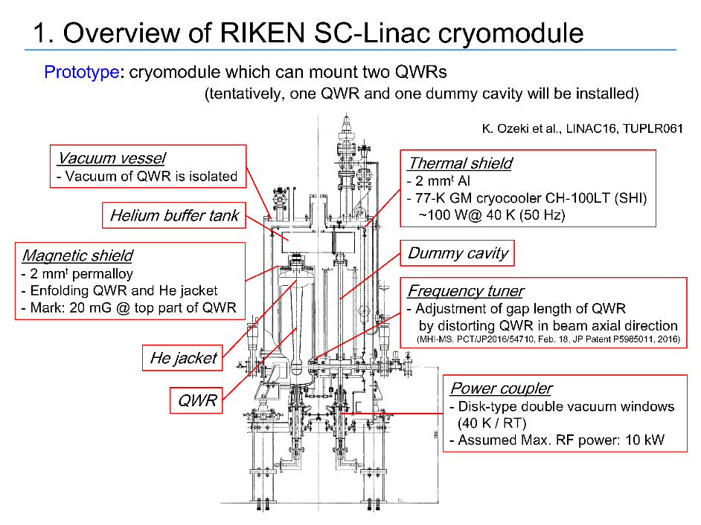
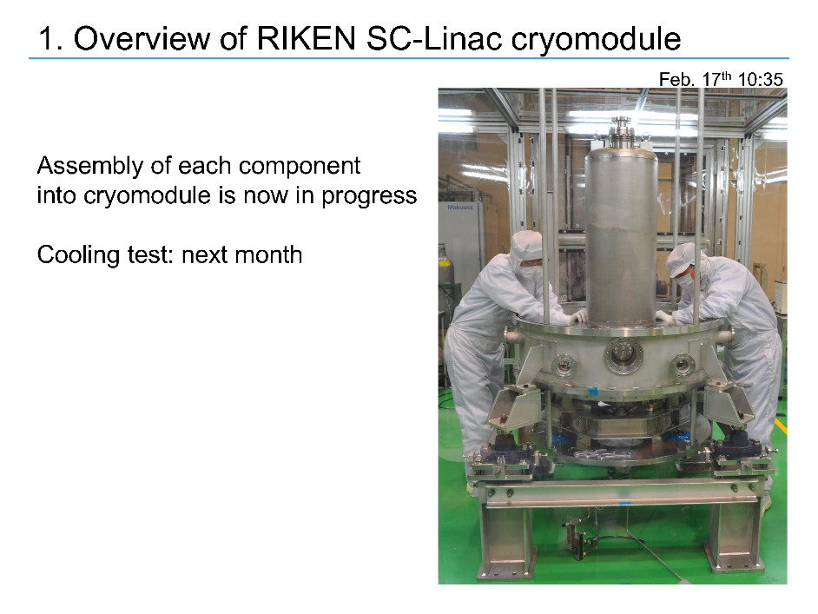
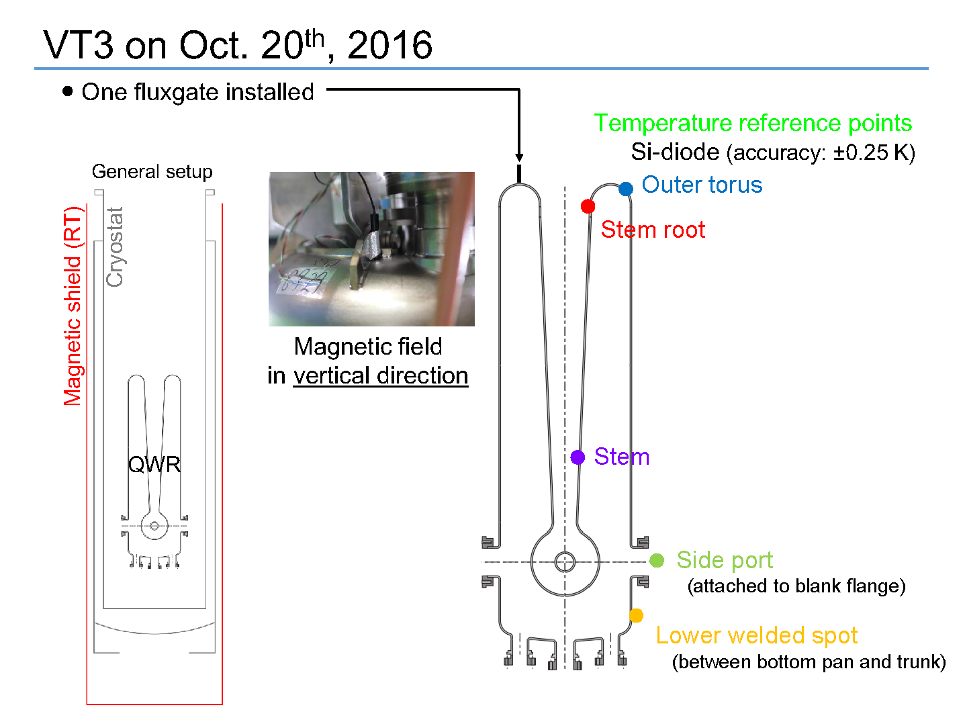
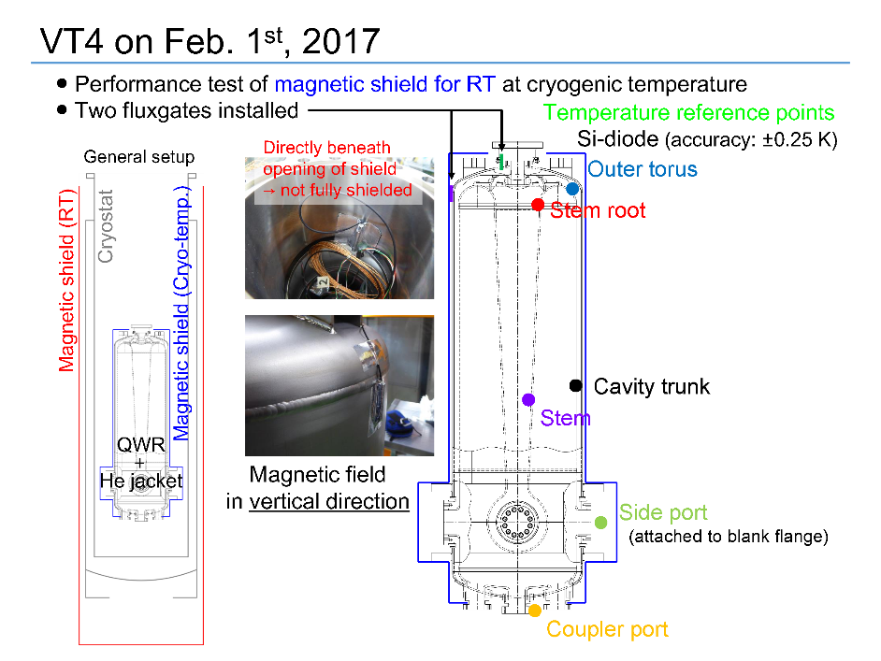
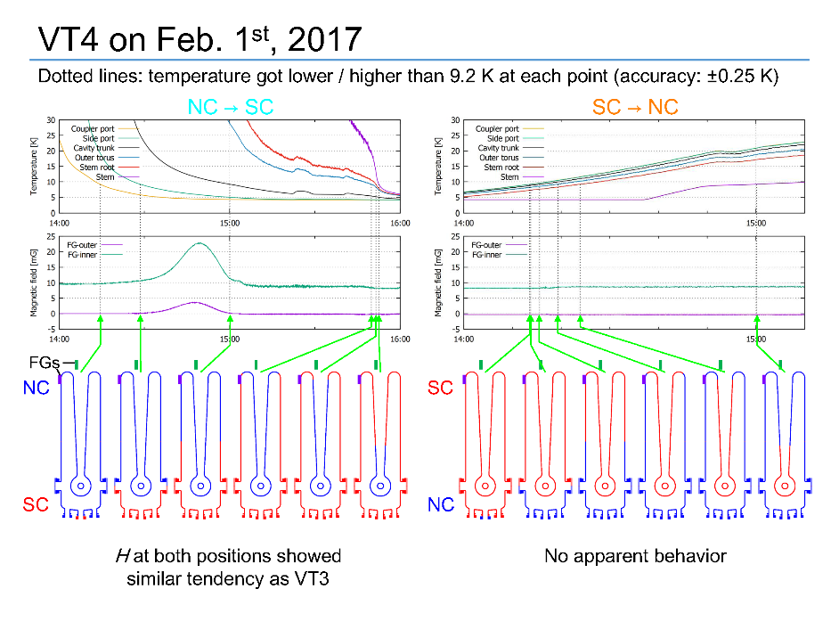
QWR Cryomodule for SC-Linac in RIKEN
K. Ozeki
RIKEN cryomodule is under construction
Magnetic shield study was done several times

Slide 5
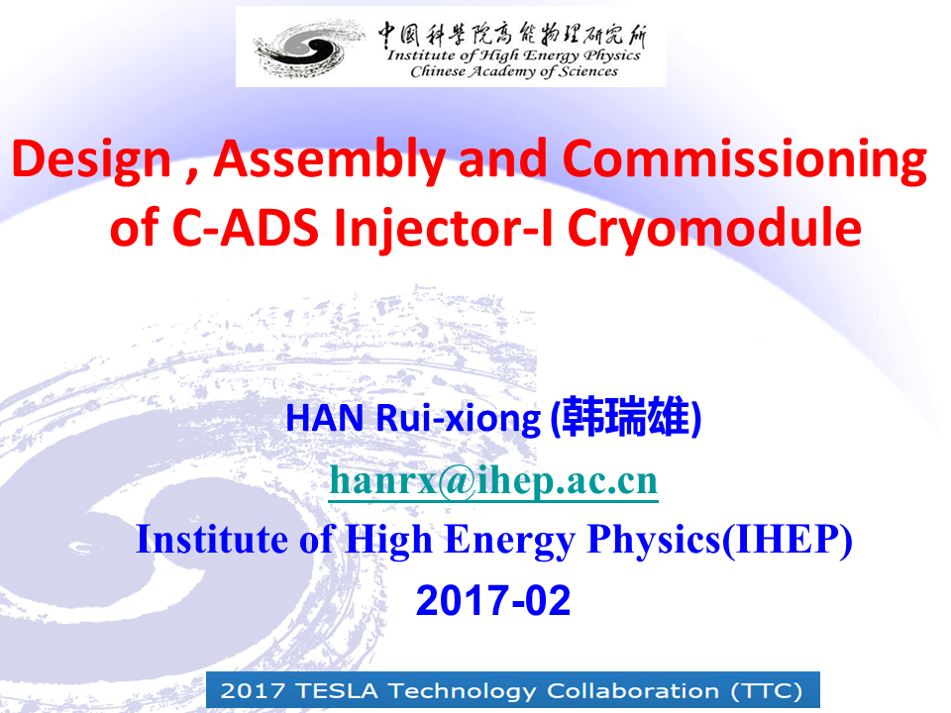
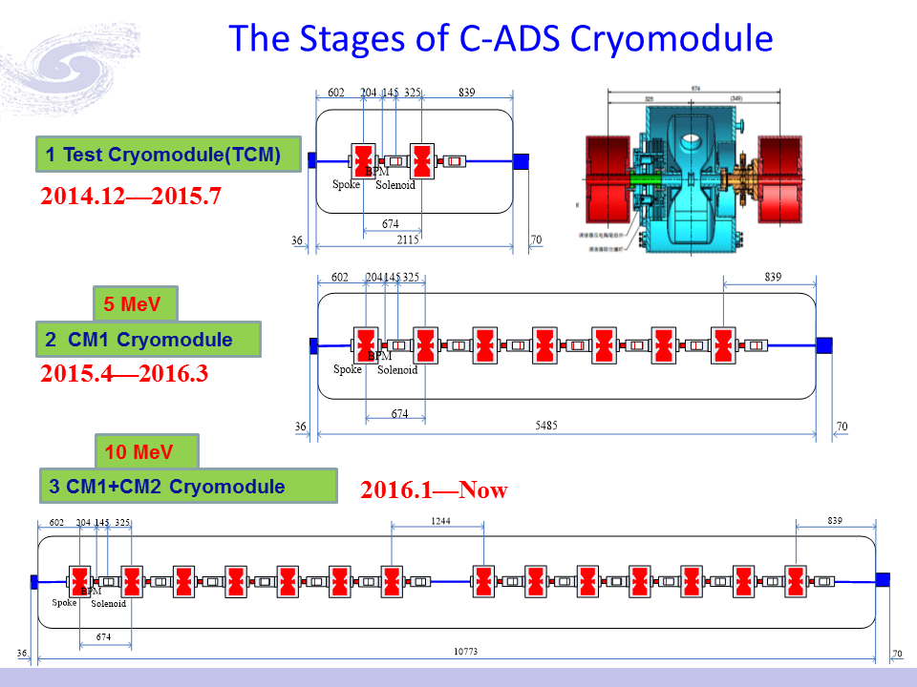
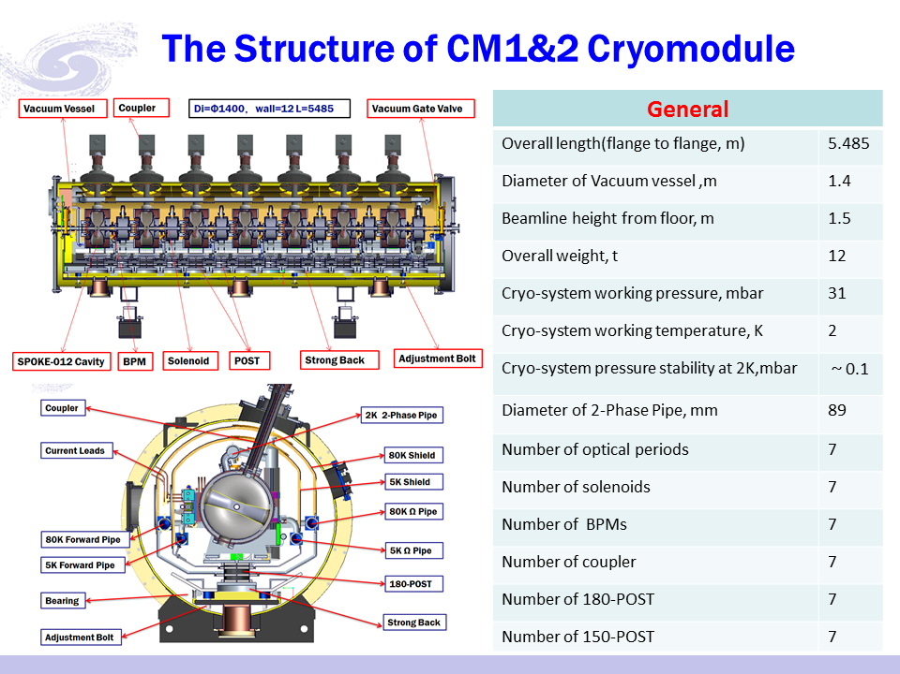
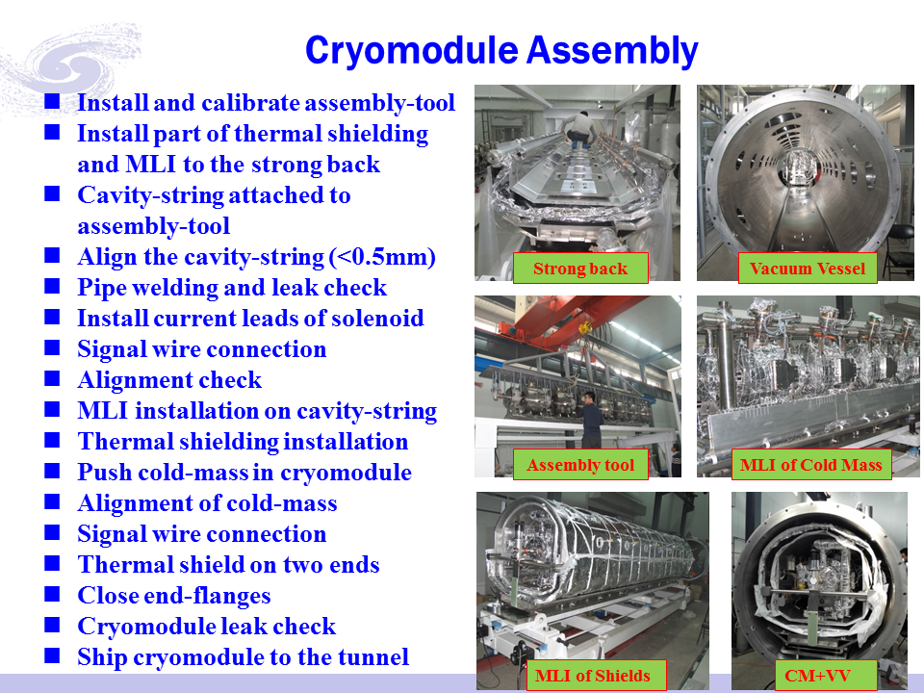
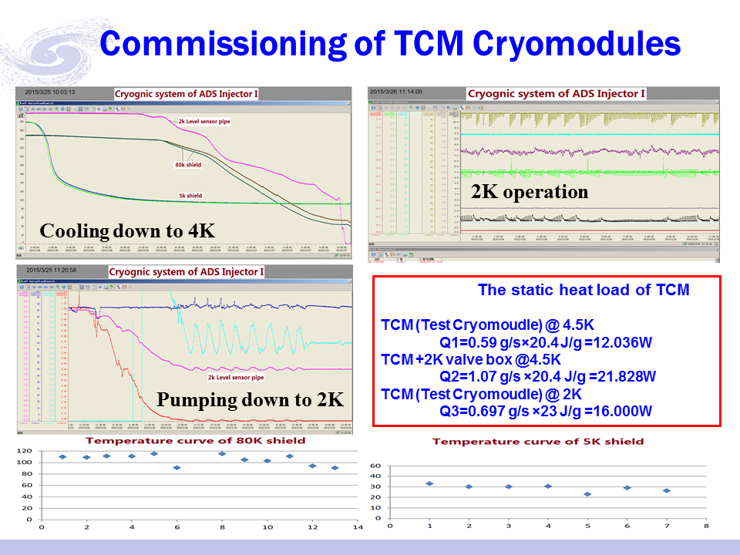
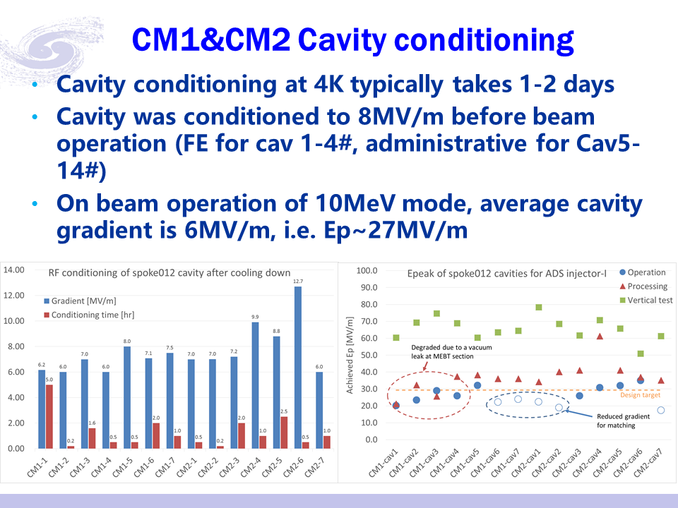
C-ADS Injector-I Cryomodule
F. He
C-ADS was continuously upgraded
Assembly work was successfully done
Beam commissioning already started

Slide 6
N. BAZIN
ISO5 is enough for low β modules Epeak=34.84 MV/m
Notes:
The low beta cryomodule experience from CEA had been presented by NICOLAS BAZIN
He pointed out that ISO5 is enough for low beta cryomodule

Slide 7
Many interfaces and small access: side→ top loading for SARAF and DONES
↙ Global magnetic shield installation
Panels directly installed on the inner surface of the vacuum vessel
↘ Magnetic
shield
hanging
from the
top plate
Notes:
Design choices have been explained taking in consideration their practical experience
From IFMIF the numerous interfaces to control due to side loading guide them toward top loading for SARF and DONES
From Spiral 2 global magnetic shield installation difficulties they decided to go for panels directly installed on the inner surface of the V V
But recent pre assembly on IFMIF convive them to choose a magnetic shleld attach to the top plate for SARAF

Slide 8
2 cavities OK 4 couplers OK
Mock-Up Activities finished
First mβ prototype module started
T. TRUBLET
6 cavities fabricated (4 with Helium tank)
The component procurements for series cryomodules are progressing well

Slide 9
FRIB
3 talks: S. Miller, D. Victory, C. Compton
Contents: FRIB module design, assembly, alignment, database (TRELLO), performance,
magnetic shield, quality check

Slide 10
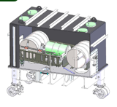
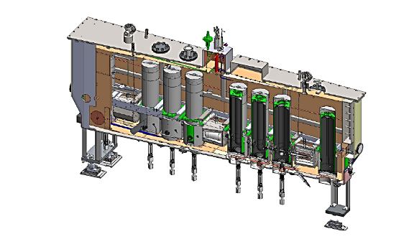
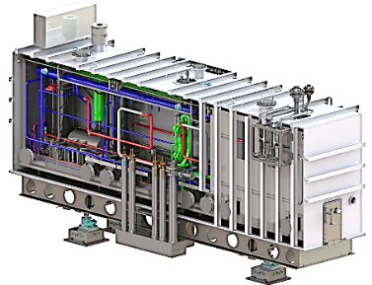
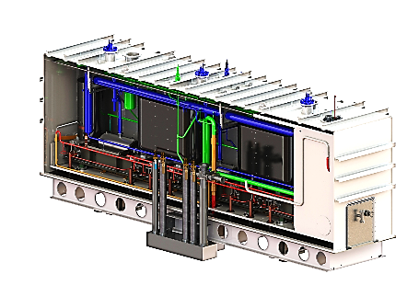
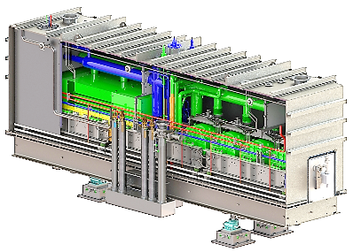
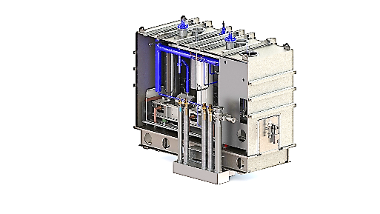

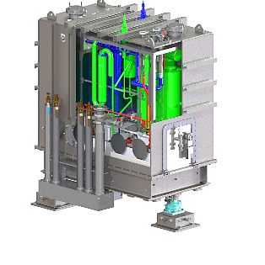
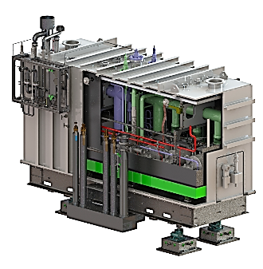
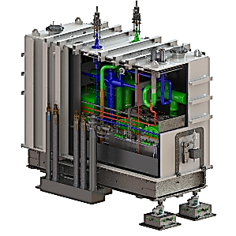
FRIB Cryomodule Road Map
ETCM, tests completed in 2013
ReA3 commissioned in 2014
ReA6/FRIB QWR-completed construction
on-line testing – Done
FRIB QWR preproduction 2015
Mass production 2016
FRIB HWR preproduction construction 2016
Testing in new SRF bay in 2016/17
FRIB β=0.041 QWR design complete in 2016
FRIB β=0.085 QWR Matching design complete in 2016
FRIB β=0.53 HWR Matching design 60% Design Review
FRIB β=0.29 HWR design complete in February 2017

Slide 11
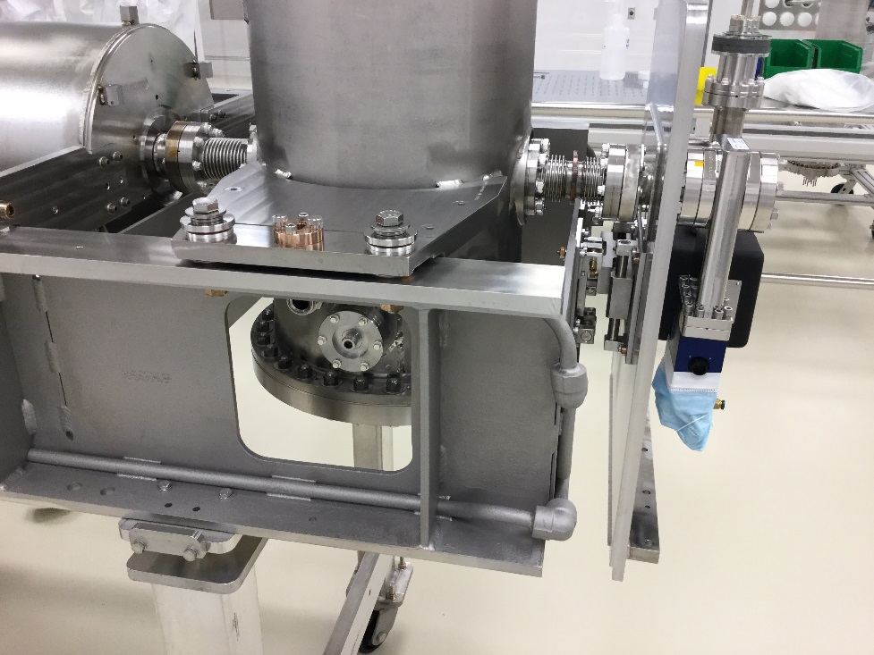
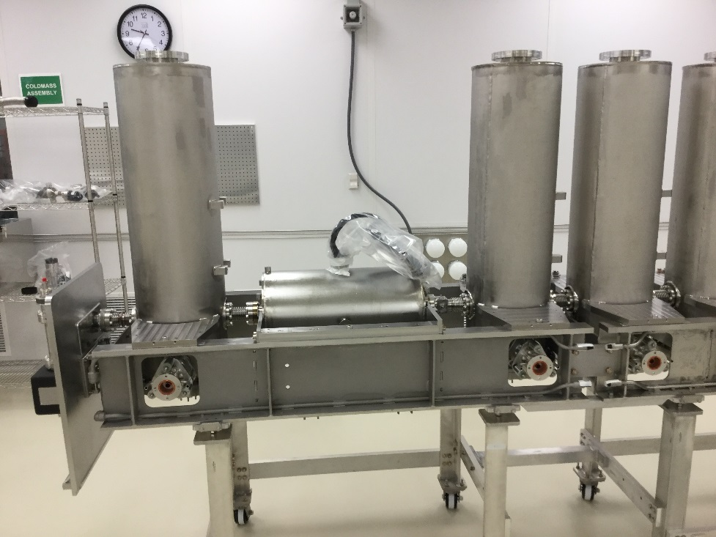
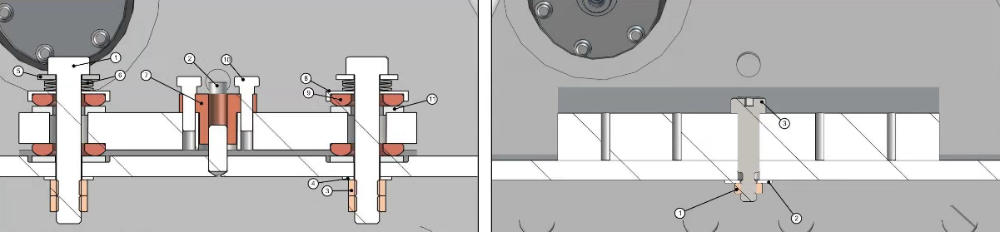
Alignment

Slide 12
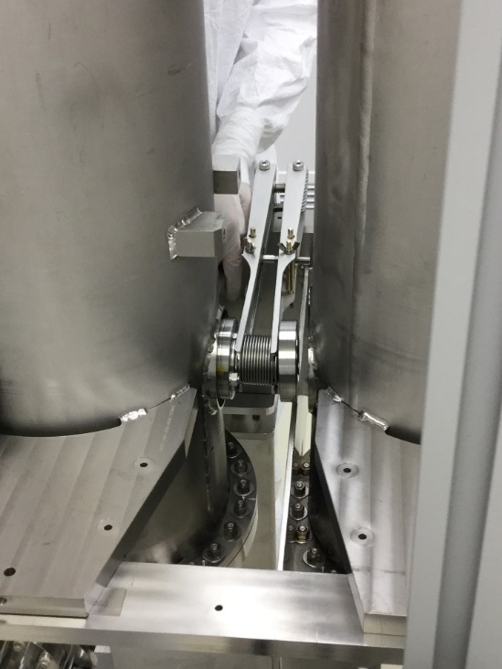
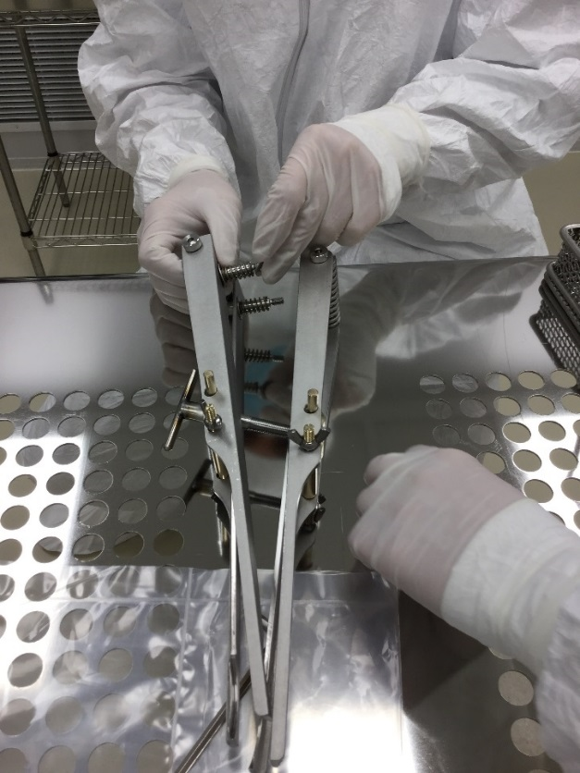
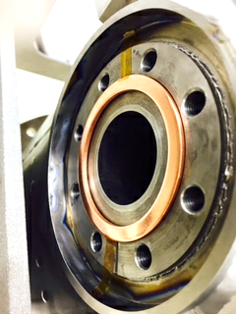
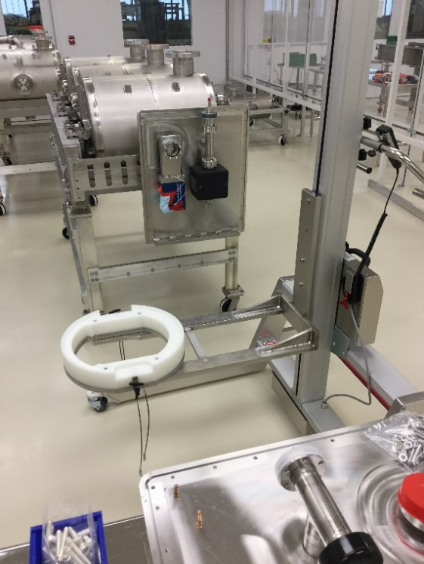
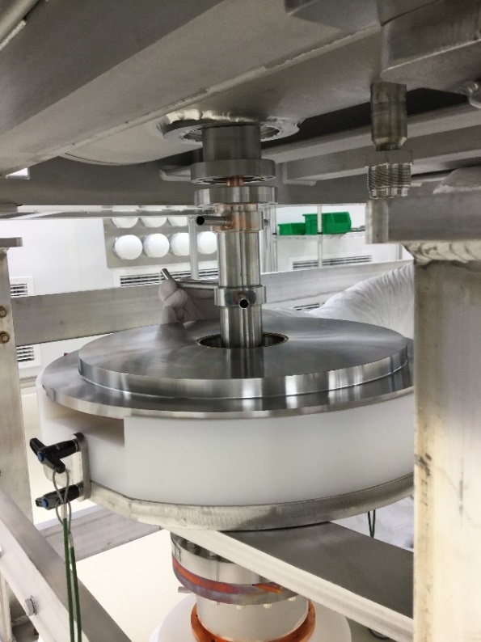
Cleanroom Installation Tooling

Slide 13
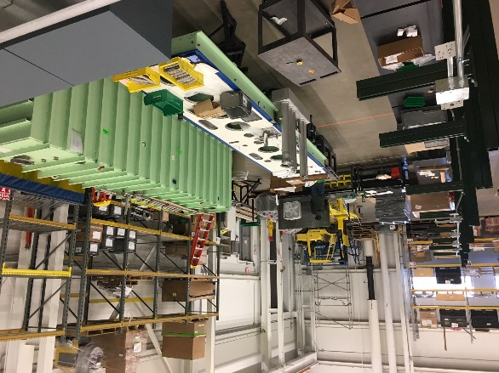
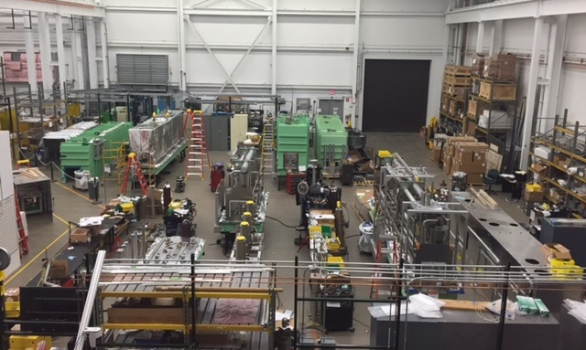
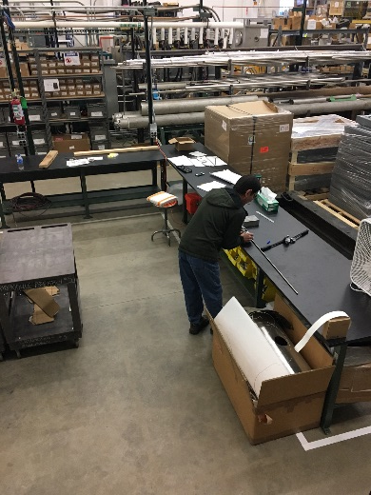
FRIB Cryomodule Assembly Floor
Bay #5
Bay #4
Bay #3
Bay #2
Bay #1
Subassembly Fabrication
- Four assembly bays ongoing, fifth assembly bay started in February 2017
- Two commissioned cryomodule test bunkers
Additional space for subassembly fabrication (solenoid leads, O-rings, G-10 posts)
2 overhead cranes
2 loading bays for coldmass and completed cryomodule transport

Slide 14
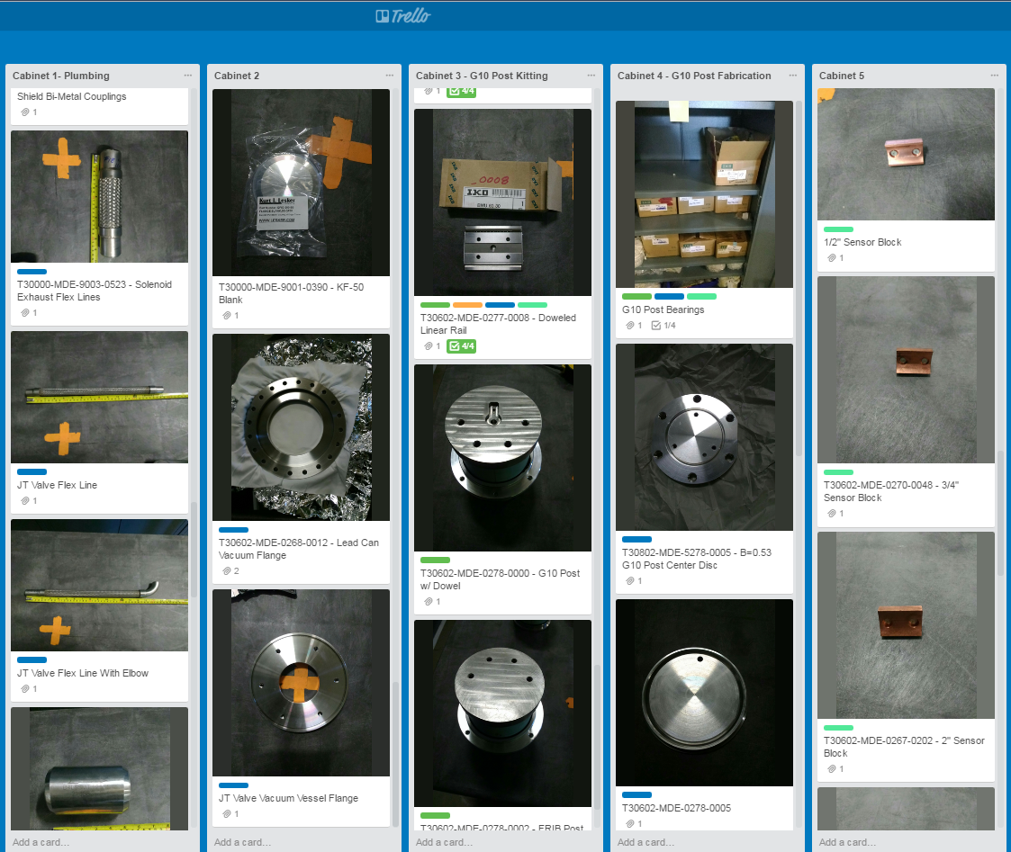
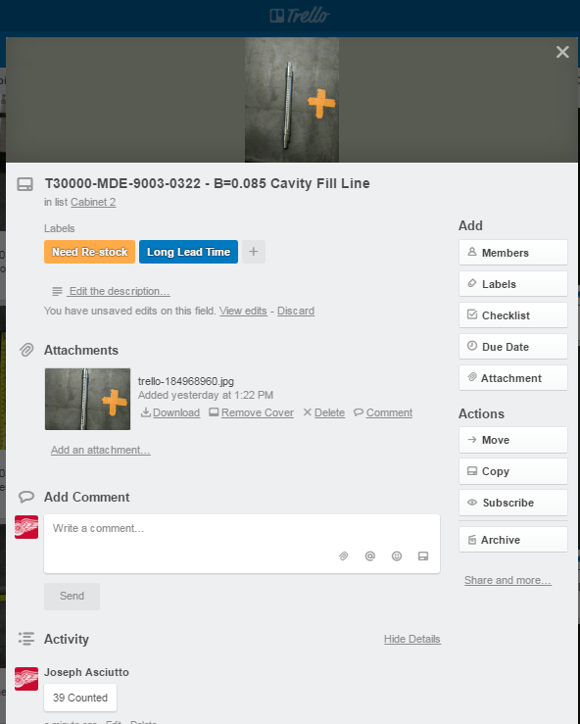
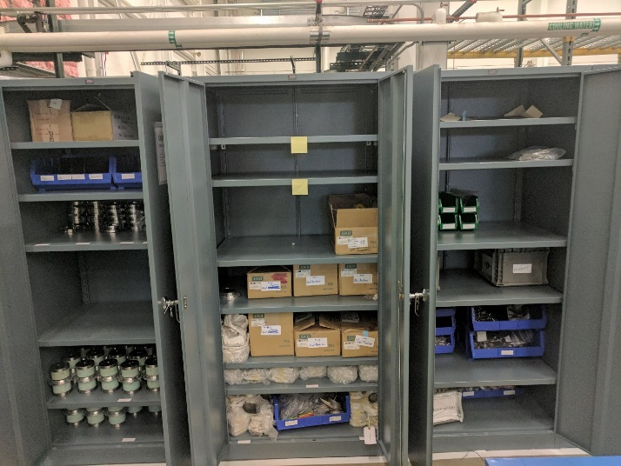
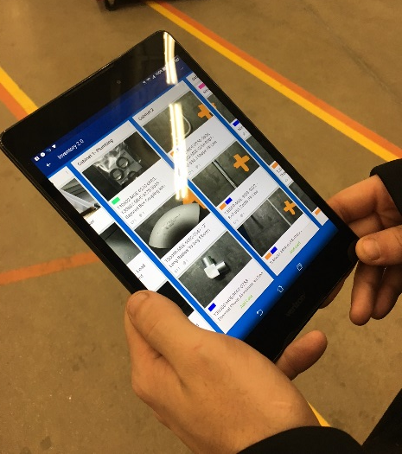
Inventory and Assembly Status Tracked using Trello (electronically)

Slide 15
LCLS-II
6 talks: C. Grimm, T. Arkan, M. Drury, R. Coy, G. Wu, T. Powers
Contents: LCLS-II module design, demagnetization, performance, slow cooldown,
installation planning, microphonics

Slide 16
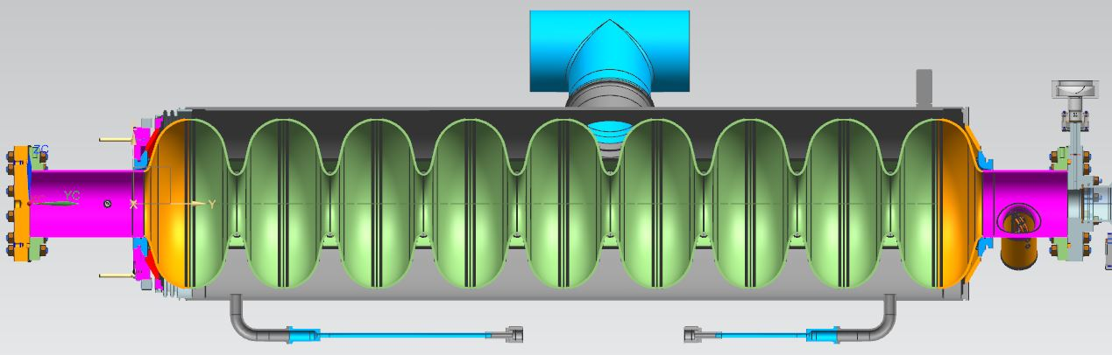
LCLS-II Cryomodule Design Considerations
Cavity - Helium Vessel Design
Cavity standard 9-cell Telsa style long-short
New surface treatments (i.e. N2 doping) for higher “Q”
  Many talks at WG1: “Performance Frontier”
Higher heat loads due to CW operations resulted in:
  Larger chimney pipe from helium to 2-phase pipe
  Larger 2-phase pipe 4” O.D. (~101mm) for low velocity vapor flow
Uniform/fast cool-down means two cool-down ports in each helium vessel
Input coupler design for 7 kW CW plus some margin
  A modification of an existing pulsed coupler design (TTF3) involving better heat transfer from and cooling of the inner conductor
  Detailed talk by Nikolay Solyak WG3 “Cavities, Tuners and Couplers”

Slide 17
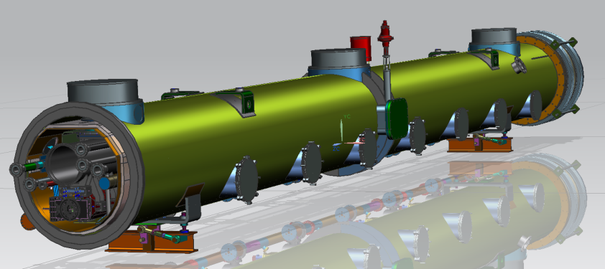
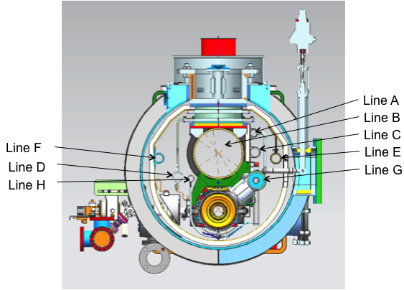
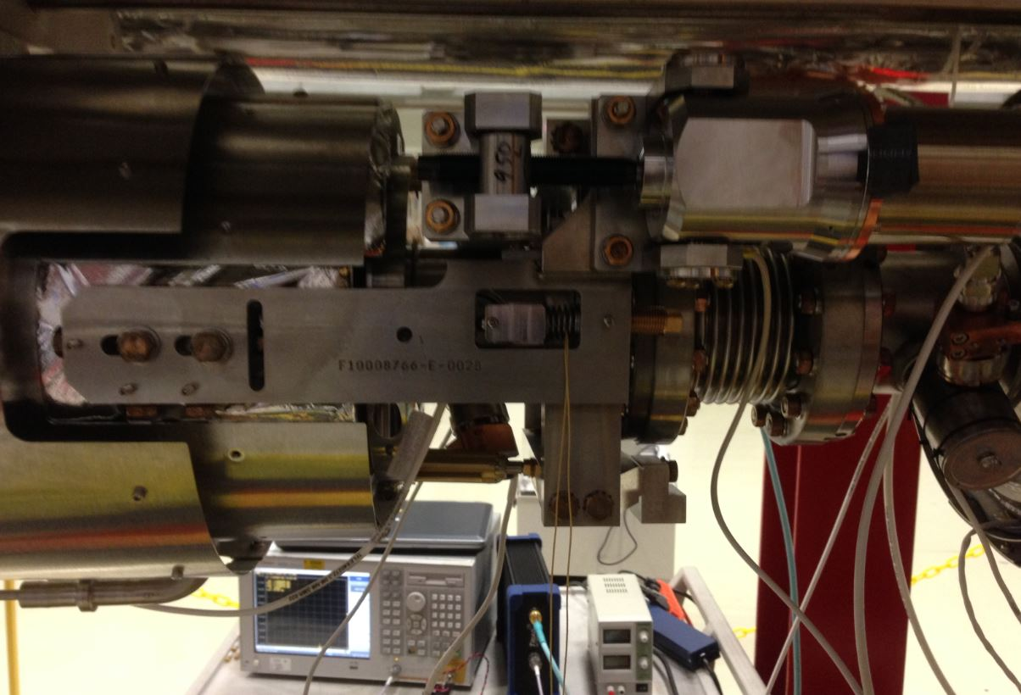
LCLS-II Cryomodule Design Considerations
Cryomodule Design
LCLS-II Cryomodule Line Designation
View From Rear Showing Tuner Access Ports and JT Valve Access
Motor Mounts
Piezo

Slide 18
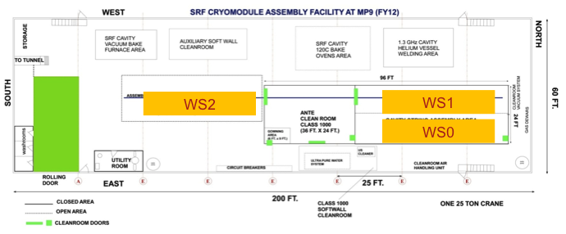
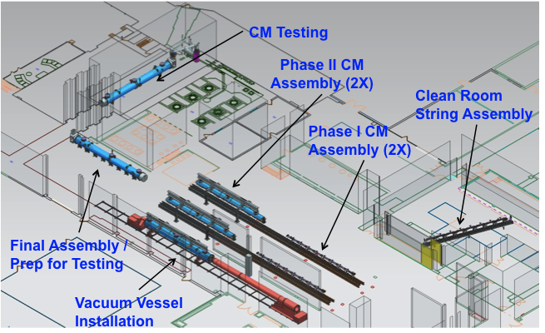
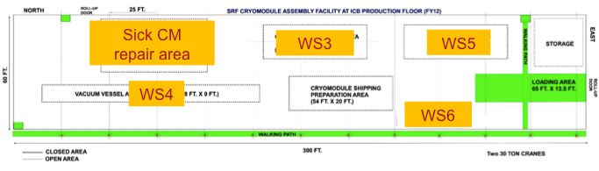
LCLS-II Production
FNAL
JLab

Slide 19
LCLS-II Schedule Overview
SLAC Receive 1st CM
SLAC Install 1st CM
SLAC Install Last CM

Slide 20

CM Installation Workflow
Acceptance Testing
Physical Install
Alignment
HGRP Weld & Exam
2” Pipe Weld & Exam
Cryo Pipe Leak Test
Pressure Test - Full String
BLA Install
BLA Pump Down & Leak Test
MLI & Heat Shield Install
Insulation Vacuum Pump and Leak Test
5 Major Install Phases
Receiving / Acceptance Testing
  Criteria Established
Physical Install / Alignment
Welding Cryo Pipes
  Serial Install and Exam
  Pressure Testing per String
Particle Free Beamline Install
  Following String Welding
Insulation Vacuum

Slide 21




Temperatures and Magnetic Fields During Fast Cool Down
Top Cernox
Top Cernox
Bottom Cernox
Bottom Cernox
45-deg B
45-deg B
Transverse B
Transverse B
9.17 K
Top Cernox
Bottom Cernox
Transverse B
45-deg B
45-deg B
Transverse B
Bottom Cernox
Top Cernox
Fast Cool Down Successfully Demonstrated in a Cryomodule
G. Wu and E. Harms | 2017 TESLA Technology Collaboration at MSU

Slide 22
Cryogenic Measurement
Liquid level well controlled with the slope.
Heat load meets spec
  Dynamic heat load ~ 64 W (Specification ≤ 80 W)
  2K static heat load 10-12 W including feed cap and end cap (specification ≤ 7 W CM only)
  5K static heat load < 10 W including feed cap and end cap (Specification ≤ 17 W)
  45K static heat load < 79 W including feed cap and end cap (Specification ≤ 123 W)
Calculated by Renzhuo Wang
Notes:
Feed cap and end cap estimated to be 1-2 W based on radiation and conduction (T. Peterson)

Slide 23



Microphonics and GDR Unit Testing
GDR operations demonstrated in a non-standard (subcritical supply) cryogenic mode for a short period. Microphonics still exceeded spec.
LCLS-II Detuning Specification:
< 10 Hz peak detuning

Slide 24

LCLS II Overall Transfer Function Graph
46 Hz mode dominant in cavities 6, 7, and 8 but still present in other cavities.
All Modes (peaks) between 20 and 90 Hz are of concern.
High Q (narrow lines) indicate modes of more concern.
Transfer function from cavity 8 beam line strike to cavity frequency shift for all 8 cavities.

Slide 25

LCLS II Microphonics and JT Valve Vibrations, Cavity 4 Jan. 26
Accelerometer on JT Valve
+/- 0.2 G
Microphonics +/-60 Hz full scale.
Spectrum
Peak harmonic 1.8 Hz-rms
Note broad large vibrational modes
Time scale 25 seconds, Frequency scale 200 Hz.
Clear correlation, cause and effect less clear.

Slide 26
Lessons Learned

Slide 27





Thermoacoustic Oscillation
RT
4K
Cryogenic valves experienced high heat load and pressure wave.
Addition of wipers significantly reduced TAO.
Notes:
JLAB data showed 2-3g/s, no icing, 4-5 g/s icing

Slide 28
Magnetic Hygiene
Shield design concepts – single/double layers, fasteners
Types of shielding - material
Assemble practices
Thermal behavior
Flux expulsion – cryo circuit designs
Fast cold down can help to expulse flux but don’t relax on magnetic hygiene
Trade-off with cryoplant cost
Pay attention to welding process

Slide 29




Magnetic Shield Design Considerations
LCLS-II
FRIB
Spiral 2
Need to ease assembly
PEM nut panel connections
Duel Layer Tank Shields
2nd Layer Center Section Removed for Clarity

Slide 30




Magnetic Field Management
13 Magnetometers indicate the remnant field < 1 mG (Specification ≤ 5 mG)
LCLS-II pCM
C50-13

Slide 31
Microphonics
How to measure
What does the measurements mean
What really hurts you – focus on the right range
Methods and ideas to attack the problem
  Absorption/Dampening materials
  Insulation concepts
  Mounting and Bracketing ideas/concepts
    Both internal and external to cryomodule
How to measure the pressure fluctuations in liquid helium
Cryogenics piping need some effort to simulate the different modes
T. Powers recommands to record tranfert function at different stages of the cryomodule production (may help to fix microphonics issues)

Slide 32
Microphonic Effects For Cavities With Large Loaded-Q’s
The structural vibrations, which cause microphonic frequency shifts, are the same independent of the loaded-Q.
JLAB is the first lab to install and operate a large number of SRF cavities with relatively large loaded-Qs, 88 in CEBAF and 16 in the FEL.
The loaded-Qs on these cavities range from 2e7 to 5e7 with most of the cavities operated between 2.6e7 and 3.4e7.
A loaded-Q of 3e7 provides a controls bandwidth of 25 Hz, which presents its own set of challenges.
Operation with our 1990 vintage analog systems is possible but painful, mostly due to static Lorentz force detuning effects.
In about 2012, we stopped production of the C100 cryomodules after #3 of 10 was built in order to improve the design. The improvement was to double the thickness of a 1-inch tuner pivot plate it resulted in a reduction in microphonics by about a factor of 2.
Last spring we started a program to harden the cryomodules to outside effects.

Slide 33



Background Floor Motion in Tunnel
Accelerometer
Dangerous modes as the cryomodules and adjacent beam line components have overlapping resonances. For example, 21, 30, 41 and 120 Hz are observed driven modes.
Conversion from acceleration to motion is a double integral. Which means that it goes as $1/{ω^{2}}$
Low Frequency Motion in um
Fortunately the cryomodules do not have any strong resonances below 10 Hz

Slide 34

Waveguide Ceiling and Strut Bracing/Damping
Ceiling bracing improved
  provides 3-axis constraint.
  Has 1/8” 50 durometer sorbothane to damp vertical motion and to a lesser extent EW/NS motion.
Waveguide struts back to existing bolts on the cryomodule
  Provides 3-axis constraint of upper end of waveguides.
  Waveguide bracket uses ¼” sorbothane to damp EW and NS motion and to a lesser extent vertical motion.

Slide 35

Tuner Damper Ring
Lower tuner flange 6” OD, 1.5” thick.
30 durometer, 1/2” x 1” sorbothane with polyethylene tape on the inner surface in order to allow vertical motion.
Split ring with a nominal ID of 7” and with two 3/8” gaps for adjustment.
  Compression adjustment made by tightening the hose clamp while measuring the OD of the short axis of the split ring.
  Damper compression setting was tuned to minimize the transfer function from striking the cryomodule end can near the beam pipe to 10 Hz cavity vibration.
Green springs adjusted to relaxed state after cavity is cold and tuned.
Mounting plates fixed in place after compression adjustment insuring minimum lateral forces on tuner.

Slide 36






Modifications on CM2 to reduce vibration
Support the capillary line from upstream end liquid level probe to cavity#8 as it is done for cavity#1 (done)
Wrap warm/up-cool down capillary lines with MLI (done)
Stiffen the support for the JT line by adding some dampening material (done)
Stiffen the 2-phase invar rods by tying them together with fiberglass strings (done)
2-Phase line heater tied to pipe with fiberglass strings (done)
Larger diameter JT fill line to 2-phase pipe interface (with baffle), for better liquid level management. (not for CM02, will be implemented on CM03)

Slide 37
Tooling and Access
Specialty tooling
  Cleanliness
  Space constraints
Working in and around tight spaces
Access to internal component that may need service during operation
  Cold motors
Moving cryomodules and subcomponents
  Bottom up designs
  Top down designs
  Sliding rail systems
  Multiply motions – slide in then drop down

Slide 38






Cryomodule Transportation and Tooling

Slide 39





Rail Interface Systems
C100’s
LCLS-II CM02

Slide 40


Typical Tunnel Cross Section – Tight Installation Conditions
Cryomodule
Being
Transported
Installed
Cryomodule

Slide 41
Radiations
Electronics, EPDM gaskets and cabling damaging
Safety issues (personal)
Max dark current for machine operation
  These are all different concerns with different threshold

