Slide 1
On Trapped Flux Losses: Expulsion and dissipation mechanisms description
Mattia Checchin
TTC Meeting, MSU, East Lansing
22-Feb-2017

Slide 2
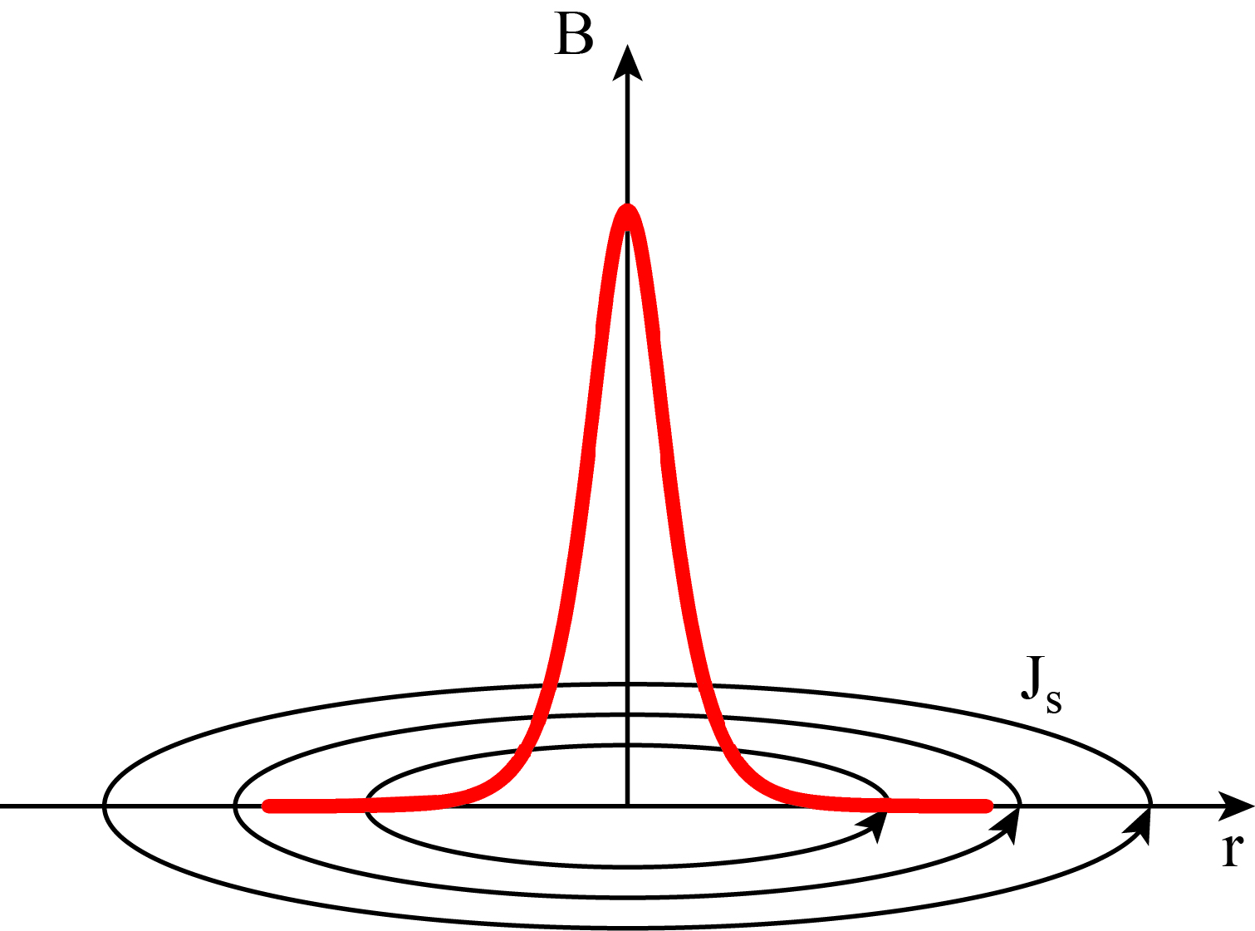
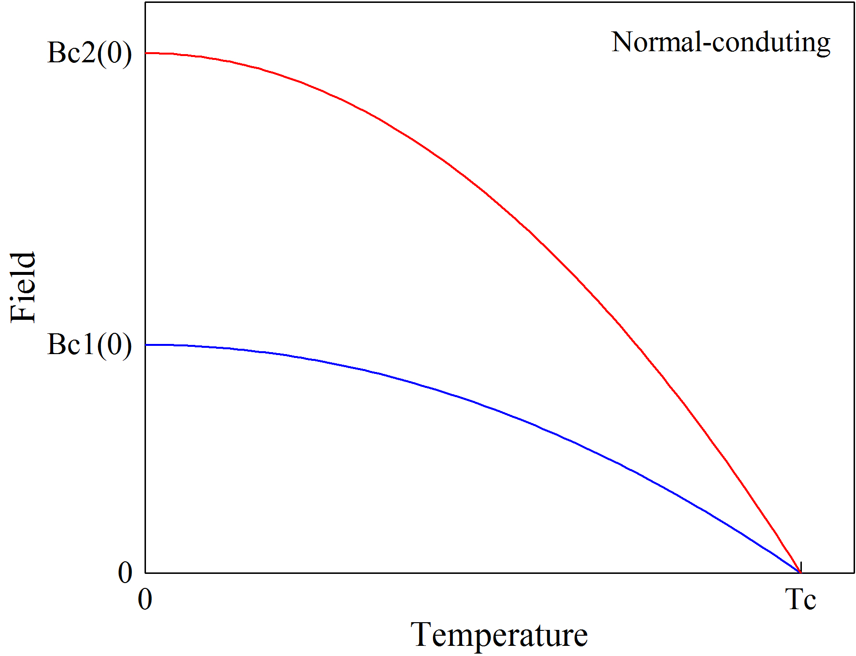
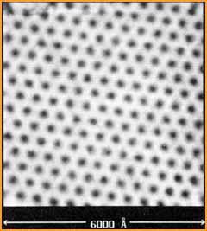
Trapped flux surface resistance
Vortex
Vortex lattice
$$R_{s}\left(T, B\right)=R_{BCS}\left(T\right)+R_{fl}\left(B\right)+R_{0}$$
$R_{BCS}$ ⇒ temperature-dependent part of the surface resistance
$R_{0}$ ⇒ intrinsic residual resistance
$R_{fl}=η_{t}SB$⇒ trapped magnetic flux surface resistance:
If pinned, vortices may survive in the Meissner state introducing dissipation
$η_{t}$—flux trapping efficiency
$S$—trapped flux sensitivity
$B$—external magnetic field
H. F. Hess et al., Phys. Rev. Lett. 62, 214 (1989)
$$B$$
Cooldown

Slide 3
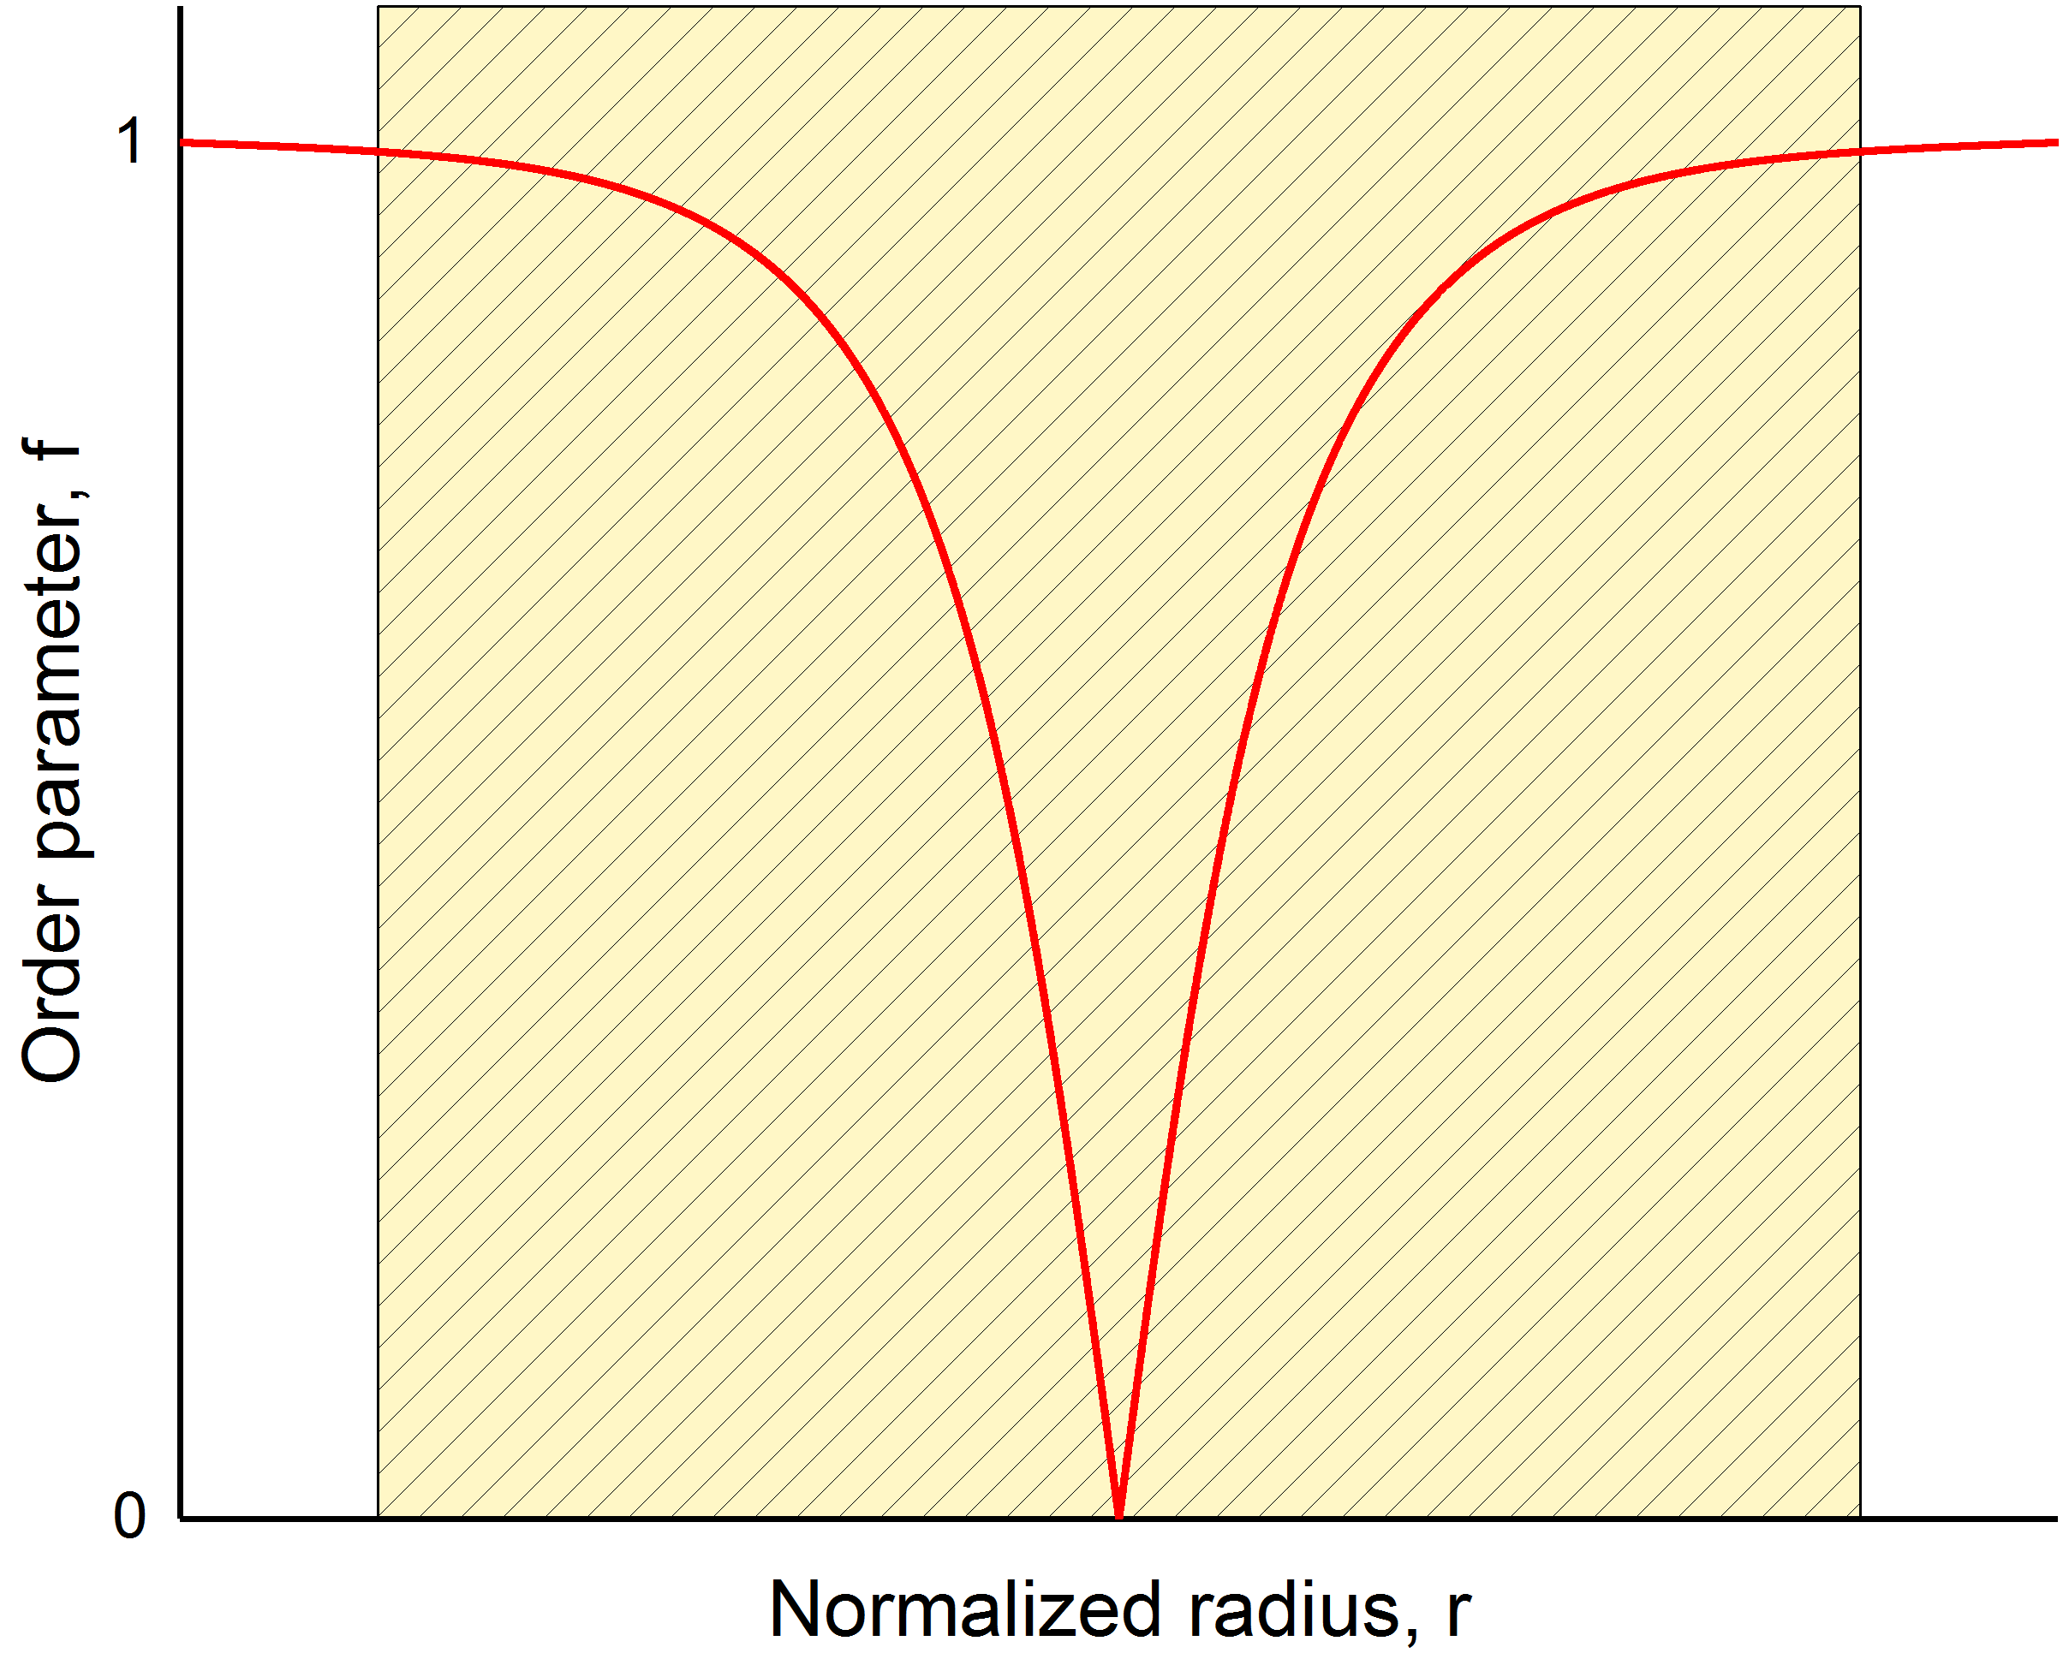
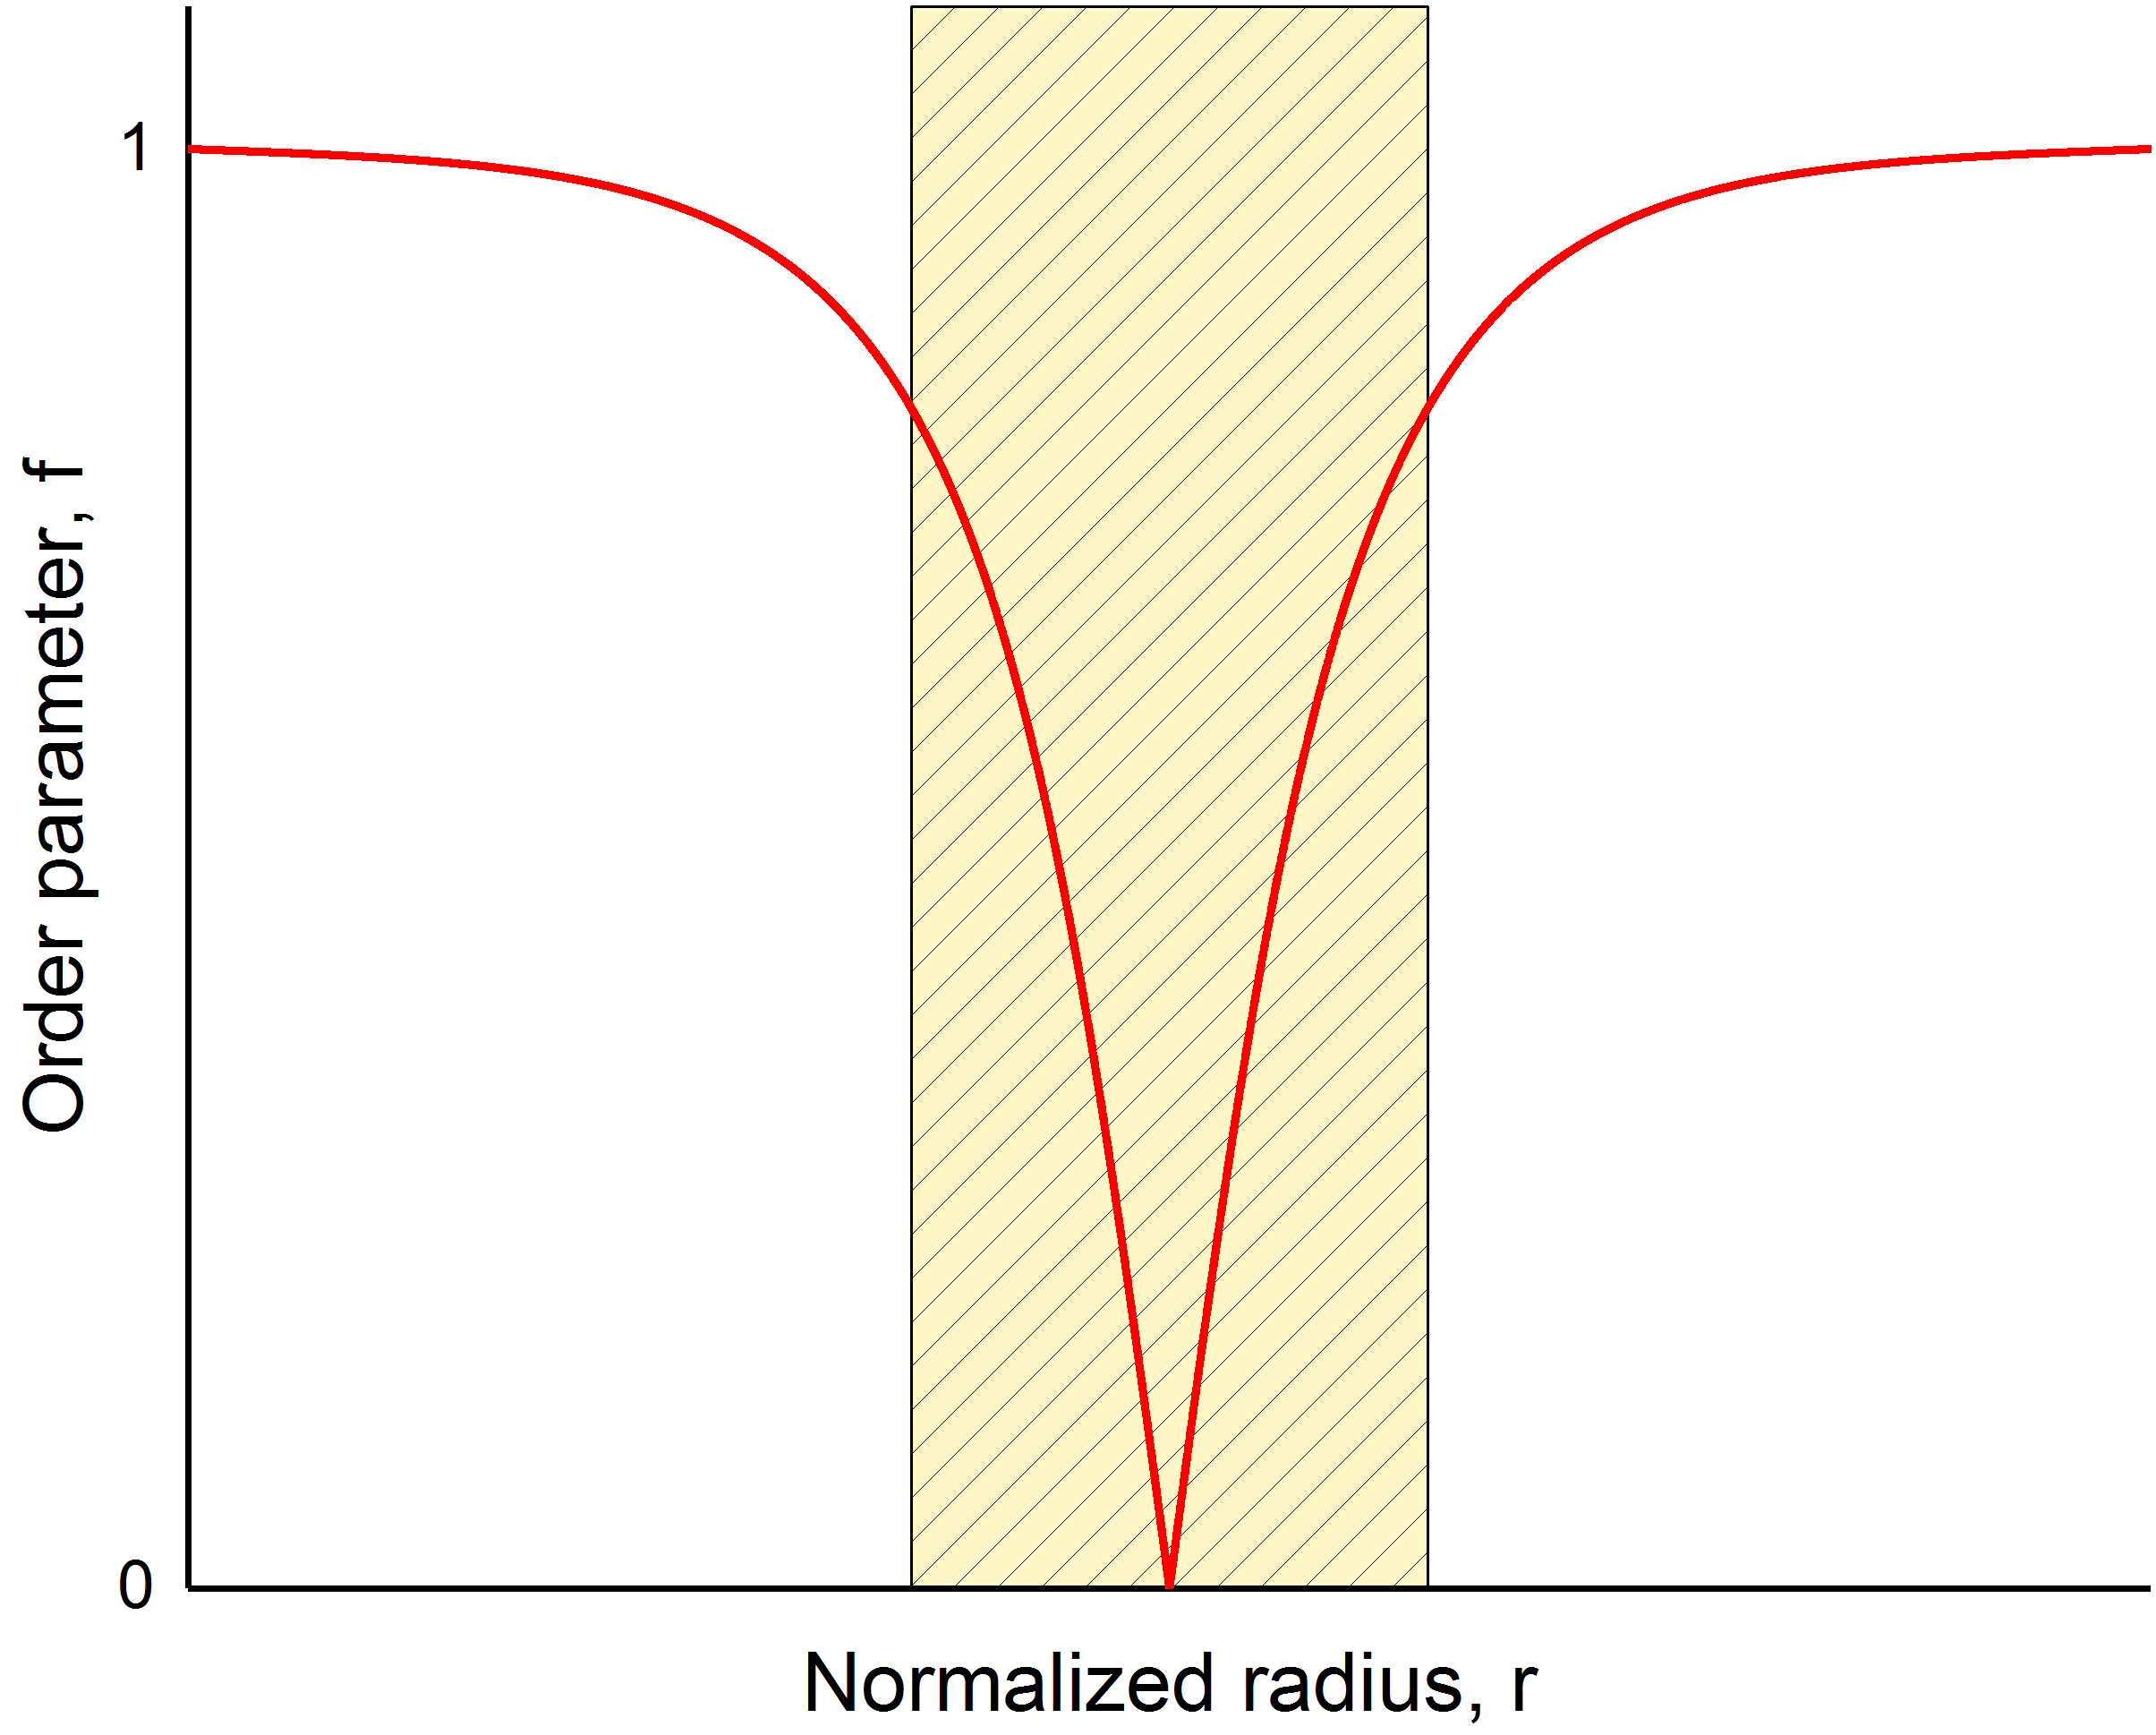
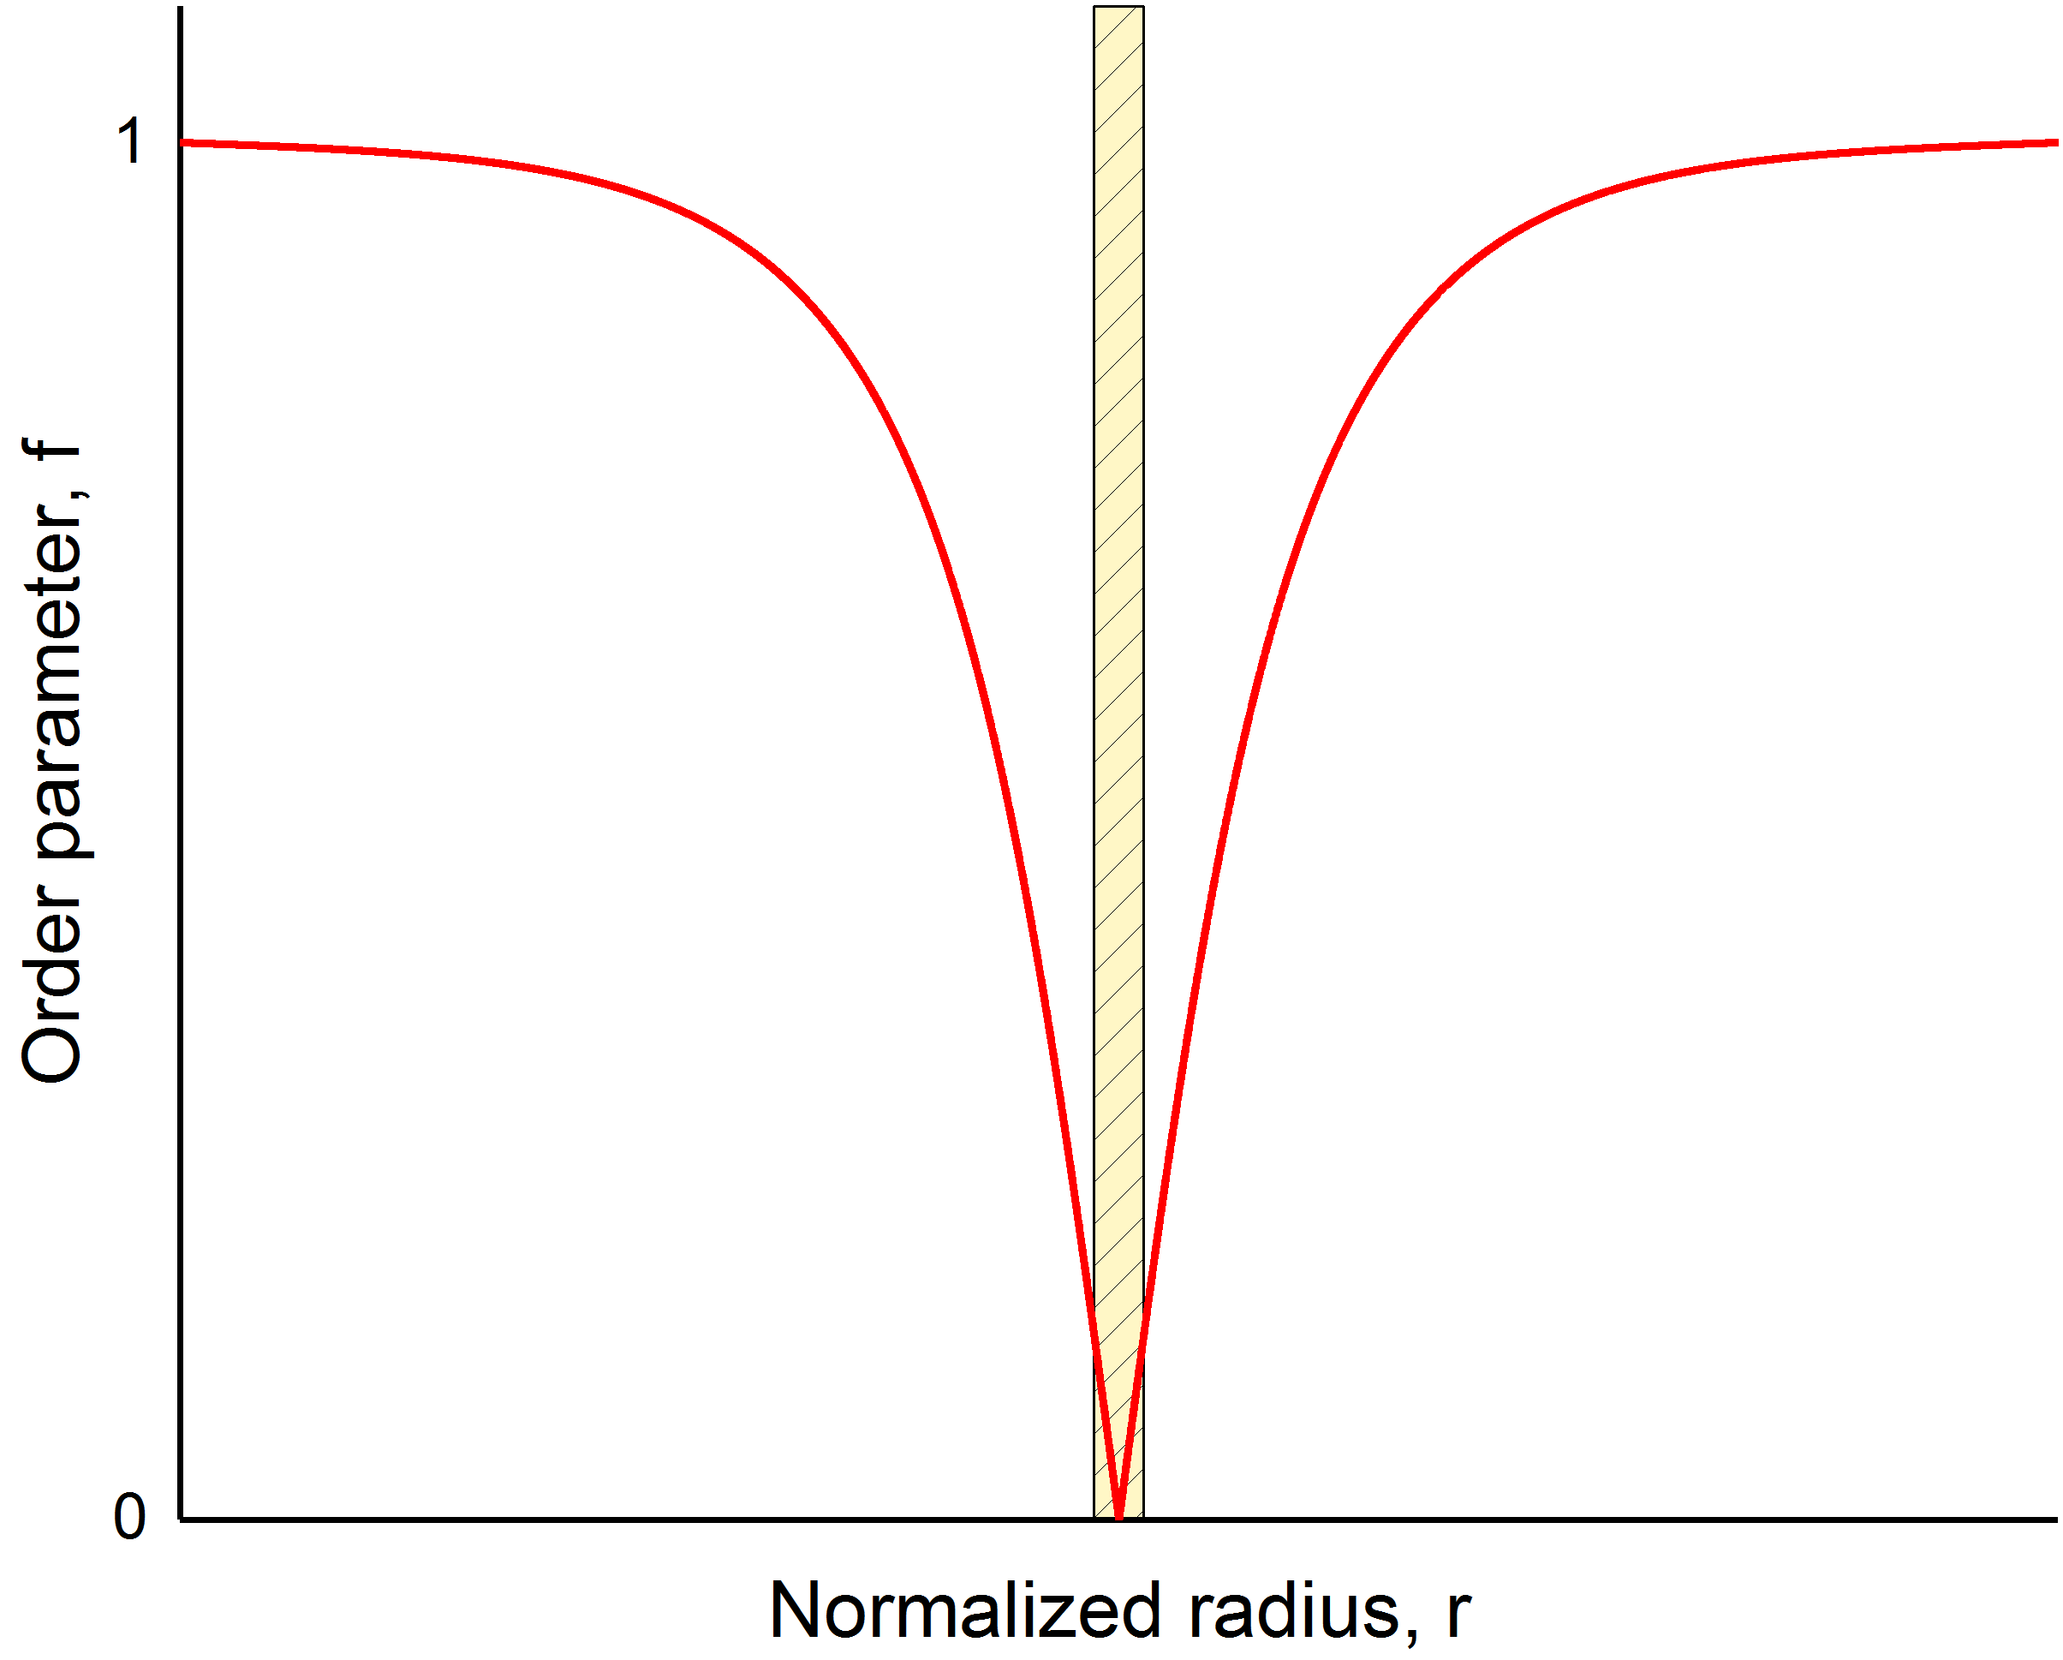
What is a pinning site?
Pinning sites are material imperfections or defects:
Normal-conducting and dielectric inclusions
Grain boundaries
Dislocations
Local disorder
Pinning $⇒$ minimization of the system energy
Vortex = loss in condensation energy
Defect = weak or not superconducting site
An efficient pinning center has dimension at least comparable to the coherence length $ξ$
For niobium $ξ≅10−38 nm$
$ξ$ is the characteristic variation length of the order parameter in the superconductor
Pinning Strength
Vortex
Pinning
center
$$\sim ξ$$

Slide 4
Flux Trapping Efficiency—$η_{t}$

Slide 5
Magnetic flux expulsion
Pinning points
$$y$$
$$x$$
$$T_{c_{1}}$$
$$T_{c_{2}}$$
Trapped vortices
Thermal gradient, $∇T$
The strongest pinning point will trap the vortex no matter whether it is on the surface or in the bulk
$⇒$ $η_{t}$ is a bulk property!

Slide 6
Thermodynamic force during cooldown (possible explanation)
The Gibbs free energy density defines the stability of vortices in the SC:
$$g(H)$$
Meissner State
Mixed
State
$$g=B(H_{c_{1}}(T)−H)$$
$$0$$
$$H$$
$$H_{c_{1}}(T)$$
We can define the thermodynamic force acting on the vortex as:
$$f=−\frac{∂g}{∂x}=−\frac{∂g}{∂T}\frac{∂T}{∂x}$$
$$y$$
$$g(x)$$
$$f$$
$$f=\frac{2BH_{c_{1}}\left(0\right)T}{T_{c}^{2}}∇T$$
$$f$$
Meissner State
Mixed State
$$x$$
$$T_{c_{1}}$$

Slide 7
Critical thermal gradient (possible explanation)
The pinning force acting against the expulsion is defined in terms of critical current density $J_{c}$:
$$f_{p}=\left|{ \overline{J}}_{c}×n{\overline{Φ}}_{0}\right|=J_{c}B$$
The minimum thermal gradient needed to expel vortices is the critical thermal gradient ${∇T}_{c}$ :
Pinning point
$$y$$
$$g(x)$$
$${∇T}_{c}=\frac{J_{c}T_{c}^{2}}{2H_{c_{1}}\left(0\right)T}$$
$$f_{p}$$
$$f$$
Meissner State
Mixed State
$$x$$
$${∇T}_{c}∝J_{c}∝f_{p}$$
$$T_{c_{1}}$$

Slide 8
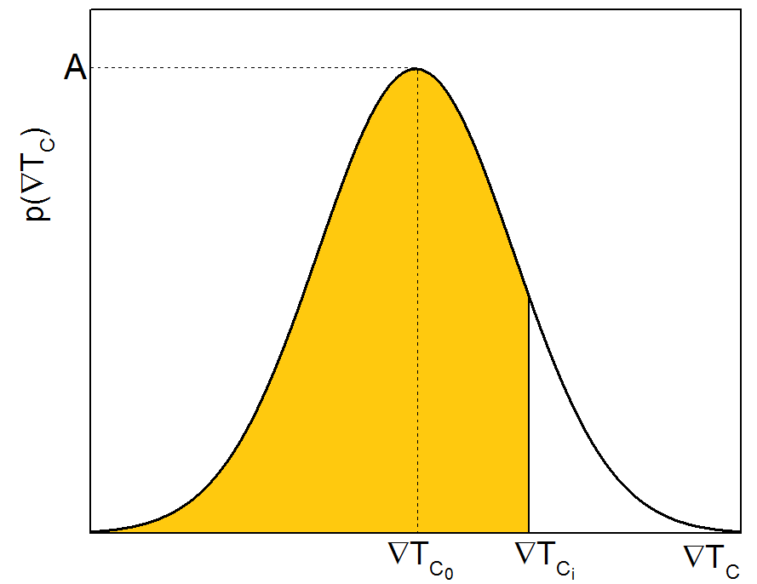
Statistical definition of the trapping efficiency
The probability of expelling vortices with the thermal gradient ${∇T}_{c_{i}}$ is $P\left({∇T}_{c_{i}}\right)$
The trapping efficiency $η_{t}$ is function of ${∇T}_{c_{i}}$:
The trapped field is then:
$$P\left({∇T}_{c_{i}}\right)$$
$$η_{t}=\left[1−P\left({∇T}_{c_{i}}\right)\right]$$
$$P\left({∇T}_{c_{i}}\right)=\int_{0}^{{∇T}_{c_{i}}}{p\left({∇T}_{c}\right)}d{∇T}_{c }$$
$$B_{t}=η_{t}B=B\left[1−P\left({∇T}_{c_{i}}\right)\right]$$

Slide 9
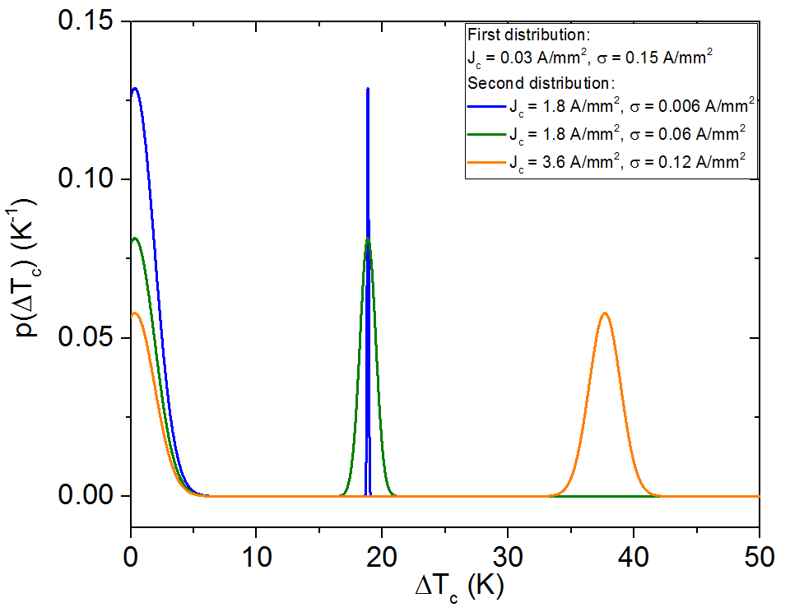
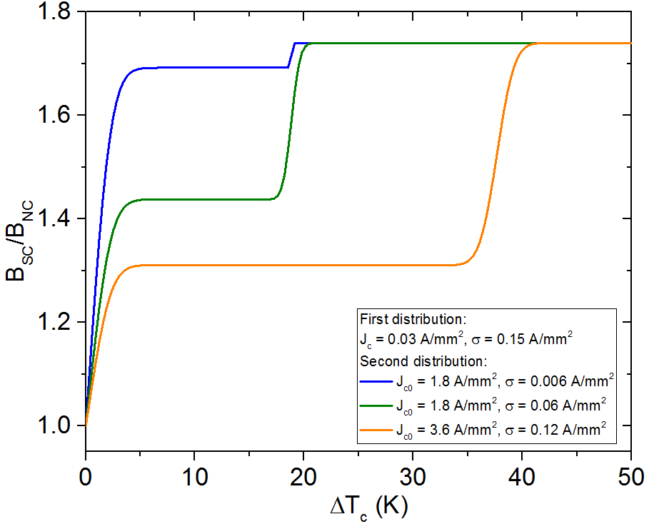
Double-peaked probability density function
Double distribution of pinning centers (e.g. dislocations + grain boundaries)
$p\left({ΔT}_{c}→0\right)≠0$ $⇒$ finite probability that vortices are not pinned
First plateau defined by the ratio of the two peaks’ area
Complete flux expulsion reached when ${ΔT}_{c}$ is larger enough so that $P\left({ΔT}_{c}\right)=1$

Slide 10
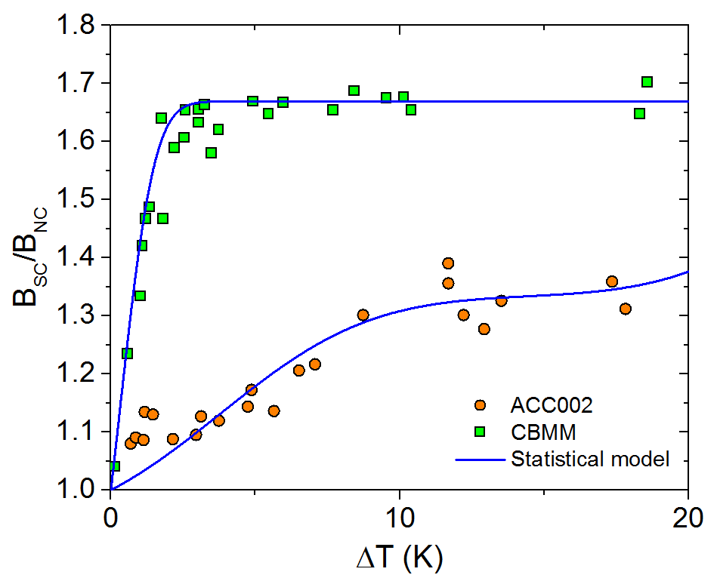
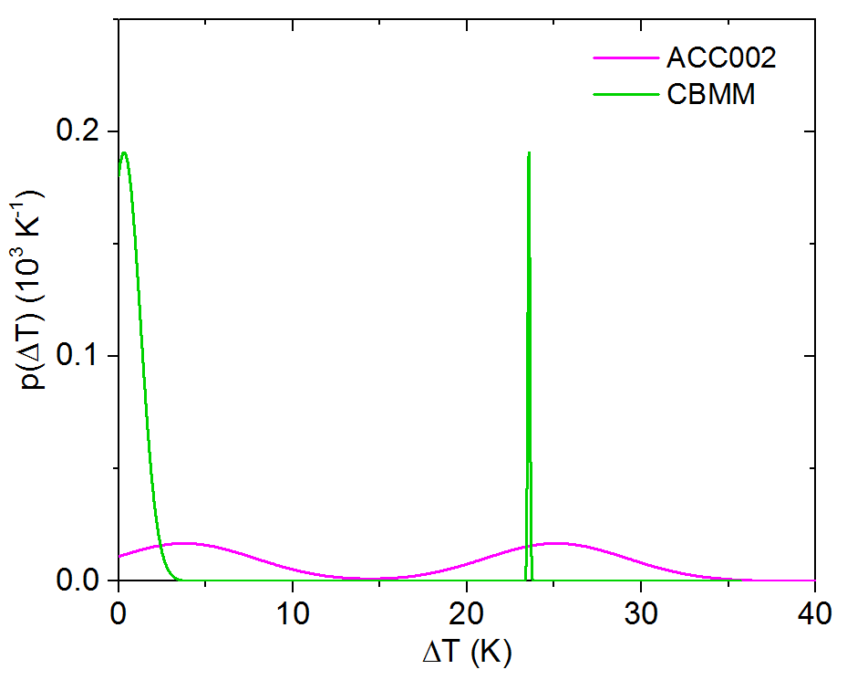
Comparison with experimental data
Magnetization measurements^{1,2} of niobium and niobium films close to $T_{c}$ show $J_{c}\sim 1−10 A/{mm}^{2}$.
The model returns $J_{c}$ in agreement with the literature ones:
Cavity name | $$<J_{c}>(A/{mm}^{2})$$
CBMM | 0.3
ACC002 | 1.6
exp. data: S. Posen et al., J. Appl. Phys. 119, 213903 (2016)
¹ G. Park, C. E. Cunningham and B. Cabrera, Phys. Rev. Lett. 68, 12 (1992)
² L. H. Allen and J. H. Claassen, Phys. Rev. B 39, 4 (1989)

Slide 11
Trapped Flux Sensitivity—$S$

Slide 12
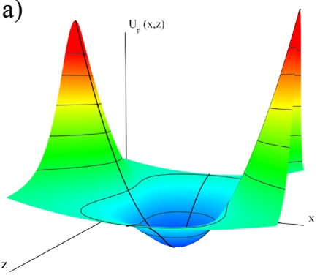
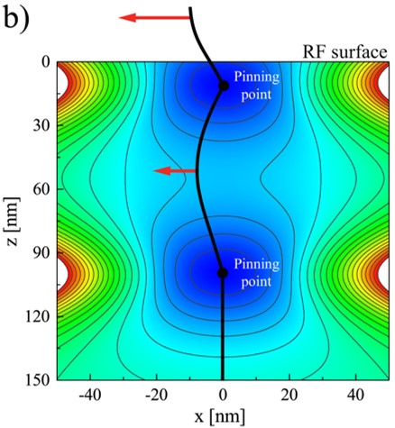
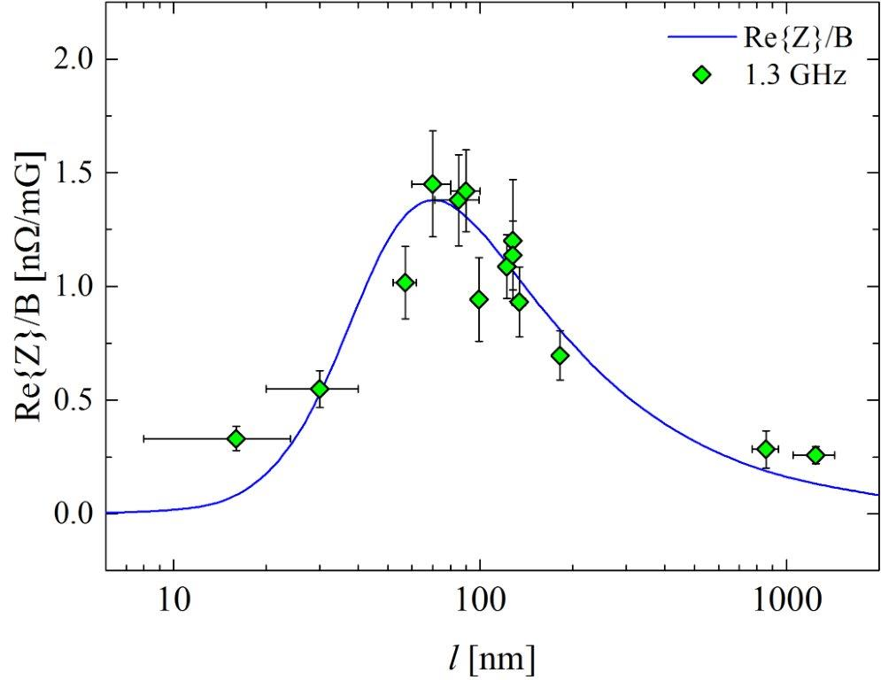
Sensitivity vs mean-free-path
Small $l$– pinning regime $η≪p$:
$$ρ_{1}\left(l,U_{0}\right)≈\frac{η(l)ω^{2}}{{p(l,U_{0})}^{2}}$$
$ρ_{1}$ increases with $l$ and $ω^{2}$, decreases with the increasing of $U_{0}$
Large $l$– flux-flow regime $η≫p$:
$$ρ_{1}\left(l\right)≈\frac{1}{η(l)}$$
$ρ_{1}$ decreases with $l$, independent on $ω$ and $U_{0}$
Pinning
regime
Flux-flow
regime
M. Checchin et al., Supercond. Sci. Technol. 30, 034003 (2017)
exp. data: M. Martinello et al., App. Phys. Lett. 109, 062601 (2016)

Slide 13
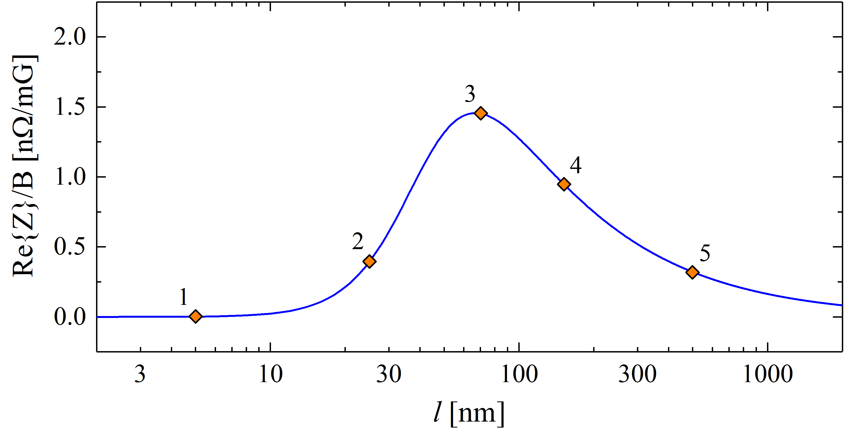
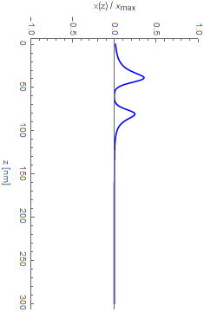
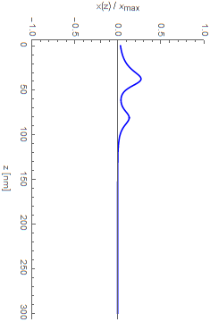
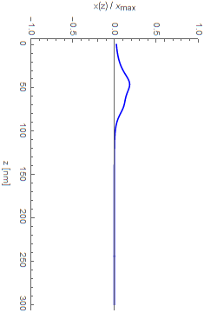
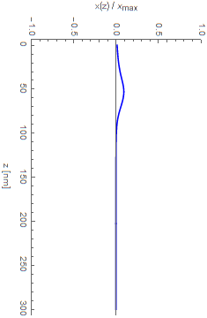
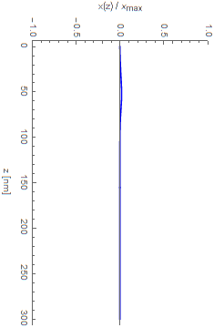
From pinning to flux-flow regime
In the pinning regime vortices are constrained by the pinning centers
In the flux-flow regime the vortex oscillation is counteracted by the material viscosity
Pinning
Flux-flow
1
2
3
4
5
M. Checchin et al., Supercond. Sci. Technol. 30, 034003 (2017)

Slide 14
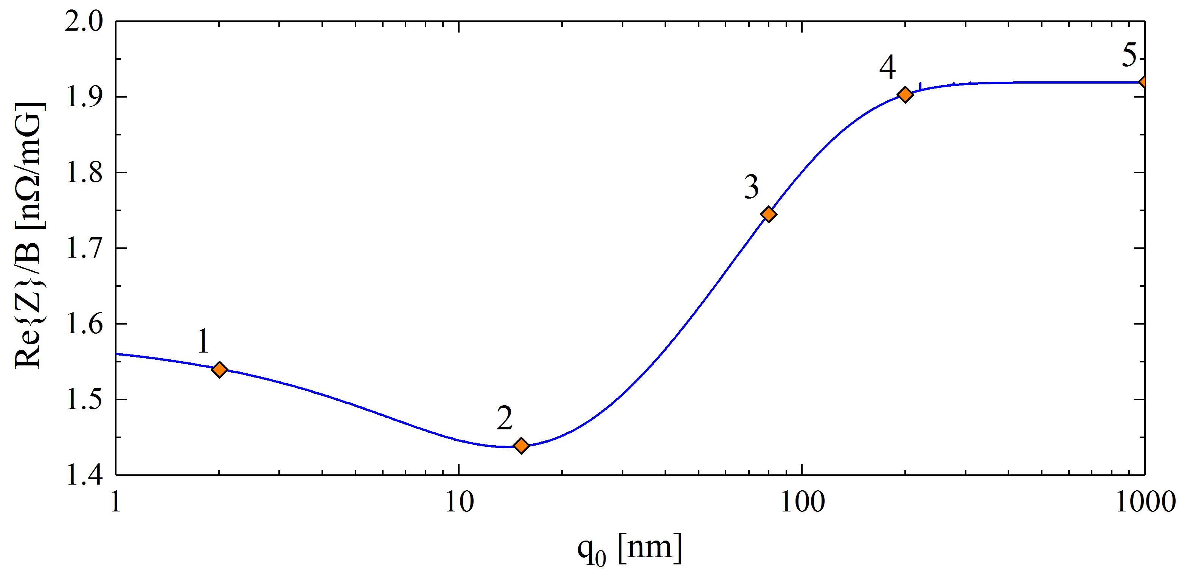
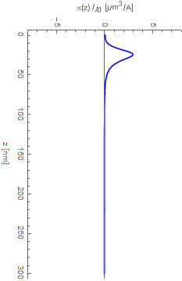
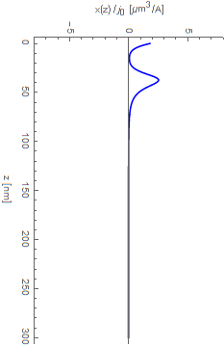
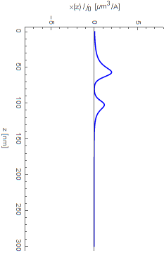
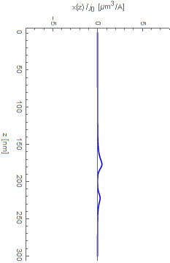
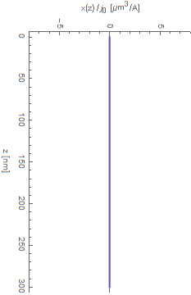
Sensitivity as a function of pinning point position
$q_{0}≅15 nm$ $⇒$ sensitivity is the lowest
$q_{0}>400 nm$ $⇒$constant sensitivity—bulk pinning does not affect the vortex oscillation!
$⇒$ $S$ is a near-surface property!
1
2
3
4
5
M. Checchin et al., Supercond. Sci. Technol. 30, 034003 (2017)

Slide 15
Conclusions

Slide 16
Conclusions
Trapping Efficiency—$η_{t}\left(∇T\right)$—bulk property:
Defined by the opposite action of pinning and Gibbs free energy gradient at the interface between Meissner and mixed states
Well described by a statistical argumentation
The higher the thermal gradient, the better the expulsion
Several types of pinning-effective defect may be involved
Trapped Flux Sensitivity—$S\left(l,U_{0}\right)$—near-surface property:
Two regimes of dissipation:
Small $l$: pinning regime
vortices are constrained by the pinning centers
—$S$ increases if $l↑$, $ω↑$ and $U_{0}↓$
Large $l$: flux-flow regime
the vortex oscillation is counteracted by the material viscosity
—$S$ decreases if $l↑$, but independent on $ω$ and $U_{0}$
Thank you for the attention

