Slide 1
JLab CM Production
Bob Legg, Ed Daly
For the Jlab Team

Slide 2
Contents
Cryomodule Assembly at JLab
Introduction
Overview
Features of Cryomodule Assembly at JLab
Production processes
Summary

Slide 3
Introduction
Jefferson lab has a long standing core competency in cryogenics and superconducting radio frequency (SRF) systems.
A partial list of large cryomodule construction projects to date at Jefferson Lab include:
Original CEBAF construction C20 CEBAF 42.25 Cryomodules
42 Cryomodules plus two Cryo-units, 338 Five (5) cell cavities
During peak Production 2 Cryomodules per month for 18 months
C50 refurbishment Program started in 2006 (12 Cryomodules as of 2016)
SNS Cryomodules, fabrication and test of 23 Cryomodules Built at JLAB
11 Medium Beta , and 12 High Beta
12 GeV , 10 Cryomodules
using a new 7 Cell Cavity design “Low Loss”, new tuner, HOM couplers and probe feed through, new RF window design
Using new cavity processing methods
LCLS-II Construction of 19 Cryomodules for SLAC currently in progress

Slide 4
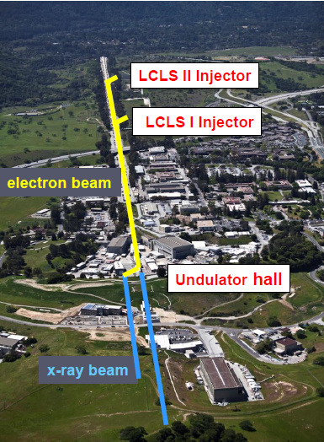
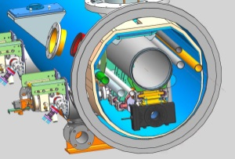
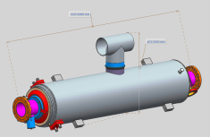
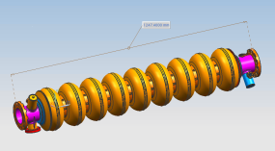
Overview of Cavity/Cryomodule Process at JLab
Supplier
Partners
JLAB SRF Facility
Receiving in SRF Inventory
Mechanical Inspection CMM
 | Component | FNAL | JLAB | SLAC
Cavity String | Niobium (Prototype) - existing cavities | NA
 | Niobium (Production) | X
 | Cavities (Prototype) - existing cavities | NA
 | Helium Vessels (Prototype) | X
 | Cavities w/Helium Vessels -VTS Ready (Production) |  | X
 | Cavity Feedthroughs |  | X
 | Cavity Flanges & Assoc. Hardware/Seals (VTS & HTS compatible) |  | X
 | Fundamental Power Coupler (FPC) |  |  | X
 | Cavity String Interconnecting Bellows |  | X
 | Cavity String Assembly Hardware & Seals | X
 | SC Magnet Assembly | X
 | Beam Position Monitor (BPM) | X
 | Gate Valves |  | X
 | Beamline Vac. Monitoring Manifold & Gauge | X
Cryomodule | Two-phase Pipe Bellows | X
 | Tuner, actuator, piezos (Prototype) | X
 | Tuner , actuator, piezos (Production) |  | X
 | Magnetic Shielding | X
 | GRHP Sub-assembly | X
 | Vacuum Vessel | X
 | Coupler Pumping Lines & Pumps (ion+TSP) + vacuum gauges | X
 | Instrumentation | X
 | Liquid Level Probes & JT Valve | X
 | Beamline Interconnect Parts including Aluminum Heat Shields | X
 | HOM Absorber |  | X
 | Shipping Frames & End Caps + Shock Log Devices |  | X
 | X = Lead Lab per SLAC LCLSII-4.1-PM-0229-R0 (June2014)
Cavity /Helium Vessel Prep. & Test
VTA RF Test in liquid Helium @ 2 K
Cavity String Assembly & Leak Test
Assemble Cavity String -Class 100 Clean Room
Courtesy Chi-Chang Kao, SLAC
Cryomodule Assembly
Instrumentation & Wiring
Tuners, MLI– Multi Layer Insulation,
Cryogenic Circuits , magnetic shielding, alignment
Super Insulation Cabling & Shield
Vacuum Vessel & Final Alignment
Install Cryogenic Supply Interfaces
Horizontal Test Preparation
Pressure Test & Leak Check (vacuum)
Commissioning at SLAC
Install Cryomodules in Accelerator, cool to 2 K
Weld & certify leak tight , pressure test
check Controls,
Gradient & Dynamic Heat Load - Q_{o}
Cryomodule Test in “Test Cave”
Cryomodule integrity @ 2 K
Tuners - Range, Hysteresis, & Resolution/ Sensitivity
Cavities for Gradient & Dynamic Heat Load Q_{o}
LCLS-II 1.3 GHz Cryomodule
Cryomodule shipping to SLAC
JLAB support for installation of first 3 Cryomodule

Slide 5
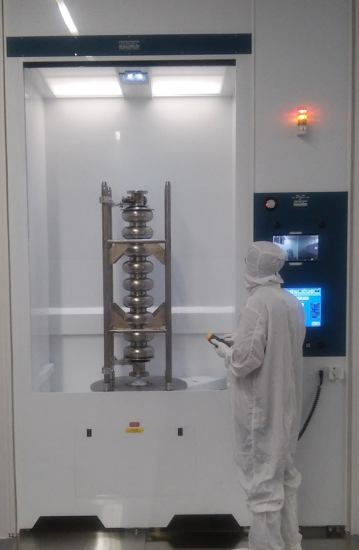
Features of the Jlab System
State of the art high pressure rinse (HPR) tool has been incorporated into JLab’s suite of cavity processing equipment. The new HPR tool provides up to 10 gallons per minute of ultrapure water (UPW) at pressures up to 1500 psig. The tool also has the capability of high pressure rinsing with ambient and 80ºC UPW.

Slide 6
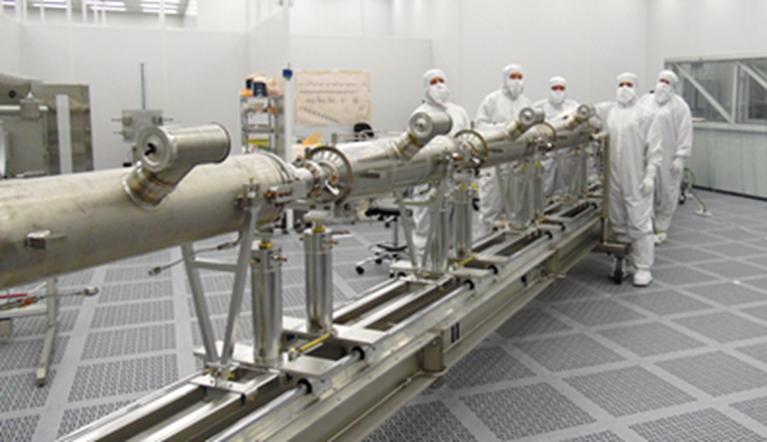
Features of the Jlab System
1800 sq. ft Clean room for string assembly
100% ULPA coverage
Laminar flow, 100% perforated RMF, side wall return
Bulk headed HPR and other process tools

Slide 7
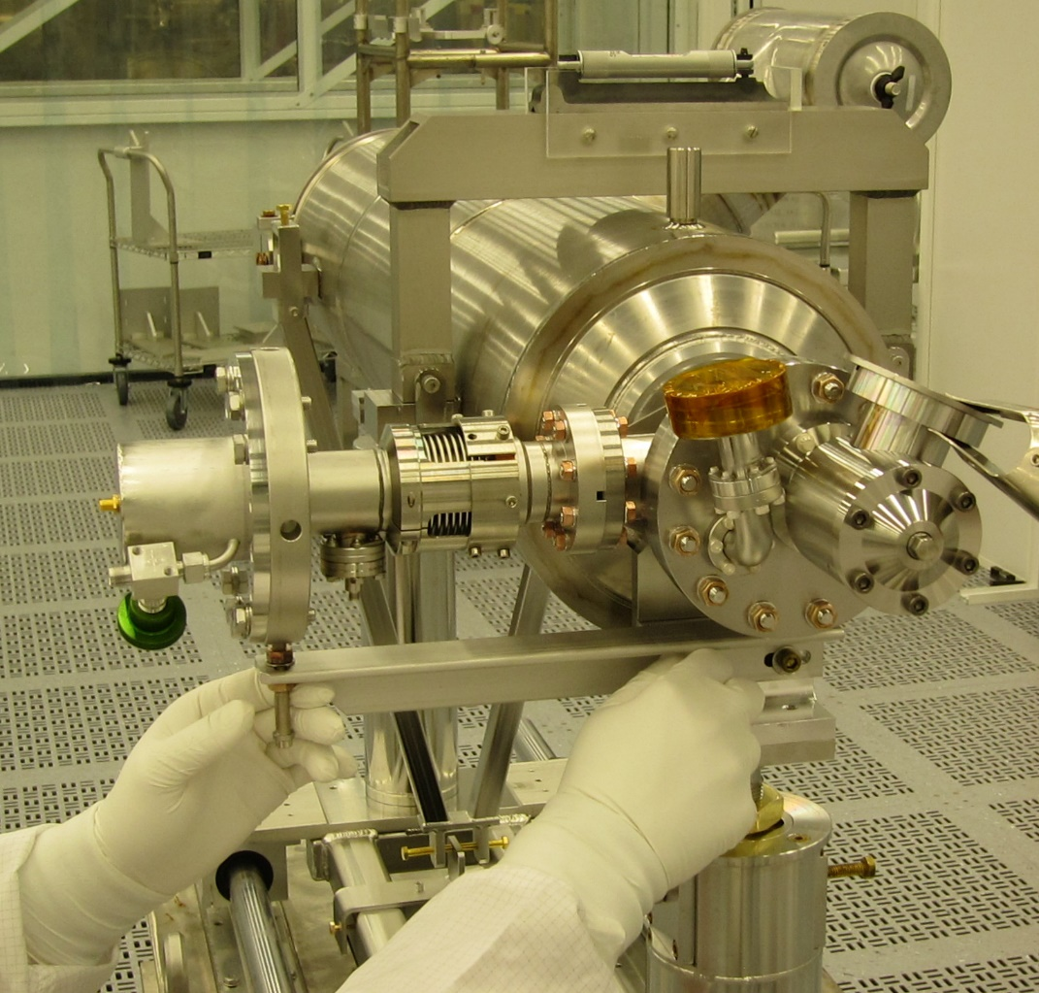
Cavity String Assembly in Clean Room
Component assembly tooling same as FNAL
“Lollipop” supports for each cavity and BPM subassembly
Lollipops mounted to mobile rail system
Use mobile rail system rather than rail-in-floor used at DESY, CEA/Saclay and FNAL
Transfer to CM assembly rails for cold mass assembly
Cold Coupler Assembly on AES033

Slide 8
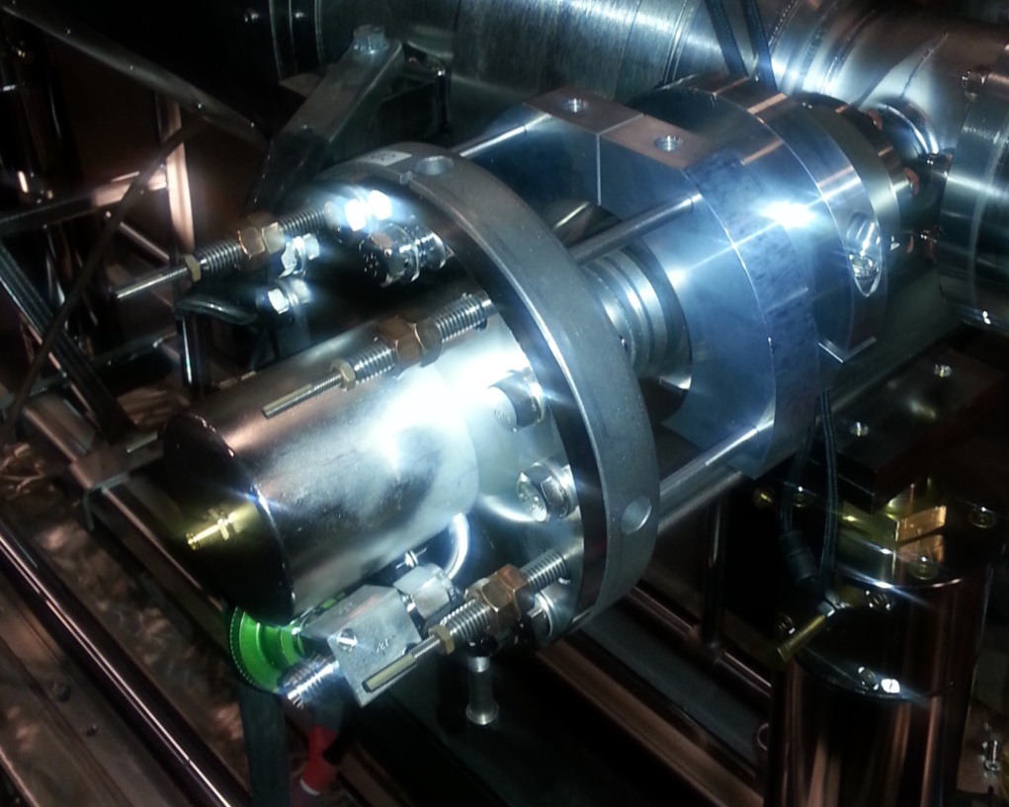
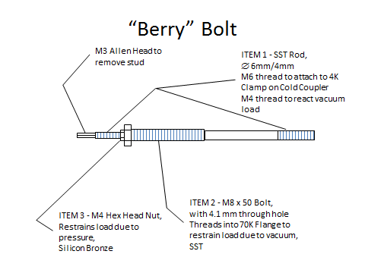
Features of the Jlab System
“Berry” Bolts restraints that enable the cavity to be pumped down and kept under vacuum throughout assembly and test.
Minimize bleed-ups (slow bleed-up/pump down procedures developed)
No nitrogen purge during assemblies

Slide 9
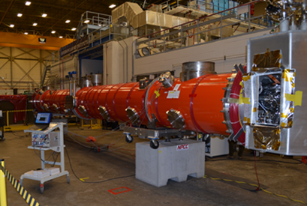
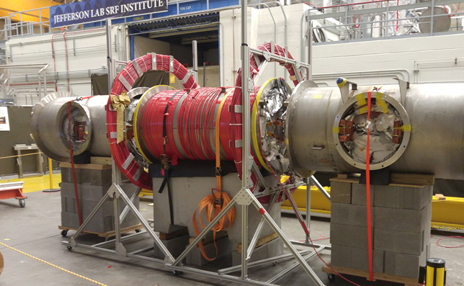
Features of the Jlab System
Magnetic Hygiene of Cavity String
Substitute materials with lower permeability materials, if possible
Measure magnetic fields on individual parts and demagnetize if needed
Set a maximum field spec for tooling used and follow it.
Measure tools before use and exchange or demagnetize if needed
Demagnetize finished cryomodule
Use magnetometer measurements to verify demagnetization procedure
The goal is to maximize the Q₀ of each finished cavity.
LCLS-II pCM
C50-13

Slide 10
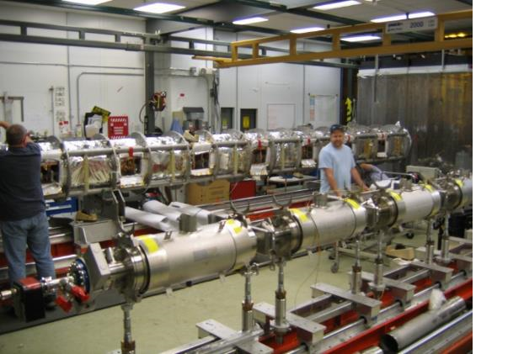
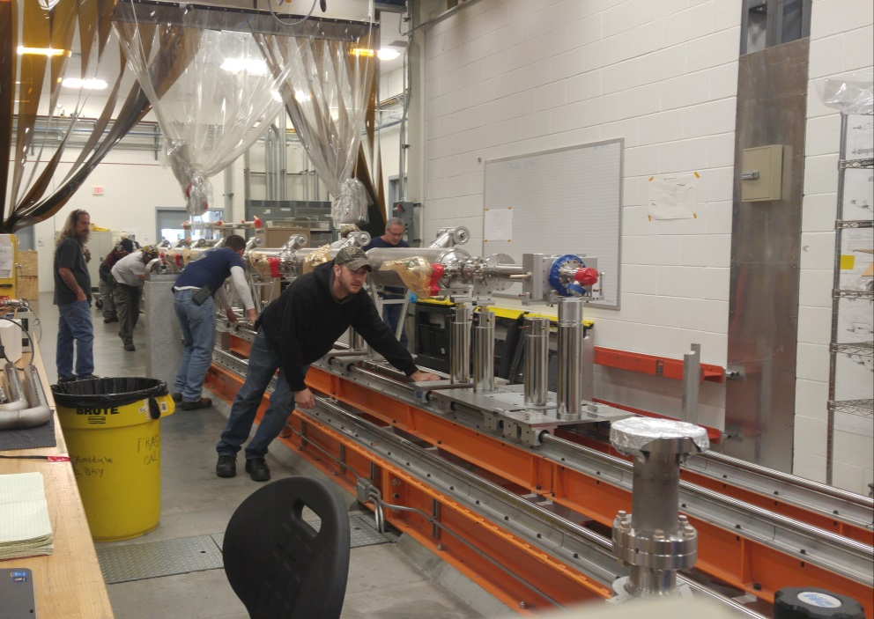
Features of the Jlab System
The mobile rail system allows assembled cavity strings on lollipops to be delivered to different assembly rails outside the clean room for integration into cryomodules.
Different types of cryomodules can be assembled concurrently on different rails or multiple copies to improve schedule.
C100’s
LCLS-II CM02

Slide 11
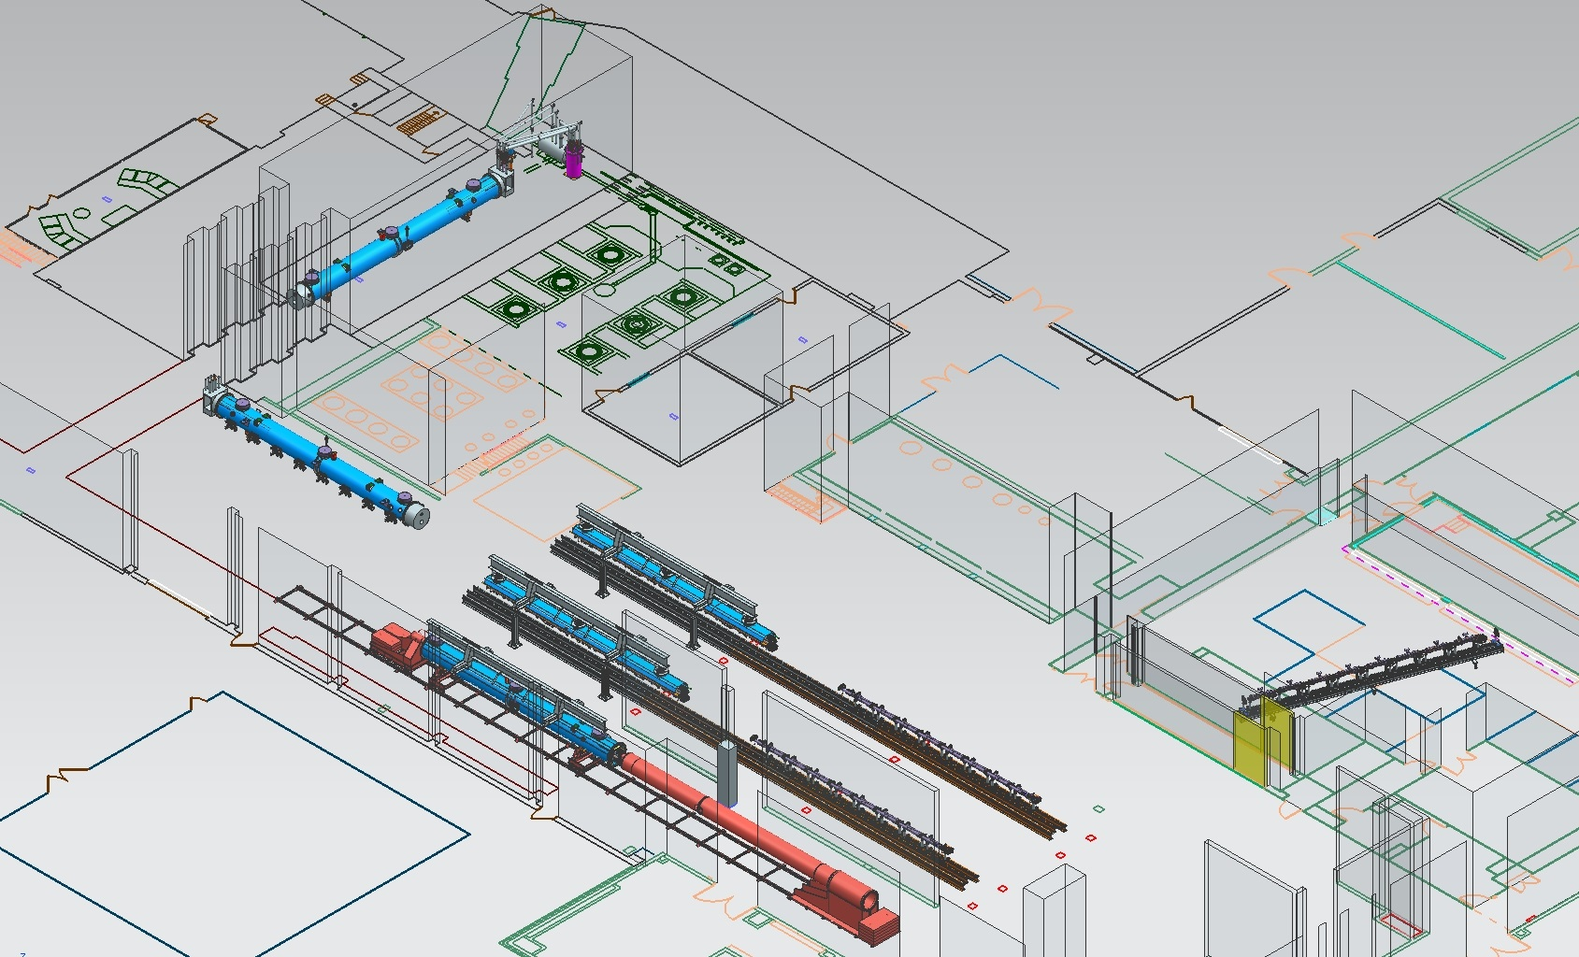
JLab Layout for LCLS-II CM Production
CM Testing
Phase II CM Assembly (2X)
Clean Room String Assembly
Phase I CM Assembly (2X)
Final Assembly / Prep for Testing
Vacuum Vessel Installation

Slide 12
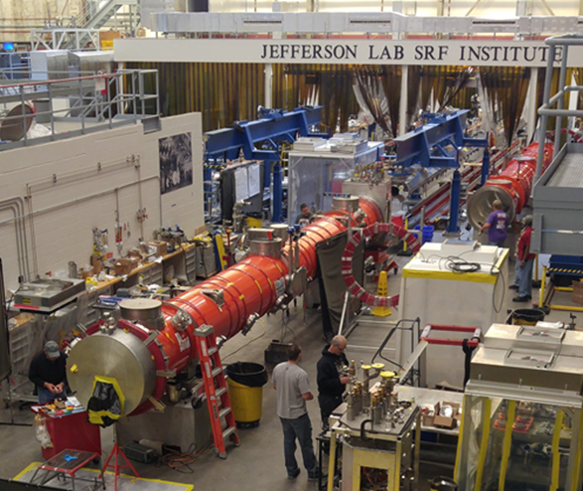
Summary
Jlab has a history of cryomodule production going back more than 25 years
In continuous production during most of that time.
Numerous upgrades of the facility to improve the performance of finished cryomodules have been implemented.
LCLS-II Production is latest CM program at Jlab and is just beginning to ramp up the production rate.

Slide 13
Thanks for your attention!
Questions?

