Slide 1
[43] FRIB Cold-mass Assembly - alignment, quality checks
Daniel Victory SRF Process Engineer II

Slide 2
Outline
FRIB Cavity Alignment points
Cryomodule Alignment Points
FRIB Coldmass beamline bellow installation tooling
FRIB FPC Installation
QWR FPC Tooling
HWR FPC Tooling

Slide 3
Alignment
FRIB Cavities are secured to the coldmass rail at three points
One side of the cavity is fixed and the other can float
Bearings installed allow the cavity to move during cool down
An additional capture point allows limits direction of cavity shrinkage
Dowel pins align linear guide
Belleville washers keep desired force on bearings

Slide 4
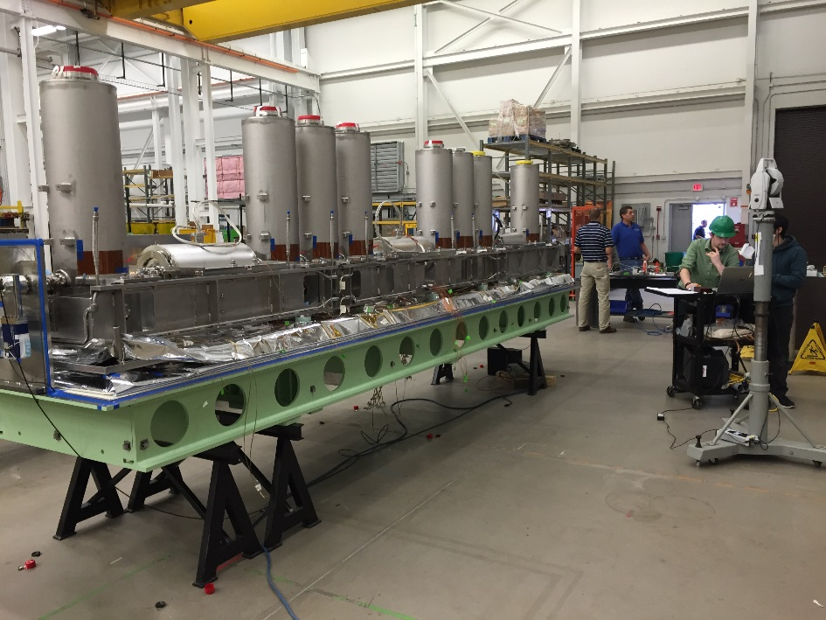
Cryomodule Alignment Factors
Cryomodule Alignment control broken into three main areas
Manufacturing and assembly steps to produce an accurate cold mass assembly with meaningful and reliable external fiducials for installation
Control and verification of the warm-to-cold offset movements during cool-down
Installation and placement accuracy of the cryomodule assembly in the tunnel

Slide 5
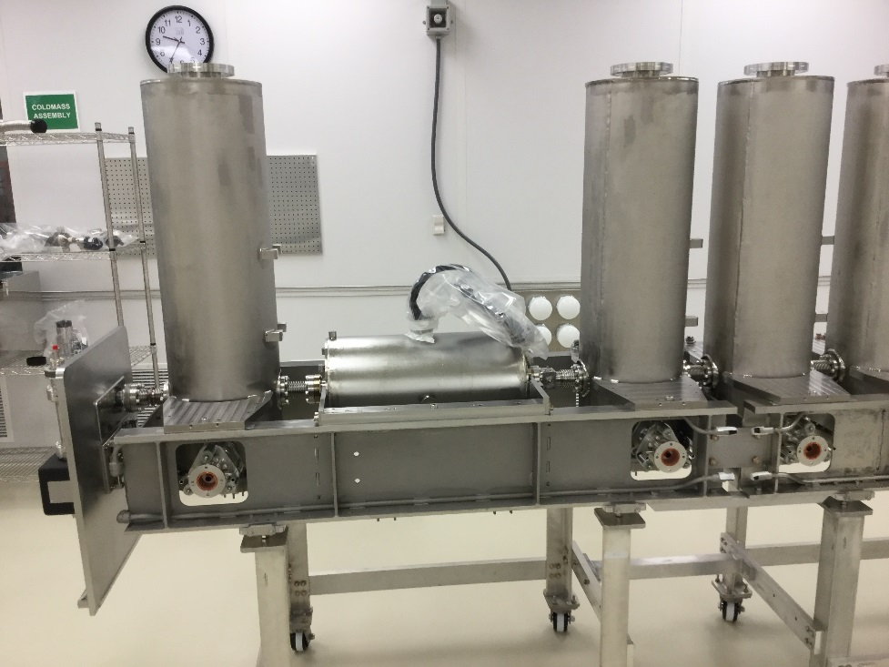
Alignment

Slide 6
Bellows Installation
A flexible coupling is connected between adjacent cavities on the beam line
Since the low profile nature of the beam line flanges does not allow for the use of gasket clips, FRIB developed a procedure to use two small pieces of tape to hold gaskets in place. Kapton® can be sufficiently cleaned for the low particulate needs of the cavities, while being also radiation resistant for the insulating vacuum.
FRIB Cavities have a recessed beamline flange which does not allow the direct installation of bellows
A compression tool was designed to squeeze bellows to fit in the small space

Slide 7
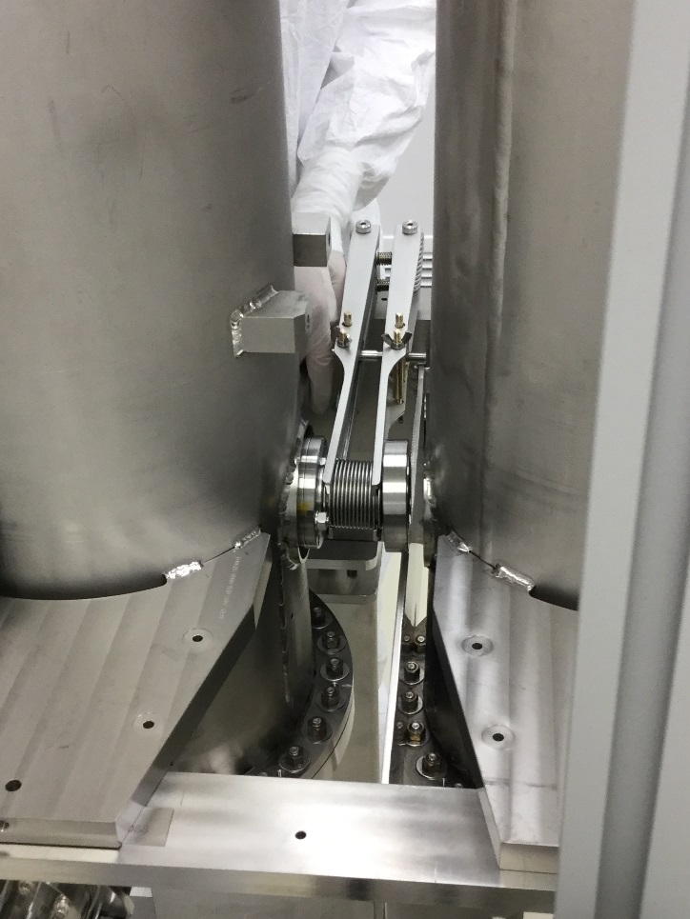
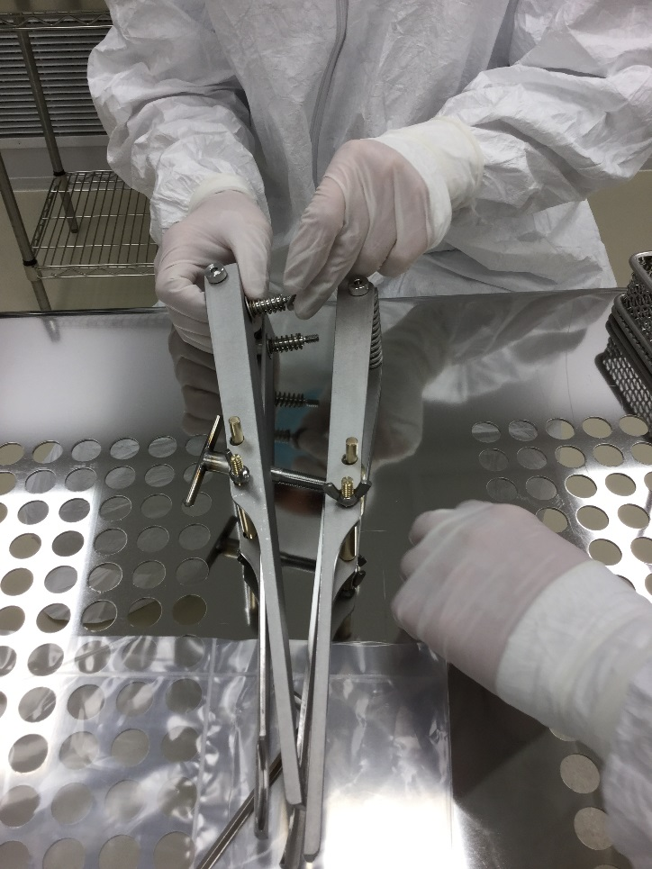
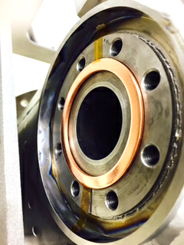
Bellow Installation Tools

Slide 8
Fundamental Power Coupler Installation
Fundamental Mode Power Couplers (FPC) are installed to Quarter Wave Resonator (QWR) cavities before coldmass installation
FPCs are installed to Half Wave Resonator (HWR) cavities after cavities are installed to coldmass
Tooling is designed to prevent damage to cavity and FPC.
Tooling is designed for ergonomics for operator
HWR FPCs weigh 75 lbs. installed to bottom of cavity

Slide 9
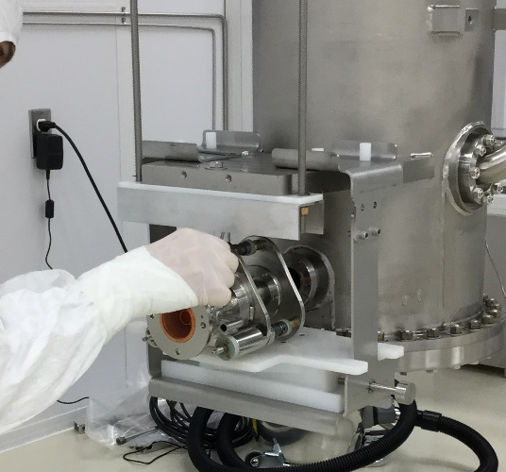
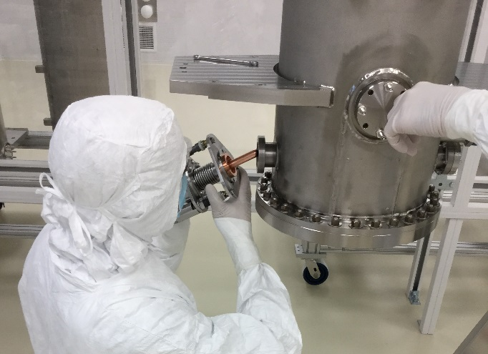
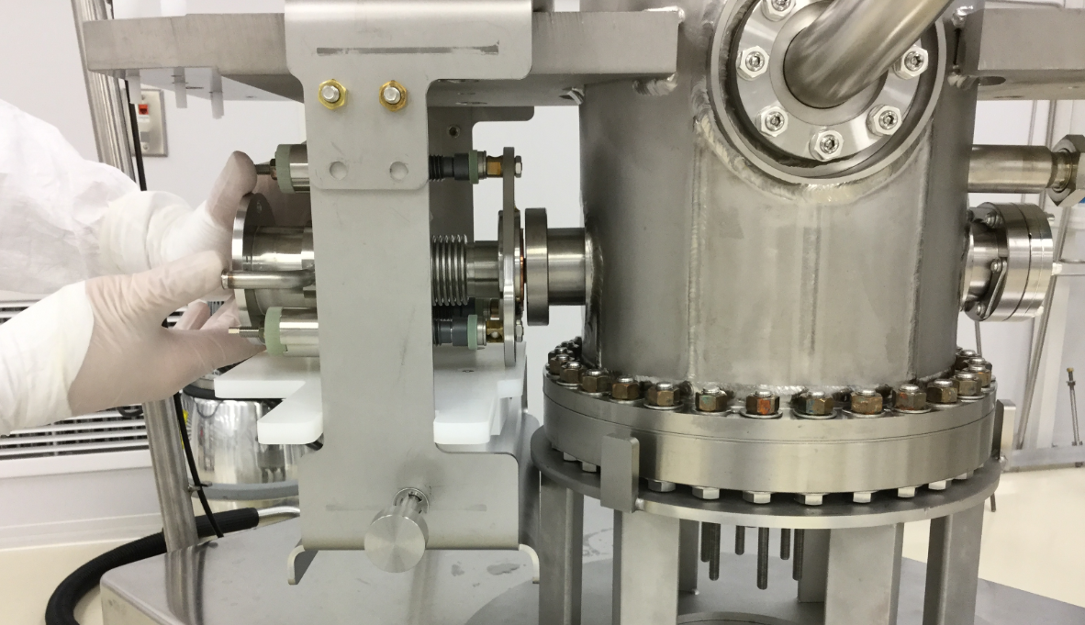
Fundamental Mode Power Coupler Installation
Adjustable height fixture to rest QWR FPC
Gasket taped in place
Adapted for both QWR cavity types

Slide 10
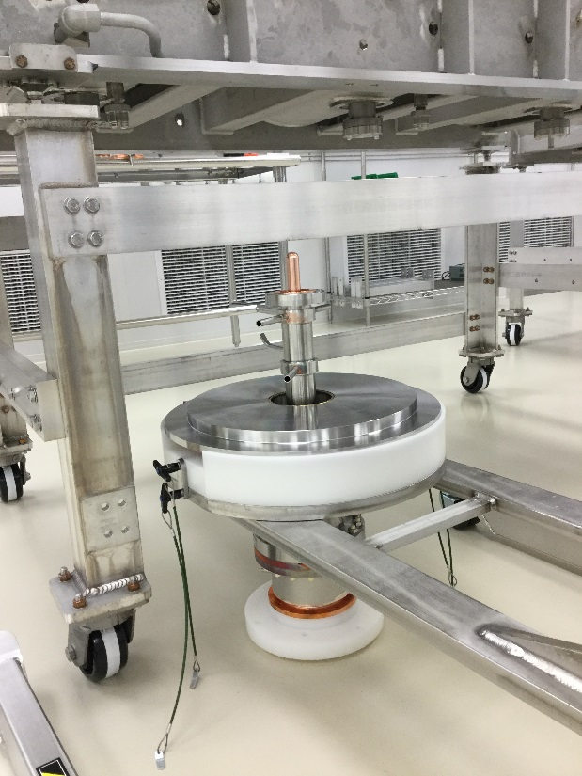
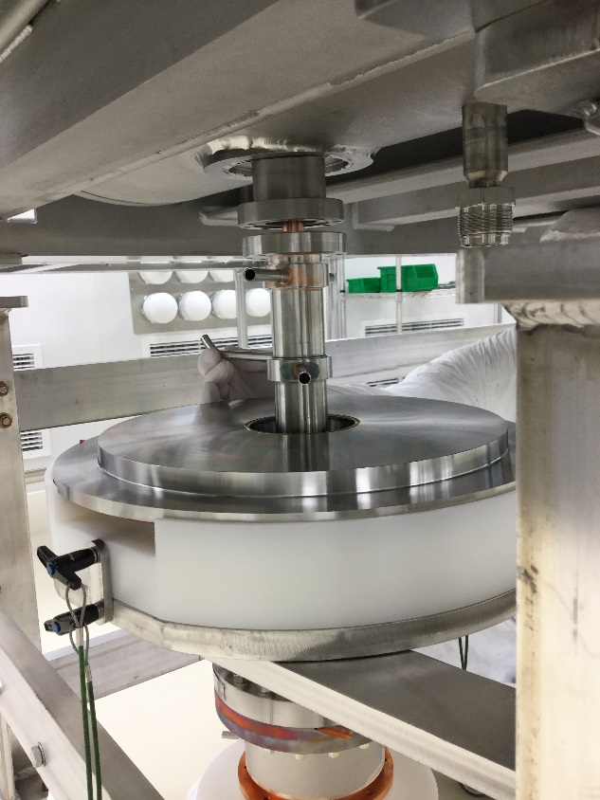
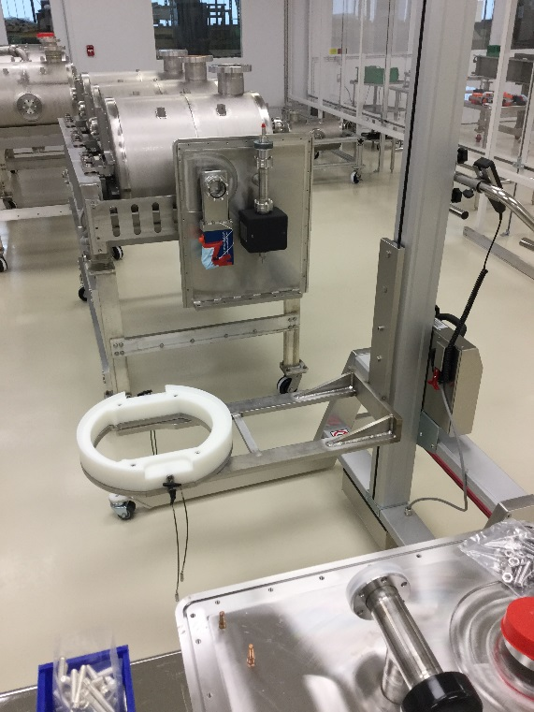
Half Wave Resonator FPC Installation
Spring resistance to give vertical movement to FPC
Springs allow for non parallel alignment from cavity to cart

Slide 11
Conclusion
FRIB coldmass assembly is optimized to assure safety, effectiveness and efficiency
Assembly procedure and tooling is used to overcome minimal space and keep cleanliness a priority
Tooling is used to allow for proper alignment and protection of components during installation

