Slide 1
European XFEL procurement strategy – lessons learned
Detlef Reschke – DESY (with J. Iversen, A. Matheisen, H. Weise)
Notes:
How to edit the title slide
Upper area: Title of your talk, max. 2 rows of the defined size (55 pt)
Lower area (subtitle): Conference/meeting/workshop, location, date, your name and affiliation, max. 4 rows of the defined size (32 pt)
Change the partner logos or add others in the last row.

Slide 2
Cavity production: Preparation Phase
Define final cavity design => TESLA design with minor design changes
Establishing surface treatment recipes => based on app. 50 prototype cavities
Industrialization of main Electropolishing surface treatment => set up of EP facilities at 2 companies
Preparation of detailed specifications => mechanical fabrication, surface treatment, HT integration, transport concept
Finalize a concept for documentation and data transfer
Qualification + selection of Nb / NbTi material vendors in 3 steps => 2 new companies
Concept for fulfilling PED requirements
Establishing “Long pulse” vertical acceptance test => protect HOM feedthroughs
Single-cell cavity R&D program (several aims)
R&D on Large Grain Nb material
Courtesy W. Singer

Slide 3
Cavity production
Contract allocated to Research Instruments (RI, Germany) and E.Zanon (EZ, Italy) in equal shares end 2010:
560 series cavities
24 cavities w/o He-tank for QC and further R&D (EU funded: “ILC-HiGrade”)
Option: 240 series cavity => Order allocated end 2012/beginning 2013 in equal shares
All Nb / NbTi material provided by DESY (~ 24420 pieces) => includes ordering, PED-applicable QC + parts tracking, shipment
Order placed following “Build-to-Print” strategy:
Production has to follow specifications precisely => close supervision by expert team + frequent visits + regular reporting (no resident expert at vendor)
No performance guarantee by vendors

Slide 4
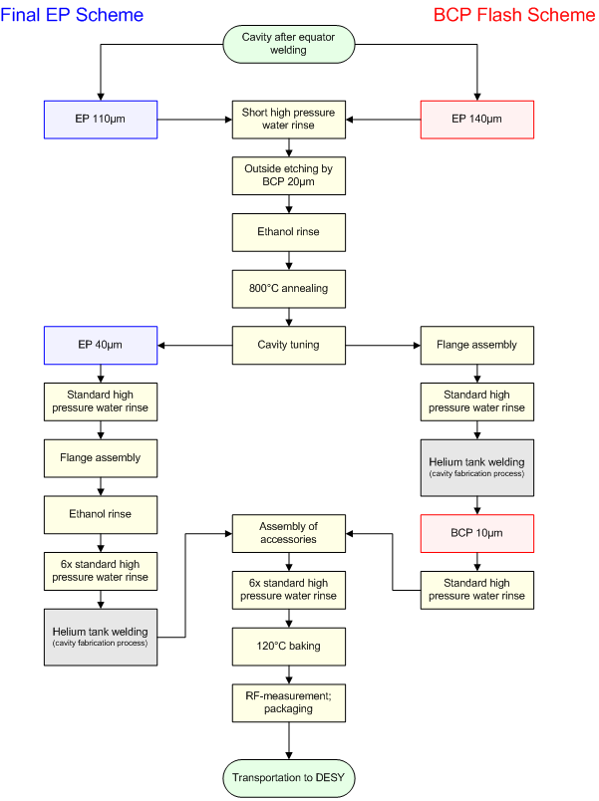
Cavity Surface Preparation
Two schemes for the final surface treatment: - E. Zanon: Final 10µm BCP (“BCP Flash”) - Research Instr.: Final 40µm EP
Successful mechanical production and surface preparation at both vendors!
No performance guarantee resulted in DESY taking responsibility for:
the risk of unexpected low gradient or field emission
retreatment (good cooperation/agreements with both vendors)
Final EP
BCP Flash

Slide 5
Quality Management + Documentation
Key technical documents: Technical Specifications + Change Reports
Quality Process based on Quality Control Plan (also for PED) including:
Vendor internal QA, QM system
Microsoft Project Plan for tracking of progress + schedule
Non Conformity Reports NCR: Documentation of all NC’s including a proposal for correction procedure
Stepwise release of production (Acceptance Levels 1, 2, 3)
All production documents (specifications, protocols, PED data, etc.) recorded electronically in data management system (EDMS)
Data analysis in cavity data base
Request Tracked e-mail communication (“tickets”)
- RF test system - direct file transfer - (manual entry)
Courtesy W. Singer

Slide 6
Lessons Learned
6
Concept of Preparation Phase successful
Pre-Qualification of cavity vendors and Nb/NbTi suppliers important
Surface treatment recipes worked well
Communication with cavity vendors and notified body of upmost importance
Trustful cooperation from tendering until (beyond) last cavity extremely helpful incl. solving problems together
Frequent meetings + visits; request tracked e-mails; good balance between personal contact and well-defined documentation; ...
Rough estimate: team of about 20 colleagues (INFN Milano + DESY)
Specification successful => make it precise wrt. to critical values and tolerances, but keep the infrastructure as generic as possible
Few mechanical tolerances to tight (inner cell shape)
RGA spec for m>50 to tight (modified on request from 1:1000 to 1:300)

Slide 7
Lessons Learned II
7
Effort of documentation and data transfer underestimated
Started late and not enough man power available
Post-documentation required a lot of additional effort
Provision of “Cavity Tuning Machine” and “HaZeMeMa” by DESY
Successful, but labor-intensive (now used for LCLS2, Mesa, Tarla cavities)
Pores in longitudinally welded Ti “2-phase pipe” caused significant rework
Lonigitudinally welded pipes fulfilled Spec + PED, but during orbital weld pores “widened up” => out of PED => surprise, surprise …
Solution: Rework with seamless pipes

Slide 8
Additional slides

Slide 9
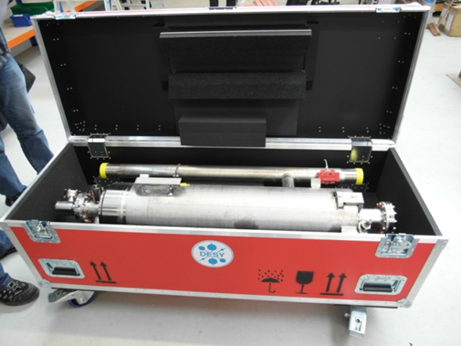
Transportation + Incoming Inspection
9
Transportation:
“Cavity ready for test” requires well-defined transport concept
Transport under vacuum => avoid particle transport
Dedicated boxes for horizontal transport by truck (Vendor => DESY => Saclay)
No performance degradation observed
Incoming inspection at DESY
Basic mechanical, electrical, RF checks + final vacuum leak check before test
Idea: Check for damages during transport
Found: - Assembly errors + contaminations - Mechanical + electrical damages - Few leaks
Incoming Inspection is mandatory
=> 54 Cv‘s back to vendor
Notes:
Remark:
Additional and comprehensive information about NC‘s + experiences with QC concept during production extend this talk => aware that this is missing

Slide 10
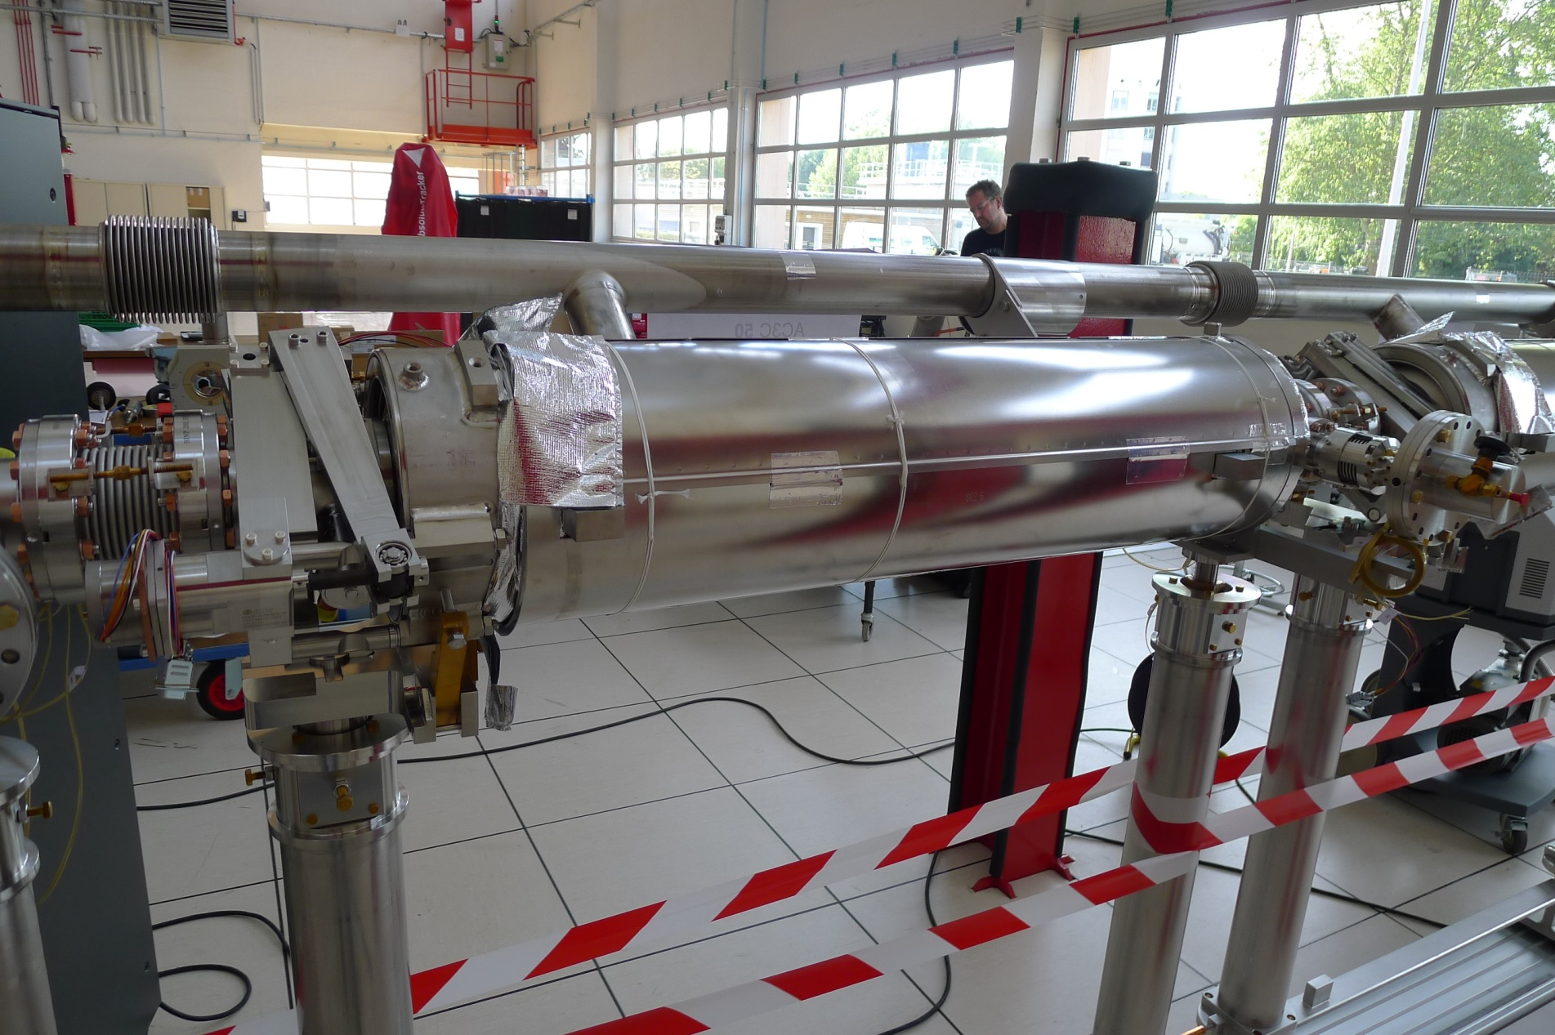
2-Phase Line (Service Pipe) Repair Work
X-ray to certify longitudinal weld
standard intersection
seamless tube
XFEL MAC & DESY MAC Meeting – May 7, 2014
Hans Weise, DESY

Slide 11
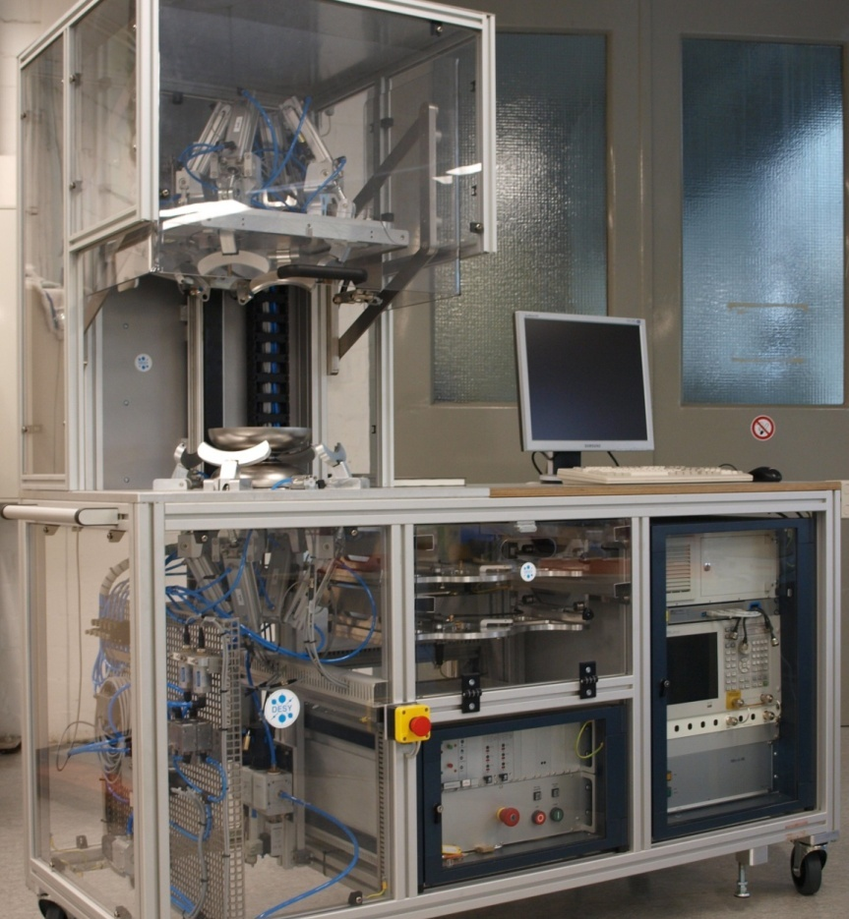
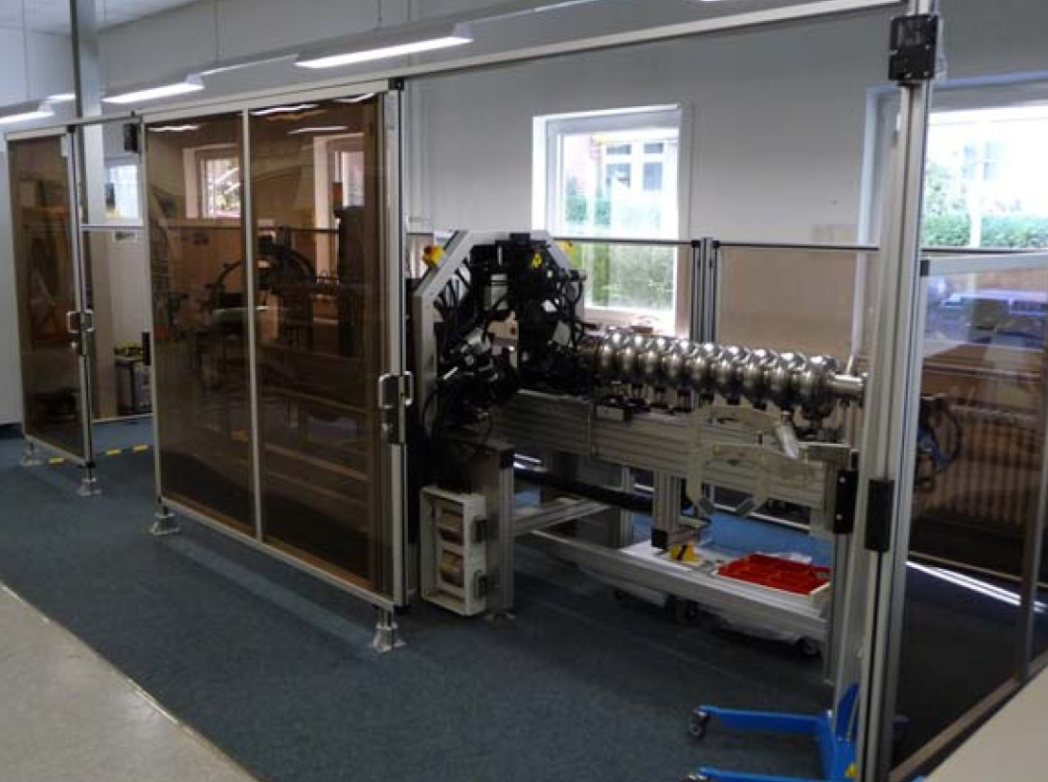
RF Measurement and Field Flatness Tuning using DESY-provided Tools
Both machines ready to be used at the companies (CE certified).
Machines can be operated by Non-RF-Experts.
Considerably shorter measurement / tuning time.
Automation and documentation guaranteed.

