Slide 1
Beam Size Along the Pulse in PIP-II IT MEBT
Igor Lobach
Belarusian State University
Summer Intern, Program: PARTI
PARTI Meeting, August 10, 2016
Supervisors:
Alexander V Shemyakin
Lionel R Prost

Slide 2
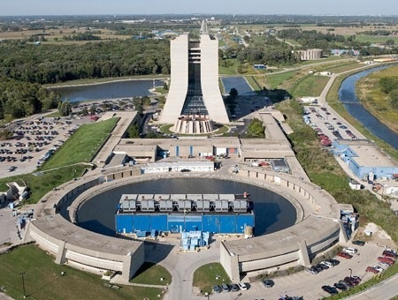
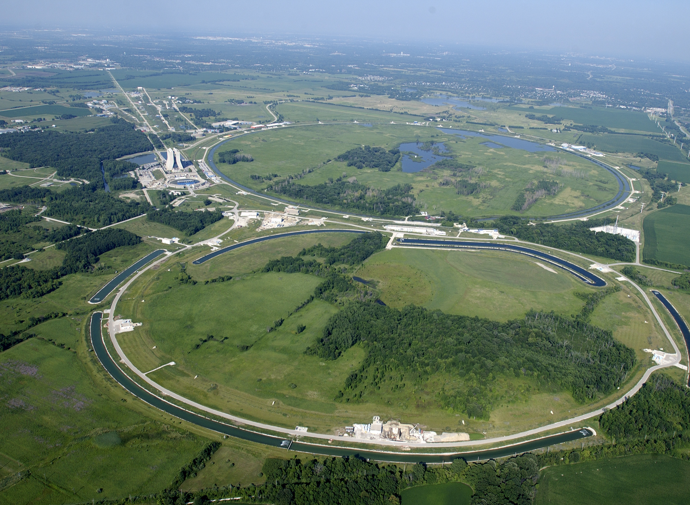
Proton Improvement Plan-II (PIP-II)
Existing accelerator complex:
Normal Conductive Linac
Booster
Main Injector
The plan is to
NC Linac
#1
Replace NC Linac with SC Linac
Booster
First, the Super Conductive Linac will work at low duty factor, but capability to operate in CW mode provides straightforward future upgrade path
NC Linac
Booster
#2
Upgrade Booster, Recycler, Main Injector
Main Injector
To accommodate new parameters of injected beam and provide higher intensity on the exit

Slide 3
Proton Improvement Plan-II (PIP-II)
Booster
Main Injector
1.2MW
DUNE
LBNF
Mu2e
g-2
SC Linac
Front End
120GeV
Other experiments
$$30 keV, β=0.0080$$
$$2.1 MeV, β=0.067, I=5 mA, RMS beam size∼2 mm$$
$H^{−}$ beam
IS
LEBT
RFQ
MEBT
To SC Linac
IT = Injector Test is the test of Front End (in CMTF building)
The MEBT is longer than 10 m, because it has the chopper, which will produce desired structure of the beam
Kickers
Absorber
* The beam entering the MEBT already consists of bunches
** Existing MEBT ends before the kickers

Slide 4
Beam Size Along the Pulse in the MEBT
Motivation:
Does short pulse diagnostics describe behavior in CW mode?
What physical effects can contribute to it?
#1
Beam neutralization
#2
Beam loading of RF cavities
#3
The beam might enter the MEBT with variable size along the pulse because of effects in the preceding sections
#4
Unforeseen effects

Slide 5
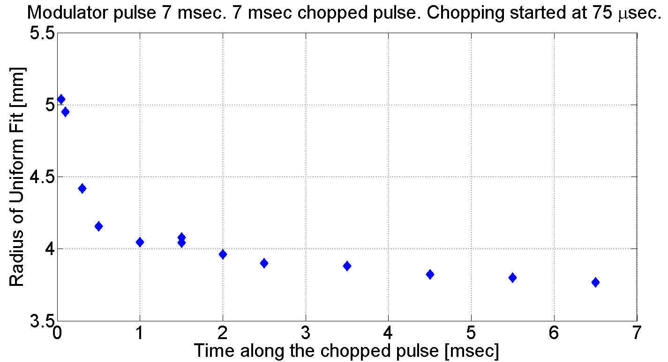
Existing Front End. Effects in the preceding sections
LEBT
MEBT
LEBT Scraper can measure beam size
The LEBT has its own Chopper
It is used in PIP-II Injector Test in order to skip the head of the pulse with variable size and send a pulse with virtually constant transverse size in the RFQ
almost constant beam size
Modulator
Pulse
Chopper
Pulse
$$75 μs$$

Slide 6
Beam Neutralization in the MEBT.
$$H_{2}$$
$$H_{2}$$
$$H_{2}$$
$$H_{2}$$
$$H^{−}$$
$$H^{−}$$
$$H_{2}$$
$$H_{2}$$
$$H_{2}$$
$$H_{2}$$
*assume that residual gas is $H_{2}$
$$H^{−}+H_{2}→H^{−}+H_{2}^{+}+e^{−}$$
Beam particles ($H^{−}$) ionize residual gas ($H_{2}$) in the beam line
Electrons readily escape (repelled)
Produced ions ($H_{2}^{+}$ of thermal energy) may accumulate within the beam area and compensate its charge
Space Charge
no compensation
full compensation
$$H^{−}$$
$$H^{−}$$

Slide 7
Beam Neutralization in the MEBT.
The MEBT might be vulnerable to beam neutralization, because
#1
Space charge in the MEBT is considerable
10 m, no external fields
4 mm
8 cm
a bunch
* in the PIP-II IT MEBT the bunches are close to spheres, it is not commonplace
#2
There is no accelerating longitudinal field which would remove $H_{2}^{+}$ ions
#3
The MEBT is very long (> 10 m) and, consequently, the beam envelopes are sensitive

Slide 8
Estimations. The destiny of $H_{2}^{+}$ ions in the MEBT.
Simulated 3-$σ$ beam envelopes in the existing MEBT
(c) Arun Saini
Potential drop due to field of the beam
Transverse | 12 eV
Longitudinal | 4.5 eV
Thermal energy
0.025 eV
longitudinal escape
transverse oscillations
longitudinal oscillations
$$T_{t}∼1 μs$$
$$T_{l}∼0.1 ms$$
Compare characteristic times:
Time between two bunches = $6.15 ns$
Period of transverse oscillations = $1 μs$ Period of longitudinal oscillations = $0.1 ms$
Time of neutralization = $10 ms$
Transverse thermal escape = $0.02 ms$ Longitudinal thermal escape = $5 ms$
The motion of ions of residual gas is mainly determined by the field produced by the $H^{−}$ beam.

Slide 9
Possible observable effects of neutralization in the MEBT
Space charge is proportional to peak current ($∼61 mA$), whereas neutralization compensates average current ($∼5 mA$).
Case #1
Relative difference between final transverse beam sizes $∼3\%$
Travel 10 m
Case #2
accumulated ions compensating average current
Phase shift between the two cases
Hill’s equation:
$$x^{′′}(s)+K(s)x(s)=0$$
General solution:
focusing strength & space charge
$$x\left(s\right)=Aw\left(s\right)\cos\left(ψ\left(s\right)+δ\right)$$
$$x^{′′}(s)+(K\left(s\right)+ΔK)x(s)=0$$
$$Δφ=\frac{ΔK}{2\sqrt{K}}×10 m=0.13 rad$$
due to accumulated ions
$$\sqrt{K}∼0.8 m^{−1}$$

Slide 10
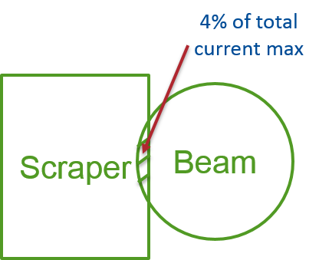
Method to measure beam size in the MEBT for long pulses
Short pulses ($20 μs$)
$$Scraper Position, mm$$
One can move the scrapers all over the beam
The profile is Gaussian with error $<1\%$
Standard deviation in the far tails (signal noise) is about 0.04 mA
$$Beamdump Current, mA$$
Far tail
Long pulses ($10 ms$)
The scrapers can intercept only a small fraction (4%) of total beam current, otherwise they brake
Proposal:
#1
Make a scraper scan of the far tails
#2
Assume that for long pulses beam profile is still Gaussian
#3
Fit the far tails with Gaussian curve and obtain RMS beam size

Slide 11
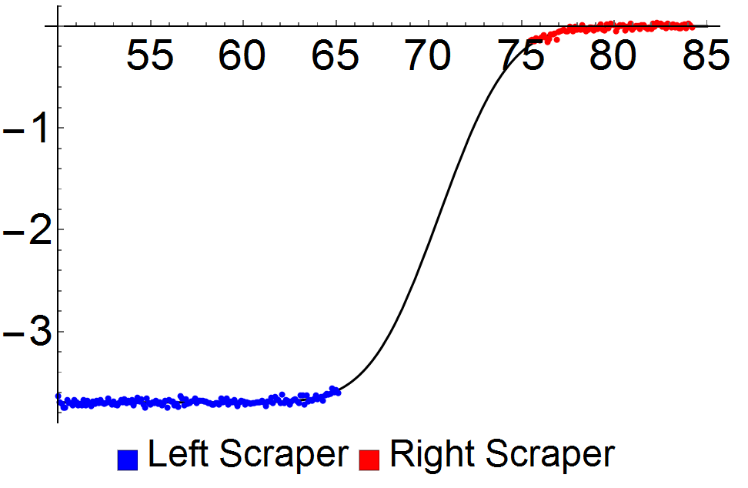
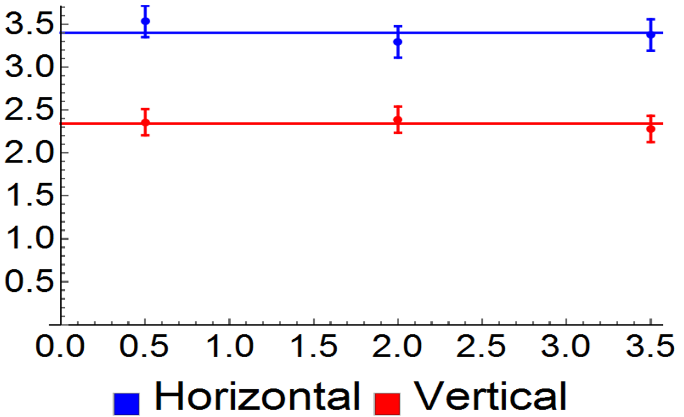
Method to measure beam size in the MEBT for long pulses
The method was tested with short pulses
$$Scraper Position, mm$$
 | Sigma
 | horizontal | vertical
Full Scraper Scan | 2.87 mm | 1.83 mm
Proposed Method | 2.96 mm | 1.86 mm
Relative error | 3.1% | 1.3%
The beam size was measured by
Full scraper scan
Proposed method (far tails)
$$Beamdump Current, mA$$
Then the results were compared
Scraper scan of the far tails
Preliminary results of beam size measurement in the MEBT for long pulses (3.5 ms)
Some difficulties of the method:
#1
Thermal expansion of the scrapers ($∼0.15$ mm)
$$RMS beam size, mm$$
#2
Long measurements (1 point $∼30$ min)
$$Position along the pulse, ms$$
#3
Noise in the beam dump current reading

Slide 12
Summary
Motion of ions of residual gas is mostly defined by the field of the $H^{−}$ beam (when neutralization is weak)
The ions “feel” averaged field of the beam
They compensate average current. Space charge is proportional to peak current.
The effect of neutralization in the LEBT was observed, the region of constant size along the pulse was found
The procedure to measure beam size for long pulses in the MEBT was developed

