Slide 1
The Design of a Resonance Control System for the IOTA RF Cavity
Gerrit Bruhaug
Lee Teng Internship Presentations
10/08/2016

Slide 2
Presentation Content
        Overview of IOTA
        Specifics of RF Cavity
        Controls System Design and Theory
        System Implementation and Results
        Thanks and References

Slide 3
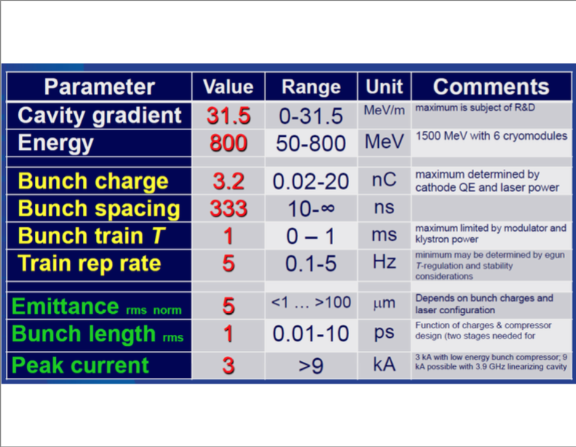
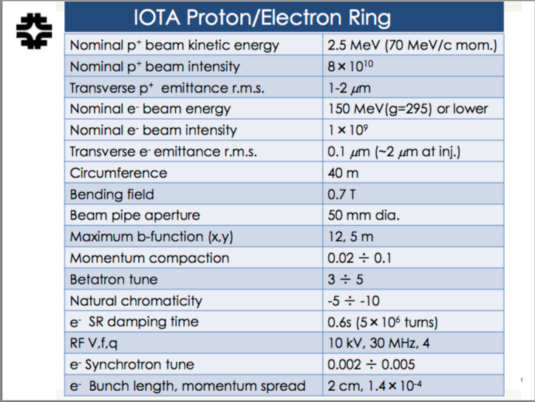
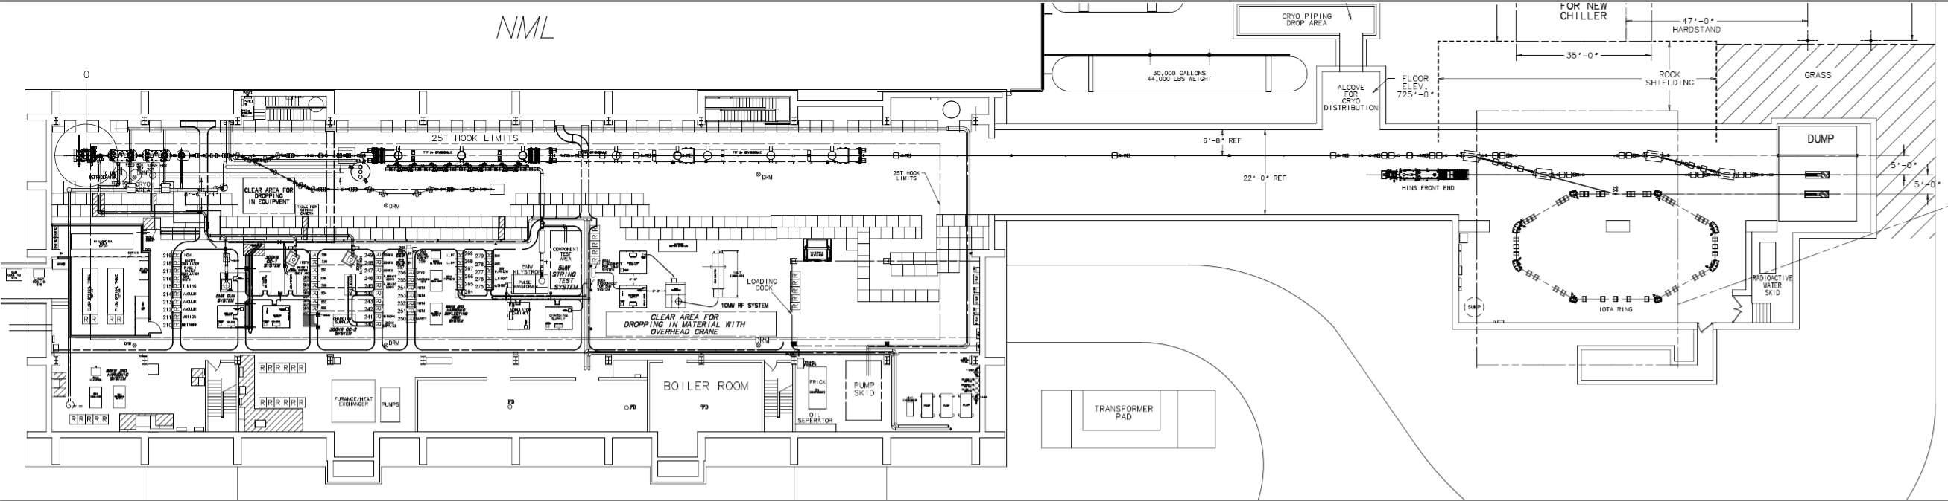
Integral Optics Test Accelerator (IOTA)
All pictures are provided by NML at Fermilab^{[1]}

Slide 4
The IOTA Bunching Cavity
Cavity has two sections
2 MHz section bunches protons
30 MHz section bunches electrons and modulates protons⁴
Drawing of IOTA Buncher¹

Slide 5
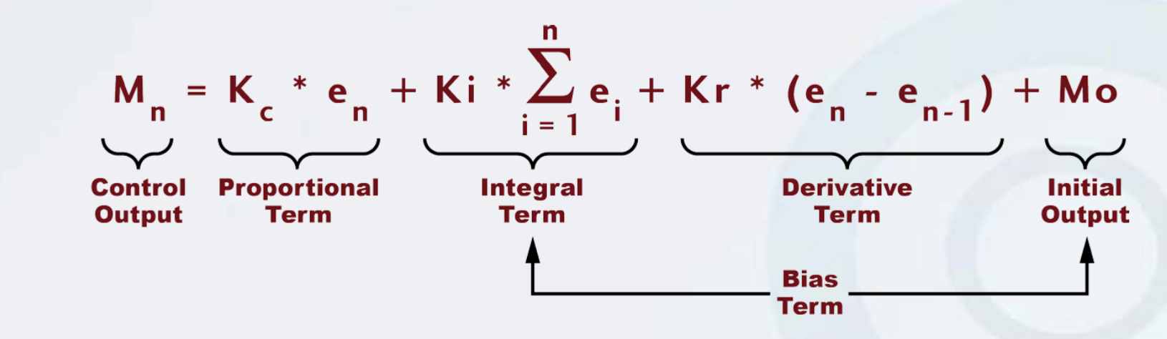
PID Loops and Controls Theory
Proportional, Integral, Derivative
Used to prevent oscillations in controls systems
Origin can be traced back to 19th Centaury steam ship controls³
PID Control Loop Equation²

Slide 6
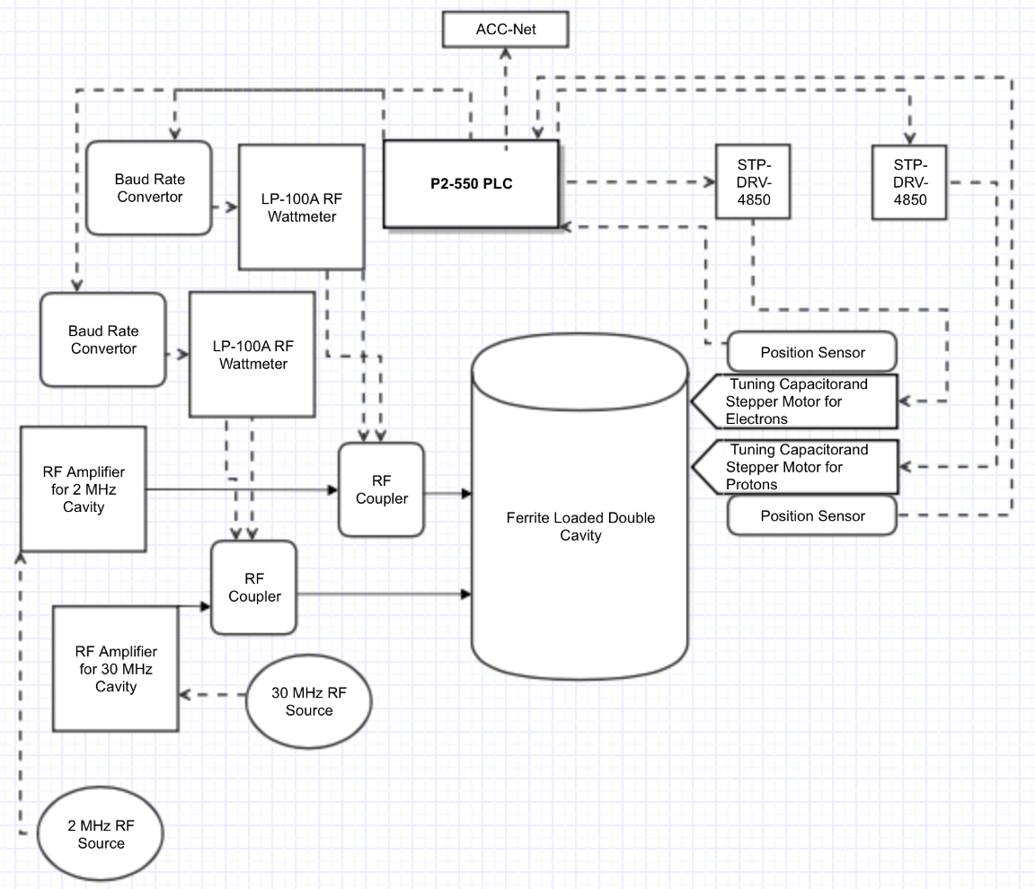
System Implementation
Overview of PLC based RF Control System

Slide 7
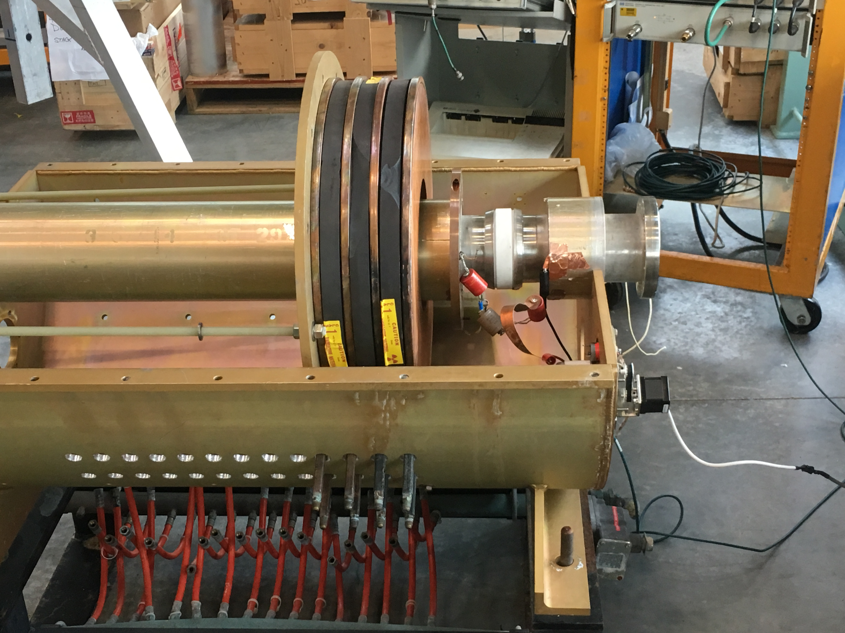
Mounting for Testing
Old Single Ceramic Break with One Stepper for Testing

Slide 8
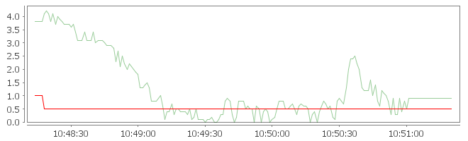
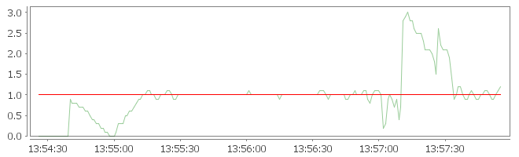
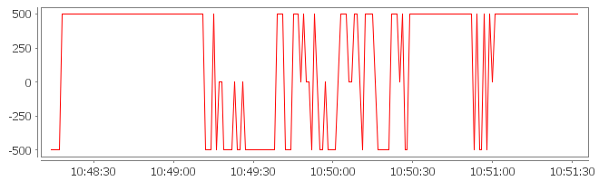
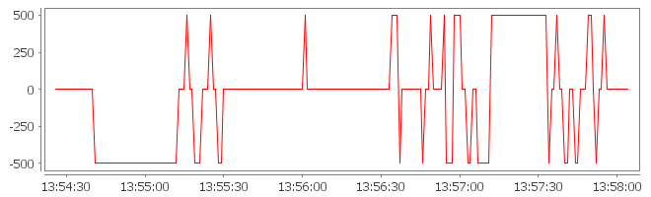
Live Test and Results
Phase of RF Cavity with Untuned PID
Phase of RF Cavity with Tuned PID
Untuned PID Output
Tuned PID Output

Slide 9
References and Acknowledgments
http://asta.fnal.gov/IOTA/IOTA_Parameters.pdf
https://www.automationdirect.com/resources/microsites/videos/take_aways/VID_L_PC_P3K_005-Programming.pdf
http://www.ieeecss.org/CSM/library/1993/dec1993/w05-HistoricalPerspectives.pdf
E.~Prebys, "RF Capture of Protons the IOTA Ring at Fermilab", Batavia, Illinois, January 2015
G.~Kazakevich, K.~Carlson, "IOTA Cavities Engineering", Batavia, Illinois, December 2015

