Slide 1
Search for X-ray channeling radiation at FAST
Tanaji Sen
August 5, 2016

Slide 2
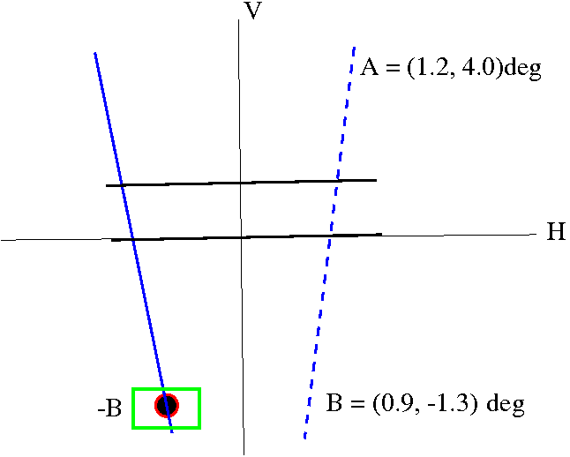
Crystal map and scans (7/30 – 8/2)
90 degree detector only, ~15 pC bunch charge
Initial scans done along the H and V axes
Beam sizes did not show any changes along the scans
X-ray counts (5mins) did not show much variation.
Over the weekend (7/30 – 7/31) points B and –B were examined with 5 min. manual scans and then longer 7x7 points scan around –B ; X-ray counts for 20 mins
There was a hot spot in the data
On 8/1, longer 1 hr scans on a 3x3 grid around the hotspot & background at (1,1) deg away from chosen spots
Goniometer Angles used by the ELBE group

Slide 3
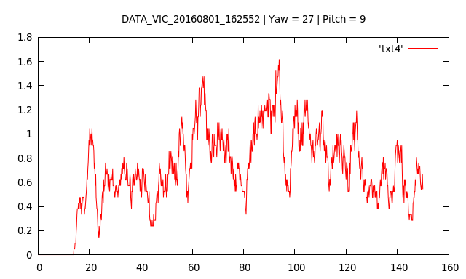
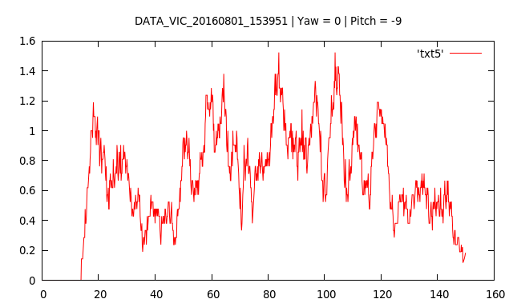
20 Minute Angular Scan
PITCH
~ 100 keV
5 minute scan
YAW

Slide 4
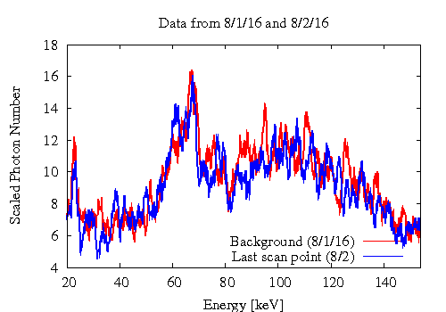
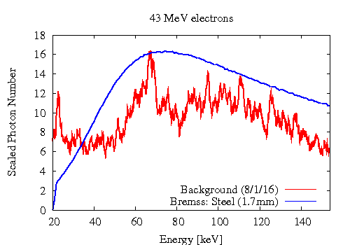
One hour scans
Data (from a scan point), Background
Background, Bremsstrahlung from steel

Slide 5
Some lessons
Spectrum in the off-axis detector was dominated by the beam and dark current that was scraped off in the chicane. Contributions from the X-rays generated by the beam going through the diamond crystal were minimal.
For the next time (among several other corrections)
Add more shielding around this detector
Check: W/o Compton scatterer, spectrum with beam and (w, w/o crystal) is nearly the same as as without beam or dark current
Reassess need for chicane to remove dark current with this detector; if still needed, then scrape less beam.
Or – move detector to other side of the beamline if possible

