Slide 1
FAST Facility MPS Upgrades For 300 MeV Operations
Arden Warner and Jin-Yuan Wu
FAST Run-2016 Ops and R&D Retreat
August 18th , 2016

Slide 2
MPS Operational issues (FAST 2016)
MPS noise induced trips
Mainly from contact signals originating from PLCs. We added some filters which reduced the noise but each contact had a different signature depending on how it was routed. We will convert to differential signals and TTL
Gun water input trips still not well understood by me
Trip record and error channel latching
We added error channel latching, functionality needs to be added to a display application
Post Mortem Analysis
Needs to be centralized
Input required from operations
Other issues
Feedback from Chip and Darren on ops.

Slide 3
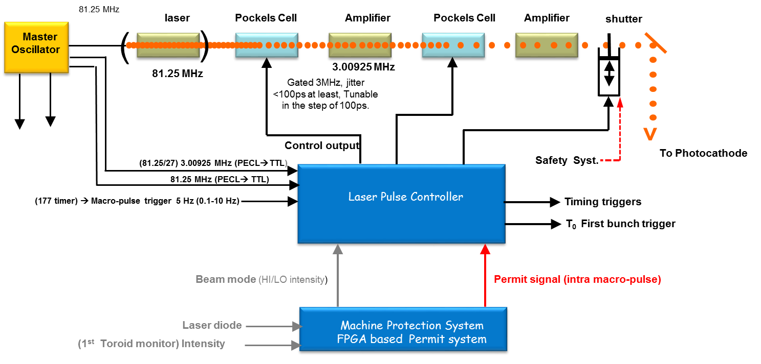
Required LPC- MPS Upgrades for 300 MeV Operations
Laser Pulse Controller (LPC)
Quantum efficiency input to qualify bunches i.e. laser diode, toroid signal and number of bunches (gate length)
Mode input
Laser shutter control
Gun RF inhibit

Slide 4
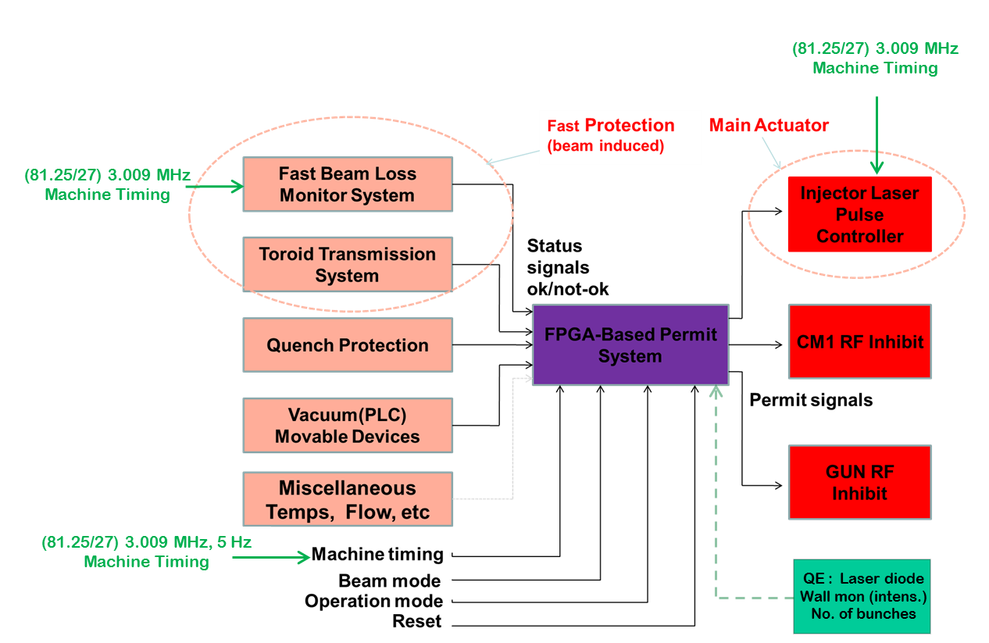
Main MPS permit system upgrade needed
Main MPS Permit System
Dipoles and critical magnets
CM1 RF inhibit
Fast protection system Loss monitors (extended)
Quench protection
Transmission losses
Beam Loading compensation
Expand movable device system and mode tables

Slide 5
Operational Requirements for 300 MeV / Summary
Fast Beam loss monitor system is more critical for 300 MeV operations
Requires a better calibration scheme
MPS
Requires a commissioning plan to operate at higher intensities
We need to install all additional system input and prepare the MPS for various operational modes as well as various beam modes.

