Slide 1
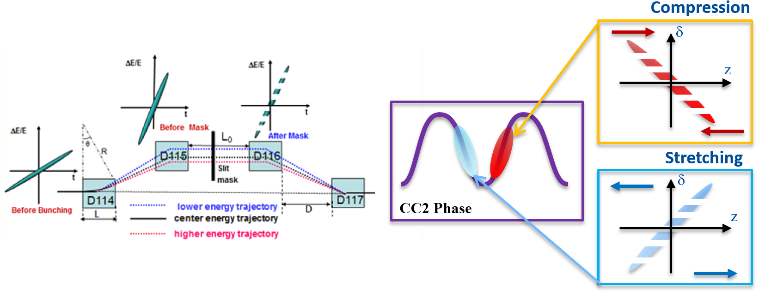
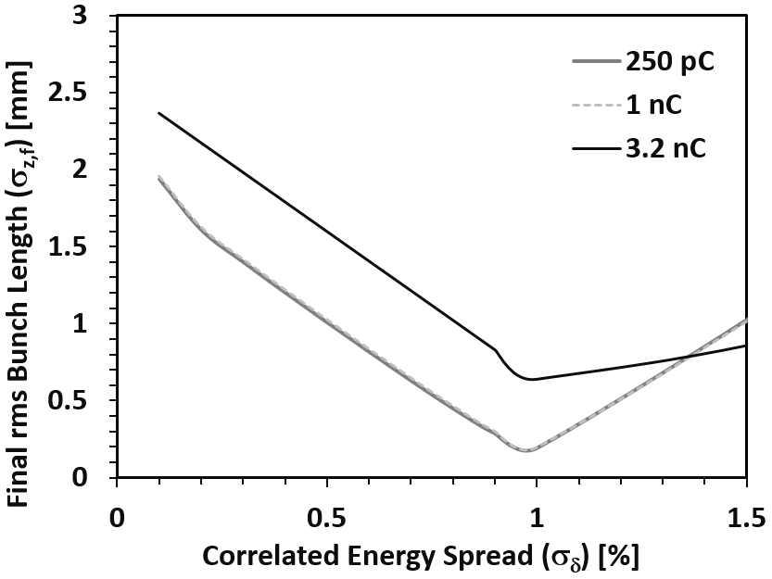
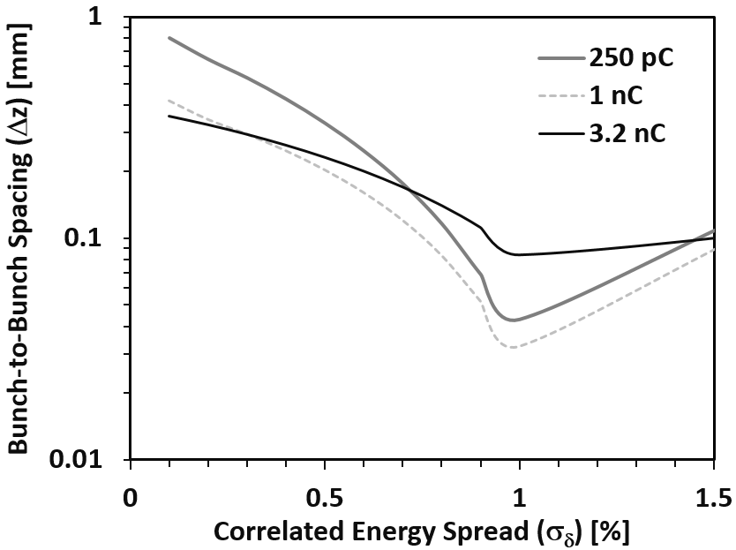
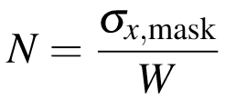
Slit-Mask Beam-Modulation Test
Motivation
This work was
For beam modulation study using a masked chicane
To demonstrate beam-shaping control of FAST linac
To continue from the 20 MeV experiment of laser year, but more focused on temporal modulation
To check micro-bunching effects on angle-dependent energy-shifts of channeling beam via crystalline targets
Objective
To identify temporal modulations responding to beam energy spreads (CC2 RF-Phases)
To characterize time structures of micro-bunches in terms of bunch charges, # of bunches, etc
To seek an indicator of energy-shift due to the presence of beam modulation effects
Input Parameters^{[4]}
σ_{δ,i} = 0.1%, R₅₆ = − 0.192 m, and η_{x} = 0.34 m
Maximum Bunching (zero-crossing)
On-Crest
Compression
Compression
η_{x,mask}: transverse dispersion at the mask, σ_{δ}: correlated energy spread
h₁: ﬁrst order chirp, R₅₆: longitudinal dispersion, σ_{z,i}: initial bunch length,
σ_{δi}:initial un-correlated RMS energy spread
[1] D.C. Nguyen, B.E. Carlsten, NIM-A 375, 597 (1996)
[2] J.C.T. Thangaraj, et. al., PRST-AB 15, 110702 (2012)
[3] X. Zhua, D.R. Broemmelsiek, and Y.-M. Shin, JINST 10 (2015)
0.04 – 0.5 mm
(0.6 – 7.5 THz)
[4] C. R. Prokop, P. Piot, B. E. Carlsten, and M. Church,NIM-A 719, 17 (2013)
Notes:
[1] Nguyen and Bruce Carlsten brought up the idea
[2] a tungsten mask with a multiple slits slices a beam into micro-bunches while the beam is being compressed
[3] Basically, if the beam is in the stretching phase with a positive slop, the beam is micro-bunched, so the sliced beamlets are physically separated
[4] and if the beam in the compression phase with a negative slop, it is modulated, which means that the sliced beamlets are superposed.
[5] This is a very simple way to create and control micro-bunches
[6] This is a first order linear equation of bunch-to-bunch spacing
[7] You first find a number of micro-bunches by diving a transverse beam size by a slit-spacing at the mask location
[8] And, you divide the bunch length by the number of micro-bunches, then it gives you a bunch-to-bunch distance or modulation wavelength.
[9] There are two key parameters to determine the bunch-spacing, correlated energy spread and slit-spacing, and maybe beam transmission
[10] About a year ago, we did some calculations with the formula
[11] For the calculation, input parameters were given by this paper, which was published by Chris Prokop, Mike Church, and Philippe,
[12] What you see here is a rms bunch length after chicane and bunch-to-bunch spacing versus correlated energy spread
[13] On-crest, the beam is not dispersed through the chicane, so it has a very small number of micro-bunches and long spacing
[14] But as the energy spread is increased, the beam size at the mask position is increased and the number of micro-bunches is increased until the energy spread reaches the maximum chirp, which is about 1 %
[15] Further increase of energy spread rather stretches the beam, so the bunch-to-bunch spacing starts to rise again.

Slide 2
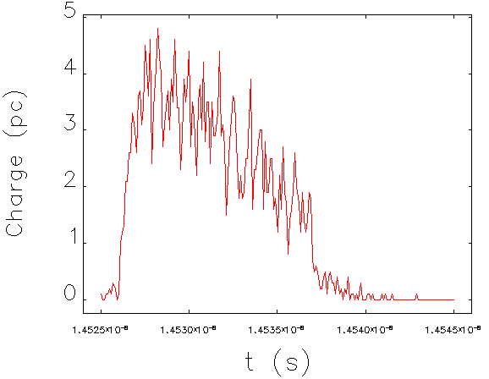
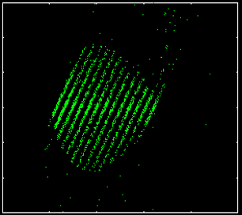
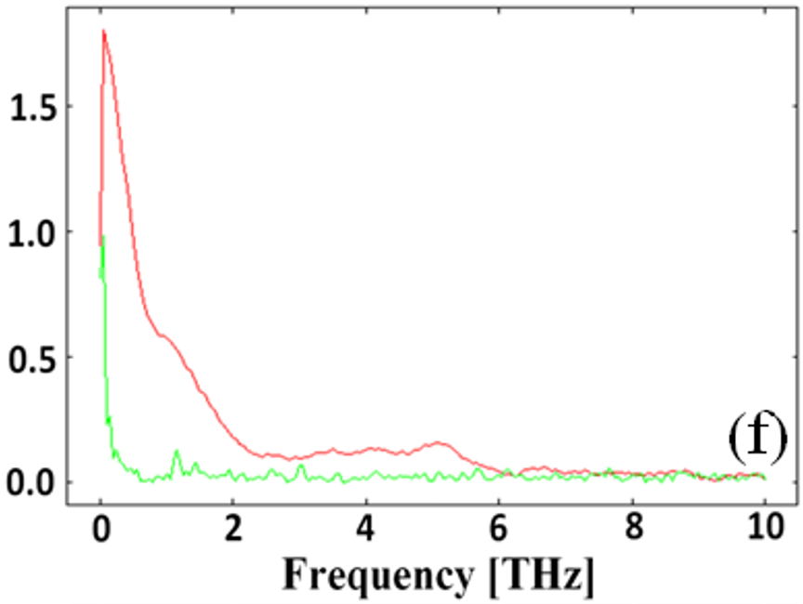
Slit-Mask Beam-Modulation Test
3. Simulations (Elegant + Shower)
Beam Energy = ~ 40 MeV
Bunch Charge = 1 nC → 333 pC (33 % Transmission)
Energy Spread → ~ 1 %
(Max. Chirp)
Location = X121
Δt ~ 0.83 ps (Δz ~ 0.25 mm, f = 1.2 THz)
x [m]
t [s]
Notes:
[1]

Slide 3
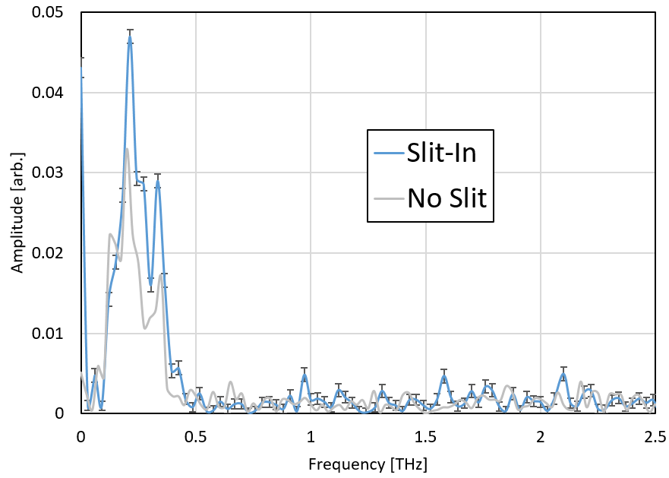
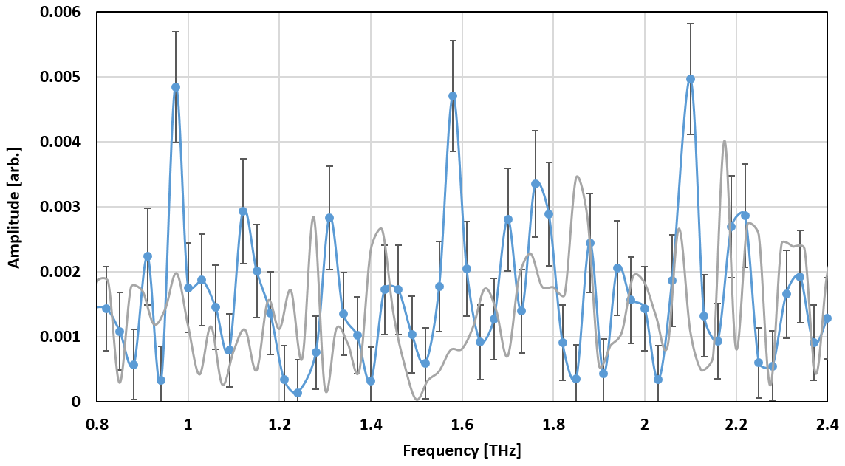
Initial Data Measurement
Beam Time (2 Shifts)
1) 1:30 – 7:00 pm, Monday (07/18/2016)
Study time: 05:00 – 07:00 pm (2 hrs)
: due to delays of system startup caused by
- Technical problems
- HOM filter installation/test
2) 8:00 am – 4:00 pm, Monday (07/25/2016)
Study time: 12:00 – 04:00 pm (4 hrs)
: beam conditioning and MPI setup
2. Study Condition
Beam Energy: 42 – 43 MeV
Bunch charge: 240 pC (slit-out), 80 pC (slit-in)
# of Bunches: 50
With Slit-in (07-18-16)
CC2 Gradient: ~ 15.2 MV/m, CC2 Phase: ~ 77 Deg
(~ 27 Deg-off from on-crest (104 deg))
Bunch Charge: ~ 73 pC (1/3 of 220 pC)/150 bunches/27 DOC
Intensity [Arb.]
Intensity [Arb.]
Notes:
This is outline

Slide 4
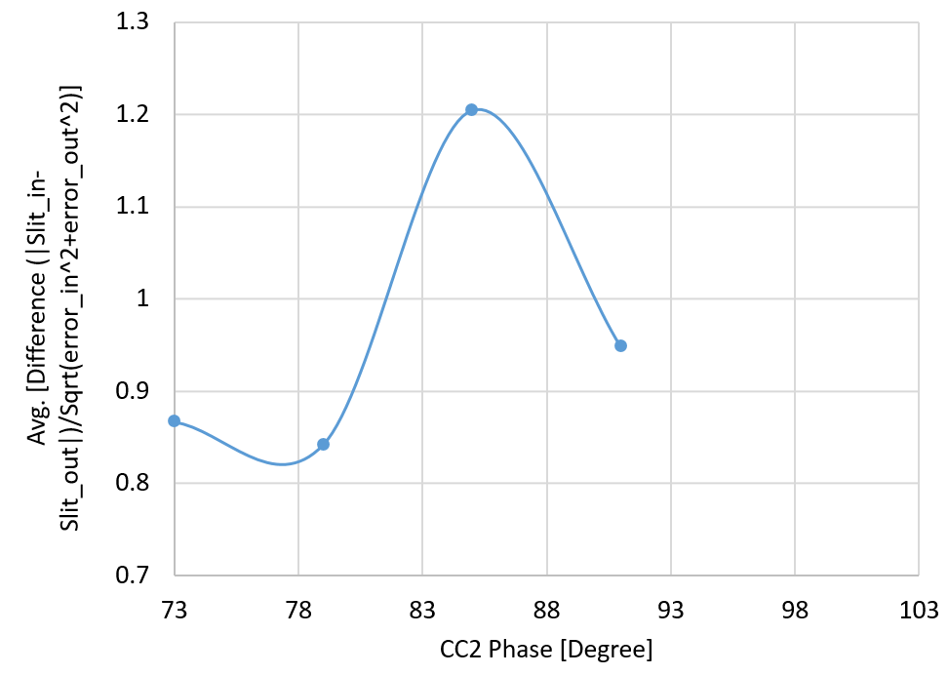
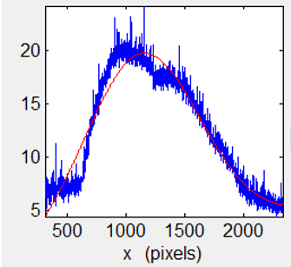
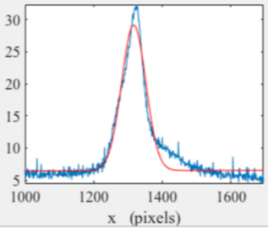
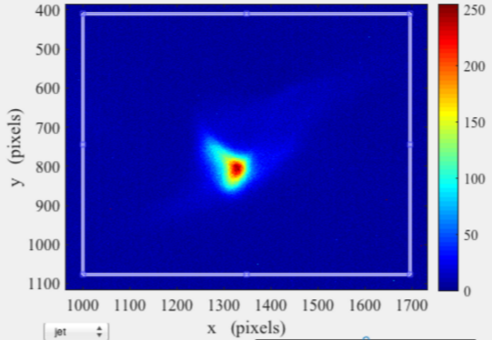
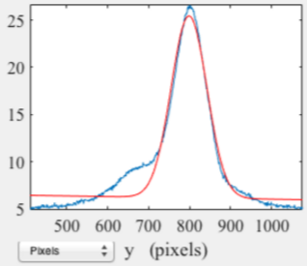
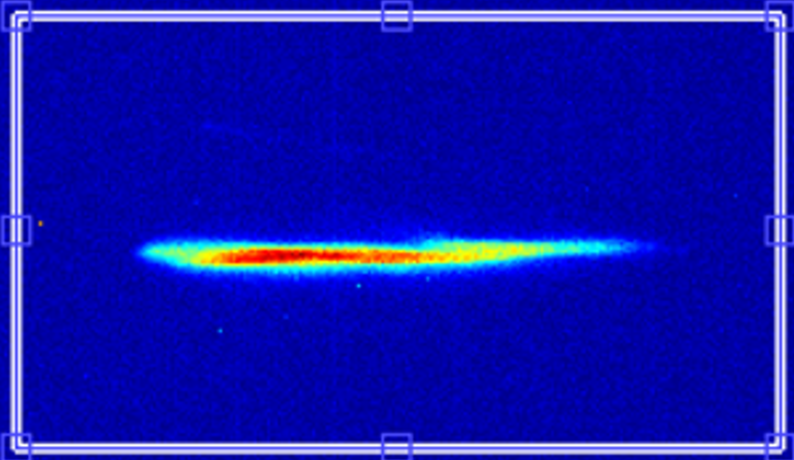
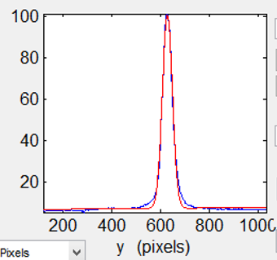
Summary of Preliminary CC2 Phase-Scan
Off-crest: Weak signal detected (no autocorrelation plot)
Over-bunched
Max. Bunching Condition: Zero-Crossing (77 – 78 Deg, 15.64 MV/m)
On-crest (103 Deg, 14 MV/m)
: No Signal Detected
σ_{h} = 4.8 mm
σ_{h} = 0.273 mm
σ_{v} = 0.382mm
σ_{v} = 0.18mm
Notes:
[1] Only have less than 30 min for MPI measurement
[2] Last Wednesday, compressed beam measured by MPI, CC2 gradient (14 MV/m) CC2 phase: 77 deg, bunch charge 60 pC, it is not much different from 73 pC
[3] This is autocorrelation plot with and without the slit
[4] These plots all seem to follow auto-correlation curve,
[5] but the slit-in has more of high frequency components in the tail of the plot
[6] These high frequency components more clearly appear in the frequency spectrum
[7] FFTed spectrum. The high frequency peaks, they aren’t very strong, but seem bigger than uncertainties.
[8] these peaks will be shifted down and their intensity will be much larger as CC2 phase is getting closer to on-crest condition.
[9]

Slide 5
Lesson from the Preliminary Tests (1st FAST Run)
Experimental Perspective
1) 80 pC/240 pC was still in a low SNR range, which is marginally close to statistic deviation range → The FFTed spectra are quite noisy: Not sufficient level of signal → Higher charge experiments (≥ 300 pC/1 nC) required
2) Micro-bunch spacing in compression-phase might be too small? → Too weak modulation → wider phase-scan from compression-phase to stretching phase (~ 103 Deg → 53 Deg) required
3) Frequency-Resolution of FFTed MPI signals was not fine enough to identify modulation peaks → Longer MPI-scan in time Required
2. Facility Operating Perspective
1) Still beam condition was somewhat unstable/unpredictable and optics setup was not also reproduceable → preparing a beam study was often significantly retarded → consumed an allocated time for experiment → For users, preparing beam-optics for experiments is burden and inefficient → Turn-key and user-friendly operation
2) Commissioning new diagnostic tools (MPI, streak camera, bunch length monitor) was not fully established still → Existing systematic errors
3) Large beam emittance (> 1 mm-mrad) → increased scatterings/noises on micro-bunched beam spectrum and reduced channeling beam transmission
3. Considerations for Next Experiments
1) Plan a study with the practical beam parameters found in the first beam-time cycle
2) Prioritize main parts of the test in order of experimental procedure for the most efficient beam-time usage
3) Maximize available beam-time (night shift, weekend, etc)
Notes:
[1] Only have less than 30 min for MPI measurement
[2] Last Wednesday, compressed beam measured by MPI, CC2 gradient (14 MV/m) CC2 phase: 77 deg, bunch charge 60 pC, it is not much different from 73 pC
[3] This is autocorrelation plot with and without the slit
[4] These plots all seem to follow auto-correlation curve,
[5] but the slit-in has more of high frequency components in the tail of the plot
[6] These high frequency components more clearly appear in the frequency spectrum
[7] FFTed spectrum. The high frequency peaks, they aren’t very strong, but seem bigger than uncertainties.
[8] these peaks will be shifted down and their intensity will be much larger as CC2 phase is getting closer to on-crest condition.
[9]

Slide 6
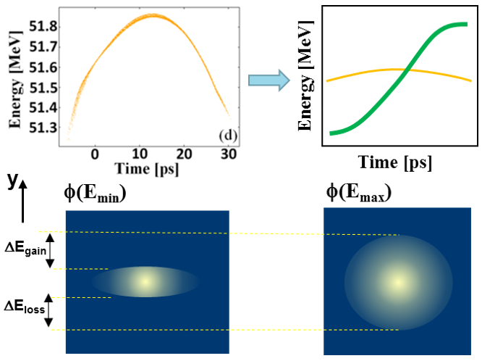
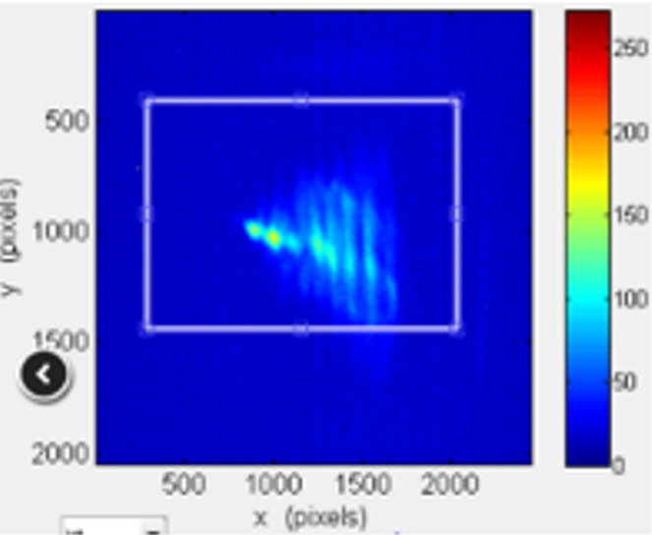
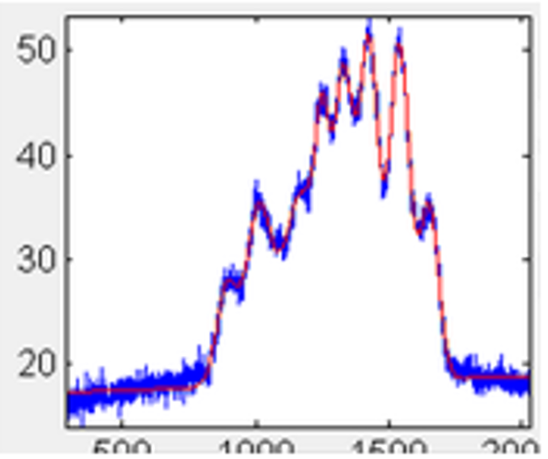
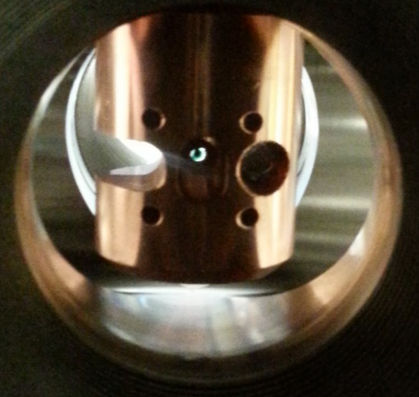
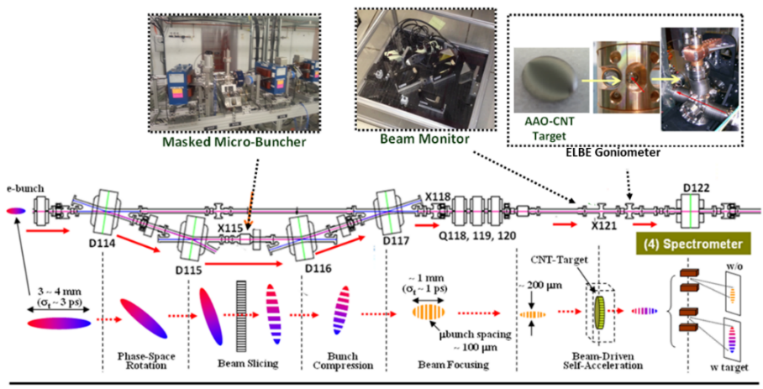
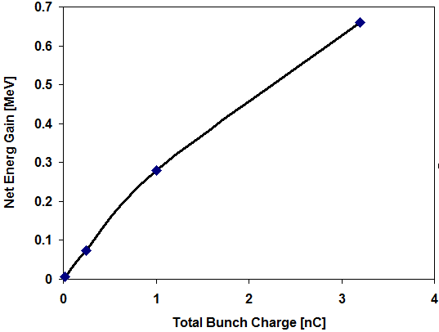
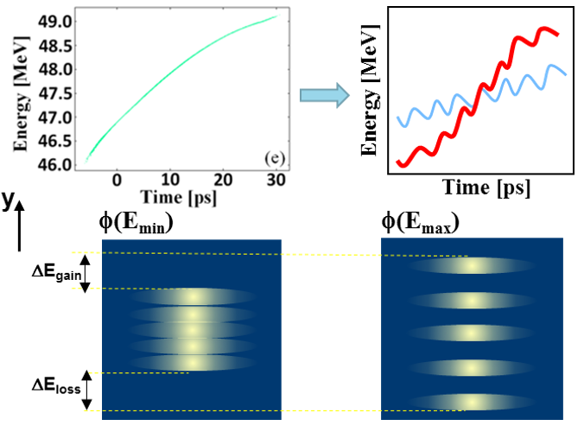
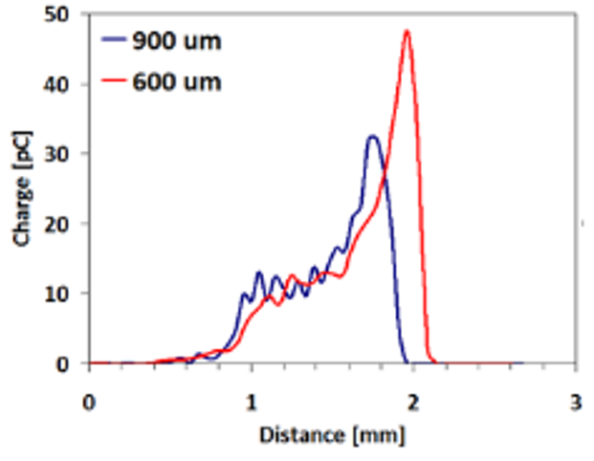
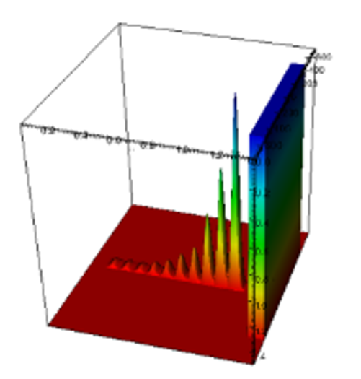
Proposed Experiments for Next Run
1. Beam Modulation + Energy Measurement (w Diamond Crystal)
Y. M. Shin, A. H. Lumpkin, and R. M. Thurman-Keup, NIMB (2015)
Beam Energy = 42 MeV
Waist Size = 50 μm
Emittance = 1 mm-mrad
Bunch charge = 300 pC – 1 nC
On-Crest w/o Beam Modulation
Beam Image @ X124
Diamond
Off-Crest with Beam Modulation
The goals of this experiment are to
Determine micro-bunching conditions of a beam going through the X115 slit-mask in the BC1 chicane and characterize modulation-signals in the frequency-domain (MPI) in terms of bunch charges (100 pC, 250 pC, 1 nC) and CC2 RF-phases (on-crest and off-crest)
Determine energy shifts (X124) of the modulated beam with a scan of crystal angles in terms of compression condition (on-crest and off-crest).
- Use the MPI/streak camera to measure beam modulation frequencies (with a X115 slit in) vs CC2 phase and charge: Scan rf phase from on-crest to a max compression, while recording beam-signals/spectra (MPI) and images (X121) with 5 degree steps in phase.
- Record images at X124 with crystal-in on scanning crystal-angles with on-crest and max-compression.
CC2 Phase Scan
Preset (on-crest)
Gun gradient: 35 MV/m, Bunch charge: 80 pC, # of bunches: 150, CC2 gradient/phase: 14 MV/m, 104 deg
Data Acquisition
- On-crest measurement (CC2: 104 deg)
Minimize a beam size at X121 with chicane on and without slit: on-crest (CC2: 14 MV/m, 104 deg) and 80 pC, 150 bunches
Take beam images at X115, X121, and X124
With on-crest condition, run MPI and streak camera and take beam signal data before putting slit in (reference)
Place the slit in-position, increase the bunch charge to 240 pC (make sure the beam size does not change at X121), and save images at X121 and X124
Run MPI/streak camera-measurements and save the data
- Off-crest measurement (CC2: 101 deg – 3 deg off)
Change CC2 phase to 101 deg (14 MV/m)
Minimize the beam size at X121 (with the slit out and 80 pC bunch charge) and take beam images at X115, X121, and X124
Repeat 3) – 5)
- Off-crest measurement (CC2: 98 deg – 6 deg off)
Change CC2 phase to 98 deg (14 MV/m)
Minimize the beam size at X121 (with the slit out and 80 pC bunch charge) and take beam images at X115, X121, and X124
Repeat 3) – 5)
- CC2 Phase scan
Finish CC2 Phase scan: Repeat from (1) to (5) until CC2 phase: 77 deg with 3 deg step
Charge Scan
Repeat 1) to 13) with bunch charges = 480 pC and 960 pC (with the slit-in)
Energy-Shift Measurements (via Crystal target)
Find CC2 phases for an optimum beam modulation condition for 240 pC (80 pC), 480 pC (160 pC), and 960 pC (320 pC) from “CC2 Phase scan”
Transport beam via chicane and a crystal without the slit in with bunch charge: 80 pC
Set CC2 phase with an optimal number for beam-modulation (from the “CC2 Phase scan”)
Take a beam image at X124
Increase the bunch charge to 240 pC and place the slit in position
Run angle-scan of crystal-orientation (0.1 mrad step over 5 mrad) with manual acquisition of X124 images each step
Run angle-scan of crystal-orientation (0.1 mrad step over 5 mrad) with manual acquisition of X124 images each step
Repeat 1) to 7) with 480 pC and 960 pC
Notes:
[1] Only have less than 30 min for MPI measurement
[2] Last Wednesday, compressed beam measured by MPI, CC2 gradient (14 MV/m) CC2 phase: 77 deg, bunch charge 60 pC, it is not much different from 73 pC
[3] This is autocorrelation plot with and without the slit
[4] These plots all seem to follow auto-correlation curve,
[5] but the slit-in has more of high frequency components in the tail of the plot
[6] These high frequency components more clearly appear in the frequency spectrum
[7] FFTed spectrum. The high frequency peaks, they aren’t very strong, but seem bigger than uncertainties.
[8] these peaks will be shifted down and their intensity will be much larger as CC2 phase is getting closer to on-crest condition.
[9]

Slide 7
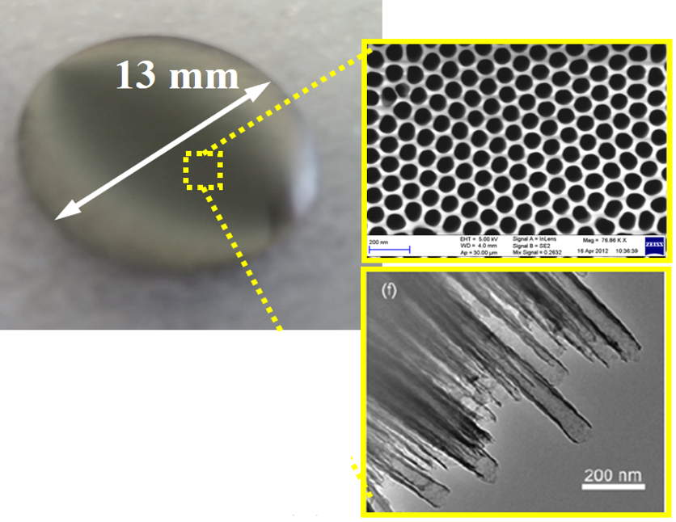
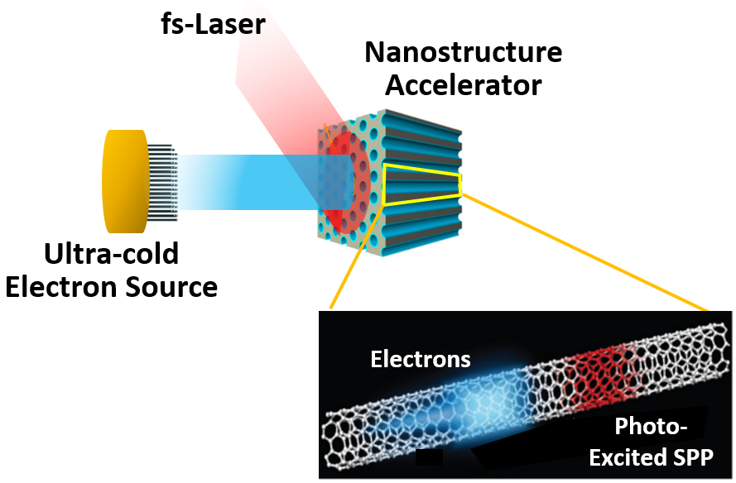
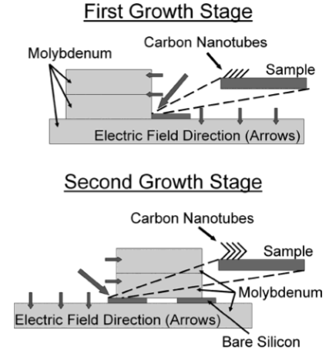
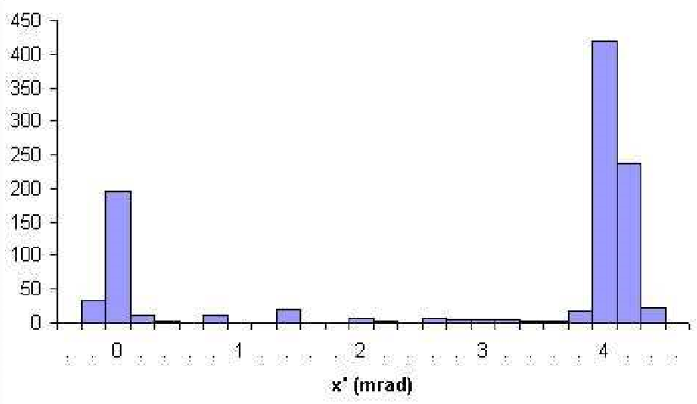
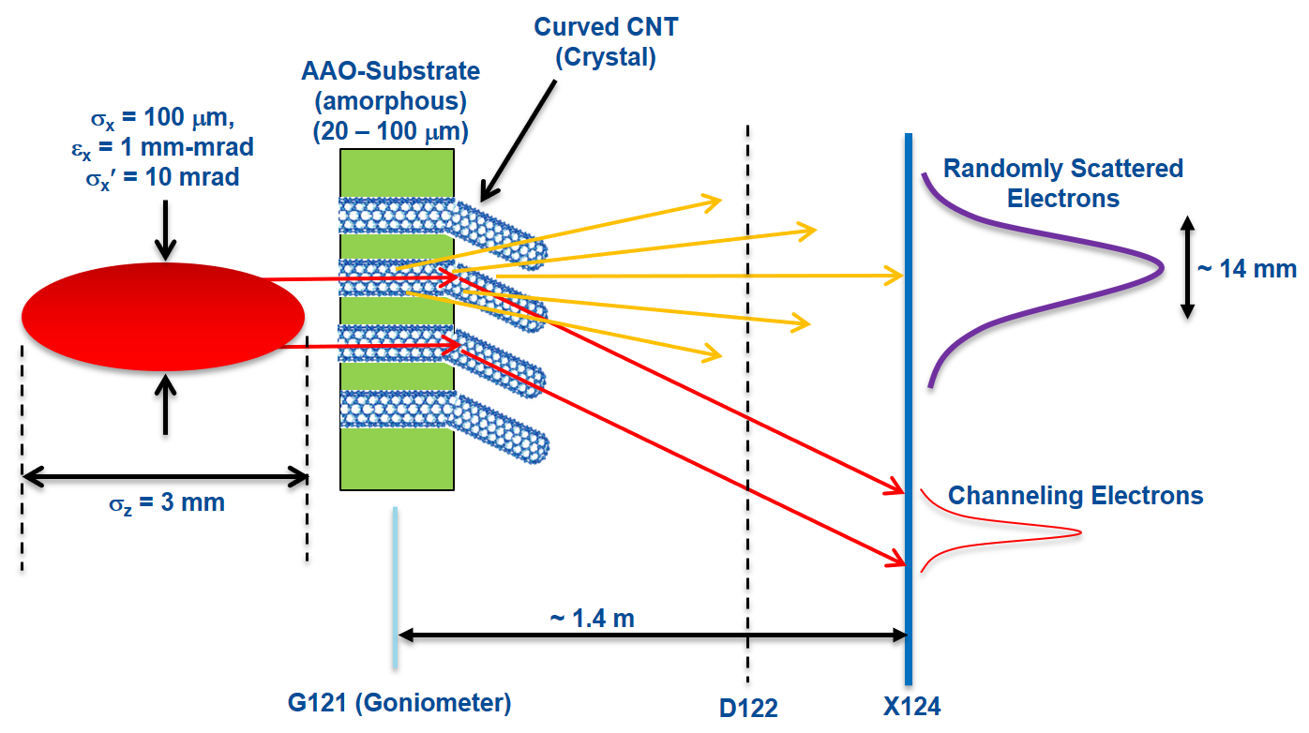
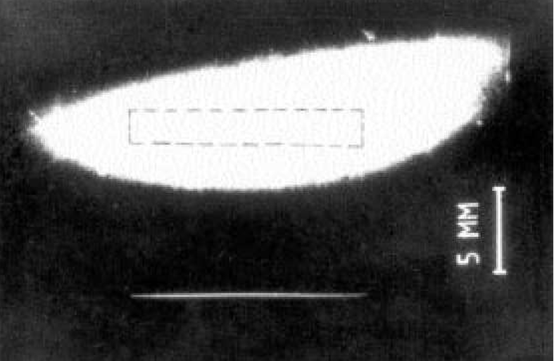
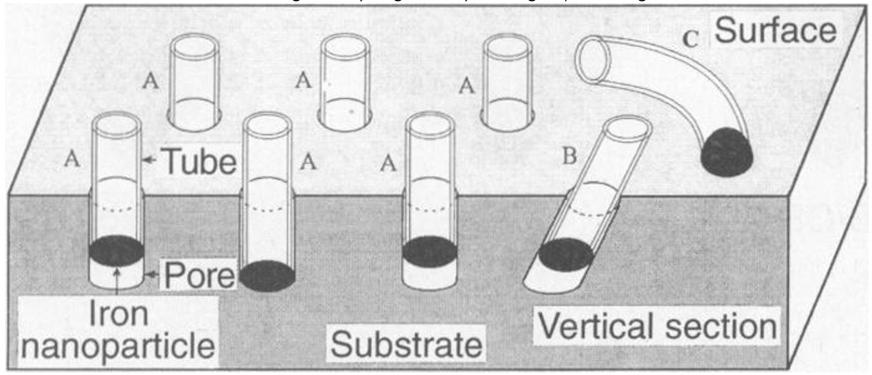
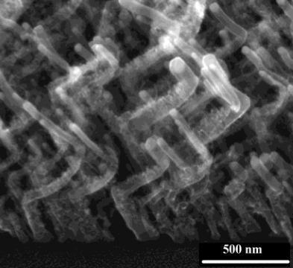
Proposed Experiments for Next Run
2. Beam Transmission/Energy-Shift Measurement (w CNT-Target)
CNT-Target
1] Channel size ↑ → Screening potential ↓ (∝ exp(- channel size)) → Beam Coupling ↑
2] Critical angle ~ 2 mrad → 100 nm in diameter/ 100 micron in length → 10 nm in diameter/10 micron in length
Channeling Electrons
To be fabricated by NIU Collaborators (T. Xu, K. T. Cho: Chemistry, EE)
The angular distribution of particles downstream of the bent nanotube, in the direction of bending (IHEP, INFN, 2002)
Wall-Density Perturbation
1- 10 nm
3. Beam-Steering Tests with a Curved CNT-Target → Possible channeling-radiation test (?)
De-channeling
σ_{x} = 100 μm
σ_{x}′ = 5 mrad
ε_{x} ≤ 0.5 mm-mrad
Qb ≤ 1 pC
1 – 10 nm
channeling
x
x
z
y
y
z
Joseph F. et.al, Nano-letters, 2004
Notes:
[1] Only have less than 30 min for MPI measurement
[2] Last Wednesday, compressed beam measured by MPI, CC2 gradient (14 MV/m) CC2 phase: 77 deg, bunch charge 60 pC, it is not much different from 73 pC
[3] This is autocorrelation plot with and without the slit
[4] These plots all seem to follow auto-correlation curve,
[5] but the slit-in has more of high frequency components in the tail of the plot
[6] These high frequency components more clearly appear in the frequency spectrum
[7] FFTed spectrum. The high frequency peaks, they aren’t very strong, but seem bigger than uncertainties.
[8] these peaks will be shifted down and their intensity will be much larger as CC2 phase is getting closer to on-crest condition.
[9]

Slide 8
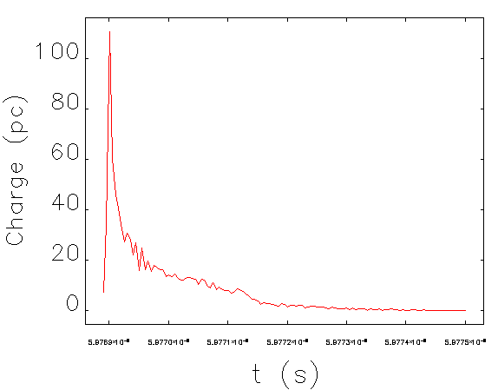
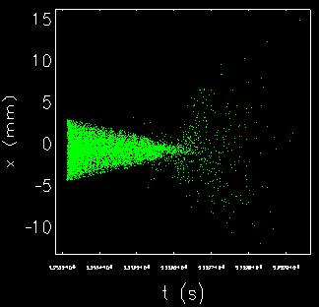
Slit-Mask Beam-Modulation Test
3. Simulations (Elegant + Shower)
This work was
For beam modulation study using a masked chicane
To demonstrate beam-shaping control of FAST linac
Notes:
This is outline

