Slide 1
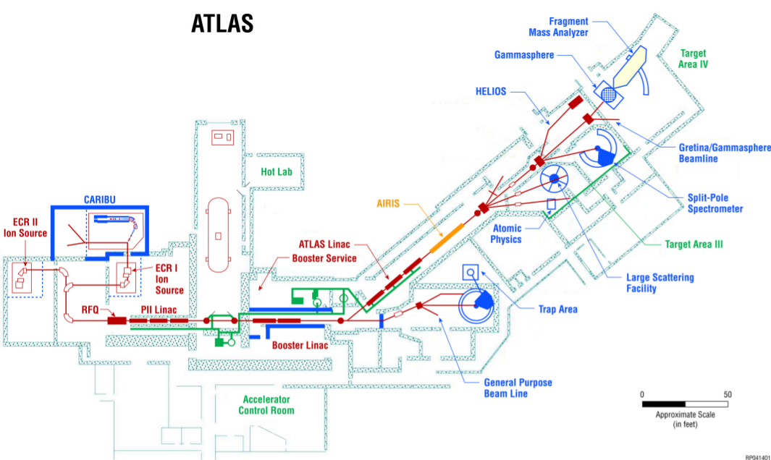
ATLAS Beamline Tuning and characterization
Lee Teng Fellowship
drhgfdjhngngfmhgmghmghjmghfmf
RAHEEM BARNETT
Mentors: Brahim Mustapha and clay dickerson
Argonne National Laboratory
PHY Division
Princeton University
Physics Department
Aug. 2016

Slide 2
Introduction and motivation

Slide 3
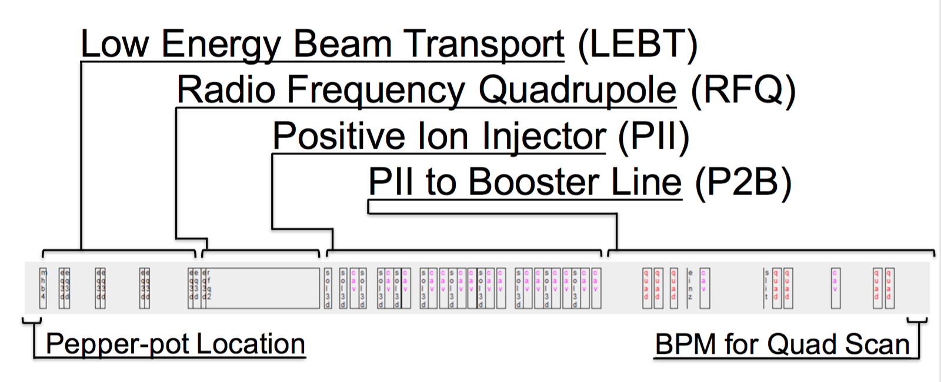
ATLAS Beamline
Overview of beamline sections
Accelerates ions from H to U
m/q ratio of up to 6
7-17 MeV/u
Notes:
PII superconducting linac – made of many resonators

Slide 4
Overview
March 2016 Runs
Purpose:
Test how accelerator handles high intensity beams
52nA to 5.2uA beams
Results:
Found beam transmission was low
90.3% through P2B when 100% should have been easily achievable
Project:
Find where this beam loss and quality degradation are occurring early on to
Prevent quenching of superconducting components
Prevent vacuum degradation from outgassing
Prevent damage to parts not designed to handle the energy deposited by lost particles
Calculate emittance at RFQ from quadrupole scan data taken on March 10th
Notes:
52nA to 5.2uA beams

Slide 5
Track beamline simulations
Popular Beam Dynamics Simulation Software
Used for:
Visualization of the beam envelope along the beamline
Verification of experimental results

Slide 6
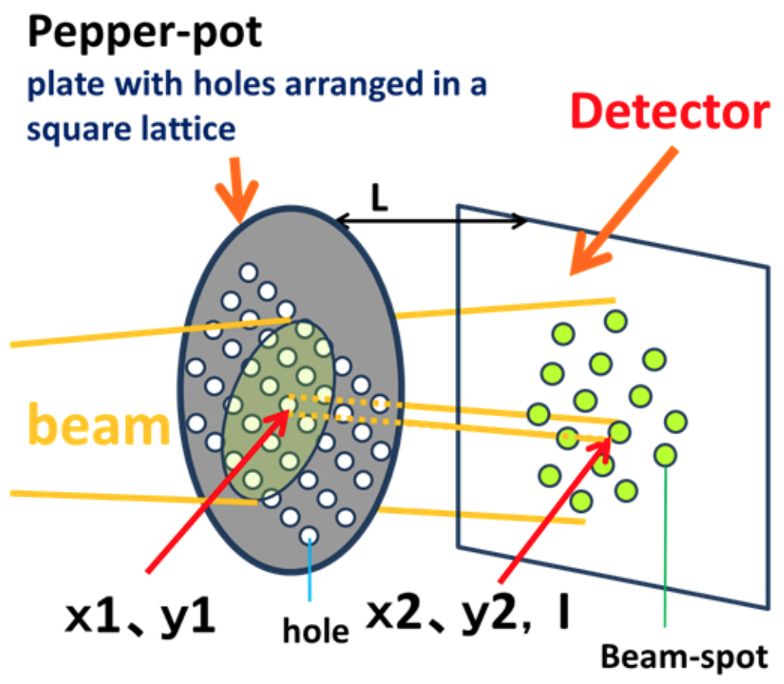
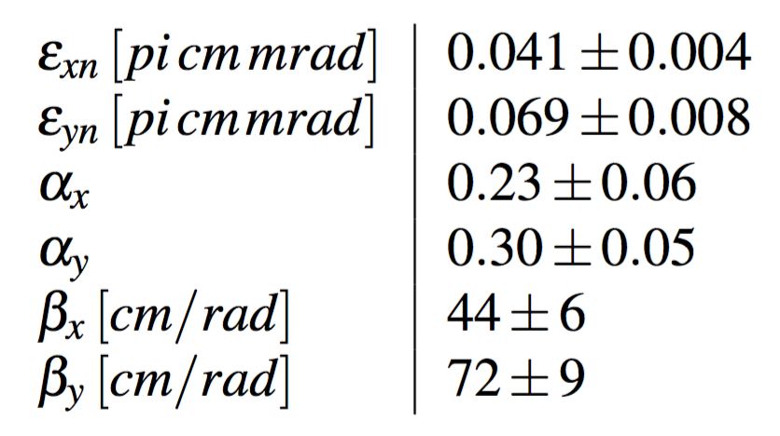
Pepper-pot Detector
Finding Beam Initial Conditions
Notes:
Position and angle (delta from holes to screen) gives you transverse emittance

Slide 7
Optimization overview
Comparison between the recorded focusing element strengths and values optimized for beam transmission in TRACK
Simulation with Recorded Focusing Strengths
Optimized Focusing Strengths
TRACK Simulated Results
From Measured Data
Notes:
83% is standard through RFQ in main bunch, the 88.1% through RFQ+PII is probably from satellite bunches

Slide 8
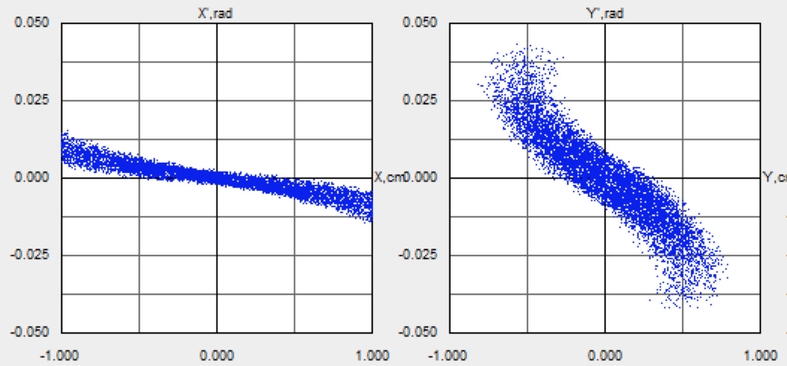
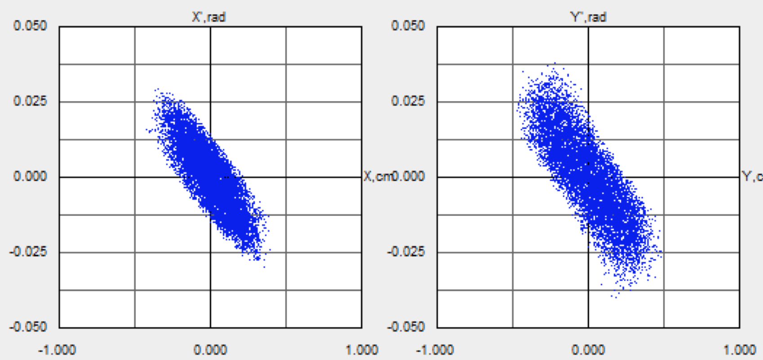
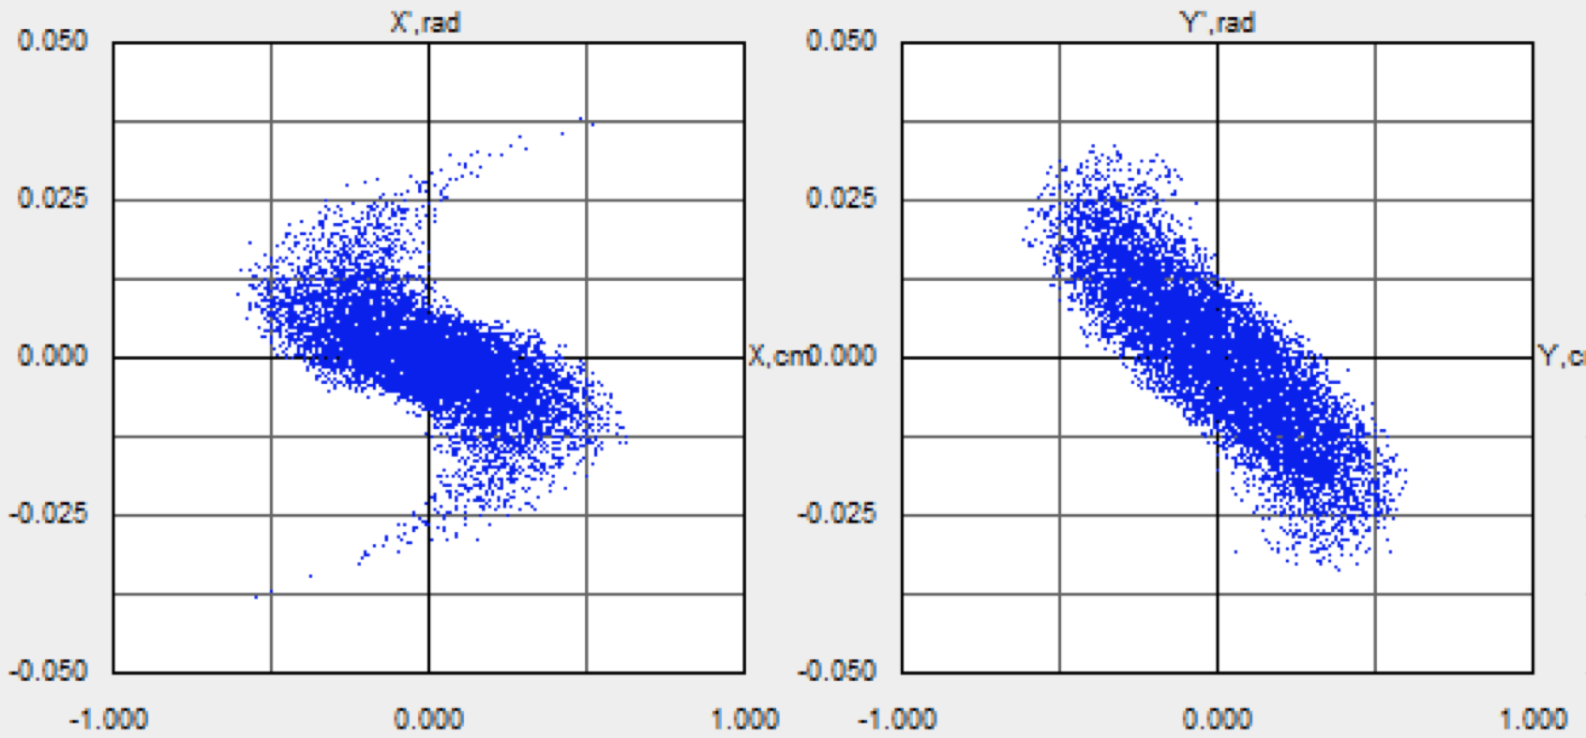
ACCELERATOR Beamline
Low Energy Beam Transport Line (LEBT)
Simulation with Recorded Focusing Strengths
RFQ Acceptance Matched
Solns. find 100% Transmission
LV Quads 42.4% avg. diff.
HV Quads 17.0% avg. diff.
HV𝜺 31.8% larger than LV𝜺
Optimized Low Voltage Focusing Strengths
Optimized High Voltage Focusing Strengths
Notes:
2 Optimized Solutions
Solutions have 100% transmission (what the operators are going on, can’t see emittance)

Slide 9
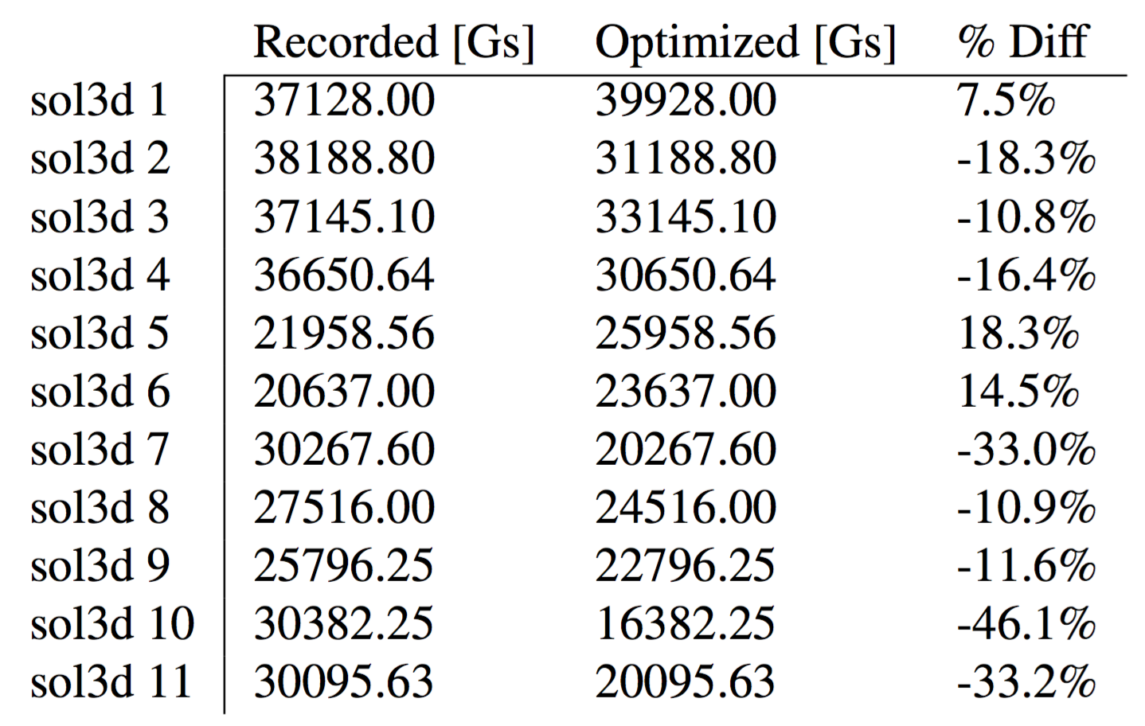
ACCELERATOR Beamline
Positive Ion Injector (PII)
Simulation with Recorded Solenoid Strengths
Optimized Solenoid Strengths
20.1% avg. difference between recorded and optimized solenoid strengths
100% Transmission

Slide 10
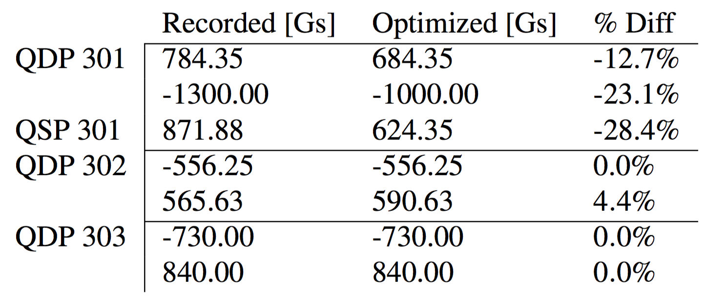
ACCELERATOR Beamline
PII to Booster Line (P2B)
Simulation with Recorded Quadrupole Strengths
Optimized Quadrupole Focusing Strengths
Beam envelope converges as intended after quad doublet
13.6% avg. diff. from optimized values

Slide 11
Quadrupole scan technique
Practical for any location with Sequential Quadrupole(s) and BPM
Used for:
Calculation of beam emittance and Twiss parameters

Slide 12
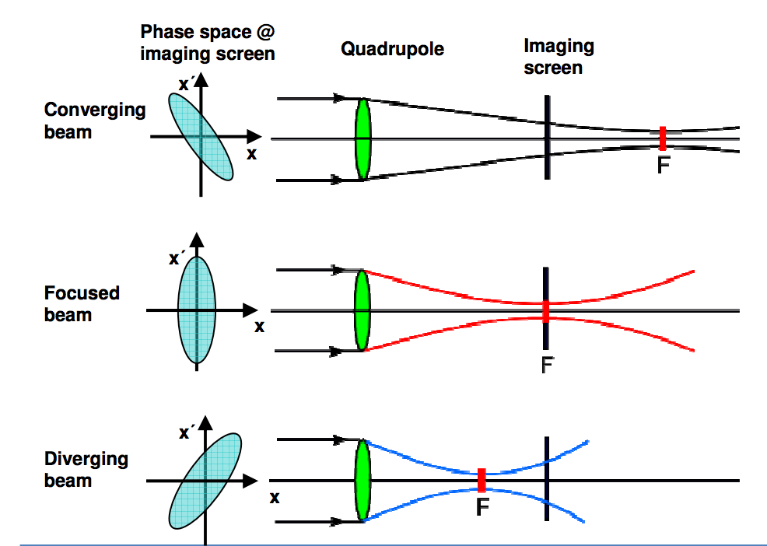
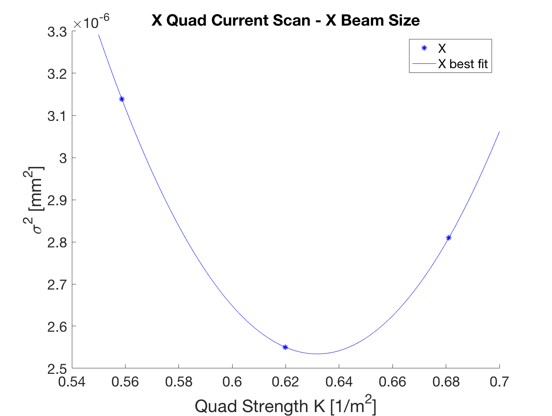
Quadrupole Scan Geometry
PII to Booster Line (P2B)
Single-Quad Scan
Quad-Doublet Scan

Slide 13
Quadrupole scan formalism
Quick overview of the beam matrix and emittance
Statistical distribution of particles in phase space described by an ellipse
Beam matrix sigma can describe the geometric properties of this ellipse
Emittance = area of the ellipse, found by the square root of the beam matrix

Slide 14
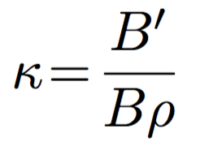
Quadrupole scan formalism
Quick overview of transfer matrices
(1)
(1)&(2) Transfer matrices for focusing and defocusing quadrupole magnets
(3) Focusing strength of a quadrupole magnet
(4) Transfer matrix for a drift
(5) Complete transfer matrix for quadrupole scan geometry
(6) Beam matrix propagated from point s₀ to point s
(2)
(3)
(4)
(5)
(6)
Notes:
B’ field gradient (strength over aperture)

Slide 15
Quadrupole scan formalism
Quadrupole Scan Calculation
Propagation of beam matrix through quad geometry
s – BPM location
s₀ – Start of first quad
(2) First element of resulting beam matrix
(3) When 3 or more measurements are taken this becomes a fully constrained system of equations with three unknowns
(4) A Moore-Penrose pseudoinverse as a least squares fit can be used to find the matrix elements
(5) Emittance calculation
(1)
(2)
(3)
(4)
(5)

Slide 16
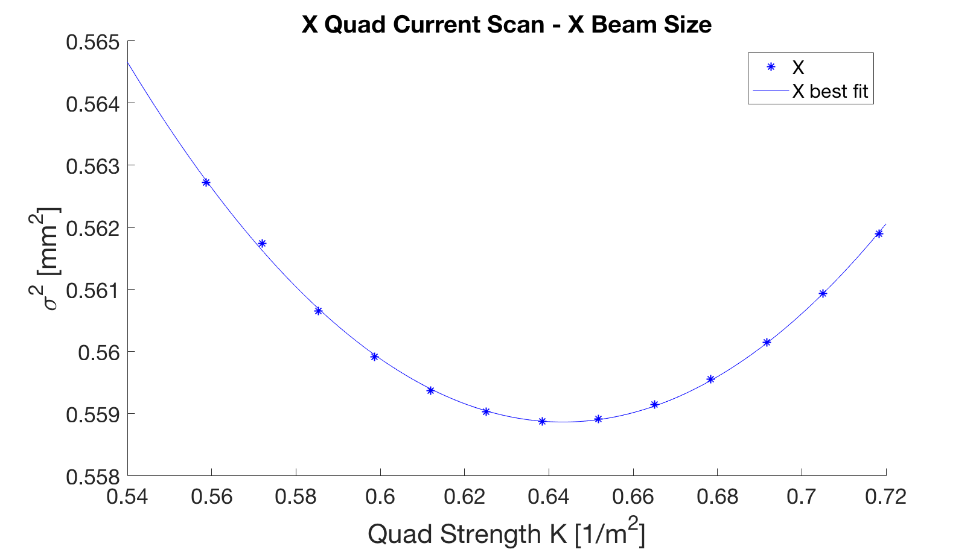
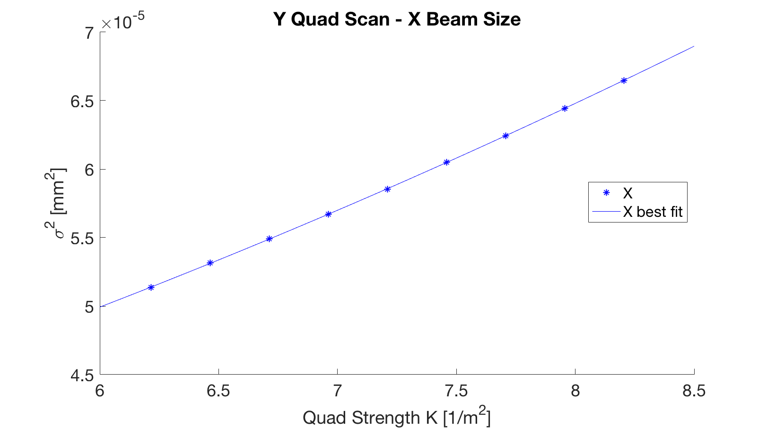
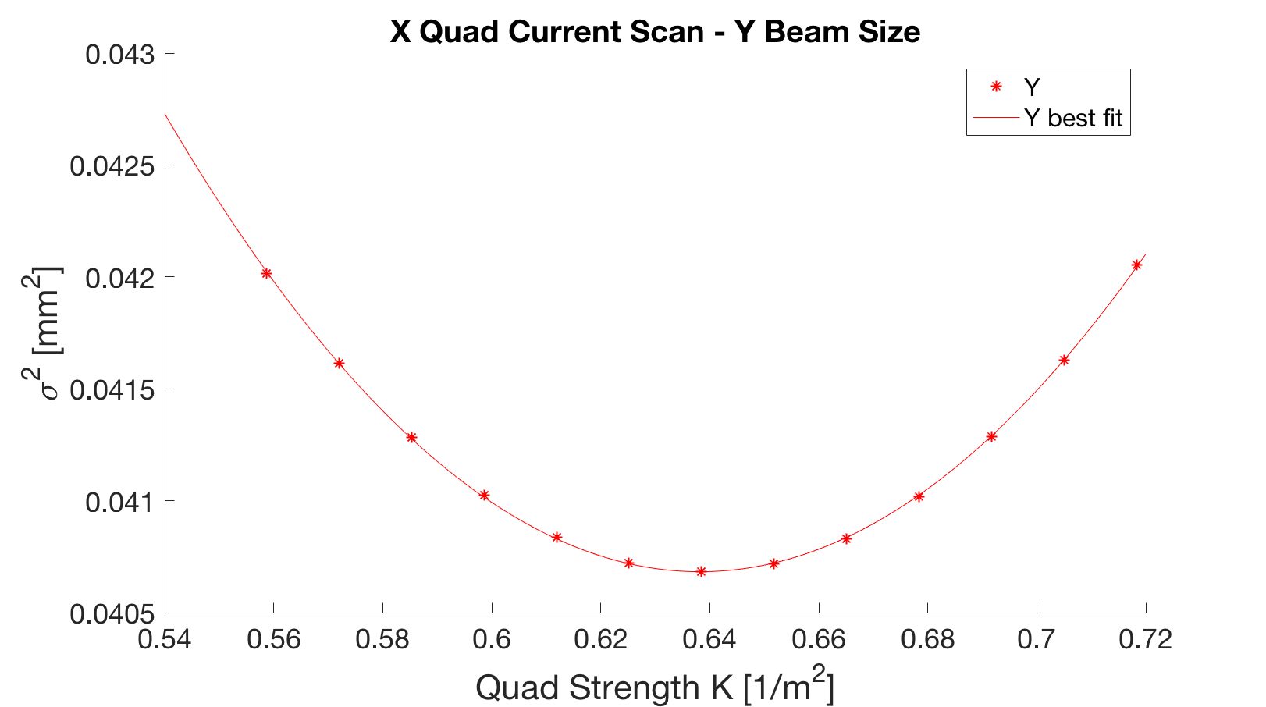
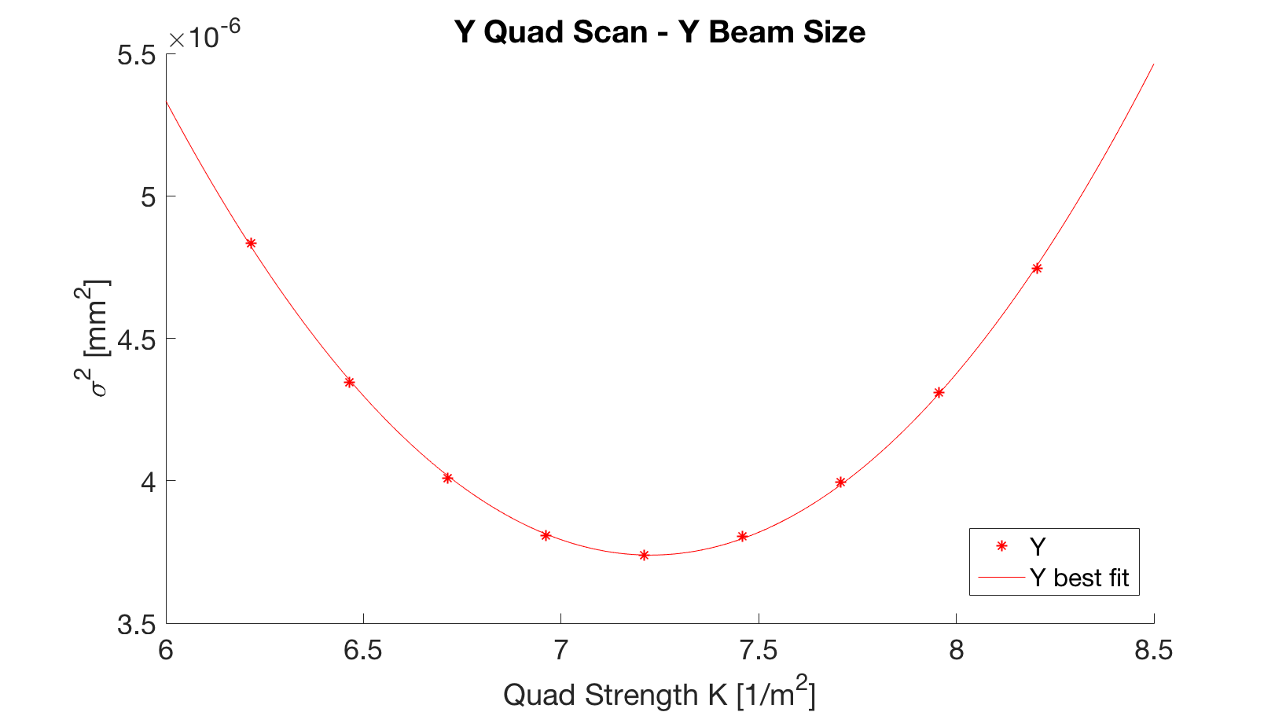
Quadrupole scan test Simulation
Comparison of symmetric and asymmetric scans about beam waist

Slide 17
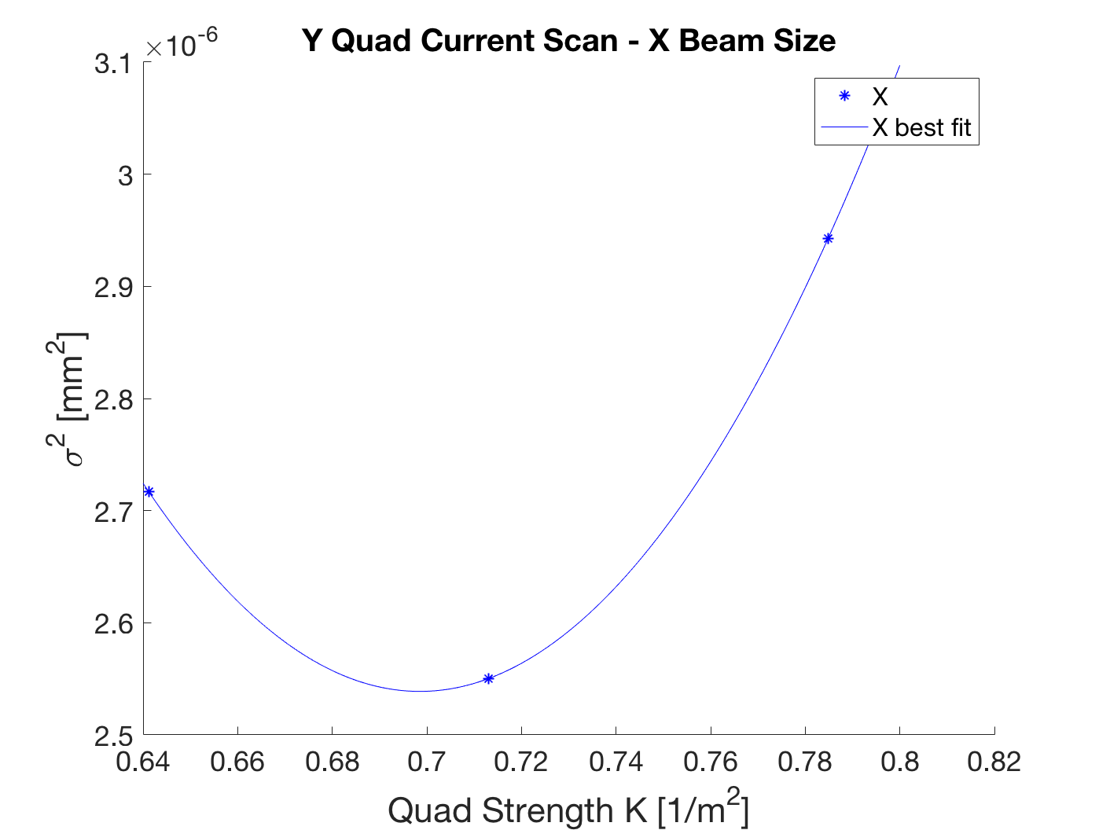
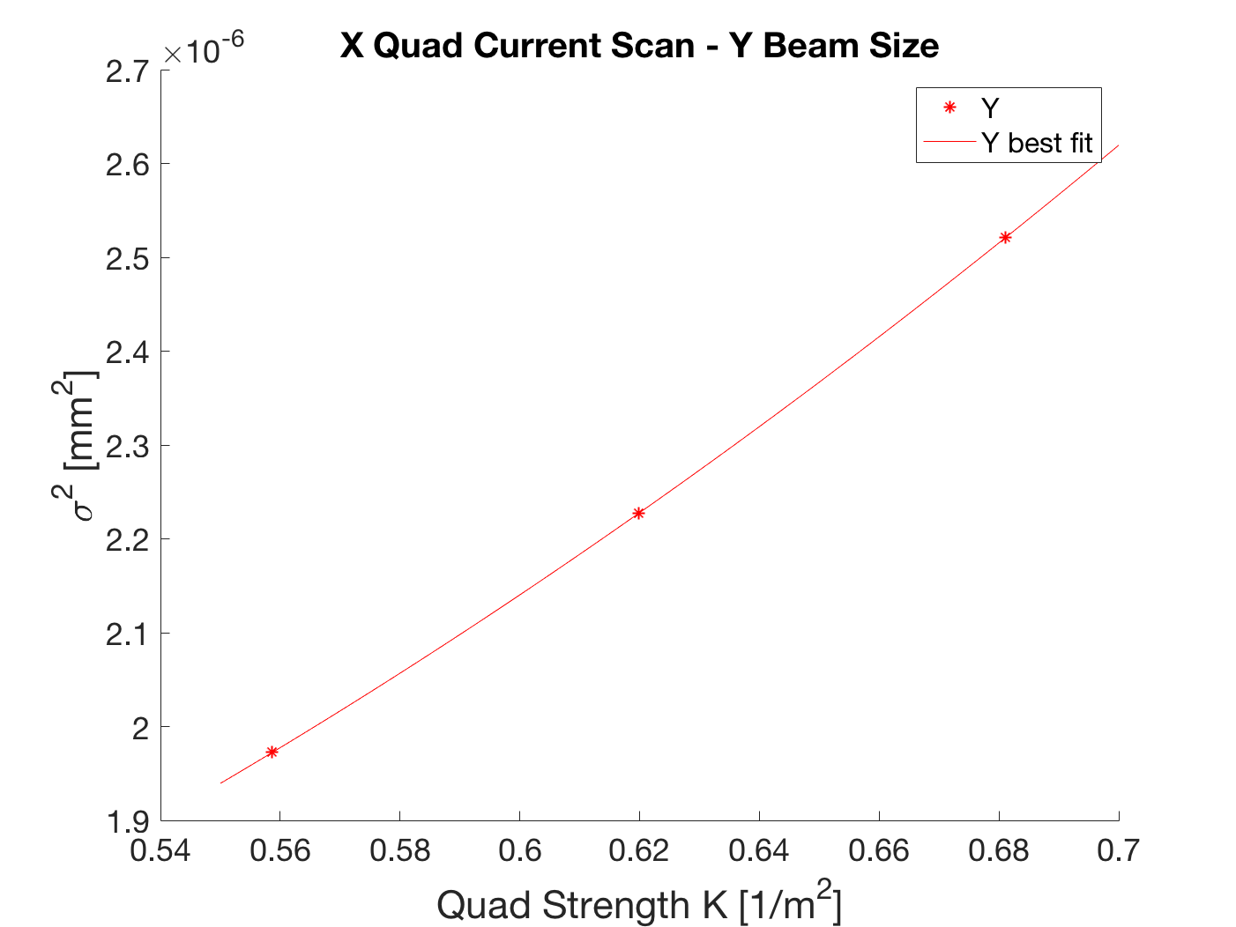
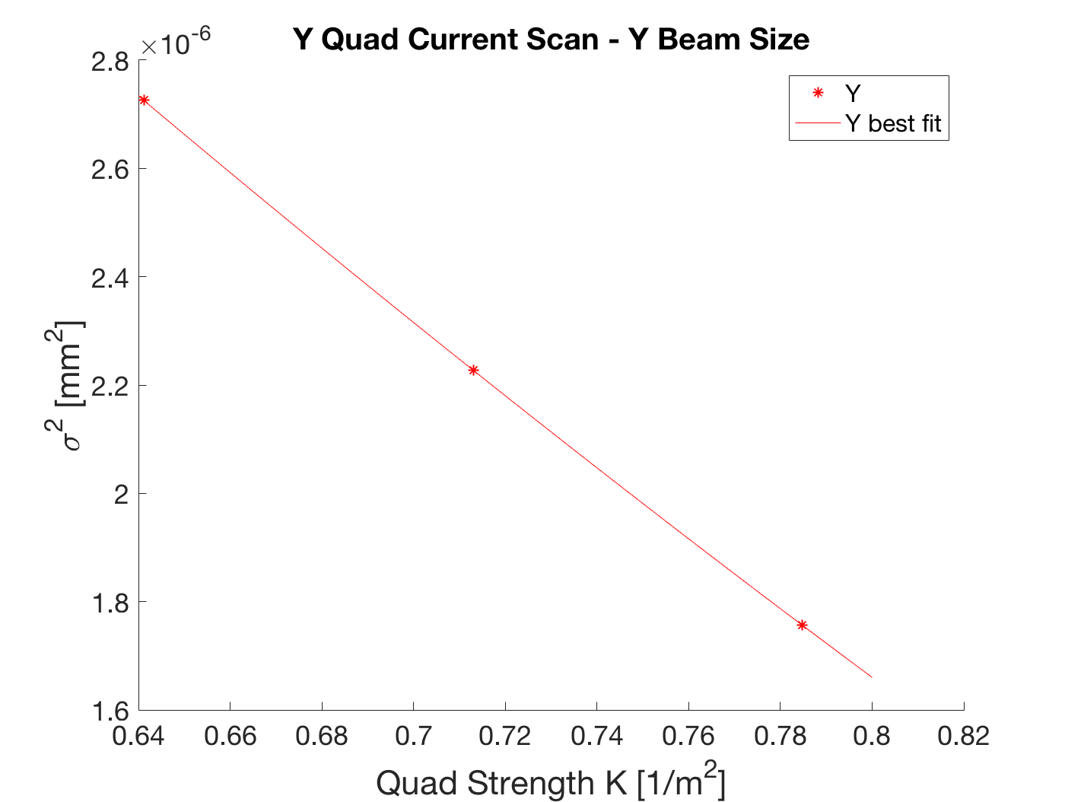
Quadrupole scan data analysis
Analysis of March 10th quadrupole scan data
Inconsistency between TRACK and calculated emittance
Calculated emittance is smaller than at Pepper-pot!
Conclusion:
Because three points are not enough to statistically determine a quadratic fit these calculations do not yield accurate results

Slide 18
Conclusions and future studies
Optimizations:
Run LEBT quadrupoles at lower current to prevent early emittance growth
Quadrupole Scan:
Quad scans should be swept over the beam waist and include as many data points as possible for greatest accuracy
Because scanning over a quad doublet the data from each quad could be combined in x and y to minimize the number of data points needed for each

Slide 19
acknowledgements
I want to express huge thanks to my advisors Brahim Mustapha and Clayton Dickerson for their guidance throughout this project.
Special thanks to the Lee Teng Fellowship and Argonne National Laboratory.
References
Rudolph, J. "Slice Emittance Measurement Techniques." Helmholtz Zentrum Berlin.
Crandall et al, “TRACE 3-D Documentation” Los Alamos National Laboratory.
Images:
https://www.phy.anl.gov/airis/layout.html
Nagatomo et al, "Development of a Pepper-pot Emittance Meter for Diagnostics of Low-energy Multiply Charged Heavy Ion Beams Extracted from an ECR Ion Source." Rev. Sci. Inst. 87.2 (2016)

Slide 20
Thank you for listening

