Slide 1
The Design of a Resonance Control System for the IOTA RF Cavity
Gerrit Bruhaug
Lee Teng Internship Presentations
08/10/2016

Slide 2
Presentation Content
        Overview of IOTA
        Specifics of RF Cavity
        Controls System Design and Theory
        System Implementation and Results
        Thanks and References

Slide 3
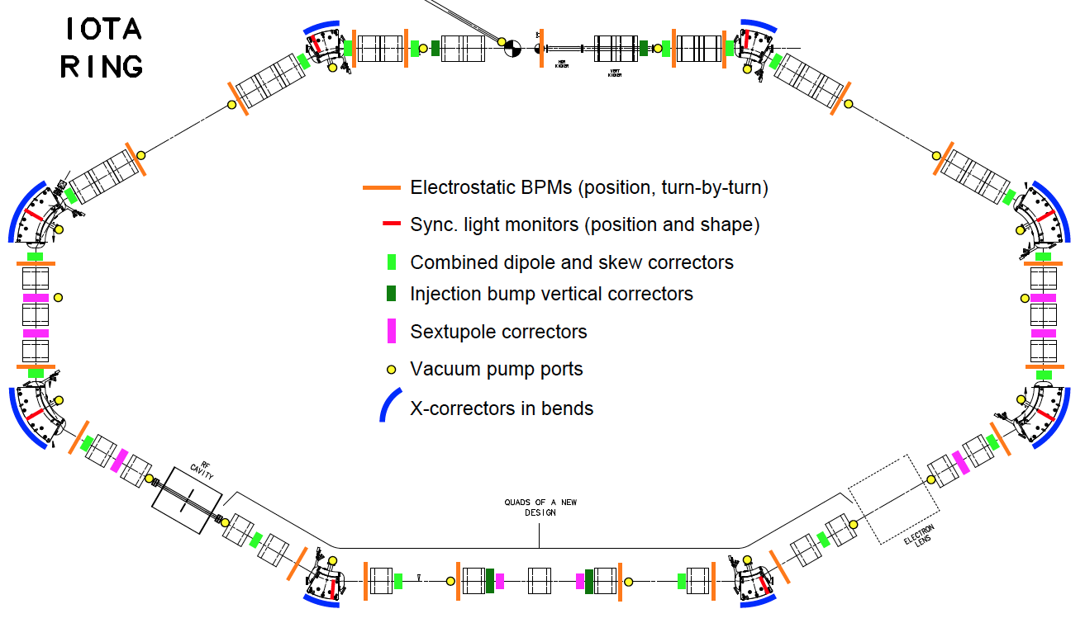
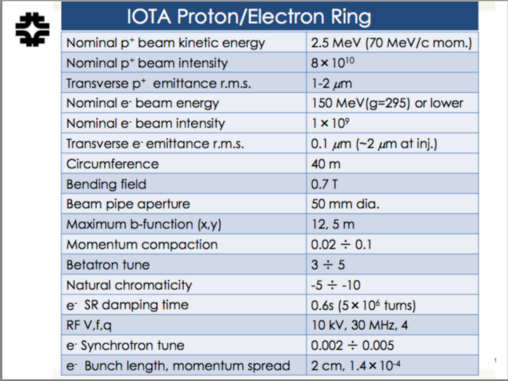
Integral Optics Test Accelerator (IOTA)
All pictures are provided by NML at Fermilab^{[1]}

Slide 4
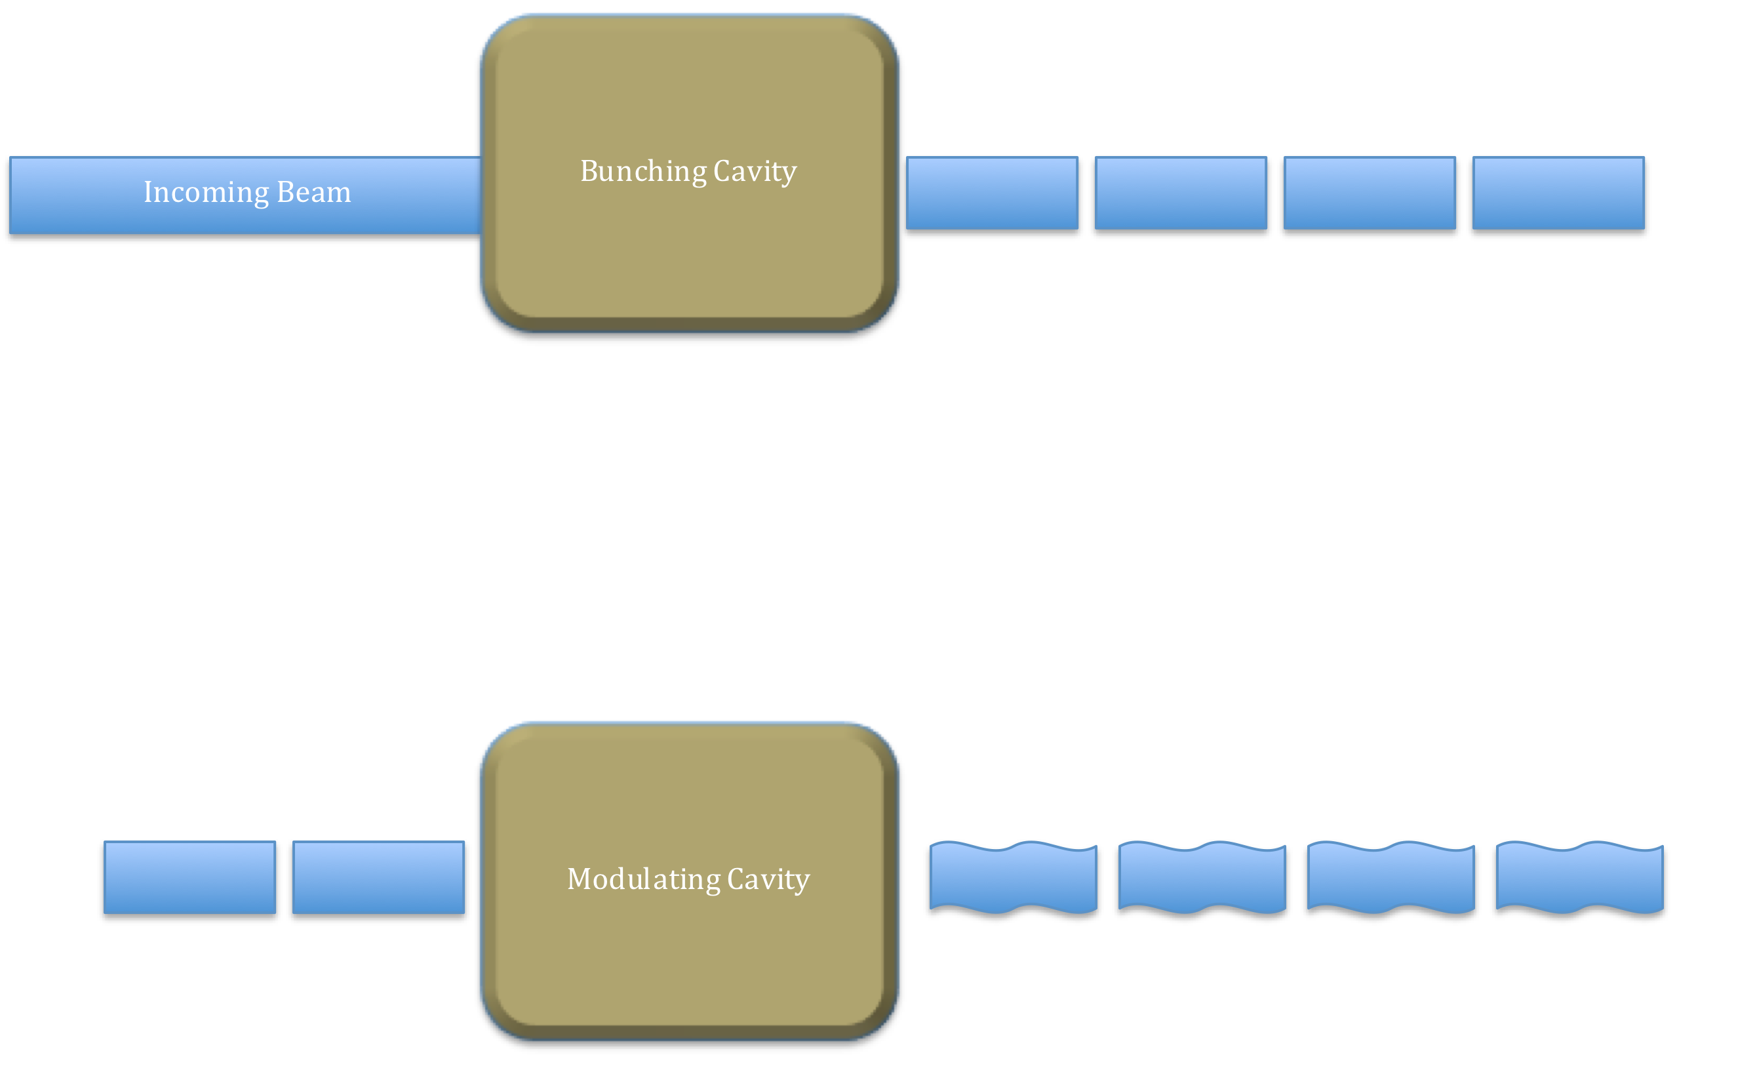
Bunching and Modulation

Slide 5
The IOTA Bunching Cavity
Cavity has two sections
2 MHz section bunches protons
30 MHz section bunches electrons and modulates protons⁴
Drawing of IOTA Buncher¹

Slide 6
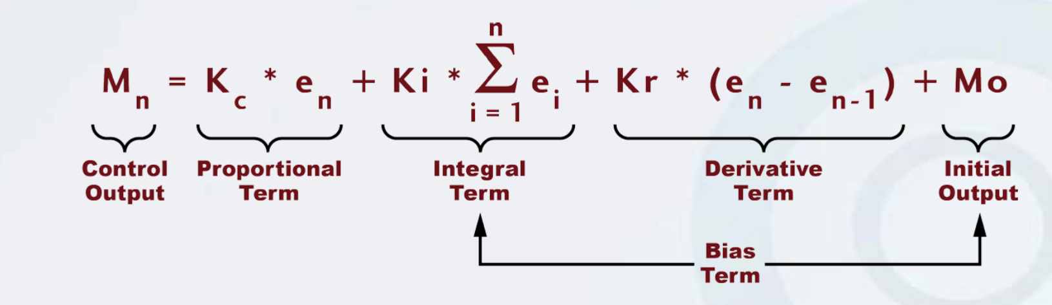
PID Loops and Controls Theory
Proportional, Integral, Derivative
Used to prevent oscillations in controls systems
Origin can be traced back to 19th Centaury steam ship controls³
PID Control Loop Equation²

Slide 7
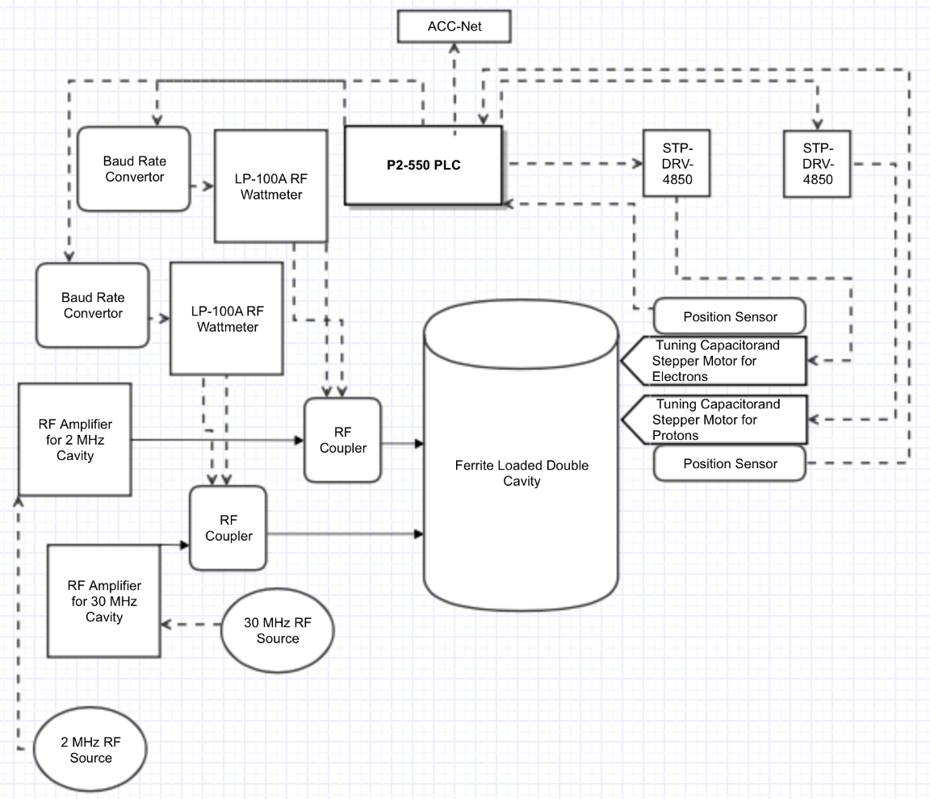
System Implementation
Overview of PLC based RF Control System
Diagram drawn with Gliffy graphics website

Slide 8
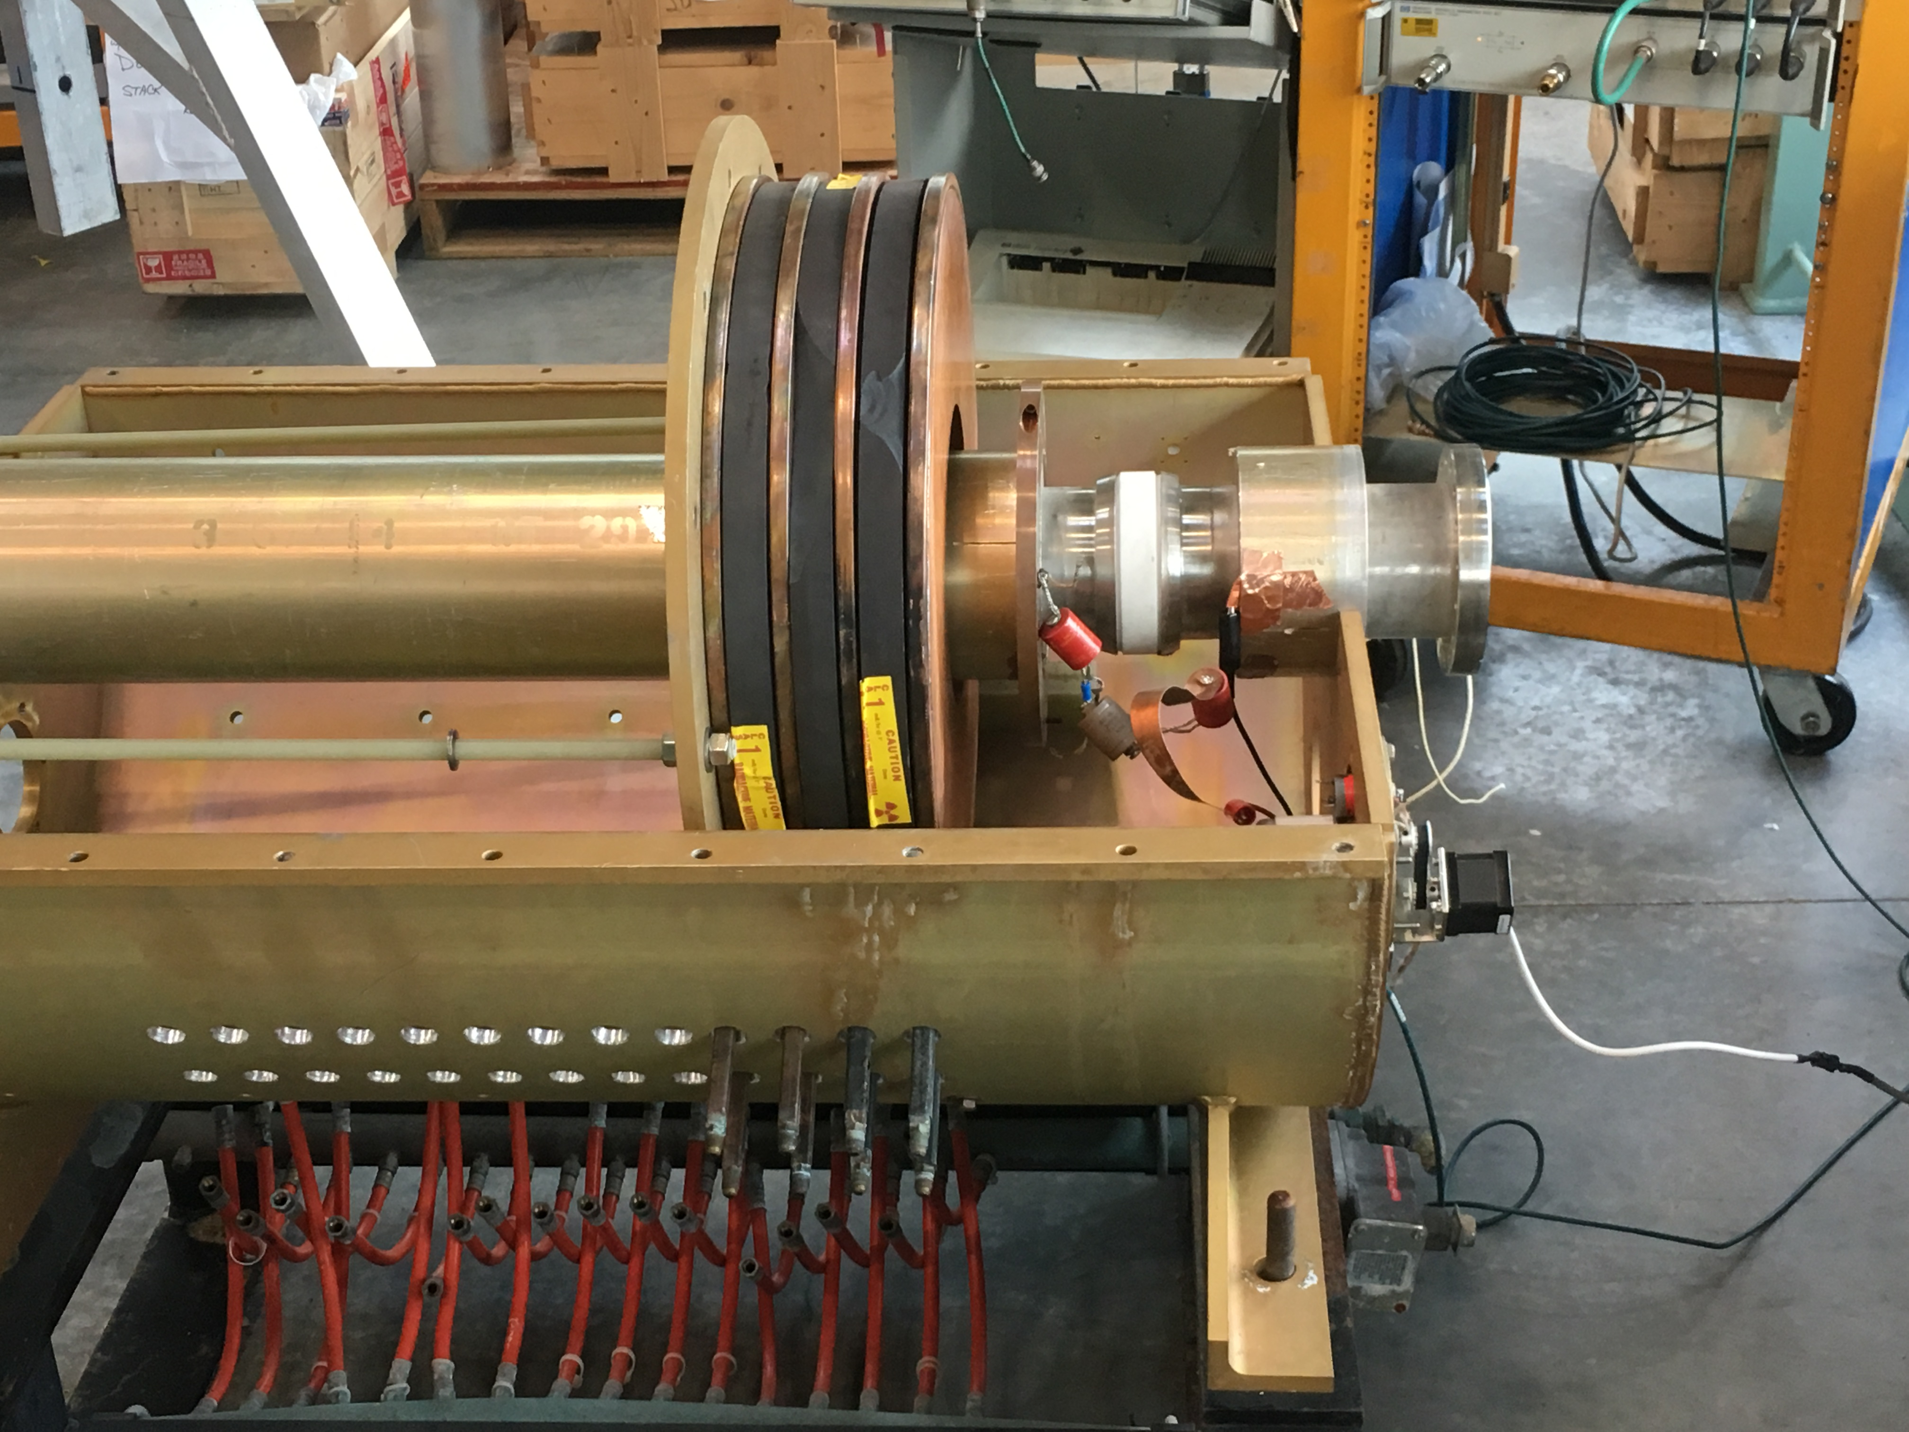
Mounting for Testing
Old Single Ceramic Break with One Stepper for Testing

Slide 9
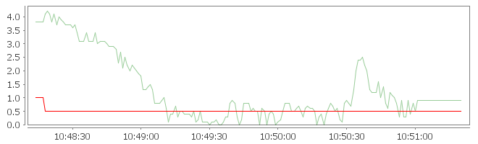
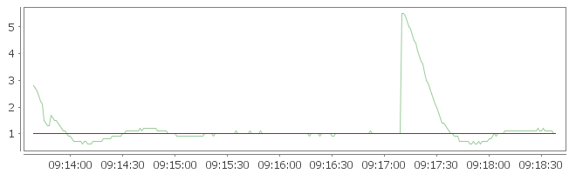
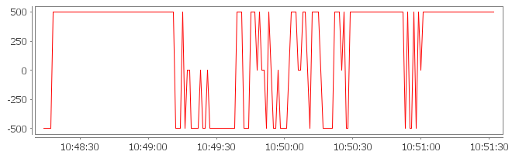
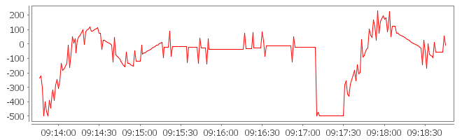
Live Test and Results
Phase of RF Cavity with Untuned PID
Phase of RF Cavity with Tuned PID
Phase
Phase
Clock Time
Clock Time
Untuned PID Output
Tuned PID Output
Steps
Steps
Clock Time
Clock Time

Slide 10
References and Acknowledgments
New Muon Lab, Fermilab,http://asta.fnal.gov/IOTA/IOTA_Parameters.pdf
Automation Direct, Introduction to PID Loops,https://www.automationdirect.com/resources/microsites/videos/take_aways/VID_L_PC_P3K_005-Programming.pdf
S. Bennet, “Historical Perspective”, 1993,http://www.ieeecss.org/CSM/library/1993/dec1993/w05-HistoricalPerspectives.pdf
E.~Prebys, "RF Capture of Protons the IOTA Ring at Fermilab", Batavia, Illinois, January 2015
G.~Kazakevich, K.~Carlson, "IOTA Cavities Engineering", Batavia, Illinois, December 2015

