Slide 1
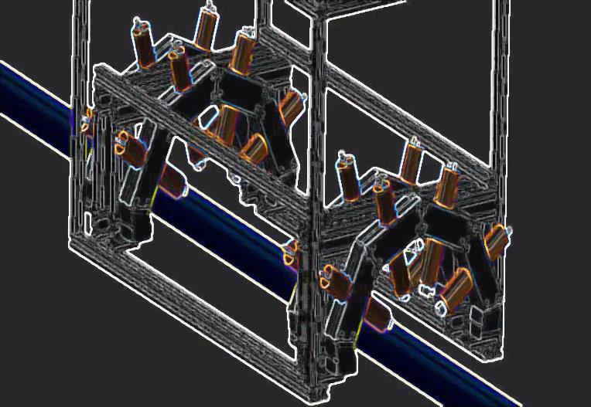
Beam Test of Quartz Radiators for Mu2e Precision Timing Profile Monitor
Rachel Margraf
Lee Teng Undergraduate Internship
Fermi National Laboratory
August 10, 2016

Slide 2
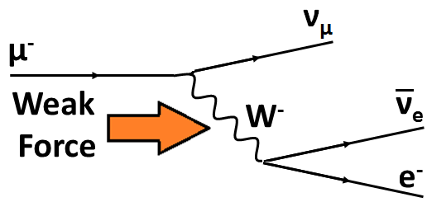
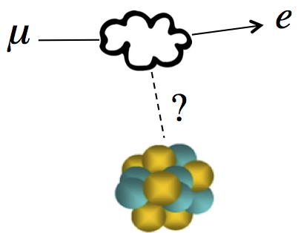
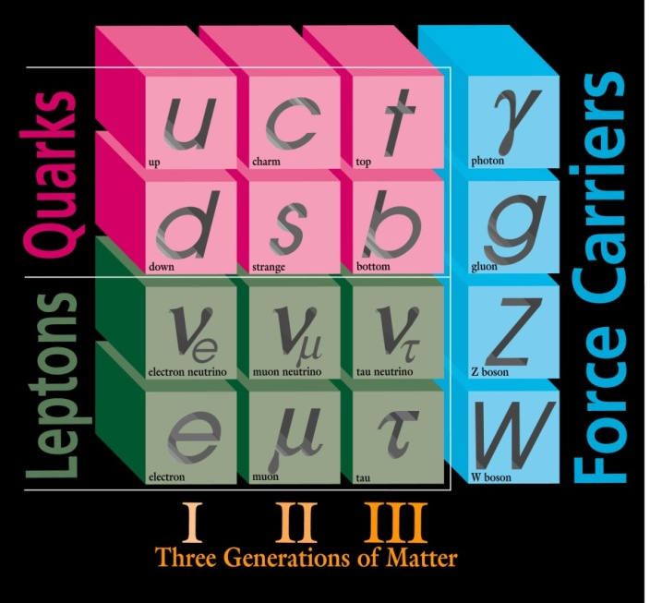
Mu2e
Weak Force Decay (common)
Direct Conversion (signal)
Search for Charged Lepton Flavor Violation (CLFV) in the form of neutrino-less muon to electron conversion (μ → e + γ).
Neutrinos mix, quarks interconvert, why not leptons?
Notes:
If observed, this would be evidence for physics beyond the standard model. The standard model does permit this decay, albeit at a rate lower than we can measure.

Slide 3
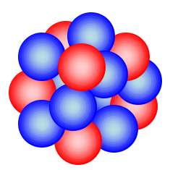

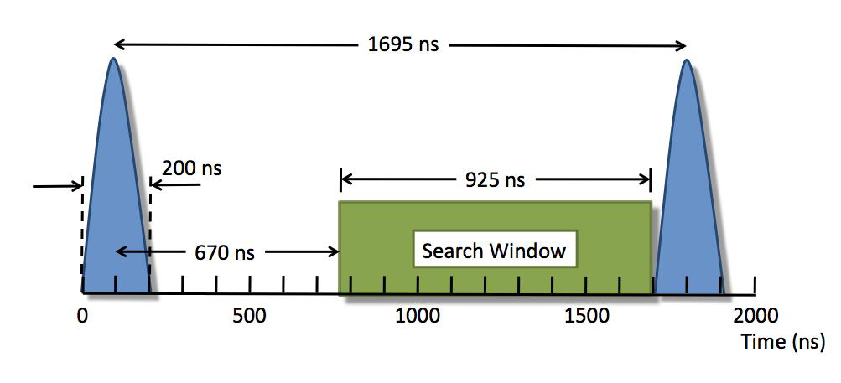
Mu2e
Proton Beam
μ ⁻
e
Energy =105MeV
π
μ
Production Target
Stopping Target
Collide protons into production target, produce pions that decay into muons
Capture muons around aluminum nuclei
If a muon converts to an electron by exchanging a photon (or other particle) with the nucleus, the electron will be given off at 105MeV
Limit search to after background products have decayed
Out of time particles may still appear in this window -> Precision Timing required!

Slide 4
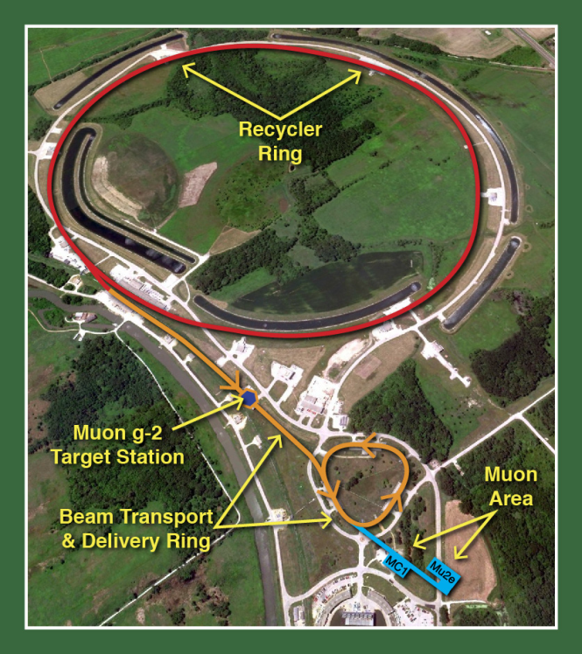
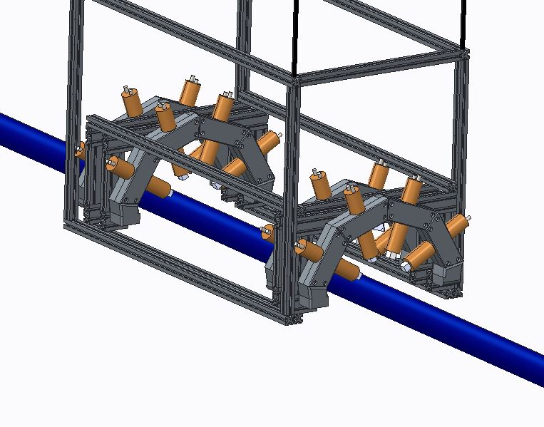
Precision Beam Timing Monitor
Ratio of out of time protons to in time protons (“extinction”) must be 10⁻⁵ in the recycler and delivery ring, and 10⁻¹⁰ at production target
Upstream monitor (left)
  4 arms with 4 Quartz Cherenkov Radiators each
  Detect protons scattered off a thin foil in the beam
  Build statistical profile of out of time protons

Slide 5
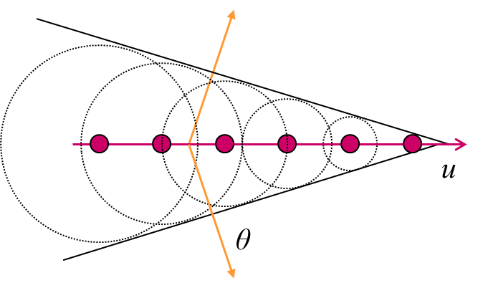
Quartz Cherenkov Radiators
Quartz
  Cherenkov light produced when a charged particle travels faster than light can travel in a medium
  Advantages over Scintillators:
  Insensitive to low energy backgrounds
  Low afterglow after large signals
  Disadvantage:
  Smaller signal
Relativistic Proton
Light “shockwave”
PMT
(Amplification)
Signal Out

Slide 6
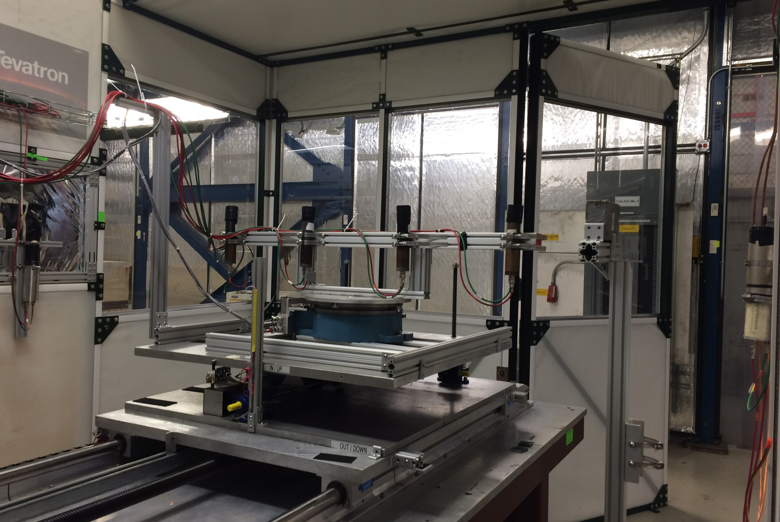
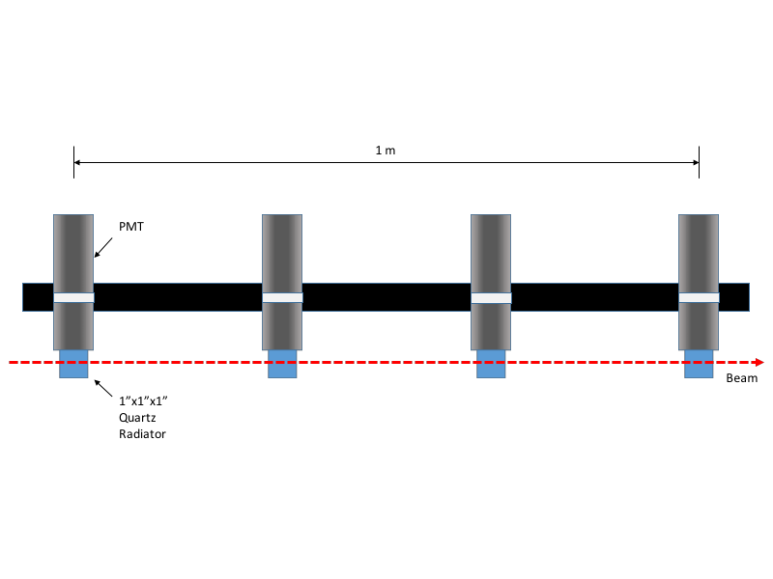
Beam Test Setup:
4 Quartz radiators 1”x1”x1” attached to photomultiplier tubes (PMTs) mounted to remotely controlled table
4 3 2 1
Beam
30 cm
2 Scintillator Triggers
Removable Lead Brick

Slide 7

Signals
One Proton Event
  Interested in:
    Amplitude of Signal
    Arrival Time of Signal
    Out of Time Signals

Slide 8
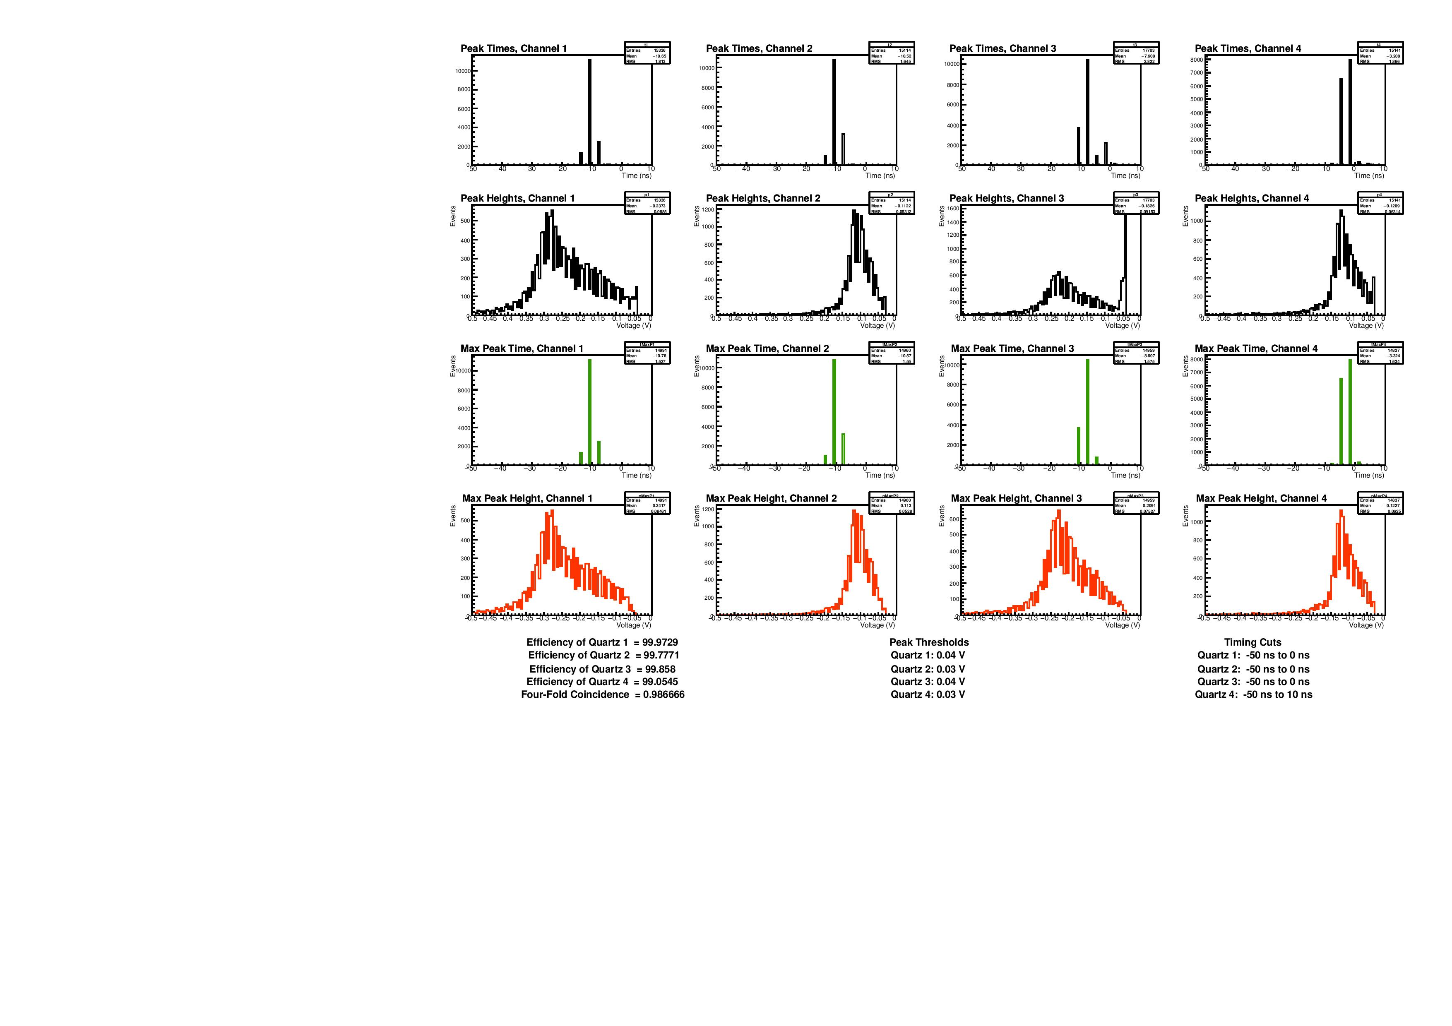
Amplitude of Signals (maximum in-time peak)
-0.2825V
-0.1075V
-0.2325V
-0.1225V

Slide 9
Resultant Efficiency
15000 events | Quadruple Coinc. | Triple Coinc. | Efficiency
Quartz 1 | 14771 | 14775 | (99.97 ± .02)%
Quartz 2 | 14771 | 14804 | (99.78 ± .02)%
Quartz 3 | 14771 | 14792 | (99.86 ± .02)%
Quartz 4 | 14771 | 14912 | (99.05 ± .02)%
Four-Fold Efficiency |  |  | (98.67 ± .05)%
$${Efficiency}_{Quartz \left(\#\right)}=\frac{Number of Quadruple Coincidences}{Number of Triple Coincidences in other Three Channels}$$
$$FourFold Efficiency={Efficiency}_{Q1}•{Efficiency}_{Q2}{•Efficiency}_{Q3}{•Efficiency}_{Q4}$$

Slide 10
Signal Arrival Time – In Time Signals
  0ns is the trigger time
  Defined “In Time Signals” as between -50ns to 0ns for Quartz 1-3, and -50ns to 10ns for Quartz 4
  Signals occur before 0ns because trigger signal passed through more electronics/wires on route to oscilloscope

Slide 11
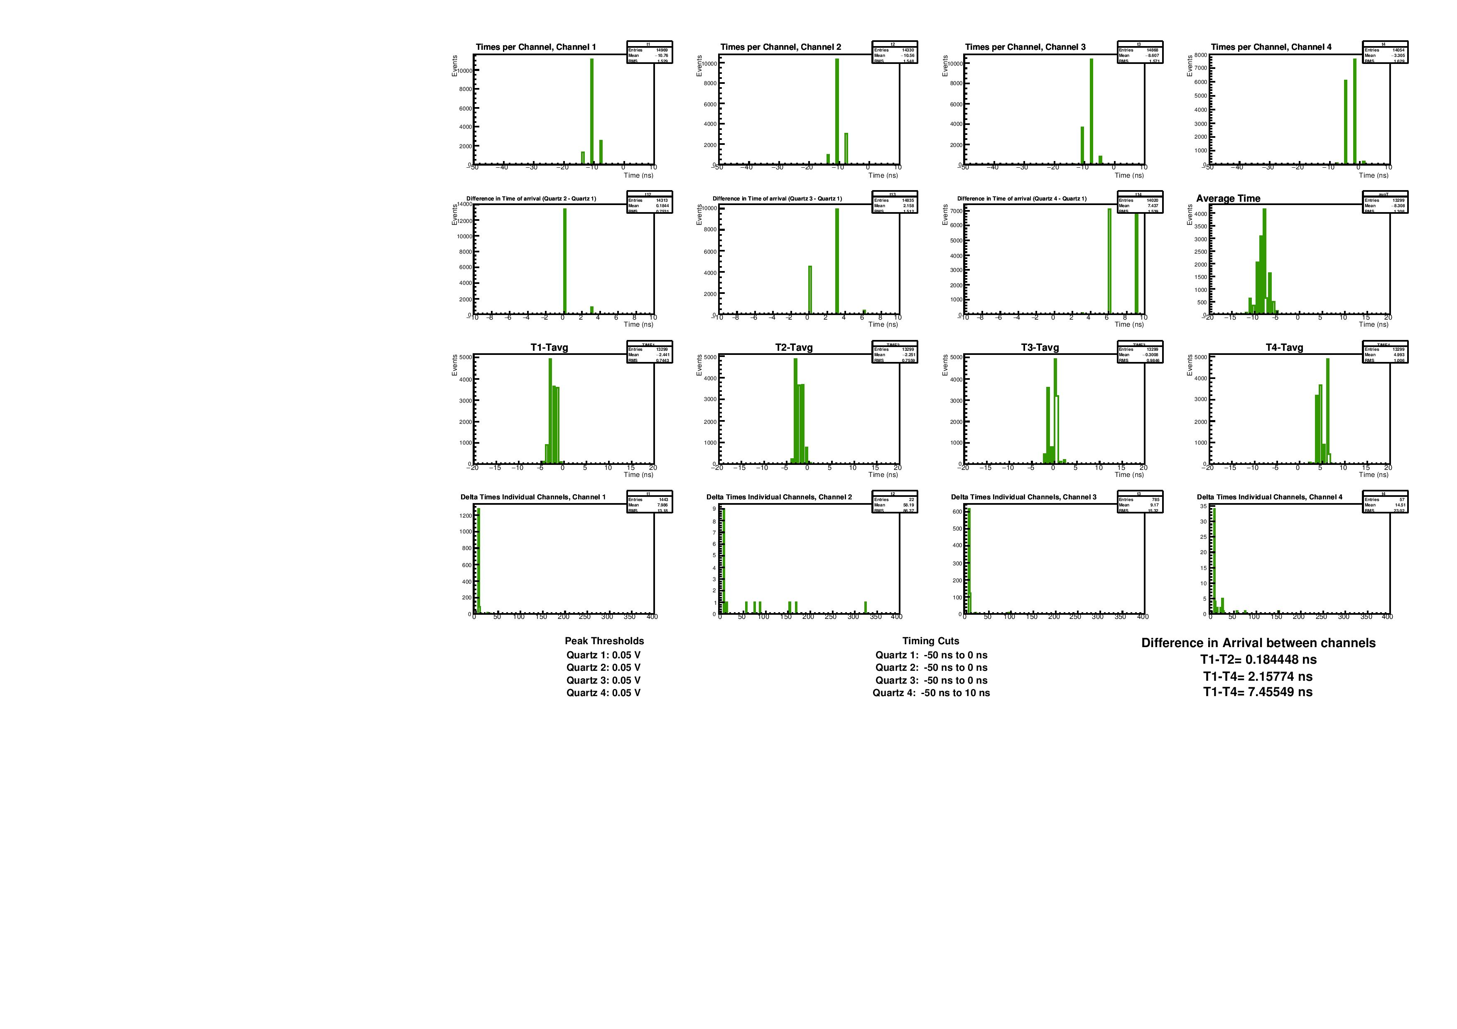
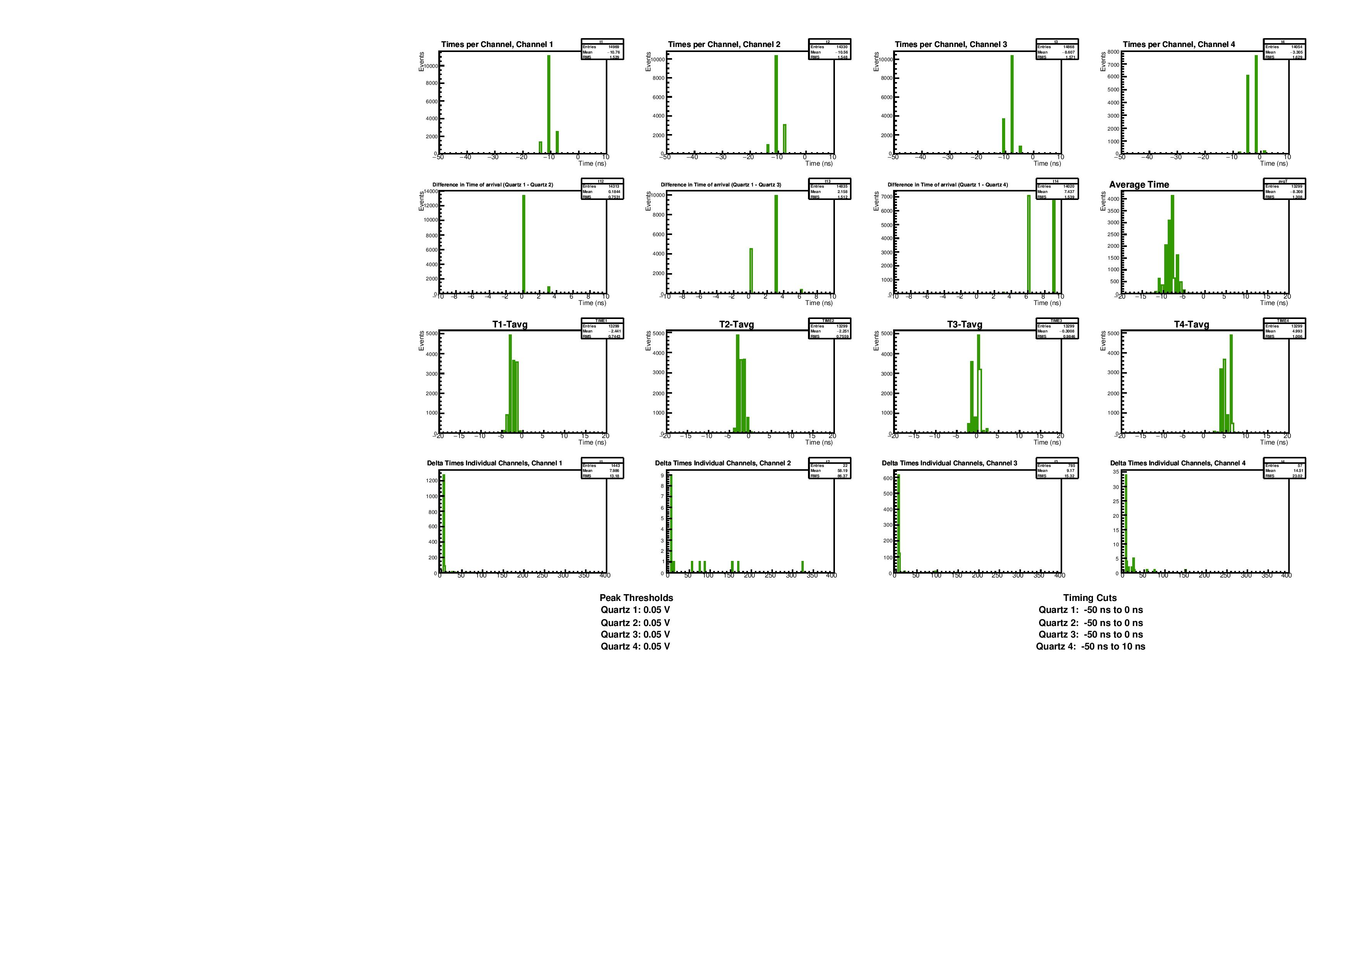


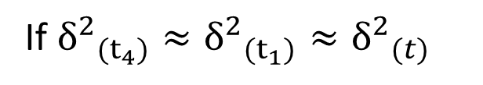

Time Resolution
$${δ^{2}}_{{(t}_{4}−t_{1})}^{}={δ^{2}}_{{(t}_{4})}^{}+{δ^{2}}_{(t_{1})}^{}$$
If ${δ^{2}}_{{(t}_{4})}^{}≈{δ^{2}}_{(t_{1})}^{}≈{δ^{2}}_{(t)}^{}$
$$δ_{{(t}_{4}−t_{1})}^{}={\sqrt{2} δ}_{(t)}^{}≤1.539ns$$
Timing Resolution:
$$δ_{\left(t\right)}^{}≤1.09ns$$
  By taking the difference between two channels, smaller time resolution
  Difference between channels 1 and 4 had the largest RMS
  Time resolution is 1.09ns or better

Slide 12
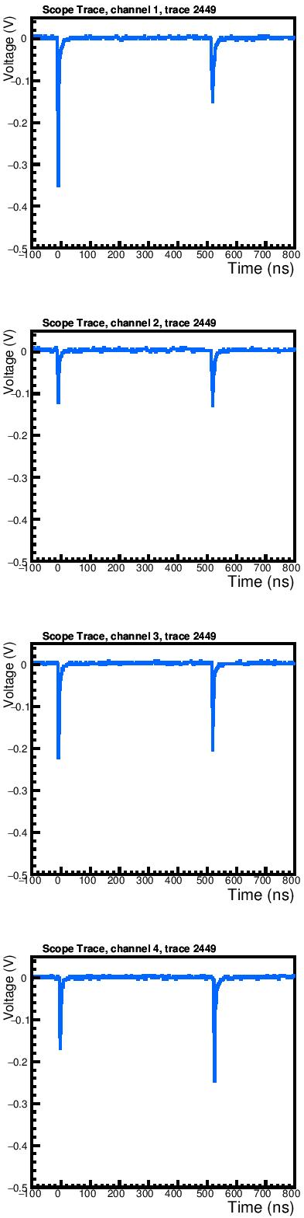
Out of Time Signals
Multiple Proton Event
After Pulsing
  If caused by out of time protons, usually leave track in all four quartz
  After pulsing occurs randomly, usually just in one channel
  If there is time structure in after pulsing, however, higher possibility of false coincidence
26000 events | Out of Time Signals | Probability
Quartz 1 | 89 | .00342 ± .00004
Quartz 2 | 62 | .00238 ± .00004
Quartz 3 | 130 | .00500 ± .00004
Quartz 4 | 30 | .00115 ± .00004
Pred. 4-Coinc. | 0 | (4.7 ± .4)•10⁻¹¹
Obs. 4-Coinc. | 23 | .00088 ± .00004

Slide 13
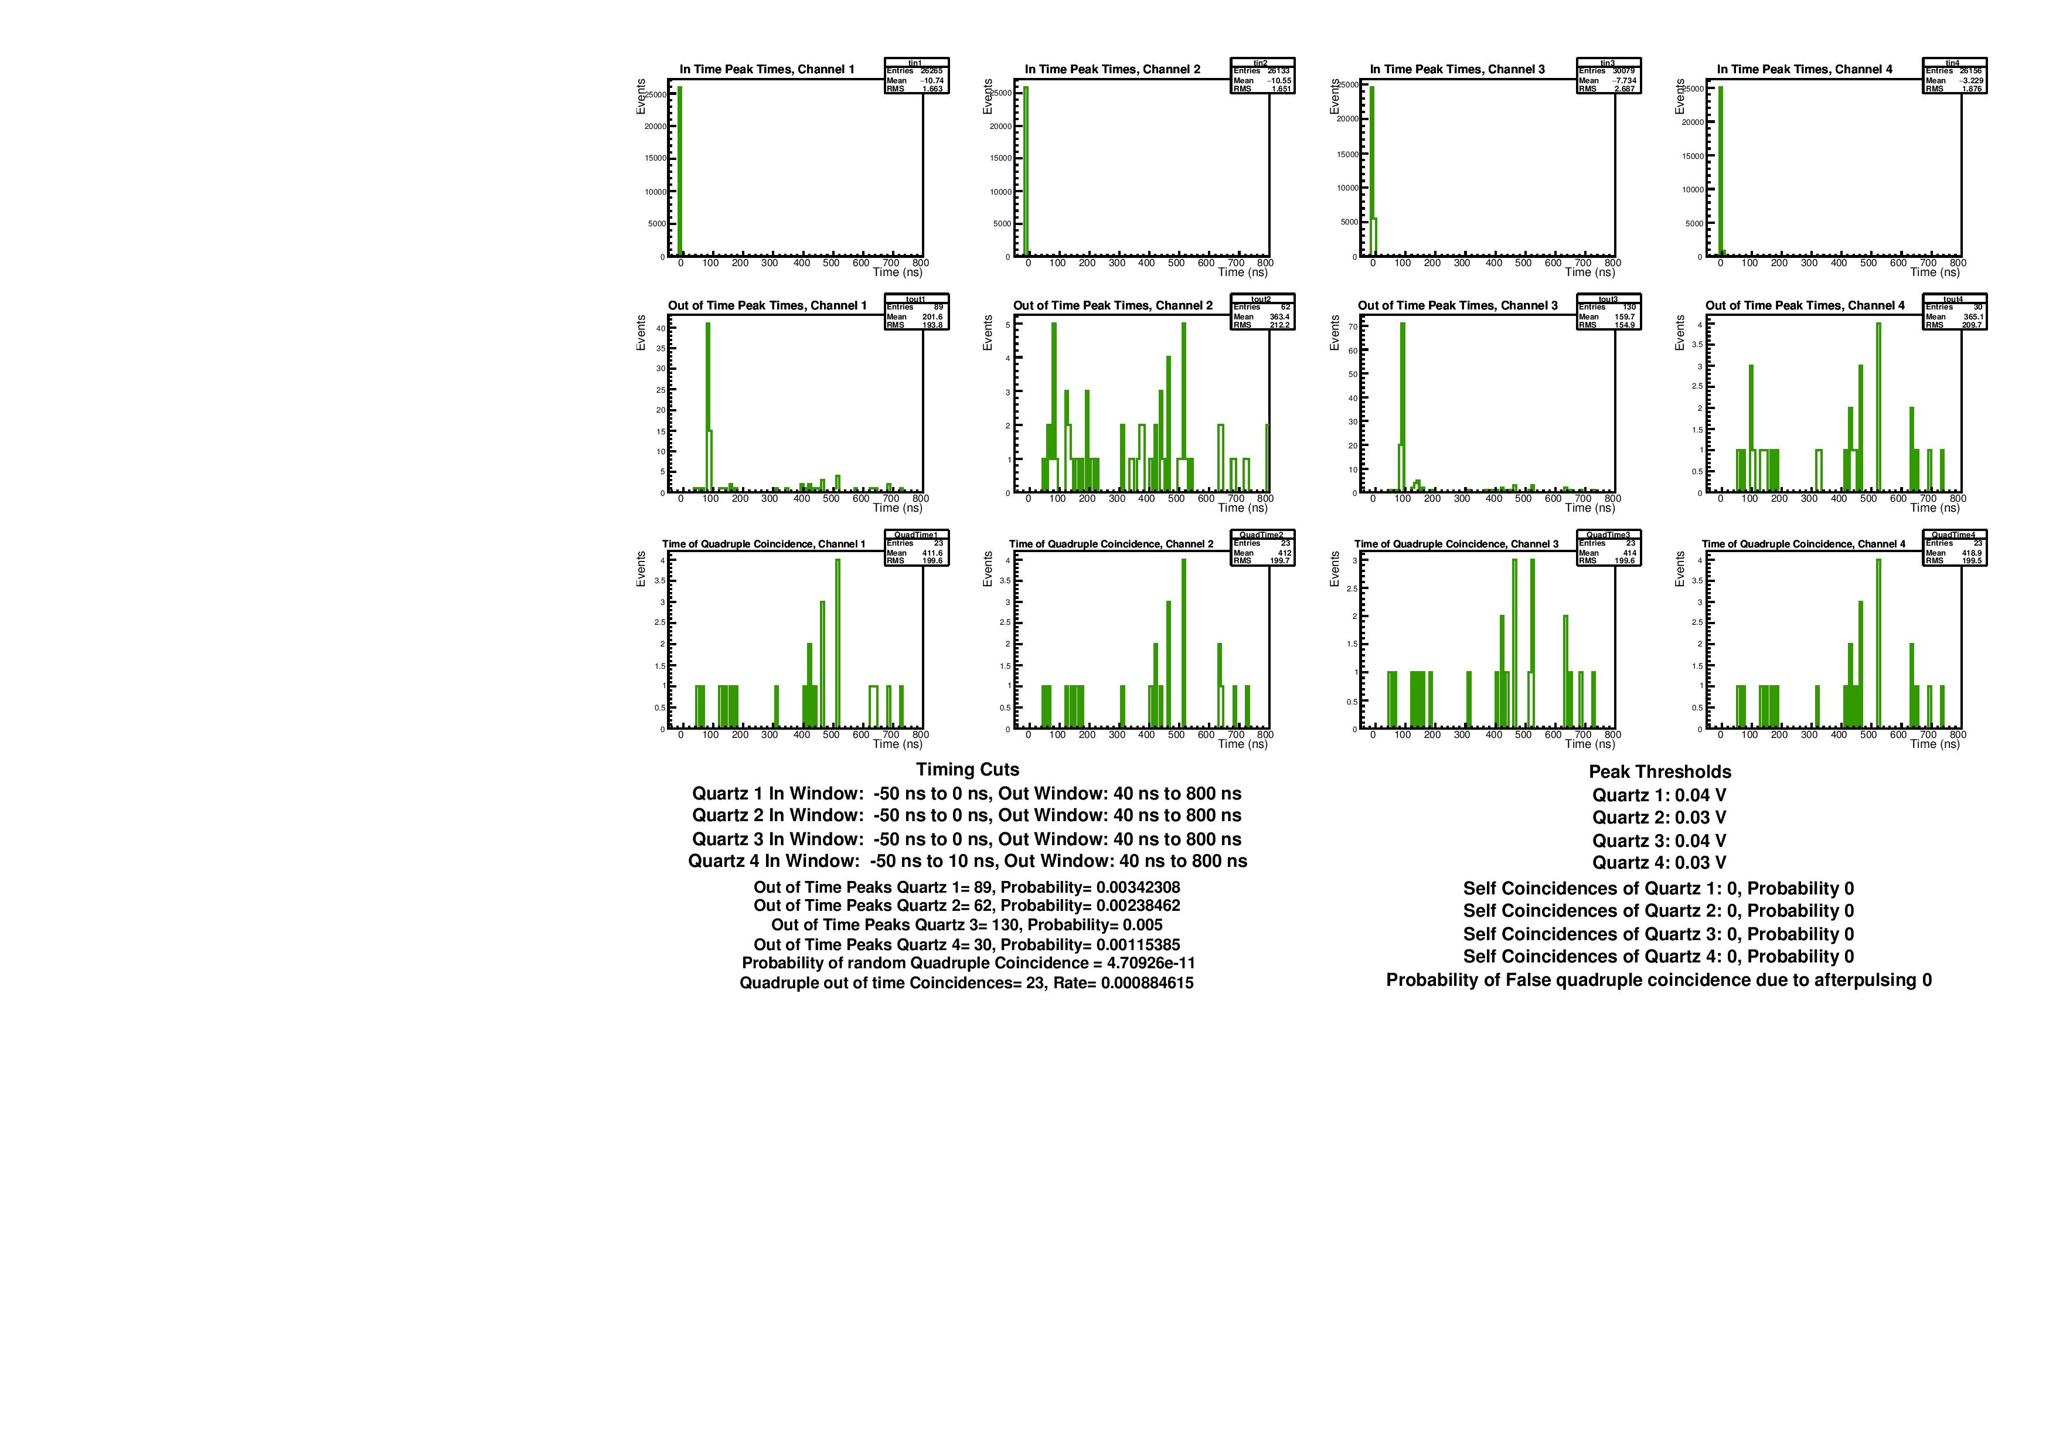


Signal Arrival Time - Out of Time Signals
Quadruple Coincidences
  Random arrival times, esp. for quadruple coincidence
  May be small amount of after pulsing around ~100ns for Quartz 1 & 3
  To calculate probability of this producing false quadruple coincidence, tested how often a record with an out of time signal had an out of time signal in previous record of same channel:
26000 events | Events | Probability
Obs. Self-Coinc. | 0 | <2•10⁻¹⁸(for 4 channels)

Slide 14
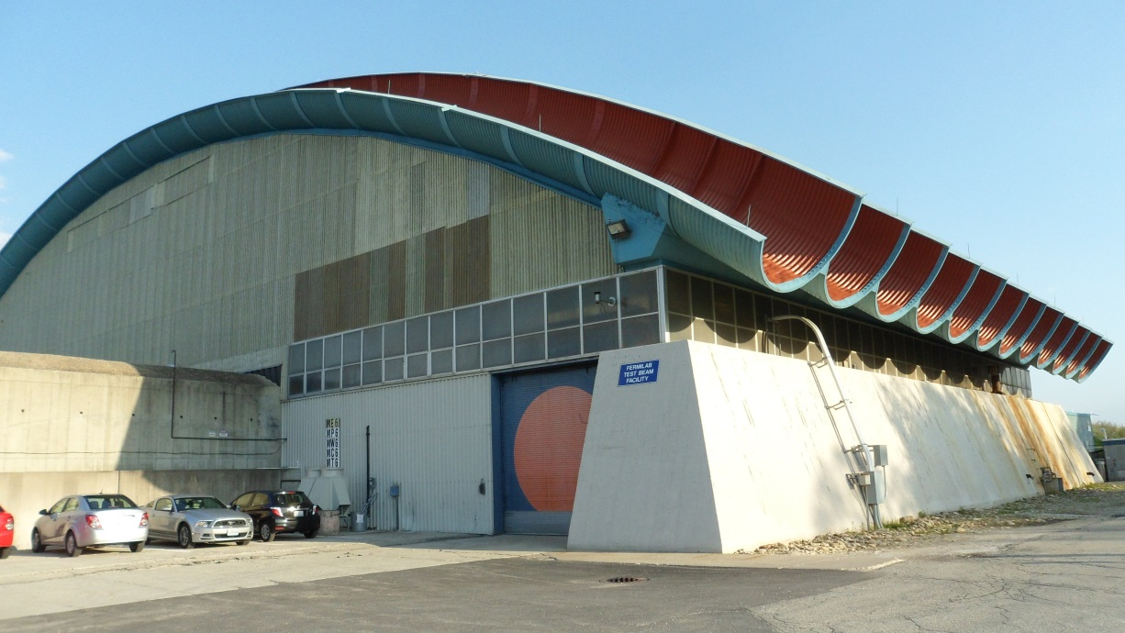
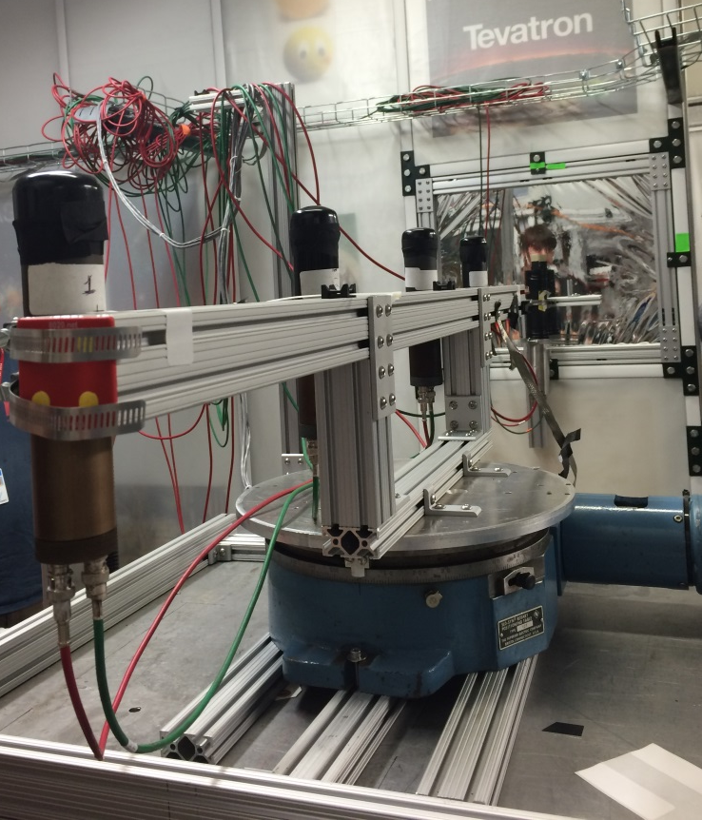
Summary:
  Signal generated by Quartz Radiators is sufficient to detect protons with high efficiency (98.7%)
  Signal time resolution is 1.09ns or better
  After pulsing will at worst produce quadruple coincidences at a rate of 2•10⁻¹⁸
Questions?

Slide 15
References:
[1] C. B. Mott, “Research and Development for the Mu2e Extinction Monitor,” M.S. Thesis, Physics Dept., Northern Illinois Univ., De Kalb, IL, 2016.
[2] E. Prebys, M. Jamison-Koenig, L. Rudd, “Tests of Quartz Radiators for Beam Precision Timing Monitor.” Beams-doc #5018-v3, 2015.
[3] L. Rudd, “Characterization of Quartz Radiators for Mu2e Upstream Extinction Monitor,” Beams-doc #5016-v1, 2015.
[4] S. Werkema, “The Fermilab Muon Campus – The Experiments, Projects, and Status,” Beams-doc #4716-v1.
[5] H. Alaeian, “An Introduction to Cherenkov Radiation,” (15 March 2014), [Online], Available: http://large.stanford.edu/courses/2014/ph241/alaeian2/.
[6] D. Hedin, E. Prebys, “Technical Scope of Work for the 2016 Fermilab Test Beam Facility Program,” Beams-doc #5203-v1.

Slide 16
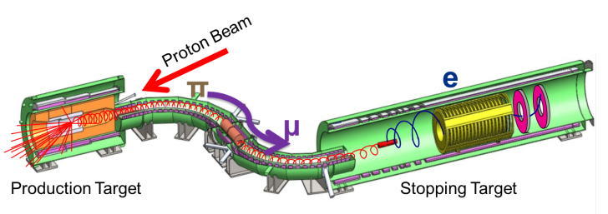

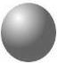
Radiative Pion Capture
105 MeV
Muon to Electron Conversion (Signal)
e⁻
γ or ?
μ ⁻
μ ⁻
Similar energy
e⁻
Radiative Pion Capture (Background)
π ⁻
γ
π⁻
e⁺
Pions can also be captured by Al nuclei and produce e⁻ around the signal energy
Limit search window to after pions have decayed
Cannot exclude out of time pions
  -> precision timing of beam required!

