Slide 1
Bend magnet heat loads & Out of orbit scenarios
drhgfdjhngngfmhgmghmghjmghfmf
Tim Valicenti
Lee Teng Intern
Wednesday, August 3rd
Lemont, Illinois

Slide 2
Overview

Slide 3
The Problem
This is an optimization problem…
What power distributions do the APS-U bend magnets emit?
Changing the position and orientation of absorbing surfaces can reduce the peak intensity.
Important for the design of components under thermal stress
Y
X
Z

Slide 4
Tasks
Find ideal path
Include orbit errors
Ray trace photons
Calculate heat loads
Verify results (SynRad)

Slide 5
Process
Lattice files from Elegant
Ideal Particle Trajectory
Ray Tracing
Power Distributions
Optimization
Missteering (Orbital Errors)

Slide 6
Theory

Slide 7
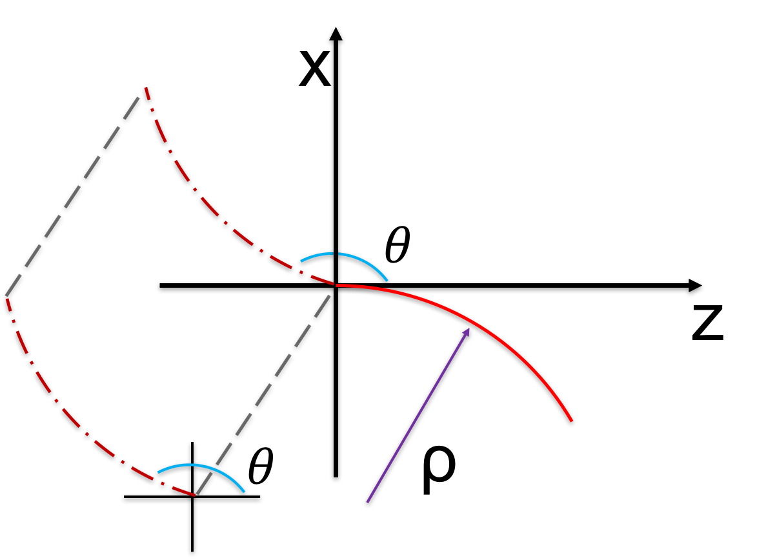
Ideal path
Uses the parameterization of an arc of a circle along with a rotation matrix and a translation vector…
$$\left[\begin{matrix}z(t) \\ x(t) \\ y(t)\end{matrix}\right]=\left[\begin{matrix}ρ\sin\left(ωt\right) \\ ρ\left(cos\left(ωt\right)−1\right) \\ 0\end{matrix}\right]$$
$$\left[\begin{matrix}z(t) \\ x(t) \\ y(t)\end{matrix}\right]=\overset{̿}{R}(θ)\left[\begin{matrix}ρ\sin\left(ωt\right) \\ ρ\left(cos\left(ωt\right)−1\right) \\ 0\end{matrix}\right]$$
$$\left[\begin{matrix}z(t) \\ x(t) \\ y(t)\end{matrix}\right]=\overset{̿}{R}(θ)\left[\begin{matrix}ρ\sin\left(ωt\right) \\ ρ\left(cos\left(ωt\right)−1\right) \\ 0\end{matrix}\right]+{\overline{r}}_{0}$$

Slide 8
Ideal path - Variables
Δϴ = θ0 – θ1: dipole kick. θ1 is used in the rotation matrix
$B=\frac{∆θ}{Length}\left(Bρ\right):$ uses the rigidity, length, and kick to get the B-field
$t=0..t_{f} where t_{f}=\frac{sEnd_{0} −sStart_{0}}{V}$: the time for which the bunch travels
$ρ=\frac{γm_{e}V}{q_{e}B}$: the radius of curvature
$ω=\frac{ρ}{V}$: effective frequency
$r_{0}=\left[\begin{matrix}Z_{0} \\ X_{0} \\ 0\end{matrix}\right]$: the initial position
$$\left(Z_{1},X_{1}\right), sEnd_{1}$$
$$θ_{1}$$
$$\left(?,?\right),{sStart}_{0}$$
$$δs=sStart_{0}−sEnd_{1}$$
$$Z_{0}=Z_{1}+δs∗cos⁡(θ_{1})$$
$$X_{0}=X_{1}+δs∗sin⁡(θ_{1})$$

Slide 9
Missteering
Bolded values come from the lattice files; everything else is either a constant of the accelerator or are already calculated.
$$𝒜_{u}={γ_{x}x}^{2}+α_{x}xx^{′}+β_{x}x^{′2}$$
$$𝒜_{u}={γ_{y}y}^{2}+α_{y}yy+β_{y}y^{′2}$$

Slide 10
Visualization of local coordinates
The global and local y-coordinates are equal while the x-coordinates differ. x’ is equivalent to dx/ds while y’ is the vertical analog: dy/ds.
y
x
s
X
Y
Z
x’
x
y
y’
s
s

Slide 11
Ray tracing
One can use their knowledge of the absorbing plane as well as the location of the electron bunch to accurately calculate rays.
Consider the velocity vector at time step: $t=t^{′}$
The equation for the ray leaving that point is: $P\left(d\right)=\left[\begin{matrix}Z(d) \\ X(d) \\ Y(d)\end{matrix}\right]=d\left[\begin{matrix}s_{Z} \\ s_{X} \\ s_{Y}\end{matrix}\right]+r\left(t′\right)$
The equation for the plane is: $\hat{n}•\left(P(Z,X,Y)−P_{0}\right)=0$
Substitute $P\left(Z,X,Y\right)=P(d)$ and solve for $d$ to find the point on the plane where the ray lands.
y
x
$$\hat{n}$$
s
X
Y
Z

Slide 12
Power Distribution
One must consider both the horizontal and vertical spread of power
Finding vertical spread on the absorber may be difficult but once done one can find the angles each vertical ray makes with the zero-angle ray.
Use: $\frac{∂^{2}P}{∂θ∂ψ}=P_{0}\frac{1}{{\left(1+X^{2}\right)}^{5/2}}\left[1+\frac{5}{7}\frac{X^{2}}{1+X^{2}}\right], X=γθ$
where $P_{0}\left(W/{mrad^{2}}\right)=5.421∗E^{4}\left(GeV\right)∗I\left(A\right)∗B(T)$
If the vertical rays are known, their distances, D, can be calculated and the intensity at each point on the plane can be converted as $\frac{1}{D^{2}}P\left(W/{mrad^{2}}\right)→P\left(W/{mm^{2}}\right)$
y
x
s
$$θ$$
Y
X
Z

Slide 13
results

Slide 14
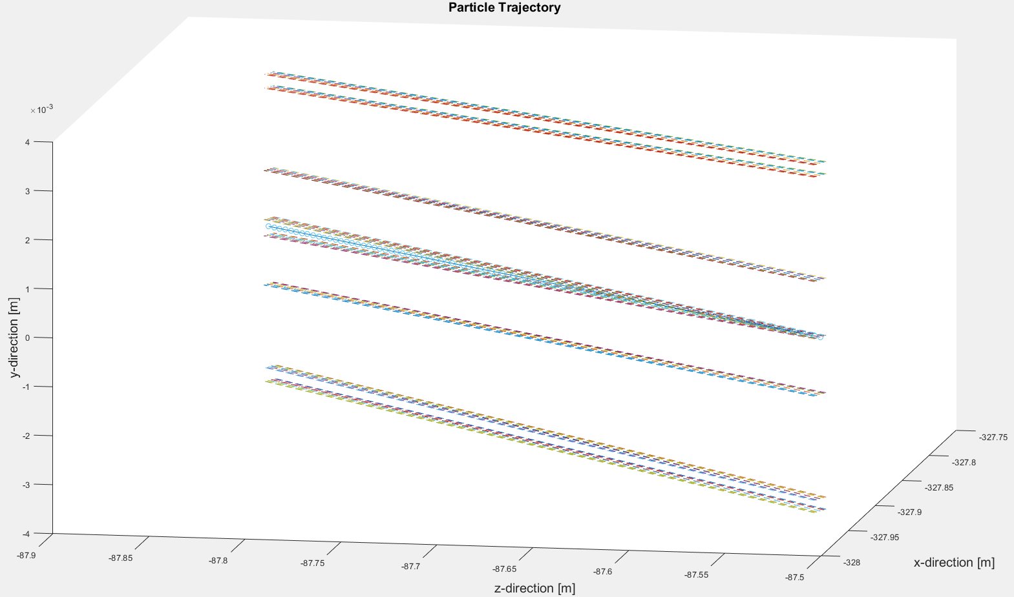
Missteering
User can enter which missteered paths they want to consider (alternatively the code has a default set of missteered paths). Note the y-axis scale.
y
x
X

Slide 15
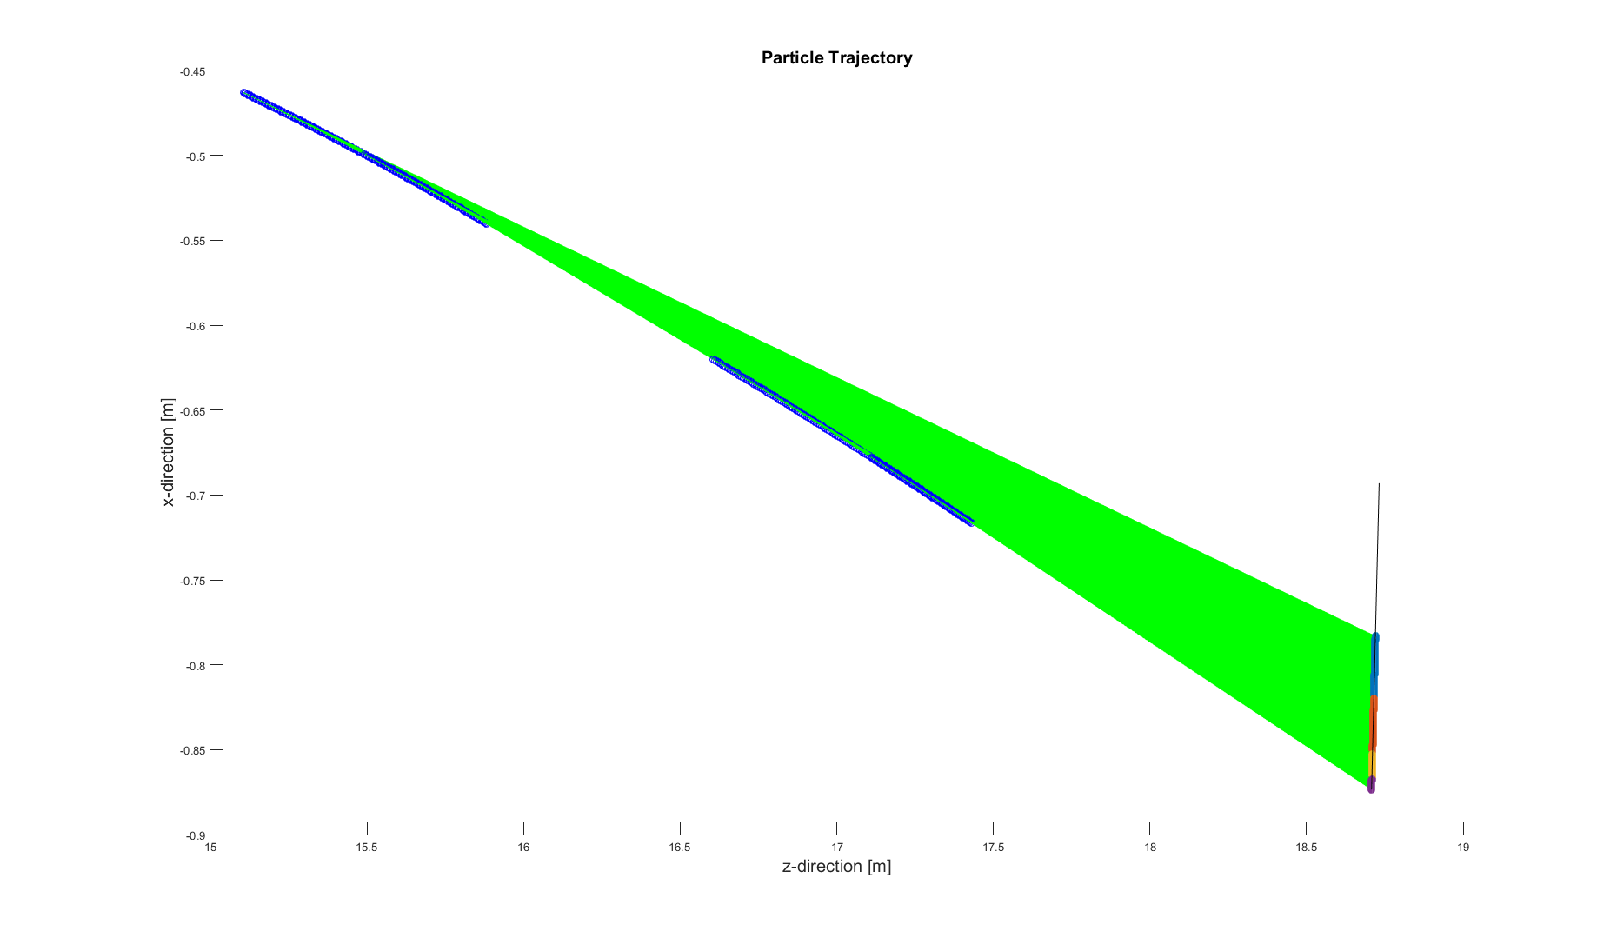
Example
Shows the rays from 4 consecutive bend magnets – M3.1, M3.2, M2.5, M2.4 – hitting the B-crotch absorber.
M3.1
M3.2
M2.5
M2.4

Slide 16
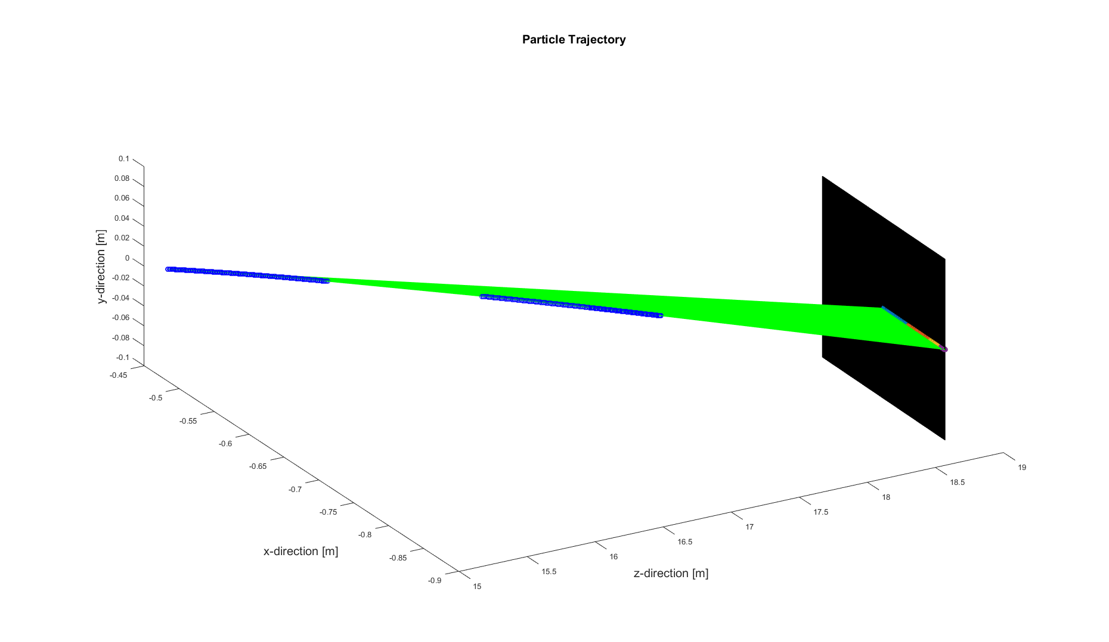
Example
Shows the rays from 4 consecutive bend magnets – M3.1, M3.2, M2.5, M2.4 – hitting the B-crotch absorber.
M3.1
M3.2
M2.5
M2.4

Slide 17
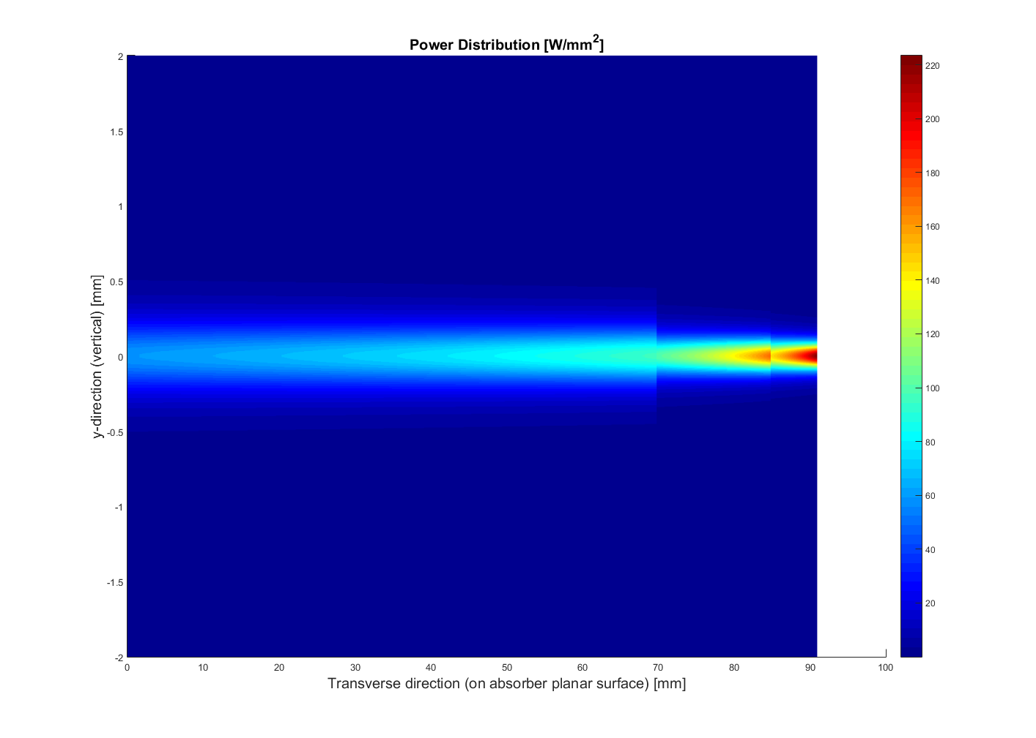
Example
Shows the intensity from 4 consecutive bend magnets – M3.1, M3.2, M2.5, M2.4 – hitting the B-crotch absorber.

Slide 18
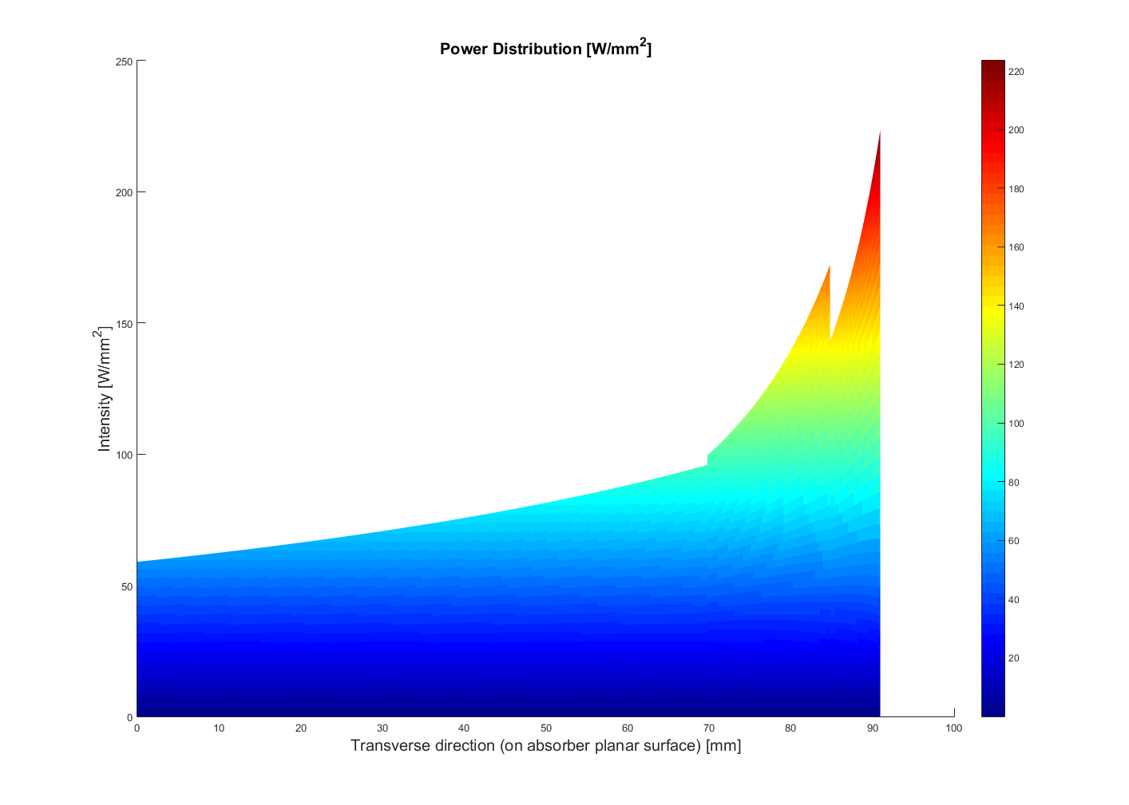
Validation with synrad
The data matches very well
SynRad: 2.84 kW
This software: 2.84 kW

Slide 19
Advantages and Applications
Analytical functions allow easy integration with other programs such as comsol
Starting with the lattice files one gains full bunch trajectories both ideal and with error
Can use any of these trajectories to determine the power distribution.
Can easily optimize by changing position and normal vector of the absorbing plane.

Slide 20
Achievements / Future work
Calculated ideal paths via lattice files
Found missteered paths in 3 dimensions
Accurately ray traced arbitrary trajectories
Solved for the heat map on any given planar surface
Verified results with SynRad
A more friendly UI (perhaps a GUI)
COMSOL Integration
More geometries of absorbers
Insertion device analogs

Slide 21
Summer Experience
Attended USPAS to take a full course on accelerator physics
Learned more than most advanced E&M books cover
Gained invaluable experience in both matlab and comsol
Had the chance to make an impact at A place like argonne while still a student
Hiked a mountain

Slide 22
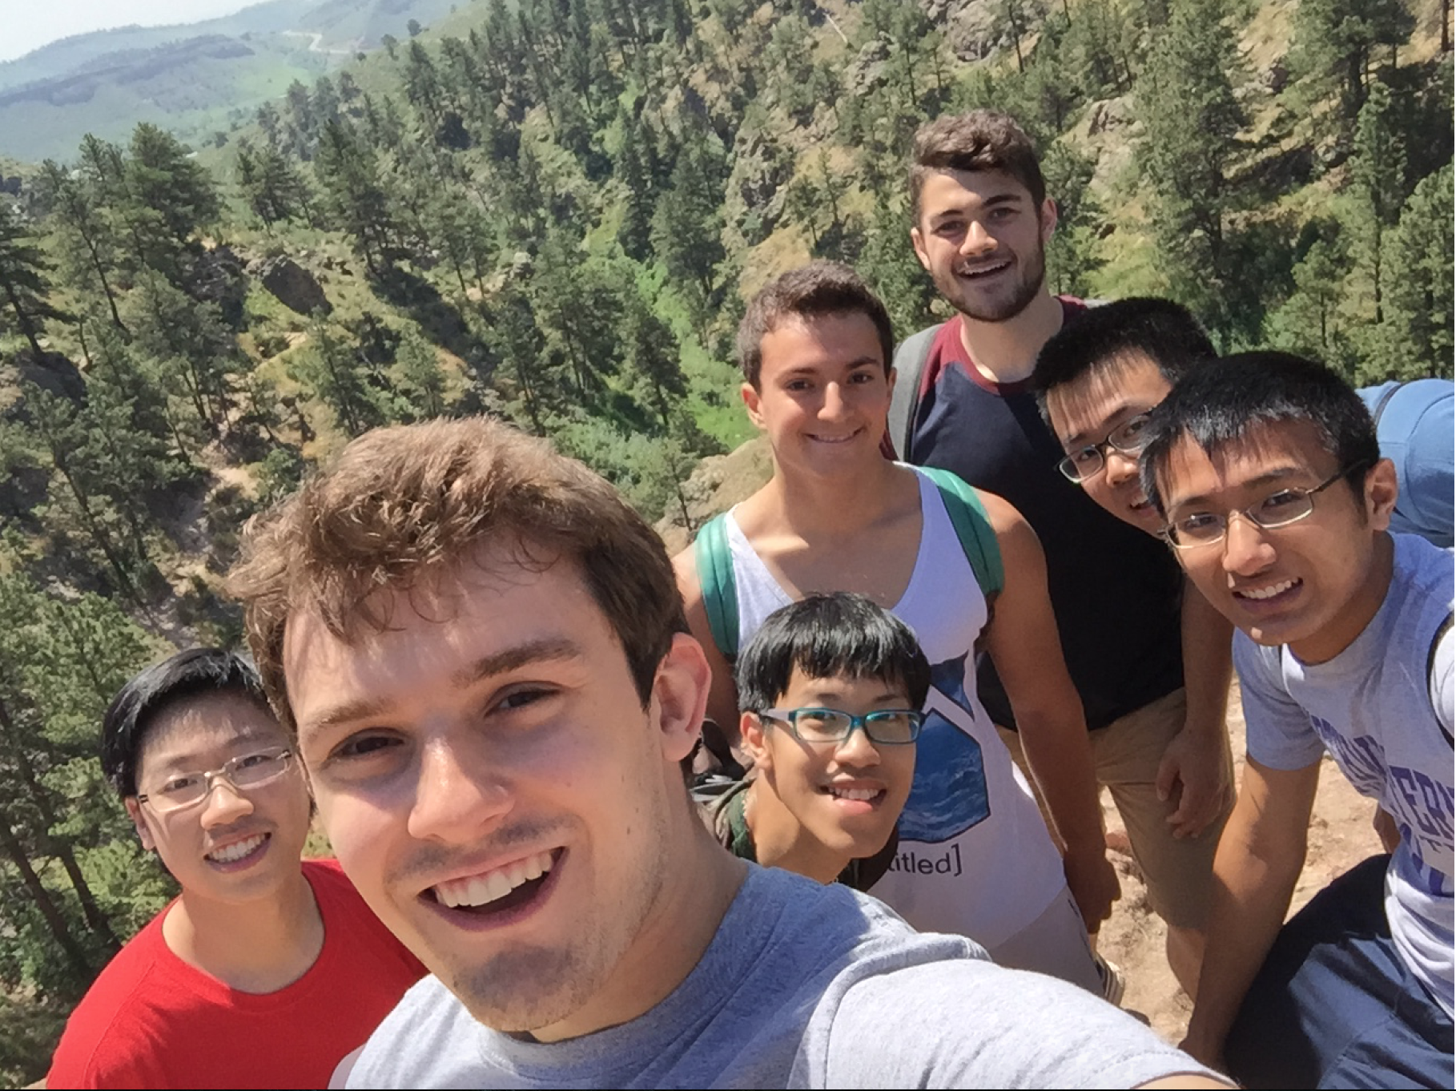

Slide 23
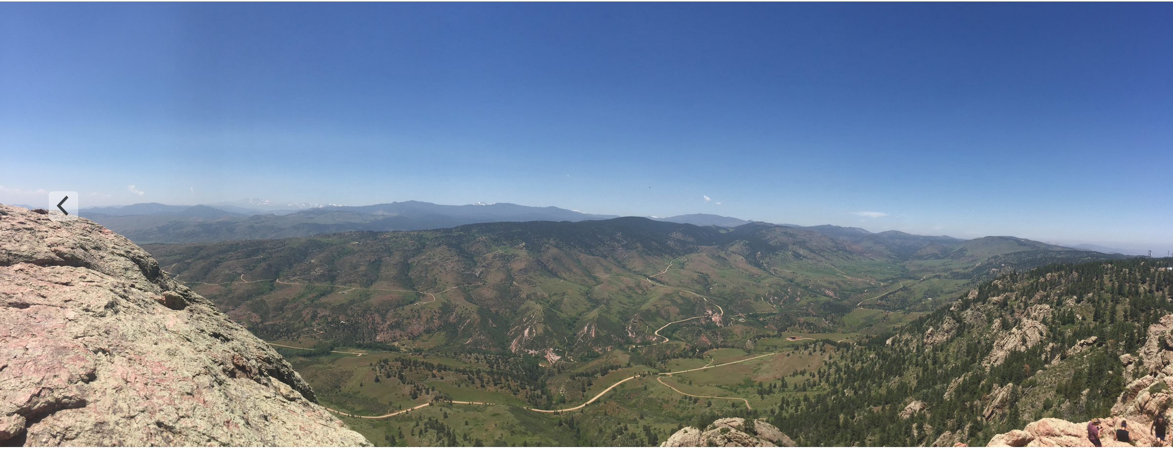

Slide 24
acknowledgements
A very special thanks to Kamlesh Suthar for
his guidance on this project; to Jason Carter, Jason Lerch, Kathy Harkay, and Roger Dejus for their insight along the way; and especially to pat den hartog, Eric Prebys, and Linda Spentzouris for giving me this opportunity and organizing the Summer 2016 student Internships.

Slide 25
Citations
Capatina, Dana. private communication (2016).
Carter, Jason. private communication (2016).
Chao, Alexander Wu., and M. Tigner. Handbook of Accelerator Physics and Engineering. River Edge, NJ: World Scientific, 1999. Print.
Dejus, Roger. "Power Distribution from a Dipole Source." Internal APS Memo (2003): 1-8. Print.
Edwards, D. A., and M. J. Syphers. An Introduction to the Physics of High Energy Accelerators. New York: Wiley, 1993. Print.
Harkay, Katherine. "Maximum Beam Orbit in MBA and Ray Tracing Guidelines." 2nd ser. (2014): 1-9. Print.
Suthar, Kamlesh. private communication (2016).

