Slide 1
Fermilab Cryomodule Assembly
C.M. Ginsburg (CAM)
LCLS-II 1.3 GHz Cryomodule Production Readiness Review
13-14 September, 2016

Slide 2
Outline
Introduction
Review charge
Technical scope of work
Current CM status
Safety considerations
Schedule
Cryomodule assembly team, roles and responsibilities
Procurement plan and supply chain
Status of design reviews
Risk registry
Conclusions

Slide 3
Introduction
Committee
FNAL and JLab cryomodule team
Joint FNAL/JLab review
Two labs are at different stages of pCM
Procedures and travelers are developed together
Assemble an equivalent product
JLab and FNAL have very complementary cryomodule design/build experience
Assembly experience by both labs adds confidence to plans

Slide 4
Charge (1/3)
The review committee is charged to evaluate the production readiness of the LCLS-II cryomodule at Fermi National Accelerator Laboratory (FNAL) and Thomas Jefferson National Accelerator Lab (JLab). To carry out this charge, the review committee should evaluate the system readiness by responding to the following:
1 Technical Scope and Schedule (FNAL and JLab) [CMG,ED,JK/YO,TA#1,AR,TA#2,RL,GW/EH]
Is the scope of work defined properly?
Is the schedule reasonable to achieve the defined scope?
Are there opportunities for schedule advancement/recovery in cases of cryomodule rework or repairs?
Are the prototype test-results, as available, consistent with initial acceptance criteria?
2 Cryomodule Assembly Team (FNAL and JLab) [CG,ED,TA,AR]
Have all key project team members been identified?
Have roles and responsibilities been clearly defined?
Is the staffing level suitable to support the production plan?
3 Design Status (FNAL) [CMG,JK/YO]
Are all design specifications, requirements, performance, and interface documents reviewed, approved and released?
Are the drawing packages 100% complete and released to permit successful fabrication?
Have all previous design review recommendations been addressed and/or closed out?

Slide 5
Charge (2/3)
4 ES&H and Work Planning and Control (FNAL and JLab) [CMG,TA#1,AR,JB,JL,TA#2,RL,GW/EH]
Is there evidence of work planning and control processes in day-to-day procedures?
Have all safety risks been identified and ranked?
Is there evidence of appropriate hazard mitigation plans?
5 Quality Assurance and Quality Control (FNAL and JLab) [JB,JL,KW,TA#1,AR,AM,KD,GW/EH]
Is there a process for configuration management in place, e.g. drawing release status, change approval authorization, red-line process, as-builts, etc.?
Is the process for incoming component inspections, sub-system check-out, documentation, and responsibilities well planned?
6 Production Management (FNAL and JLab) [CMG,ED,TA#1,AR,JB,JL,KW,AM,KD,GW/EH]
Have all of the major risks been identified and managed?
Is the supply chain in place and well planned, especially drop-shipments between partner laboratories?
Are the processes for qualification, QA, material handling, storage, and risk mitigation adequate for the cavities and fundamental power couplers (FPCs), both of which are high-risk, no guarantee elements?
Have lessons learned and traveler documentation from Eu-XFEL, Fermilab CM02, and JLab 12 GeV Upgrade been incorporated into the assembly procedures and component/system check-out planning?
Are all travelers and assembly procedures updated and available?
Is there an agreed upon plan in place to collect and deliver all relevant inspection, assembly and testing data to SLAC for each cryomodule?

Slide 6
Charge (3/3)
7 Miscellaneous (FNAL and JLab) [CMG, All]
Have all of the major risks been identified and managed?
Are there any other issues that have been identified that need to be addressed?
8 Overall Readiness (FNAL and JLab) [CMG, ED, All]
Are all plans, processes and resources in place to fabricate the LCLS-II cryomodule, so that there is a high likelihood of success to meet the schedule and system performance requirements?

Slide 7
FNAL cryomodule WBS scope of work – for this review (1/4)
PL Management & Integration (1.04.05.01)
Oversight and integration of all WBS 1.04.05 related activities
Overall CM support in areas that include ES&H, QA/QC, and supporting engineering
CM related travel M&S (including vendor visits)
Engineering & Design (1.04.05.05)
Design 1.3GHz prototype and production cryomodules, and 3.9 GHz cryomodules
Produce all necessary calculations, analyses, models, and drawings
Perform design verification tests of cryomodule subcomponents
Prototype Cryomodule (1.04.05.06)
Procure materials for prototype CM
Surface process and test bare cavities, dress cavities
Vertical and horizontal cavity tests
CM assembly
CM test
1.3 GHz design activities are complete and closed
As it informs production CM assembly

Slide 8
FNAL Cryomodule WBS scope of work - for this review (2/4)
1.3 GHz Cryomodule Procurements (1.04.05.07)
Procurement responsibilities for the production cryomodules are shared between FNAL and JLAB as outlined in document LCLSII-4.1-PM-0229-R0
Each lab will procure quantities sufficient for all production cryomodules
SLAC LCLS-II Procurement Management plan outlines the formal process for procurements including reviews and approvals
1.3 GHz Cryomodule Cavity Prep/Test (1.04.05.08)
Receive and inspect dressed cavities as received from vendors(s)
Vertically test all cavities, horizontally test a subset
Reprocess as required
Prepare all cavities for use in strings for FNAL constructed cryomodules

Slide 9
FNAL Cryomodule WBS scope of work – for this review (3/4)
1.3 GHz Cryomodule Cavity String Assembly (1.04.05.09)
Receive cavities from cavity prep/test step
Prepare and clean parts
Assembly cold ends of couplers
Assemble cavity string in clean room
Includes leak checking and backfilling cavities, leak checking and assembling couplers, aligning cavities, installing gate valves, assembling cavity-to-cavity string with bellows, BPM, and string pump down, leak check, and backfill
1.3 GHz Cryomodule Assembly (1.04.05.10)
Receive cavity string from Cavity String Assembly WBS
Install 2-phase pipes, bellows, magnetic shield, tuners, insulation, instrumentation, GRHP, thermal shields, cooling straps, SC magnet, vacuum vessel, warm part of coupler, coupler pumping lines
Perform electrical and RF checks, and leak and pressure check

Slide 10
Cryomodule WBS scope of work – for this review (4/4)
1.3 GHz Cryomodule Test (1.04.05.11)
Transport production cryomodules to CMTS
Install on test stand, make coupler and cavity vacuum connections and leak check, connect RF, cooldown
Perform cold RF testing
Warm up, disconnect test connections, prepare for shipment to SLAC

Slide 11
XFEL CM Modifications for LCLS-II (components)
Component design – leverage existing designs optimally
Cavities – XFEL identical
Helium vessel – XFEL-like
HOM coupler – XFEL-like
Magnetic shielding – increased to maintain high Q₀
Tuner – XFEL-like end-lever style
Magnet – Fermilab/KEK design split quadrupole/corrector package
BPM – DESY button-style with modified feedthrough
Coupler – XFEL-like (TTF3) modified for higher Q_{L} and 7 kW CW
Concerns based on global experience
Tuner motor and piezo lifetime: Include vacuum vessel access ports
Maintain high Q₀ by minimizing flux trapping: Study and confirm cooldown characteristics and magnetic shielding, avoid magnetic components

Slide 12
XFEL CM Modifications for LCLS-II (cryo-mech)
Cryo-mechanical design – increased pipe sizes
Larger chimney pipe from helium vessel to 2-phase pipe
Larger 2-phase pipe (~100 mm OD) for low velocity vapor flow
Both high heat load & 0.5% slope of the SLAC tunnel require
Closed-ended 2-phase pipe providing separate 2 K liquid levels in each cryomodule
2 K JT (liquid supply) valve on each cryomodule
Additional cooldown valve for cavity cooldown control
Cost savings: Omit 5 K thermal shield
Simplification since large dynamic heat at 2 K makes such a thermal shield of marginal value
Retain 5 K intercepts on input coupler

Slide 13
FNAL CM technical/project status
Approval of LCLS-II CD2/3: “construction start”
Cost/schedule DOE baselined April 2016; 4 months of DOE tracking
Prototype 1.3 GHz cryomodule assembled
Cryomodule Test Stand 1 (CMTS1) completed
Cave construction, cryogenic system complete and commissioned, insulating and beamline vacuum systems installed, RF system including 8 SSA’s from SLAC installed and tested (with load), magnet power supply tested, safety systems complete, tested, and approved; controls, RF interlock, and LLRF systems being commissioned
Cryomodule test protocol established – technical meeting spanned LCLS-II and other experienced labs
Prototype cryomodule test ongoing
Most production cryomodule procurement contracts placed

Slide 14
Design Basis – Multi-Lab Safety Considerations
Cryomodule derived from the DESY TESLA cryomodule design
Design modified at Fermilab for ILC development using Fermilab Engineering, QA and ES&H policies
Cryomodule further modified at Fermilab to satisfy LCLS-II project requirements
As a result, it was necessary to ensure that Fermilab policies also satisfy the requirements of SLAC and JLAB
SLAC reviewed the safety and QA programs at the partner laboratories
Common areas determined to be consistent with the SLAC program and therefore the LCLS-II project requirements
Unique areas were addressed
Seismic (FNAL and JLAB)
ODH (SLAC)

Slide 15
Safety Summary
Partner Lab Engineering, Pressure Safety and QA processes have been reviewed and approved for use on the LCLS-II project
Cryomodule/CDS pressure systems were reviewed and approved by the SLAC Pressure System Program Manager
LCLS-II dressed cavities have been reviewed and approved at FNAL and JLAB prior to horizontal testing
Cryomodule/CDS FMEA and What-If analyses are developed, identifying maximum credible incidents and tied into the SLAC tunnel/gallery ODH analysis
Electrical safety being addressed through existing policies
Seismic analysis has been successfully reviewed by the SLAC Seismic Program Manager and Building Inspection Office related to internal elements
CM seismic design signed off Jun.’16: LCLSII-4.5-EN-0430-R0
Minor modifications to tunnel floor anchoring being discussed

Slide 16
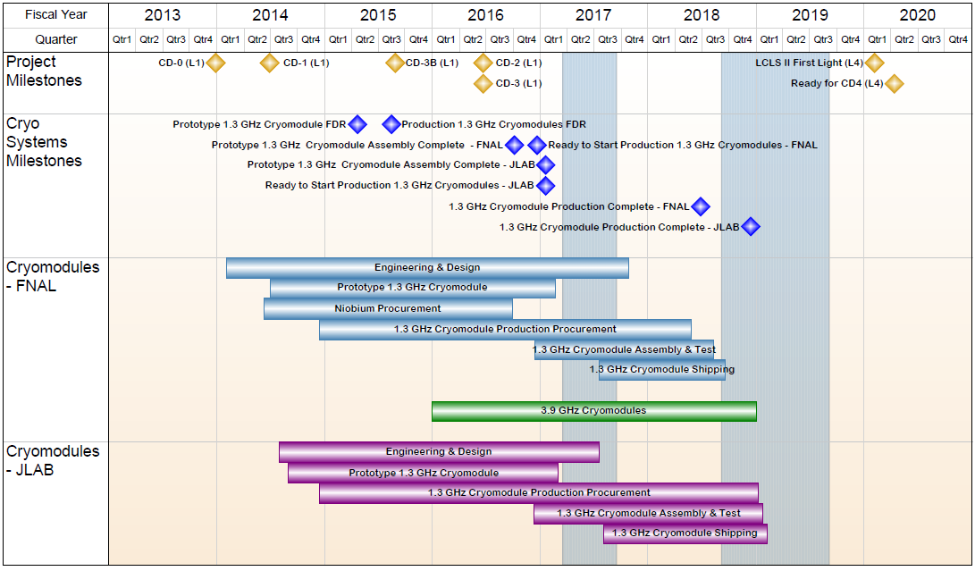
1.04.05 - FNAL Cryomodules - Summary Schedule

Slide 17
FNAL CM Staff
S. Chandrasekaran
Highly experienced staff who worked on prototype CM continue to work on production CM’s

Slide 18
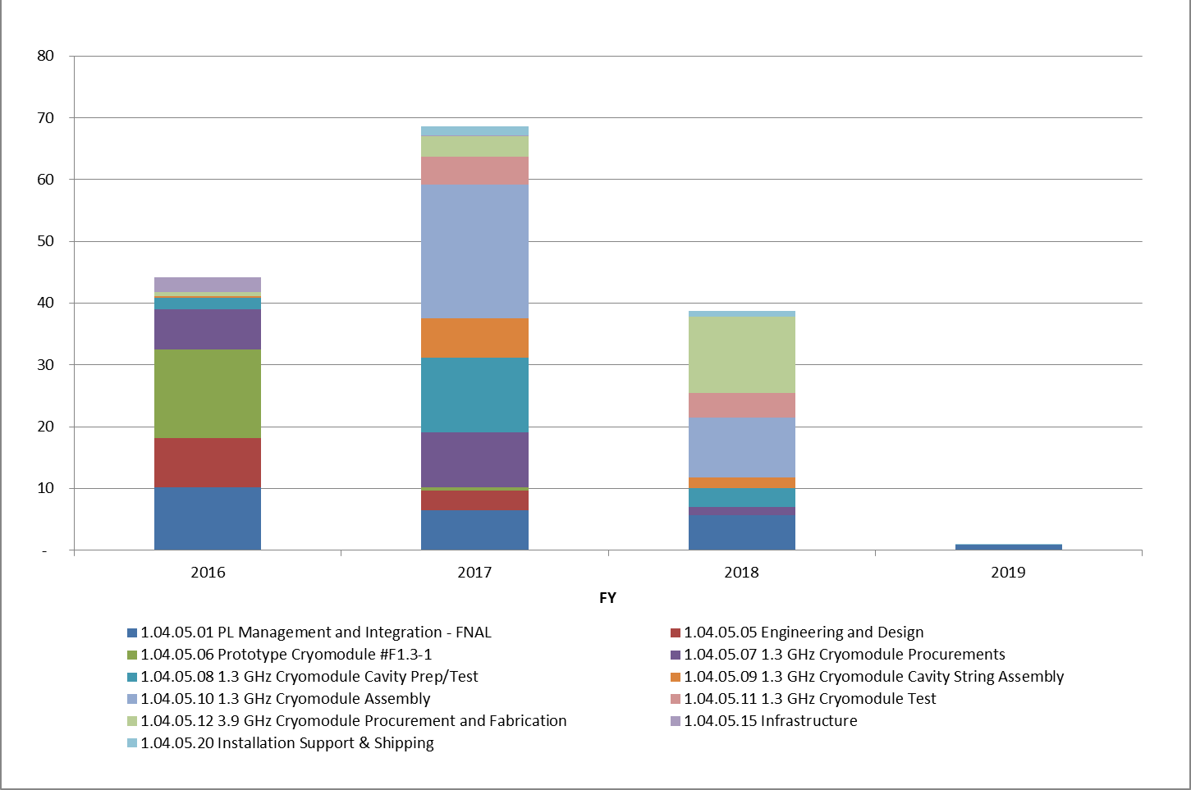
1.04.05 - FNAL Cryomodules – Staffing (FTEs)
Thru month end June 2016 averaging 39.3 FTE
FNAL LCLS-II FY17 plans were vetted through the Divisions for annual budget planning
No issues with FNAL staff resource assignments.
In FY16, 147 different people worked on FNAL LCLS-II (56 of them were between 5% and 25%) so much of the increase will come from existing people ramping up time.
Will add ~7 contract techs for CM production. Tech workforce ramp up between CM2&CM3.

Slide 19
1.3 GHz production CM procurement status
Procurements shared between labs, split delivery to both labs
Most major production procurements awarded

Slide 20
Procurements 93% awarded, by cost
93% awarded by end Aug 2016

Slide 21
Major Past Reviews (1/2)
LCLS-II Director’s CD-1 Review – 9-11.Dec. 2013
LCLS-II DOE CD-1 Review – 4-6.Feb. 2014
Prototype 1.3 GHz dressed cavity – 5. Apr. 2014
Cavity, helium vessel, preliminary tuner
https://indico.fnal.gov/conferenceDisplay.py?confId=8598
Prototype 1.3 GHz Cryomodule – 6.Jun. 2014
CM cryomechanical issues
https://indico.fnal.gov/conferenceDisplay.py?confId=8398
LCLS-II Cryogenic System Preliminary Design Review 13-15.Aug. 2014
LCLS-II DOE Status Review – 19-20.Aug.2014
Helium vessel procurement – 4.Nov 2014
https://indico.fnal.gov/conferenceDisplay.py?confId=9247
GHRP and vacuum vessel (prototype CM) – 4. Dec. 2014
https://indico.fnal.gov/conferenceDisplay.py?confId=9151
BPM and gate valve – 12.Dec. 2014
https://indico.fnal.gov/conferenceDisplay.py?confId=9156
Notes:
Timergali Khabiboulline, T. Nicol (chair), Leonardo Ristori, Ed Daly, J. Preble
Elvin Harms (chair), John Mammosser, Joel Fuerst, Tom Nicol, and Jerry Makara

Slide 22
Major Past Reviews (2/2)
Prototype 1.3 GHz cryomodule 20-21.Jan. 2015 – Final Design
https://indico.fnal.gov/conferenceDisplay.py?confId=9245
LCLS-II FAC Review at SLAC 5-6.Feb.2015
LCLS-II Director’s CD3B Review at SLAC 17-19.Feb.2015
LCLS-II DOE CD3B Review at SLAC 6-9.Apr.2015
1.3 GHz cryomodule cavity tuner 15.Apr. 2015 – Final Design
https://indico.fnal.gov/conferenceDisplay.py?confId=9769
1.3 GHz cryomodule magnet 16.Apr. 2015 – Final Design
https://indico.fnal.gov/conferenceDisplay.py?confId=9808
1.3 GHz Production CM Final Design Review May 12-14 2015
https://indico.fnal.gov/conferenceDisplay.py?confId=10102
Cryomodule Interconnect Review July 29 2015
https://indico.fnal.gov/conferenceDisplay.py?confId=9874
All review recommendations closed, except two not specific to PRR
Notes:
Timergali Khabiboulline, T. Nicol (chair), Leonardo Ristori, Ed Daly, J. Preble
Elvin Harms (chair), John Mammosser, Joel Fuerst, Tom Nicol, and Jerry Makara

Slide 23
Risks & Risk Mitigations (High Impact) (1/2)
Title | IF/THEN | Mitigations | Schedule
pCM Assembly | If pCM designs don't integrate as planned, THEN production assembly will be delayed | Develop Lessons Learned, Use prototype work to refine processes and design to reduce impact to production assembly. Revise tooling, update procedures, and revise QA/QC processes. cold test will give lessons learned, design changes and process improvements. | Fermilab pCM begins cold testing 09.2016 JLab pCM cold testing 10.2016.
Damage during shipping | If shipping subjects CM has extreme shock Then delivery will be delayed. | Other labs (DESY XFEL) have realized 2/101 failure without mitigations in place. SNS similar Perform dry-runs under realistic conditions. Investigate and determine alternate scheme. Shipping test March 2017. labs will need to store Cryomodules until OK. | Preliminary shipping test for Q1FY17
CM rework | Production Cryomodule fails test Then require rework/retest | Supply Chain, Defective Parts Include pre-production Cryomodule in project plan at each partner laboratory. Production plan includes longer duration for the first three Cryomodules to finalize assembly and QC procedures. | pCM almost complete 9/2016.

Slide 24
Risks & Risk Mitigations (High Impact) – (2/2)
Title | IF/THEN | Mitigations | Schedule
JLAB Cryomodule test lab availability | If the CMTF is not available because of cryoplant refurbishment, then the project will experience delays in testing | Actively seeking other cryogenic facilities for backup testing, and evaluating testing cycles, assessing schedule impact. | CMTF cryoplant work is scheduled for early 2017. Integrated planning underway
Cryo. Heat Load | If cavities do not expel magnetic flux and residual magnetic field is high, then cryo. heat load will be high → cryogenic margin reduced 2x | Improvements to flux expulsion-based on single-cell testing. Include higher bake temperature, tuning and stress analysis. Assure low residual magnetic field | Single cell cavity tests May-Nov 2016 9 cell tests begin August through Nov 2016. Production process improvement steps in Q1FY17

Slide 25
FNAL Cryomodule Summary
FNAL prototype CM well underway
Fully assembled, test in progress
Safety, QA/QC have been well developed within the existing partner lab and SLAC/LCLS-II framework
Staff in place and working, with clear roles and responsibilities
Procurements well advanced; most awards are placed
Design reviews are complete
Plans for production CM assembly are mature; risk mitigations have been considered
Passing this review is required to consider WS2 complete for CM02
We look forward to a productive review and Thanks(!) in advance for your help

