Slide 1
Project Overview:
JLab CM Production
Edward Daly for the JLab CM Team
LCLS-II 1.3 GHz CM PRR
13-14 September, 2016

Slide 2
Outline
  Introduction
  JLab’s PRR Approach
  Infrastructure Status
  Procurement Status
  Staffing
  Schedule
  Challenges
  Summary

Slide 3
Introduction
  Original plans for PRRs had separate parallel meetings
  FNAL & LCLS-II agreed to host a combined meeting
  JLab’s PRR Plan is an effort to advance the schedule
    Split into two phases – production readiness & pCM test results
  Production Readiness
    Utilizing existing tested production tools (Pansophy)
    Logistics & Inventory Management are in place
    String assembly plans/documents very well developed
    CM assembly plans/documents – some progress; linked to pCM assembly completion
  Plan to start CM02 string assembly at conclusion of this review

Slide 4
Production Readiness – High Level Summary
  Tooling and Infrastructure for assembly is in use
    Two parallel CM assembly lines
  Preparing for production assembly efforts
    Receipt inspection efforts have commenced
    Assembly procedures in progress
    Traveler system in place including reporting
    Staff is ramping up
  Currently completing CM Testing Facility
  Production procurements are progressing well
    All contracts placed; vendors have begun deliveries
  JLab PRR was scheduled for October 2016

Slide 5
JLab’s PRR Approach
  Schedule
    PRR scheduled for October 2016
    pCM test results available in November 2016
    CM02 string planned for October 2016; CM03 - Jan 2017
  Contains three elements:
    Design completion (FNAL focus)
    Travelers, procedures, processes, infrastructure (Both)
    Results from pCM testing (Both)
  Approach
    Participate in FNAL PRR in SEP to review travelers and procedures (Phase I)
    Follow up with JLab review of pCM test results in NOV (Phase II)
    Build CM02 & CM03 cavity strings as schedule risk mitigation if components are available

Slide 6
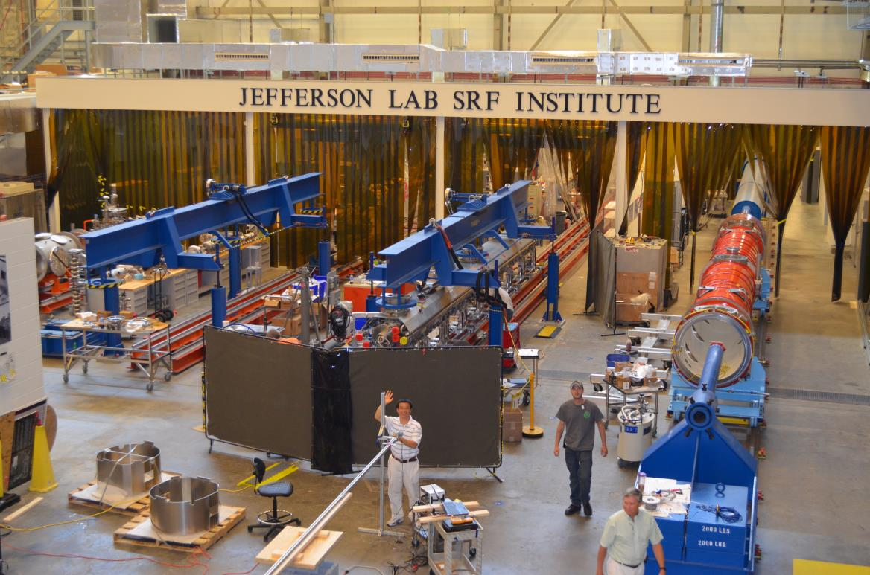
Cryomodule Assembly at JLab
LCLS-II @

Slide 7
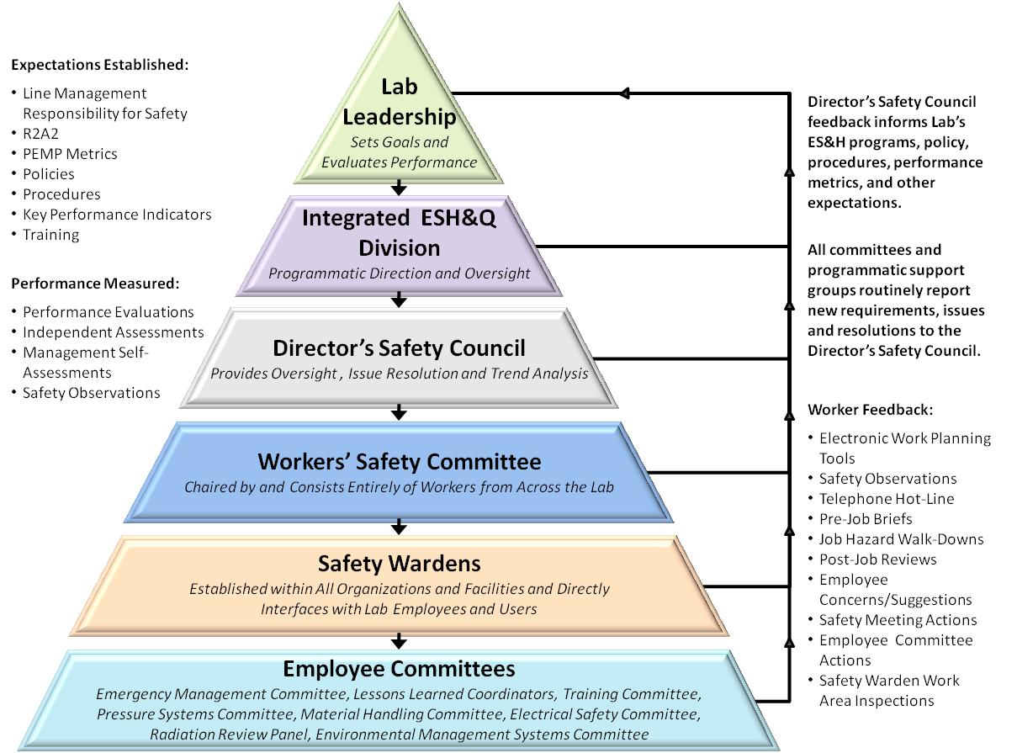
LCLS II Uses Well-Established JLab ISM program
  15 work Observations were conducted,
  ESH professionals, Division Safety Officer, and Accelerator Division staff and management.
  All safe for all observations
  ISM – Integrated Safety Management applies for all work.
    Presenters will address their specific areas (VTA, Assembly, Testing)
  Example - Shoulder injury experienced by a technician while loosing a bolt on a LCLSII cavity flange.
    Immediate actions to modify work procedures, larger wrench
    Follow up in depth investigation by Division Safety Officer
    All corrective actions are either complete or on-schedule for completion.

Slide 8
Processes, Procedures and Travelers
Developed list of procedures and travelers for CM production based on CM assembly processes
  Leveraged C100 experience
Procedures are a composite of C100 and LCLS II Qo experience folding in FNAL procedures and XFEL techniques in use at Saclay
  Assembly travelers for pCM cavity string assembly
  Assembly travelers for pCM assembly
  Procedure development - good collaboration with FNAL team
Implemented receiving and inspection travelers for the prototype and production CM components
  FNAL & JLab SOTRs are collaborating
  Plan to refine production procedures and travelers based on pCM experience & Lessons Learned
  PRR – venue for review prior to start of string assembly

Slide 9
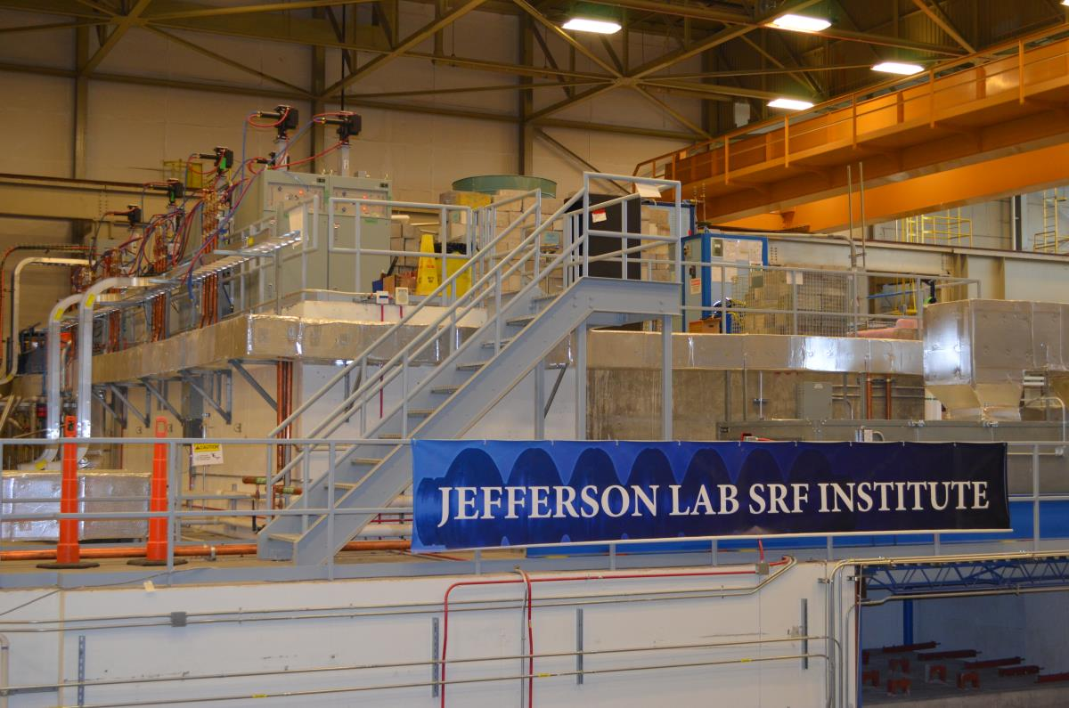
CM Test Facility – SSAs Installed

Slide 10
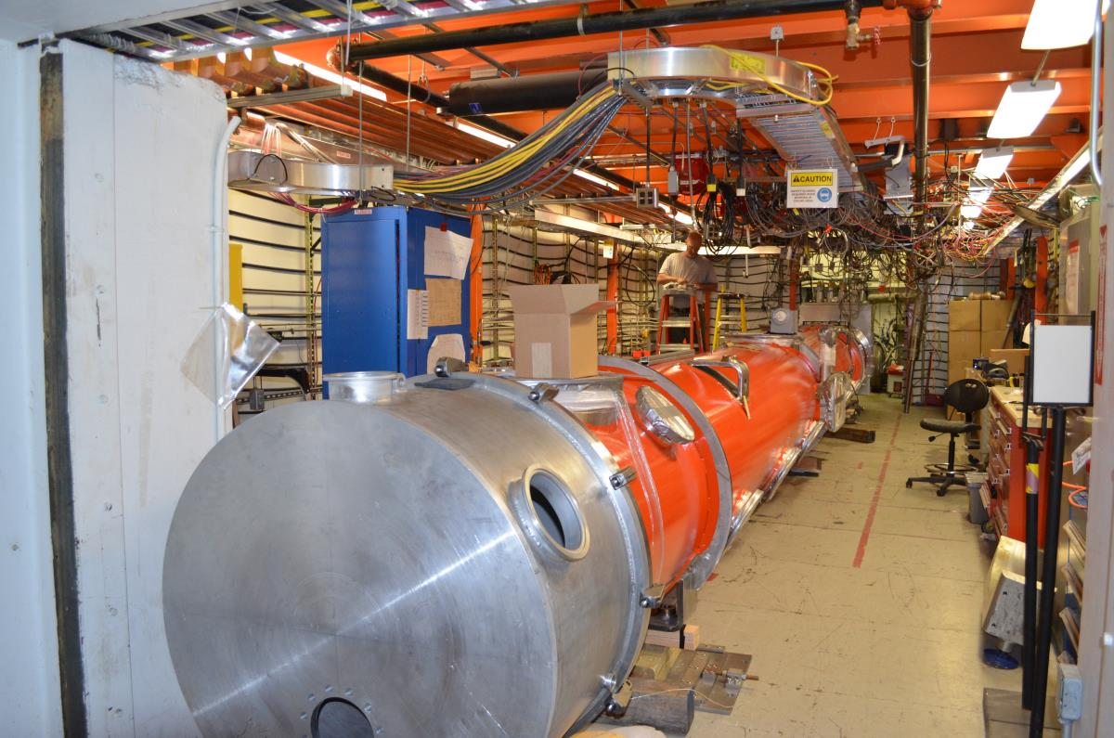
CM Test Facility – Checking CM Position

Slide 11
SRF Operations:
Organization
https://www.jlab.org/accel/office/org_chart.pdf
Approximately 43 people including several hires would in part work on LCLS-II production
Engineering Department Staff (matrixed/assigned to SRF Engineering)
K. Wilson G. Cheng
H. K. Park T. Hiatt

Slide 12

SRF Operations FY16/17 Staffing Plan
LCLS II Term Hires
Cryomodule Group
Add (8-10) mechanical technicians
  Need to be capable of completing C50/C75 cryomodules during LCLS II
  Two hires are in progress
  Add (2) per quarter through Q2FY17
  Be fully staffed by end of Q2FY17
Cavity Group
Add (2) cleanroom mechanical assembly technicians
Add (1) general duty technician
Add (1) parts clean technician (?)
VTA/Electrical Group
Add (1) electronics technician
Project Support/QA Group
Add (1) computer scientist
Add (1) QC/CMM operator
Technical Services Group
Add (1) produciton support technician
Hires by Quarter
Q1FY16
(2) cryomodule assembly technicians
(2) cleanroom assembly technician
(1) general duty technician
(1) computer scientist – Done
Q2FY16
(2) cryomodule assembly technicians
(1) QA/CMM operator
Q3FY16
(2) cryomodule assembly technicians
(1) inventory technician
Q4FY16
(2) cryomodule assembly technicians
(1) cleanroom technician
Q1FY17
(2-4) cryomodule assembly technicians
  Actual number will be determined based on prototype cryomodule experience
Done
Done

Slide 13
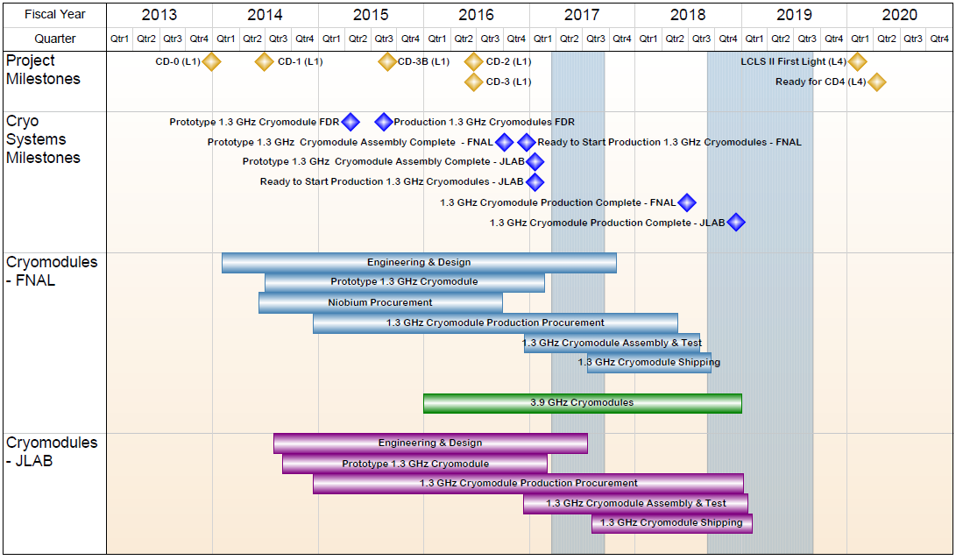
1.04.06 JLAB Cryomodules- Summary Schedule

Slide 14
Challenges
Production cavity delivery schedule (recipe improvements, baseline machine vs. HE)
Supply chain management – continuity and understanding technical requirements
On-site inventory & logistics – quantity of components, available space
Transferring processes between labs
  SOTRs & Production Leads, Equivalent processes
  Updates, modifications and improvements
  Implementation of acceptance criteria listing (ACLs)

Slide 15
Summary
Goal for production of CMs at JLab/FNAL is “identical design, identical parts, equivalent processes to yield equivalent performance”
pCM assembly in progress with initial procedures/travelers
Procedures in progress for production CMs
Assembly tooling is complete; CMTF is nearly ready
Overall Plan for Cryomodule Production
  Start of Production 1.3 GHz CMs (33 units) Jul-2016
    Rates of 1 CM per 6 weeks in current plans
  CMTF Complete Sep-2016
  CM02 String Assembly Start Sep-2016
  Prototype CM completed and in CMTF Oct-2016
  Production Readiness Review (Phase I) Oct-2016
  PRR (Phase II) includes pCM Test Results Nov-2016

Slide 16
Acknowledgements
  Huge Thanks – V. Bookwalter, M. Salvador (Pansophy Team)
  Big Thanks - J. Fischer, F. Marhauser, K. Davis, C. Ginsburg, T. Arkan
  Many Thanks - JLab, FNAL and SLAC colleagues
  Danke Schoen & Merci Beaucoup - XFEL Project Team at DESY & CEA/Saclay

Slide 17
Back Up

Slide 18
Strategy – One Design, Two Production Lines
  Designs for Prototype and Production CMs (aim to satisfy PR and CM FRS)
  Identical Prototypes - utilize as much existing hardware as possible to reduce schedule risk and reduce overall cost while achieving the same performance as the production CMs
  Identical Production Designs - utilize as much of the DESY/XFEL design as practically possible to reduce schedule risk and reduce overall cost
    FNAL produces 16 CMs; JLab produces 17 CMs + 1 spare CM
  Identical Parts Received at Partner Labs
    Well-developed drawing packages, clear requirements and specifications
    Concurrent reviews within LCLS-II project
    Procurement activities – lead technical contacts at Jlab/FNAL/SLAC work together during all phases
  Identical Tooling Interfaces
    Interfaces between CM hardware and tooling are identical
      Avoid adding custom features to CM
    Adapt non-CM hardware interfaces to Lab-specific tooling
  Equivalent Processes yielding Equivalent Performance
    Recognize that some tools are different at each lab (e.g. HPR, vertical testing systems, vacuum leak checking equipment, etc.)
    Monitor key process variables in consistent fashion (e.g. samples to verify etch rates)

Slide 19
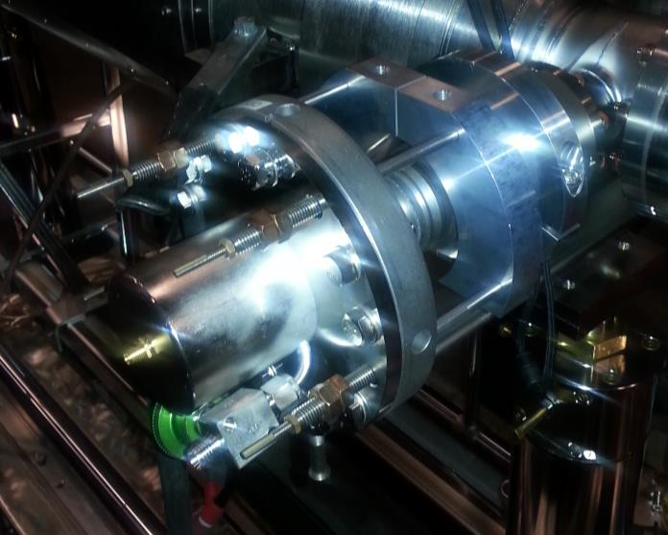
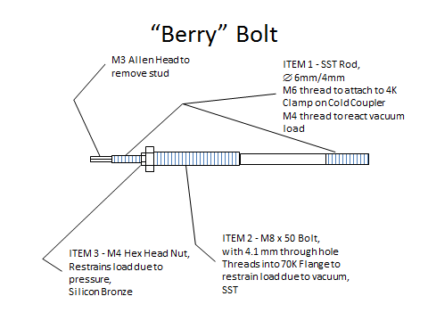
JLab Cavity String Assembly – Berry Bolts
Restraint that enable pump down and keep cavity string under vacuum using “Berry” Bolts
Installed outside of clean room during cryomodule assembly phase I

Slide 20
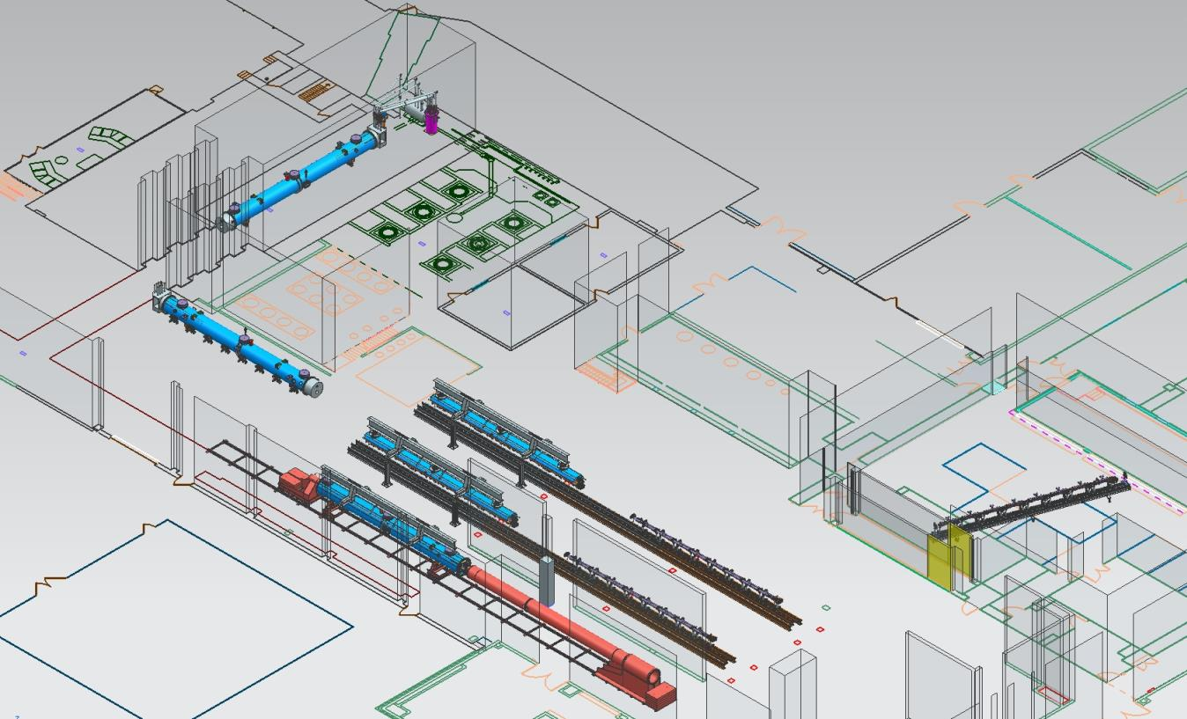
JLab Layout for LCLS-II CM Production
CM Testing
Phase II CM Assembly (2X)
Clean Room String Assembly
Phase I CM Assembly (2X)
Final Assembly / Prep for Testing
Vacuum Vessel Installation

Slide 21

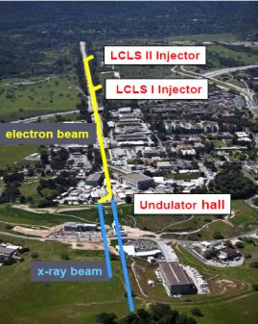

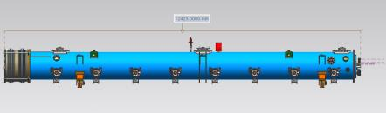
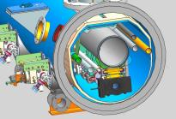
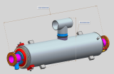
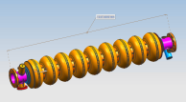
LCLS-II Cavity/Cryomodule Process at JLab
Supplier
Partners
JLAB SRF Facility
Receiving in SRF Inventory
Mechanical Inspection CMM
 | Component | FNAL | JLAB | SLAC
Cavity String | Niobium (Prototype) - existing cavities | NA
 | Niobium (Production) | X
 | Cavities (Prototype) - existing cavities | NA
 | Helium Vessels (Prototype) | X
 | Cavities w/Helium Vessels -VTS Ready (Production) |  | X
 | Cavity Feedthroughs |  | X
 | Cavity Flanges & Assoc. Hardware/Seals (VTS & HTS compatible) |  | X
 | Fundamental Power Coupler (FPC) |  |  | X
 | Cavity String Interconnecting Bellows |  | X
 | Cavity String Assembly Hardware & Seals | X
 | SC Magnet Assembly | X
 | Beam Position Monitor (BPM) | X
 | Gate Valves |  | X
 | Beamline Vac. Monitoring Manifold & Gauge | X
Cryomodule | Two-phase Pipe Bellows | X
 | Tuner, actuator, piezos (Prototype) | X
 | Tuner , actuator, piezos (Production) |  | X
 | Magnetic Shielding | X
 | GRHP Sub-assembly | X
 | Vacuum Vessel | X
 | Coupler Pumping Lines & Pumps (ion+TSP) + vacuum gauges | X
 | Instrumentation | X
 | Liquid Level Probes & JT Valve | X
 | Beamline Interconnect Parts including Aluminum Heat Shields | X
 | HOM Absorber |  | X
 | Shipping Frames & End Caps + Shock Log Devices |  | X
 | X = Lead Lab per SLAC LCLSII-4.1-PM-0229-R0 (June2014)
Cavity /Helium Vessel Prep. & Test
VTA RF Test in liquid Helium @ 2 K
Cavity String Assembly & Leak Test
Assemble Cavity String -Class 100 Clean Room
Courtesy Chi-Chang Kao, SLAC
Cryomodule Assembly
Instrumentation & Wiring
Tuners, MLI– Multi Layer Insulation,
Cryogenic Circuits , magnetic shielding, alignment
Super Insulation Cabling & Shield
Vacuum Vessel & Final Alignment
Install Cryogenic Supply Interfaces
  Horizontal Test Preparation
  Pressure Test & Leak Check (vacuum)
Commissioning at SLAC
Install Cryomodules in Accelerator, cool to 2 K
Weld & certify leak tight , pressure test
check Controls,
Gradient & Dynamic Heat Load - Q_{o}
Cryomodule Test in “Test Cave”
Cryomodule integrity @ 2 K
Tuners - Range, Hysteresis, & Resolution/ Sensitivity
Cavities for Gradient & Dynamic Heat Load Q_{o}
LCLS-II 1.3 GHz Cryomodule
Cryomodule shipping to SLAC
JLAB support for installation of first 3 Cryomodule

Slide 22
1.3 GHz Production CM Procurement Status
Vast majority of production procurements awarded

Slide 23
1.3 GHz Production CM Procurement Status
Dressed Cavities (F. Marhauser’s Talk)
  HOM & FP Feedthrus (100% received)
  Parts in Circulation (100% received)
Cu Plated Bellows and Spools
  SLAC has plated four sets successfully
  Production stainless parts (>50% received)
  Qualified first of two production plating vendors
Gate Valves – 100% Received at PLs
End Lever Tuners – first production units received
Beamline HOM Absorbers – planned for award OCT-16

Slide 24
Production Cavity Summary Table
Init_FEonsetMVm value of 100 means no FE
CAV SN | Init_FEonset MVm | Qo_Grad_16 |  | final_EmaxMVm | final_Qo At Emax | final_Rad Max | Comment
005 | 16.5 | 2.2 E10 |  | 16.4 | 2.20E+10 | 0.001 mR/h | Quench Limited
002 | 100 | 2.6 E10 |  | 24.2 | 2.63E+10 | 0.006 mR/h | Post degaus of HeV Admin Limited
001 | 100 | 2.3 E10 |  | 24.1 | 1.69E+10 | 0.001 mR/h | Admin Limited
004 | 100 | 2.5 E10 |  | 21.0 | 2.51E+10 | 0.004 mR/h | Cable BD limited to 21 MV/m
009 | 100 | 2.7 E10 |  | 17.1 |  | 0.001 mR/h | Quench limit 17.1 MV/m
012 | 17 | 2.3 E10 |  | 16.8 | 2.0 E10 | 834mR/h | Radiation limited: rinse retest 8/30
010 | 17.5 | 2.1 E10 |  | 17.5 | 2.1e10 | 30 mR/h | Quench limited, plan to rerinse, retest 9/7
014 | 100 | 2.7 E10 |  | 24.0 | 2.7 E10 | 0.001 mR/h | Admin limited
Fully Qualified, no NCR |  |  |  |  | Major NCR, no rework planned |  | Jlab NCR, rework/retest planned

