Slide 1
Fermilab Cryomodule QA/QC
Jamie Blowers
LCLS-II 1.3 GHz Cryomodule Production Readiness Review
13-14 September, 2016

Slide 2
Outline
LCLS-II Quality Assurance Framework, including integration between Fermilab and SLAC
Material Handling
Incoming Inspection
Traveler System
Configuration Management
Records and data handoff to SLAC
Summary

Slide 3
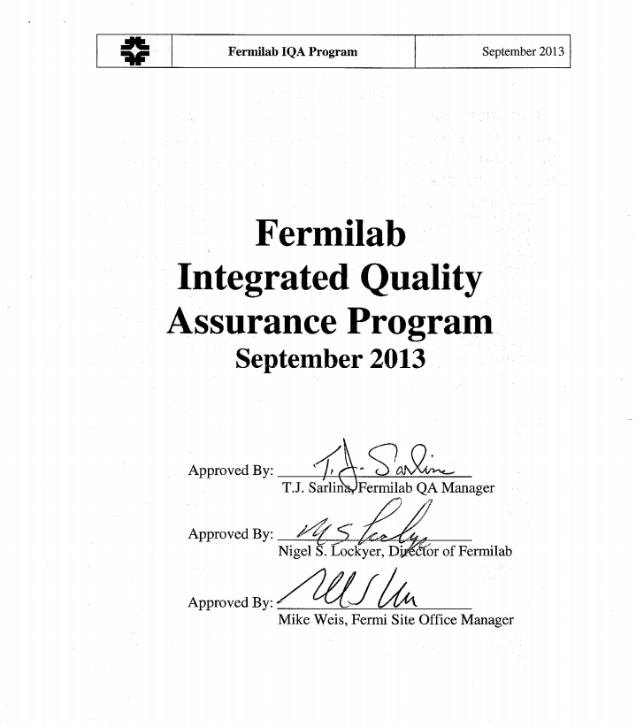
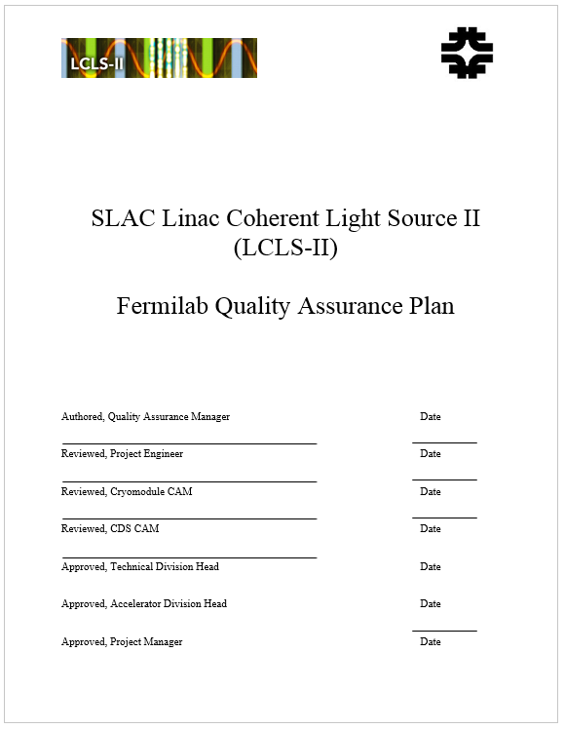
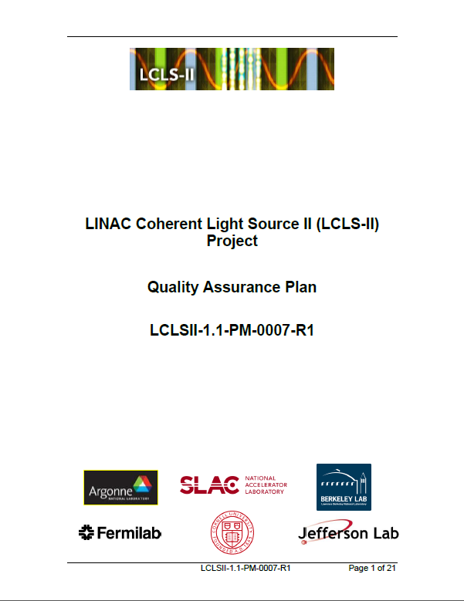
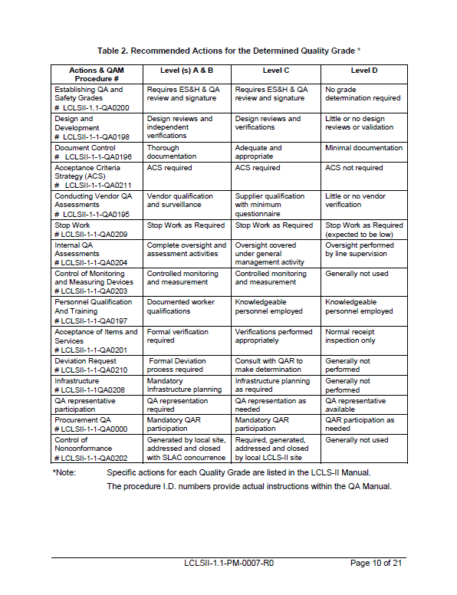
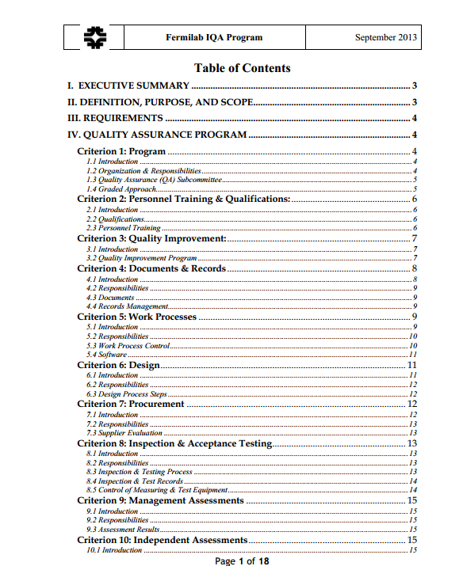
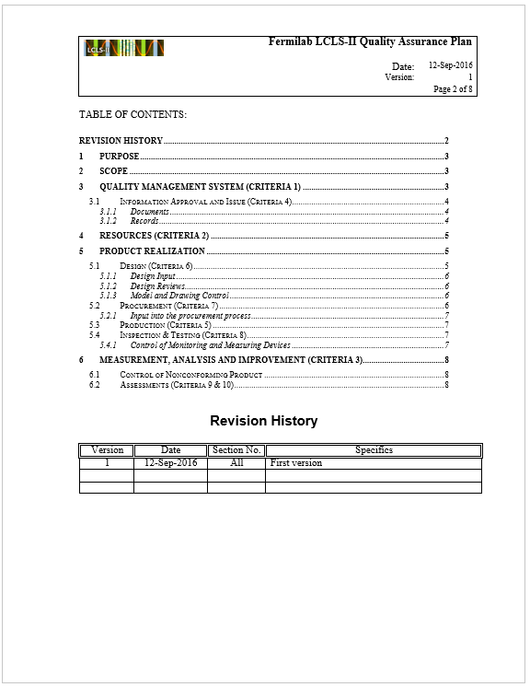
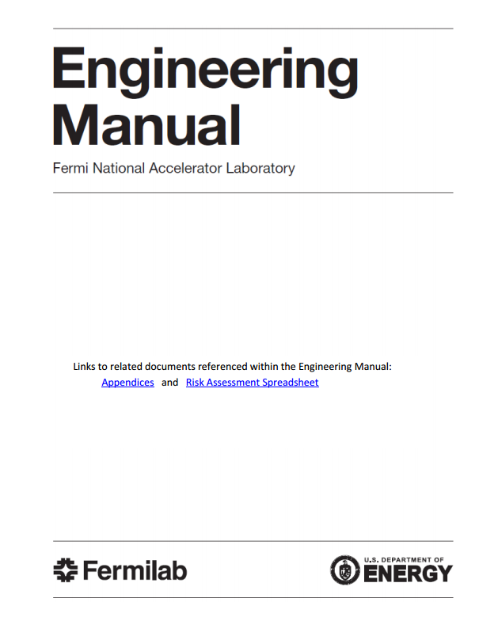
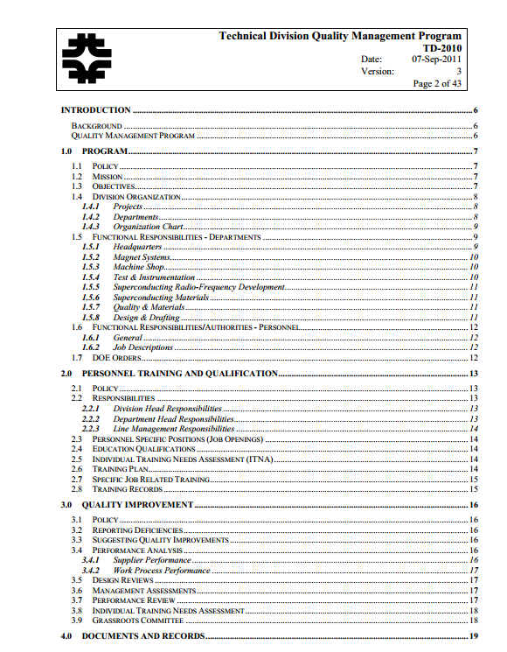
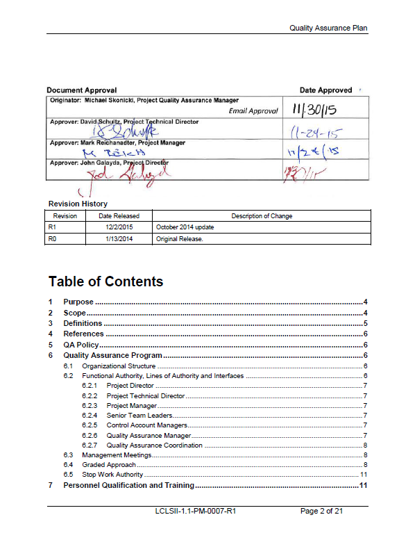
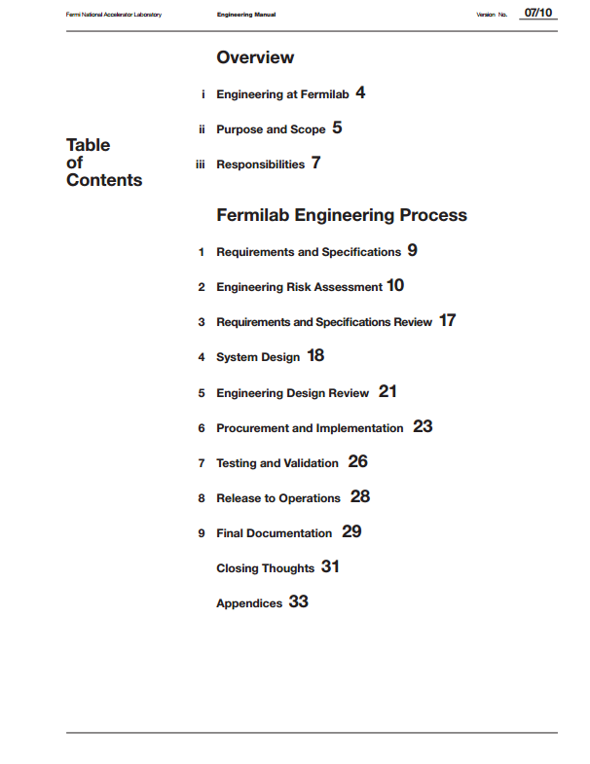
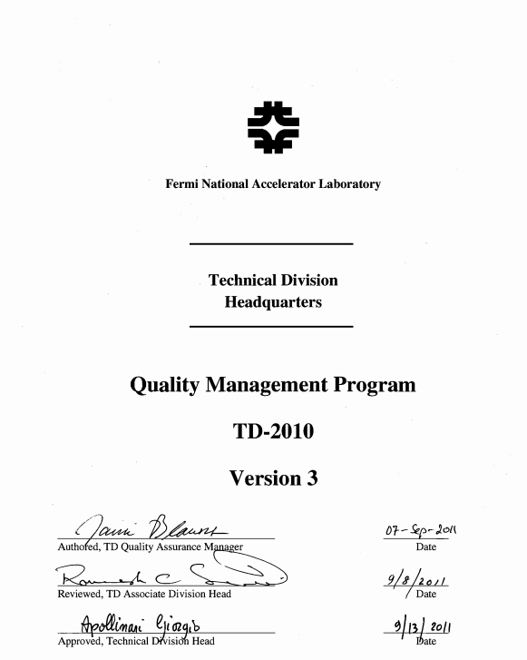
QA Framework
Fermilab, the Technical Division (organization where the LCLS-II cryomodules are designed and assembled), and the LCLS-II Project have formal QA programs.

Slide 4
QA Framework - Integration
SLAC QA Requirements have been integrated into the Fermilab LCLS-II QA Plan, e.g. Acceptance Criteria Strategies, Significant Nonconformances, Reviews
SLAC LCLS-II QA Manager has performed two QA assessments:
  Dec-2014 QA “Crosswalk”: “The FNAL LCLS II QA Program is compatible with the SLAC/LCLS II Quality Program. Many outstanding QA and QC practices were observed.”
  July-2016 Welding: “The Quality practices reviewed at FNAL, as applied to LCLS II Cryomodule production, were found to be satisfactory. No further action from the LCLS II QA is requested at this time.”

Slide 5
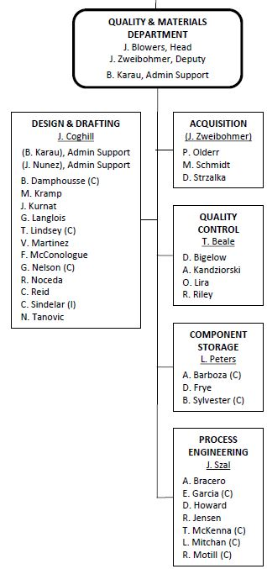
QA Framework – TD Organization
In the Technical Division the quality functions are centralized in one department
This department covers Design/Drafting, Acquisition, Incoming QC, Process Engineering (travelers), and Inventory/Parts Control, and overall QA

Slide 6
Material Handling
QA Plan section 4: “Resources necessary to safely complete the work of the Project [are provided]. These resources include…the necessary infrastructure and work environment to allow the work to be done safely and to meet all quality requirements.”
As much as possible material handling is done through the use of tooling and fixturing, so as to protect workers and materials.
When fixturing is not practical, materials are handled carefully by hand, using appropriate PPE.
Handling and transportation methods were successfully exercised during the pCM assembly.

Slide 7
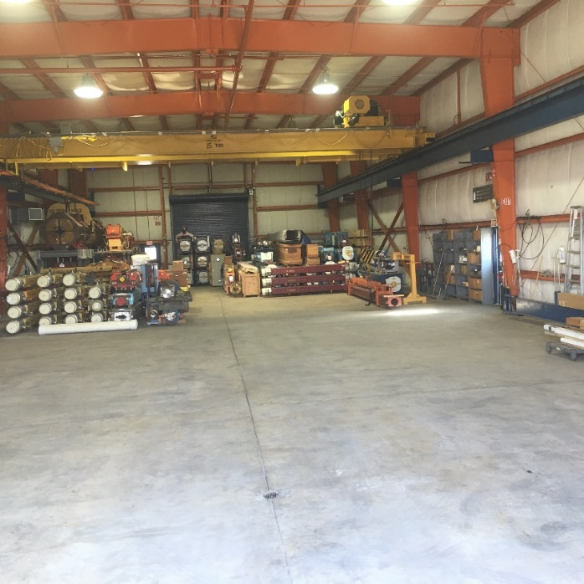
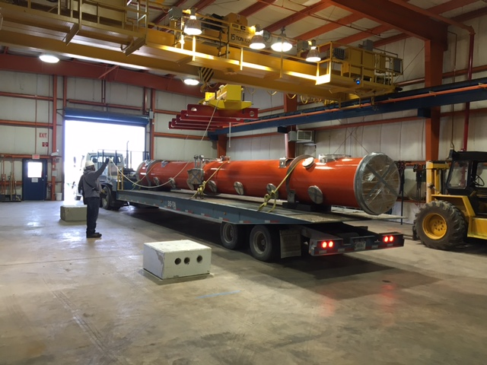
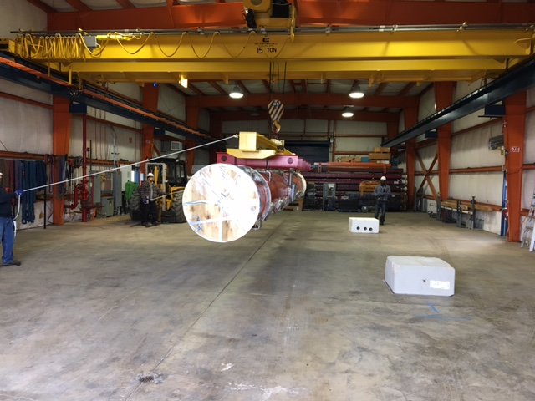
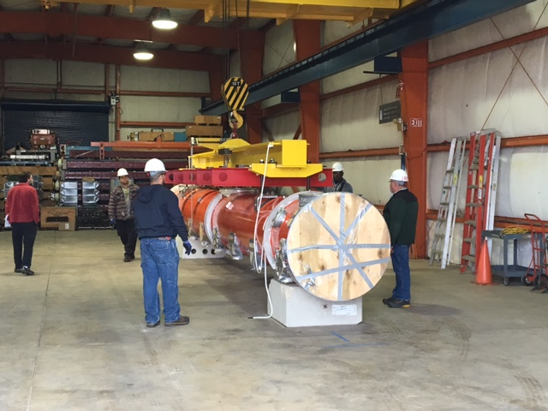
Material Handling - Storage
In preparation to receive and store the VV’s and UCM’s, we have reconfigured one of our storage buildings to provide ~ 4k sq ft of space
Plan to store 6 VV’s and 6 UCM’s
We have storage space in our receiving building for 30+ cavities (in their crates), with any “overflow” going to our Lab storage warehouse
We have staging/storage space for all other components

Slide 8
Incoming Inspection
All components go through an incoming inspection, which may be formal (performed by the QC Group) or informal (performed by the SOTR* or production staff)
  The SOTR makes this decision
All components are logged into a tracking database
  Each receiving “batch” is assigned a unique “Routing Form” number, which connects the parts back to their Purchase Order and to their inspection results
Serialized components are inspected according to a traveler; non-serialized parts are inspected as a batch
“Acceptance Criteria Strategy” documents are maintained per the SLAC LCLS-II QA Plan requirements
* Subcontracting Officer’s Technical Representative, a.k.a. technical lead

Slide 9
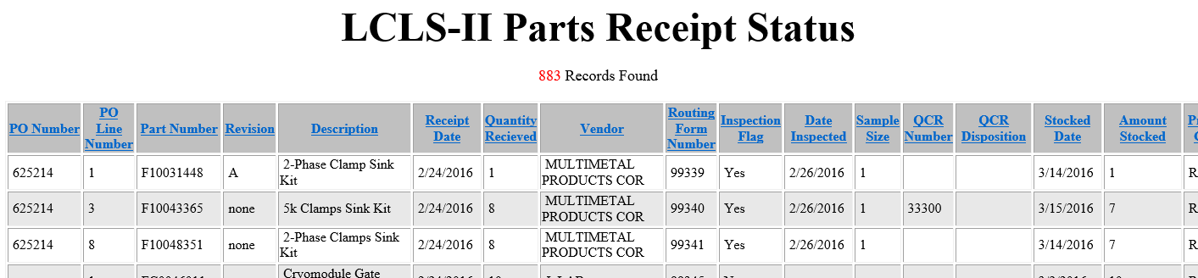
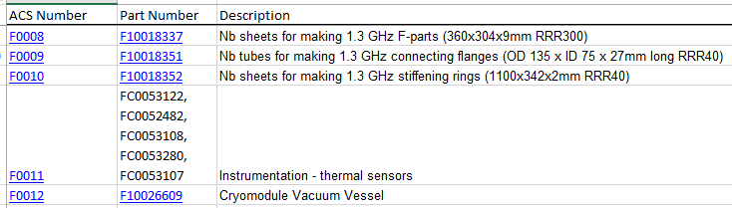
Incoming Inspection
Parts listing: https://vector-dev.fnal.gov/webhosting/RoutingForm/LCLSIIPartsReceiptStatus.asp
ACS’s: ftp://filesrv01.fnal.gov/t/td-ms/pick-up/LCLSII/ACS/ACS_list.xlsx

Slide 10
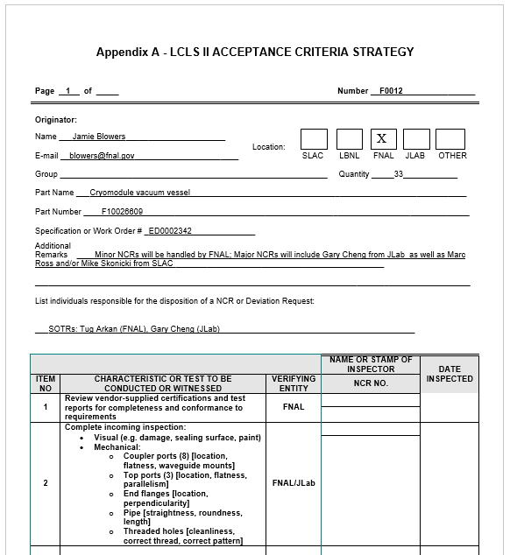
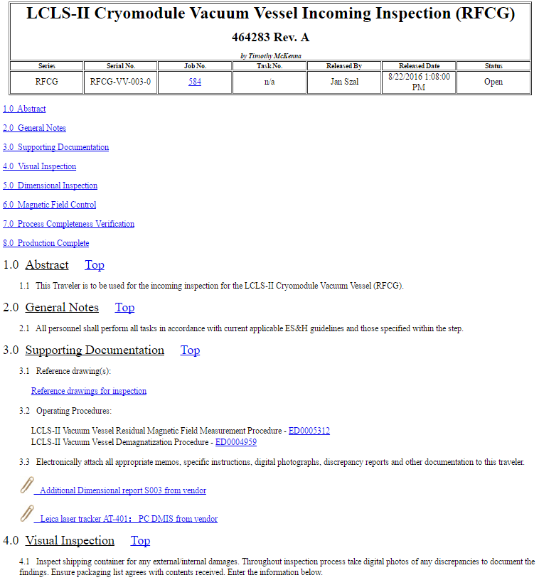
Incoming Inspection Example: Vacuum Vessel

Slide 11
Incoming Inspection – Current Statistics
To date we have received 883 shipments of LCLS-II parts
386 went through formal QC inspection, and 9 are awaiting inspection
186 “Quality Control Reports” were generated
  May be an NCR, or may be data that needs to be reviewed and dispositioned (e.g. CMM report)
171 QCRs have been dispositioned, and 15 are awaiting disposition
Plots on next slide

Slide 12
Incoming Inspection – Current Statistics

Slide 13
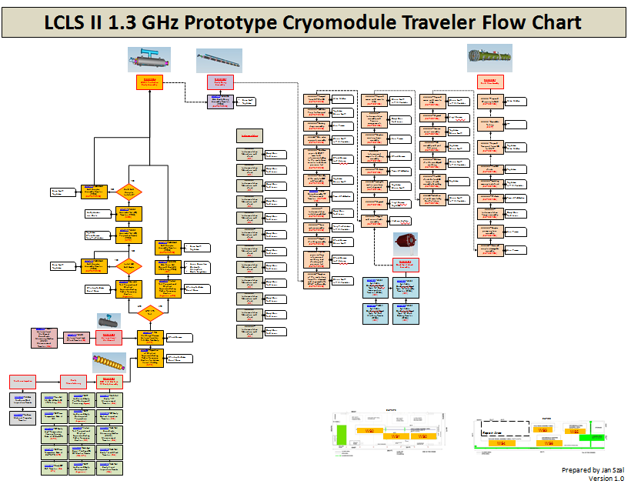
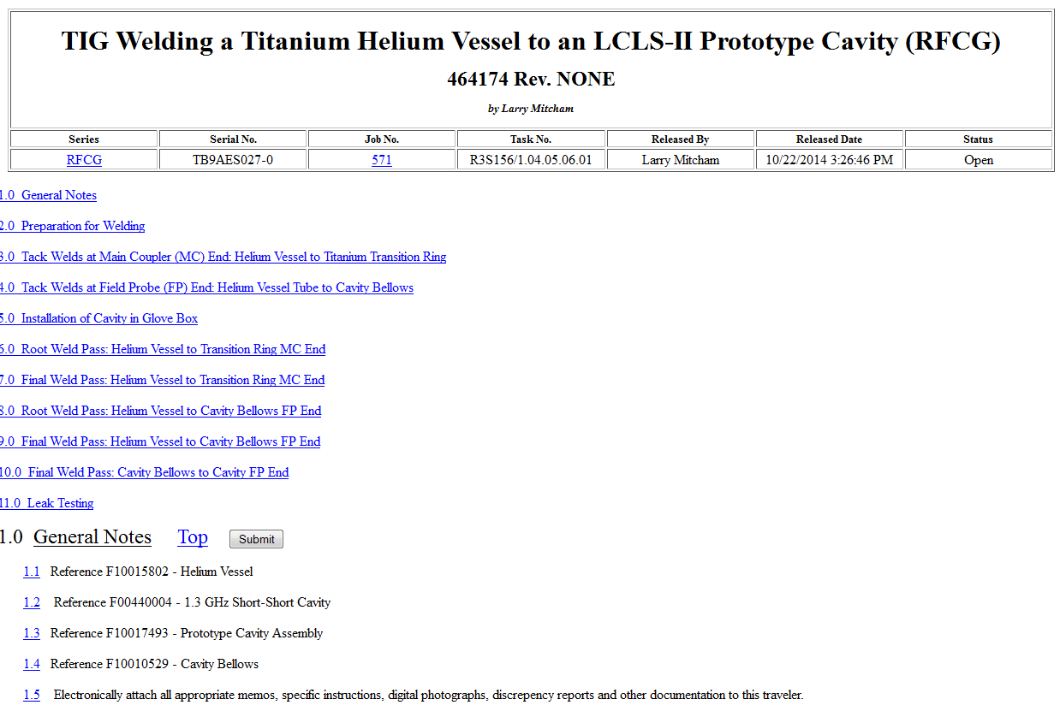
Traveler System
All LCLS-II CM assembly and testing work is done according to travelers
Travelers include detailed instructions, measurement results, signoffs, and general safety requirements

Slide 14
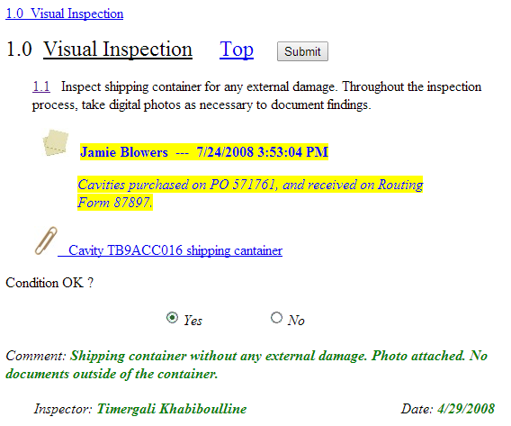
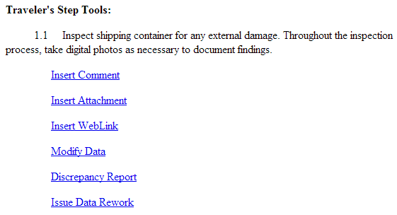
Traveler System
All travelers are fully electronic; http://vector.fnal.gov/
System is currently read-only to the world, so easy data sharing is in place
As much as we could, we replicated the functionality and flexibility of a paper traveler

Slide 15
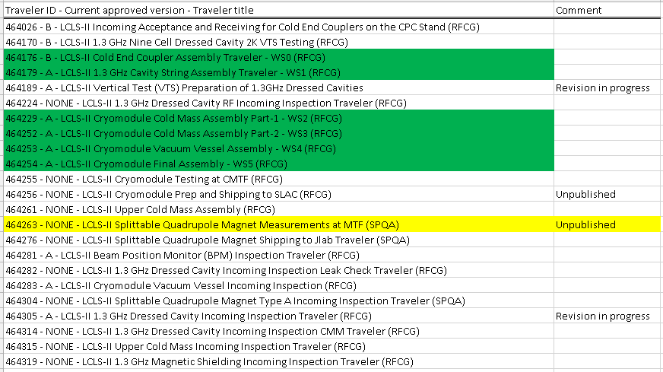
Traveler System – LCLS-II Travelers
23 travelers in place for the Production CM:

Slide 16
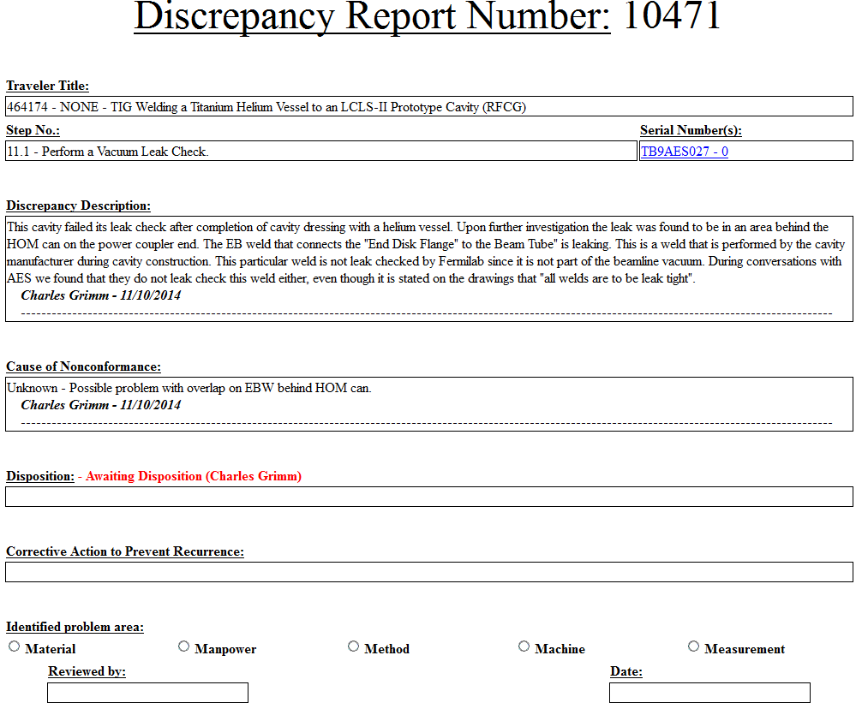
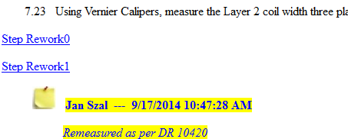
Traveler System - NCRs
All non-conformances are recorded using built-in Discrepancy Report System and are resolved by the Lead Engineer before proceeding to next step
Rework Steps will be issued if process repeat is needed

Slide 17
Traveler System – pCM NCRs
For the prototype cryomodule, and its subassemblies, there were 60 Discrepancy Reports written
  22 were related to cavity processing and dressing
  20 were related to interferences between parts
  3 were for contamination
Remaining were primarily from incorrect materials or nonconforming measurements

Slide 18
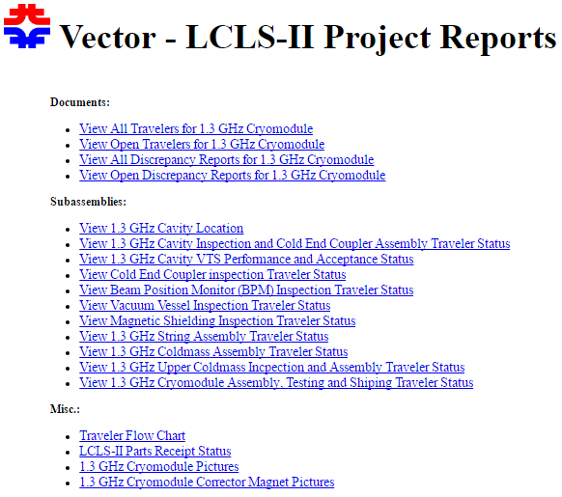
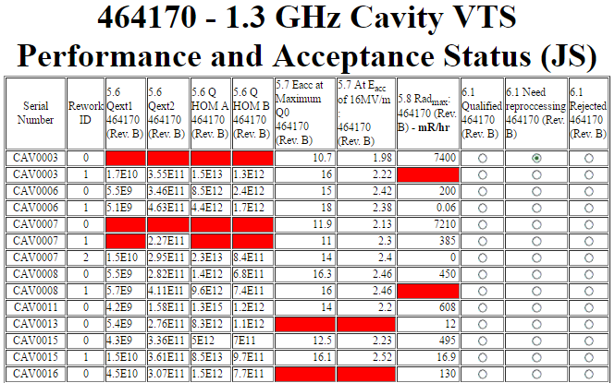
Traveler System - Reporting
The Vector system includes highly-customizable reporting, as well as LCLS-II specific reports: https://vector-onsite.fnal.gov/Tools/Reports/Custom/Projects/LCLS-II/LCLS-II.asp

Slide 19
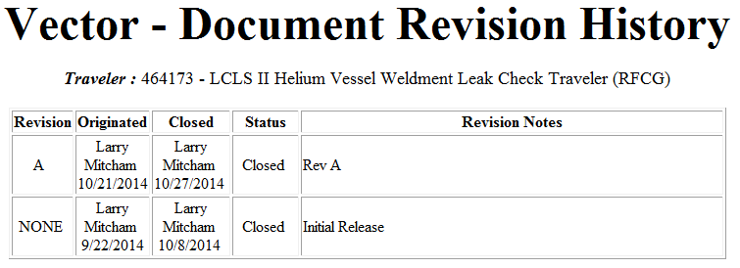
Configuration Management - Travelers
All travelers are under version control, and revisions are incorporated using a change management process
Changes to travelers can be initiated through Discrepancy Reports (e.g. part fitup), “sticky notes” (e.g. “move this step to xxx”), and Lessons Learned
Process Engineering Group is responsible for managing all the travelers, and all changes are formally approved

Slide 20
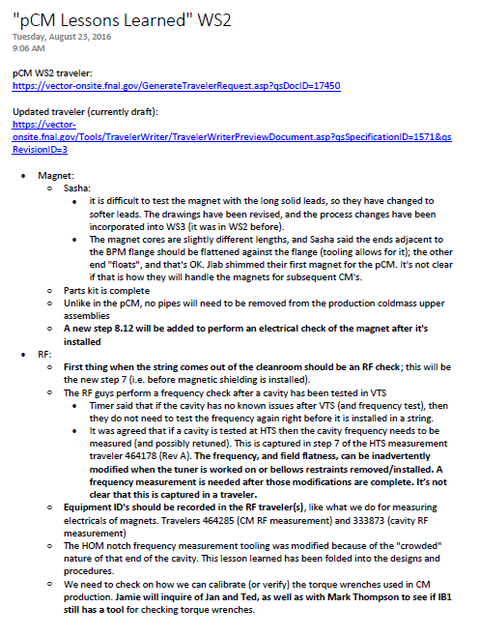
Configuration Management - Travelers
Beyond DRs and “sticky notes”, we also held “Lessons Learned” meetings with staff who performed the pCM work
Improvements were made to both workflow/efficiency, as well as to the travelers

Slide 21
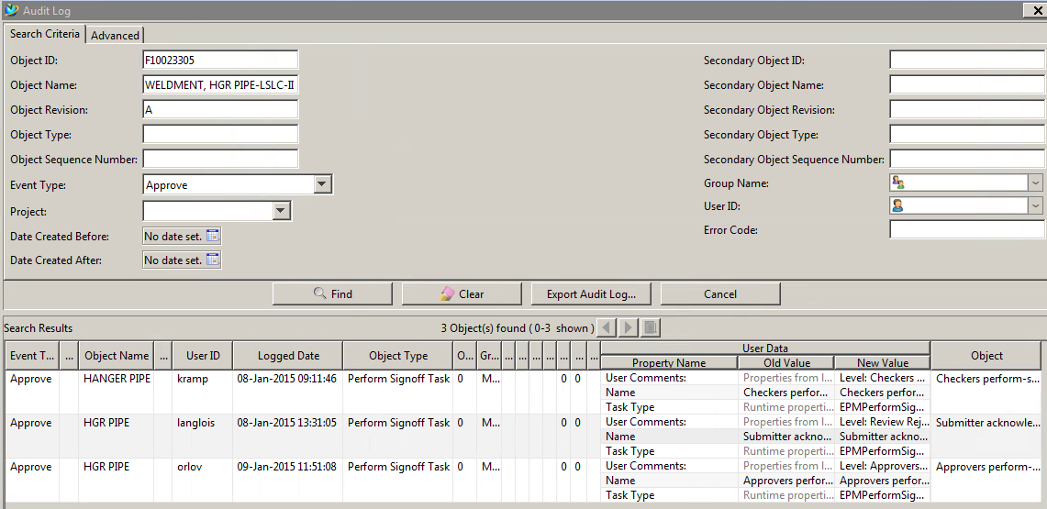
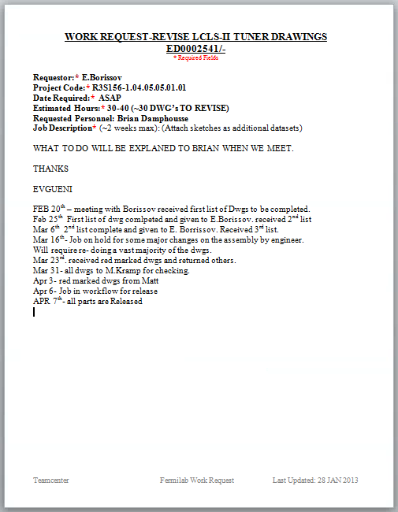
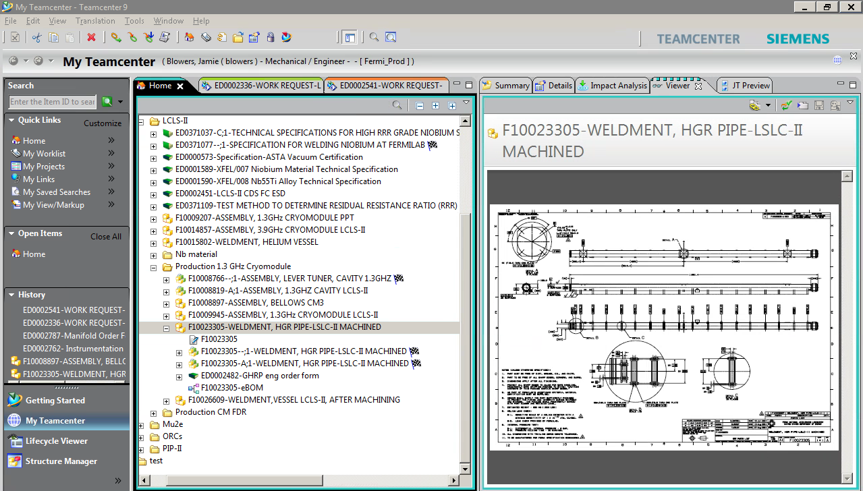
Configuration Management - Drawings
The outputs of all engineering work are managed in Teamcenter
Requests for design work are formalized
Design releases are reviewed and approved using a Teamcenter workflow
Design changes that affect the functional requirements will be brought to the attention of the SLAC Change Control Board for review and approval
To ensure that consideration is given to the effects of “smaller” design changes, they are discussed during weekly Fermilab/JLab coordination meetings and communicated to the appropriate SOTR*s
Parts and material are not procured without approved drawings
  Both Labs pull final (approved) drawings from Teamcenter
* Subcontracting Officer’s Technical Representative, a.k.a. technical lead

Slide 22
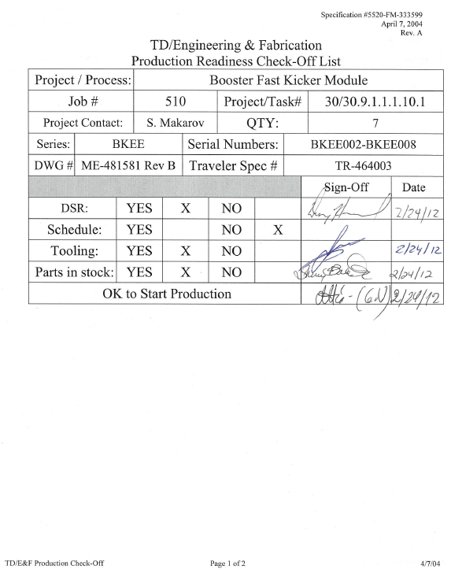
Configuration Management – Readiness Reviews
Starting with the next string assembly, small readiness reviews will be conducted prior to commencing work at each workstation
Purpose of these reviews is to ensure that drawings, travelers, parts, and tooling are all in place
Functions involved: Engineering, Production, Process Engineering
Output includes revision levels of the applicable drawings

Slide 23
Records and Data Handoff to SLAC
Fermilab Teamcenter staff are ready to work with SLAC staff to copy our drawings and meta-data to the SLAC system
Travelers are read-only to the world, and SLAC staff are already accessing them
Conclusion of the recent “handoff workshop” is SLAC will receive the following record/data deliverables:
    a final CM performance report (from CMTF results)
    material certifications
    all drawings (and all versions)
    configuration management report for each CM, indicating the versions of the drawings used for construction for that CM

Slide 24
Summary
QA/QC systems are in place, and have been validated through the prototype CM work
SLAC QA requirements have been integrated into our work
Materials are handled safely, and are inspected upon receipt
Travelers are in place for every workstation
Travelers and Drawings are under configuration control
There is a records and data handoff plan
We believe we are ready to commence CM production

