Slide 1
JLab Prototype Cryomodule Status
Tony Reilly
LCLS-II 1.3 GHz Cryomodule Production Readiness Review
13-14 September, 2016

Slide 2
Contents
First Section
Overview of SRF Facilities at JLab
Infrastructure added for LCLS II
Second Section
pCM Status and Experience
  Scope of Work
  Documentation
  Cavity and string assembly
  Cryomodule assembly
  Staff
Summary

Slide 3

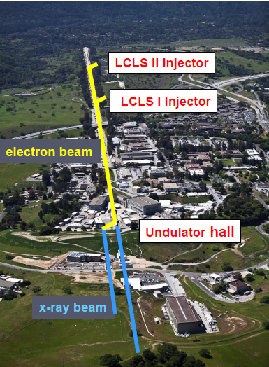

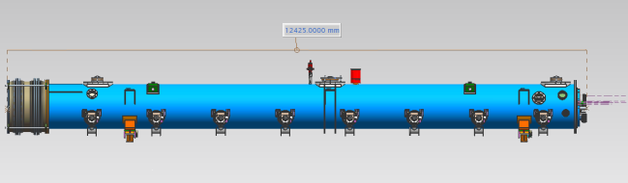
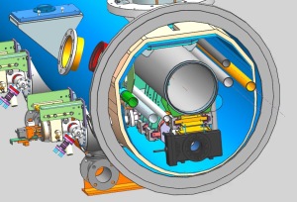
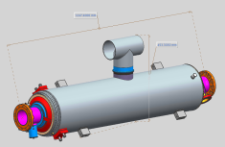
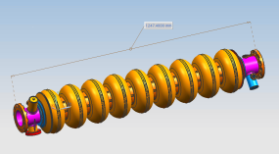
LCLS-II Cavity/Cryomodule Process at JLab
Supplier
Partners
JLAB SRF Facility
Receiving in SRF Inventory
Mechanical Inspection CMM
 | Component | FNAL | JLAB | SLAC
Cavity String | Niobium (Prototype) - existing cavities | NA
 | Niobium (Production) | X
 | Cavities (Prototype) - existing cavities | NA
 | Helium Vessels (Prototype) | X
 | Cavities w/Helium Vessels -VTS Ready (Production) |  | X
 | Cavity Feedthroughs |  | X
 | Cavity Flanges & Assoc. Hardware/Seals (VTS & HTS compatible) |  | X
 | Fundamental Power Coupler (FPC) |  |  | X
 | Cavity String Interconnecting Bellows |  | X
 | Cavity String Assembly Hardware & Seals | X
 | SC Magnet Assembly | X
 | Beam Position Monitor (BPM) | X
 | Gate Valves |  | X
 | Beamline Vac. Monitoring Manifold & Gauge | X
Cryomodule | Two-phase Pipe Bellows | X
 | Tuner, actuator, piezos (Prototype) | X
 | Tuner , actuator, piezos (Production) |  | X
 | Magnetic Shielding | X
 | GRHP Sub-assembly | X
 | Vacuum Vessel | X
 | Coupler Pumping Lines & Pumps (ion+TSP) + vacuum gauges | X
 | Instrumentation | X
 | Liquid Level Probes & JT Valve | X
 | Beamline Interconnect Parts including Aluminum Heat Shields | X
 | HOM Absorber |  | X
 | Shipping Frames & End Caps + Shock Log Devices |  | X
 | X = Lead Lab per SLAC LCLSII-4.1-PM-0229-R0 (June2014)
Cavity /Helium Vessel Prep. & Test
VTA RF Test in liquid Helium @ 2 K
Cavity String Assembly & Leak Test
Assemble Cavity String -Class 100 Clean Room
Courtesy Chi-Chang Kao, SLAC
Cryomodule Assembly
Instrumentation & Wiring
Tuners, MLI– Multi Layer Insulation,
Cryogenic Circuits , magnetic shielding, alignment
Super Insulation Cabling & Shield
Vacuum Vessel & Final Alignment
Install Cryogenic Supply Interfaces
  Horizontal Test Preparation
  Pressure Test & Leak Check (vacuum)
Commissioning at SLAC
Install Cryomodules in Accelerator, cool to 2 K
Weld & certify leak tight , pressure test
check Controls,
Gradient & Dynamic Heat Load - Q_{o}
Cryomodule Test in “Test Cave”
Cryomodule integrity @ 2 K
Tuners - Range, Hysteresis, & Resolution/ Sensitivity
Cavities for Gradient & Dynamic Heat Load Q_{o}
LCLS-II 1.3 GHz Cryomodule
Cryomodule shipping to SLAC
JLAB support for installation of first 3 Cryomodule

Slide 4
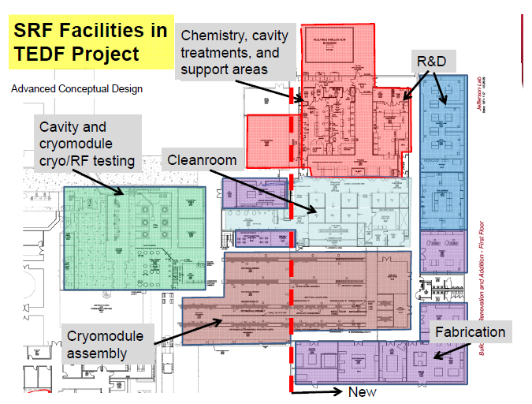
SRF Facilities at JLab
Located in Annex –
Receiving
Inspection
Inventory
Start
Offsite Storage (Production)
CMM/RF Checks
Ship

Slide 5
JLab Facilities Improvements:
Assembly Tools Completed & Utilized for pCM
Main Cavity Tools
  Mobile clean room rail for cavity string
  Clean room tooling - small fixtures for coupler installation, flange alignment
  Cavity handling and storage equipment
Main Cold Mass and Cryomodule Assembly Tools
  Cold Mass 4-poster/spreader bar (x2) - Supports / Positions Cold Mass for cavity string attachment
  Cantilever System - Installation of cold mass into vacuum tank
  Vacuum Tank Supports - Used in Final Assembly
  Spreader Bar - Lifts Cryomodule
Clean Room
  Dedicated ~ 1800 sq.ft. ISO-4 zone (majority of open clean room area)
  Clean room curtains used for segregation
  Compartments for cavity staging, component staging, coupler prep and parts blow down
- Similar to FNAL

Slide 6
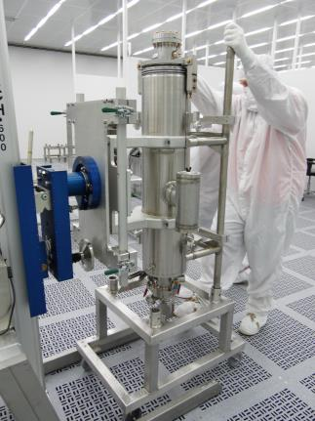
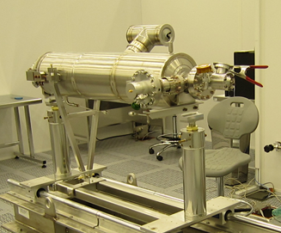
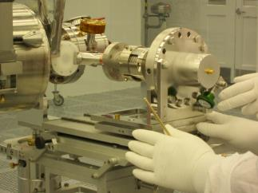
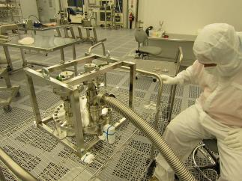
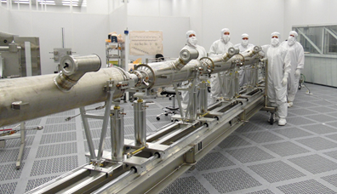
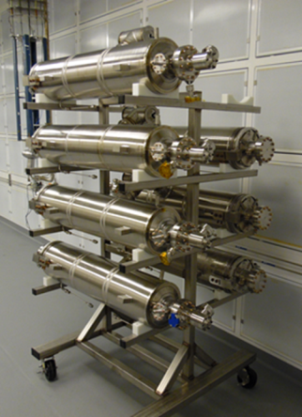
pCM Cavity String Components & Tooling

Slide 7
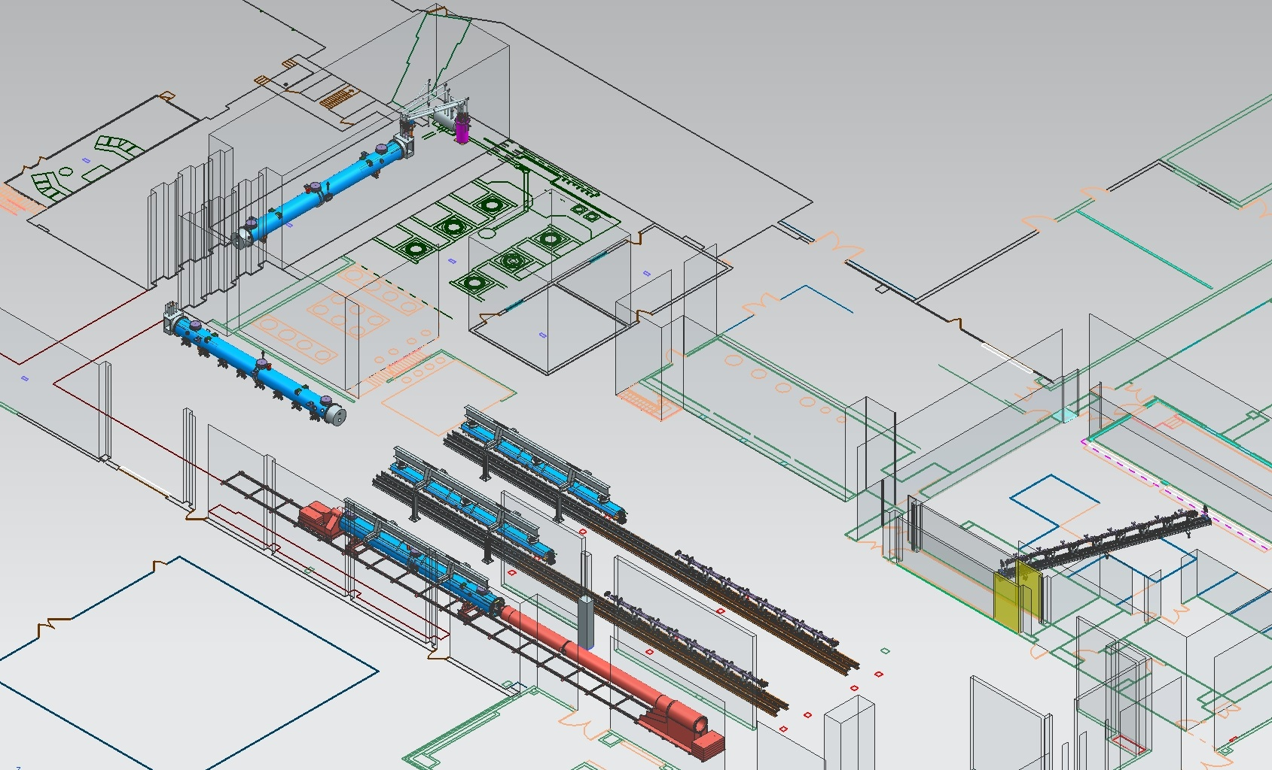
JLab Layout for LCLS-II CM Production
CM Testing
Phase II CM Assembly (2X)
Clean Room String Assembly
Phase I CM Assembly (2X)
Final Assembly / Prep for Testing
Vacuum Vessel Installation

Slide 8
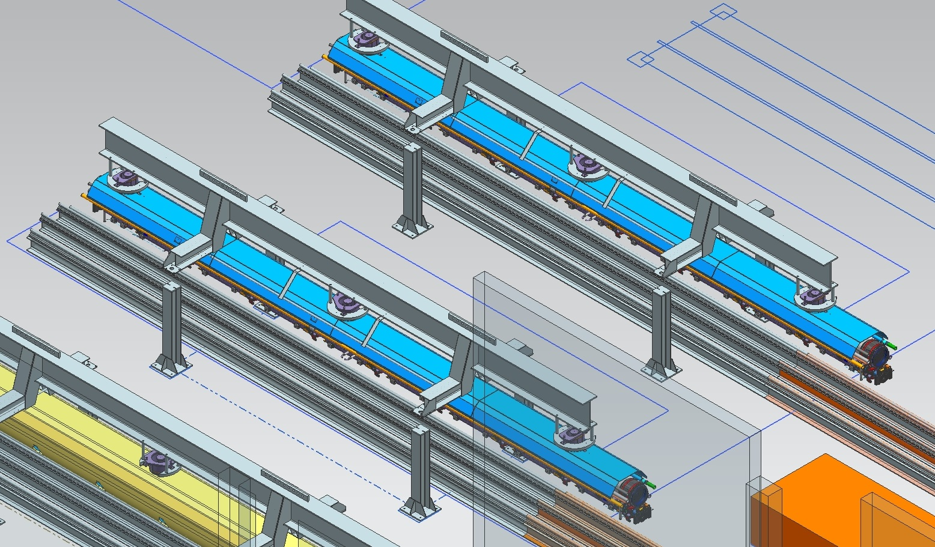
LCLS-II Cold Mass with FNAL Tooling above JLab-style Rails - Cold Mass Assembly II
Existing JLab Rail Systems
“Four-Post” Fixture
Cold Mass Assy (10 kips)

Slide 9
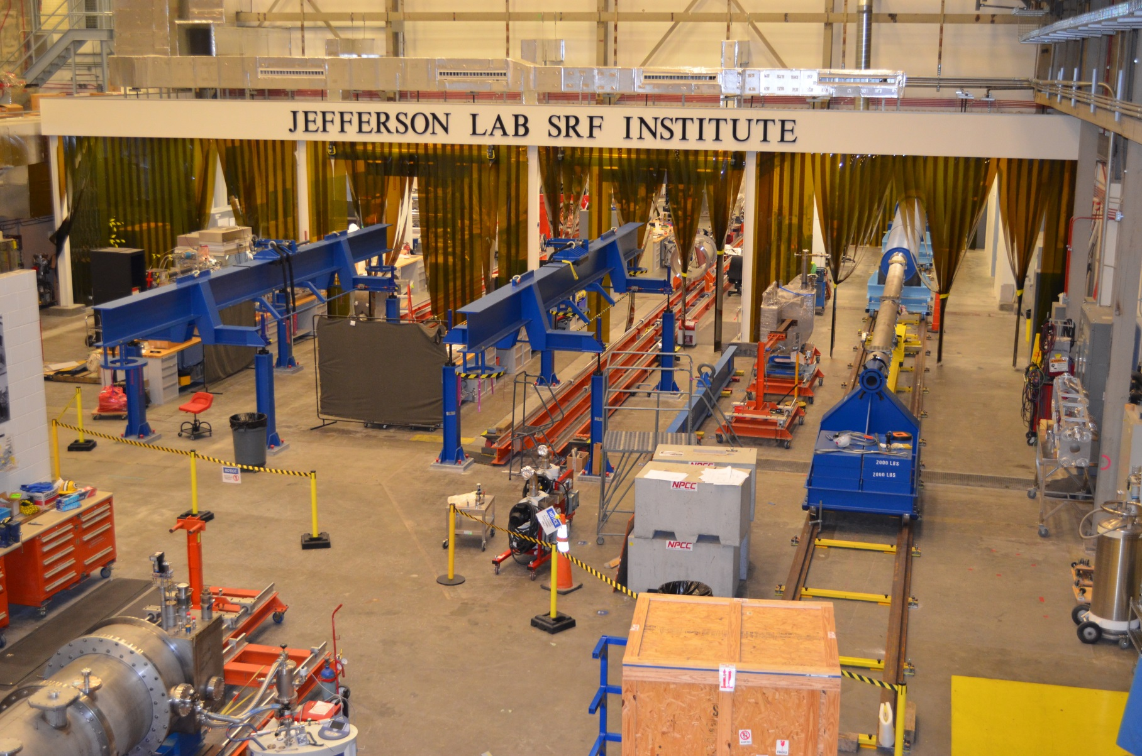
LCLS II Cryomodule Assembly

Slide 10
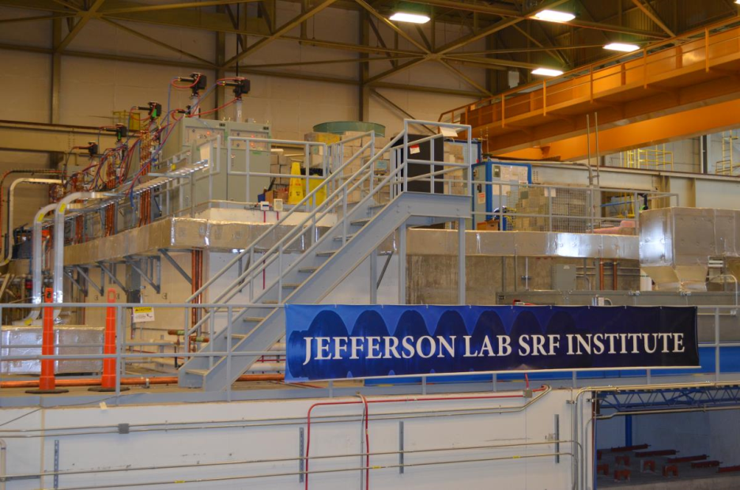
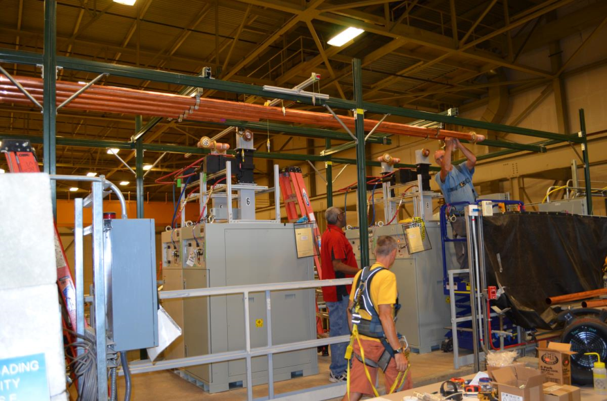
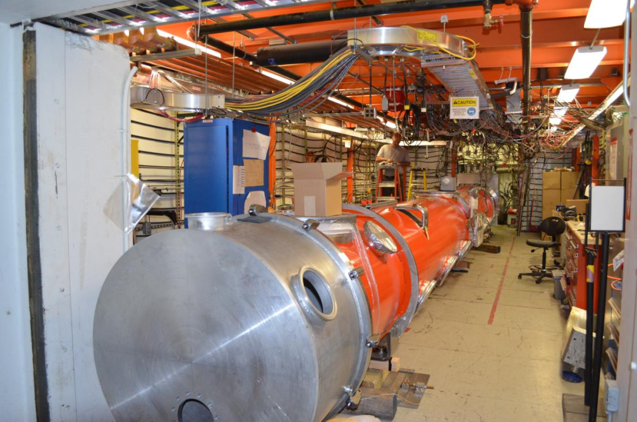
Cryomodule Test Facility Improvements
Solid State Amps on roof of CMTF
Hard line coax wave guide installation
Test fit of pCM vacuum vessel with end caps into CMTF

Slide 11
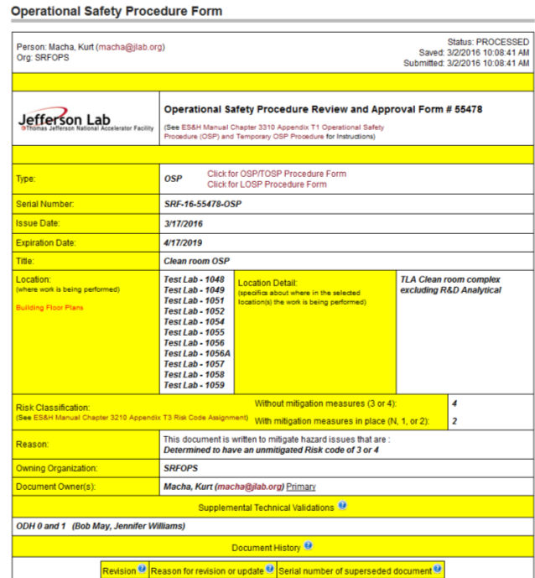
Safety – Work Center Operational Safety Procedures
All work centers have an Operational Safety Procedure (OSP)
  A Work Control Document, with a limited effective life of up to three years
  OSPs address unique or complex hazards not covered in the ES&H Manual, or require more specific detailed instructions.
  The document is signed by the appropriate authorities before work proceeds; and is read and signed by each worker before they take part in the work.
Equipment within work centers exceeding the risk category prescribed by the ES&H manual also has an associated OSP
Work center OSPs were reviewed and revised where required to incorporate infrastructure added for LCLS II
Cavity vertical and cryomodule test have additional work control documents associated with radiological control (Rad Worker Permits)

Slide 12
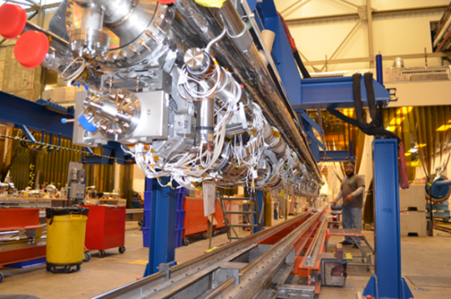
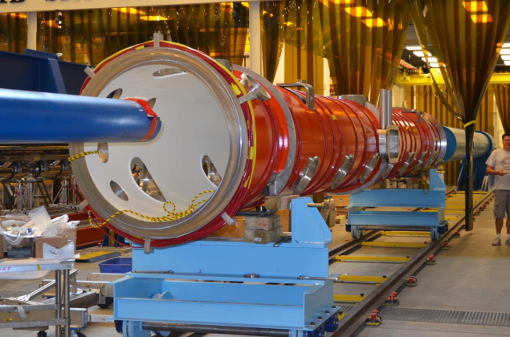
pCM Status and Experience
Technical Scope
Major Task
Component Acceptance
Cavity Prep and Qualification
  pCM Cavity Vertical Test Results Summary
Cavity String Assembly Experience
Cold Mass Assembly Status
Completion Plans
Staffing
Summary

Slide 13
1.04.06.06 JLab Prototype 1.3 GHz Cryomodule
Technical Objective
Producing and testing one 1.3 GHz prototype cryomodule incorporating many of the LCLS-II features.
CM meets technical specification for the machine.
Scope of Work
Development of all procedures and documentation required to support cryomodule production, production of one cryomodule with 8 cavities, 1 SC magnet and 1 BPM package
Deliverables
All procedures and documentation required to support cryomodule production, one cryomodule with 8 cavities similar to the LCLS-II production design
Relationship/Interfaces
1.04.06.05.01 JLab Prototype Design, 1.04.06.05.04 High Q0 Development, 1.04.06.06.04 Infrastructure
Assumptions
Design will be such that Cryomodule will be usable as ""first article "" at SLAC Cavities provided from FNAL's ILC inventory

Slide 14
JLab pCM Assembly – Major Tasks
  Documentation Travelers and Procedures
  Component Acceptance
  Cavity Preparation and Test
    Inspection, CMM, Chemistry, Clean Assembly, Vertical Test
  Cavity String Assembly
  Upper Cold Mass Assembly
  Cold Mass Assembly I
  Cold Mass Assembly II
  Vacuum Vessel Assembly
    Cold Mass Insertion into Vacuum Vessel
  Final Assembly
  Cryomodule Acceptance Test
  Ship
Completed

Slide 15
Processes, Procedures and Travelers
Developed a master list of procedures and travelers for CM production based on C100 experience
  Master list refined as our understanding of the LCLS II cryomodule improved
Initial contents of travelers and procedures were influenced by
  LCLS II Qo R&D program
  Discussions with SME at Saclay
  FNAL documents shared through Vector and between assembly and engineering peers
Documents have continued to evolve (and will continue)
  Hands-on experience with pCM
  Collaborative efforts of assembly groups
    Site visits, many meetings and discussions
  Maturing of the cryomodule design
  Plan to refine production procedures and travelers
    Based on collective pCM experience
    Lessons learned

Slide 16
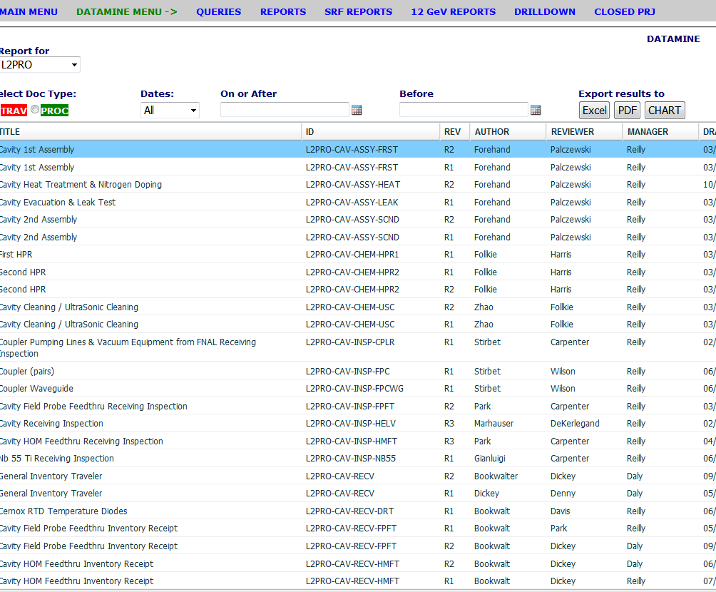
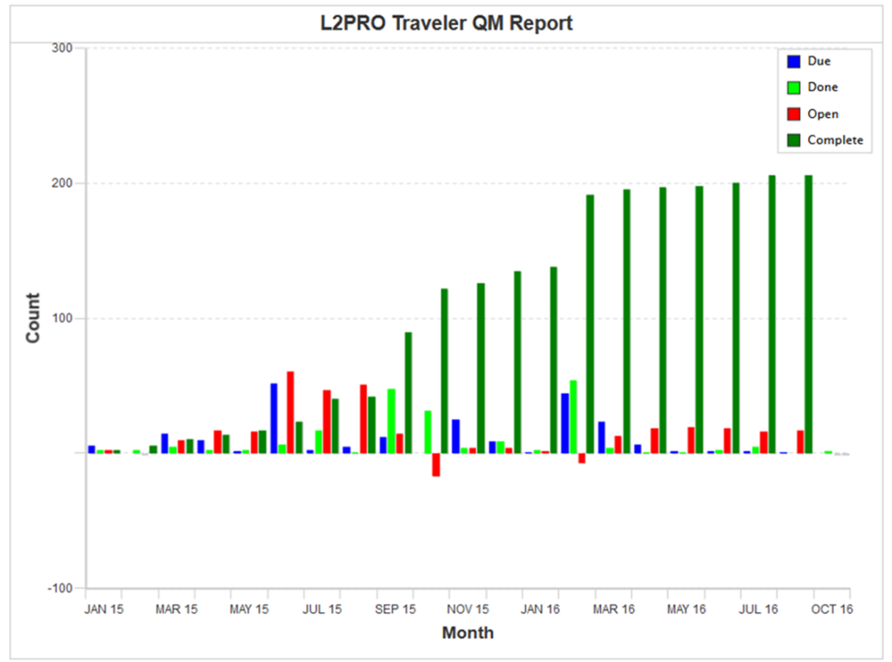
pCM Documentation - Travelers & Procedures
Travelers and procedures were developed and implemented from receiving and acceptance inspections through all phases of pCM assembly
Travelers
~ 70 Receiving
~ 70 Acceptance Inspection
~ 20 Assembly
5 Test
2 pCM Shipping
Procedures
~ 40 Assembly

Slide 17
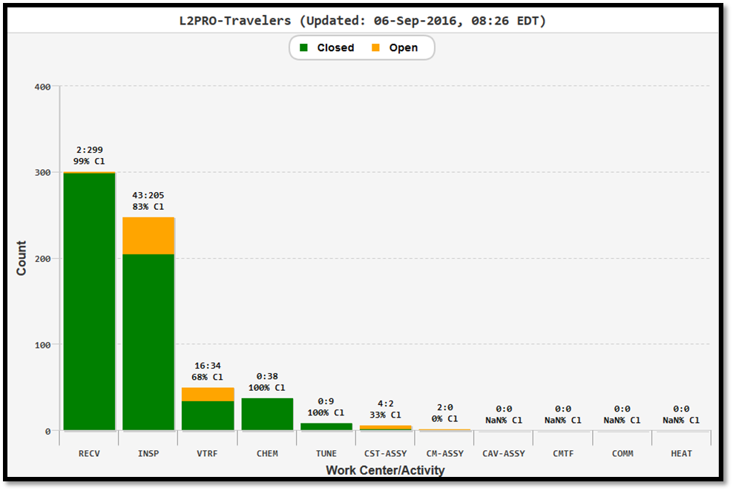
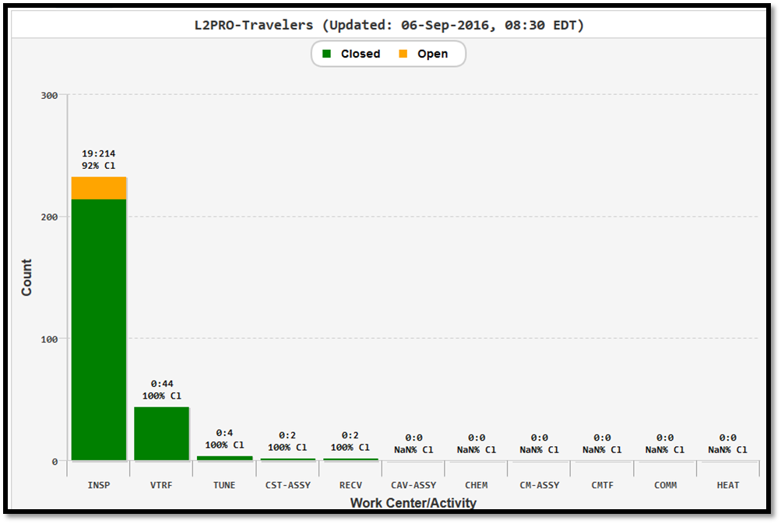
Component Receipt and Acceptance
As of Sept. 9th, over 300 receipt travelers and about 248 acceptance inspection travelers have been initiated
  83% of acceptance inspection travelers are closed
233 non-conformance reports (NCR) have been generated, 92% are closed

Slide 18
1.04.06.06.02 JLab Prototype Cavity Prep/Test
Technical Objective
Complete all cavity preparation and qualification required for the production of one 1.3 GHz prototype cryomodule.
Scope of Work
Receive, inspect, qualify, rework and re-qualify as needed, SRF cavities (8) required for the JLab 1.3 GHz prototype cryomodule.
Deliverables
Qualified cavities with completed production travelers and associated reports and documentation.
Status
Eight prototype cavities were received, inspected, processed and qualified
  Met initial cavity performance requirements
  Cavity qualification was completed in Feb 2016 (based on traveler)
Initiated 97 travelers, 84% of which are closed. Final test travelers are closed

Slide 19
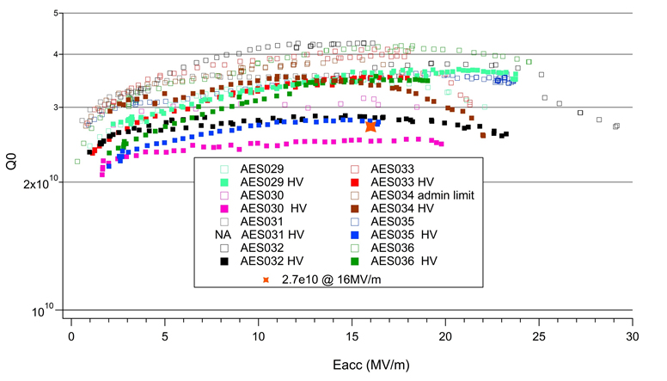
Prototype Cavity Test Results
Dressed Cavity Vertical Test Acceptance Criteria (Production)
Parameters Numbers Unit
Min Gradient 19 MV/m
Q0 2.5e10 (at 16 MV/m)
Field emission Onset > 17.5 MV/m
Field Emission at onset <1 nA
Reference: “Final Report on LCLS-II Cavity Test Acceptance Criteria and Test Procedures”, Note Number: LCLSII-4.5-EN-0590-R0

Slide 20
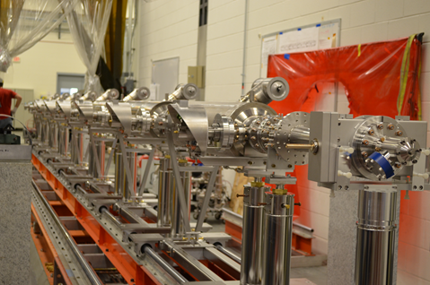
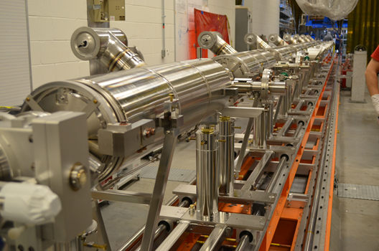
1.04.06.06.03 JLab Prototype Cavity String Assembly
Technical Objective
Produce a string of 8 cavities as part of the Jlab 1.3 GHz prototype cryomodule
Scope of Work
Receive qualified components (cavities, magnets, BPMs, valves, bellows, and various hardware) and assemble into cavity strings.
Deliverables
One cavity string delivered to the cryomodule assembly areas with travelers completed and associated reports and documentation.
Relationships/Interfaces
Interfaces with internal JLab production, QA and QC elements.
Assumptions
NA
Status
String assembly travelers and associated procedures were completed and implemented for the pCM
Cavity string was completed and delivered to the cryomodule assembly area in May 2016
Cavity string assembly lesson’s learned completed in May 2016

Slide 21
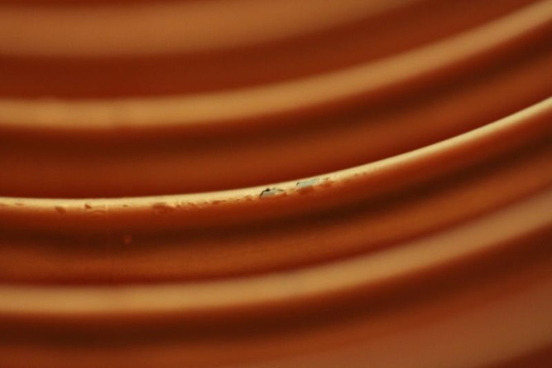
Cavity String Assembly Experience and Lessons Learned
Copper plated bellows
Quality issues with plated parts from vendor
  Pin holes, blistering and flaking of Cu plating, scratches on flanges
  Engaged SLAC plating SME
    Process changes implemented at vendor
    Parts stripped and plated at SLAC and vendor
  Delayed string assembly by weeks
SLAC is currently providing copper plated string components for first two production strings
New plating vendor qualified and under contract
Significant NCR issued to Project

Slide 22
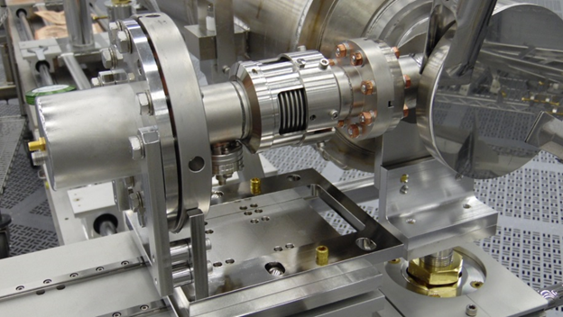
Cavity String Assembly Experience and Lessons Learned
Initial string assembly was completed in about 3 weeks
  Cavity bleed-up, disassembly, HPR, string assembly, pump down and leak check
Leak check revealed leaks along the beam line and at the FPC
  Attempts to correct the leaks using higher torques were not successful
String was completely disassembled
  All sealing surfaces were inspected and any suspect blemish was polished
  Discovered that three of the FPCs were not aligned properly at the flange
    Corrective actions taken to eliminate misalignment
      Mock assemblies, additional quality checks (visual and feeler gauge)

Slide 23
Cavity String Assembly Experience and Lessons Learned
Second assembly of string took slightly less than 3 weeks
  String passed leak check (based on C100), rolled out to cryomodule assembly
  String did not meet LCLS II spec – no dectectable leak with calibrated leak of 1x10¹⁰ mbar-l/s
  Beam line leaks were higher than the allowable leak rate
  Flange bolts were systematically torqued until successful leak check
Two Significant NCRs issue to Project for string leaks
  Both are closed
A total of 17 items were capture in the Lessons Learned Log, including the leaks
  Cause and effects were identified and corrective actions assigned
  Changes were made to tooling, assembly procedures and quality checks

Slide 24
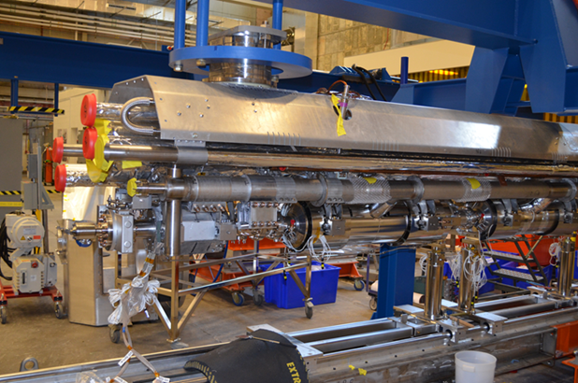
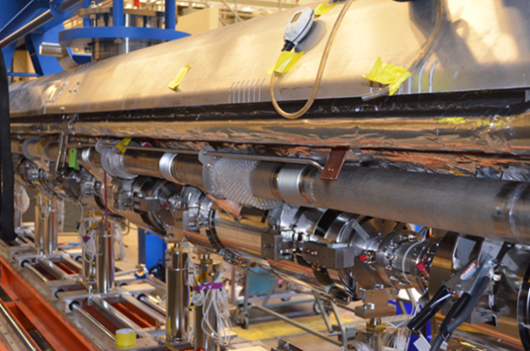

1.04.06.06.04 JLab Prototype Cryomodule Assembly
Technical Objective
Produce one prototype cryomodule as part of the Jlab LCLS II cryomodule production.
Scope of Work
Receive qualified components (cavity strings, frequency tuners, instrumentation, thermal and magnetic shields, cryogenic piping, and various hardware) and assemble into the JLab prototype cryomodule. Prepare the cryomodule for testing.
Deliverables
One prototype cryomodule delivered to the cryomodule test facility with travelers completed and associated reports and documentation.
Status
Completed upper cold mass assembly
Completed cold mass assembly phase I
Completed cold mass phase II
Cold mass is being moved onto the cantilever system for installation into the vacuum vessel

Slide 25
pCM Cold Mass Assembly – Completed Task
  CMA I Primary Task
  2-phase helium pipes & bellows welding
  Cavity magnetic shields installation
  Tuner system installation
  Cavity insulation installation
  Temperature sensors instrumentation and RF cables installation
  Cavity helium vessel lugs needle bearings and housings installation
  Various leak checks / pressure tests of the helium circuit
  Various electrical and RF checks
  CMA II Primary Task
  Put the cold mass on the 4 support spreader bar fixture
  Align cavity string to GRHP to 0.1 mm (laser tracker)
  Complete the interconnect magnetic shielding assembly
  Complete the coupler heat shields intercepts assembly
  Complete cooling straps assembly to the cavities HOM
  Complete the harnessing of the instrumentation wires & RF cables
  Various electrical checks
  Weld the magnet current leads to the magnet instrumentation box
  Various leak checks of the helium circuit

Slide 26
pCM Assembly Experience
Assembly of the prototype cryomodule has been challenging
  New style of cryomodule with an unfamiliar design
    Learning curve
  Different means of doing business for JLab CM groups
    Engineering done in house for past projects (SNS, 12 GeV)
      Communication and ability to catch design changes is more readily done
  Evolving design
    Even with parallel project structures, joint meetings, site visits from both sides, peer to peer communication, schedule and the shear volume of work made it difficult to keep up with
  NOT for lack of trying
  ALL parties (SLAC,FNAL, JLab) made (still making) significant genuine efforts to communicate and provide support needed to produce the highest quality pCM possible
  No one had the sole job function to transfer information (technology transfer)
    May be a consideration for future

Slide 27
Cold Mass Assembly Experiences
Quadrupole Magnet
  The quad magnet had an assembly problem which confused alignment
  The two halves faces were not in plane
  We eventually aligned the center of the quad to the centerline of the beamline and ignored the magnet faces
  The magnet face needed to be shimmed where it bolted to the BPM flange
Magnetic Shielding
  All the magnetic shields had to be modified prior to installation
  The mods did not always match the FNAL model
  Two suppliers, different designs, special controls
Alignment
  Alignment of the string was more complicated than originally thought
  Had to add an additional clamp to keep cavity one from sliding due to the vacuum loading
  Could not correct for rolled cavities because our string was sealed and under vacuum
  Because there were multiple translations by the alignment crew, it wasn't always clear if we were in or out of spec
  Learning curve

Slide 28
Cold Mass Assembly Experiences
HOM clamps
  Redesigned to incorporate the thermal sensor and scallop feature
  Would not go on as originally designed and received
  Needed modification by the machine shop
Helium Circuit Stainless Steel Pipe
  Pipe acquired by the project for the He piping did not work well with the orbital welder, surface finish not polished
  Sections needed to be hand welded
Vacuum Vessel
  The lifting fixture for the vacuum vessel was specified with slots for metric all thread supports
  When SAE parts were substituted in the design, the slots no longer fit
  Modifications were made and because it was part of a lifting fixture, certification was required
    Load test by an outside source
Thermal Shields
  50K shields required re-machining to match new drawings

Slide 29
Magnetic Hygiene
Magnetic hygiene has been performed per the FNAL specification
The magnetic fields of cavity string hardware and components were checked just prior to final UHV cleaning by chemistry technicians after training
Components exceeding the specified criteria was demagnetized before cleaning
Tools were also checked and demagnetized prior to string assembly
For cold mass assembly, components that received quality inspections were also surveyed for magnetic field where required
In some instances, components exceeding the specified criteria were taken to the cryomodule test cave (CMTF) to be demagnetized
Other components were demagnetized in the CMM room (CMTF not available)
Field surveys were also conducted, particularly during tuner installation
  A set of split rings and a tuner bracket were found to have higher fields, both were removed and demagnetized

Slide 30
Magnetic Hygiene – Flux Gates
There are 13 flux gates installed on the cold mass
  Eight are located inside the helium vessels on cavities 1, 4, 5 and 8
    Two per cavity; top and bottom
  Three are attached to the second layer magnetic shields
Flux gate measurements have been taken at predetermined phases of cold mass assembly

Slide 31
Magnetic Hygiene – Data and Observations (G.Cheng)
Inside HV FGs show lower readings compared to Fermi's 6/1 data, when pCM cold mass is slid into VV
Numbers above 5 mG are unfavorable. Both JLab and Fermi have values above 5 mG, 7.89 mG and 11.08 mG (both are transverse components) and 26 mG and 10 mG, respectively
Two FGs attached to mag shield show 3.1 mG and 4 mG readings.
Courtesy of Gary Cheng, JLab Mechanical Engineering

Slide 32
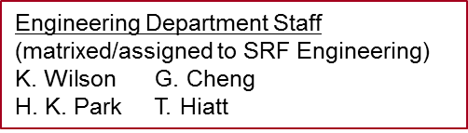
SRF Operations Organization
SRF Operations
Part of Accelerator Division
Execution of all SRF related project
Technical support to onsite accelerators
LCLS II
  Most of the Organization experienced the pCM and will be engaged in Production
LCLSII Project in SRF Operations
Cost Account Manager (CAM)
Ed Daly
Project Engineer
Katherine Wilson
SRF Engineering
pCM Tooling
Cavity Processing
Cavity processing, vertical test and string assembly
CM instrumentation
Cryomodule Group
Cryomodule assembly and welding
SRF Project Support
Acceptance inspections, document control and quality
SRF Beam Support
Cryomodule test

Slide 33
pCM Completion
Vacuum Vessel Primary Tasks
  Install and weld lower 5K aluminum shields
  Wrap 10 layers of MLI
  Install and weld 80K shields
  Lay and wrap 30 layers of MLI
  Trim insulations around main couplers, magnet and cold mass support posts
  Slide vacuum vessel onto the cold mass
  Align cold mass to the vacuum vessel (laser tracker)
Final Assembly Primary Tasks
  Install warm part of the main power couplers + RF Waveguides
  Route & terminate instrumentations wires and RF cables to the feedthrough flanges on the vacuum vessel
  Install warm end coupler vacuum/pumping lines
  Pump down and leak check warm end coupler vacuum
  Install End Cans and Prep for CM Test
pCM Assembly is scheduled to be completed by late October

Slide 34
P6 Schedule (July)
July P6 shows pCM assembly to be completed by 10/20
Acceptance test to be completed by 11/30

Slide 35
Summary
Infrastructure added for LCLS II has all been installed and exercised through the pCM assembly
  Actual use and mock-ups
  CMTF upgrades are still in progress
The documentation processes and work control documents (travelers, procedures, NCRs) were implemented and in full use for the pCM
  Will provide a good starting point for production systems and documents
Acceptance Inspection and QA work centers got a lot of “burn-in” with the pCM (well over 200 NCRs!)
Cavity Prep and Test yielded a very good set of prototype cavities
CM assembly groups have gained a lot of experience with the LCLS II type of cryomodule and with technology transfer!
  The collaborations have gained much run time!
Staff in SRF Ops have all had a hand in the production aspects of the LCLS II pCM
  Have gained a good amount of experience which will pay dividends in our production efforts
The pCM cold mass assembly is almost 100% done and plans are to insert it into the vacuum vessel week of Sep. 19th, test in Winter of ‘16

Slide 36
Thanks for your attention!
Questions?

Slide 37
Backup Material

Slide 38
1.04.06.06.05 JLab Prototype Cryomodule Test
Technical Objective:
Perform acceptance testing of one prototype cryomodule as part of the Jlab LCLS II cryomodule production.
Scope of Work:
Install prototype cryomodule in the cryomodule test facility and perform warm and cold functional tests. Prepare cryomodule for shipping.
Deliverables:
Completed travelers and test reports and associated documentation.
Relationships/Interfaces:
Shipping
Assumptions:
NA

Slide 39
1.04.06.06.01 JLab Prototype Procurements
Technical Objective
Procure required components to support the production of 0ne 1.3 GHz prototype cryomodules at FNAL and JLAB
Scope of Work
Source selection, procurement and technical support for long-lead and non-long-lead components.
Deliverables
pCM hardware
Relationships/Interfaces
FNAL design efforts
Assumptions
NA
Status
Provided SOTRs (Subcontracting Officer’s Technical Representatives) for all procurements
Lead Lab for pCM cavity feed-throughs, vertical test hardware, gate valves, copper plated string components (spools and bellows), and shipping frame
All procurements have been completed
Shipping Frame

Slide 40

pCM Traveler Development Progress Chart

Slide 41
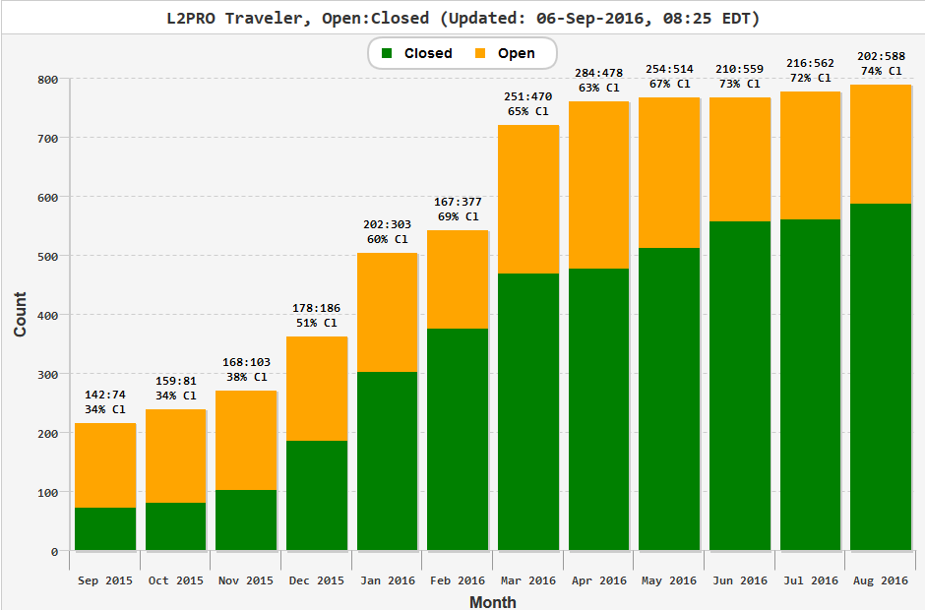
Traveler Status (listed by Month)

Slide 42
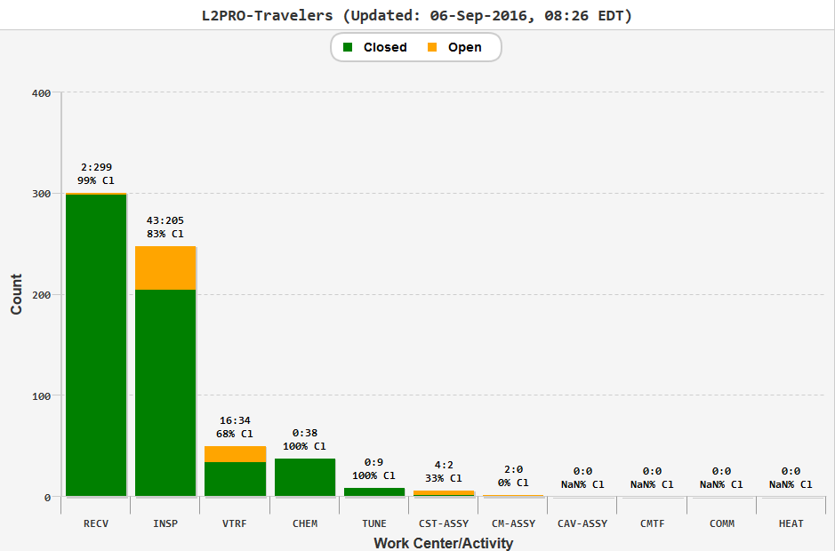
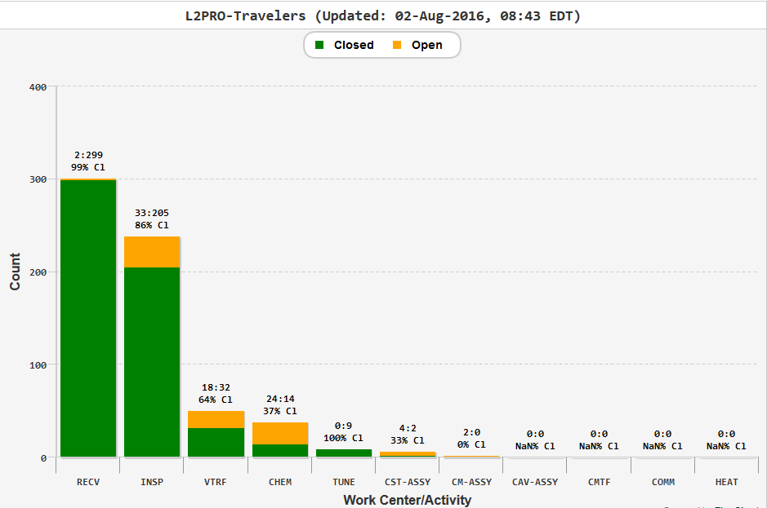
Traveler Status (listed by Work Center Activity)

Slide 43
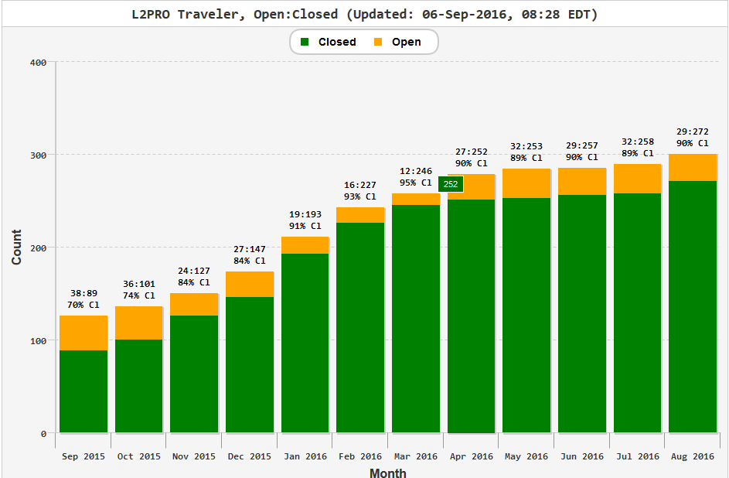
NCR Status (listed by Month)

Slide 44
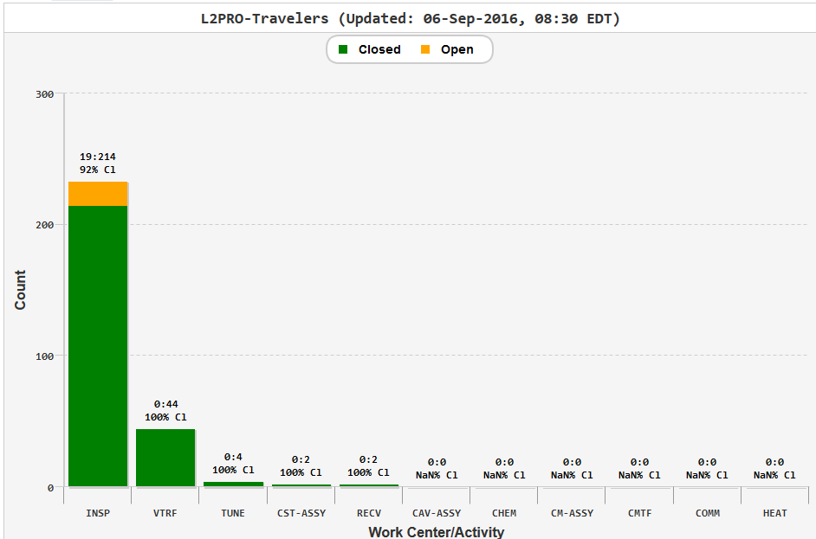
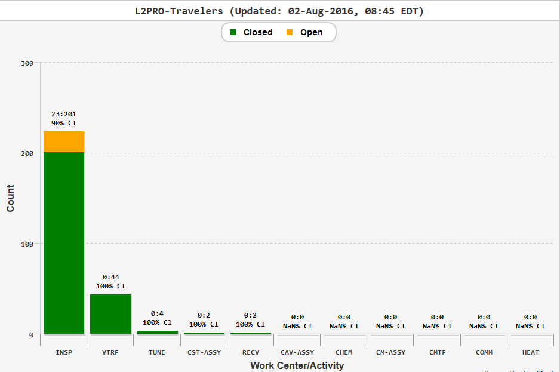
NCR Status (listed by Work Center Activity)

Slide 45
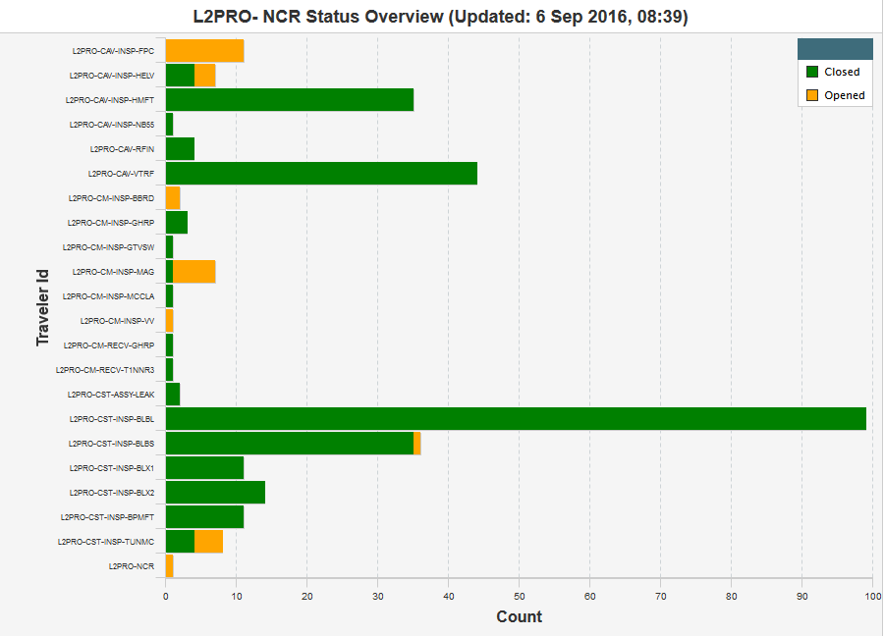
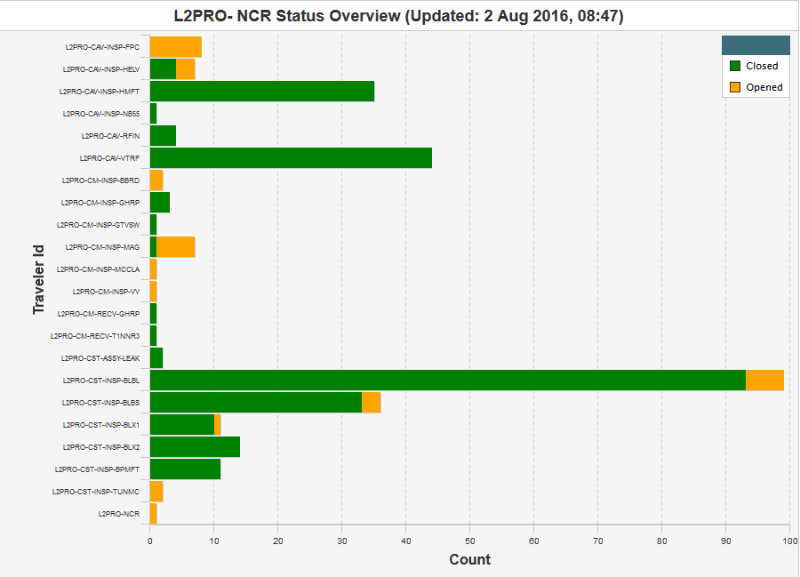
NCR Status (listed by traveler)

Slide 46
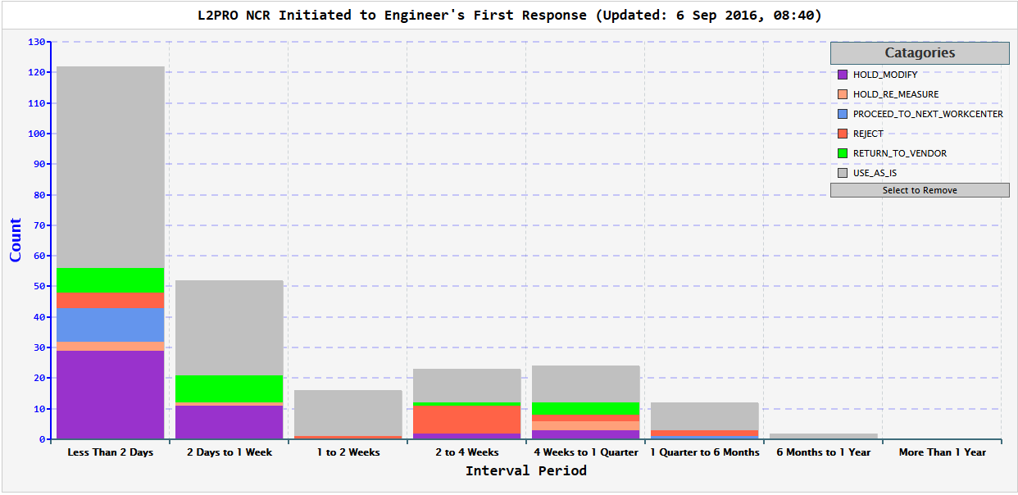
NCRs Initiated to First Response
6 new NCR this month…
122
52
16
23
24
12
2
118
52
16
22
23
11
2
Last Month

Slide 47
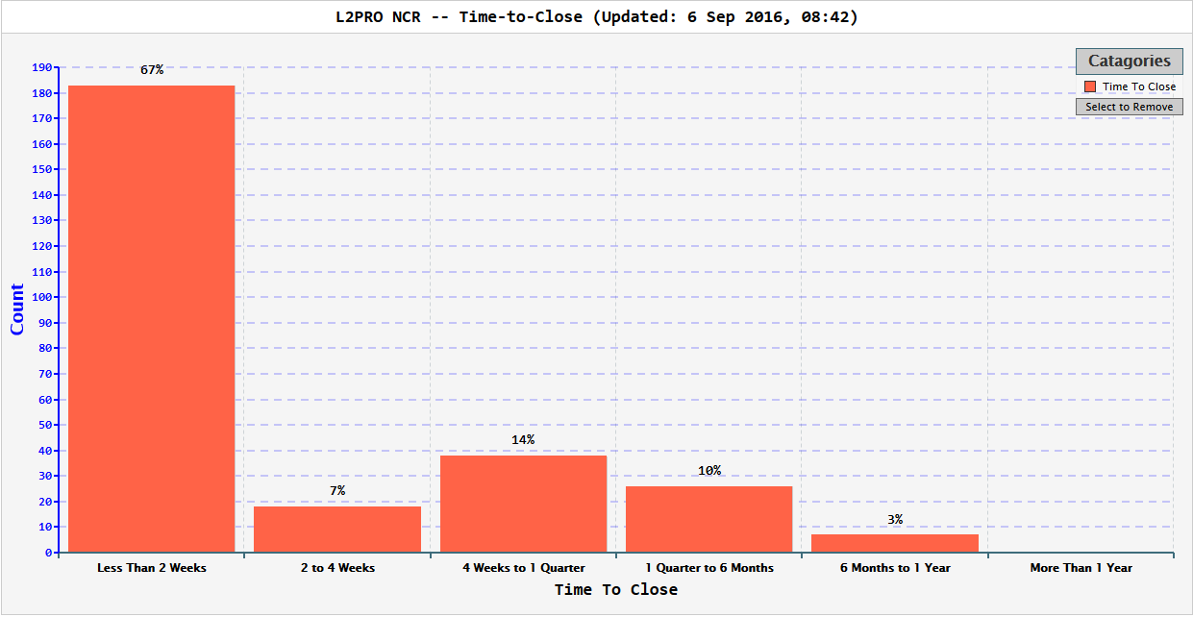
NCRs Time to Closure
71
5
14
8
2
Last Month

Slide 48
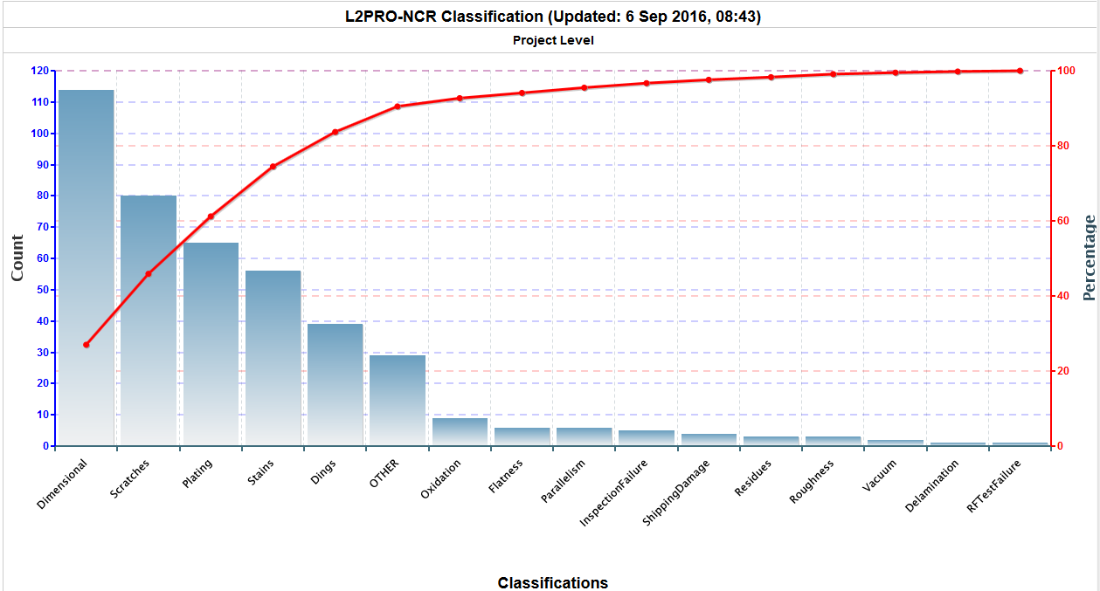
NCRs by Classification

Slide 49
Open NCRs: HELV & FPC
Status Report for L2PRO-NCR,L2PRO-NCR on 06-Sep-16
TRAV_SEQ_NUM | TRAV_OPEN_DATE | PARTDESCRIPTION | DESCRIBECOMMENT | SN | TRAVELERID | TRAVSEQNUMBER | DISPOSITION
86 | 6-Aug-15 | Cavity | Visual and dimensional out of tolerance, please see pictures and CMM report. | TB9AES034 | L2PRO-CAV-INSP-HELV | 7 | Hold/Modify
87 | 6-Aug-15 | Cavity | Field Probe flange has partial groove in seal surface, probably left by seal rin | TB9AES029 | L2PRO-CAV-INSP-HELV | 8
90 | 12-Aug-15 | Cavity | Please see attached for dimensional non-conforming. Beam tube flange (FP end) ha | TB9AES031 | L2PRO-CAV-INSP-HELV | 9
271 | 13-Apr-16 | UNKN | Shock recorder missing | CPI FPC Pair03 | L2PRO-CAV-INSP-FPC | 7
285 | 4-May-16 | UNKN | With main valve (SN2516) on CPC R397361-02-04 in close position, cannot achieve pressure better than 2 10-5 mbar. Suppose damaged valve. Red tagged valve - CPI should check/replace this valve. | CPI-PA-04 | L2PRO-CAV-INSP-FPC | 8
286 | 4-May-16 | UNKN | Static vacuum of CPI-PA-04 R397361-02-04 1000 mbar (normal pressure). Main valve related or improperly torque nuts on cavity flange. Leak check OK. | CPI-PA-04 | L2PRO-CAV-INSP-FPC | 8
287 | 4-May-16 | UNKN | Difficult to remove cold ceramic protection cup and found residues form the flat VITON gasket on CF100 copper plated. | CPI-PA-04 | L2PRO-CAV-INSP-FPC | 8
288 | 4-May-16 | UNKN | Push-rod 006 with weld issues on bellows. Sent back to CPI to be replaced. | CPI-PA-04 | L2PRO-CAV-INSP-FPC | 8
289 | 5-May-16 | UNKN | Dirty Swagelog nitrogen admission valves (on WP as well as on CP). | R397361-02-04A04 | L2PRO-CAV-INSP-FPC | 8
290 | 5-May-16 | UNKN | Dirty Swagelog nitrogen admission valves (on WP as well as on CP). | CPI-PA04 | L2PRO-CAV-INSP-FPC | 8
296 | 1-Aug-16 | UNKN | Missing hardware Kit Electron probe with male sex High particulate counts on external surfaces 5K copper anchor oxidized Blood like stains on test stand frame Greasy Swagelog valves | PA003 | L2PRO-CAV-INSP-FPC | 11
304 | 17-Aug-16 | LCLSII couplers | 1. Greasy nitrogen admission valves on cold ceramic protection cups. 2. SMA connectors with reverse sex. - Use adapters. 3. Particulate counts on external surfaces higher than ESD specifications ( >>100 counts). 4. Oxidized 5K copper anchors. | CPI LPA#04 | L2PRO-CAV-INSP-FPC | 12
305 | 17-Aug-16 | CPI couples for LCLSII | 1. Particulate counts on external surfaces higher than ESD specifications ( >>100 counts). 2. Oxidized 5K copper anchors. 3. Missing M8 Nitronic hardware 4. Missing manual antenna actuators | CPI LPA07 | L2PRO-CAV-INSP-FPC | 13
306 | 17-Aug-16 | CPI LCLSII couplers | 1. Particulate counts on external surfaces higher than ESD specifications ( >>100 counts). 2. Oxidized 5K copper anchors. 3. Missing M8 Nitronic hardware 4. Missing manual antenna actuators | CPI LPA#08 | L2PRO-CAV-INSP-FPC | 14

Slide 50
Open NCRs: Magnetic Shielding
Status Report for L2PRO-NCR,L2PRO-NCR on 06-Sep-16
TRAV_SEQ_NUM | TRAV_OPEN_DATE | PARTDESCRIPTION | DESCRIBECOMMENT | SN | TRAVELERID | TRAVSEQNUMBER | DISPOSITION
278 | 20-Apr-16 | Magnetic Shielding | Part number F10017757 does not match drawing; additional tabs present; Part number F10017758 does not match drawing; additional tabs present. Note:Spacer holes are NOT present on the above parts and and the drawing does not require them.Part number F10018116 does not match drawing; additional tabs present;Part number F10018117 does not match drawing; additional tabs present;Note: the above two parts DO have spacer holes not required by the drawing.Note:Part number F10017749,F10017754,F10017755,F10017756 Do Not have spacer holes. Part number: F10018116,F10018117,F10018120,F10018121,F10039382,F10039384 Do Have Spacer holes present. Drawing does not require them. | 10 | L2PRO-CM-INSP-MAG | 9 | Hold/Modify
279 | 20-Apr-16 |  | Part number F10017757 does not match drawing; additional tabs present; Part number F10017758 does not match drawing; additional tabs present. Note:Spacer holes are NOT present on the above parts and and the drawing does not require them.Part number F10018116 does not match drawing; additional tabs present;Part number F10018117 does not match drawing; additional tabs present;Note: the above two parts DO have spacer holes not required by the drawing.Note:Part number F10017749,F10017754,F10017755,F10017756 Do Not have spacer holes. Part number: F10018116,F10018117,F10018120,F10018121,F10039382,F10039384 Do Have Spacer holes present. Drawing does not require them. Part number F10018117 has a broken screw in threaded insert. | 11 | L2PRO-CM-INSP-MAG | 10 | Hold/Modify
280 | 20-Apr-16 | Magnetic Shielding | Part number F10017757 does not match drawing; additional tabs present; Part number F10017758 does not match drawing; additional tabs present. Note:Spacer holes are NOT present on the above parts and and the drawing does not require them.Part number F10018116 does not match drawing; additional tabs present;Part number F10018117 does not match drawing; additional tabs present;Note: the above two parts DO have spacer holes not required by the drawing.Note:Part number F10017749,F10017754,F10017755,F10017756 Do Not have spacer holes. Part number: F10018116,F10018117,F10018120,F10018121,F10039382,F10039384 Do Have Spacer holes present. Drawing does not require them. | 12 | L2PRO-CM-INSP-MAG | 11 | Hold/Modify
281 | 20-Apr-16 |  | Part number F10017757 does not match drawing; additional tabs present; Part number F10017758 does not match drawing; additional tabs present. Note:Spacer holes are NOT present on the above parts and and the drawing does not require them.Part number F10018116 does not match drawing; additional tabs present;Part number F10018117 does not match drawing; additional tabs present;Note: the above two parts DO have spacer holes not required by the drawing.Note:Part number F10017749,F10017754,F10017755,F10017756 Do Not have spacer holes. Part number: F10018116,F10018117,F10018120,F10018121,F10039382,F10039384 Do Have Spacer holes present. Drawing does not require them. | 13 | L2PRO-CM-INSP-MAG | 12 | Hold/Modify
282 | 20-Apr-16 |  | Part number F10017757 does not match drawing; additional tabs present; Part number F10017758 does not match drawing; additional tabs present. Note:Spacer holes are NOT present on the above parts and and the drawing does not require them.Part number F10018116 does not match drawing; additional tabs present;Part number F10018117 does not match drawing; additional tabs present;Note: the above two parts DO have spacer holes not required by the drawing.Note:Part number F10017749,F10017754,F10017755,F10017756 Do Not have spacer holes. Part number: F10018116,F10018117,F10018120,F10018121,F10039382,F10039384 Do Have Spacer holes present. Drawing does not require them. | 14 | L2PRO-CM-INSP-MAG | 13 | Hold/Modify
283 | 20-Apr-16 |  | Part number F10017757 does not match drawing; additional tabs present; Part number F10017758 does not match drawing; additional tabs present. Note:Spacer holes are NOT present on the above parts and and the drawing does not require them.Part number F10018116 does not match drawing; additional tabs present;Part number F10018117 does not match drawing; additional tabs present;Note: the above two parts DO have spacer holes not required by the drawing.Note:Part number F10017749,F10017754,F10017755,F10017756 Do Not have spacer holes. Part number: F10018116,F10018117,F10018120,F10018121,F10039382,F10039384 Do Have Spacer holes present. Drawing does not require them.Part number F10037667 has a bent corner. | 15 | L2PRO-CM-INSP-MAG | 14 | Hold/Modify

Slide 51
Open NCRs: Bellows & TUNMC & CM
Status Report for L2PRO-NCR,L2PRO-NCR on 06-Sep-16
TRAV_SEQ_NUM | TRAV_OPEN_DATE | PARTDESCRIPTION | DESCRIBECOMMENT | SN | TRAVELERID | TRAVSEQNUMBER | DISPOSITION
156 | 24-Nov-15 | Weldment Bellows Long | Dark stains and blisters remain in plating after final disposition of cleaning in NCR #155. | 19 | L2PRO-NCR | 155
234 | 16-Feb-16 | Weldment Bellows Short | Scratches in seal area and cuffs. Dent on convolution, dark spots in plating. | 10 | L2PRO-CST-INSP-BLBS | 12 | Hold/Modify
297 | 1-Aug-16 |  | Remnant field is over 5 mG, worst area measured 475 mG. Ceramic balls do not rotate while in the assembly. | 9 | L2PRO-CST-INSP-TUNMC | 2
302 | 8-Aug-16 |  | Tuner assembly missing one lid bearing. Please see attached. Ceramic balls do not rotate while in the assembly. Remnant field is over 5 mG, measured 497 mG | 13 | L2PRO-CST-INSP-TUNMC | 7
303 | 9-Aug-16 |  | Remnant field is over 5 mG, measured 392 mG. Ceramic balls do not rotate while in the assembly. | 14 | L2PRO-CST-INSP-TUNMC | 8
293 | 14-Jul-16 |  | Remnant field is over 5 mG, worst area measured 439 mG. F10008766 missing item number 2 and 12. F10006870 missing item number 2,6,9 and 13. Bolt threads damaged from set screw. Please see attached. | 7 | L2PRO-CST-INSP-TUNMC | 1 | Hold/Modify
291 | 20-Jun-16 | Vacuum Vessel | Damage and scratches present on some flanges.Damage F10030811 . Damage F10026614. See detailed inspection report attached and photos link. Scratches present on some flanges.Paint residue F10018083 (DS). Contamination found in o-ring groove F10023643..Contamination found in o-ring groove F10020935. Scratches F10030285. Scratches/damage F10030301. Refer to Vacuum Vessel Inspection report attached. Most threaded holes are contaminated with chips,burrs,and dirt making the Go Thread Gage not go for full depth. Photo link: M:\cmm\Pictures\Inspection Pictures\LCLS2\Prototype CM\Vacuum Vessel | 2 | L2PRO-CM-INSP-VV | 1 | Hold/Modify
294 | 26-Jul-16 | Rupture Disc Holder | Seal surface scratched. | 15006443A-1 | L2PRO-CM-INSP-BBRD | 1
295 | 26-Jul-16 | Rupture Disc Holder | Scratches present on seal surface. | 15001065A-2 | L2PRO-CM-INSP-BBRD | 2

Slide 52
Cavity String Lessons Learned Log

Slide 53
Cavity String Lessons Learned Log

Slide 54
Cavity String Lessons Learned Log

Slide 55
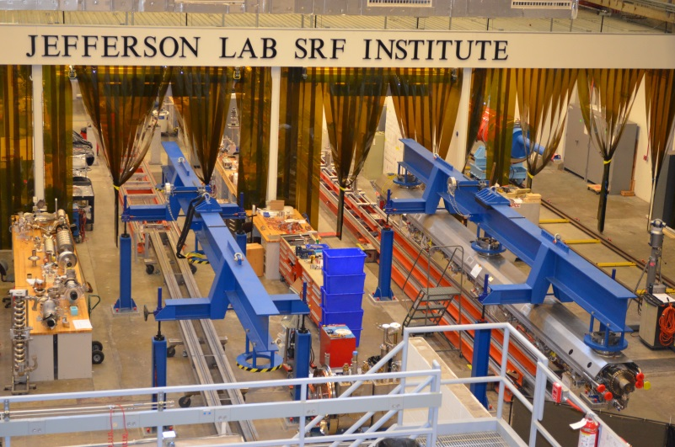

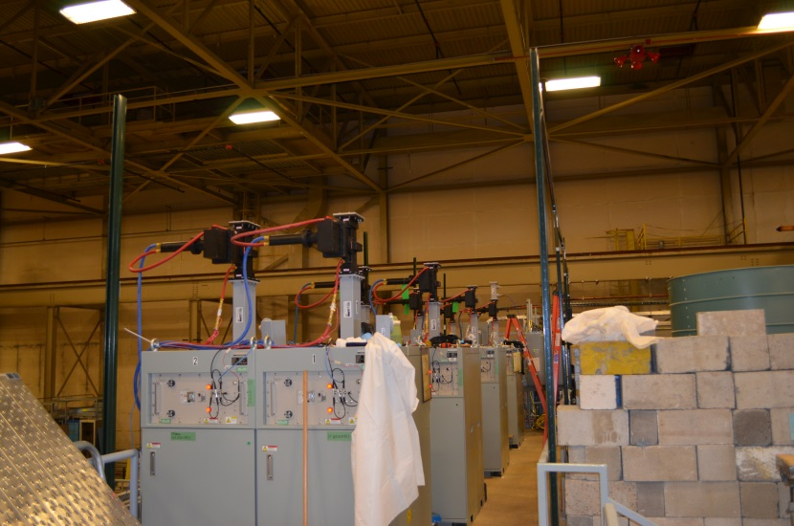
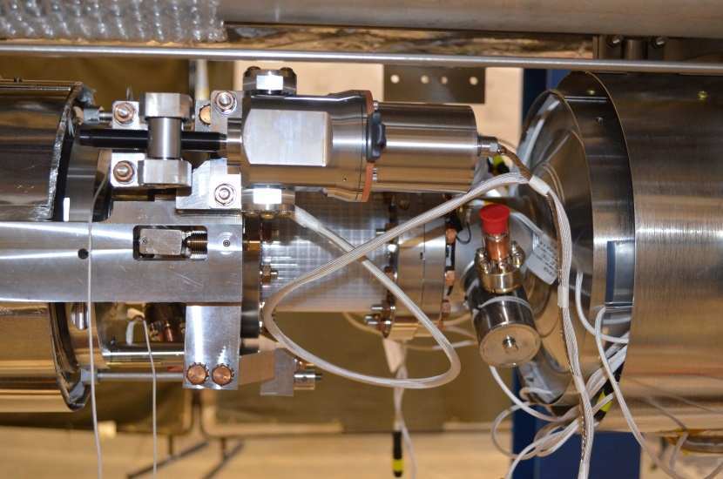
Cryomodule Hardware
Test Lab Assembly Facility
pCM Cold Mass Assembly
LCLS II Solid State Amplifiers
pCM Cavity Tuner Assembly

Slide 56
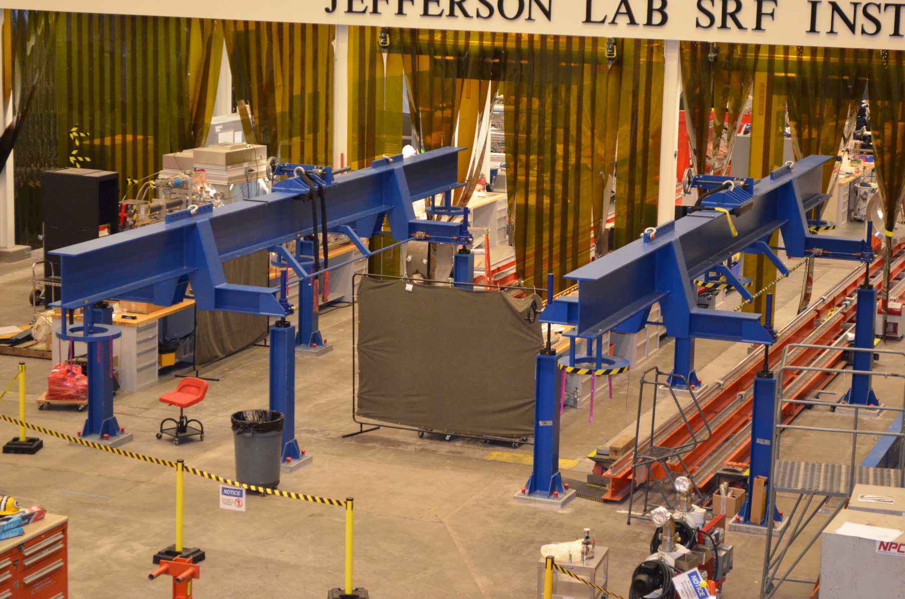
LCLS-II Cold Mass Spreader Bar Installed
(Phase II Assembly)

